Slide 1
An Introduction to Workflows with DAGMan
Presented by Lauren Michael

Slide 2
Covered In This Tutorial
Why Create a Workflow?
Describing workflows as directed acyclic graphs (DAGs)
Workflow execution via DAGMan (DAG Manager)
Node-level options in a DAG
Modular organization of DAG components
DAG-level control
Additional DAGMan Features

Slide 3
Automation!
Objective: Submit jobs in a particular order, automatically.
Especially if: Need to reproduce the same workflow multiple times.
split
1
2
3
...
N
combine

Slide 4
DAG = ”directed acyclic graph”
topological ordering of vertices (“nodes”) is established by directional connections (“edges”)
“acyclic” aspect requires a start and end, with no looped repetition
can contain cyclic subcomponents, covered in later slides for workflows
Wikimedia Commons
wikipedia.org/wiki/Directed_acyclic_graph

Slide 5
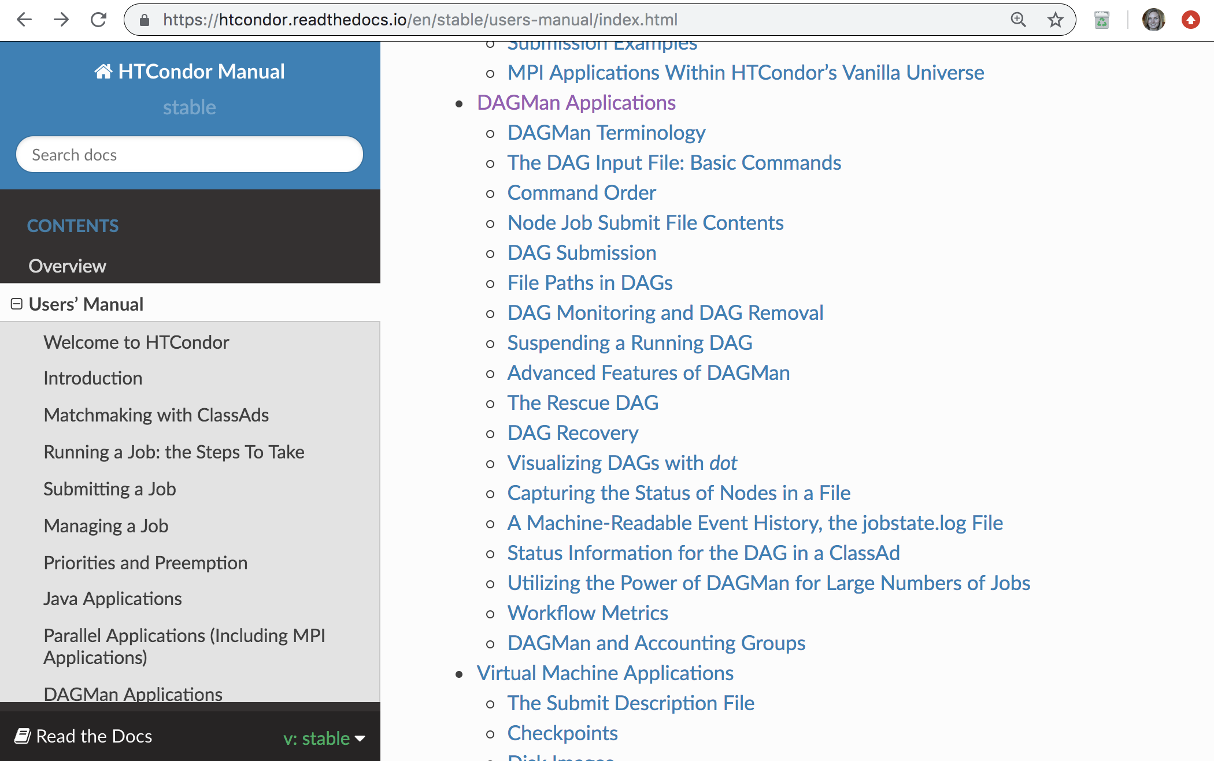
HTCondor has a DAG Manager (DAGMan)!
https://htcondor.readthedocs.io/en/stable/users-manual/index.html

Slide 6
An Example HTC Workflow
User must communicate the “nodes” and directional “edges” of the DAG
split
1
2
3
...
N
combine

Slide 7
Simple Example for this Tutorial
The DAG input file communicates the “nodes” and directional “edges” of the DAG
A
B1
B2
B3
...
BN
C
HTCondor Manual: DAGMan Applications > DAG Input File

Slide 8
Basic DAG input file: JOB nodes, PARENT-CHILD edges
A
my.dag
JOB A A.sub
JOB B1 B1.sub
JOB B2 B2.sub
JOB B3 B3.sub
JOB C C.sub
PARENT A CHILD B1 B2 B3
PARENT B1 B2 B3 CHILD C
B1
B2
B3
...
BN
Node names are used by various DAG features to modify their execution by DAG Manager.
C
HTCondor Manual: DAGMan Applications > DAG Input File

Slide 9
Basic DAG input file: JOB nodes, PARENT-CHILD edges
my.dag
(dag_dir)/
JOB A A.sub
JOB B1 B1.sub
JOB B2 B2.sub
JOB B3 B3.sub
JOB C C.sub
PARENT A CHILD B1 B2 B3
PARENT B1 B2 B3 CHILD C
A.sub B1.sub
B2.sub B3.sub
C.sub my.dag
(other job files)
Node names and filenames can be anything.
Node name and submit filename do not have to match.
HTCondor Manual: DAGMan Applications > File Paths in DAGs

Slide 10
Endless Workflow Possibilities
Wikimedia Commons
https://confluence.pegasus.isi.edu/display/pegasus/WorkflowGenerator

Slide 11
DAGs are also useful for non-sequential work
‘bag’ of HTC jobs
disjointed workflows
B1
B2
B3
...
BN

Slide 12
Basic DAG input file: JOB nodes, PARENT-CHILD edges
A
my.dag
JOB A A.sub
JOB B1 B1.sub
JOB B2 B2.sub
JOB B3 B3.sub
JOB C C.sub
PARENT A CHILD B1 B2 B3
PARENT B1 B2 B3 CHILD C
B1
B2
B3
...
BN
C
HTCondor Manual: DAGMan Applications > DAG Input File

Slide 13
Submitting and Monitoring a DAGMan Workflow

Slide 14
Submitting a DAG to the queue
Submission command:
condor_submit_dag dag_file
$ condor_submit_dag my.dag
------------------------------------------------------------------
File for submitting this DAG to HTCondor : my.dag.condor.sub
Log of DAGMan debugging messages : my.dag.dagman.out
Log of HTCondor library output : my.dag.lib.out
Log of HTCondor library error messages : my.dag.lib.err
Log of the life of condor_dagman itself : my.dag.dagman.log
Submitting job(s).
1 job(s) submitted to cluster 87274940.
------------------------------------------------------------------
HTCondor Manual: DAGMan > DAG Submission

Slide 15
A submitted DAG creates a DAGMan job process in the queue
DAGMan runs on the submit server, as a job in the queue
At first:
$ condor_q
-- Schedd: submit-3.chtc.wisc.edu : <128.104.100.44:9618?... OWNER BATCH_NAME SUBMITTED DONE RUN IDLE TOTAL JOB_IDS
alice my.dag+128 4/30 18:08 _ _ _ _ 0.0
1 jobs; 0 completed, 0 removed, 0 idle, 1 running, 0 held, 0 suspended
$ condor_q -nobatch
-- Schedd: submit-3.chtc.wisc.edu : <128.104.100.44:9618?...
ID OWNER SUBMITTED RUN_TIME ST PRI SIZE CMD
128.0 alice 4/30 18:08 0+00:00:06 R 0 0.3 condor_dagman
1 jobs; 0 completed, 0 removed, 0 idle, 1 running, 0 held, 0 suspended
DAGMan > DAG Monitoring and DAG Removal

Slide 16
Jobs are automatically submitted by the DAGMan job
Seconds later, node A is submitted:
$ condor_q
-- Schedd: submit-3.chtc.wisc.edu : <128.104.100.44:9618?... OWNER BATCH_NAME SUBMITTED DONE RUN IDLE TOTAL JOB_IDS
alice my.dag+128 4/30 18:08 _ _ 1 5 129.0
2 jobs; 0 completed, 0 removed, 1 idle, 1 running, 0 held, 0 suspended
$ condor_q -nobatch
-- Schedd: submit-3.chtc.wisc.edu : <128.104.100.44:9618?...
ID OWNER SUBMITTED RUN_TIME ST PRI SIZE CMD
128.0 alice 4/30 18:08 0+00:00:36 R 0 0.3 condor_dagman
129.0 alice 4/30 18:08 0+00:00:00 I 0 0.3 A_split.sh
2 jobs; 0 completed, 0 removed, 1 idle, 1 running, 0 held, 0 suspended
DAGMan > DAG Monitoring and DAG Removal

Slide 17
Jobs are automatically submitted by the DAGMan job
After A completes, B1-3 are submitted
$ condor_q
-- Schedd: submit-3.chtc.wisc.edu : <128.104.100.44:9618?... OWNER BATCH_NAME SUBMITTED DONE RUN IDLE TOTAL JOB_IDS
alice my.dag+128 4/30 18:08 1 _ 3 5 130.0 ... 132.0
4 jobs; 0 completed, 0 removed, 3 idle, 1 running, 0 held, 0 suspended
$ condor_q -nobatch
-- Schedd: submit-3.chtc.wisc.edu : <128.104.100.44:9618?...
ID OWNER SUBMITTED RUN_TIME ST PRI SIZE CMD
128.0 alice 4/30 18:08 0+00:20:36 R 0 0.3 condor_dagman
130.0 alice 4/30 18:28 0+00:00:00 I 0 0.3 B_run.sh
131.0 alice 4/30 18:28 0+00:00:00 I 0 0.3 B_run.sh
132.0 alice 4/30 18:28 0+00:00:00 I 0 0.3 B_run.sh
4 jobs; 0 completed, 0 removed, 3 idle, 1 running, 0 held, 0 suspended
DAGMan > DAG Monitoring and DAG Removal

Slide 18
Jobs are automatically submitted by the DAGMan job
After B1-3 complete, node C is submitted
$ condor_q
-- Schedd: submit-3.chtc.wisc.edu : <128.104.100.44:9618?... OWNER BATCH_NAME SUBMITTED DONE RUN IDLE TOTAL JOB_IDS
alice my.dag+128 4/30 18:08 4 _ 1 5 133.0
2 jobs; 0 completed, 0 removed, 1 idle, 1 running, 0 held, 0 suspended
$ condor_q -nobatch
-- Schedd: submit-3.chtc.wisc.edu : <128.104.100.44:9618?...
ID OWNER SUBMITTED RUN_TIME ST PRI SIZE CMD
128.0 alice 4/30 18:08 0+00:46:36 R 0 0.3 condor_dagman
133.0 alice 4/30 18:54 0+00:00:00 I 0 0.3 C_combine.sh
2 jobs; 0 completed, 0 removed, 1 idle, 1 running, 0 held, 0 suspended
DAGMan > DAG Monitoring and DAG Removal

Slide 19
Status files are Created at the time of DAG submission
(dag_dir)/
A.sub B1.sub B2.sub
B3.sub C.sub (other job files)
my.dag my.dag.condor.sub my.dag.dagman.log
my.dag.dagman.out my.dag.lib.err my.dag.lib.out
my.dag.nodes.log
*.condor.sub and *.dagman.log describe the queued DAGMan job process
*.dagman.out has detailed logging (look to first for errors)
*.lib.err/out contain std err/out for the DAGMan job process
*.nodes.log is a combined log of all jobs within the DAG
DAGMan > DAG Monitoring and DAG Removal

Slide 20
DAG Completion
(dag_dir)/
A.sub B1.sub B2.sub
B3.sub C.sub (other job files)
my.dag my.dag.condor.sub my.dag.dagman.log
my.dag.dagman.out my.dag.lib.err my.dag.lib.out
my.dag.nodes.log my.dag.dagman.metrics
*.dagman.metrics is a summary of events and outcomes
*.dagman.log will note the completion of the DAGMan job
*.dagman.out has detailed logging for all jobs (look to first for errors)
DAGMan > DAG Monitoring and DAG Removal

Slide 21
Removing a DAG from the queue
Remove the DAGMan job in order to stop and remove the entire DAG:
condor_rm dagman_jobID
Creates a rescue file so that only incomplete or unsuccessful NODES are repeated upon resubmission
$ condor_q
-- Schedd: submit-3.chtc.wisc.edu : <128.104.100.44:9618?... OWNER BATCH_NAME SUBMITTED DONE RUN IDLE TOTAL JOB_IDS
alice my.dag+128 4/30 18:08 4 _ 1 6 133.0
2 jobs; 0 completed, 0 removed, 1 idle, 1 running, 0 held, 0 suspended
$ condor_rm 128
All jobs in cluster 128 have been marked for removal
DAGMan > DAG Monitoring and DAG Removal
DAGMan > The Rescue DAG

Slide 22
Node Failures Result in DAG Failure and Removal
If a node JOB fails (non-zero exit code)
DAGMan continues to run other JOB nodes until it can no longer make progress
Example at right:
B2 fails
Other B* jobs continue
DAG fails and exits after B* and before node C
A
B1
B2
B3
...
BN
C
DAGMan > DAG Monitoring and DAG Removal
DAGMan > The Rescue DAG

Slide 23
Best Control Achieved with One Process per JOB Node
While submit files can ‘queue’ many processes, a single process per submit file is usually best for DAG JOBs
Failure of any process in a JOB node results in failure of the entire node and immediate removal of other processes in the node.
RETRY of a JOB node resubmits the entire submit file.
A
B1
B2
B3
...
BN
C
HTCondor Manual: DAGMan Applications > DAG Input File

Slide 24
Resolving held node jobs
$ condor_q -nobatch
-- Schedd: submit-3.chtc.wisc.edu : <128.104.100.44:9618?...
ID OWNER SUBMITTED RUN_TIME ST PRI SIZE CMD
128.0 alice 4/30 18:08 0+00:20:36 R 0 0.3 condor_dagman
130.0 alice 4/30 18:18 0+00:00:00 H 0 0.3 B_run.sh
131.0 alice 4/30 18:18 0+00:00:00 H 0 0.3 B_run.sh
132.0 alice 4/30 18:18 0+00:00:00 H 0 0.3 B_run.sh
4 jobs; 0 completed, 0 removed, 0 idle, 1 running, 3 held, 0 suspended
Look at the hold reason (in the job log, or with ‘condor_q -hold’)
Fix the issue and release the jobs (condor_release) -OR- remove the entire DAG, resolve, then resubmit the DAG
DAGMan > DAG Monitoring and DAG Removal

Slide 25
Beyond the Basic DAG: Node-level Modifiers

Slide 26
By default, JOB files are relative to the DAG submission directory
my.dag
(dag_dir)/
JOB A A.sub
JOB B1 B1.sub
JOB B2 B2.sub
JOB B3 B3.sub
JOB C C.sub
PARENT A CHILD B1 B2 B3
PARENT B1 B2 B3 CHILD C
A.sub B1.sub
B2.sub B3.sub
C.sub my.dag
(other job files)
What if you want to organize different JOB node files in different directories?
HTCondor Manual: DAGMan Applications > File Paths in DAGs

Slide 27
Designate different submission directories with DIR
combine DIR with submit file contents (file paths) to achieve your desired organization
my.dag
(dag_dir)/
JOB A A.sub DIR A
JOB B1 B1.sub DIR B
JOB B2 B2.sub DIR B
JOB B3 B3.sub DIR B
JOB C C.sub DIR C
PARENT A CHILD B1 B2 B3
PARENT B1 B2 B3 CHILD C
my.dag
A/ A.sub (A job files)
B/ B1.sub B2.sub
B3.sub (B job files)
C/ C.sub (C job files)
HTCondor Manual: DAGMan Applications > DAG Input File

Slide 28
PRE and POST scripts run on the submit server, as part of the node
my.dag
A
JOB A A.sub
SCRIPT POST A sort.sh
JOB B1 B1.sub
JOB B2 B2.sub
JOB B3 B3.sub
JOB C C.sub
SCRIPT PRE C tar_it.sh
PARENT A CHILD B1 B2 B3
PARENT B1 B2 B3 CHILD C
POST script
B1
B2
B3
...
BN
PRE script
Use sparingly for light work; otherwise include work in submitted jobs
C
DAGMan Applications > DAG Input File > SCRIPT

Slide 29
RETRY failed nodes to overcome transient errors
Retry a node up to N times if it fails (the job exit code is non-zero):
RETRY node_name N
See also: retry except for a particular exit code (UNLESS-EXIT)
Note: max_retries in the submit file are preferable for simple cases
Example:
JOB A A.sub
RETRY A 5
JOB B B.sub
PARENT A CHILD B
DAGMan Applications > Advanced Features > Retrying
DAGMan Applications > DAG Input File > SCRIPT

Slide 30
Modular Organization and Control of DAG Components

Slide 31
Repeating DAG Components!!
https://confluence.pegasus.isi.edu/display/pegasus/LIGO+IHOPE

Slide 32
Submit File Templates via VARS
VARS line defines node-specific values that are passed into submit file variables
VARS node_name var1=“value” [var2=“value”]
Allows a single submit file shared by all B jobs, rather than one submit file for each JOB.
my.dag
B.sub
JOB B1 B.sub
VARS B1 data=”B1” opt=“10”
JOB B2 B.sub
VARS B2 data=“B2” opt=“12”
JOB B3 B.sub
VARS B3 data=“B3” opt=“14”
…
InitialDir = $(data)
arguments = $(data).csv $(opt)
…
queue
DAGMan Applications > Advanced Features > Variable Values

Slide 33
SPLICE subsets of the DAG to simplify lengthy DAG files
my.dag
A
JOB A A.sub
SPLICE B B.spl
JOB C C.sub
PARENT A CHILD B
PARENT B CHILD C
B1
B2
B3
...
BN
B.spl
JOB B1 B1.sub
JOB B2 B2.sub
…
JOB BN BN.sub
C
DAGMan Applications > Advanced Features > DAG Splicing

Slide 34
What if some DAG components can’t be known ahead of time?
A
e.g. If the value of N can only be determined as part of the work of the prior node (A) …
B1
B2
B3
...
BN
C

Slide 35
A SUBDAG within a DAG
my.dag
A
JOB A A.sub
SUBDAG EXTERNAL B B.dag
JOB C C.sub
PARENT A CHILD B
PARENT B CHILD C
B1
B2
B3
...
BN
B.dag (written by A)
JOB B1 B1.sub
JOB B2 B2.sub
…
JOB BN BN.sub
C
A SUBDAG is not submitted (so contents do not have to exist) until prior nodes in the outer DAG have completed.
DAGMan Applications > Advanced Features > DAG Within a DAG

Slide 36
Use a SUBDAG to achieve Cyclic Components within a DAG
A
POST script determines whether another iteration is necessary; if so, exits non-zero
RETRY applies to entire SUBDAG, which may include multiple, sequential nodes
my.dag
B
JOB A A.sub
SUBDAG EXTERNAL B B.dag
SCRIPT POST B iterateB.sh
RETRY B 100
JOB C C.sub
PARENT A CHILD B
PARENT B CHILD C
POST script
RETRY
C
DAGMan Applications > Advanced Features > DAG Within a DAG

Slide 37
More at the end of this presentation and in the HTCondor Manual!!!
https://htcondor.readthedocs.io/en/stable/users-manual/dagman-applications.html

Slide 38
Covered in Later Slides
Why Create a Workflow?
Describing workflows as directed acyclic graphs (DAGs)
Workflow execution via DAGMan (DAG Manager)
Node-level options in a DAG (cont…)
Modular organization of DAG components (…)
DAG-level control (…)
Additional DAGMan Features

Slide 39
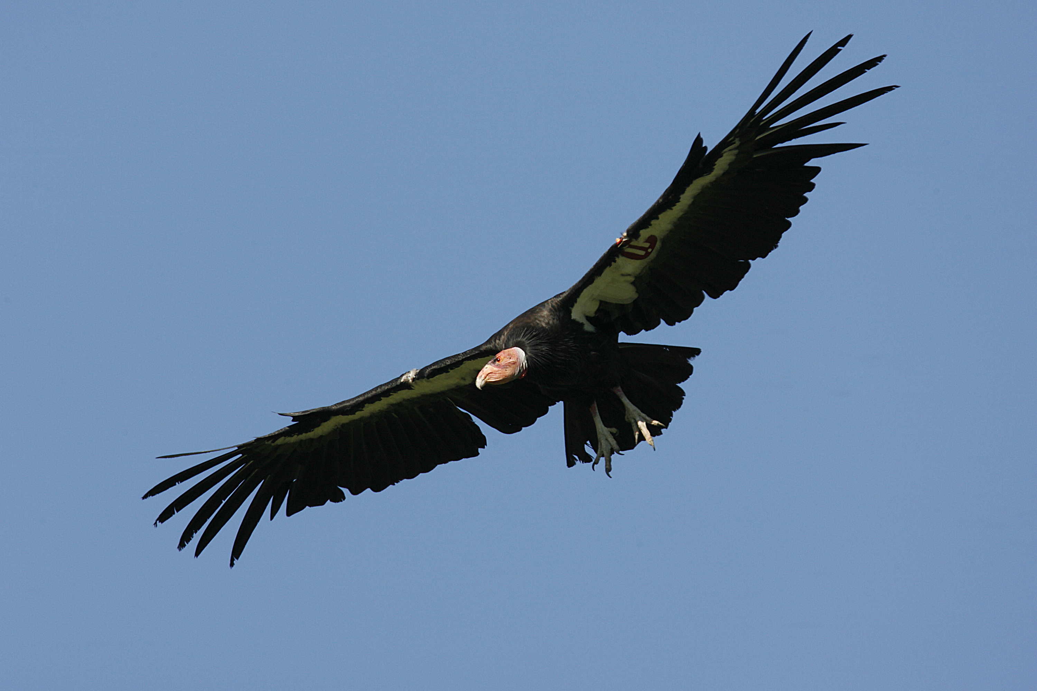
Questions?
htcondor-users@cs.wisc.edu
lmichael@wisc.edu

Slide 40
Beyond the Basic DAG: Node-level Modifiers

Slide 41
RETRY applies to whole node, including PRE/POST scripts
PRE and POST scripts are included in retries
RETRY of a node with a POST script uses the exit code from the POST script (not from the job)
POST script can do more to determine node success (or need for iteration)
Example:
SCRIPT PRE A download.sh
JOB A A.sub
SCRIPT POST A checkA.sh
RETRY A 5
DAGMan Applications > Advanced Features > Retrying
DAGMan Applications > DAG Input File > SCRIPT

Slide 42
SCRIPT Arguments and Argument Variables
JOB A A.sub
SCRIPT POST A checkA.sh my.out $RETURN
RETRY A 5
$JOB: node name
$JOBID: cluster.proc
$RETURN: exit code of the node
$PRE_SCRIPT_RETURN: exit code of PRE script
$RETRY: current retry (‘iteration’) count
(more variables described in the manual)
DAGMan Applications > Advanced Features > Retrying
DAGMan Applications > DAG Input File > SCRIPT

Slide 43
Other Node-Level Controls
Set the PRIORITY of JOB nodes with:
PRIORITY node_name priority_value
Use a PRE_SKIP to skip a node and mark it as successful, if the PRE script exits with a specific exit code:
PRE_SKIP node_name exit_code
DAGMan Applications > Advanced Features > Setting Priorities
DAGMan Applications > The DAG Input File > PRE_SKIP

Slide 44
Modular Organization and Control of DAG Components

Slide 45
Use nested SPLICEs with DIR for repeating workflow components
my.dag
A
JOB A A.sub DIR A
SPLICE B B.spl DIR B
JOB C C.sub DIR C
PARENT A CHILD B
PARENT B CHILD C
B.spl
B1
BN
B2
B.spl
SPLICE B1 ../inner.spl DIR B1
SPLICE B2 ../inner.spl DIR B2
…
SPLICE BN ../inner.spl DIR BN
1
1
1
...
2
2
2
inner.spl
JOB 1 ../1.sub
JOB 2 ../2.sub
PARENT 1 CHILD 2
C
DAGMan Applications > Advanced Features > DAG Splicing

Slide 46
Use nested SPLICEs with DIR for repeating workflow components
my.dag
(dag_dir)/
JOB A A.sub DIR A
SPLICE B B.spl DIR B
JOB C C.sub DIR C
PARENT A CHILD B
PARENT B CHILD C
my.dag
A/ A.sub (A job files)
B/ B.spl inner.spl
1.sub 2.sub
B1/ (1-2 job files)
B2/ (1-2 job files)
…
BN/ (1-2 job files)
C/ C.sub (C job files)
B.spl
SPLICE B1 ../inner.spl DIR B1
SPLICE B2 ../inner.spl DIR B2
…
SPLICE BN ../inner.spl DIR BN
inner.spl
JOB 1 ../1.sub
JOB 2 ../2.sub
PARENT 1 CHILD 2
DAGMan Applications > Advanced Features > DAG Splicing

Slide 47
More on SPLICE Behavior
HTCondor takes in a DAG and its SPLICEs as a single, large DAG file.
SPLICEs simply allow the user to simplify and modularize the DAG expression using separate files
A single DAGMan job is queued with single set of status files.
Great for gradually testing and building up a large DAG (since a SPLICE file can be submitted by itself, without its outer DAG).
SPLICE lines are not treated like nodes.
no PRE/POST scripts or RETRIES
DAGMan Applications > Advanced Features > DAG Splicing

Slide 48
More on SUBDAG Behavior
Each SUBDAG EXTERNAL is a DAGMan job running in the queue, and too many can overwhelm the queue.
WARNING: SUBDAGs should only be used (rather than SPLICES) when absolutely necessary!
SUBDAGs are nodes (can have PRE/POST scripts, retries, etc.)
DAGMan Applications > Advanced Features > DAG Within a DAG

Slide 49
Other Modular Controls
Append NOOP to a JOB definition so that its JOB process isn’t run by DAGMan
Test DAG structure without running jobs (node-level)
Simplify combinatorial PARENT-CHILD statements (modular)
Communicate DAG features separately with INCLUDE
e.g. separate files for JOB nodes and for VARS definitions, as part of the same DAG
Define a CATEGORY of JOB nodes to throttle only a specific subset
DAGMan Applications > The DAG Input File > JOB
DAGMan Applications > Advanced Features > INCLUDE
DAGMan Applications > Advanced > Throttling by Category

Slide 50
DAG-level Control

Slide 51
Throttle job nodes of large DAGs via DAG-level configuration
If a DAG has many (thousands or more) jobs, submit server and queue performance can be assured by limiting:
Number of jobs in the queue
Number of jobs idle (waiting to run)
Number of PRE or POST scripts running
Limits can be specified in a DAG-specific CONFIG file (recommended) or as arguments to condor_submit_dag
DAGMan > Advanced Features > Configuration Specific to a DAG

Slide 52
DAG-specific throttling via a CONFIG file
my.dag
A
JOB A A.sub
SPLICE B B.dag
JOB C C.sub
PARENT A CHILD B
PARENT B CHILD C
CONFIG my.dag.config
B1
B2
B3
...
BN
my.dag.config
DAGMAN_MAX_JOBS_SUBMITTED = 5000
DAGMAN_MAX_JOBS_IDLE = 1000
DAGMAN_MAX_PRE_SCRIPTS = 4
DAGMAN_MAX_POST_SCRIPTS = 4
C
DAGMan > Advanced Features > Configuration Specific to a DAG

Slide 53
Removal of a DAG results in a rescue file
(dag_dir)/
A.sub B1.sub B2.sub B3.sub C.sub (other job files)
my.dag my.dag.condor.sub my.dag.dagman.log
my.dag.dagman.out my.dag.lib.err my.dag.lib.out
my.dag.metrics my.dag.nodes.log my.dag.rescue001
Named dag_file.rescue001
increments if more rescue DAG files are created
Records which NODES have completed successfully
does not contain the actual DAG structure
DAGMan > DAG Monitoring and DAG Removal
DAGMan > The Rescue DAG

Slide 54
Rescue Files For Resuming a Failed DAG
A rescue file is created any time a DAG is removed from the queue by the user (condor_rm) or automatically:
a node fails, and after DAGMan advances through any other possible nodes
the DAG is aborted (covered later)
the DAG is halted and not unhalted (covered later)
The rescue file will be used (if it exists) when the original DAG file is resubmitted
override: condor_submit_dag dag_file -f
DAGMan > The Rescue DAG

Slide 55
Pause (then resume) a DAG by holding it
Hold the DAGMan job process:
condor_hold dagman_jobID
Pauses the DAG
No new node jobs submitted
Queued node jobs continue to run (including SUBDAGs), but no PRE/POST scripts
DAG resumes when released (condor_release dagman_jobID)
DAGMan > Suspending a Running DAG

Slide 56
Cleanly quit a DAG with a halt file
Create a file named DAG_file.halt in the same directory as the submitted DAG file
Allows the DAG to complete nodes in-progress
No new node jobs submitted
Queued node jobs and SUBDAGs (including POST scripts) continue to run, but not PRE scripts
After all queued jobs have completed, the DAG creates a rescue DAG file and exits.
If the DAG hasn’t yet exited and the file is deleted, then the DAG resumes
DAGMan > Suspending a Running DAG
DAGMan > The Rescue DAG

Slide 57
Other DAG-Level Controls
Replace the node_name with ALL_NODES to apply a DAG feature to all nodes of the DAG
Abort the entire DAG if a specific node exits with a specific exit code:
ABORT-DAG-ON node_name exit_code
Define a FINAL node that will always run, even in the event of DAG failure (to clean up, perhaps).
FINAL node_name submit_file
DAGMan Applications > Advanced > ALL_NODES
DAGMan Applications > Advanced > Stopping the Entire DAG
DAGMan Applications > Advanced > FINAL Node

