Slide 1
dHTC for LHAASO Exp.
Jingyan Shi, Xiaowei Jiang, Ran Du
Institute of High Energy Physics, Chinese Academy of Science
(IHEP, CC)
shijy@ihep.ac.cn
jiangxw@ihep.ac.cn
duran@ihep.ac.cn

Slide 2
Outline
1
Brief Introduction to LHAASO
2
Motivation
3
Design and Architecture
4
Current Status and Plan
5
Summary

Slide 3
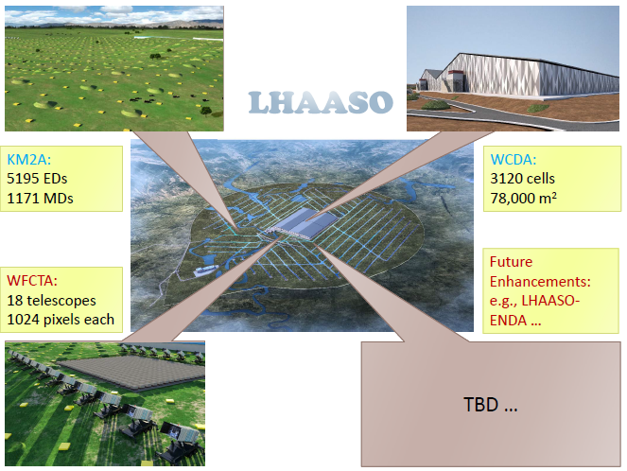
Introduction to LHAASO Project
Large High Altitude Air Shower Observatory (LHAASO)
A new generation all-sky facility
combined study of cosmic rays and gamma rays
wide energy range of 10¹¹ -- 10¹⁷ ev
Located in Daocheng, Sichuan province
Altitude : 4410 m
Coverage area : 1.3 km²
Fully completed in June, 2021
Data taken starts in 2018
Raw data per year : 6 PB
Storage Capacity > 20 PB

Slide 4
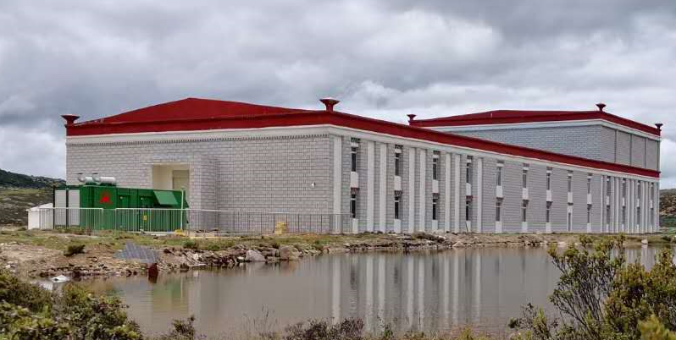
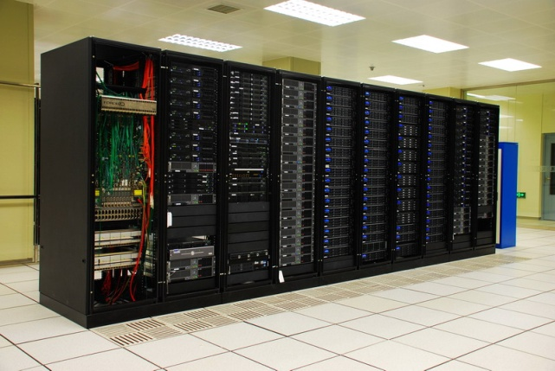
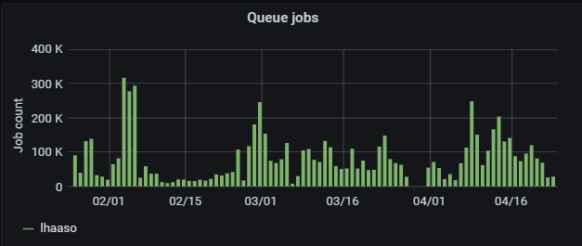
LHAASO Data Processing
~2.2Gbps
The small on-site Data Center at Haizi Mountain observatory (altitude ～4500m).
~2000 CPU cores and 1.64PB disk storage for calibration and rapid reconstruction.
The large Offline Data Center at IHEP
~4000 CPU cores, 4PB disk storage and 20PB tape storage
Computing issues from software and users
LHAASO software is still under development
No mature data management system developed
Most users are not sophisticated
LHAASO Computing requirement
Most data processing is serial with single CPU core running at HTCondor cluster at IHEP
Estimation: ~20K CPU cores and 20 PB disk storage are required
Reality: <5K CPU cores
A simplified job management tool developed for users
For example: hep_sub -g lhaaso job.sh
Big gap → jobs have to wait in queue for a long time

Slide 5
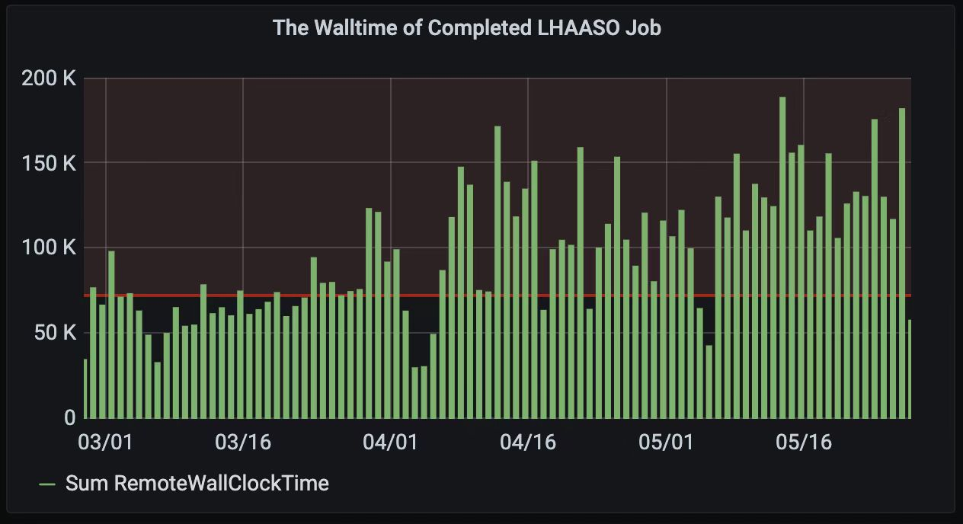
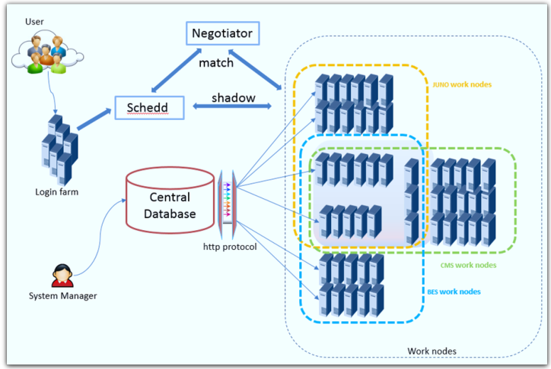
Find More Computing Resources for LHAASO(1)
The HTCondor cluster at IHEP site -- ~25k cpu cores
Main persistent computing resources for LHAASO
All experiments share their CPU cores in a big pool
Fair share policy is adopted based on group quota for each Exp.
MAT[*] system is used to control the “match condition” on worker nodes
Maintenance automation tool for the dynamically adjust worker nodes and job matching policy
Average job slots efficiency of IHEP HTCondor cluster is over 90%
LHAASO got more CPU time from other exp. resources
Contributed by LHAASO
The walltime statistics of LHAASO job at HTCondor cluster
Architecture of MAT system
* Jingyan Shi;etc.; An automatic solution to make HTCondor more stable and easier, 24th International Conference on Computing in High Energy and Nuclear Physics

Slide 6
Find More Computing Resources for LHAASO(2)
The Slurm cluster at IHEP -- case 1
Resource partitions with ~1000 CPU cores
Willing to accept LHAASO jobs when the partitions are idle
Known idle period
Same username space(uid/gid) as the HTCondor cluster
More domestic computing sites would like to contribute resources
Large sites : Big Data Center -- case 2
A new Data Center supported by HUAWEI is built in Dongguan, Guangdong province
30k intel x86 CPU cores, 10k ARM CPU cores and 3PB disk storage
10 Gbps network connection to IHEP
Small sites from the collaboration organization -- case 3
Small scale and short of maintenance man power
Not a stable and persistent provider -- no MoU
The amount of the resources contributed to LHAASO would be changed based on site own requirement

Slide 7
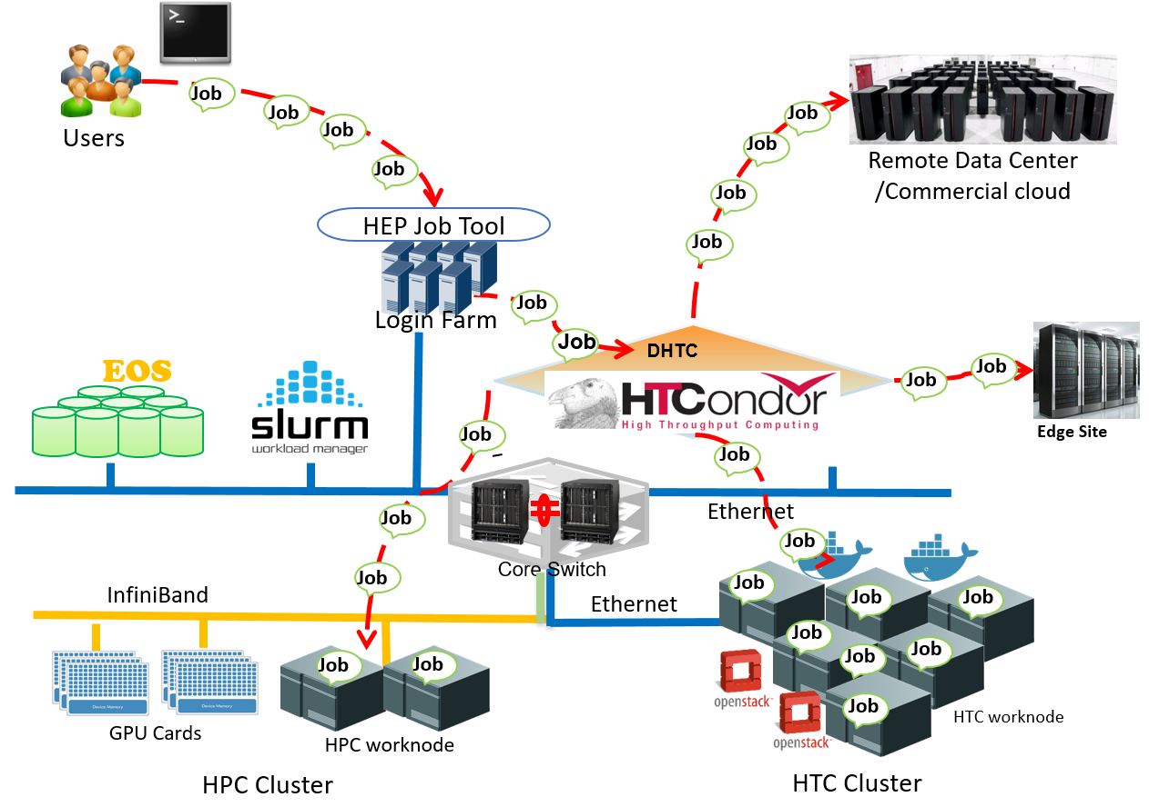
Simplified dHTC for LHAASO
Computing mode
Distributed High Throughput Computing:
A local cluster + glidein jobs
Keep the same usage patterns
Integrate remote computing resources into the HTCondor cluster at IHEP
3 issues need to be considered
Easy to integrate
Data access
LHAASO data processing features typical massive I/O mode
Authentication & Authorization
Simplified dHTC based on a local HTCondor cluster

Slide 8
Schedule LHAASO Jobs to Remote Worker Nodes
Scheduled LHAASO jobs from local HTCondor cluster
Issue 1 : easy to integrate
LHAASO jobs running in containers
Publish singularity image for LHAASO job to /cvmfs
Glidein jobs run in Singularity containers
Access LHAASO software from /cvmfs
Glidein job management
Submit glidein jobs manually during the know idle period
Next step：A simple glidein job tool is under development
Generate and submit glidein job automatically based on the real idle job slots
Keep the same usage pattern
All are wrapped in hep job tool
Example:
hep_sub –site remote -jobtype lhaaso_wcda_simrec job.sh
Issue 2 : data access
Policy : try to reduce data transfer as much as possible
EOS replica mechanism for big data access
Xcache for temporary remote data access
Issue 3 : authentication & authorizaiton
Now : the simplest way
Group “lhaaso” should be created on each remote site
LHAASO users are mapped to one or two “lhaaso group” users at remote sites
Glidein jobs are run with lhaaso uid/gid
Next step：Based on Tokens

Slide 9
Case 1: the IHEP Slurm Cluster
Environment is almost the same as the IHEP HTCondor cluster
User namespace: same uid/gid
Storage: same shared file system
Job running environment: almost same
Known job slots idle period
Submit glidein jobs to Slurm worker nodes during the job slots idle period as root
Glidein jobs run as user “condor”
Same as the owner of “startd” daemon run in the local HTCondor cluster
Jobs access data files from a shared file system
LHAASO User
Jobs
Glidein
Jobs
HTCondor
Pool
Glidein Factory
&WMS Pool
Worker
worker
HPC Cluster
Public Computing

Slide 10
Case 2: Dongguan Data Center (1)
Two Slurm clusters are runing in the federation mode
serve for MPI jobs and corporate with Huawei
Heterogeneous resources: Intel x86 CPUs, Arm CPUs and GPU cards
No access to worker nodes directly from outside
Worker nodes can be access outside
10 Gbps Network connection
Site Storage is available
3 PB disk storage
Not for persistent data file storage -- Data created needs to be transferred to IHEP at last

Slide 11
Run LHAASO Jobs at Dongguan Data Center
Network would be a bottleneck
10 Gbps Network connection but 10K job slots available
Suitable jobs should be those with small input and output
Choose WCDA, one detector of LHAASO, data processing
5 types of jobs from WCDA: Corsika → Geant4-step1 →Geant4-step2 → Reconstruction → Analysis
The output from this step is the input of the next step
Better choice:
Simulation + reconstruction in one job to reduced the transferred data
The output of “Geant4-step1” is replicated back with EOS replica mechanism
The output of reconstruction is transferred back on job exit by HTCondor
Submit glidein jobs as the “lhaaso group” user
 | Corsika | Geant4(step1) | Geant4(step2) | Reconstruction | Analysis
input | tiny | middle | large | small | various
output | middle | large | small | small | small
output persistent store? | No | Yes | No | Yes | No
CPU hours | long | Long | Short | Short | Various
users | Dedicate user | Dedicate user | Dedicate user | Dedicate user | Various user

Slide 12
Run LHAASO Jobs at Dongguan Data Center (2)
Data storage and access
EOS replica mode
The LHAASO data files created and saved to Dongguan EOS replica
Big data files are replicated by EOS asynchronously
Small data files are transferred back to IHEP by HTCondor on job exit
Workflow
Users submit jobs to the IHEP HTCondor cluster
Jobs are scheduled to the glidein job slots at Dongguan DC
Jobs write big data files into EOS replica at Dongguan DC, while small data files are written into local disks on worker nodes and later ransferred back to IHEP by HTCondor
Big data are replicated to IHEP by EOS replica mechanism
Users get output data files from the IHEP HTCondor cluster
IHEP
Dongguan DC
EOS
@IHEP
EOS
Replica @Dongguan DC
④
⑤
③
Login
Node
①
HTCondor at IHEP
②
Woker
Node at Dongguan

Slide 13
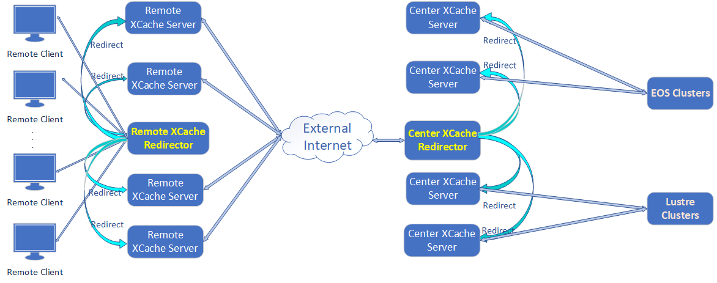
Case 3: Edge Sites
Edge sites
No dedicated storage for LHAASO
Small scale
LHAASO jobs run in glidein job slots
Output data are written to local scratch directory of worker nodes
Job results are transferred back by HTCondor
Set up xcache at edge sites
Jobs access IHEP storage via xcache
Suitable Jobs
Short queue time
schedule to edge sites
Less stable worker nodes and less queue time

Slide 14
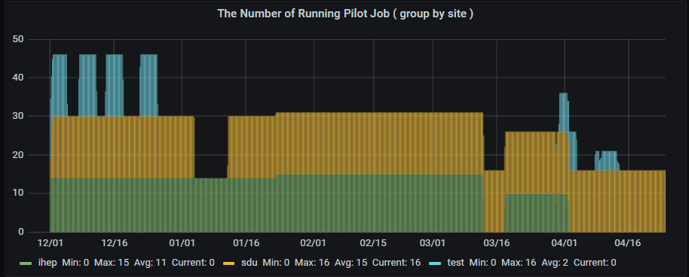
Current Status
IHEP Slurm Cluster runs LHAASO jobs at its idle slots
Tests on Dongguan DC is almost finished
Will be in production next month
2 edge sites succeed to run LHAASO jobs
Tests on jobs scheduled from IHEP and running Dongguan DC
Glidein job running at SDU site
LHAASO jobs running at edge site
Glidein job running at LZU site

Slide 15
Summary
A big gap between the requirement and reality of LHAASO computing resources
No persistent resources provided from other sites
Depends on local HTCondor cluster
Try to integrate more resources → Local HTCondor cluster + glidein job slots
Keep the same usage pattern
Three cases with handrolled glidein job slots
Local Slurm cluster, Dongguan Data Center and small edge sites
Thank to the HTCondor team, especially to Greg
Got tons of help
Lots of work need to be done in the coming days
Glidein job factory
Authentication and authorization based on tokens

Slide 16
Thank you!
Question?

