Slide 1

Motivation for a muon collider

Slide 2
Overview
Introduction to Particle physics
How we study particles
Previous colliders
What comes next?
What we need to study

Slide 3
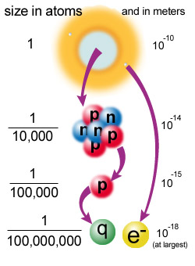
Scale of the ATOM
While an atom is tiny, the nucleus is ten thousand times smaller than the atom and the quarks and electrons are at least ten thousand times smaller than that. We don't know exactly how small quarks and electrons are; they are definitely smaller than 10⁻¹⁸ meters, and they might literally be points, but we do not know.
It is also possible that quarks and electrons are not fundamental after all, and will turn out to be made up of other, more fundamental particles.

Slide 4
Fundamental Blocks
Two types of point like constituents
Plus force carriers (will come to them later)
For every type of matter particle we've found, there also exists a corresponding antimatter particle, or antiparticle.
Antiparticles look and behave just like their corresponding matter particles, except they have opposite charges.
Leptons
Quarks
e
ν₁
u
d
μ
ν₂
c
s
τ
ν₃
t
b

Slide 5
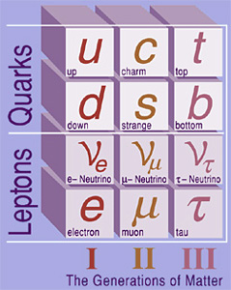
Generations of Quarks and LEPTONS
Note that both quarks and leptons exist in three distinct sets. Each set of quark and lepton charge types is called a generation of matter (charges +2/3, -1/3, 0, and -1 as you go down each generation). The generations are organized by increasing mass.
All visible matter in the universe is made from the first generation of matter particles -- up quarks, down quarks, and electrons. This is because all second and third generation particles are unstable and quickly decay into stable first generation particles.

Slide 6
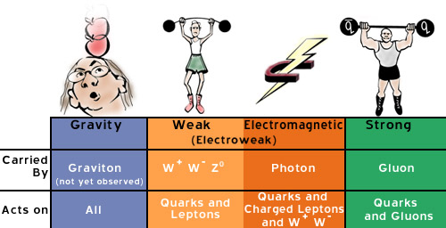
Forces at the Fundamental Level
The particles (quarks and leptons) interact through different “forces”, which we understand as due to the exchange of “field quanta” known as “gauge bosons”.

Slide 7
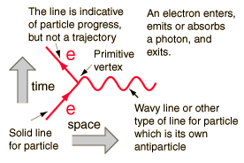
Feynman Diagrams
Feynman diagrams are graphical ways to represent exchange forces. Each point at which lines come together is called a vertex, and at each vertex one may examine the conservation laws which govern particle interactions. Each vertex must conserve charge, baryon number and lepton number.
Developed by Feynman to describe the interactions in quantum electrodynamics (QED), the diagrams have found use in describing a variety of particle interactions. They are spacetime diagrams, ct vs x. The time axis points upward and the space axis to the right. Particles are represented by lines with arrows to denote the direction of their travel, with antiparticles having their arrows reversed. Virtual particles are represented by wavy or broken lines and have no arrows. All electromagnetic interactions can be described with combinations of primitive diagrams like this one

Slide 8
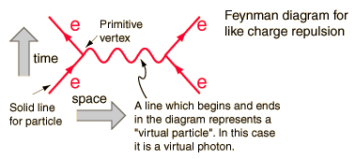
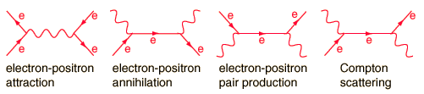
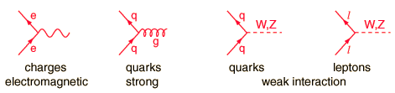
Feynman Diagrams II
Only lines entering or leaving the diagram represent observable particles. Here two electrons enter, exchange a photon, and then exit. The time and space axes are usually not indicated. The vertical direction indicates the progress of time upward, but the horizontal spacing does not give the distance between the particles.
After being introduced for electromagnetic processes, Feynman diagrams were developed for the weak and strong interactions as well. Forms of primitive vertices for these three interactions are

Slide 9
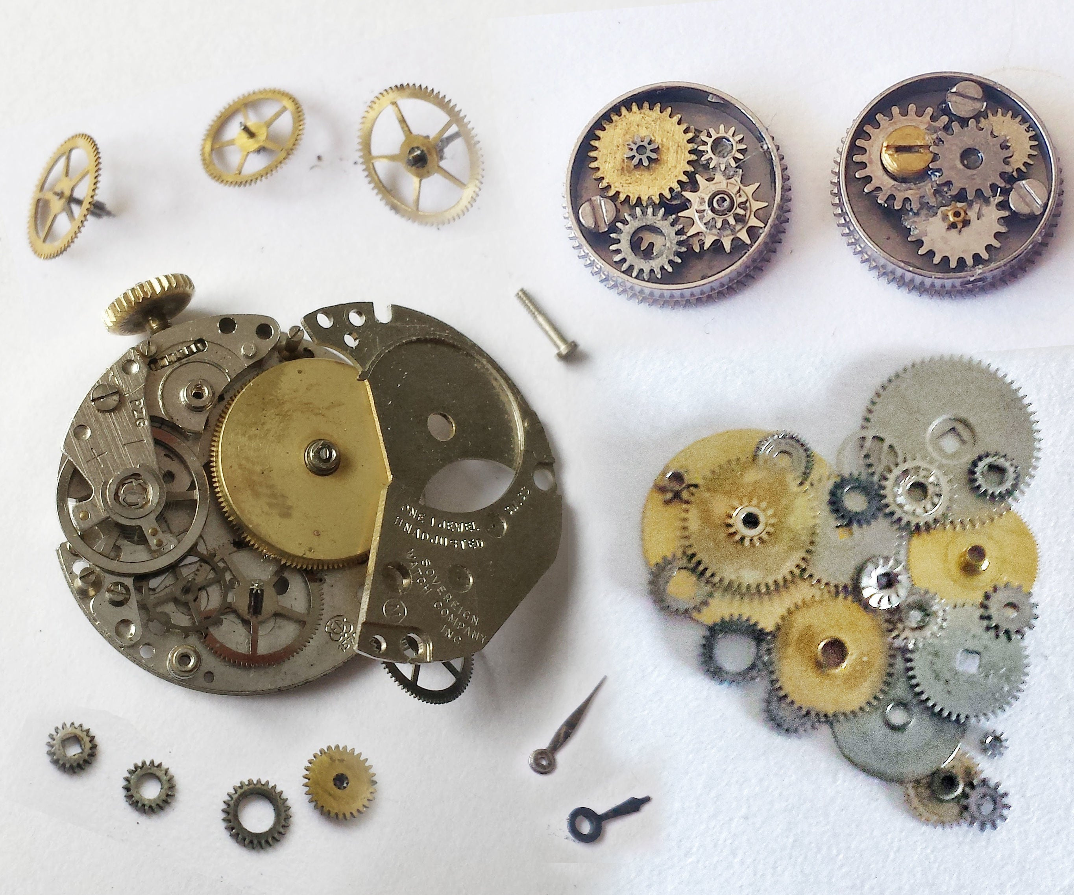
Why Colliders?
If you wanted to know how a mechanical watch worked, a reasonable approach might be to find the right screwdriver and take apart the watch and examine the individual gears and connections, etc

Slide 10
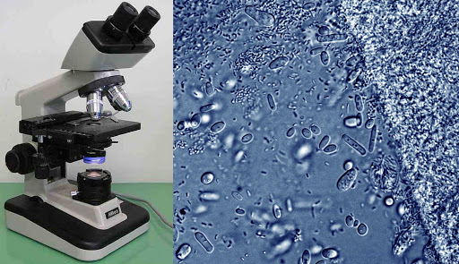
Why Colliders?
Or if to understand cellular organisms to look at them under a powerful microscope

Slide 11
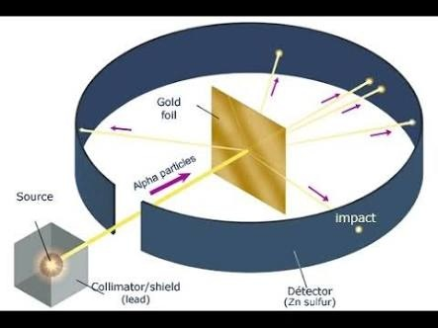
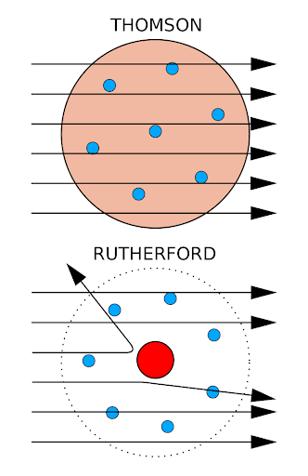
Why Colliders?
In each case you had to have the appropriate probe or tool (screwdriver on right scale, wavelength or light and right lens)
But what if you wanted to study an atom? Or an elementary particle?
Need the right probe!
Rutherford scattered alpha particles off a gold foil to probe atom structure (too tiny to use a screwdriver!)
In fact, only way to probe an elementary particle is with another elementary particle!

Slide 12
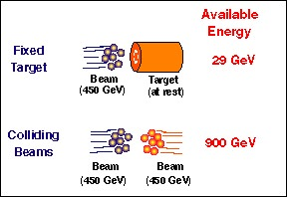
Fixed Target Versus Collider
Generically two types of configurations:
  Fixed Target: Accelerate a beam at a target at rest
    Pro: ”easy” to hit a wall with a baseball
    Con: Need to conserve energy and momentum, so much of that energy goes into simply conserving momentum of the initial state
  Colliding Beams: Accelerate two beams at each other
    Pro: All energy available (simply the sum of the two beams) for production of new particles
    Con: Much more difficult to hit another elementary particle than a large target of macroscopic size!

Slide 13
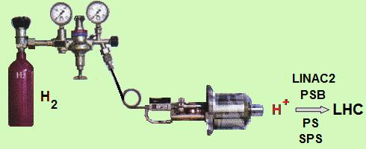
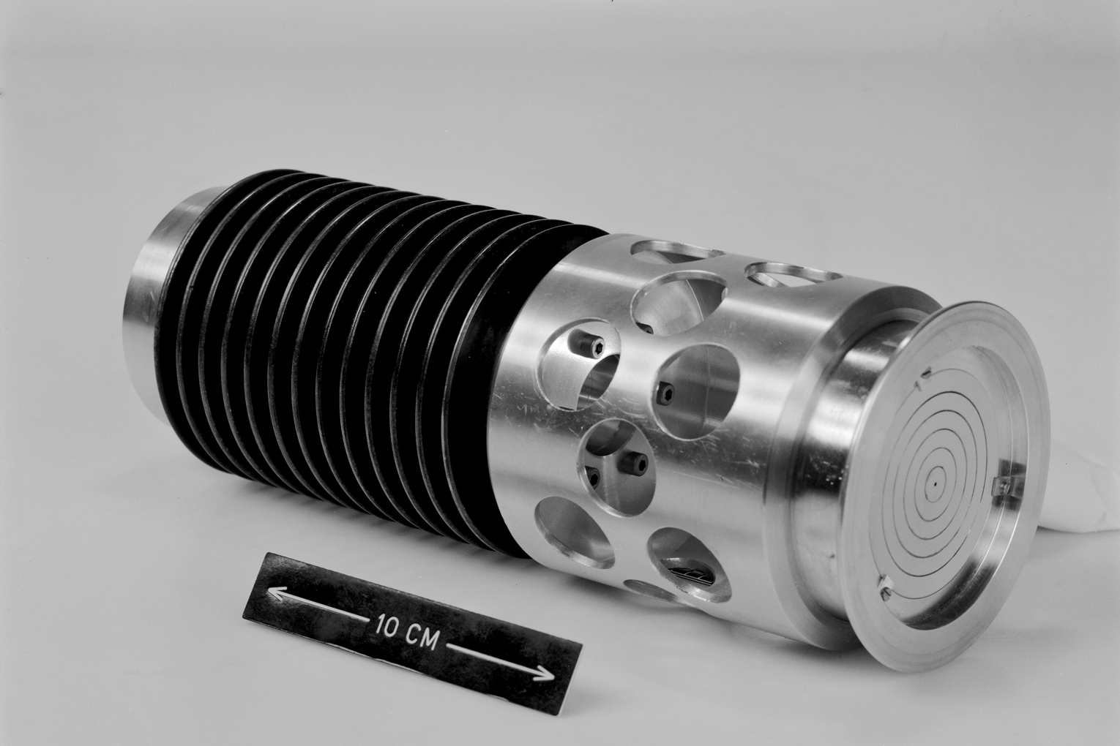
Types of particles to collide
So far all colliders have collided electrons/positrons, protons/antiprotons, or heavy nuclei
Protons and electrons are stable and in large abundance (eg. Open a bottle of hydrogen and ionize it to get a source of either H+ ions or electrons)
Positrons / Anti-protons produced by fixed target and then accumulated and accelerated

Slide 14
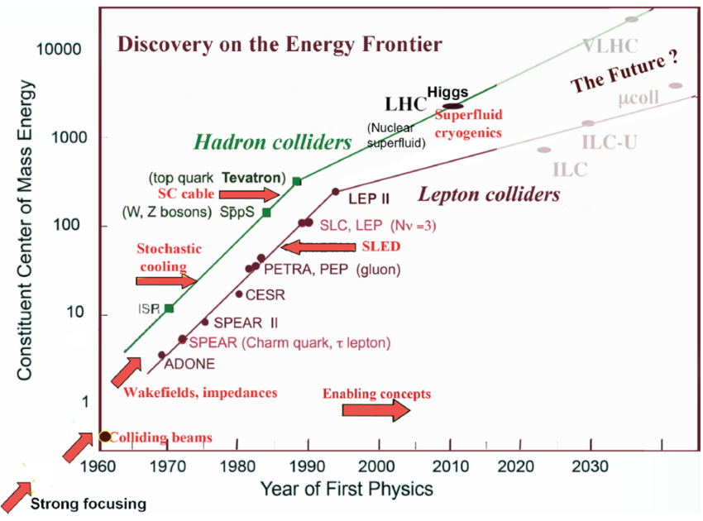
History of colliders
Fixed Target machines until the 1960s
Collisions of e+e- in early 60s onward
Collisions of protons from 70s onward and proton/antiproton starting in 80s
Note log scale of energy and change in slope with LHC

Slide 15
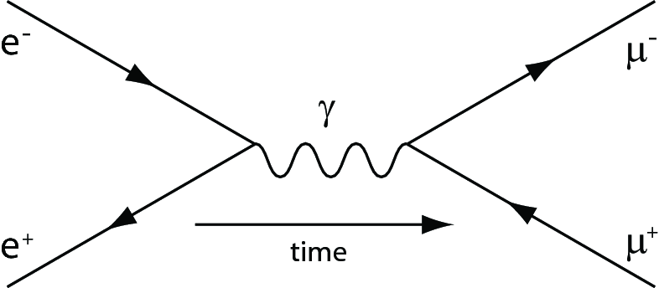
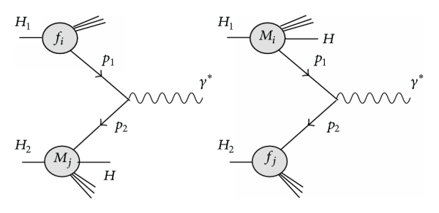
Comparing Hadron and Electron Machines
Lepton Collisions:
  Generally much “cleaner” (i.e. fundamental collision + photon radiation)
  All energy available for production of new particles
Hadron Collisions
  Are made up of quarks and gluons , have much more additional spectators that produce other particles unrelated to hard subprocess
  Only fraction of energy available for production of new particles

Slide 16
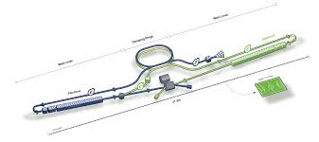
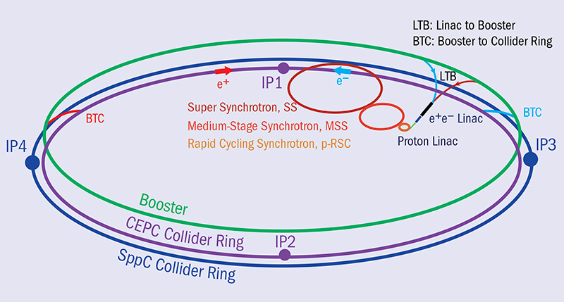

Linear Versus Circular Colliders
Linear Collider
  Simple, accelerate in one direction and collide
  ”One shot”, particles are lost after first attempt to collide, need continuously new particles
  With fixed acceleration gradient can get very long
Circular Collider
  Re-use particles over and over again
  Need magnets to bend particle trajectory
  Charged particles radiate when bent by field (strong mass dependence making electrons radiate much more !)

Slide 17
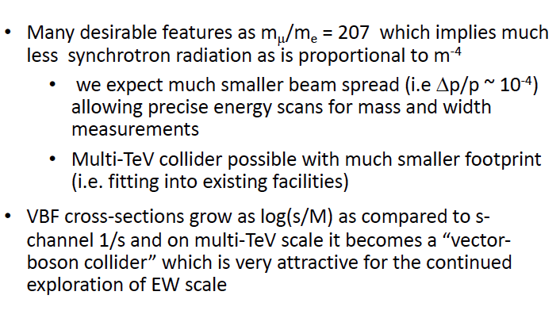
Why a muon collider

Slide 18
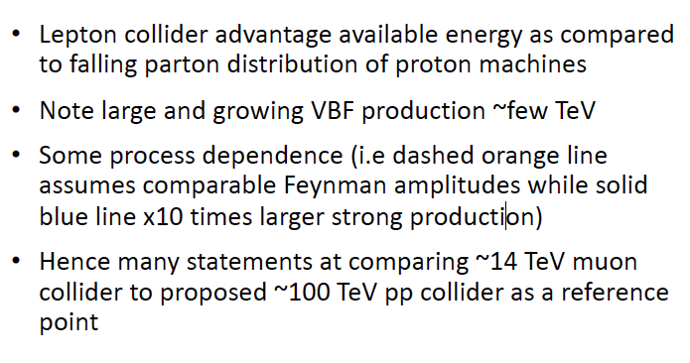
Comparison with Hadron Machines

Slide 19
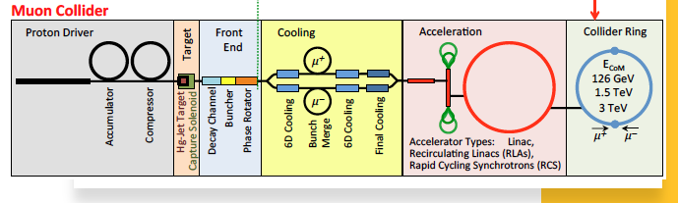
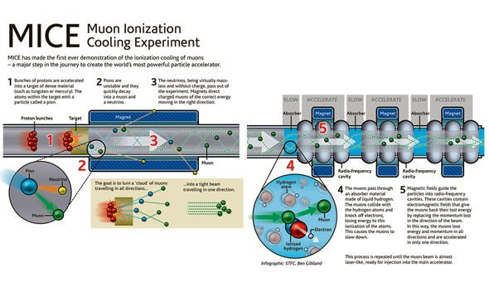
Production and Cooling
Need to produce muons (fixed target production)
Need to “cool muons” (i.e. we want muons accelerated in one direction but are produced with large transverse momentum as well)
Need to cool and accelerate quickly!!
Further complications due to muon decay in accelerator

Slide 20
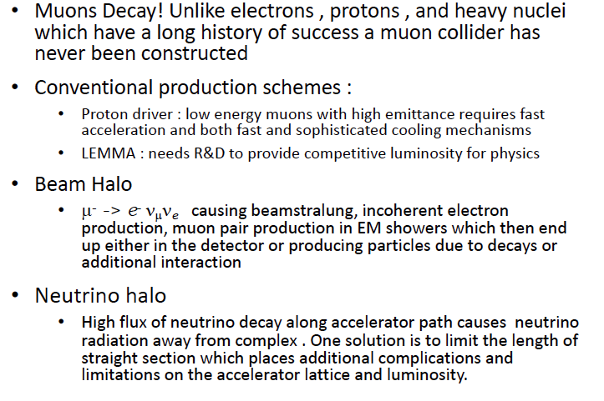
Challenges of A MUON COLLIDER

Slide 21
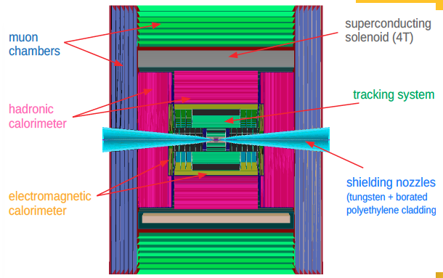
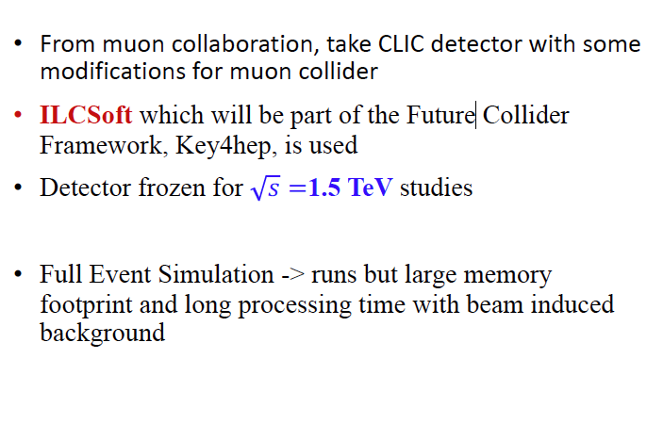
GEANT SIMULATION
Vertex Detector (VXD) § 4 double-sensor barrel layers 25x25μm2 § 4+4 double-sensor disks 25x25μm2
Inner Tracker (IT) § 3 barrel layers 50x50μm2 § 7+7 disks ’’ Outer Tracker(OT) § 3 barrel layers 50x50μm2 § 4+4 disks ’’ Electromagnetic Calorimeter (ECAL) § 40 layers W absorber and silicon pad sensors, 5x5 mm
Hadron Calorimeter (HCAL) § 60 layers steel absorber & plastic scintillating tiles, 30x30 mm2

Slide 22
Studies
Precision Higgs Measurements (typically optimized by electron machines for precise control of kinematics and clean final states)
New physics searches (typically optimized by proton machines for highest energy)
Muon Collider
  One ring to rule them all
  Potential to optimize for both precision studies and searches in one machine

Slide 23
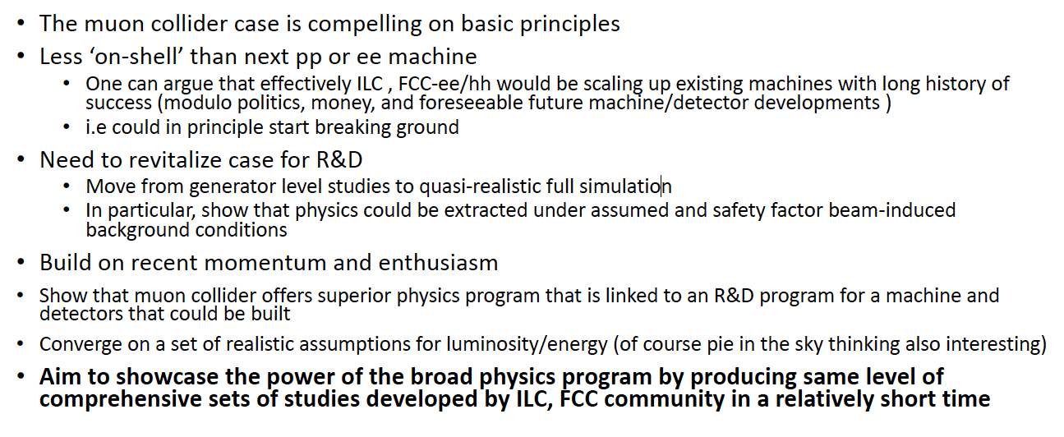
GOALS

