Slide 1
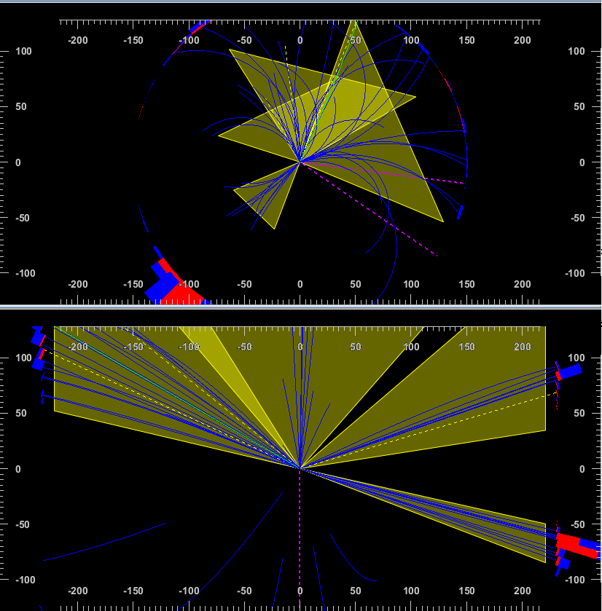
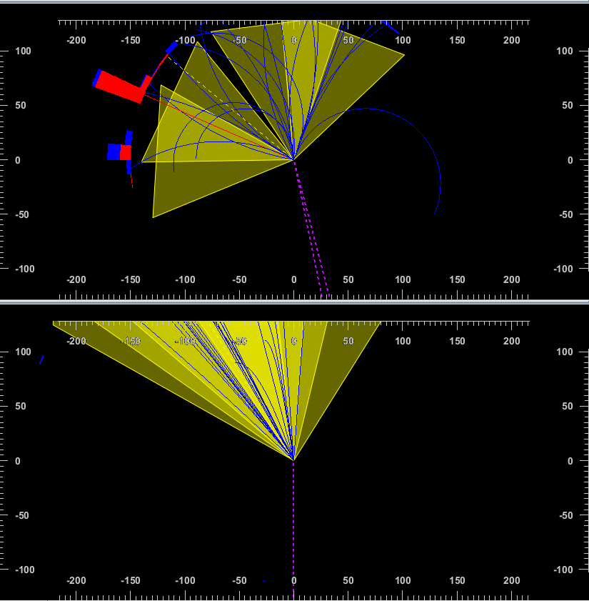
Event Display
Small modification to example/EventDisplay.C
Results generated using card/MuonColliderDet.tcl
81.510139
193.266159
168.515274
95.436325
30.561722
27.052027
51.727951
123.539749

Slide 2
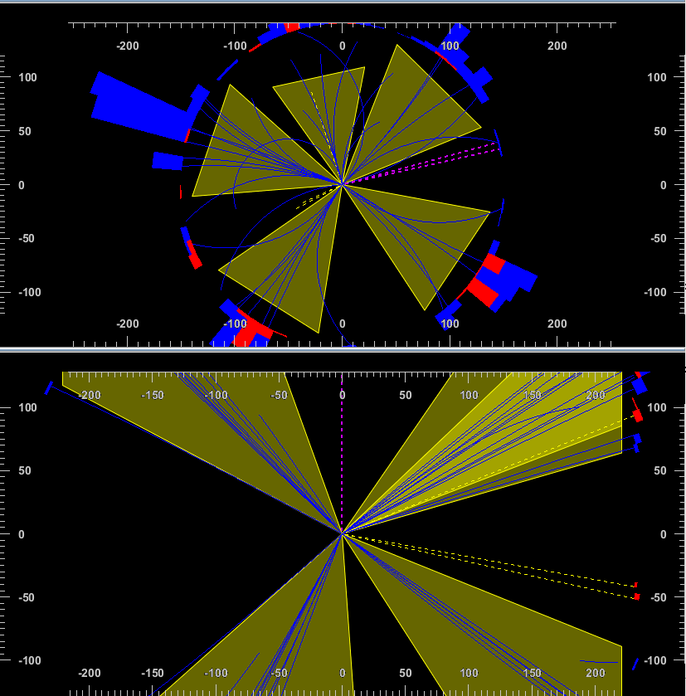
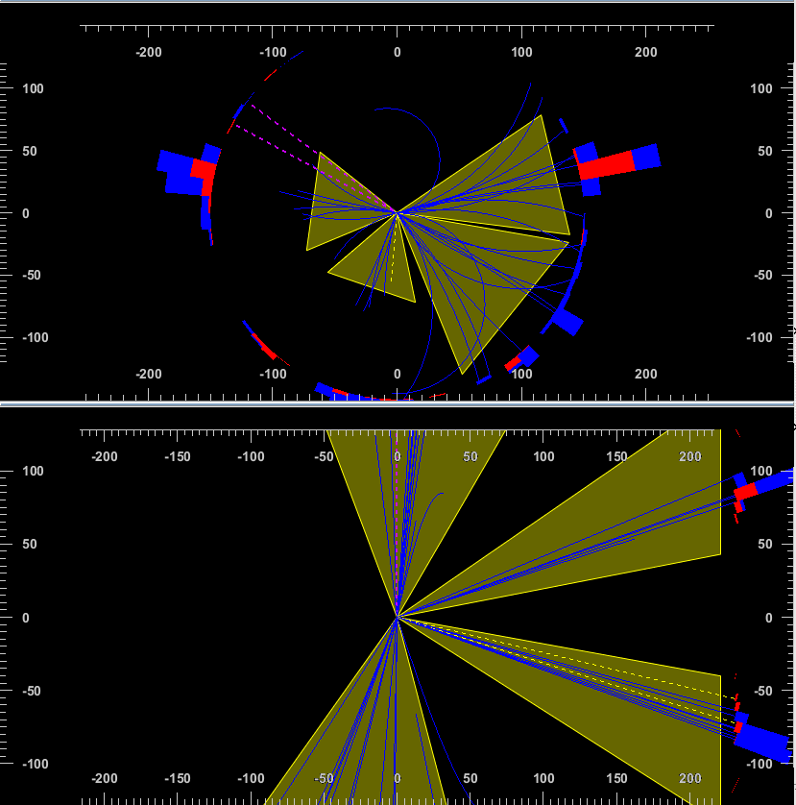
Background Events
mu+ mu- > vm vm~ b b~ h
64 events generated
24.094587
31.671791
152.779419
109.706917
57.873669
64.731239
89.465767
56.130619
82.268257

Slide 3
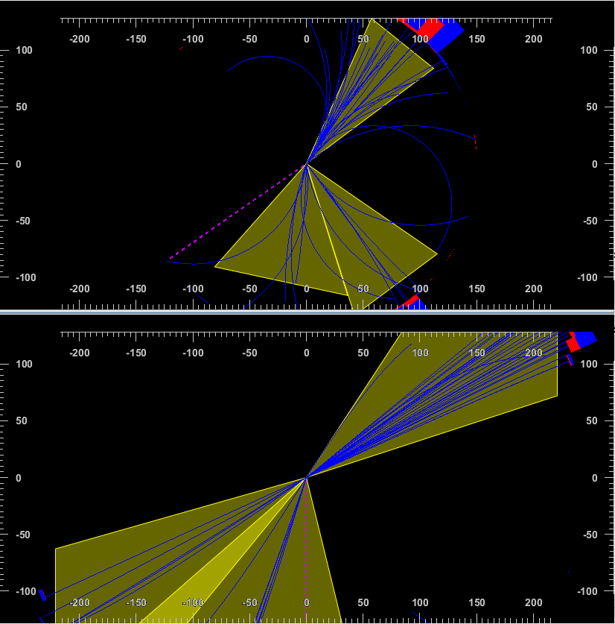
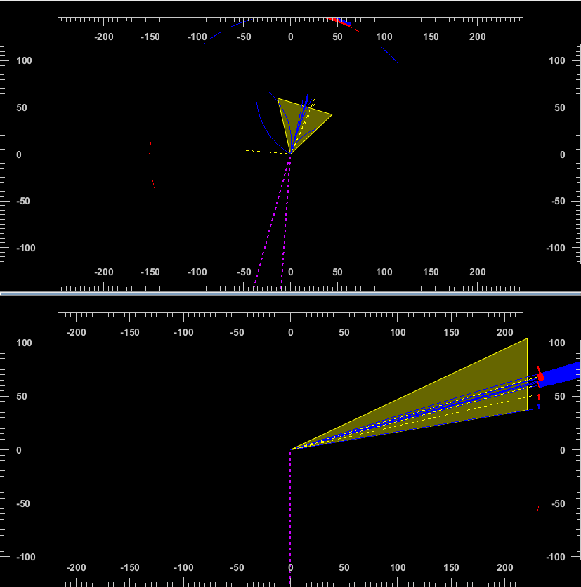
mu+ mu- > vm vm~ b b~ z
60 events generated
598.139893
98.091080
29.216513
149.977463

