Slide 1
F. Maltoni, T. McElmurry, S. Willenbrock
University of Illinois at Urbana-Champaign
Pheno 2009
5/12/09

Slide 2
Factorization is the key to being able to calculate in pQCD.
At NLO we have divergences we have to subtract back into the PDFs. This introduces a factorization scheme & scale (μ).
The hadronic cross section is a physical observable: it does not depend on μ.

Slide 3
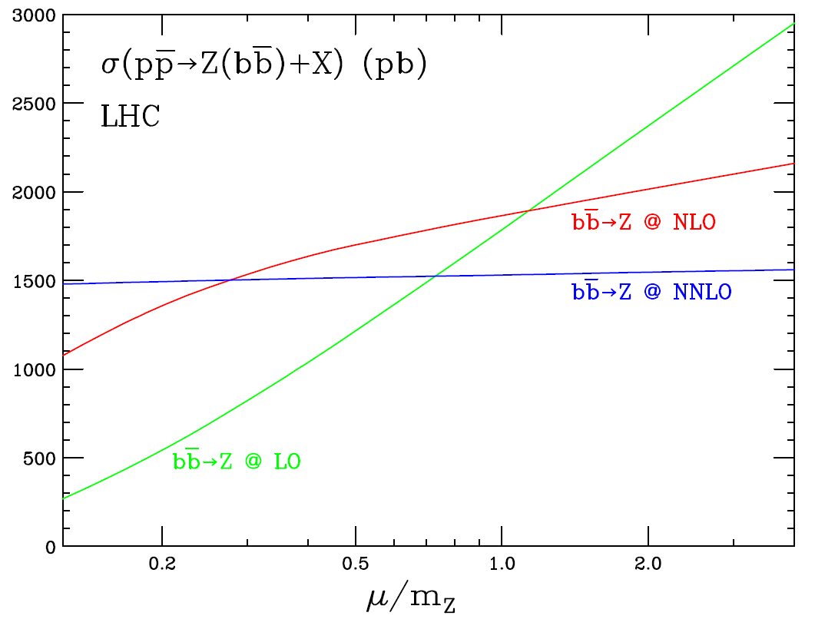
However at any given order in perturbation theory we do have dependence on μ.
Maltoni, McElmurry, Willenbrock hep-ph/0505014

Slide 4
Clearly the best solution is to calculate to higher orders.
What do we do if that’s not possible and our calculation still depends highly on μ?
Either we must accept a large uncertainty due to varying the scale, or we must find a way to pin down the scale μ.

Slide 5
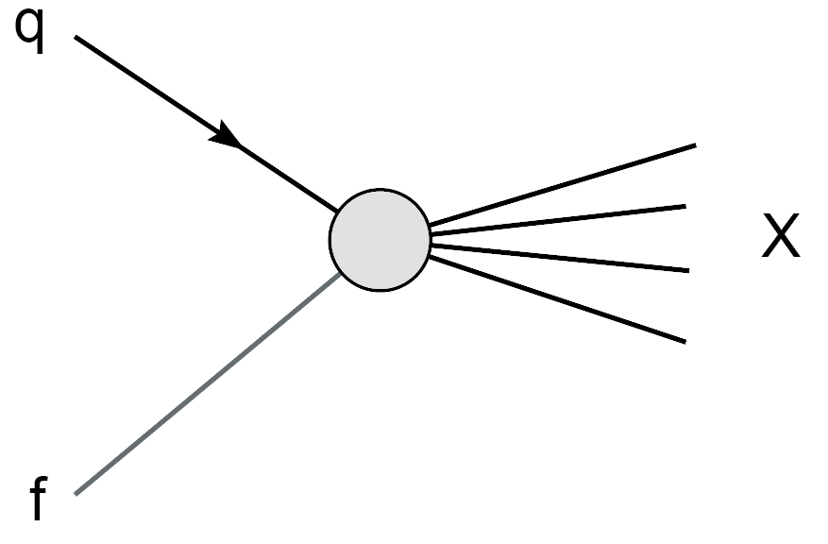
Consider a process with an incoming quark:
qf → X
How does the cross section change when we change the initial state?

Slide 6
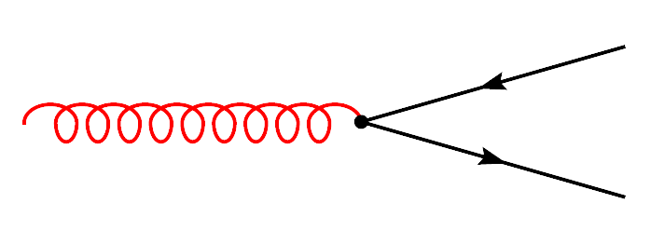
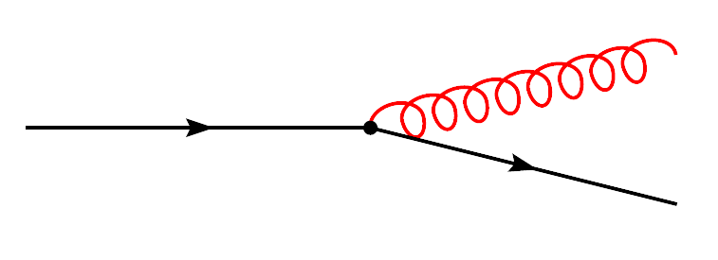
We can alter the initial state one of two ways:
The quark that scatters is radiated by a gluon
The quark that scatters is radiated by a quark
Let’s consider the case of the quark radiated by a gluon first.

Slide 7
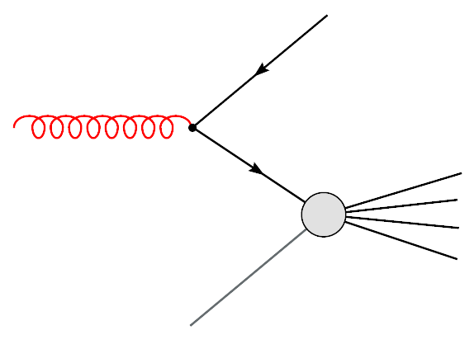
In general the matrix element will be very different.
In the collinear limit it must be a product:

Slide 8
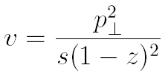
Using the collinear limit as an anchor point we define a counterterm by cutting in
This yields a PDF counterterm:
To satisfy DGLAP we must have v_{cut} = μ²/Q²

Slide 9
How is this different from MS bar?
The two terms of order Є that hit the collinear divergence:
Phase space
D dimensional splitting function

Slide 10
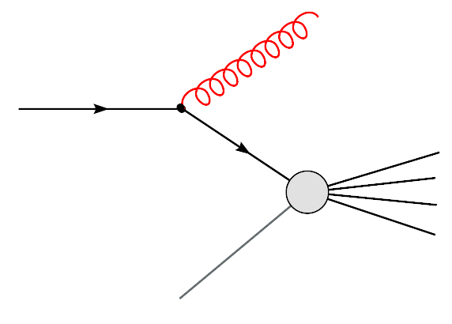
We can follow a similar procedure for the other correction.
Virtual corrections complicate things.

Slide 11
We can follow the same approach to find the corrections to the gluon PDF.
Note again additional terms that don’t appear in the MS bar factorization scheme.

Slide 12
Now that we have our counterterms, how do we choose μ?
We should factorize as much as we can into the PDFs.
We should subtract the entire term that arises from the squared matrix element factorizing.
This corresponds to taking v_{cut} = 1, or μ = Q.

Slide 13
We have to create a set of collinear scheme PDFs.
How well does it work?
We consider two different processes:
Drell Yan
Higgs Production by Gluon Fusion

Slide 14
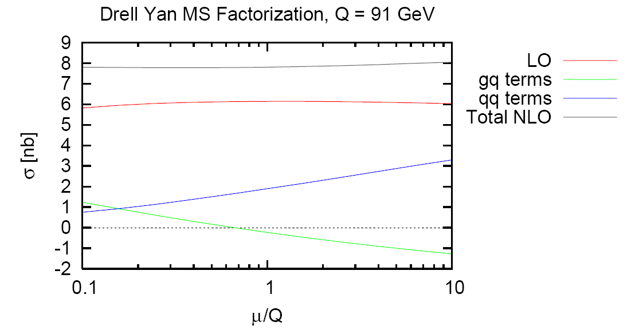
Real Z Production at the Tevatron
MS Bar Factorization

Slide 15
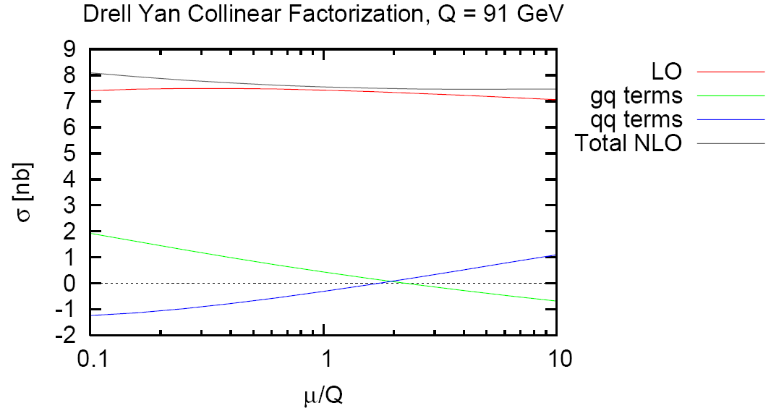
Real Z Production at the Tevatron
Collinear Factorization

Slide 16
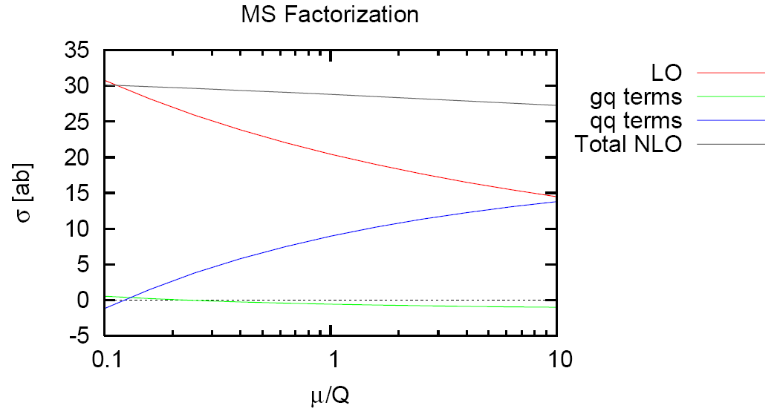
Z Production at the LHC Q = 3.5 TeV

Slide 17
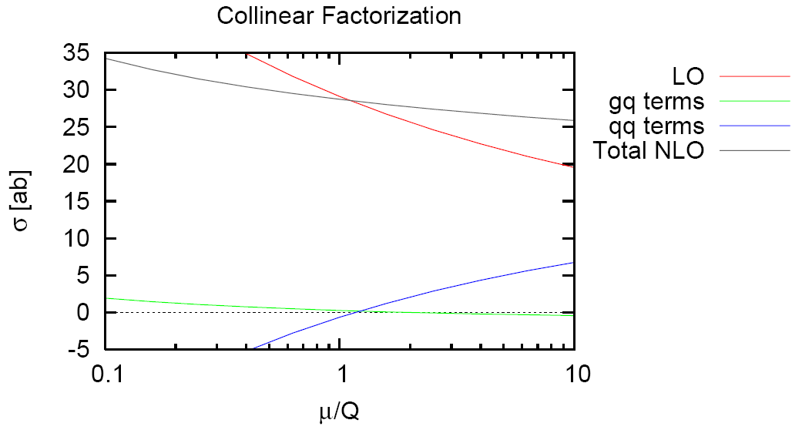
Z Production at the LHC Q = 3.5 TeV

Slide 18
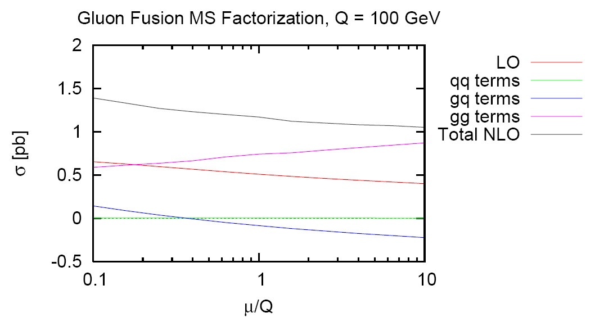
gg → H at the Tevatron, M_{h} = 100 GeV
MS Bar Factorization

Slide 19
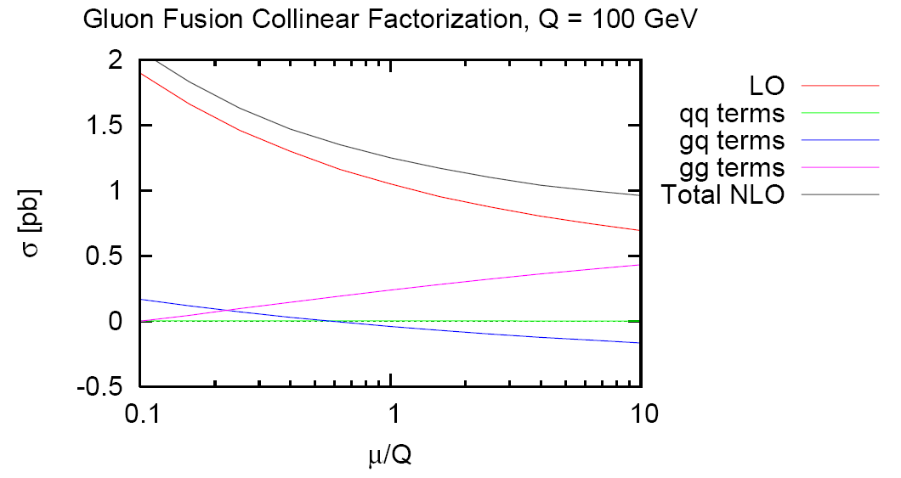
gg → H at the Tevatron, M_{h} = 100 GeV Collinear Factorization

Slide 20
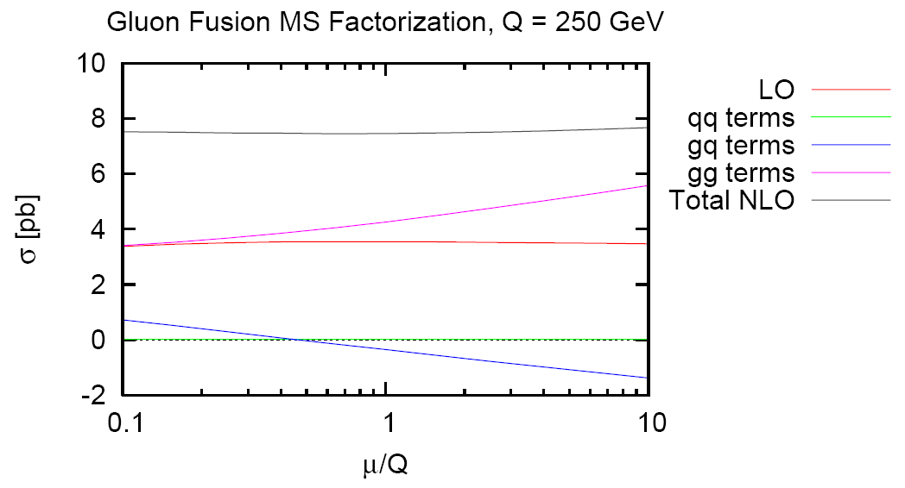
gg → H at the LHC, M_{h} = 250 GeV
MS Bar Factorization

Slide 21
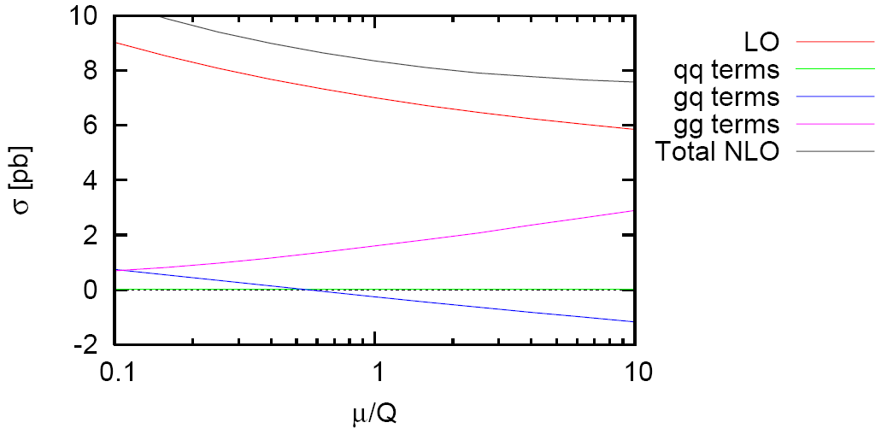
gg → H at the LHC, M_{h} = 250 GeV Collinear Factorization

Slide 22
Examining the collinear limit allows one to define a factorization scheme based on the collinear physics.
This scheme subtracts the divergent terms arising from the collinear divergence, but also the Є⁰ terms that arise from this divergence.
In this scheme the factorization scale can be pinned down.

Slide 23
When using this factorization scheme and scale the convergence of cross sections in pQCD is significantly improved.
Factorization is clearly important and deserves further work and thought:
What about a 2 → 2 or 2 → n process?
Can we somehow relate this to MS Bar?

