Slide 1
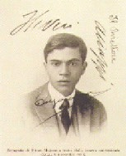
www.sanfordlab.org
www.sanfordlab.org
Pulse-Shape-Based Analysis using Machine Learning in the Majorana Demonstrator
Laxman Paudel
On behalf of Majorana collaboration
CIPANP 2022
www.lngs.infn.it

Slide 2
Outline
Majorana Demonstrator
Traditional Pulse Shape Analysis
Motivation and Network’s Performance:
Interpretable Machine Learning Model (Part I)
Pileup Waveforms Study (Part II)
Summary and Outlook

Slide 3
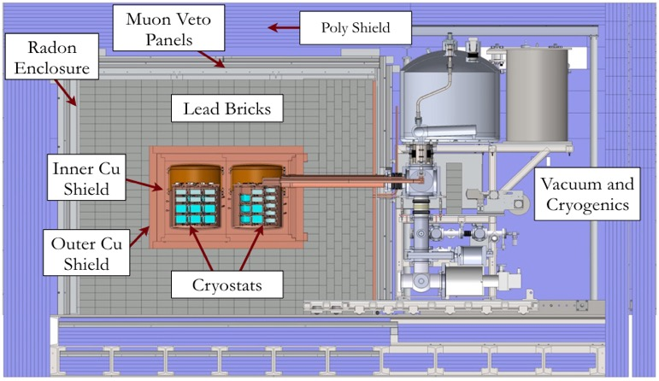
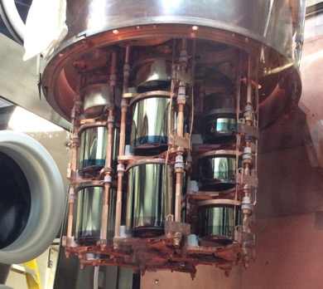
Majorana Demonstrator
Searching for neutrinoless double-beta decay of ⁷⁶Ge in HPGe detectors, probing additional physics beyond the standard model, and informing the design of the next-generation LEGEND experiment
Source and Detector: Array of p-type, point contact (PPC) detectors
30kg of 88% enriched ⁷⁶Ge crystals – 14 kg of natural Ge crystals
Included 6.7 kg of ⁷⁶Ge inverted coaxial, point contact detectors (ICPC) in final run
Excellent Energy Resolution: 2.5 keV FWHM @ 2039 keV
and Analysis Threshold: 1 keV
Low Background: 2 modules within a compact graded shield and active muon veto using ultra-clean materials
Reached an exposure of ~65 kg-yr before removal of the enriched detectors for the LEGEND-200 experiment at LNGS
Continuing to operate at the Sanford Underground Research Facility with natural detectors for background studies and other physics
3

Slide 4
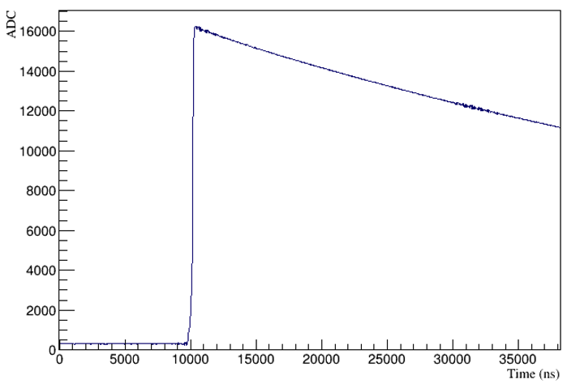
Detector Signal
Falling edge
Rising edge
Baseline
Features of the waveform varies with types of interaction: rising edge carries most of the information
Pulse shape analysis (PSA) parameters are developed to identify the types of interaction
P-type point contact (PPC) geometry enables pulse shape analysis techniques

Slide 5
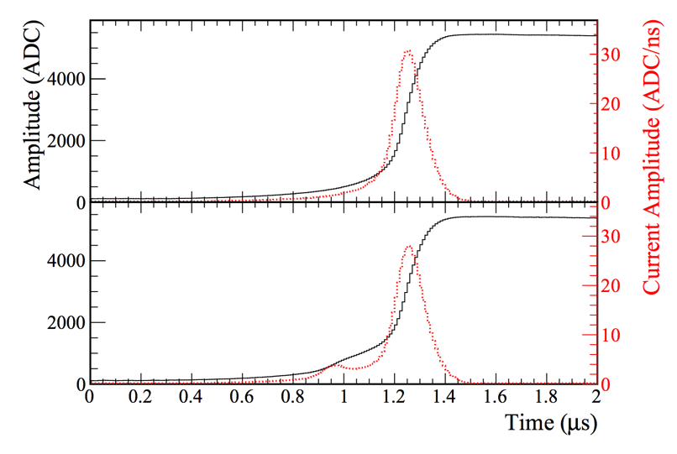
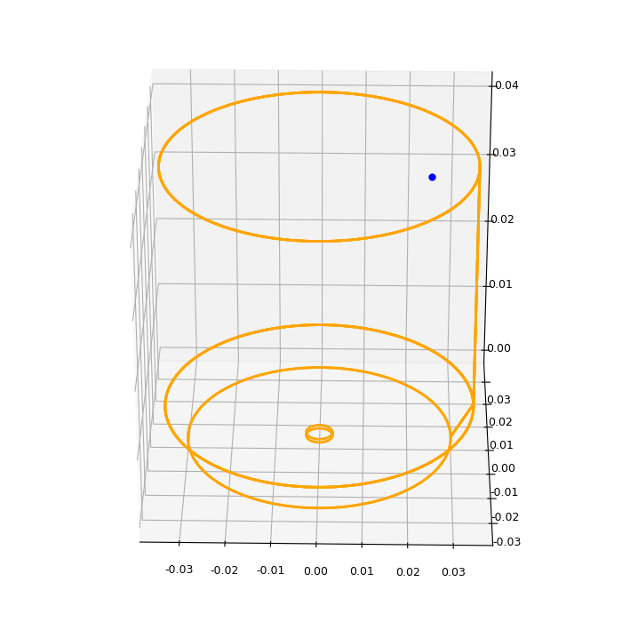
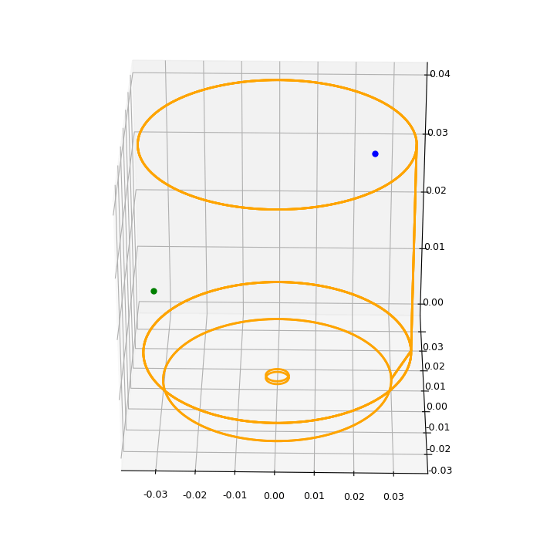
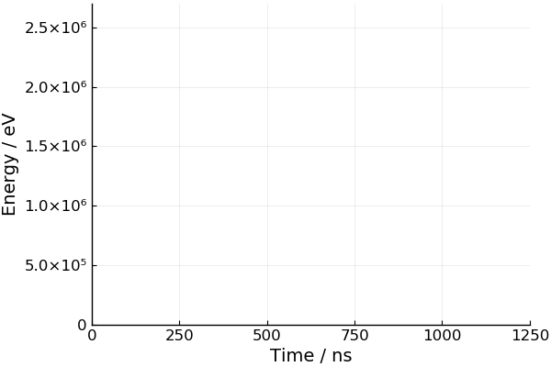
Traditional Pulse Shape Analysis
Amplitude of current pulse is suppressed for a multi-site event compared to a single-site event of the same event energy (AvsE).
PRC 99 065501 (2019)
Single-site event
Multi-site event
γ
ββ

Slide 6
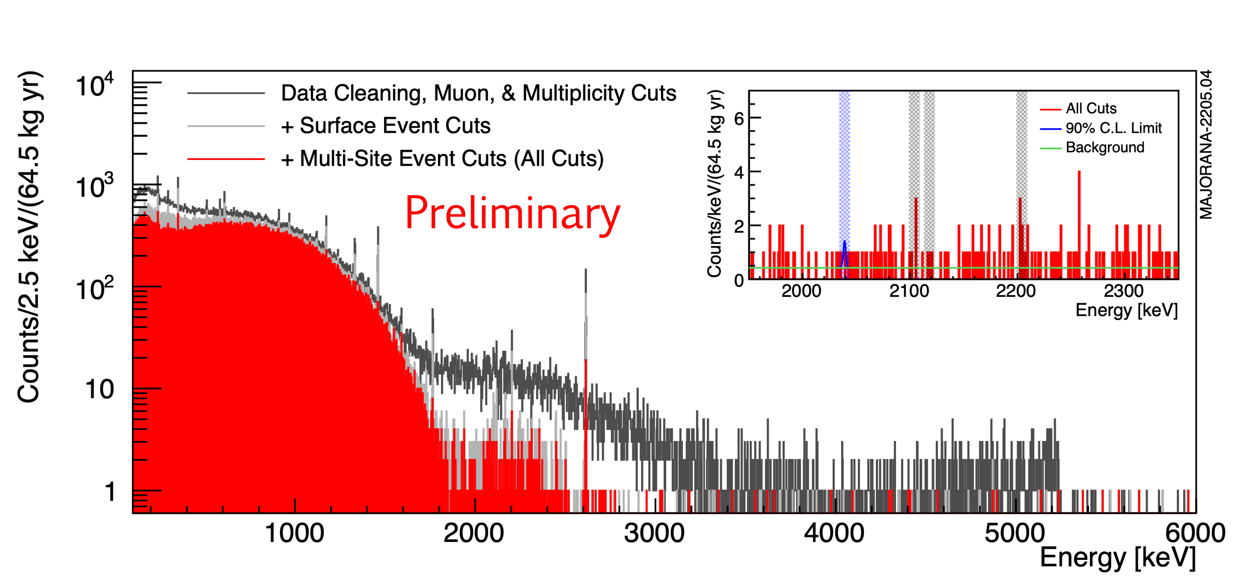
Majorana Demonstrator 2022 $0νββ$ Result
Operating in a low background regime and benefiting from excellent energy resolution
Final enriched detector active exposure: 64.5 ± 0.9 kg-yr
Background index at 2039 keV in lowest background configuration
15.7 ± 1.4 cts/(FWHM t yr)
Background Index:
(6.2 ± 0.6) × 10⁻³ cts/(keV kg yr)
Energy resolution: 2.5 keV FWHM @ Qββ
See talk by W. Pettus on Sept 3rd in the plenary session at this meeting for an overview and final results of the Majorana Demonstrator.
Frequentist Limit:
Median T1/2 Sensitivity: 8.1 × 10²⁵ yr (90% C.I.)
65 kg-yr Exposure Limit: T1/2 > 8.3 × 10²⁵ yr (90% C.I.)
Bayesian Limit: (flat prior on rate)
65 kg-yr Exposure Limit: T1/2 > 7.0 × 10²⁵ yr (90% C.I.)
m_{ββ} < 113 - 269 meV
Using M0ν = 2.66 - 6.34
Boosted Decision Tree analysis: arXiv:2207.10710

Slide 7
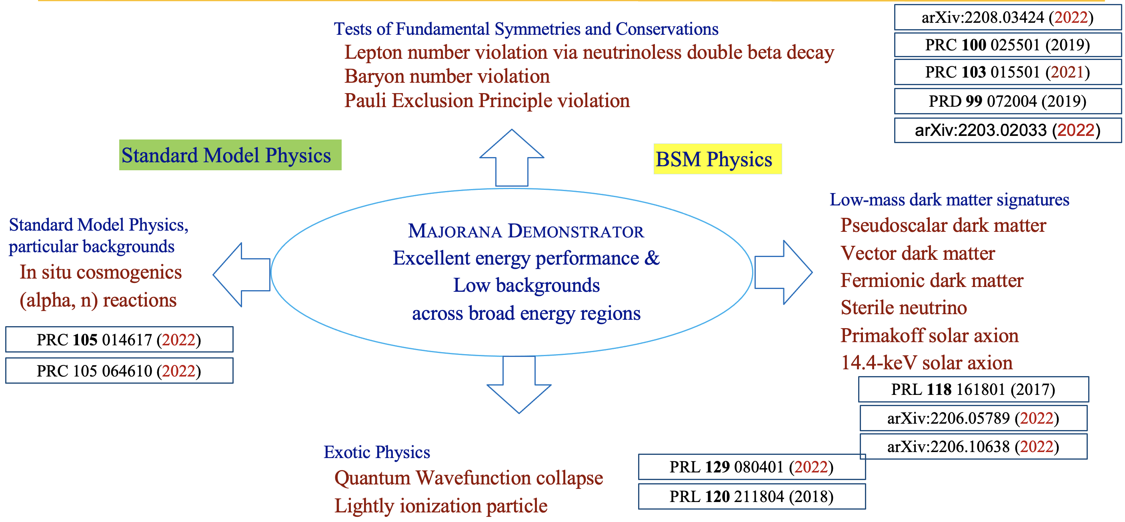
Rich and Broad Physics Program
PRL 129.081803 (2022)
See talk by C. Wiseman on Aug 30 in Dark Matter session for the Majorana BSM physics.

Slide 8
Classification with Interpretable Machine Learning Model
Results are all work in progress
Part I

Slide 9
Motivation for Interpretable Machine Learning
Machine learning based pulse shape analysis has a potential to outperform traditional analysis
We can simultaneously train all detectors to avoid detector by detector tuning
This will be important for next-generation experiment with a larger channel count like LEGEND
Leverage interpretability to understand the source of the classification power

Slide 10
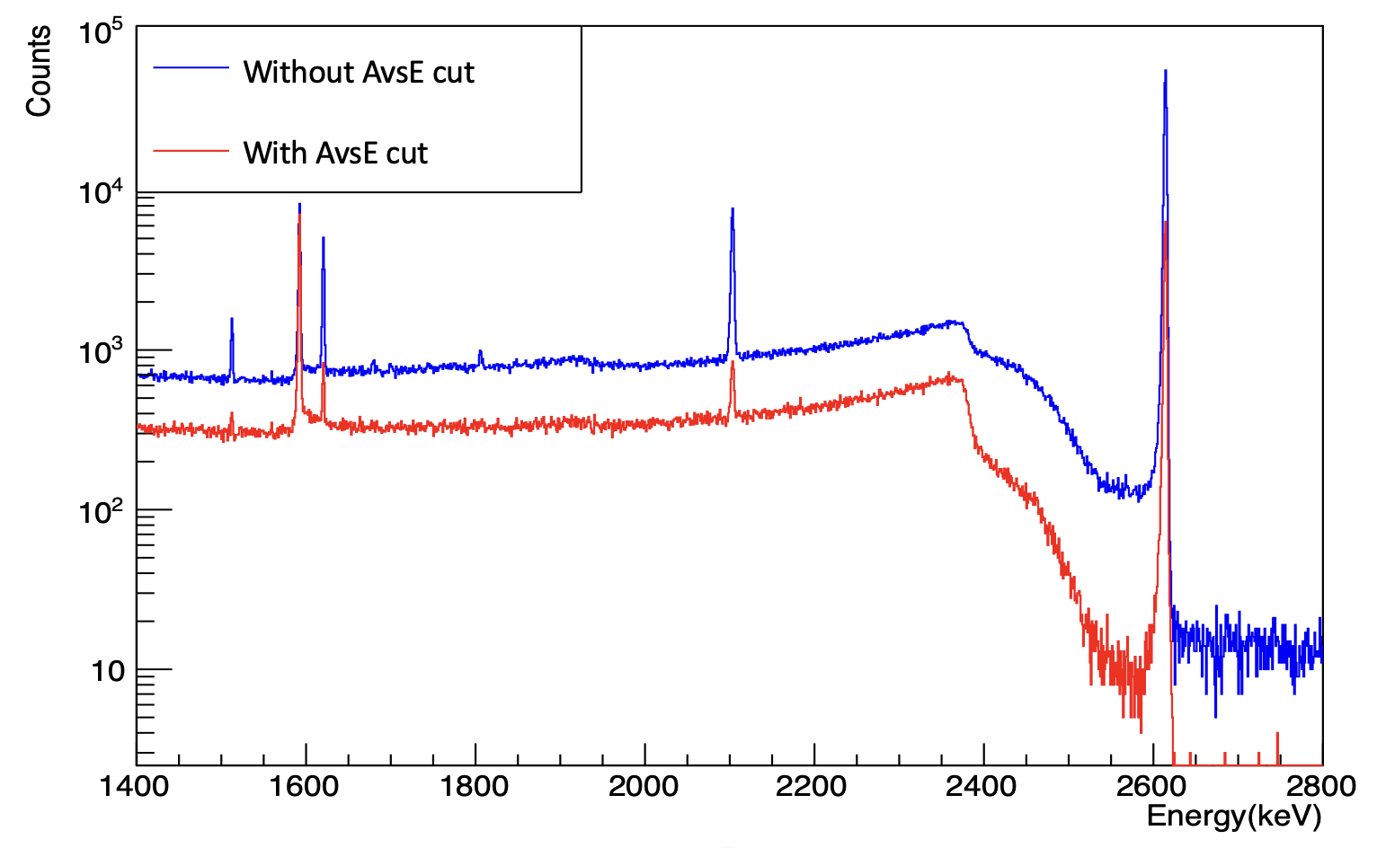
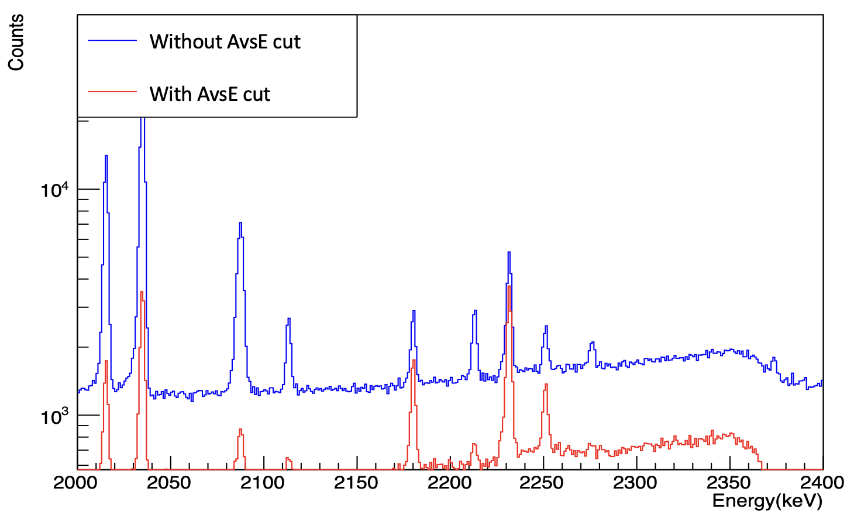
Data Selection
Data used from ²²⁸Th and ⁵⁶Co calibration data
Collect single escape peak (SEP) and double escape peak (DEP) events based on energy cut
²²⁸Th calibration data
⁵⁶Co calibration data
Signal: DEP events
(single-site)
Events from 2180 keV DEP peak
Background: SEP events
(multi-site)

Slide 11
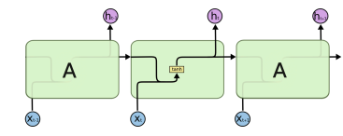
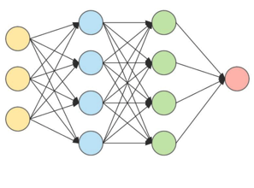
Recurrent Neural Network (RNN)
RNN is a canonical model for processing waveform data – the key improvement here is the inclusion of attention mechanism.
Attention mechanism allows RNN to zoom in the part which contains most important information (rising edge of the waveform)
Attention mechanism also helps to explain the decision of the model
http://colah.github.io
Fully connected NN
Context vector + final hidden state output
Outputs: classification
Attention score is an important tools for interpretability of models

Slide 12
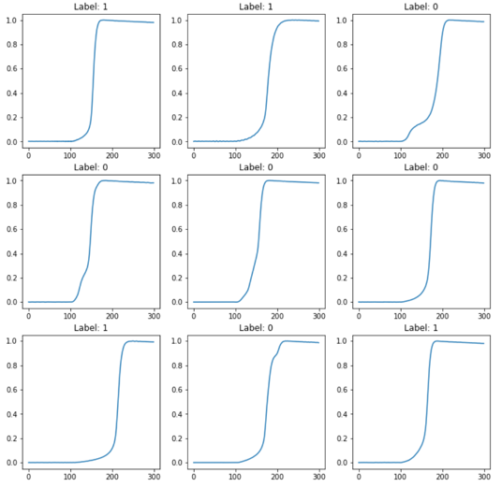
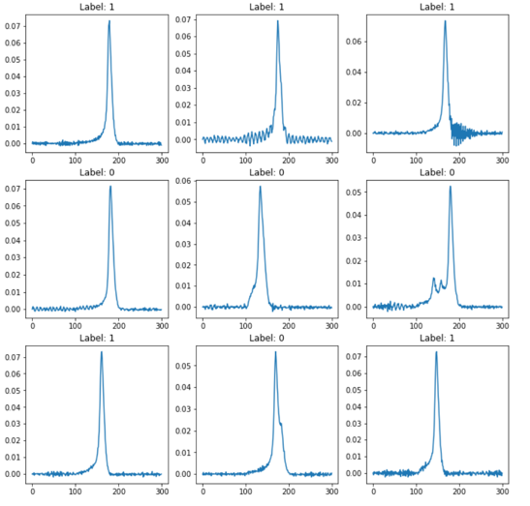
RNN Training
Input Features: [waveform, AvsE, detector, start time of the rising edge]
Waveforms are normalized
Waveform in charge domain
Waveform in current domain
Training data:
Multiple detector data with one hot encoding applied to detector ID
DEP (signal) and SEP (background) events of 2614 keV from ²²⁸Th calibration data
Labeling of waveform (signal label = 1, background label = 0)
Testing data:
Individual detector data
DEP at 2180 keV from ⁵⁶Co data and SEP events at 2103 keV (not seen in training) from ²²⁸Th calibration data
Evaluate performance on testing data
Trained model takes 4 features as input and outputs a sigmoid value between [0,1]
Value close to 0 and 1 means the network thinks background-like and signal-like events

Slide 13
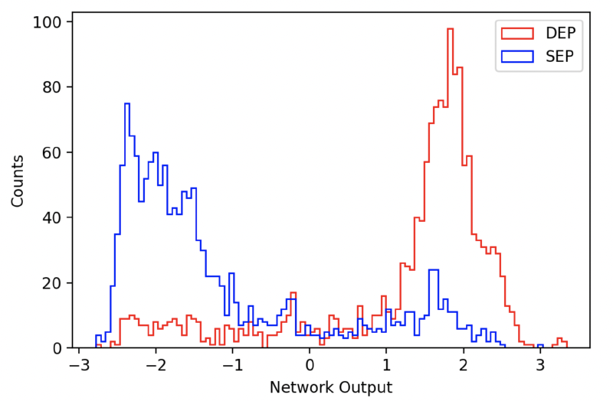
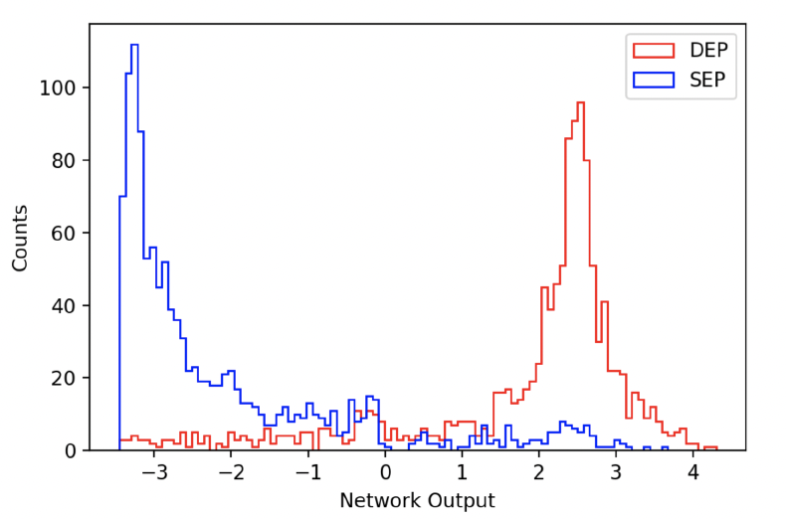
Network Output
Distribution of network outputs for signal-like (DEP) and background-like (SEP) events in the RNN network for a detector.
Charge Domain
Current Domain

Slide 14
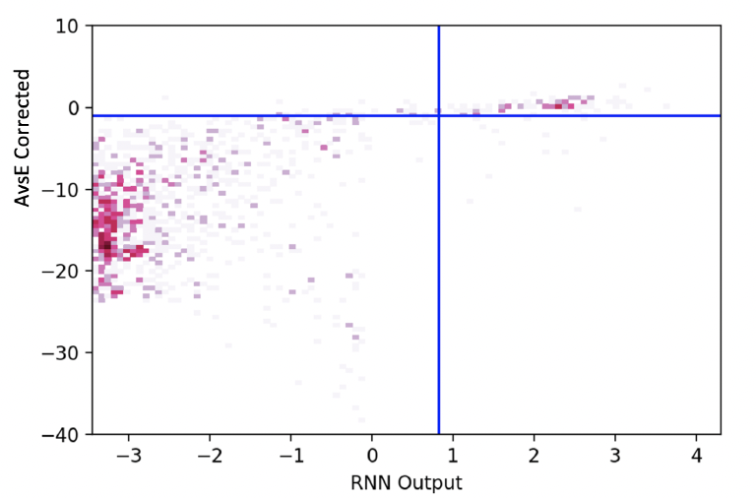
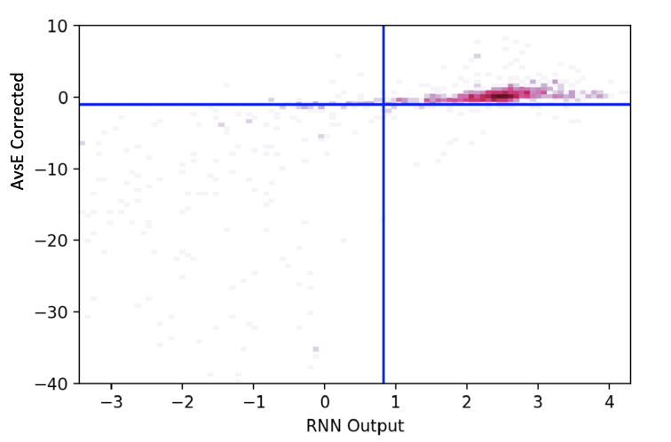
Confusion Matrix
Each entry in a confusion matrix represents classification based on the traditional approach of AvsE and the prediction by the network.
SEP and DEP events in an example detector:
SEP events
DEP events

Slide 15
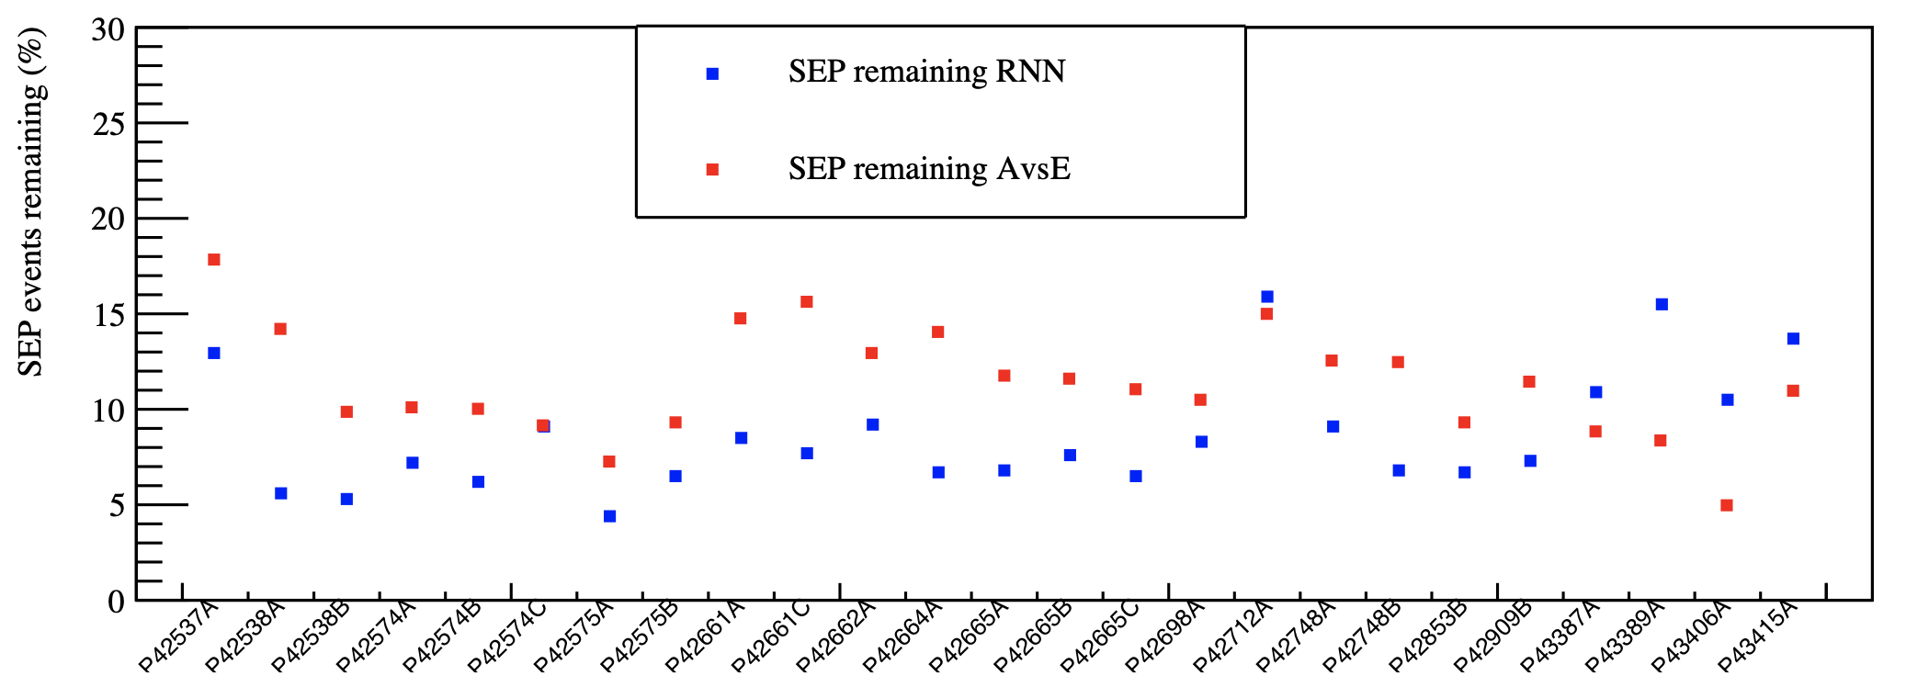
SEP Remaining
ICPC detector
Lower the percentage of SEP events remaining, better the performance of classification
A good performance of RNN in terms of single-site and multi-site events classification with far less parameters tuning than in AvsE is observed
AvsE has better performance in ICPCs.

Slide 16
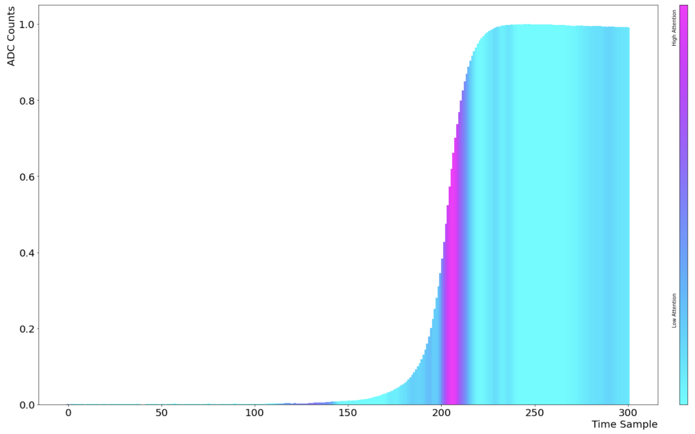
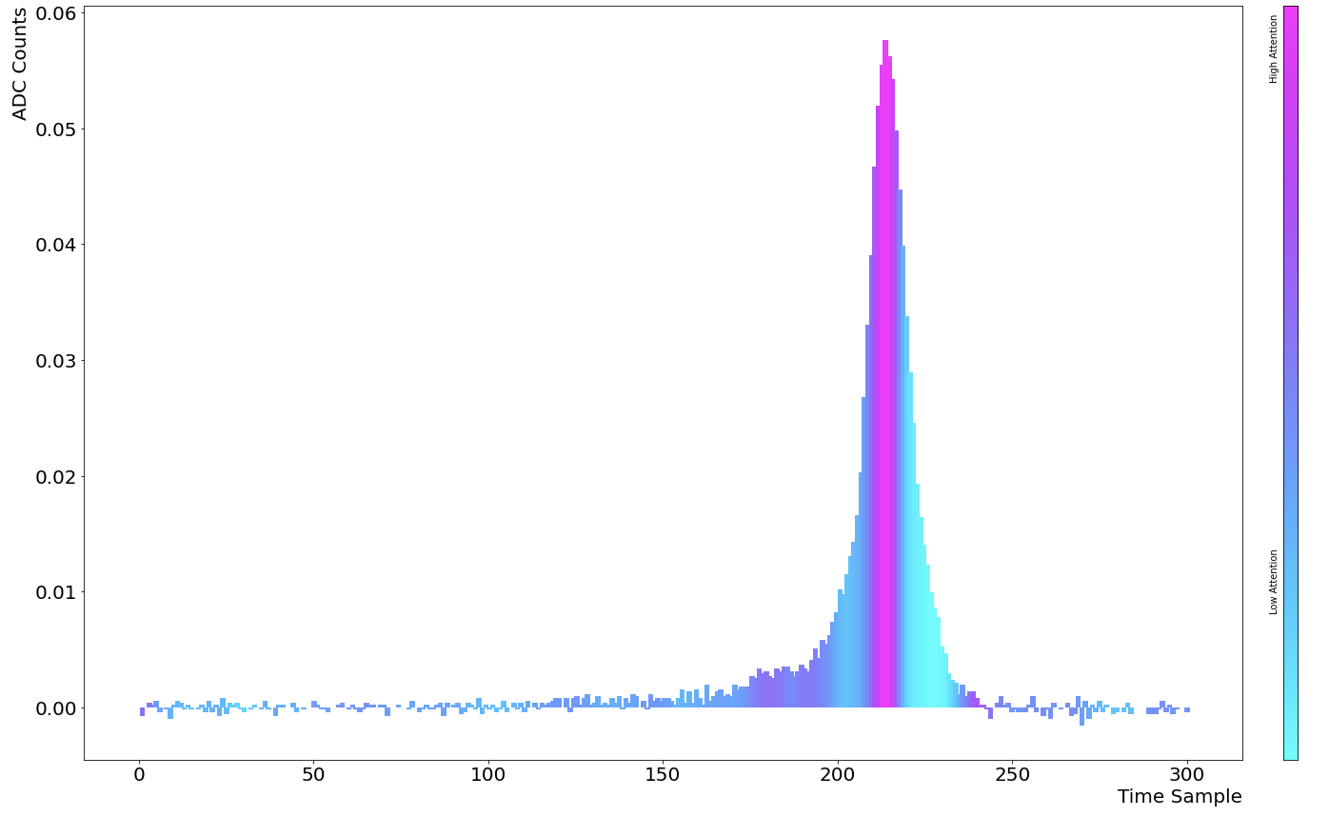
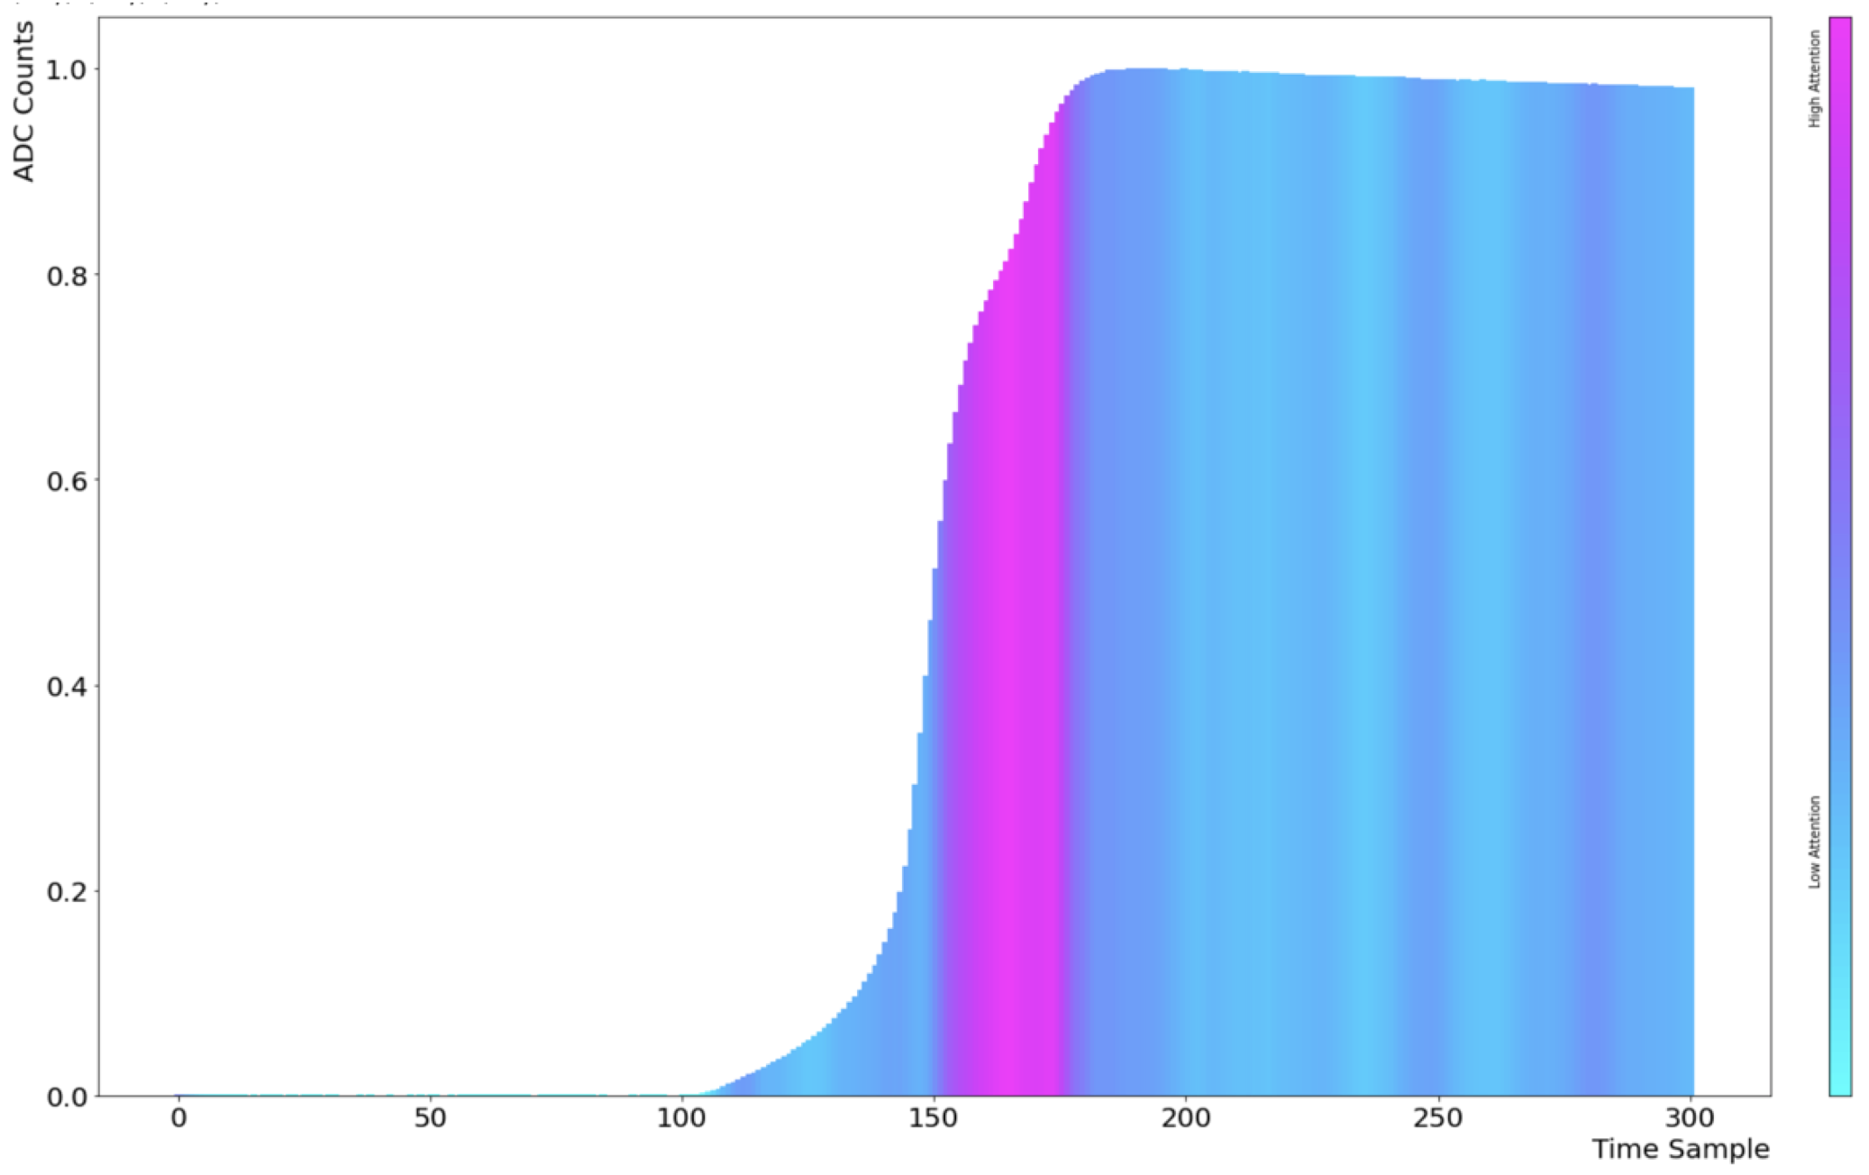
Interpretability of the Model
Accepted by the model
Rejected by the model
Current waveform
Charge waveform
Charge waveform
Attention score at the rising edge is higher as expected.
Classification power comes from the feature of the rising edge.
Network puts more focus to learn from the rising edge.

Slide 17
Parameter Regression for Pileup Waveforms
Results are all work in progress
Part II

Slide 18
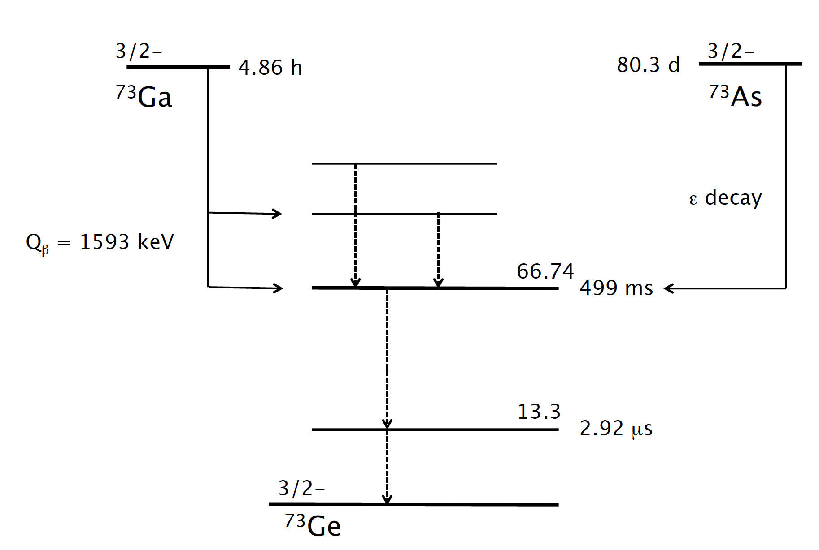
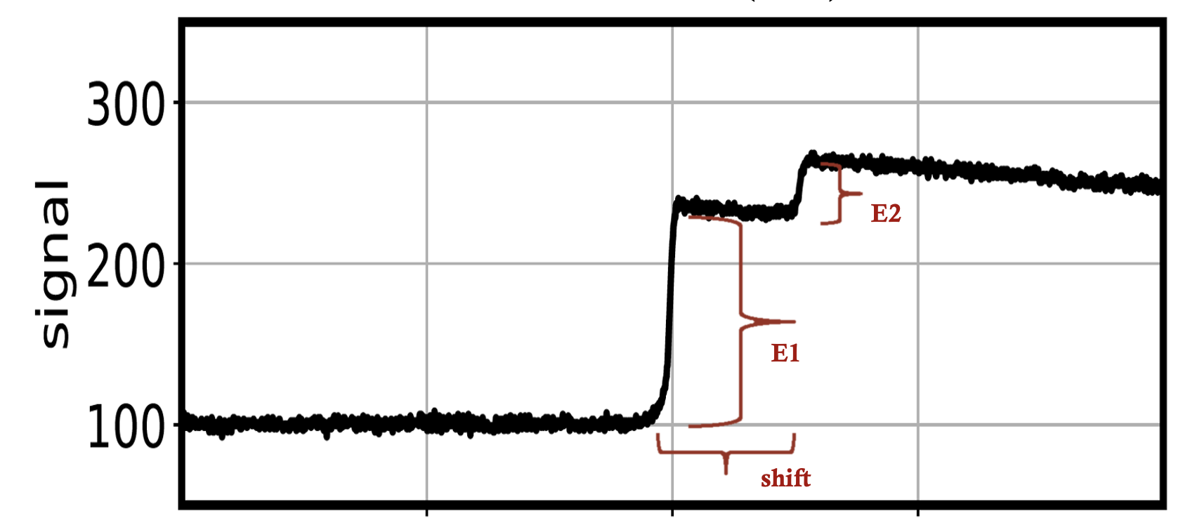
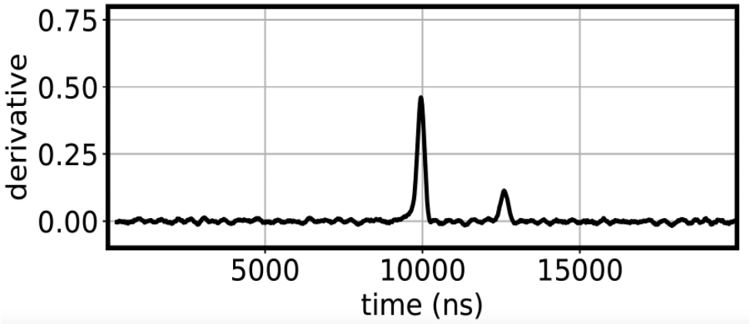
Motivation for Pileup Waveform Study
E1
time (ns)
E2
Distinguish between pileup and single waveforms using machine learning approach.
In physics data, there is a small amount of expected pileup waveforms, e.g., the signature of isomeric gamma transition following cosmogenic production of certain isotopes
Look for shift and energy’s peak ratio (E1/E2) for the signature.
This determination is implemented as regression in machine learning approach.

Slide 19
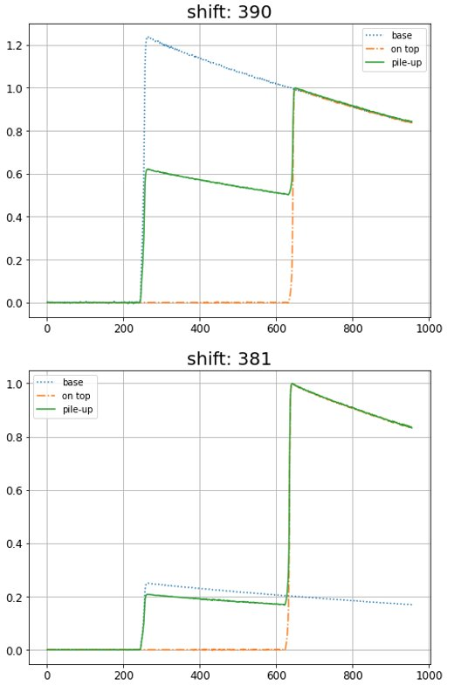
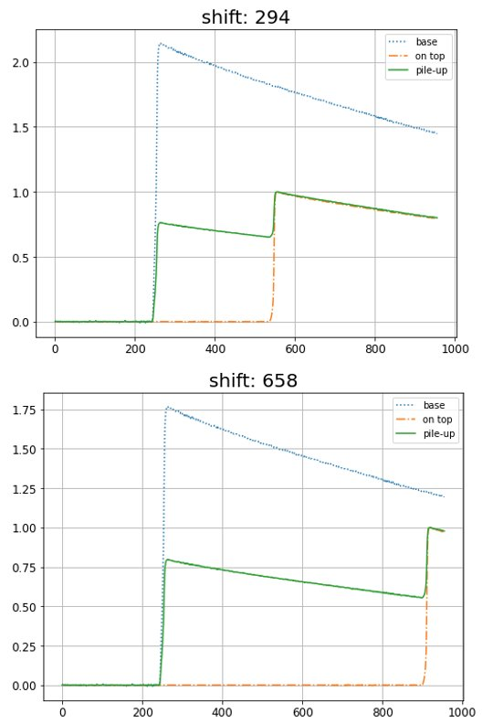
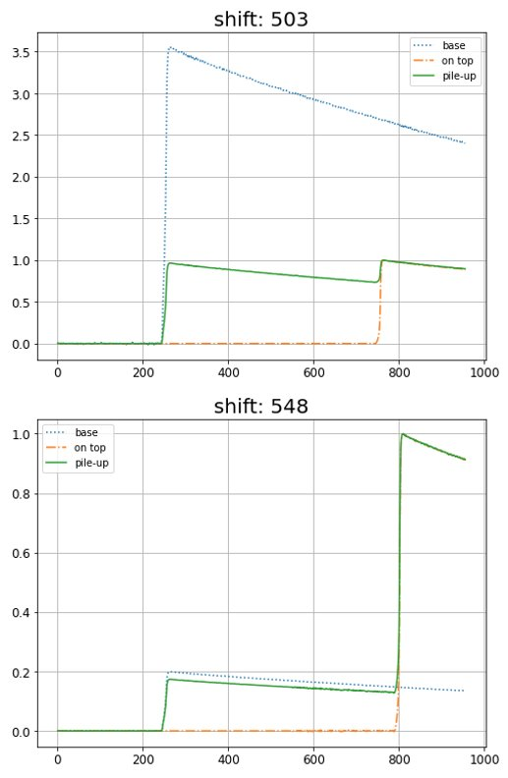
Simulated Pileup Waveforms Dataset
Waveforms are single site events taken from the Calibration data. Use these single waveforms to simulate pileup wfs.
Simulation Parameters:
Scaling: Random scaling for waveform height for both base (1st) and on-top (2nd) waveform.
Relative shift (Samples/Bins): Random relative shift for on-top waveform from base waveform.

Slide 20
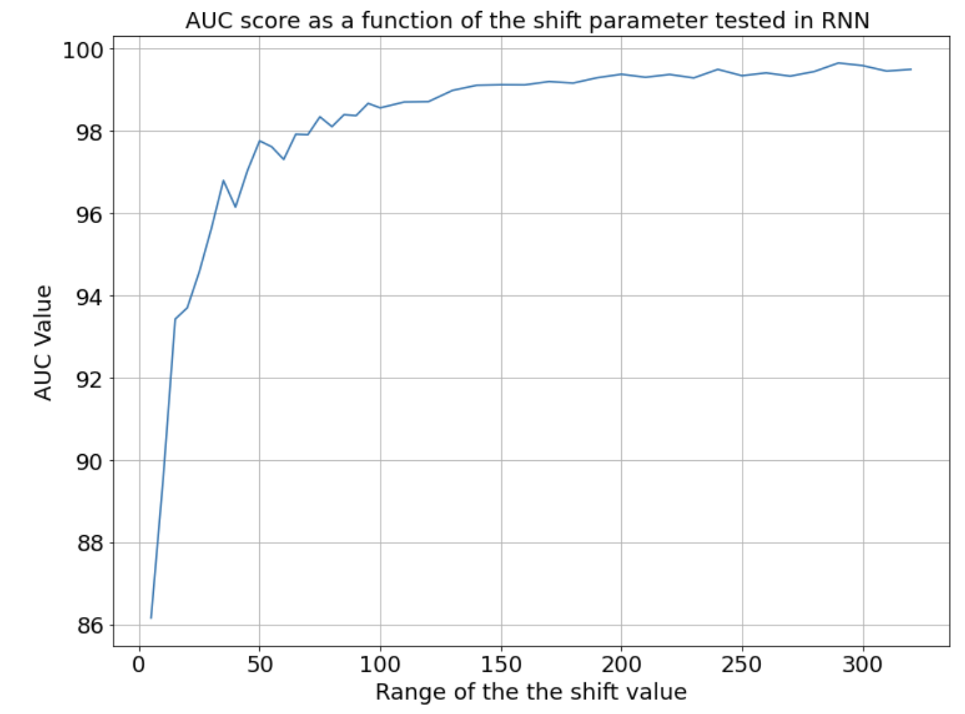
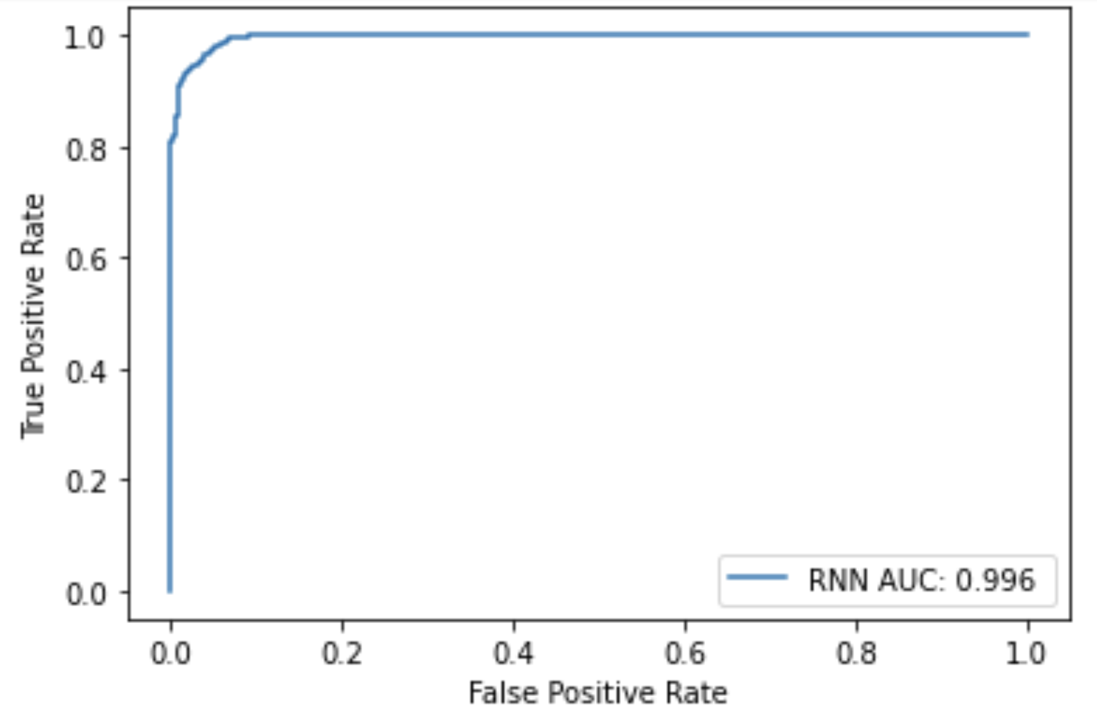
RNN Performance for Simulated Pileup Waveforms
Classification power of RNN to distinguish between single and pileup waveforms
performs very well when the pileup is obvious.
GRU
Fully Connected Layer
For shift range of 300 samples
Good performance for both small and large maximum shifts.

Slide 21
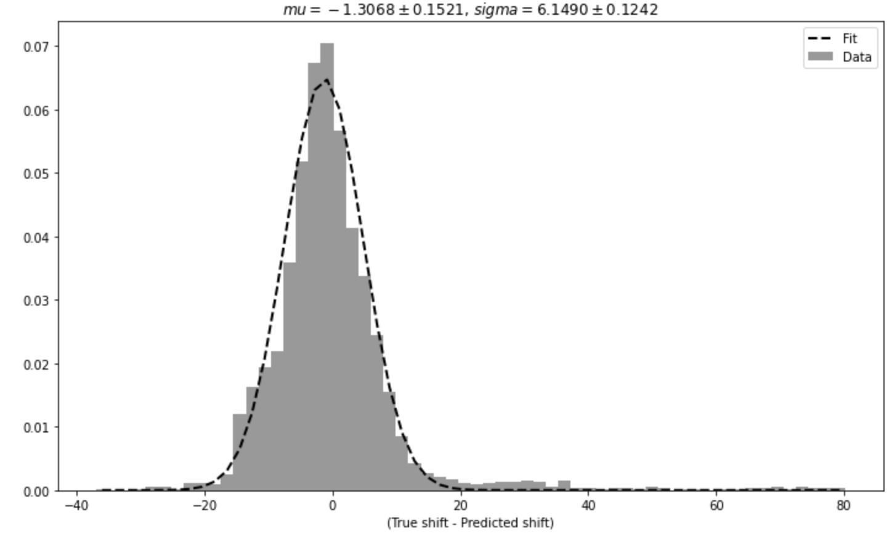
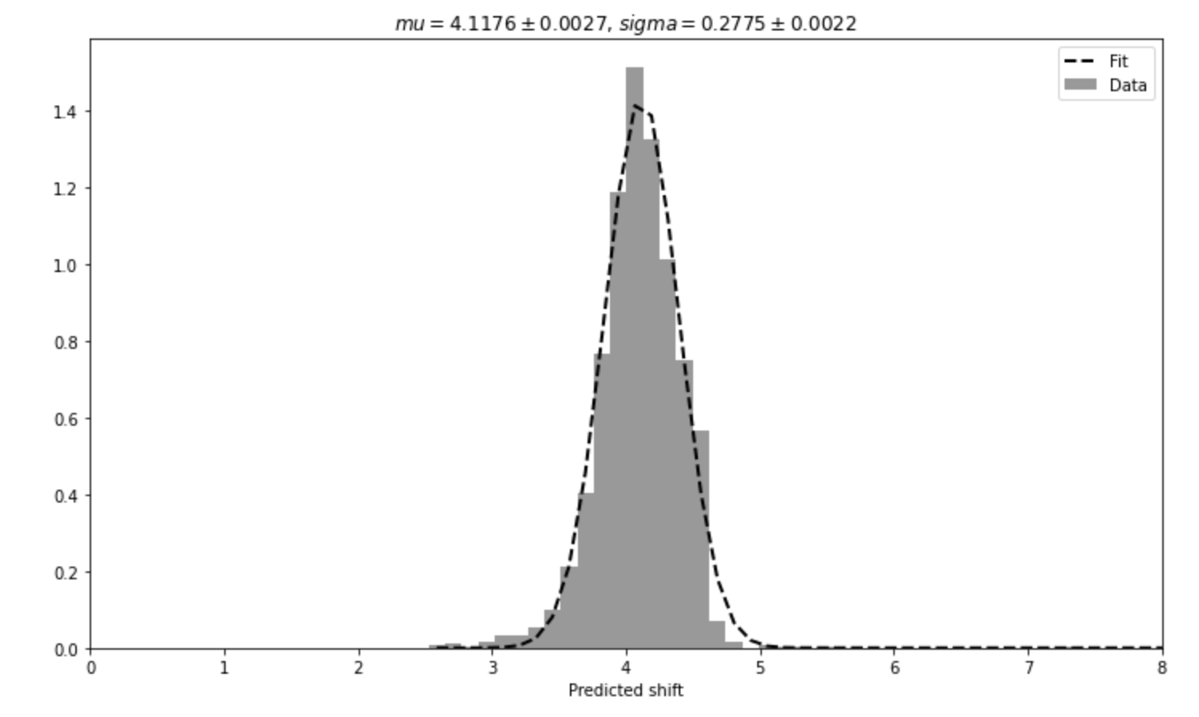
Parameter Regression in RNN
Differences between true shift and predicted shift from the regression is studied
For simulated pileup waveforms (having shift between 0 and 100 )
For real single waveforms (having 0 shift)
Likely boundary effect
One can filter the waveforms for the pileup first, and then send the pileups for the regression
Good parameter determination performance.

Slide 22
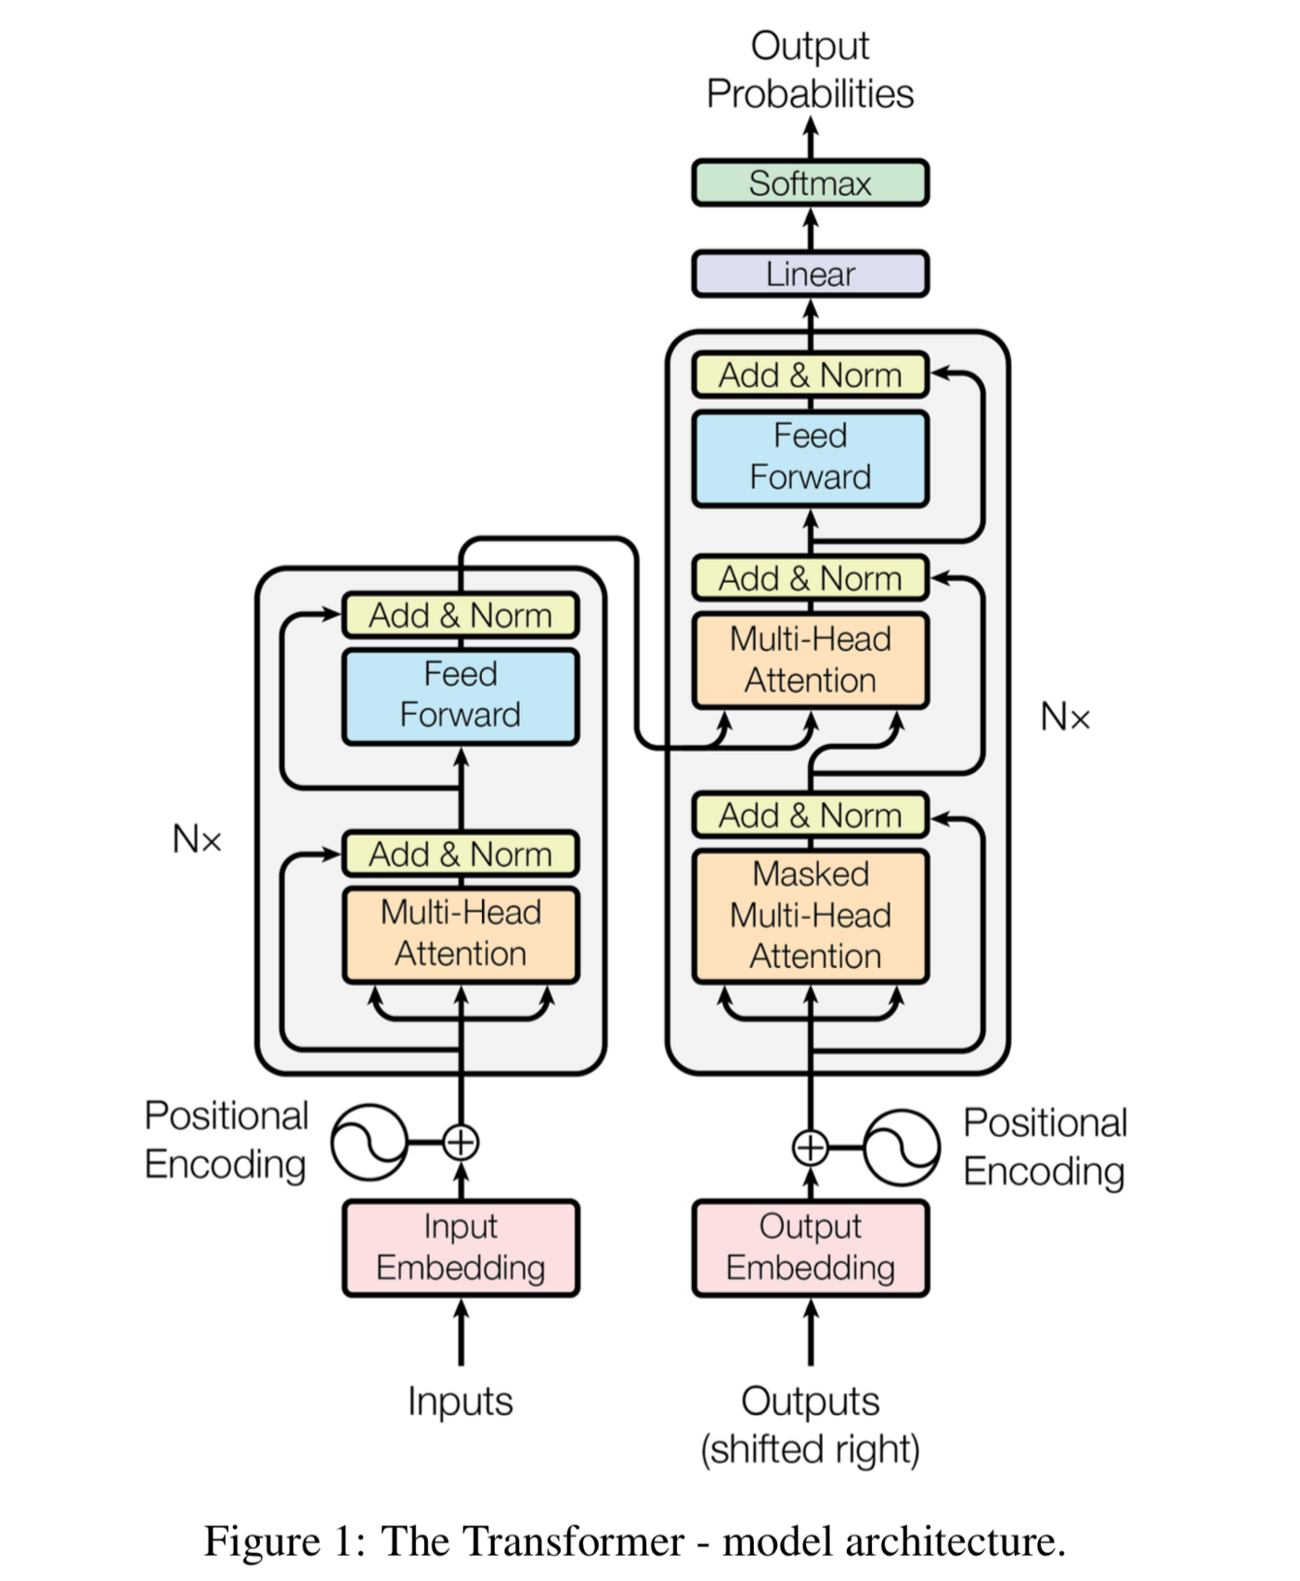
Transformer Model
We have some disadvantages of RNN model:
Lack of long-range correlation
Sequential processing (therefore can’t be trained in parallel)
Transformer model was first described in 2017 in the paper “Attention is all you need”.
Main characteristics of Transformer model:
Non-Sequential
Self Attention
Positional Embeddings (PE)
It allows parallel computation (to reduce training time), so Transformers are faster than RNN-based models (as all the input is ingested once).

Slide 23
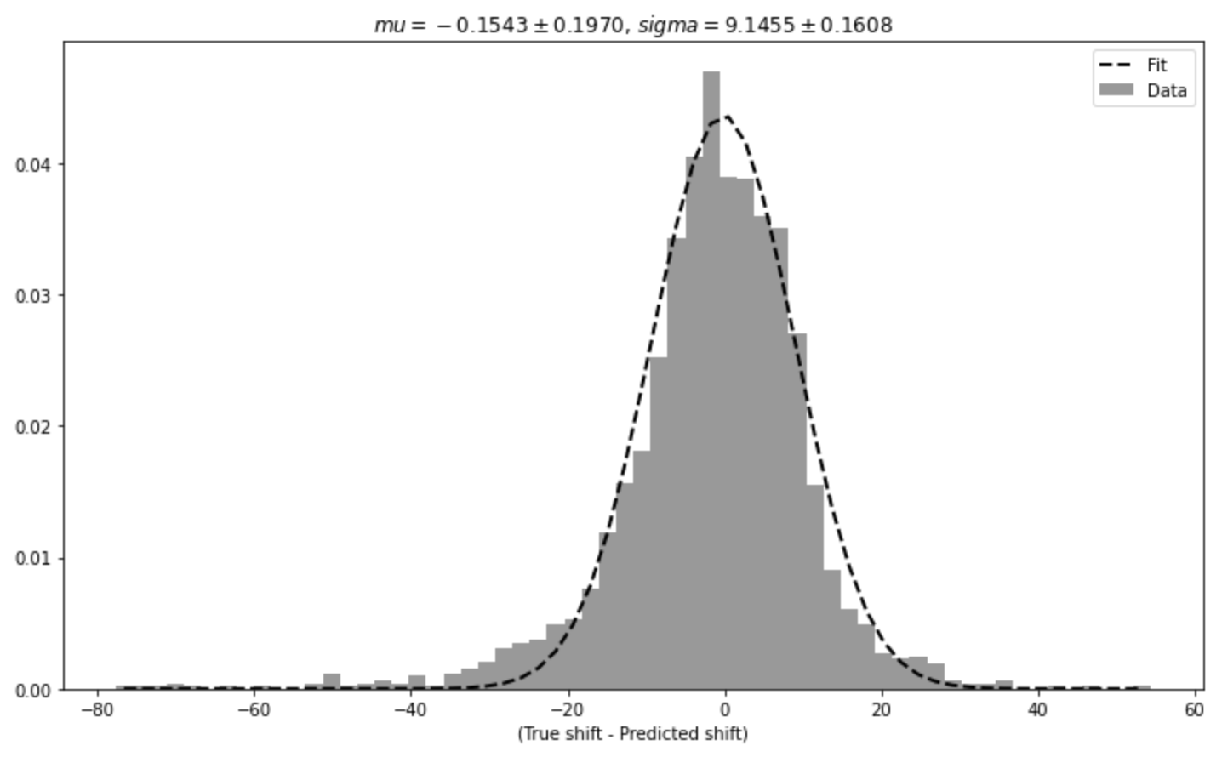
Parameter Regression in Transformer Model
For simulated pileup waveforms
Shows a similar performance as RNN

Slide 24
Summary and Outlook
We are developing machine learning tools for various waveform-based analyses in Majorana.
Interpretable RNN models were developed to identify single-site and multi-site events.
Model was trained using multiple detectors simultaneously and the background rejection is comparable to traditional AvsE parameter with far less tuning, which could be beneficial for experiments with numerous detectors.
Further study on model interpretability may allow us to learn from the machine to benefit traditional analysis.
Machine learning-based parameter determination expands the scope of ML applications.
Reasonable determination of the time shift parameter in pile-up waveforms.
We have some success on multidimension regression in extracting both the shift and energy’s peak ratio simultaneously.
This could be used to look for the signature of isomeric gamma transition in real data.
Machine learning-based tools can be valuable for the next-generation Ge-based $0νββ$ project, LEGEND.
Final $0νββ$ result from Majorana, arXiv:2207.07638
Boosted Decision Tree for Majorana, arXiv:2207.10710
Majorana and LEGEND talks at this conference:
W. Pettus,
Final results from the
Majorana Demonstrator,
Plenary session, Sept. 3rd
C. Wisemen
Exotic dark matter searches with the Majorana Demonstrator
DM session Aug. 30th
W. Xu
The search of neutrinoless double beta decay and the LEGEND experiment
NN session Sept. 3rd
C.J. Barton
An update on muon-induced backgrounds in LEGEND-1000
Nu session Aug. 30th
This material is supported by the U.S. Department of Energy, Office of Science, Office of Nuclear Physics, the Particle Astrophysics and Nuclear Physics Programs of the National Science Foundation, and the Sanford Underground Research Facility.

Slide 26
Backup Slides

Slide 27
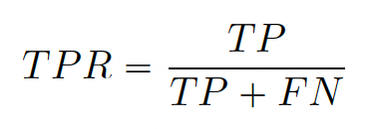
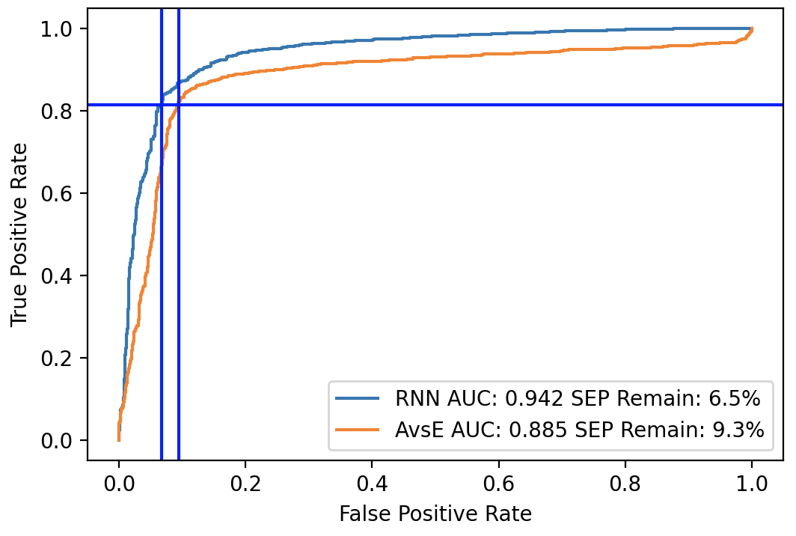
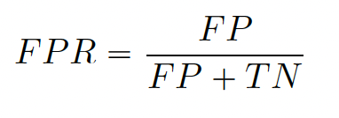
Quantitative Analysis
ROC (Receiver operating characteristic) curve
True positive Rate
False positive Rate
ROC-AUC (Area under ROC curve) value is a measure of classification power!
Smaller SEP remaining for same acceptance of TPR is better!

Slide 28
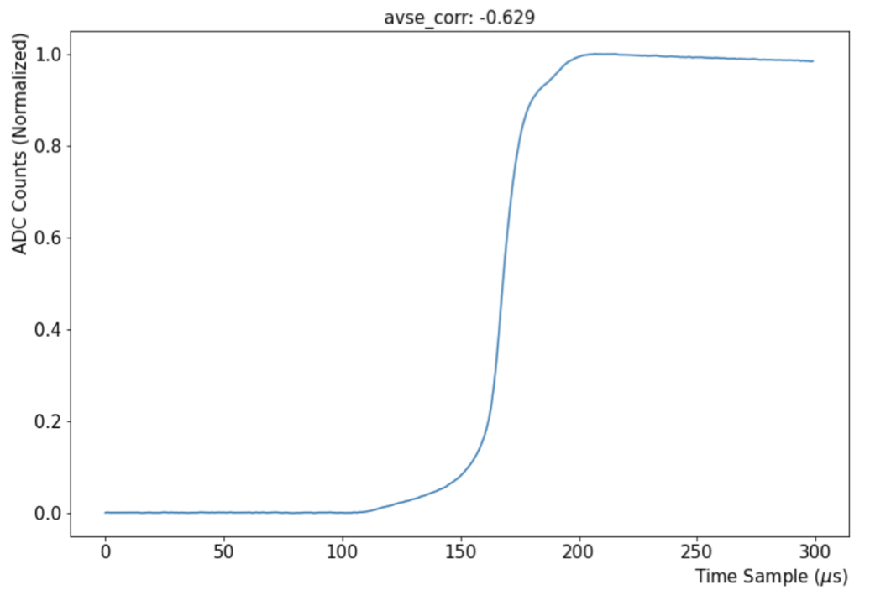
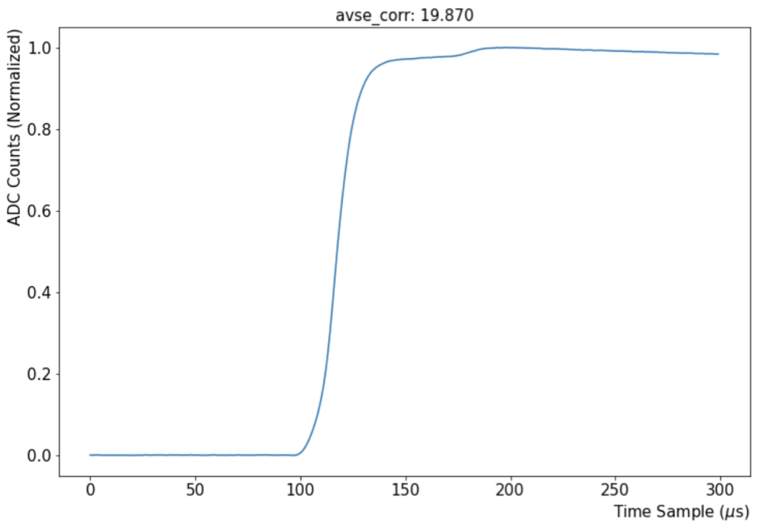
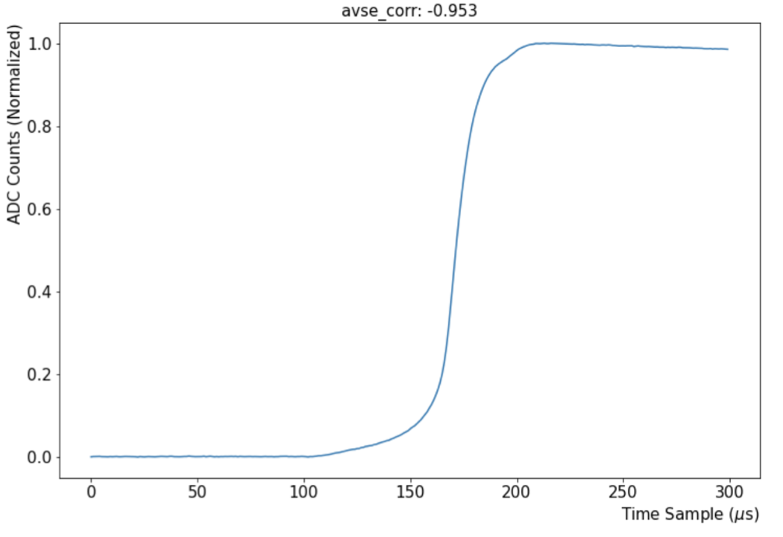
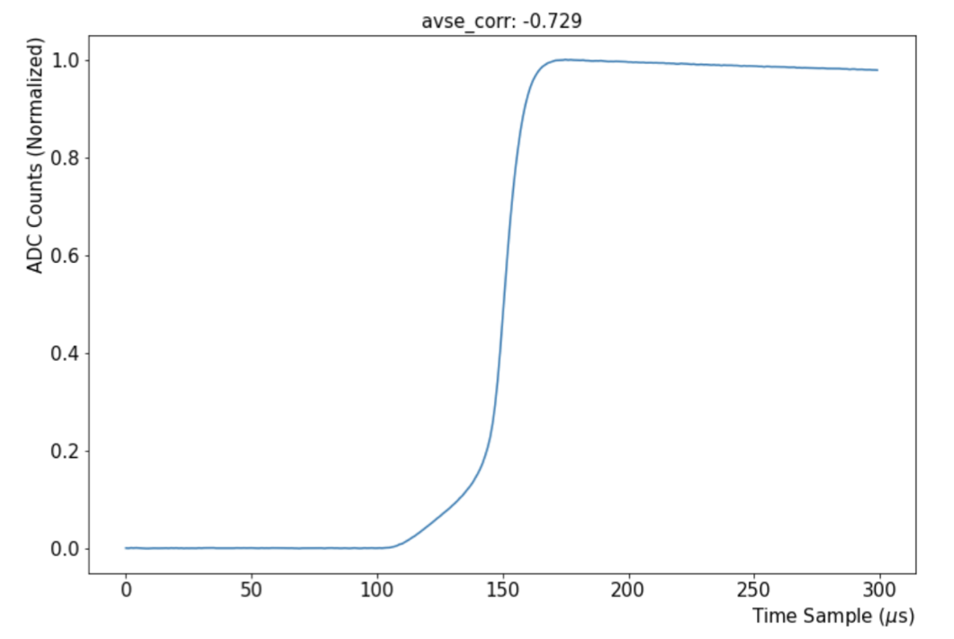
Waveforms Rejected by RNN but Accepted by AvsE

Slide 29
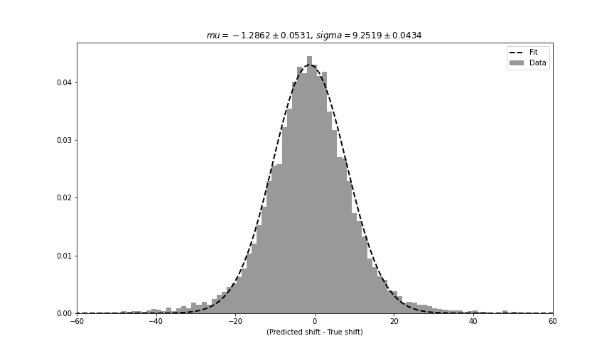
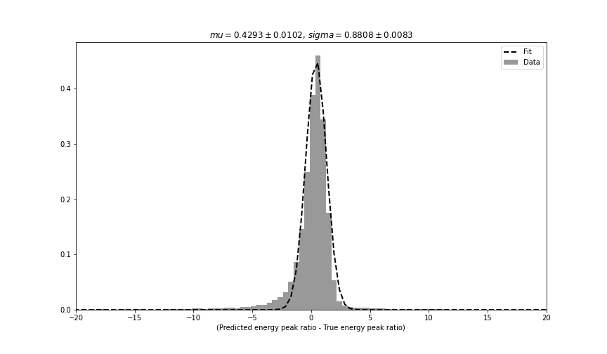
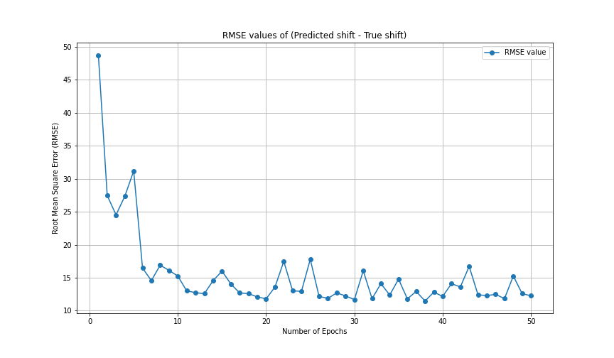
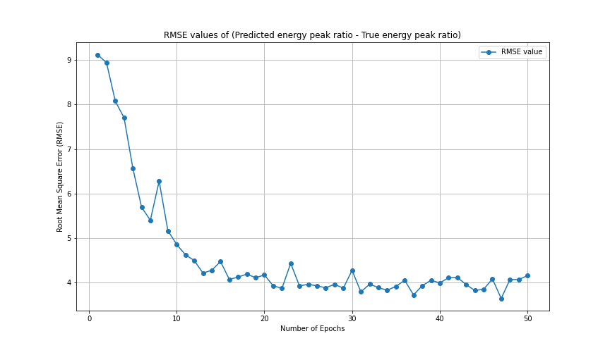
Multilabel Regression (Initial Result)
Waveform dataset has shift (< 500 samples) and E_ratio (<100)

Slide 30
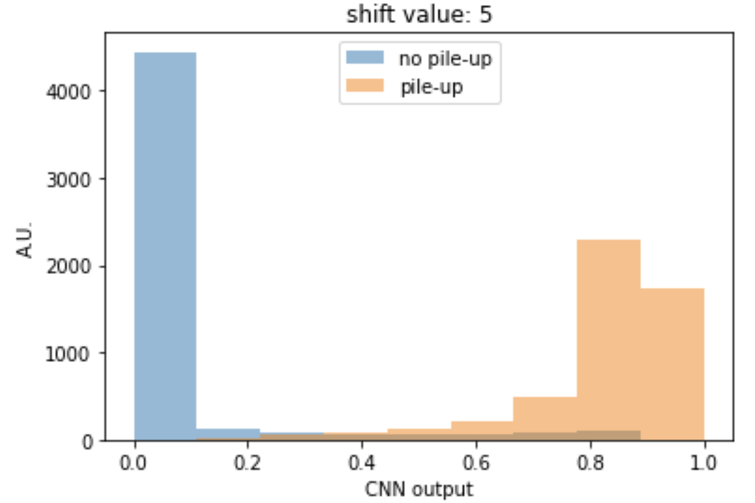
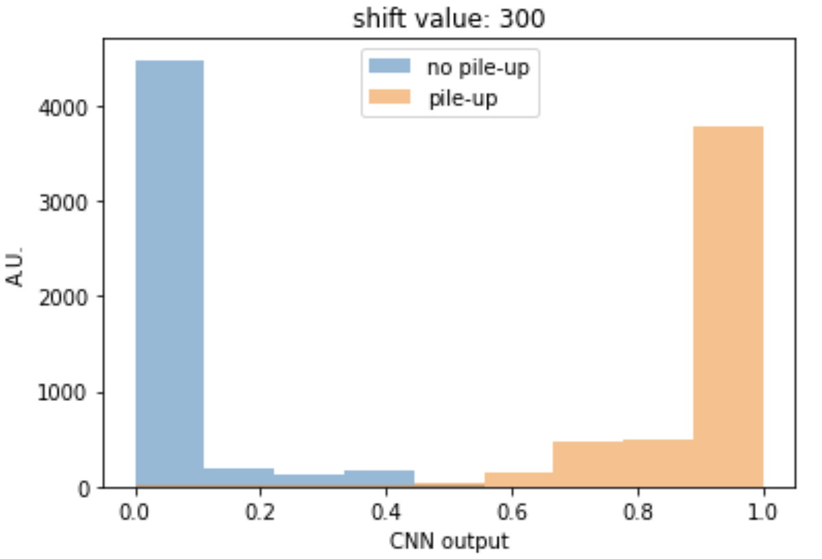
CNN Output for Pile-up and No Pile-up Waveforms:
CNN outputs for a maximum shift range up to 5 samples (50 ns) and a maximum shift range up to 300 samples (3000 ns).
Clear identification achieved in both cases

Slide 31
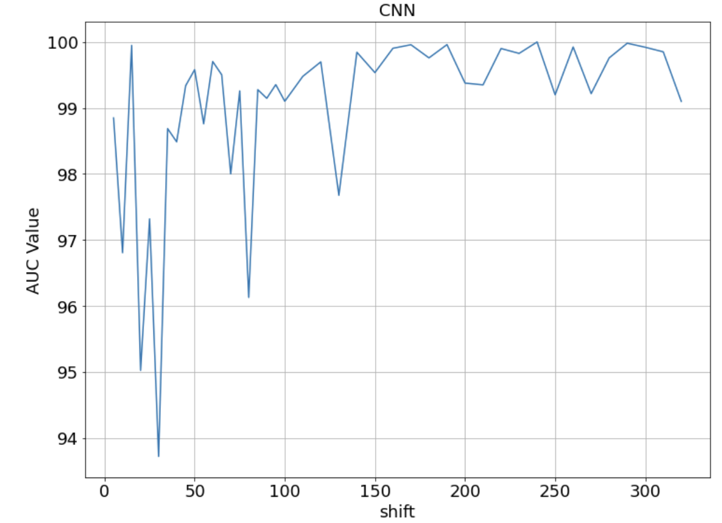
AUC Value as a Function of Maximum Shifts in Separate Simulations:
AUC Value as a Function of Maximum Shifts in Separate Simulations:
Good performance for large maximum shifts
Unstable performance for small maximum shifts
Maximum

