Slide 1
Nuclear-Network Calculations with Long-Lived Isomers
Brad Meyer
Clemson University

Slide 2
Goal
Try to give a clear idea of how isomeric states can be included in a reaction network.

Slide 3
$$Y_{i}=\frac{n_{i}}{ρN_{A}}$$
But really:
$$Y_{i}=\underset{j}{∑}Y_{i}^{(j)}$$
$$Y_{i}^{(j)}=Y_{i}\frac{(2J_{j}+1)e^{-E_{j}/kT}}{G_{i}(T)}$$
$$G_{i}(T)=\underset{j}{∑}(2J_{j}+1)e^{-E_{j}/kT}$$

Slide 4
Presence of isomer(s)
May invalidate assumption of internal equilibrium in nucleus
Example treatment: Gupta and Meyer 2001

Slide 5
$$P=constantproductionrate$$
$$\frac{dY}{dt}=P-\frac{Y}{τ}$$
$$τ=destructiontimescale$$
$$Y(t)=Y(0)e^{-t/τ}+Pτ\left(1-e^{-t/τ}\right)$$
$$Y(t)→Pτ⇒\frac{dY}{dt}=0$$
$$fort≫τ$$

Slide 6
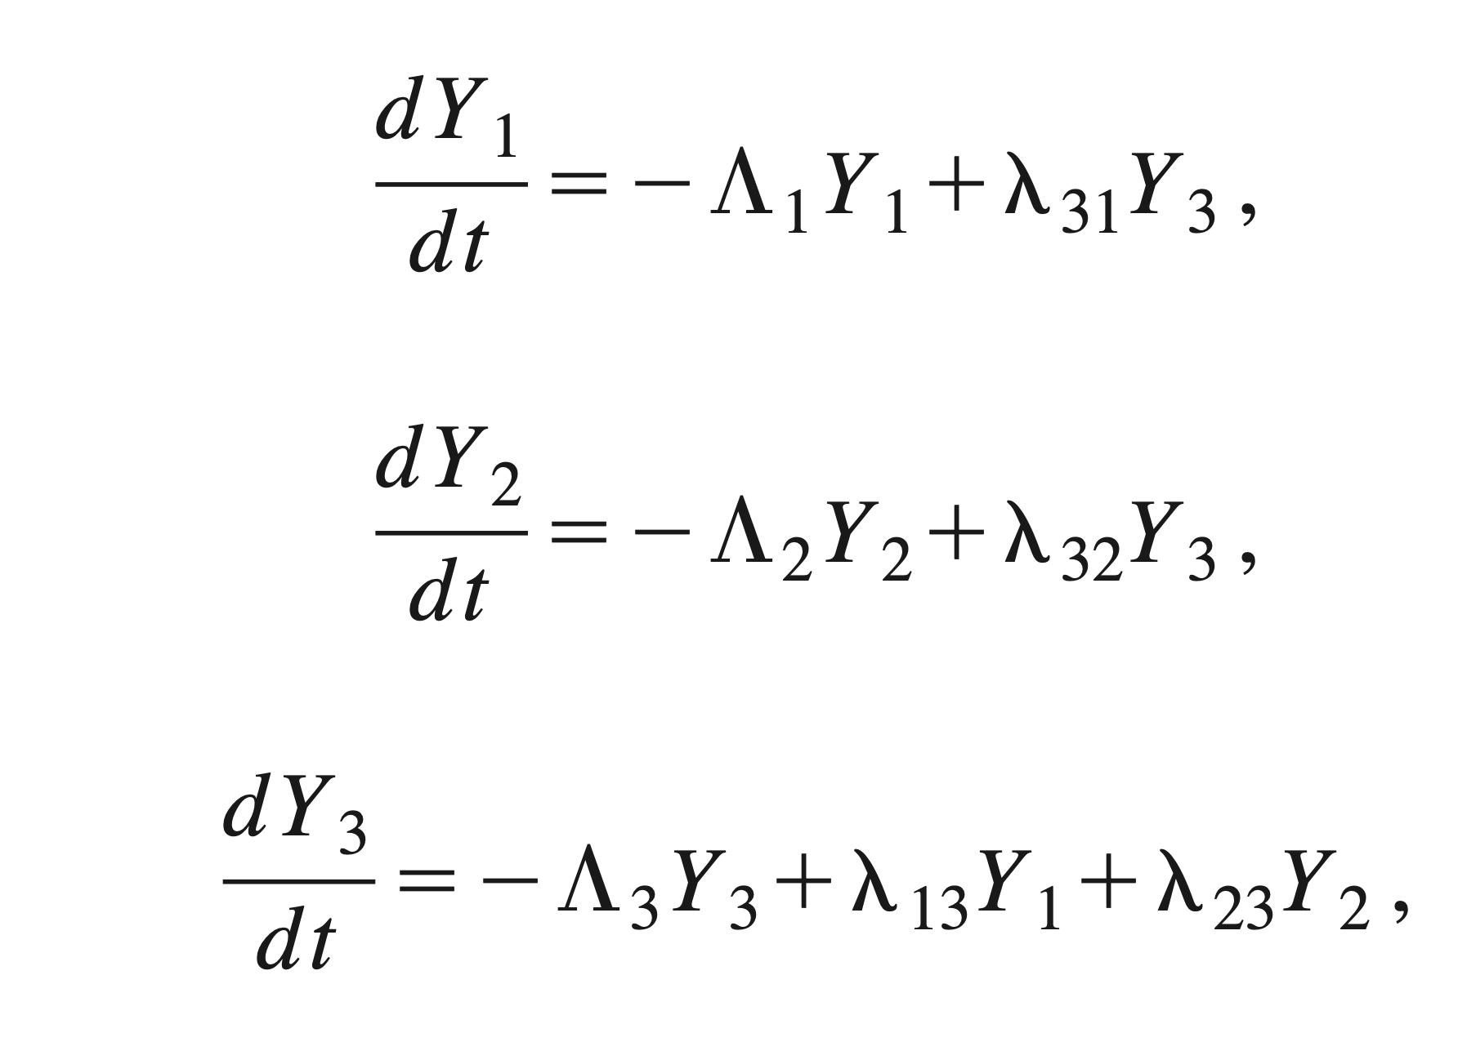
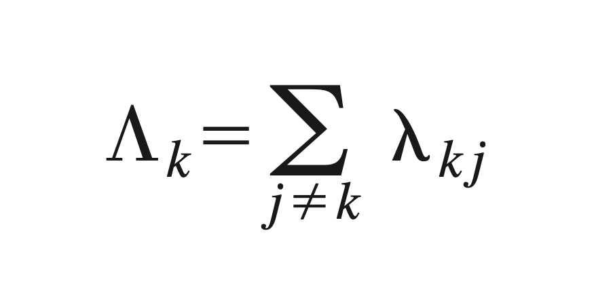
3
2
1

Slide 7
$$\frac{dY_{3}}{dt}→0⇒λ_{12}^{eff}=λ_{13}f_{32}andλ_{21}^{eff}=λ_{23}f_{31}$$
$$f_{ij}=\frac{λ_{ij}}{Λ_{i}}$$

Slide 8
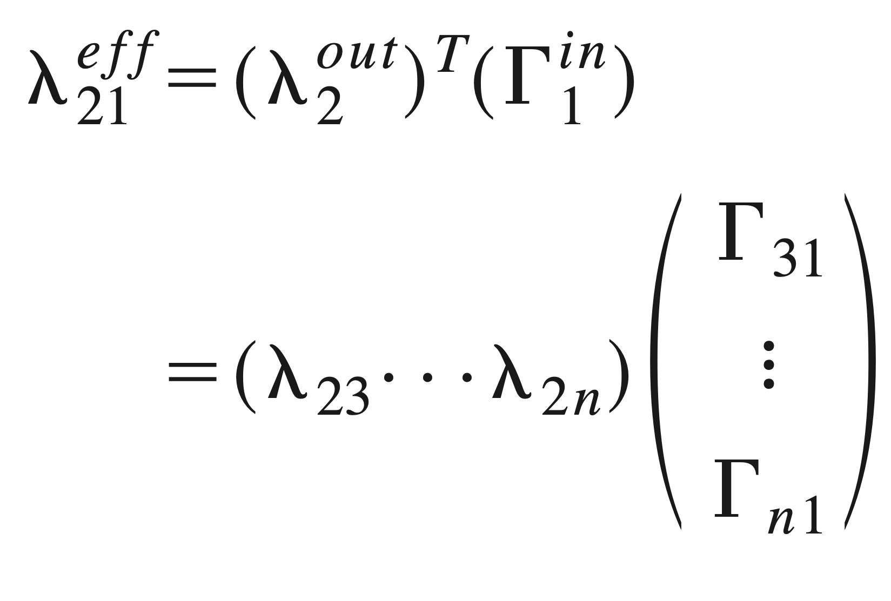

Slide 9
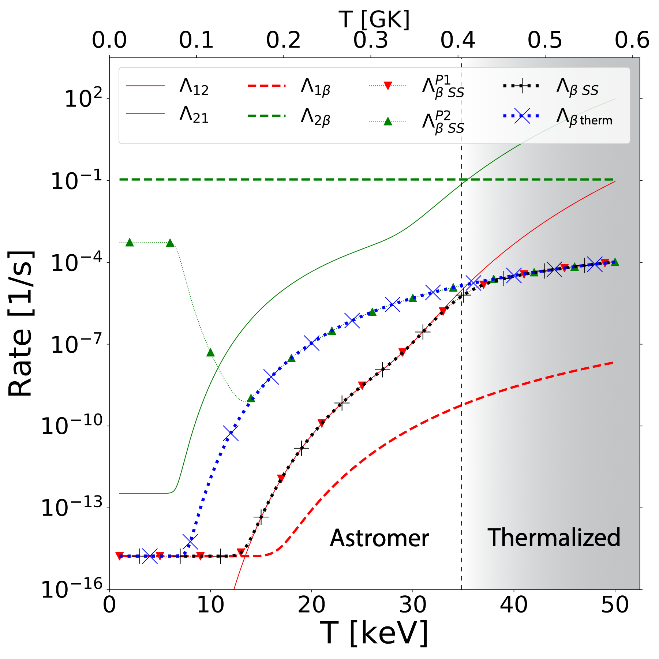
Misch

Slide 10
$$ϕ=fugacity(ϕ>=0)$$

Slide 11
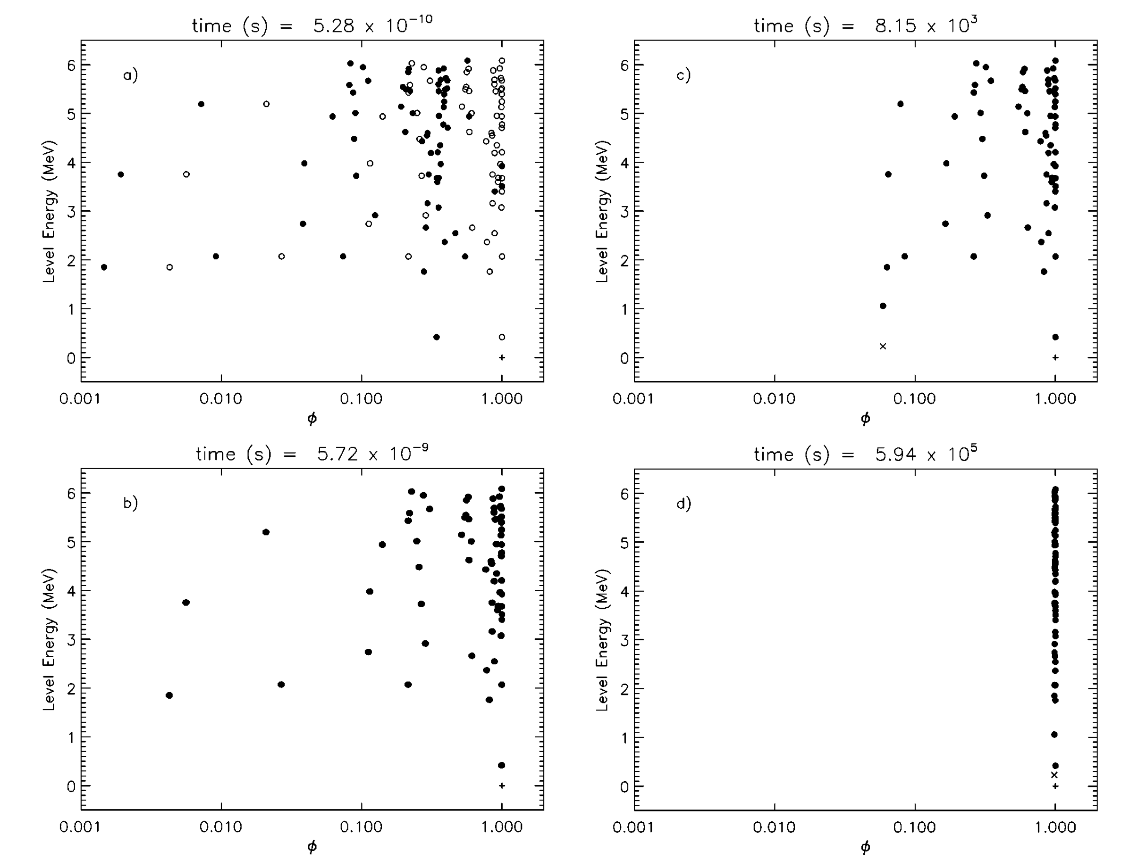
$$T_{9}=0.2$$

Slide 12
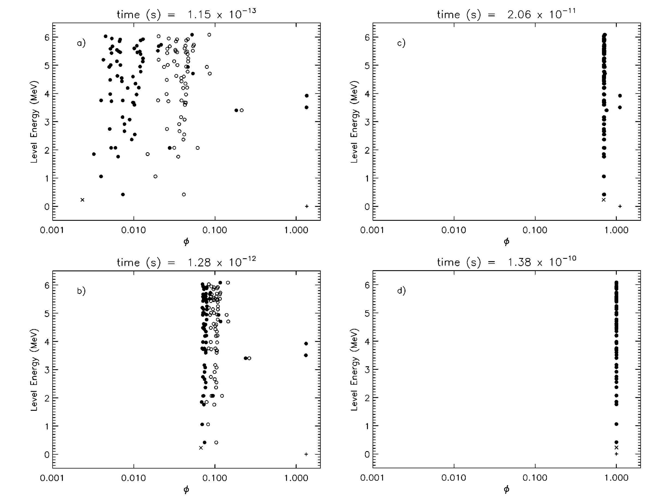
$$T_{9}=5$$

Slide 13
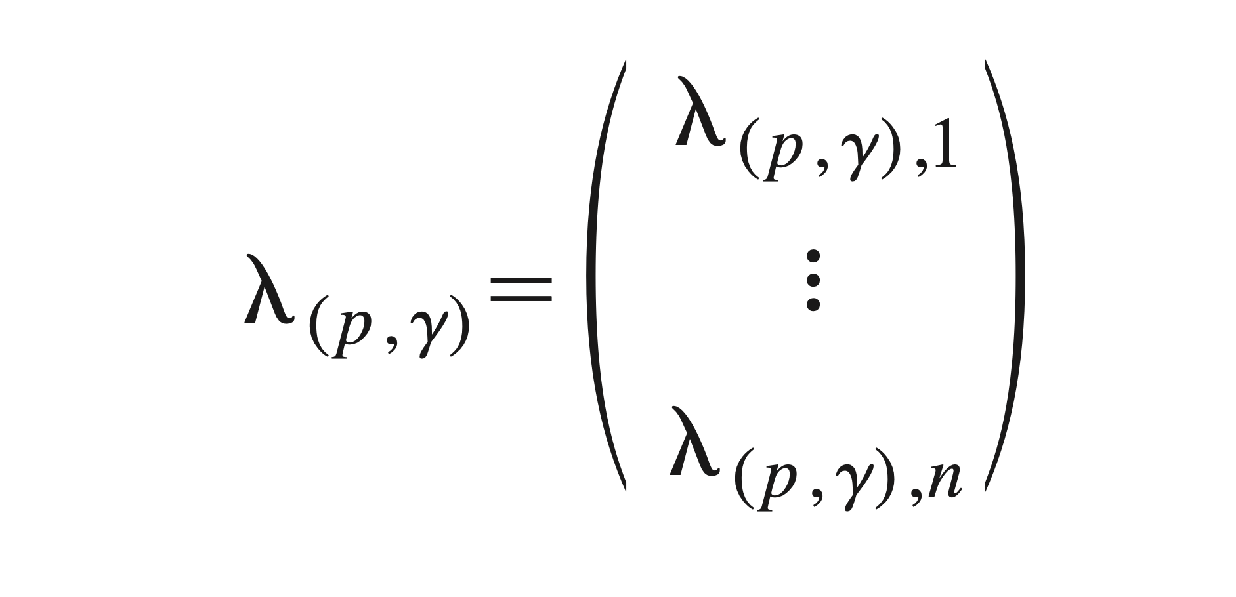
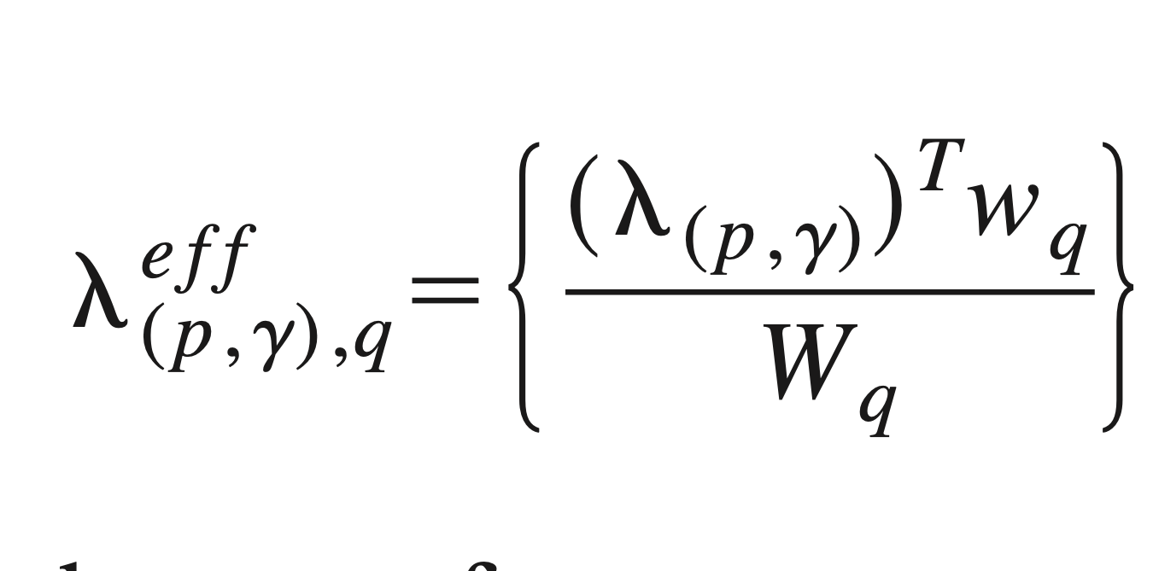

Slide 14
In a reaction network

Slide 15
Nuclide data
<!--kr85-->
<nuclide>
<z>36</z>
<a>85</a>
<states>
<state id="g">
<source>example</source>
<mass_excess>-81.4803</mass_excess>
<spin>4.5</spin>
<partf_table>
<point>
<t9>0.0011605</t9>
<log10_partf>0</log10_partf>
</point>
…
<point>
<t9>11.605</t9>
<log10_partf>0.442687</log10_partf>
</point>
</partf_table>
</state>
<state id="m">
<source>example</source>
<mass_excess>-81.1753</mass_excess>
<spin>0.5</spin>
<partf_table>
<point>
<t9>0.0011605</t9>
<log10_partf>0</log10_partf>
</point>

Slide 16
Reaction Data
<!--kr85m + gamma -> kr85g-->
<reaction>
<source>LANL</source>
<reactant>kr85m</reactant>
<reactant>gamma</reactant>
<product>kr85g</product>
<rate_table>
<point>
<t9>0.0011605</t9>
<rate>9.1113e-06</rate>
<sef>1</sef>
<!--kr85m + n -> kr86 + gamma-->
<reaction>
<source>LANL</source>
<reactant>kr85m</reactant>
<reactant>n</reactant>
<product>kr86</product>
<product>gamma</product>
<rate_table>
<point>
<t9>0.0116</t9>
<rate>19825694.0</rate>
<sef>1.0</sef>
…
…
https://github.com/mbradle/webnucleo_xml
https://webnucleo.readthedocs.io

Slide 17
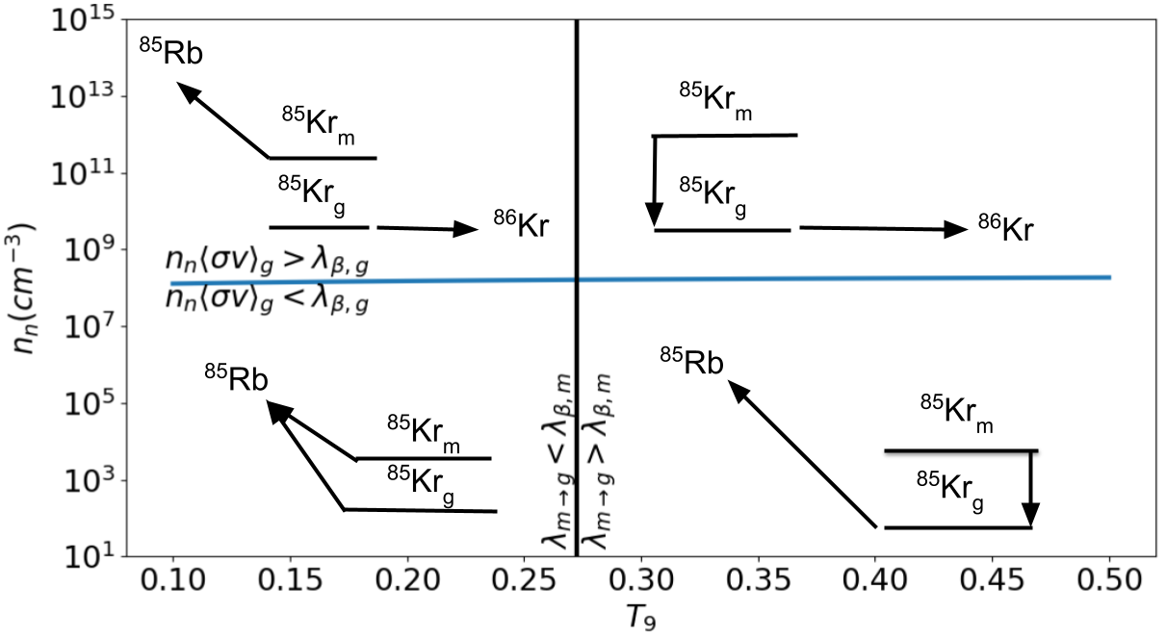

Slide 18
Simple illustrative calculation
Modified network data to randomly create 10% of species as isomeric.
Isomer at 300 keV
Isomer beta decays 10x faster than ground state
Apply to i-process calculations.

Slide 19
Intermediate (i) process
May happen when protons ingested into helium-rich shell, particularly in low-metallicity stars.
Production of ¹³C (via proton capture on ¹²C)
Release of neutrons via ${}^{13}C(α,n)^{16}O$
Neutron number densities in the range 10¹² to 10¹⁵ per cc

Slide 20
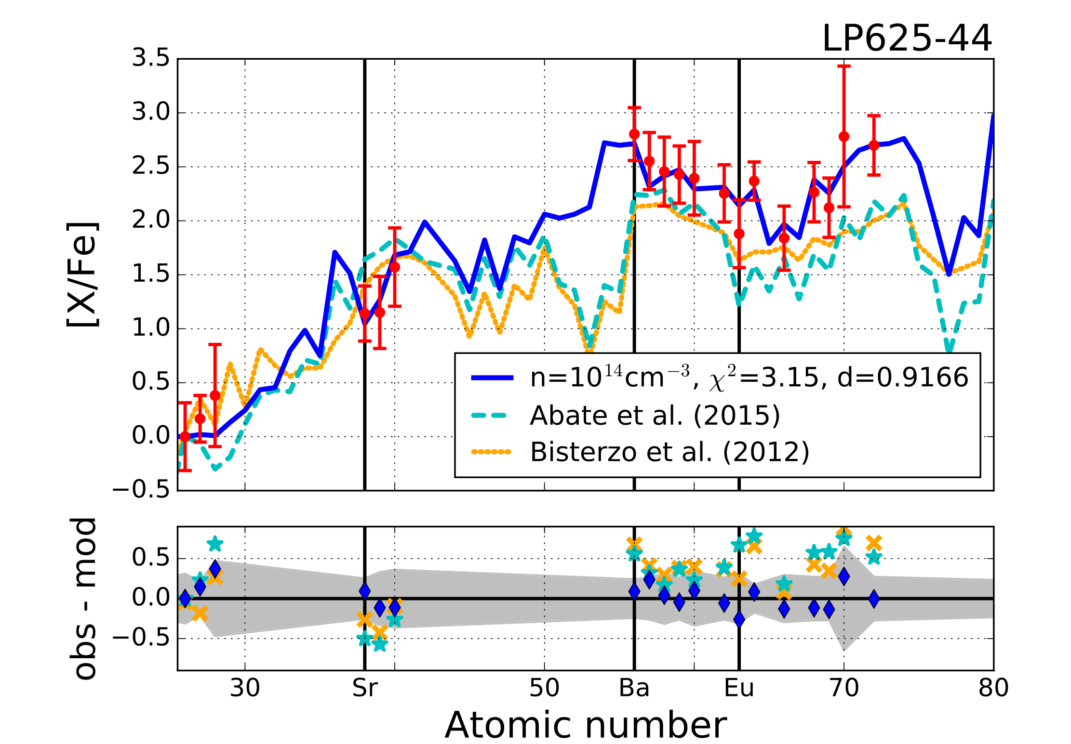
Hampel et al. (2016)

Slide 21
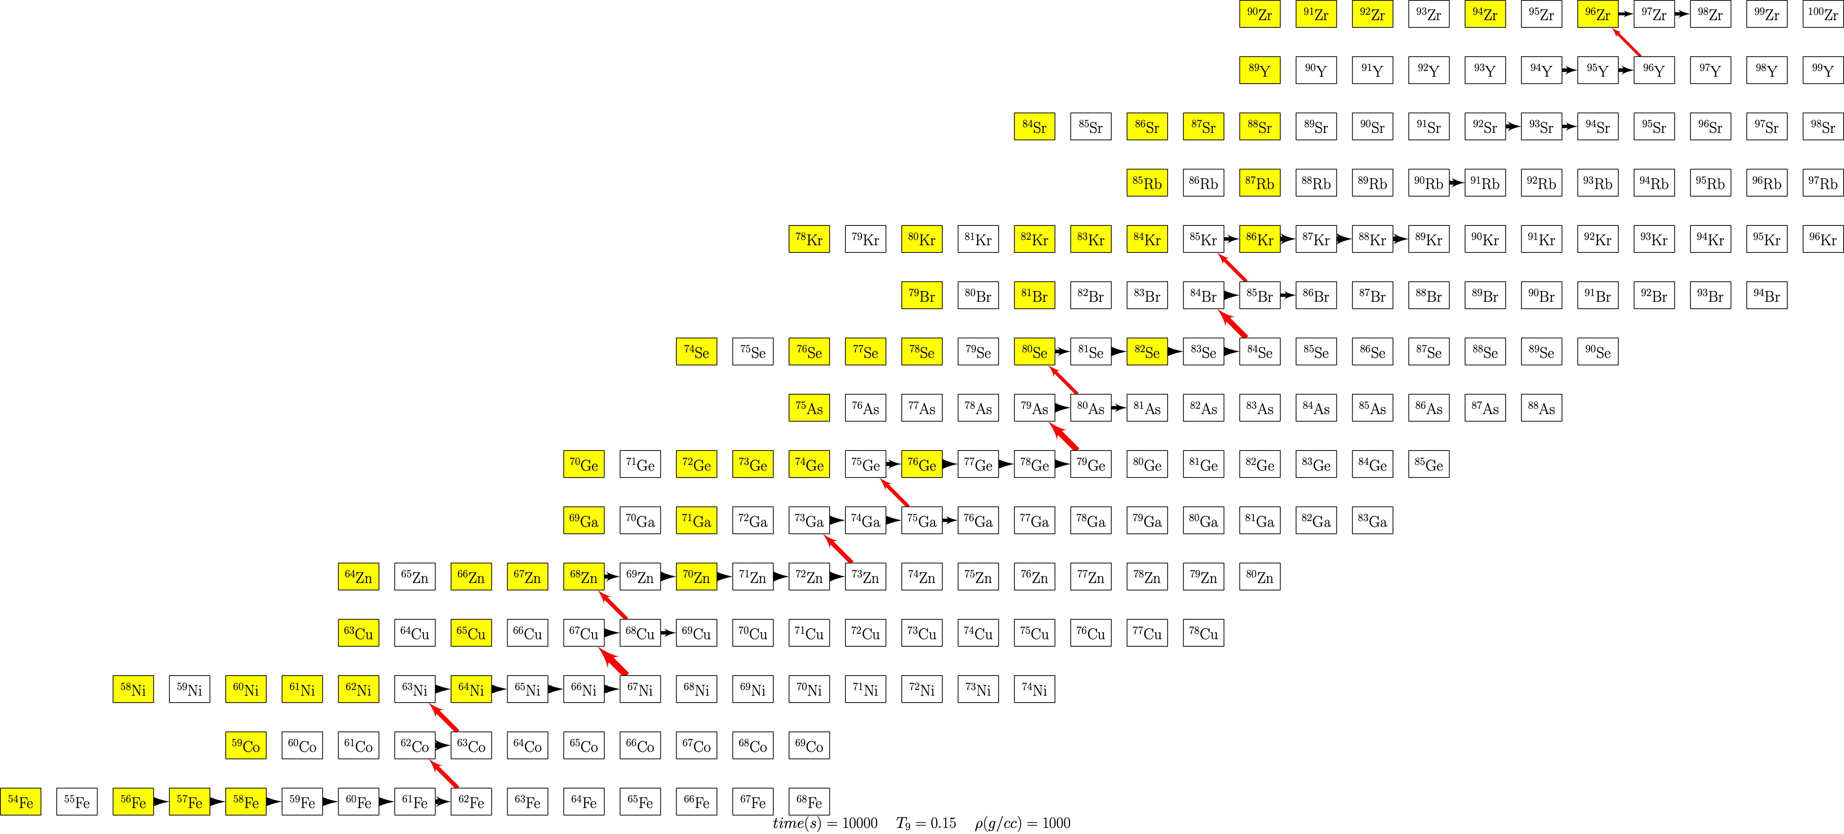

Slide 22
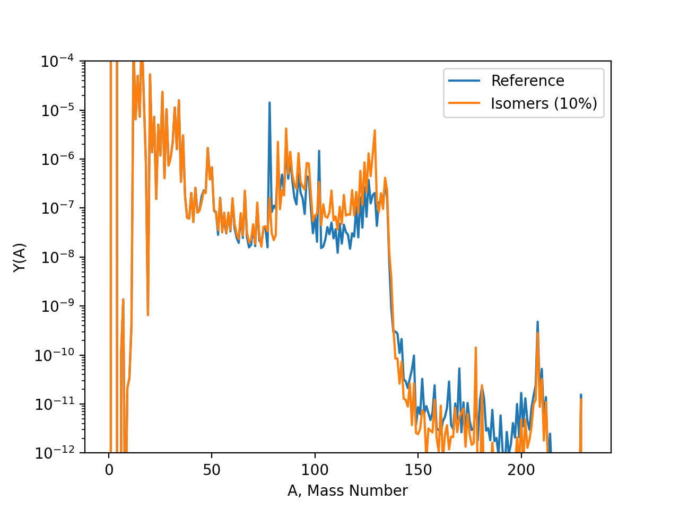
$$n_{n}={10}^{15}cm^{-3}$$
$$τ=1.67mb^{-1}$$

Slide 23
Summary
Apart from usual reaction parameters, inclusion of isomers requires energy, multiplicity, and Einstein A coefficient (spontaneous decay rate) of all relevant nuclear levels to permit us to compute effective thermalization rates.
In a reaction network, the isomer and ground state should be each thought of as an ensemble of states. Each upper-lying level belongs partly to the ground-state ensemble and partly to the isomer ensemble (depending on the generalized cascade parameter).
Equilibration of ground and isomer should be thought of as merging of the ground-state and isomer ensembles.
Isomers likely will play a role in i-process nucleosynthesis.
Open-source codes to compute two-level equivalents of isomeric systems available at https://bitbucket.org/mbradle/two_level

