Slide 1



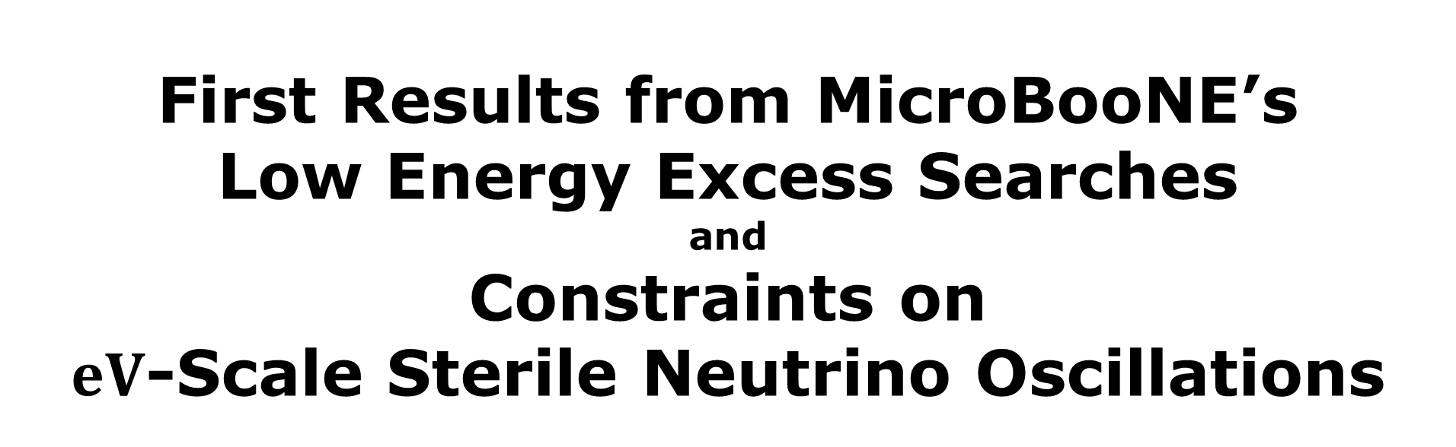
First Results from MicroBooNE’s
Low Energy Excess Searches and
Constraints on
$eV$-Scale Sterile Neutrino Oscillations
14th Conference on the Intersections of Particle and Nuclear Physics
September 1st, 2022
J. L. Barrow
Zuckerman Postdoctoral Scholar
On Behalf of the MicroBooNE Collaboration

Slide 2
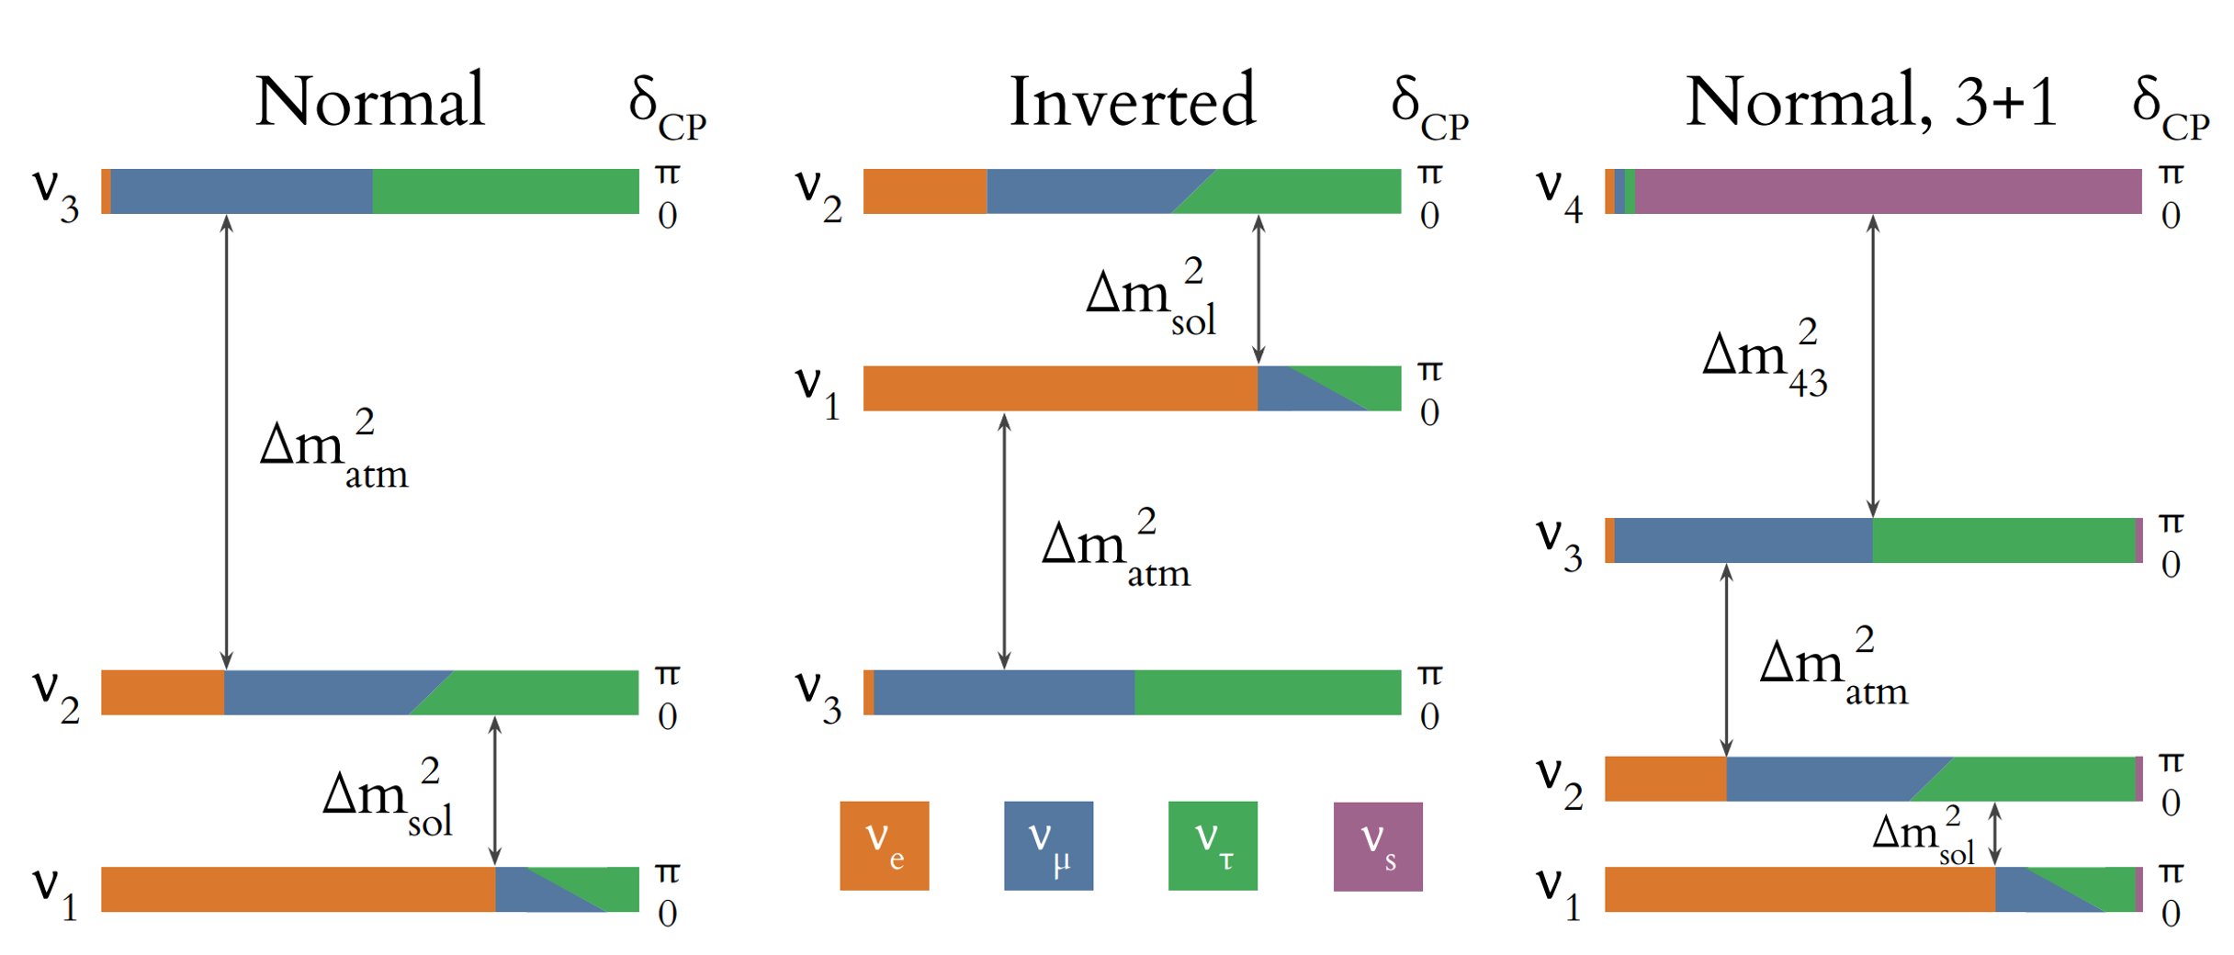
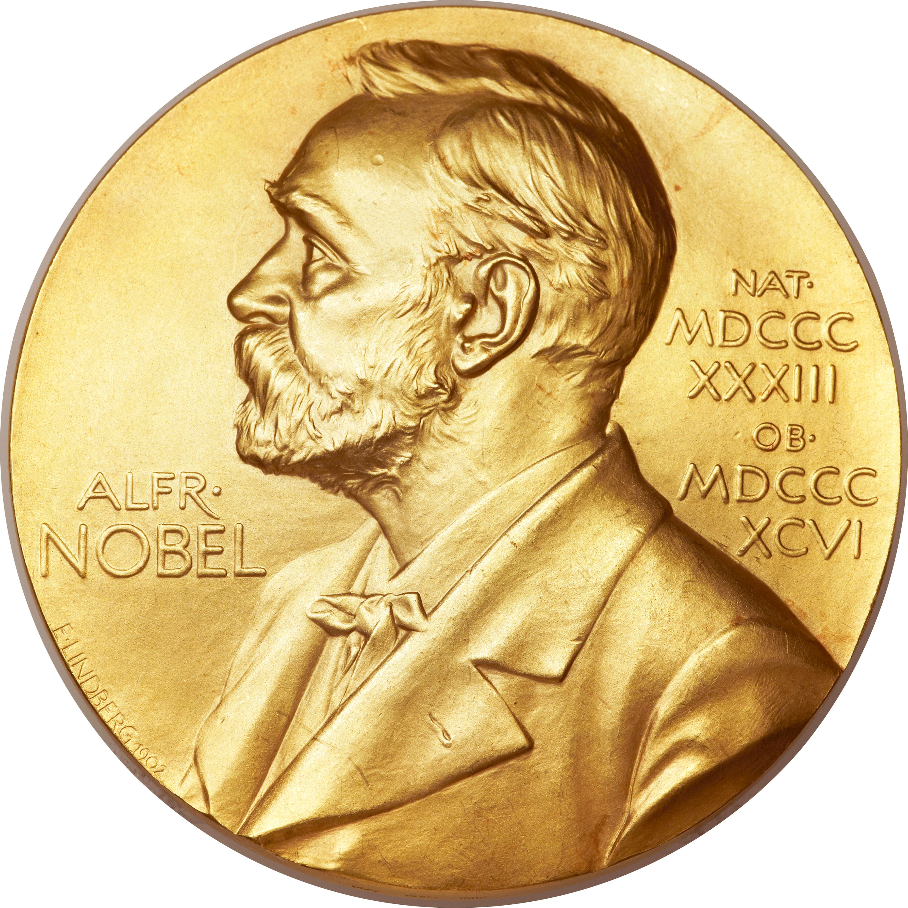
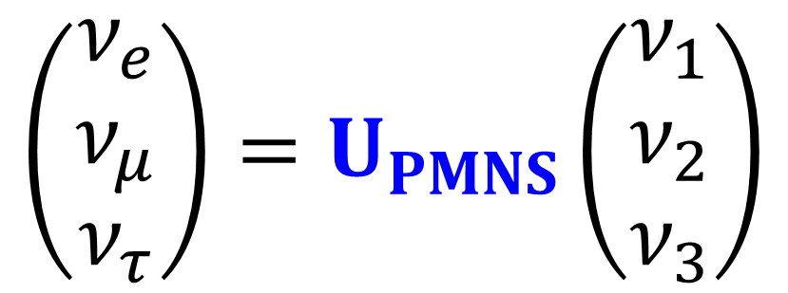
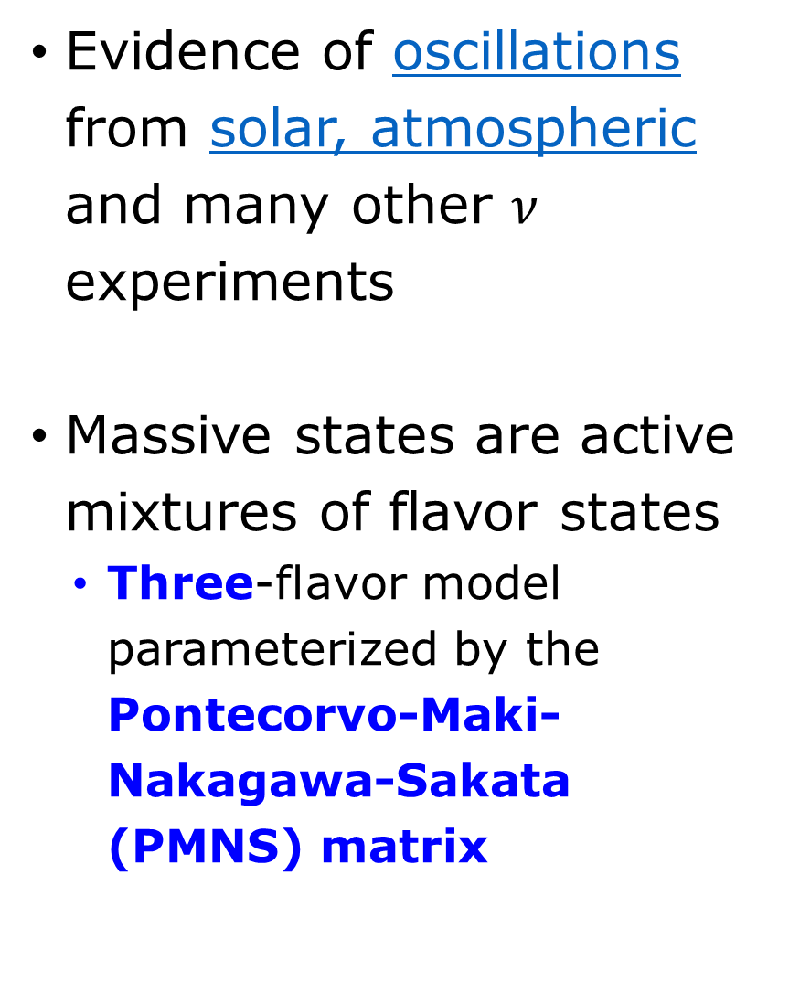



Neutrino Oscillations: 3-Flavor Mixing
Evidence of oscillations from solar, atmospheric and many other $ν$ experiments
Massive states are active mixtures of flavor states
  Three-flavor model parameterized by the Pontecorvo-Maki-Nakagawa-Sakata (PMNS) matrix
$$\sim 2.5×{10}^{−3}eV^{2}$$
$$\sim 7×{10}^{−5}eV^{2}$$
$$Δm^{2}≡m_{α}^{2}−m_{β}^{2}$$
$$\left(\begin{matrix}ν_{e} \\ ν_{μ} \\ ν_{τ}\end{matrix}\right)=U_{PMNS}\left(\begin{matrix}ν_{1} \\ ν_{2} \\ ν_{3}\end{matrix}\right)$$
PDG
NuFit
Phys. Rev. Lett. 81, 1562 (1998)
Phys. Rev. Lett. 87, 071301 (2001)
Phys. Rev. Lett. 89, 011301 (2002)
R. S. Jones’ thesis
2015 Nobel Prize in Physics

Slide 3
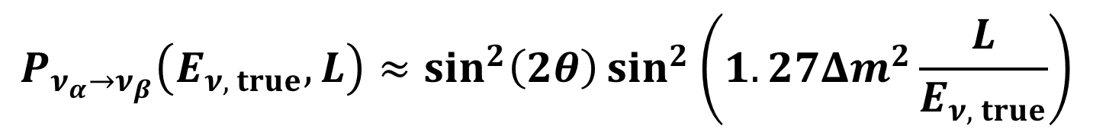

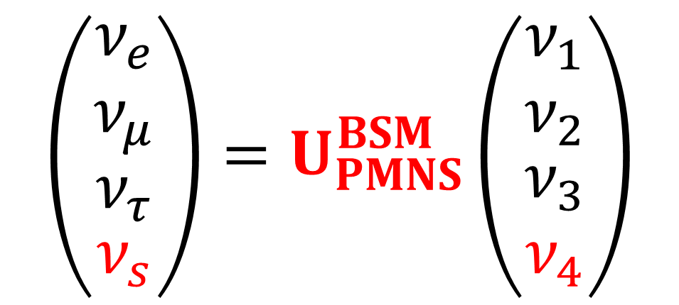
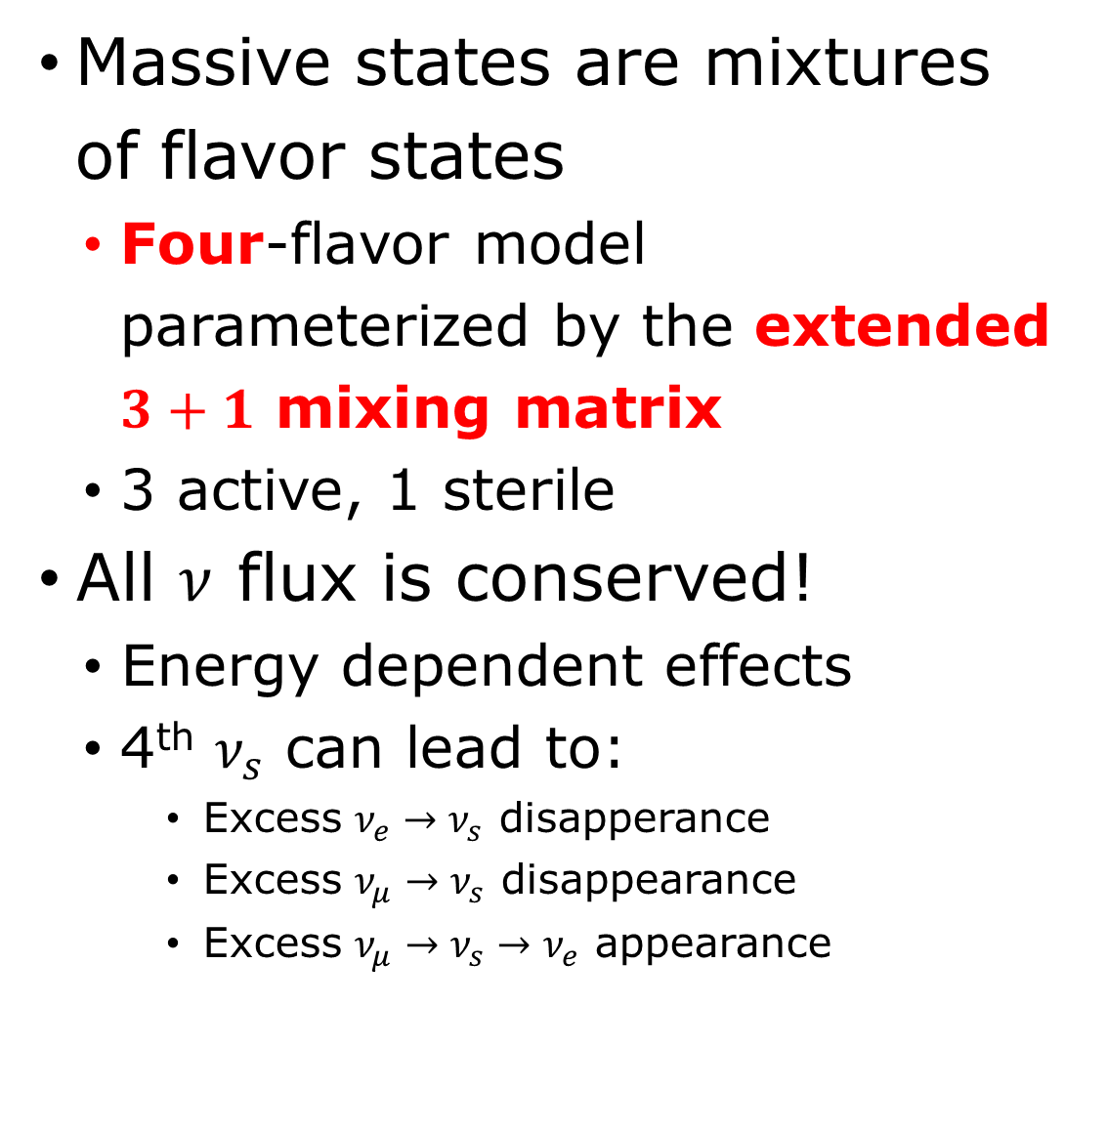
Neutrino Oscillations: 4-Flavor Mixing
Massive states are mixtures of flavor states
  Four-flavor model parameterized by the extended $3+1$ mixing matrix
  3 active, 1 sterile
All $ν$ flux is conserved!
  Energy dependent effects
  4th $ν_{s}$ can lead to:
    Excess $ν_{e}→ν_{s}$ disapperance
    Excess $ν_{μ}→ν_{s}$ disappearance
    Excess $ν_{μ}→ν_{s}→ν_{e}$ appearance
$$\sim 1 eV^{2}$$
$$\left(\begin{aligned}\begin{matrix}ν_{e} \\ ν_{μ} \\ ν_{τ}\end{matrix} \\ ν_{s}\end{aligned}\right)=U_{PMNS}^{BSM}\left(\begin{matrix}ν_{1} \\ ν_{2} \\ \begin{aligned}ν_{3} \\ ν_{4}\end{aligned}\end{matrix}\right)$$
$$P_{ν_{α}→ν_{β}}\left(E_{ν, true},L\right)≈\sin^{2}\left(2θ\right)\sin^{2}\left(1.27Δm^{2}\frac{L}{E_{ν, true}}\right)$$

Slide 4
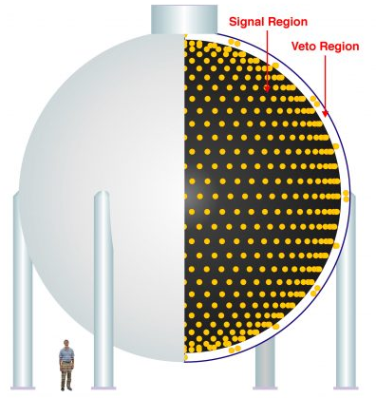
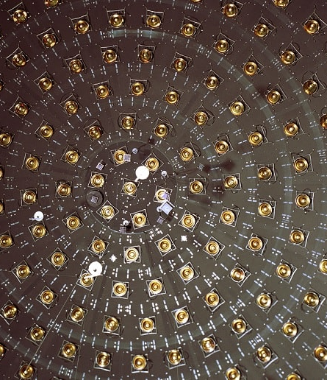
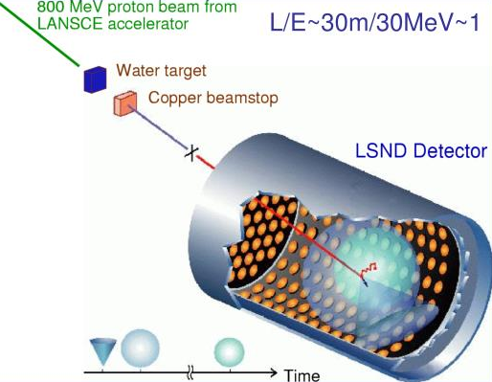
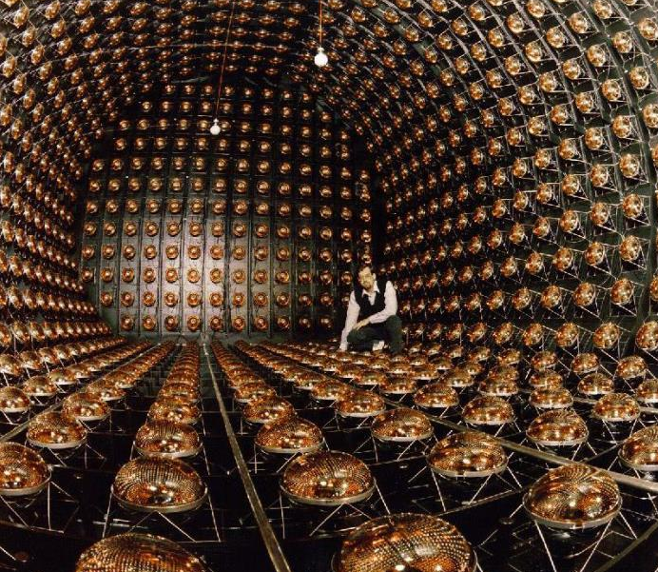
Challenges to the Three Neutrino Paradigm
Anomalies: The Low-Energy Excess
LSND Detector
MiniBooNE Detector
Neutrino oscillation results from LSND
Updated MiniBooNE neutrino oscillation results with increased data and new background studies

Slide 5
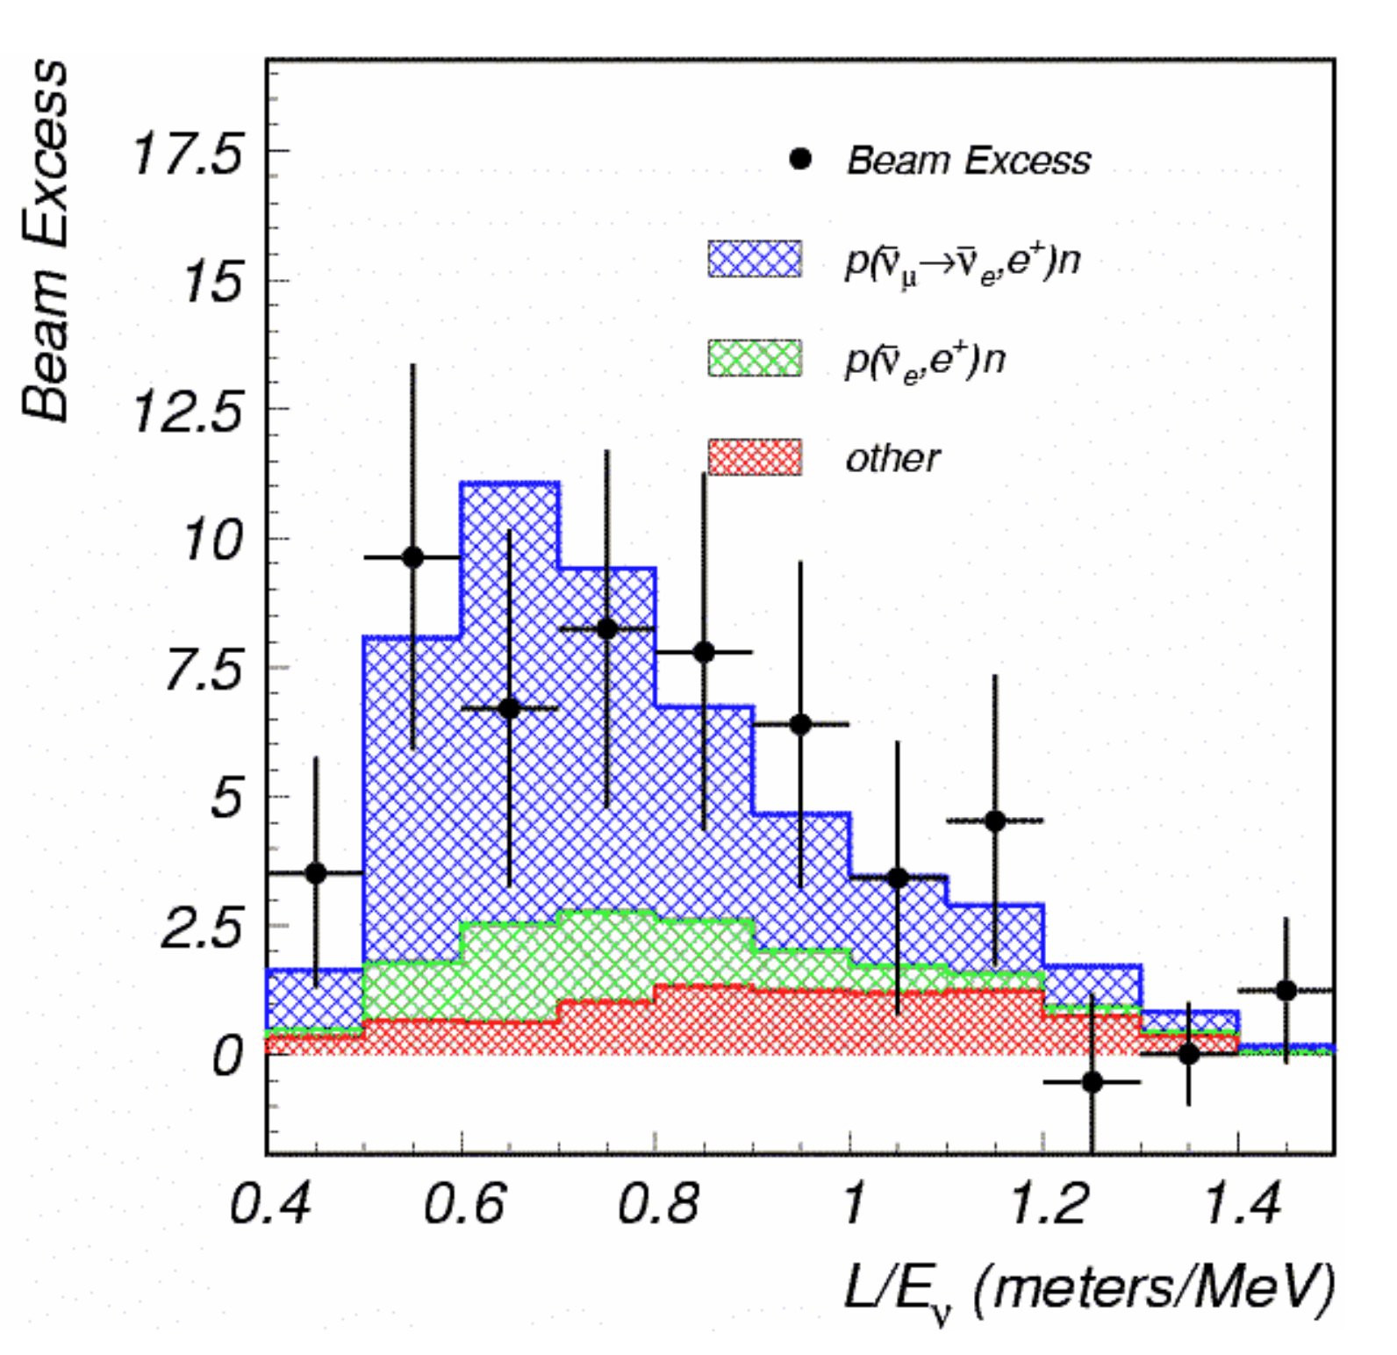
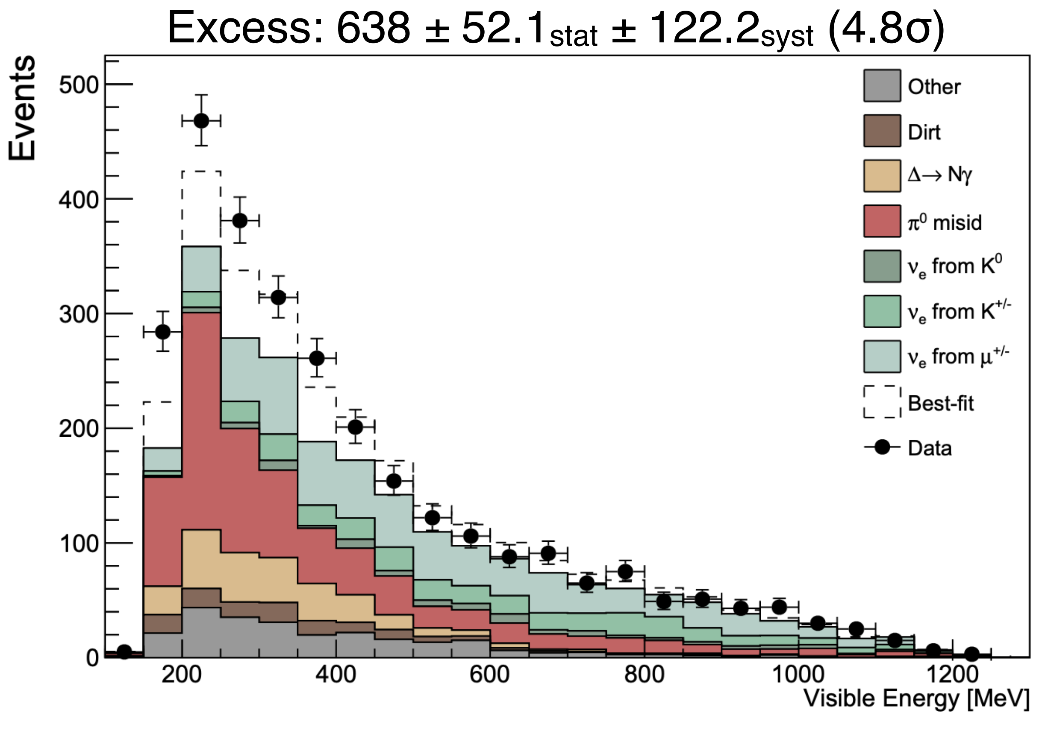
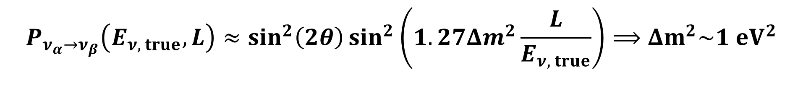
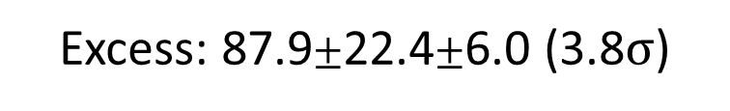
Challenges to the Three Neutrino Paradigm
Anomalies: The Low-Energy Excess
Excess: 87.9$±$22.4$±$6.0 (3.8$σ$)
$$P_{ν_{α}→ν_{β}}\left(E_{ν, true},L\right)≈\sin^{2}\left(2θ\right)\sin^{2}\left(1.27Δm^{2}\frac{L}{E_{ν, true}}\right)⟹Δm^{2}\sim 1 eV^{2}$$
Adapted from Pedro Machado
Neutrino oscillation results from LSND
Updated MiniBooNE neutrino oscillation results with increased data and new background studies

Slide 6
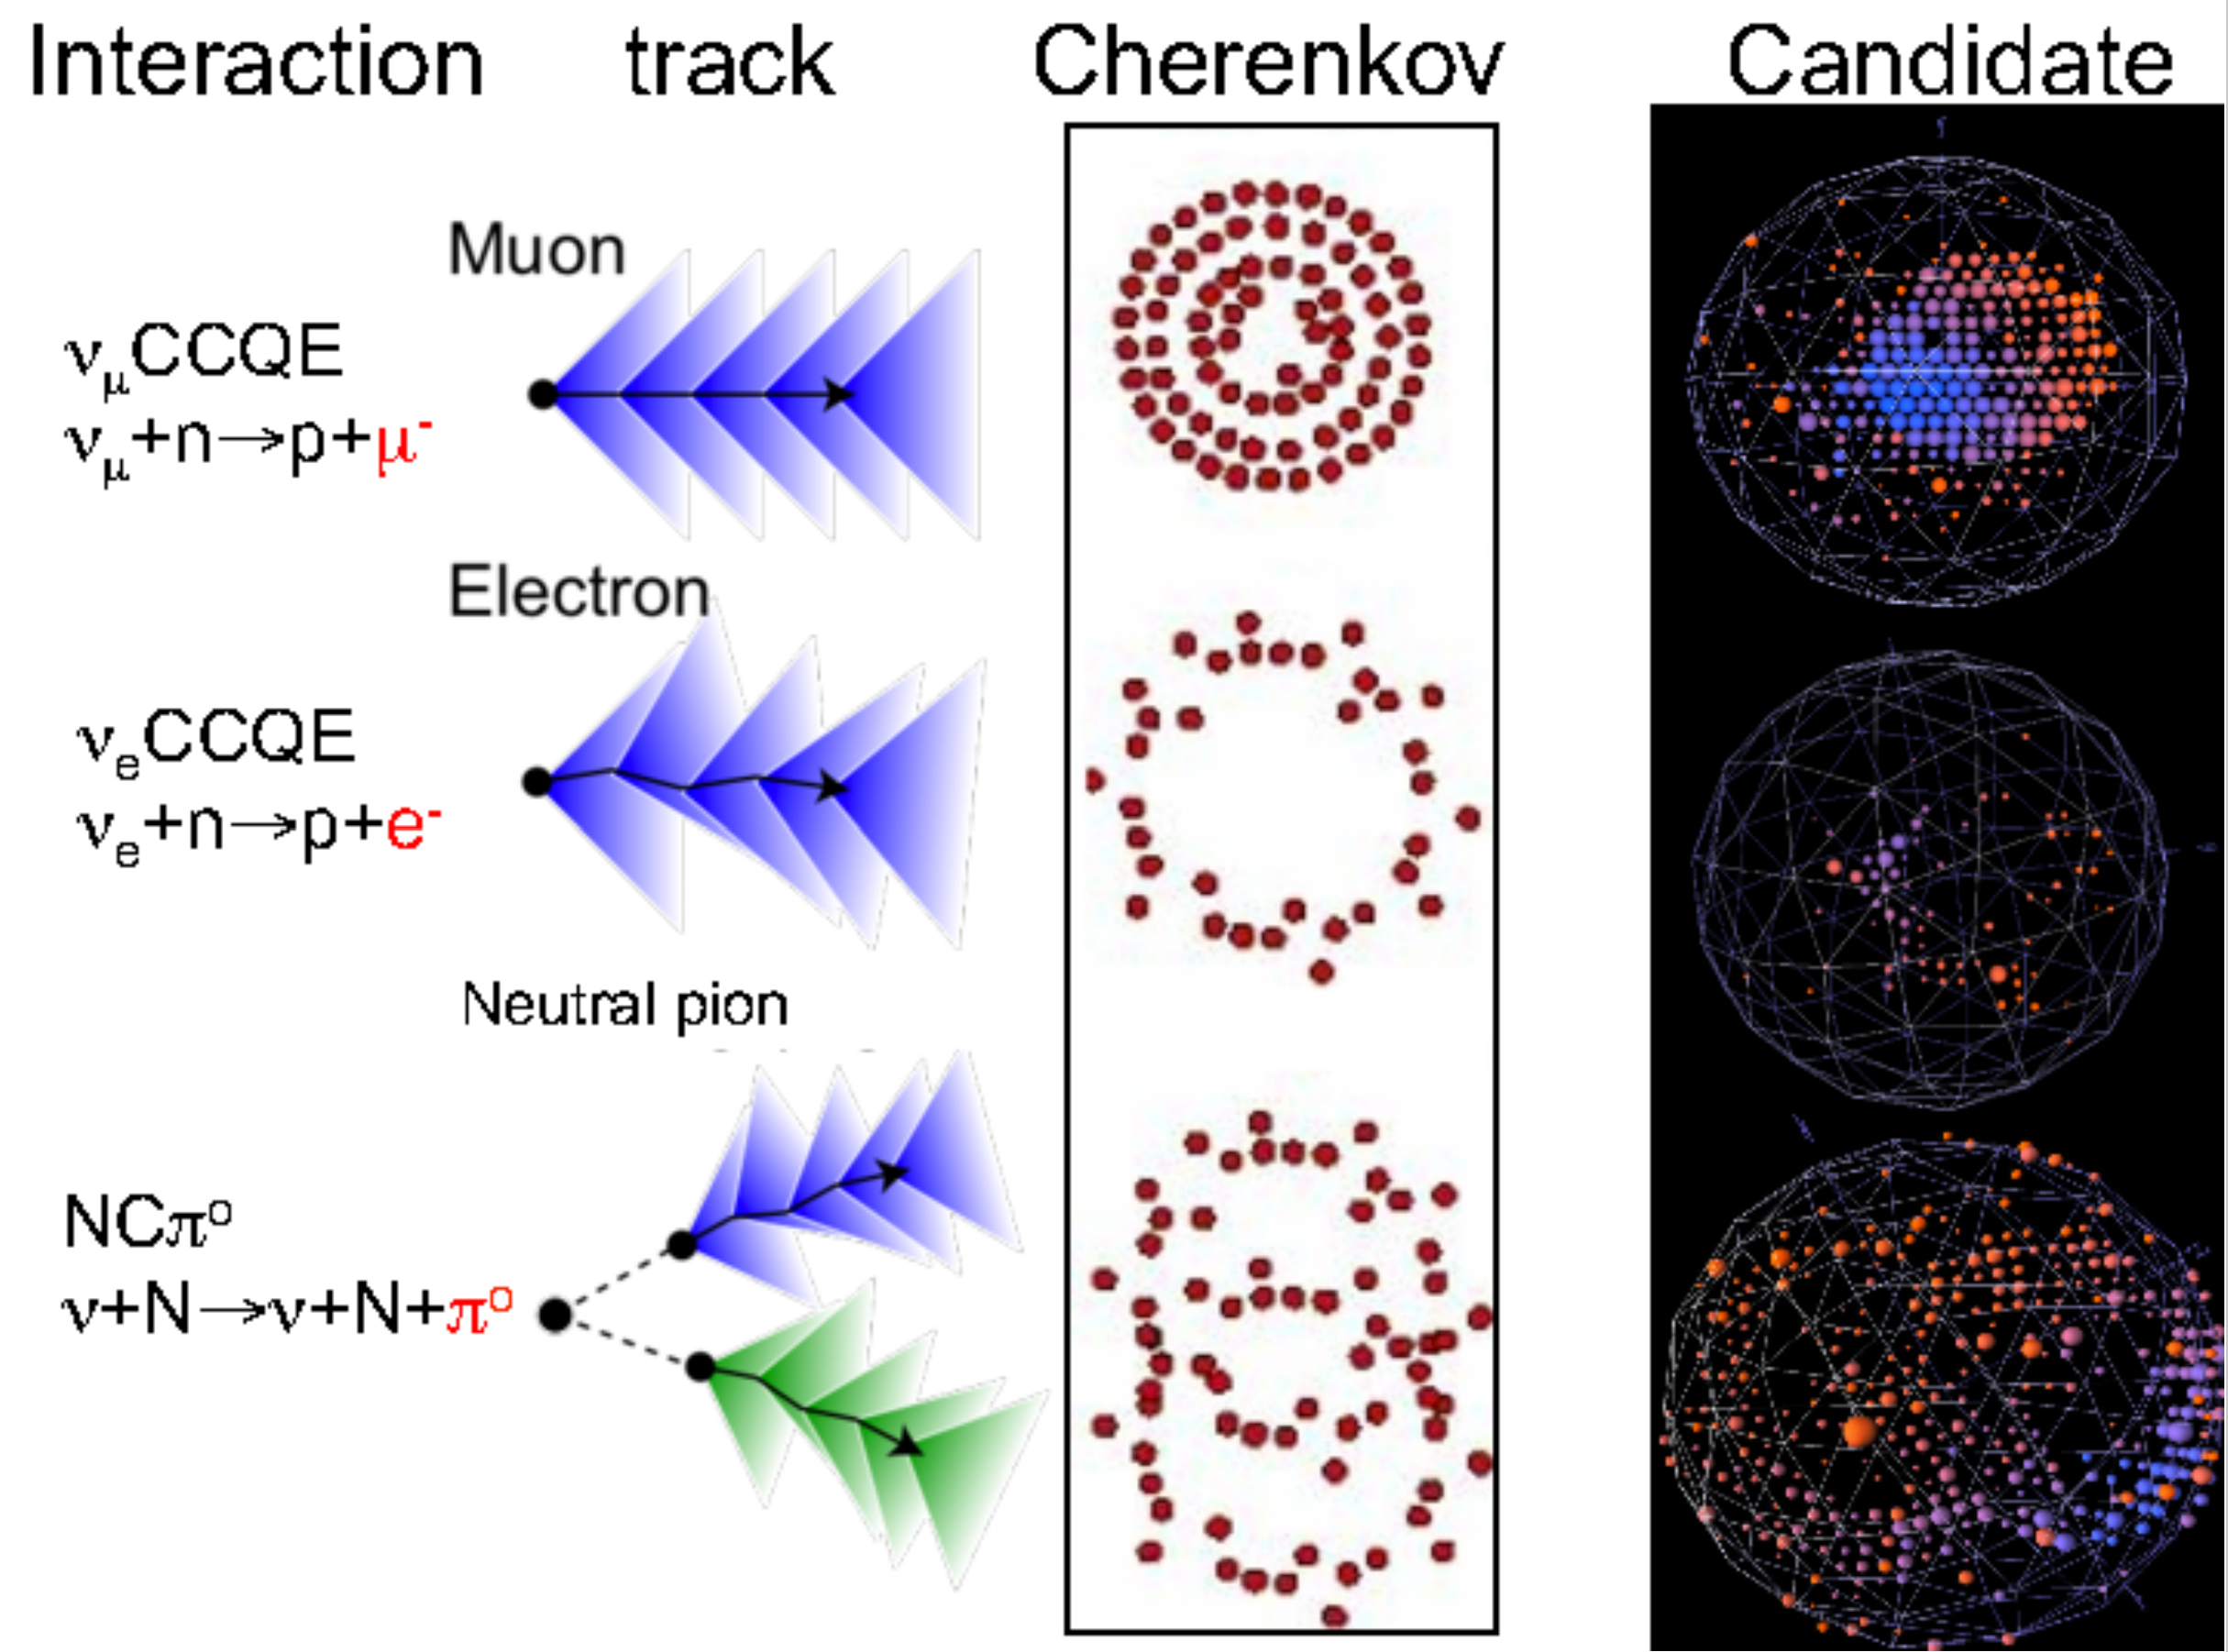
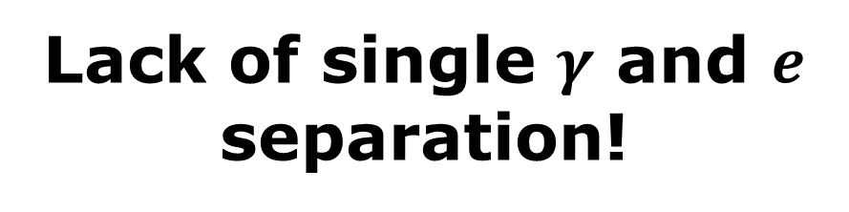


Challenges to the Three Neutrino Paradigm
Anomalies: The Low-Energy Excess
Oscillations? Something else?
$$γ$$
$$γ$$
Excess is mostly from single diffuse rings
Lack of single $γ$ and $e$ separation!
How to improve?
Updated MiniBooNE neutrino oscillation results with increased data and new background studies

Slide 7
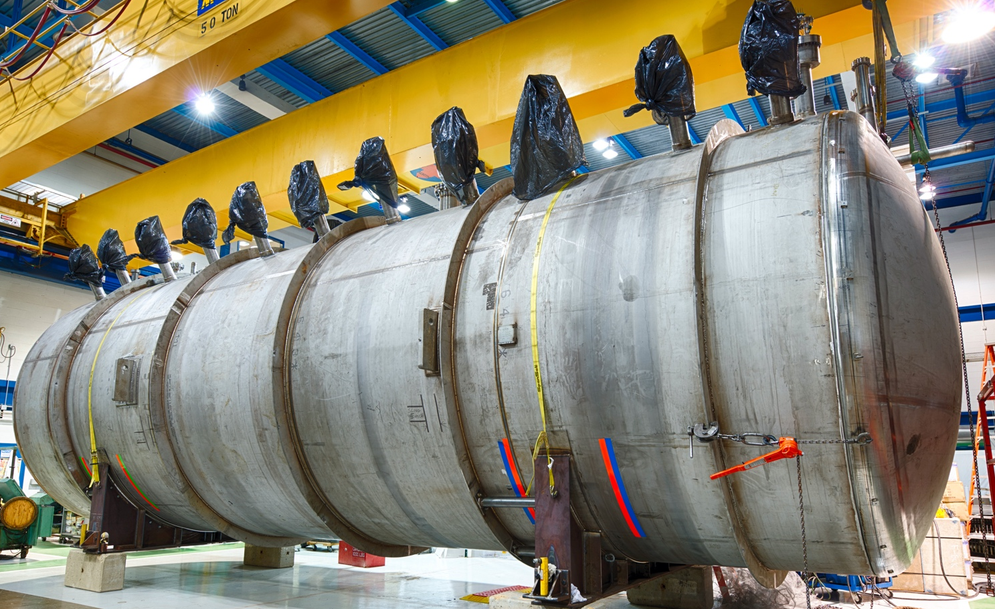
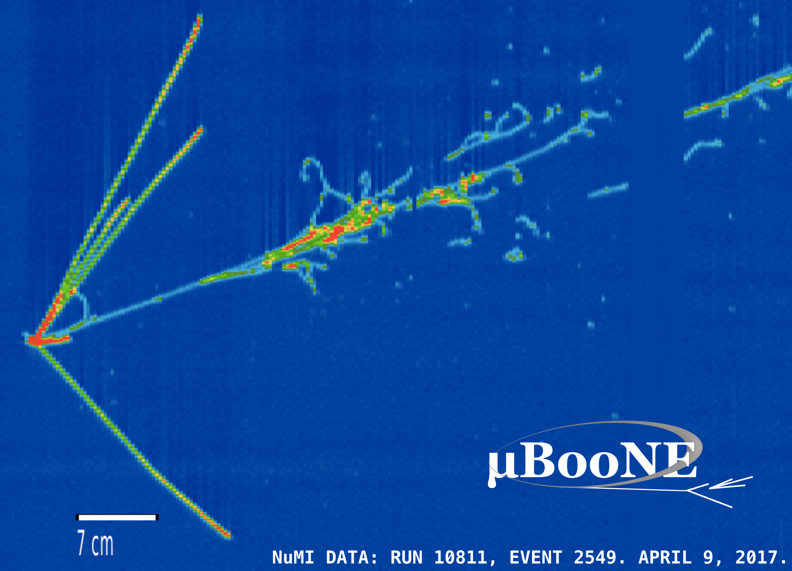
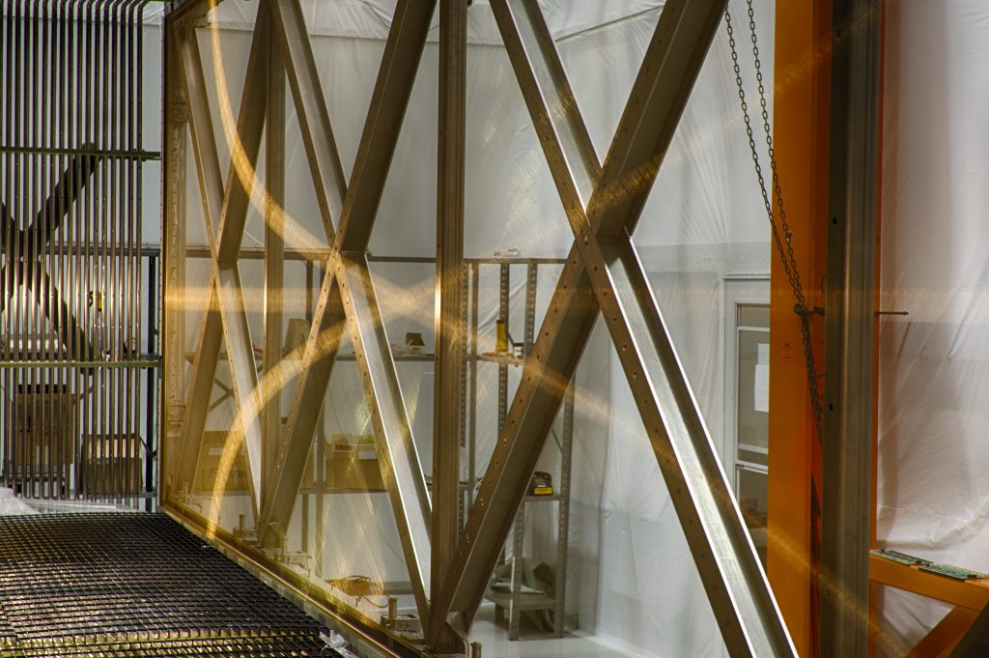


Slide 8
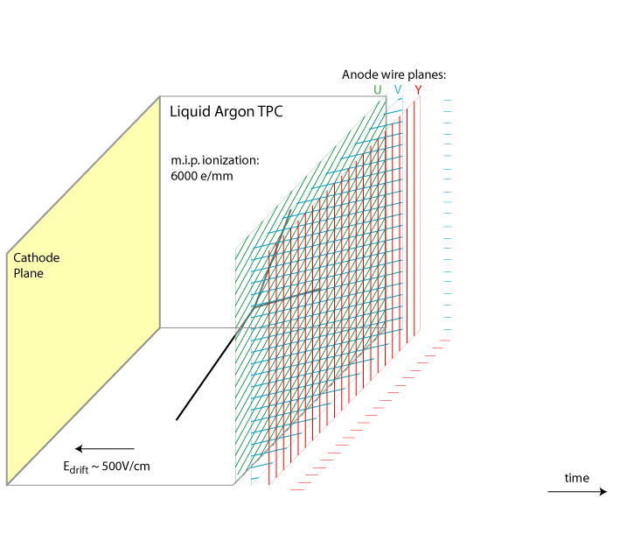
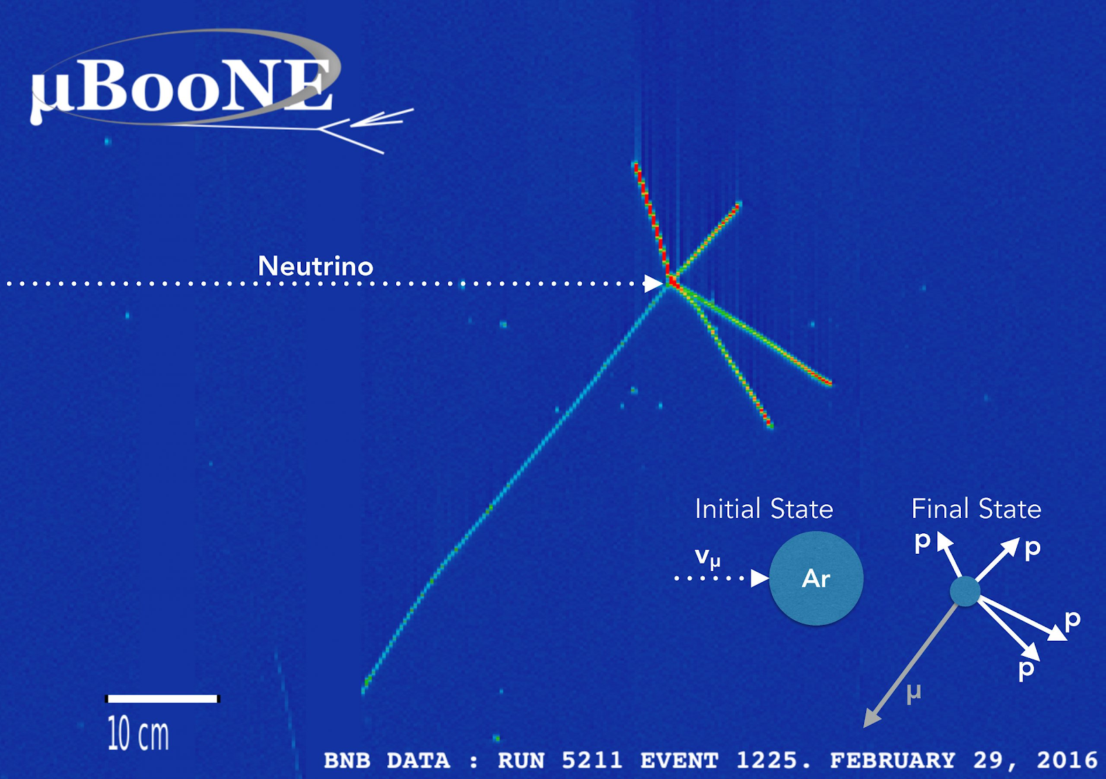
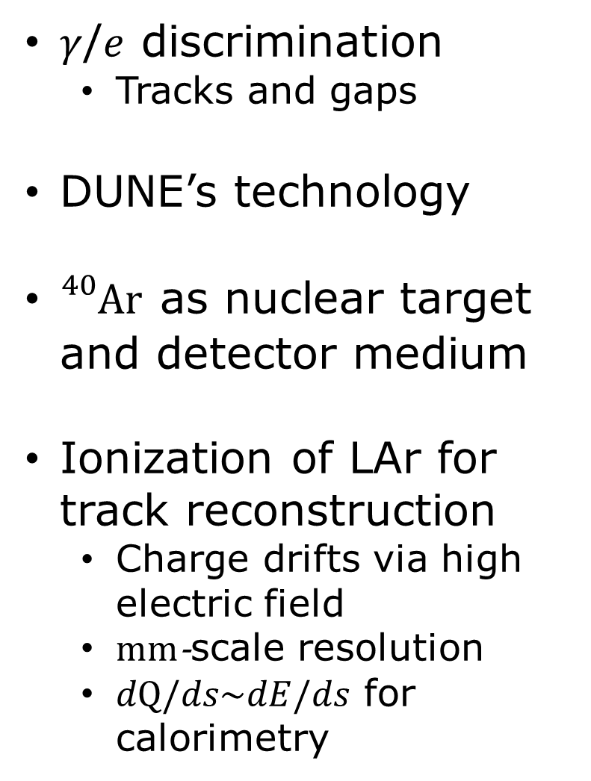
Liquid Argon Time Projection Chambers
Designed to Discover the Nature of the LEE
$γ$/$e$ discrimination
  Tracks and gaps
DUNE’s technology
${}_{}^{40}{Ar}$ as nuclear target and detector medium
Ionization of LAr for track reconstruction
  Charge drifts via high electric field
  $mm$-scale resolution
  $dQ/ds\sim dE/ds$ for calorimetry
Animation from Bo Yu (BNL)

Slide 9
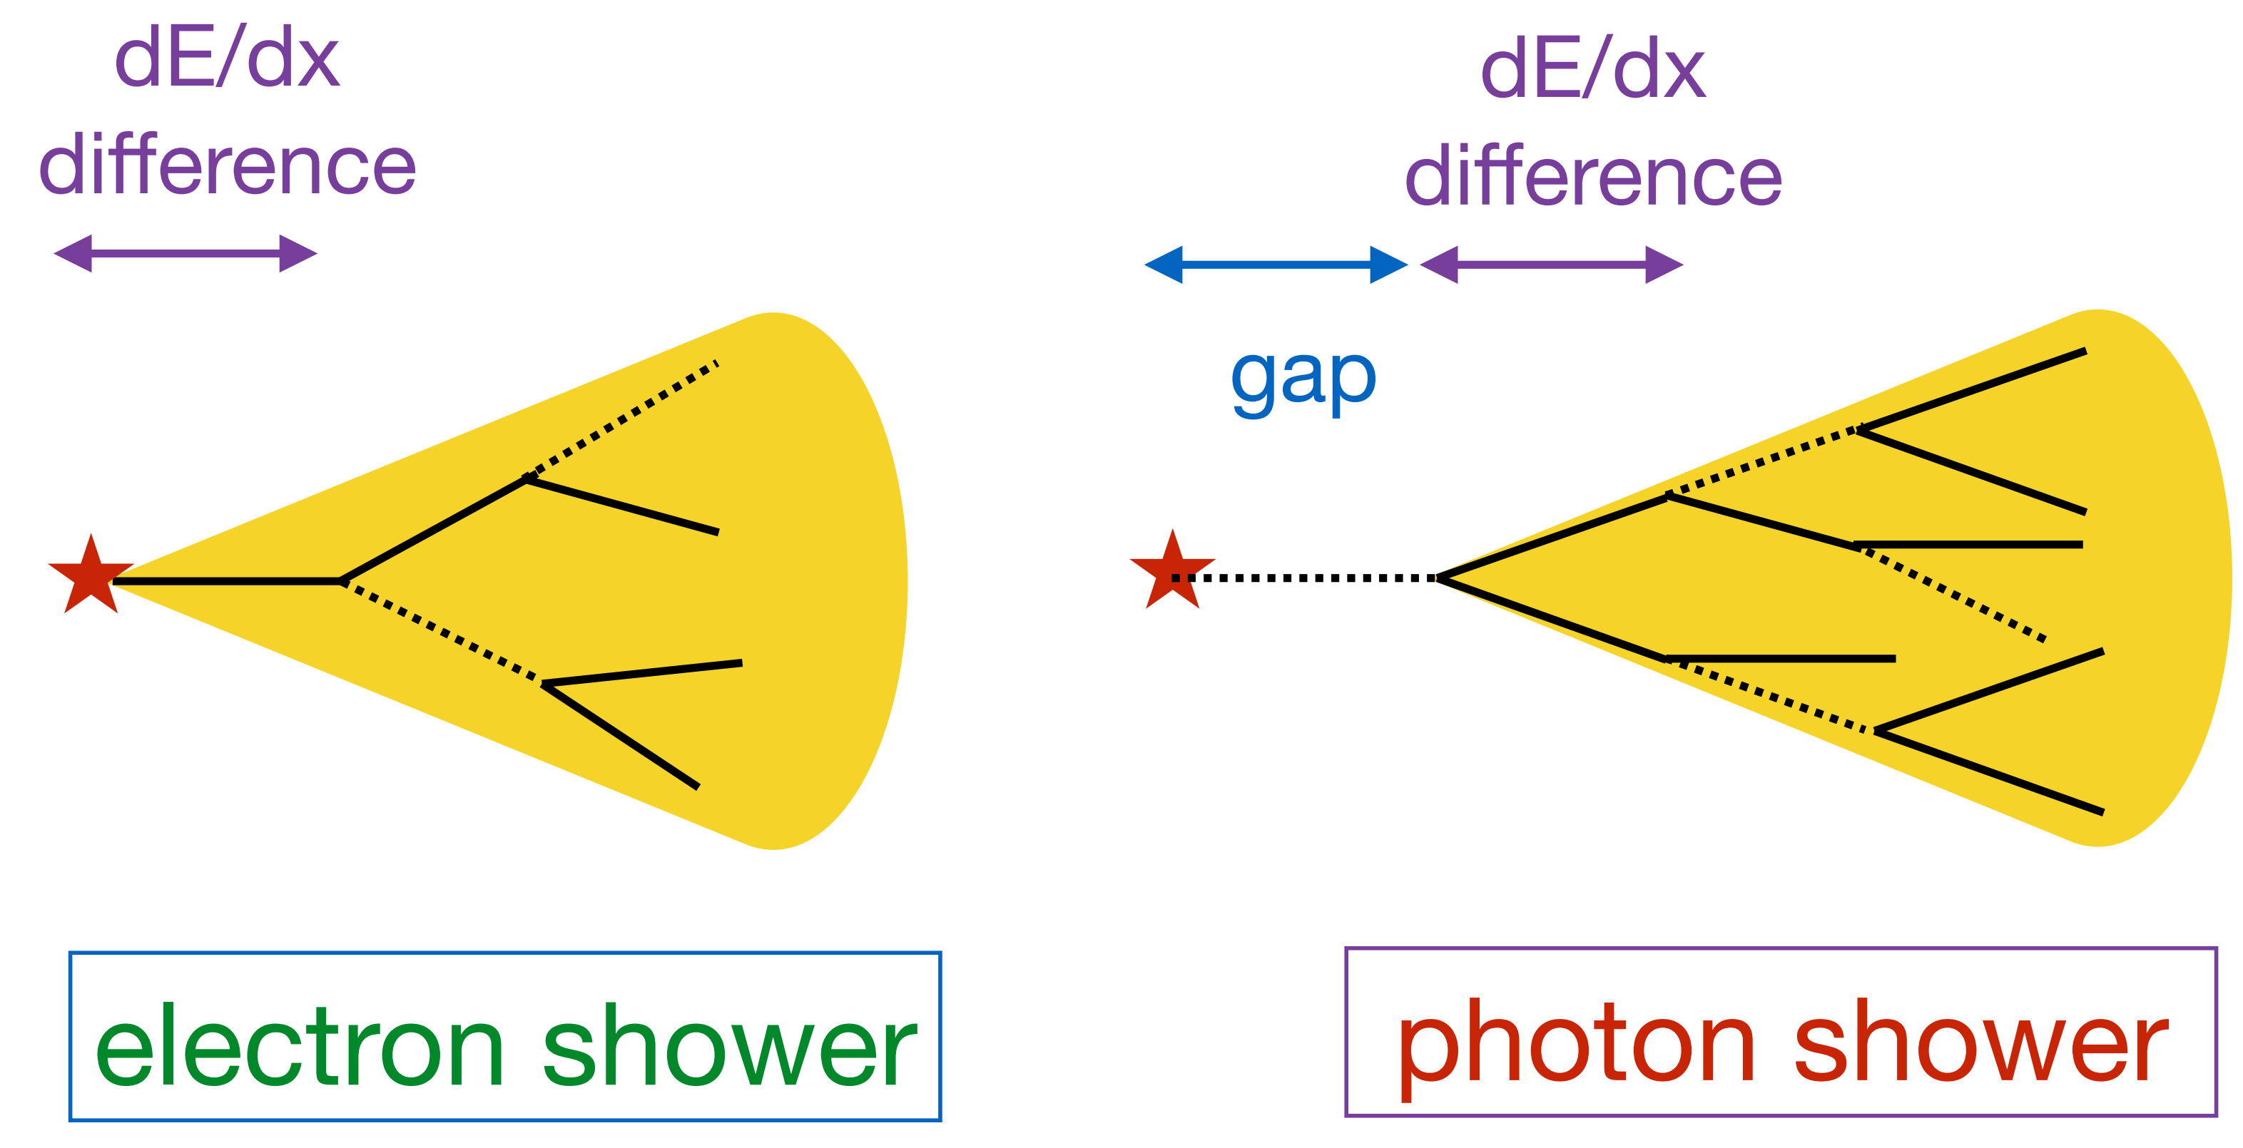
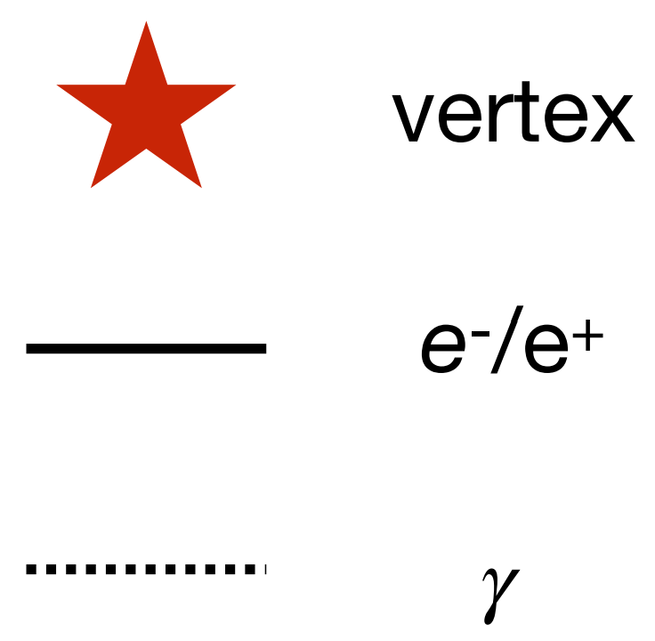

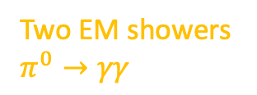


Liquid Argon Time Projection Chambers
Designed to Discover the Nature of the LEE
$γ$/$e$ discrimination
  Tracks and gaps
DUNE’s technology
${}_{}^{40}{Ar}$ as nuclear target and detector medium
Ionization of LAr for track reconstruction
  Charge drifts via high electric field
  $mm$-scale resolution
  $dQ/ds\sim dE/ds$ for calorimetry
Protons
Delta-ray
Pion?
Two EM showers $π^{0}→γγ$
Vertex of neutrino interaction
Beam
Drift
$$MIP×1$$
$$e^{+}e^{−} \text{production}$$
$$MIP×2$$
Adapted from Hanyu Wei and Jay Hyun Jo

Slide 10
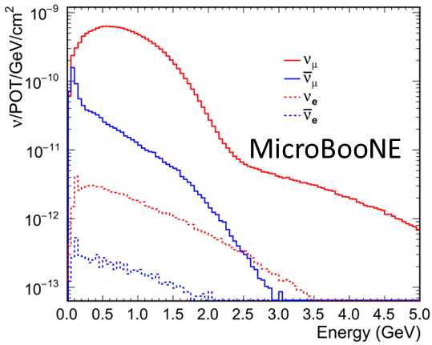
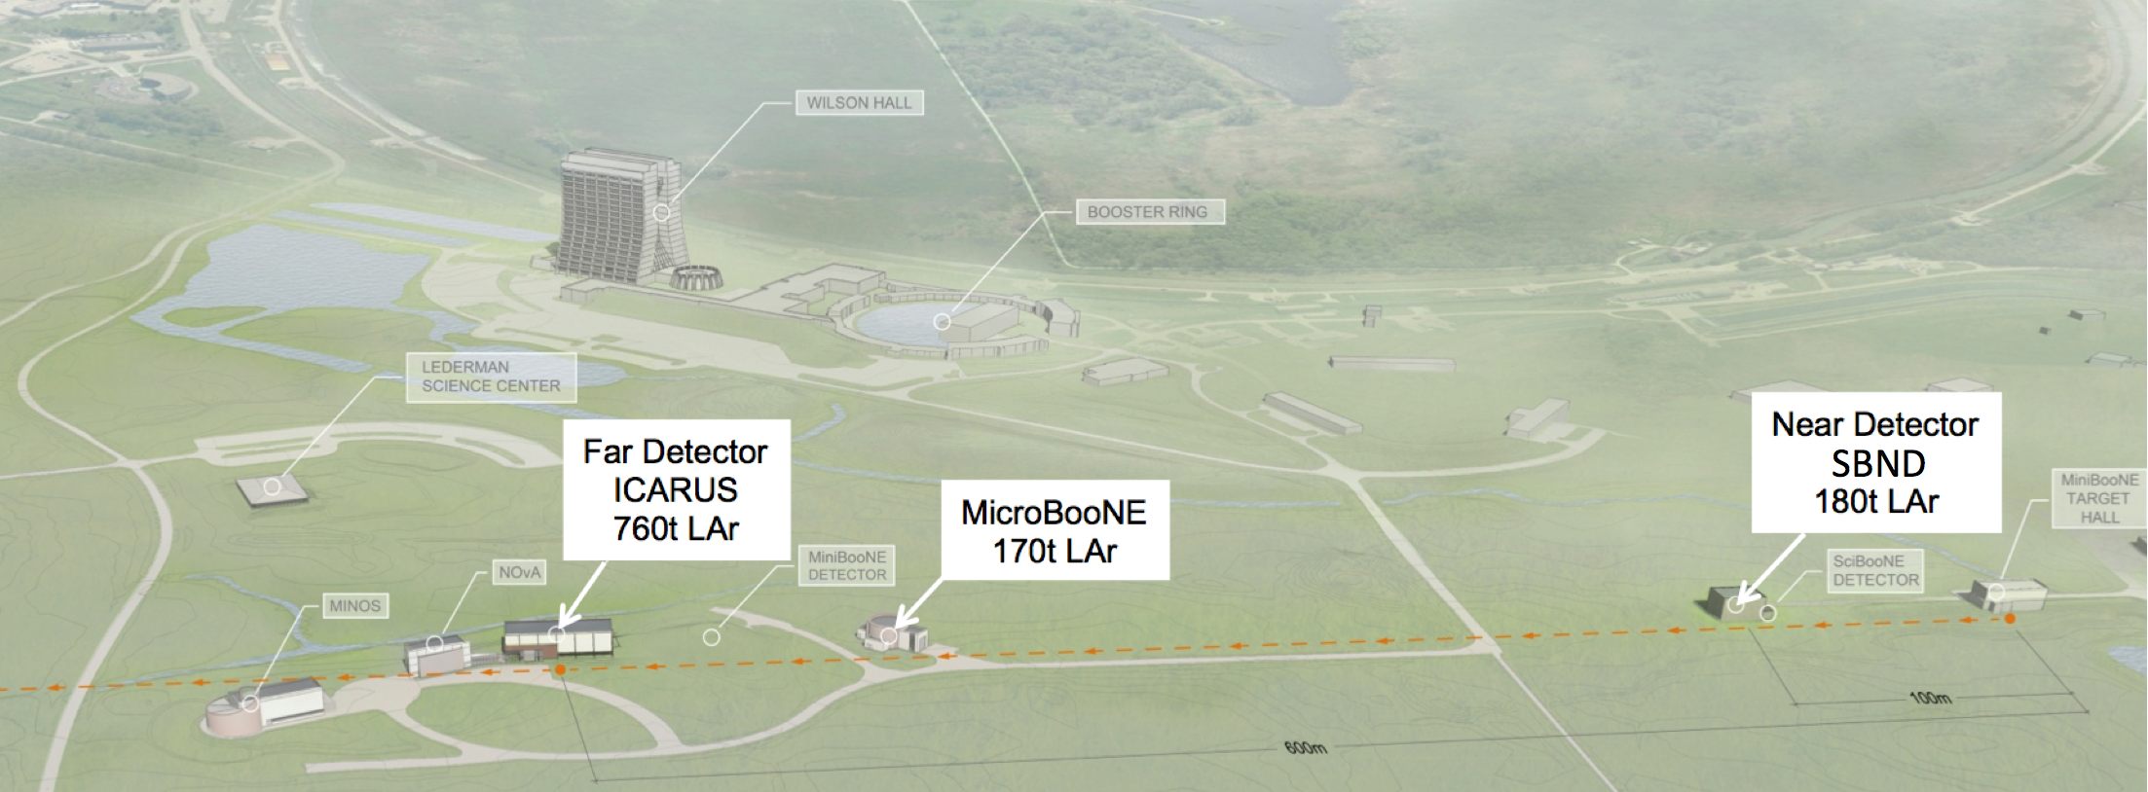


The Short-Baseline Neutrino Facility
Furthering the Investigation of $ν$ Interactions & the LEE
MicroBooNE just the first of many large LArTPCs to come
Incoming $ν$ flux
MiniBooNE and MicroBooNE sees ~identical flux
Ideal to test BSM hypotheses!
Neutrino flux prediction at MiniBooNE
MICROBOONE-NOTE-1031-PUB

Slide 11
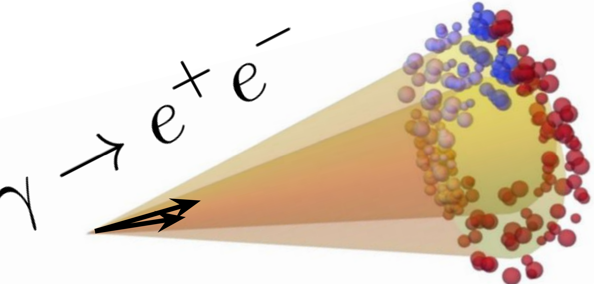
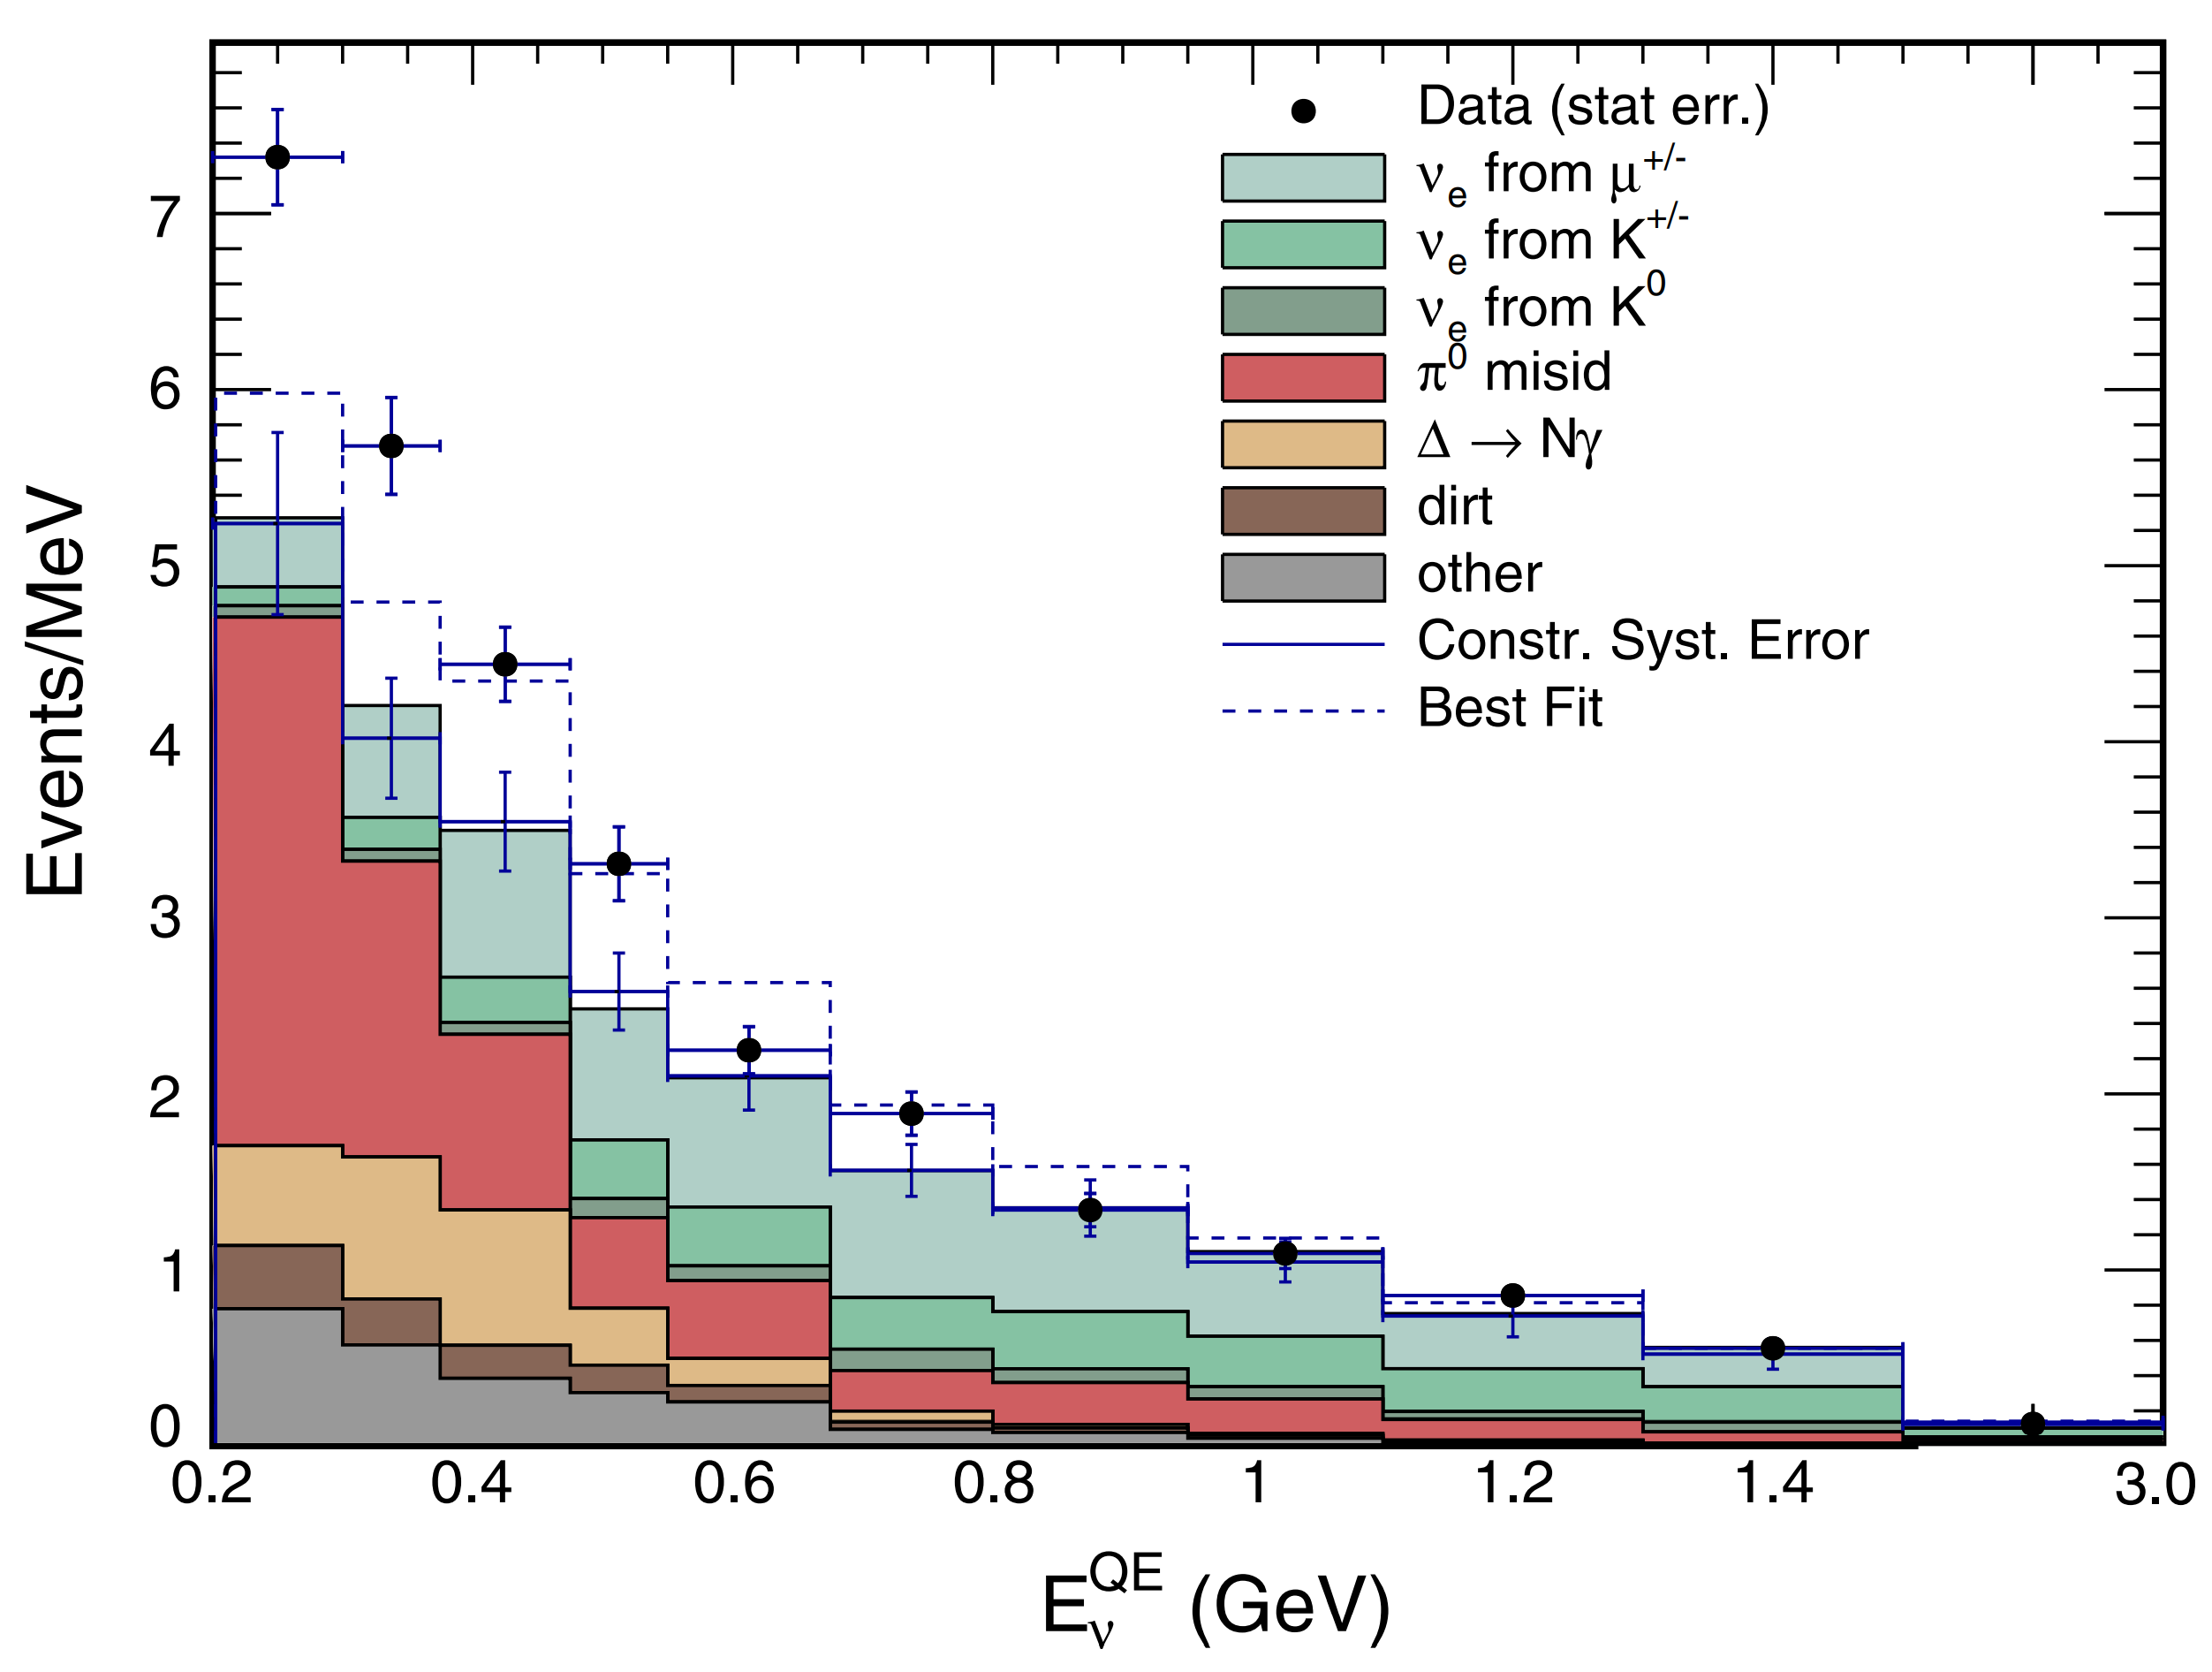
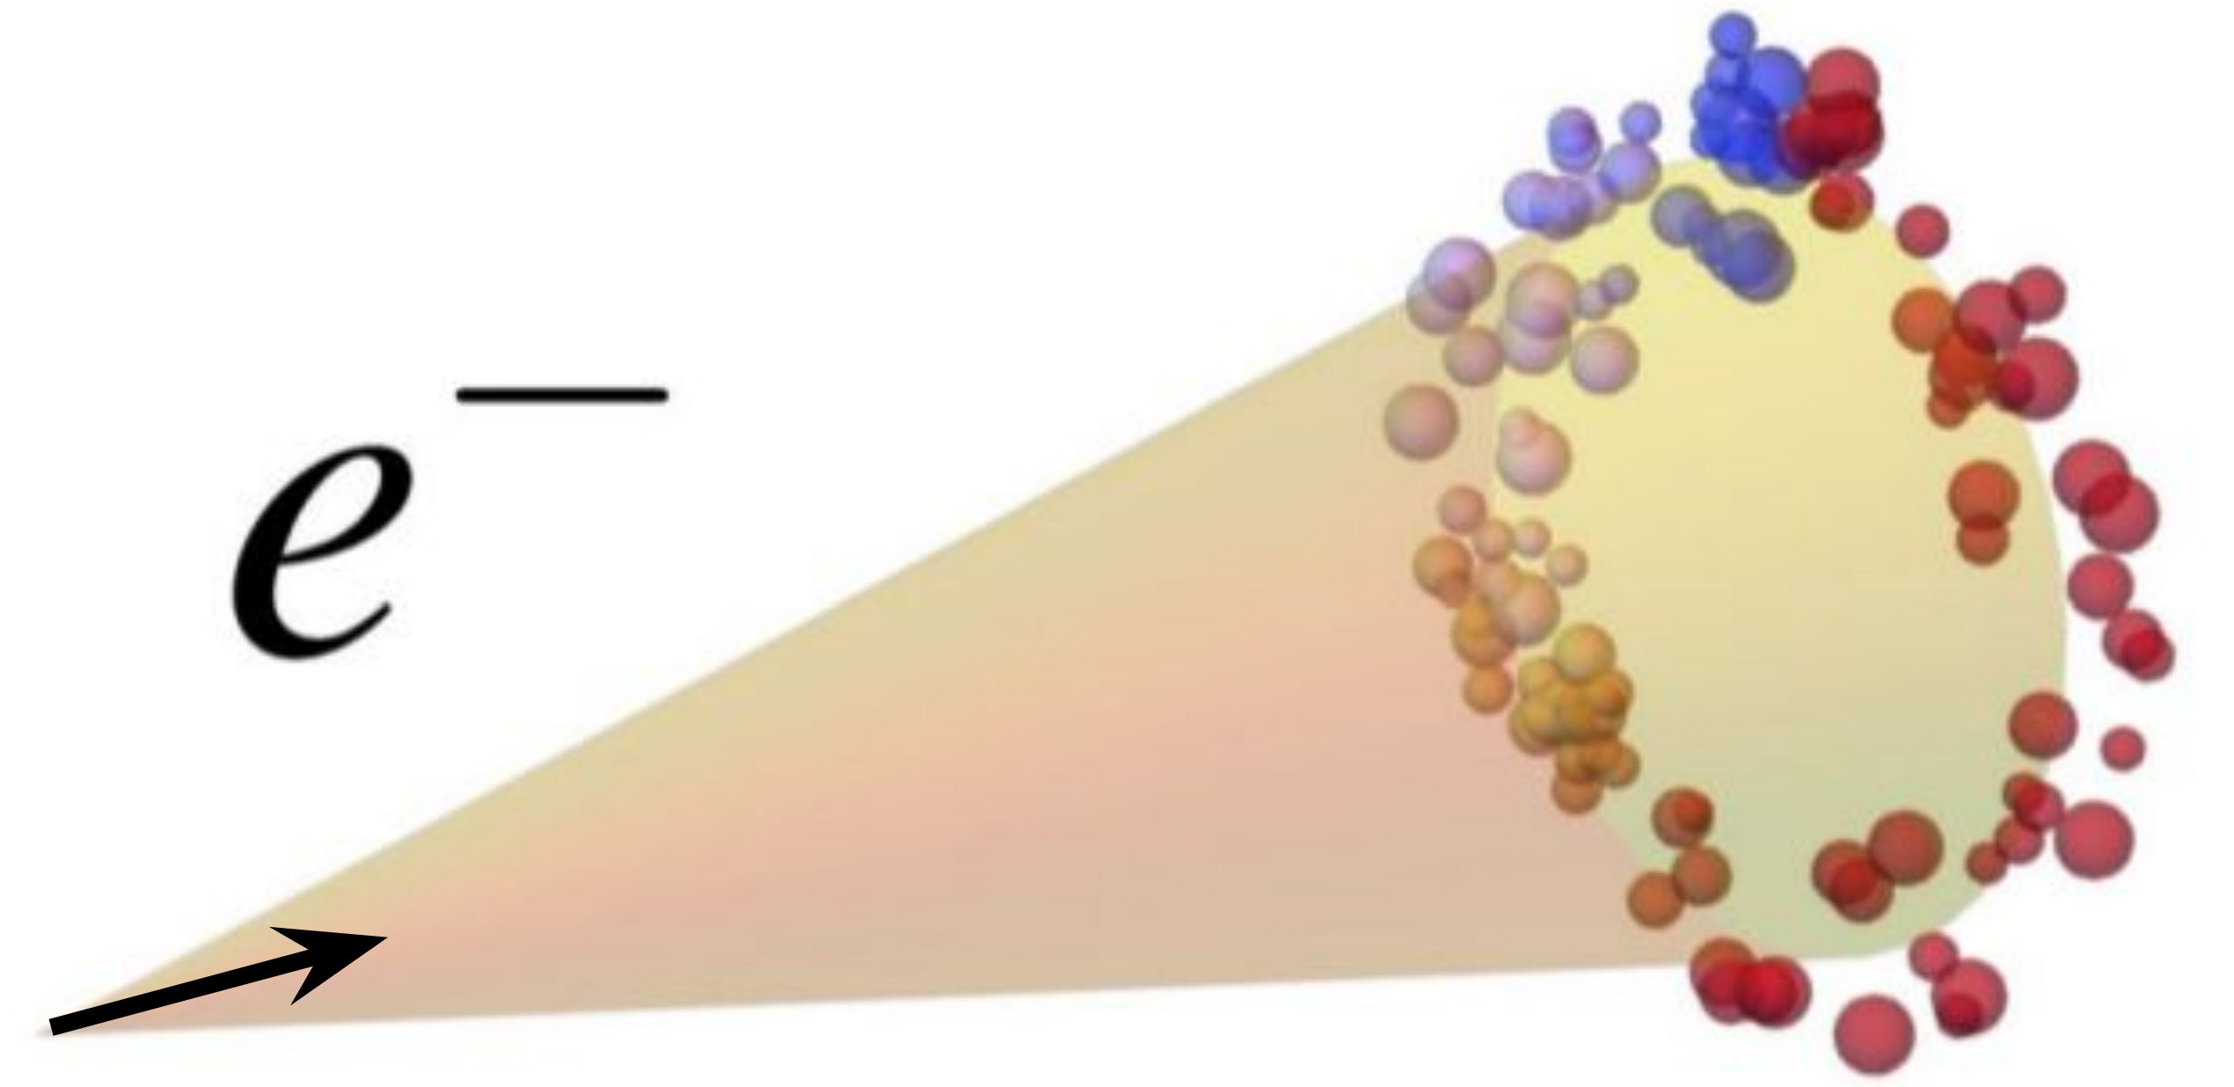
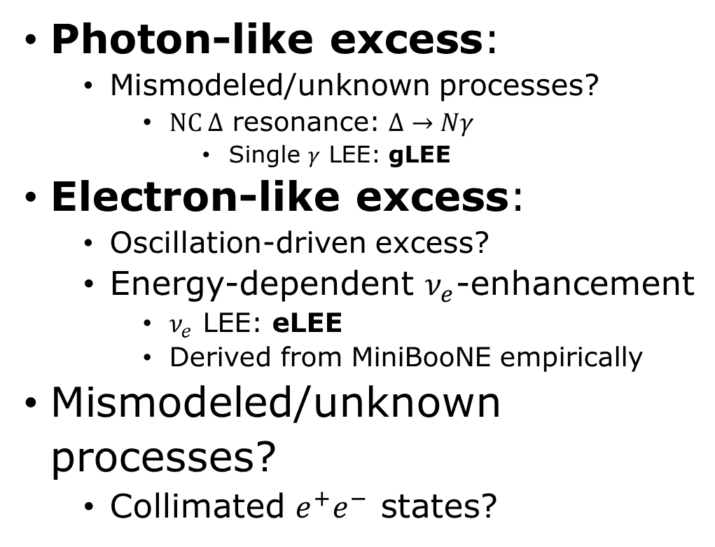
What Type of Excess from MiniBooNE?
Photon-like excess:
  Mismodeled/unknown processes?
    $NC Δ$ resonance: $Δ→Nγ$
      Single $γ$ LEE: gLEE
Electron-like excess:
  Oscillation-driven excess?
  Energy-dependent $ν_{e}$-enhancement
    $ν_{e}$ LEE: eLEE
    Derived from MiniBooNE empirically
Mismodeled/unknown processes?
  Collimated $e^{+}e^{−}$ states?
Updated MiniBooNE neutrino oscillation results with increased data and new background studies
Adapted from Jay Hyun Jo and Mark Ross-Lonergan

Slide 12
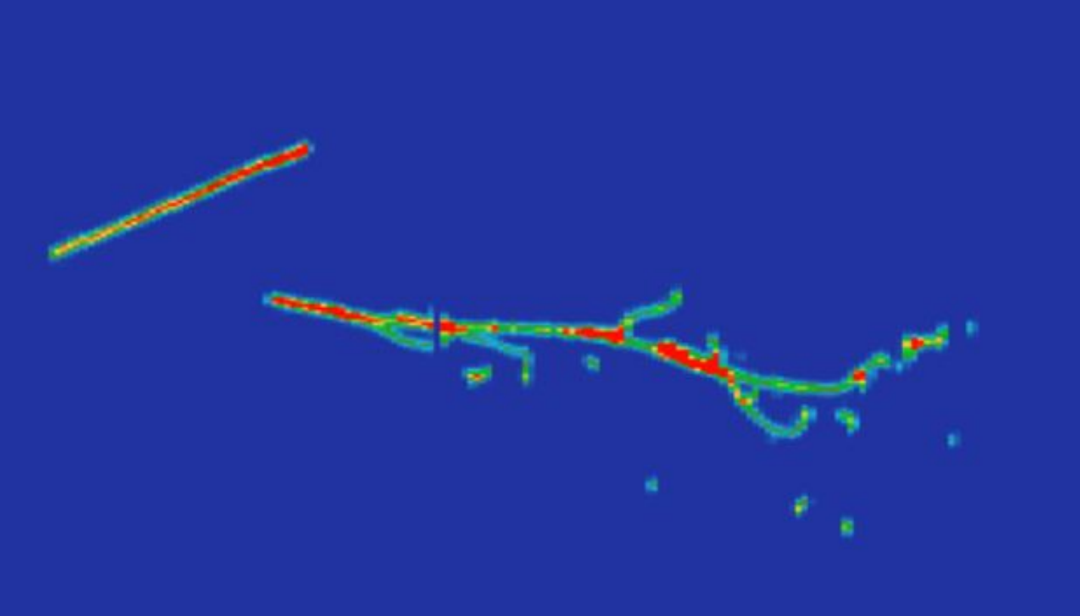
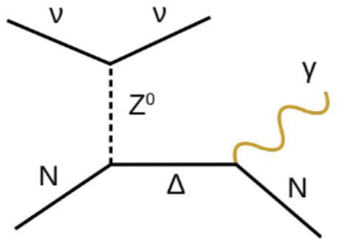
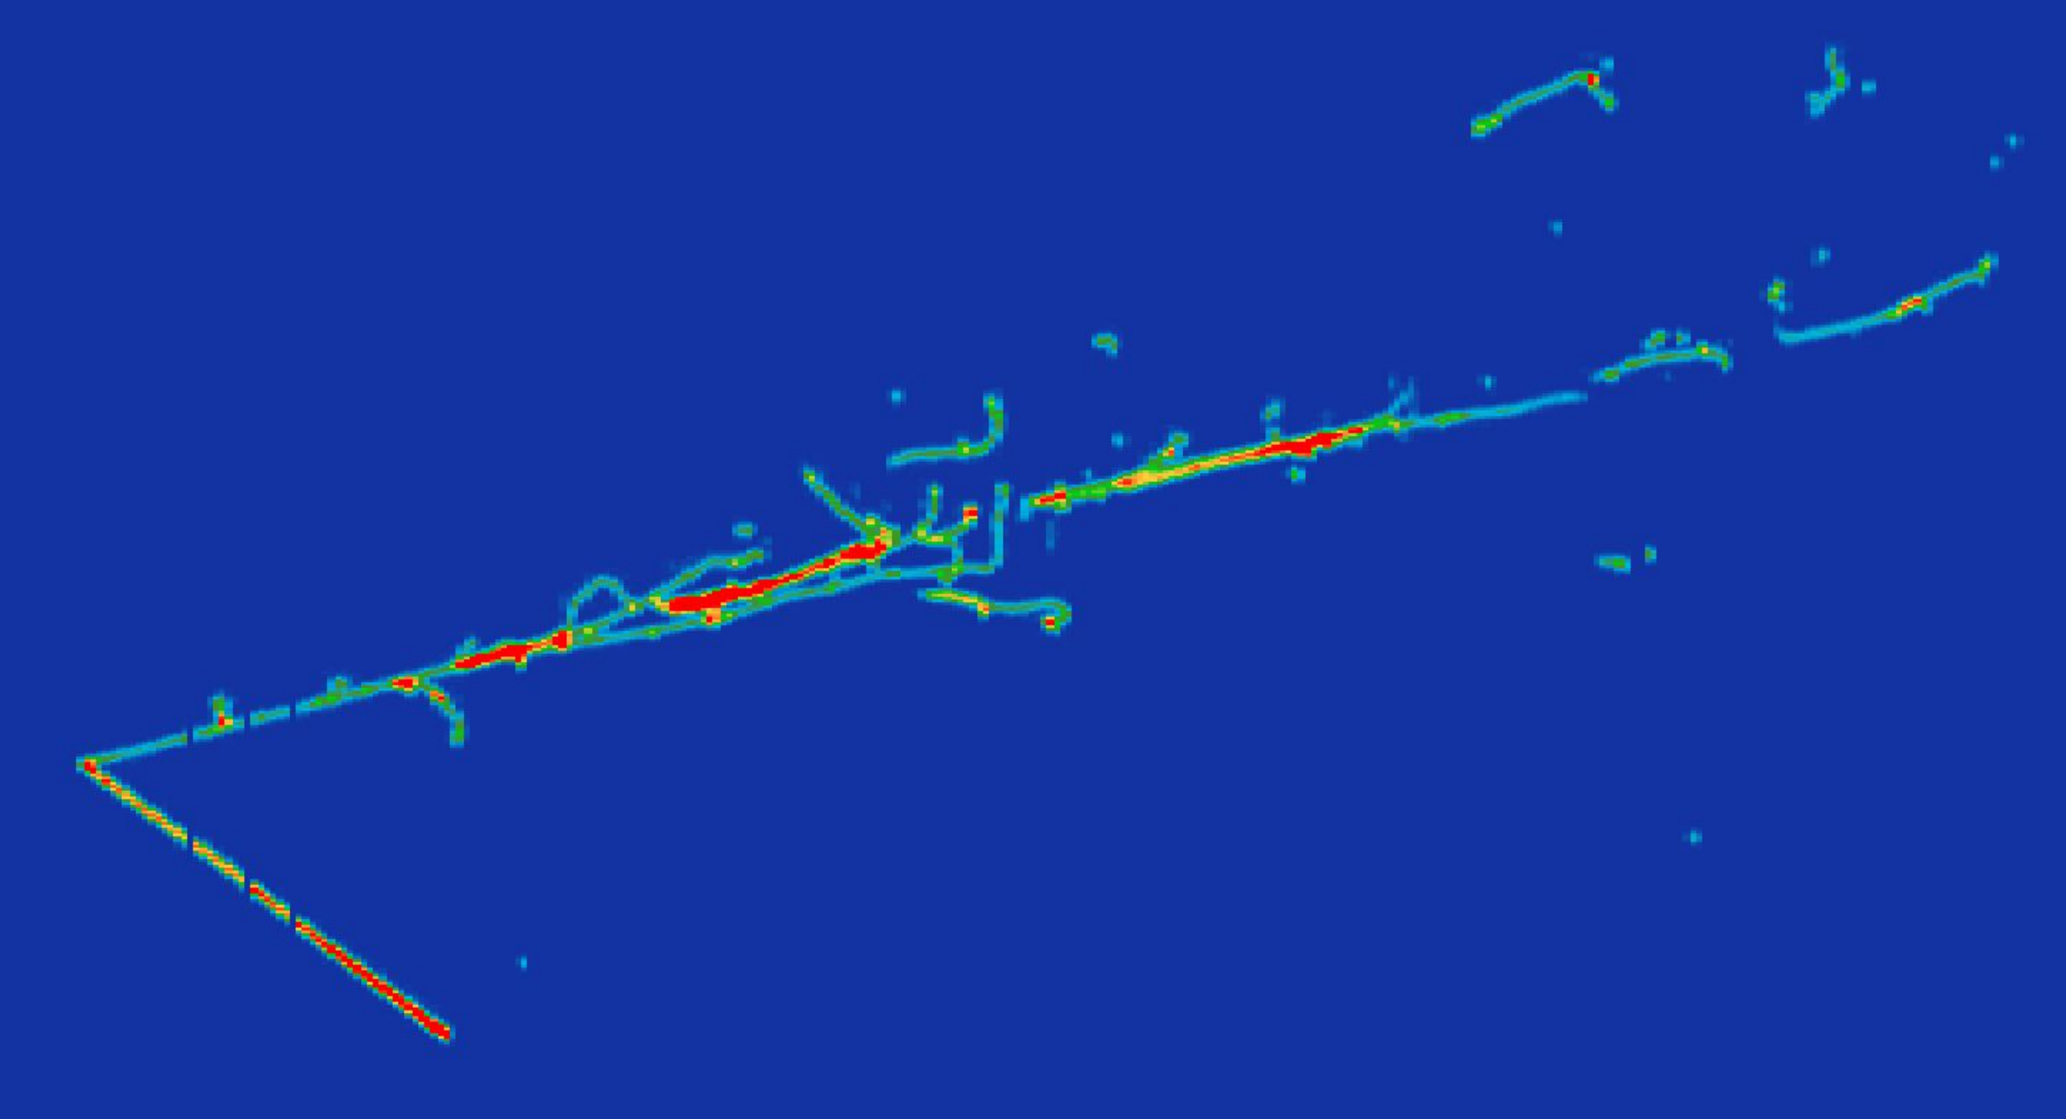


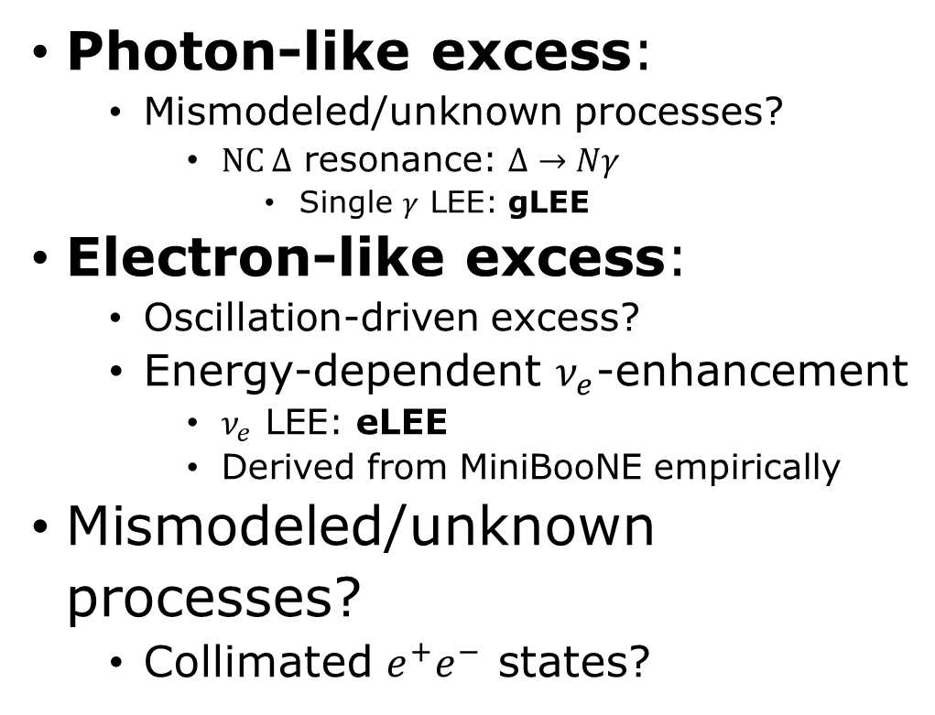

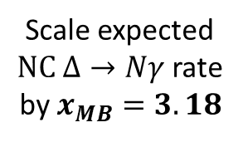
What Type of Excess from MiniBooNE?
MiniBooNE view
Photon-like excess:
  Mismodeled/unknown processes?
    $NC Δ$ resonance: $Δ→Nγ$
      Single $γ$ LEE: gLEE
Electron-like excess:
  Oscillation-driven excess?
  Energy-dependent $ν_{e}$-enhancement
    $ν_{e}$ LEE: eLEE
    Derived from MiniBooNE empirically
Mismodeled/unknown processes?
  Collimated $e^{+}e^{−}$ states?
$$NC Δ→Nγ Signal$$
Low $p$ thresholds!
MicroBooNE view
MicroBooNE Simulation
Scale expected
$NC Δ→Nγ$ rate
by $x_{MB}=3.18$
MicroBooNE view
BNB Run: 8617, Subrun: 46, Event: 2328
MiniBooNE view
Low $p$ thresholds!
MicroBooNE Data
Updated MiniBooNE neutrino oscillation results with increased data and new background studies
Adapted from Jay Hyun Jo and Mark Ross-Lonergan

Slide 13
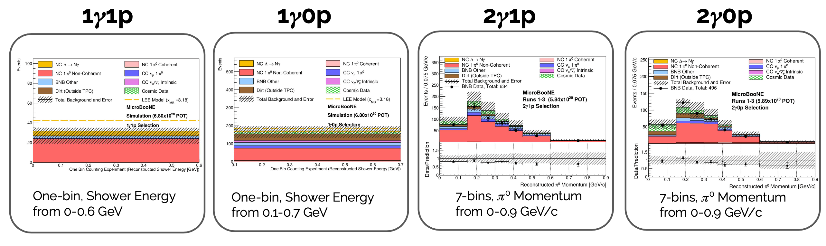
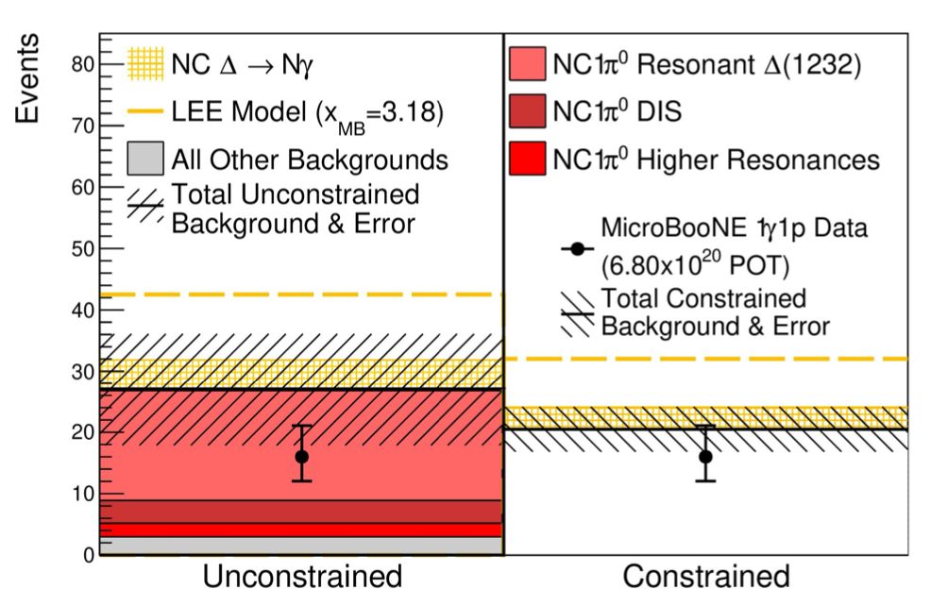
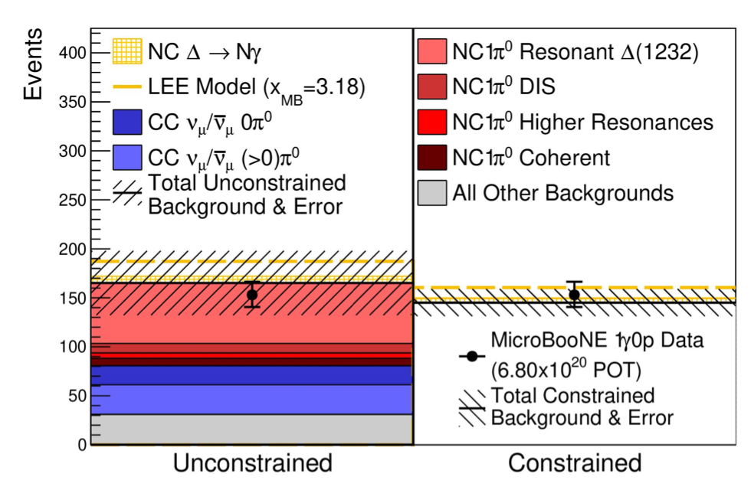
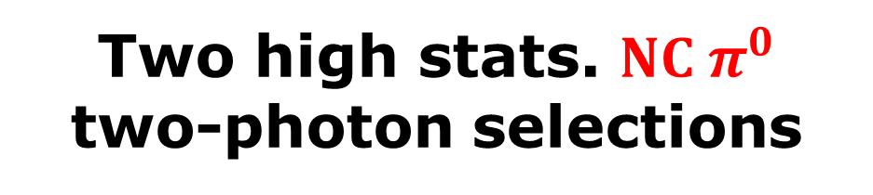











gLEE Searches
Two $NC Δ→Nγ$ single-photon selections
Two high stats. $NC π^{0}$ two-photon selections
$$p$$
$$n$$
Shower
Shower
$$γ$$
$$γ$$
$$p$$
$$n$$
$$γ$$
Shower
$$γ$$
Shower
$$γ$$
Shower
$$γ$$
Shower
Vertex
Vertex
Vertex
Vertex
Phys. Rev. Lett. 128, 111801
Adapted from Hanyu Wei

Slide 14
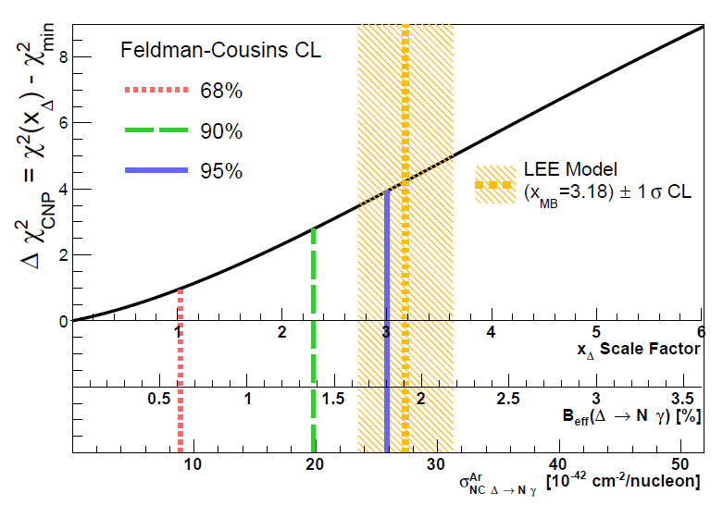
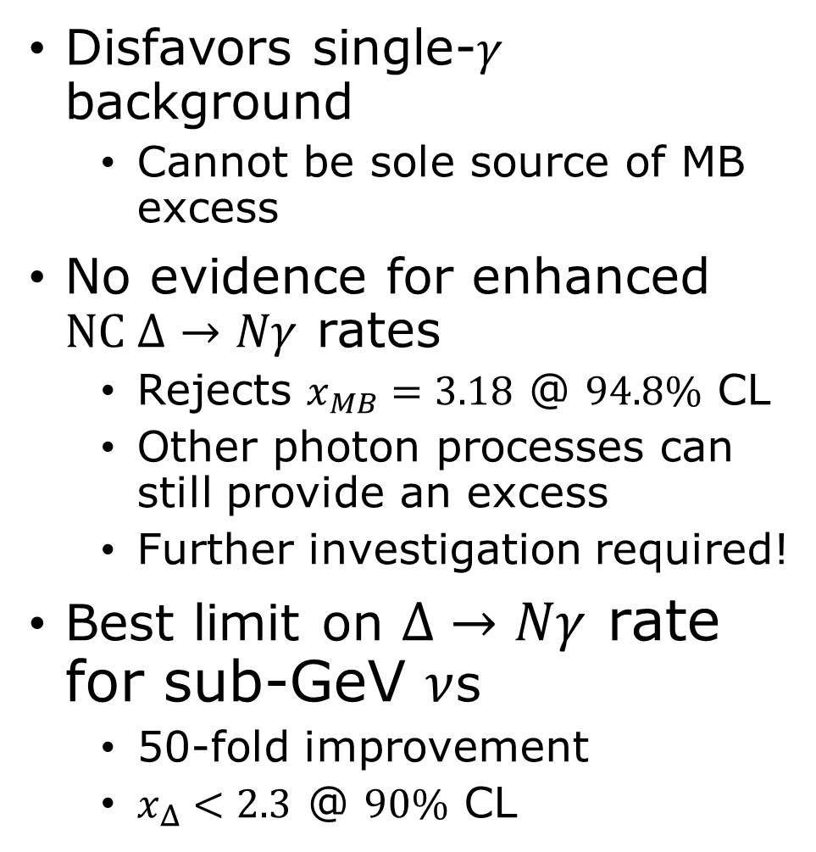
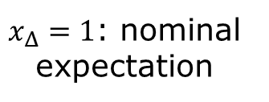
gLEE Search Results
Disfavors single-$γ$ background
  Cannot be sole source of MB excess
No evidence for enhanced
$NC Δ→Nγ$ rates
  Rejects $x_{MB}=3.18$ @ $94.8\%$ CL
  Other photon processes can still provide an excess
  Further investigation required!
Best limit on $Δ→Nγ$ rate for sub-GeV $ν$s
  50-fold improvement
  $x_{Δ}<2.3$ @ $90\%$ CL
$x_{Δ}=1$: nominal expectation
Phys. Rev. Lett. 128, 111801
Adapted from Hanyu Wei

Slide 15
What Type of Excess from MiniBooNE?
MiniBooNE view
Photon-like excess:
  Mismodeled/unknown processes?
    $NC Δ$ resonance: $Δ→Nγ$
      Single $γ$ LEE: gLEE
Electron-like excess:
  Oscillation-driven excess?
  Energy-dependent $ν_{e}$-enhancement
    $ν_{e}$ LEE: eLEE
    Derived from MiniBooNE empirically
Mismodeled/unknown processes?
  Collimated $e^{+}e^{−}$ states?
$$NC Δ→Nγ Signal$$
Low $p$ thresholds!
MicroBooNE view
MicroBooNE Simulation
MicroBooNE view
BNB Run: 8617, Subrun: 46, Event: 2328
MiniBooNE view
Low $p$ thresholds!
MicroBooNE Data
Neutrino oscillation results from LSND
Updated MiniBooNE neutrino oscillation results with increased data and new background studies
Adapted from Jay Hyun Jo and Mark Ross-Lonergan

Slide 16
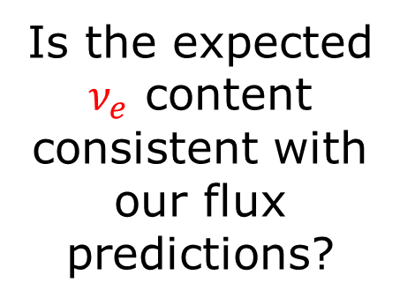
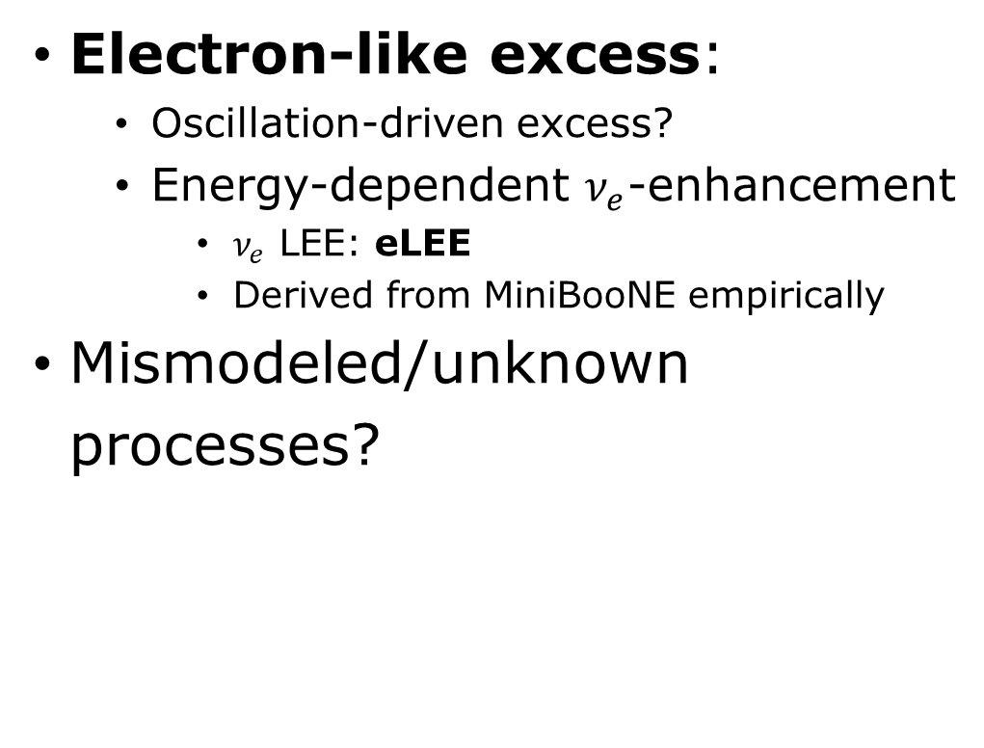
What Type of Excess from MiniBooNE?
Electron-like excess:
  Oscillation-driven excess?
  Energy-dependent $ν_{e}$-enhancement
    $ν_{e}$ LEE: eLEE
    Derived from MiniBooNE empirically
Mismodeled/unknown processes?
MiniBooNE view
BNB Run: 8617, Subrun: 46, Event: 2328
MicroBooNE Data
Is the expected $ν_{e}$ content consistent with our flux predictions?
Adapted from Jay Hyun Jo and Mark Ross-Lonergan

Slide 17
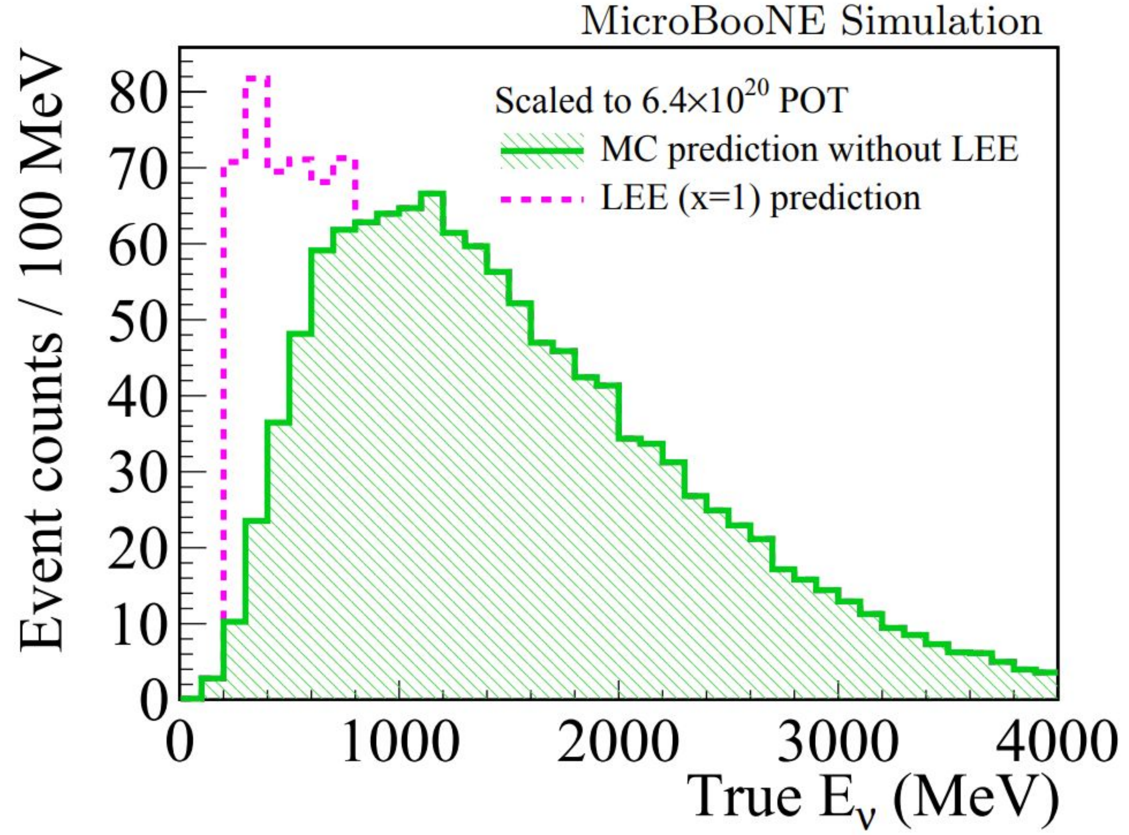







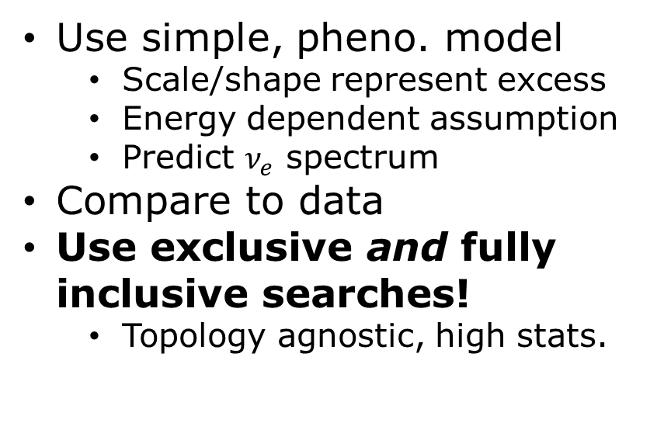





eLEE Searches
Phys. Rev. D 105, 112004 (2022)
$$p$$
$$p$$
Use simple, pheno. model
  Scale/shape represent excess
  Energy dependent assumption
  Predict $ν_{e}$ spectrum
Compare to data
Use exclusive and fully inclusive searches!
  Topology agnostic, high stats.
$$1eNp$$
Three independent searches!
$$1e0p$$
$e$ Shower
$e$ Shower
Vertex
Vertex
$$p$$
$$p$$
$$p$$
$$π^{±}$$
All the above…and many others…
$$1e1p$$
$e$ Shower
Vertex
Vertex
$e$ Shower
$$1eX$$
Phys. Rev. D 105, 112003 (2022)
Phys. Rev. D 105, 112005 (2022)
Adapted from Hanyu Wei and Mark Ross-Lonergan

Slide 18
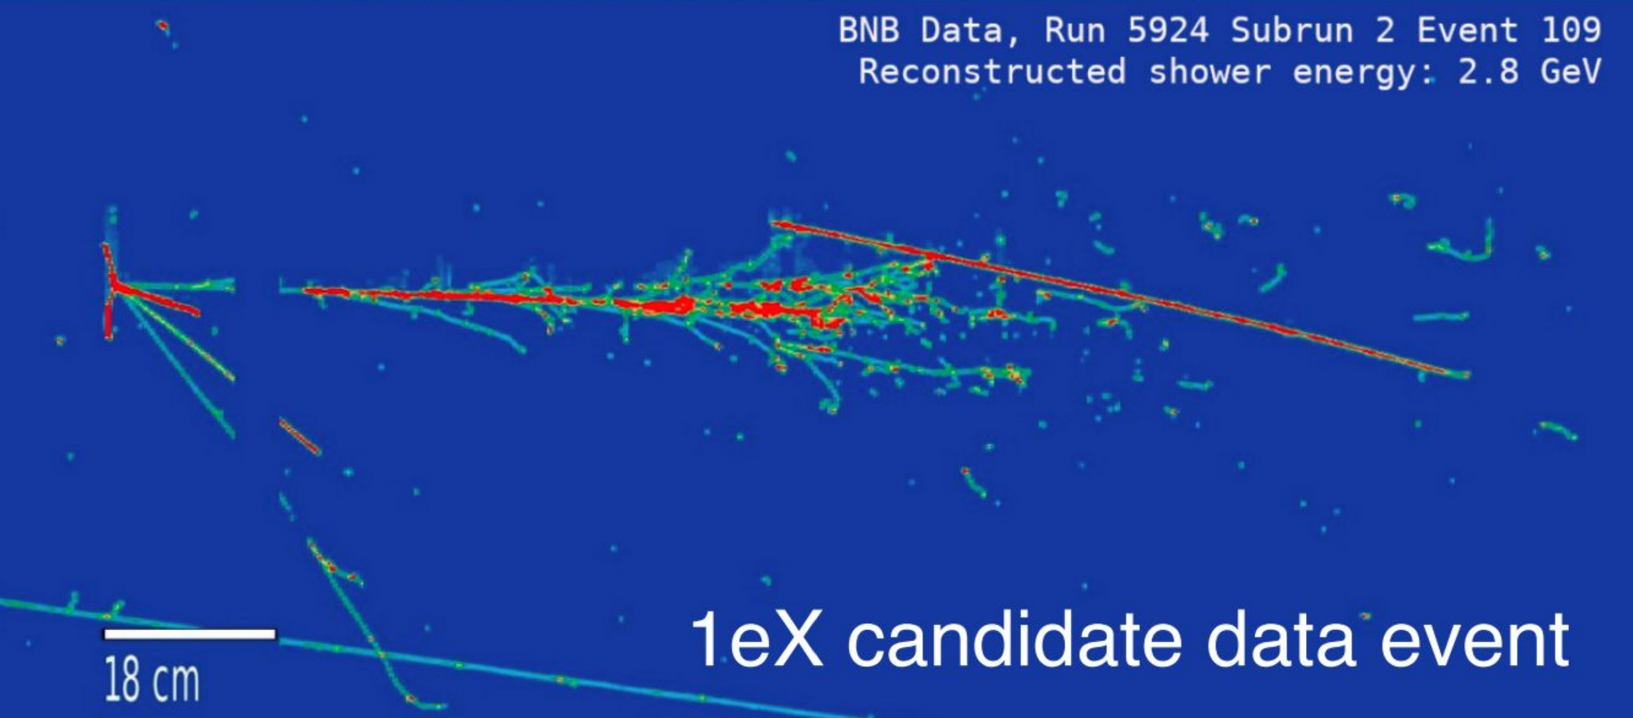


Adapted from Mark Ross-Lonergan

Slide 19










$ν_{e}$ Reconstructed Energy Spectra
Blind analysis
  Use topological characteristics
  Validate on codeveloped $ν_{μ}$ selection and sidebands
    Common flux parentage
    Common flux and cross section correlations
  Validate on
  kinematic
  sidebands
  Open the box!
$∼80\%$ purity
Up to $50\%$ efficient
$$1e1p0π$$
$$1eNp0π$$
Blinded region
Blinded region
$$1eX$$
Blinded region
$$1e0p0π$$
Blinded region
Adapted from Hanyu Wei

Slide 20





$ν_{e}$ Reconstructed Energy Spectra
Blind analysis
  Use topological characteristics
  Validate on codeveloped $ν_{μ}$ selection and sidebands
  Validate on
  kinematic
  sidebands
  Opened the box Summer 2021!
No observation of
$ν_{e}$ excess in low energy region
  $1e0p0π$ has low
  purity
$$1e1p0π$$
$$1eNp0π$$
$$1eX$$
$$1e0p0π$$
Phys. Rev. D 105, 112004 (2022)
Phys. Rev. D 105, 112003 (2022)
Phys. Rev. D 105, 112005 (2022)
Adapted from Hanyu Wei

Slide 21



eLEE Search Results
Adapted from Hanyu Wei
Phys. Rev. Lett. 128, 241801 (2022)
$ν_{e}$ candidate rates are statistically consistent with those predicted
Original median LEE model hypothesis:
  “$ν_{e}$ events are fully responsible for the median MiniBooNE LEE”
  Rejected at $>97\%$ CL
    This is $>3σ$ in the fully inclusive channel, not true for $1e0p0π$

Slide 22









What About $ν_{α}→ν_{s}$ Oscillations?
eLEE searches disfavor pure $ν_{e}$-like excess generating the MB anomaly
  Does not rule out steriles!
  Rules out certain sole solutions to the eLEE
$ν_{s}$ hypothesis can be tested in MicroBooNE:
  $ν_{α}→ν_{s}→ν_{e}$ appearance
  $ν_{α}→ν_{s}$ disappearance
    Degeneracy!
Utilize a full $3+1$ model w/simultaneous fit
  $θ_{ee}∝ν_{e}$ disappearance
  $θ_{μe}∝ν_{e}$ appearance
  $θ_{μμ}∝ν_{μ}$ disappearance
Does not originate from $ν_{e}$ solely?
$ν_{e}({\overline{ν}}_{e})$ disappearance
${\overline{ν}}_{e}$ appearance
Adapted from Hanyu Wei and Jay Hyun Jo

Slide 23





Reconstructed $E_{ν}$ Spectra
Adapted from Hanyu Wei
Fully Contained
Partially Contained
Simultaneous fit across many channels
Validated $E_{ν}$ reconstruction
  Hadronic energy, especially
Used frequentist-motivated CLs method
  Consistent w/$3ν$ hypothesis
    Only a $0.8σ$ discrepancy
  Made $95\%$ CL frequentist exclusion limits
7 Channels
MICROBOONE-NOTE-1116-PUB

Slide 24




$ν_{e}$ Disappearance Results
$6.369×{10}^{20} POT$ BNB
$1.917×{10}^{19} POT$ NuMI
Competitive limit on $eV$-scale $ν_{e}$ disappearance, first on ${}_{}^{40}{Ar}$
With $\sim 50\%$ BNB data (Run 1-3) and adding $\sim 20\%$ NuMI data…
  Expect increased sensitivities! (simplified computation method)
  $ν_{e}$ app.-disapp. degeneracy mitigation via fractionally higher intrinsic $ν_{e}$ content
Adapted from Hanyu Wei and Jay Hyun Jo

Slide 25





$ν_{e}$ Appearance Results
$ν_{e}$ appearance-only; reasonable approximation due to low statistics on intrinsic ${\overline{ν}}_{e}$
$6.369×{10}^{20} POT$ BNB
$1.917×{10}^{19} POT$ NuMI
Part of LSND allowed region excluded at $95\%$ CL
  Does not include best fit point
Sensitivity expected to improve when combining BNB and NuMI
LSND: Phys. Rev. D 64, 112007
Adapted from Hanyu Wei and Jay Hyun Jo

Slide 26




$ν_{μ}→ν_{s}$ Disappearance Results
Feldman-Cousins allowed region
Utilizes deep-learning methods for CCQE-dominated $1μ1p$ selection
BNB data found to be consistent with $3ν$ null hypothesis
MICROBOONE-NOTE-1106-PUB
Adapted from Hanyu Wei

Slide 27

Excesses via Other Final States?
Incredibly Rich Phenomenologies Remain Possible
Half of our data left to analyze!
Many more topics to explore!
MicroBooNE Public Notes
MicroBooNE Documents and Publications

Slide 28

Summary
MicroBooNE’s first LEE searches have found:
  No evidence for excessive $ν_{e}$ production
    Disfavors pure $ν_{e}$ excess as sole source of anomaly at $3σ$
  No evidence for excessive $NC Δ→Nγ$ production
    Disfavors pure $Δ$ excess as sole source of anomaly at $\sim 2σ$
Full $3+1$ oscillation analyses seek out the sterile neutrino
  Runs 1-3 ($50\%$ of total dataset) are consistent with $3ν$ hypothesis
    Our statistics are soon to grow by a factor of 2!
  Utilizing both BNB and NuMI datasets show great sensitivity promise
MiniBooNE anomaly still stands, with diminishing parameter space
Many searches on the way!
  Expanded scope of sterile oscillation searches
    Utilize deep learning methods for combined $ν_{e}/ν_{μ}$ selections
  Exotic $e^{+}e^{−}$ pair production searches
  Many other BSM particles and processes coming soon!
Adapted from Hanyu Wei

Slide 29






Micro Booster Neutrino Experiment
May 5, 2022 @ Rutgers
Adapted from Hanyu Wei

Slide 30


Neutrino Properties and Types
No strong interactions
Neutral
Only weak interaction
  Affect the $Z^{0}$ decay
    $Z^{0}→invisibles$
  Studied extensively at Large Electron-Positron Collider, Standard Linear Collider
Measurements consistent with three active neutrinos
  As predicted by the SM
  $m_{ν}=0$ was expected…
Says nothing of “sterile” (non-EW-interacting) types
Precision electroweak measurements on the Z resonance
Adapted from P. Machado and M. Ross-Lonergan

Slide 31








Neutrino Oscillations
Super-Kamiokande
Homestake Detector
$$ν_{e}+{}_{}^{37}{Cl}→{}_{}^{37}{Ar}+e^{−}$$
2002 Nobel Prize in Physics
2015 Nobel Prize in Physics
Sudbury Neutrino Observatory

Slide 32




$$P_{ν_{α}→ν_{β}}\left(E_{ν, true},L\right)≈\sin^{2}\left(2θ\right)\sin^{2}\left(\frac{Δm^{2}L}{4E_{ν, true}}\right)$$
$$ν_{e}$$
$$ν_{μ}$$
$$ν_{τ}$$
Wiki

Slide 33




What Type of Excess from MiniBooNE?
MiniBooNE view
$$NC Δ→Nγ Signal$$
Photon-like excess:
  Mismodeled/unknown processes?
    $NC Δ$ resonance: $Δ→Nγ$
      Single $γ$ LEE: gLEE
MicroBooNE view
MicroBooNE Simulation
Scale expected
$NC Δ→Nγ$ rate
by $x_{MB}=3.18$
Updated MiniBooNE neutrino oscillation results with increased data and new background studies
Adapted from Jay Hyun Jo and Mark Ross-Lonergan

