Slide 1
Status and Prospects with the Facility for Rare Isotope Beams
Brad Sherrill
FRIB Scientific Director

Slide 2
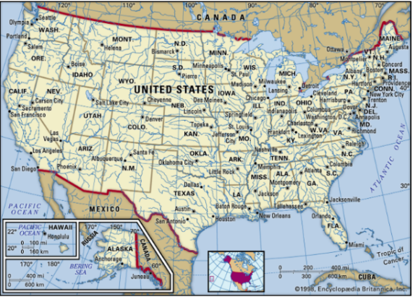
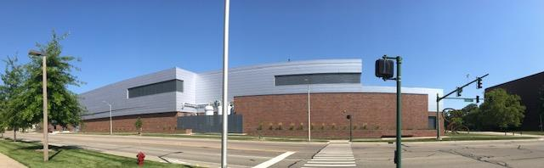
Facility for Rare Isotope Beams
FRIB is a US DOE Office of Science scientific user facility (one of 28) intended to provide beams of rare isotopes
FRIB started in 2008 and reached the last project milestone in January 2022, five months ahead of schedule and on budget
Experiments began in May 2022. The first (three) experiments have all completed successfully
FRIB is open to researchers from around the world based on scientific merit – Program committee approximately once per year

Slide 3
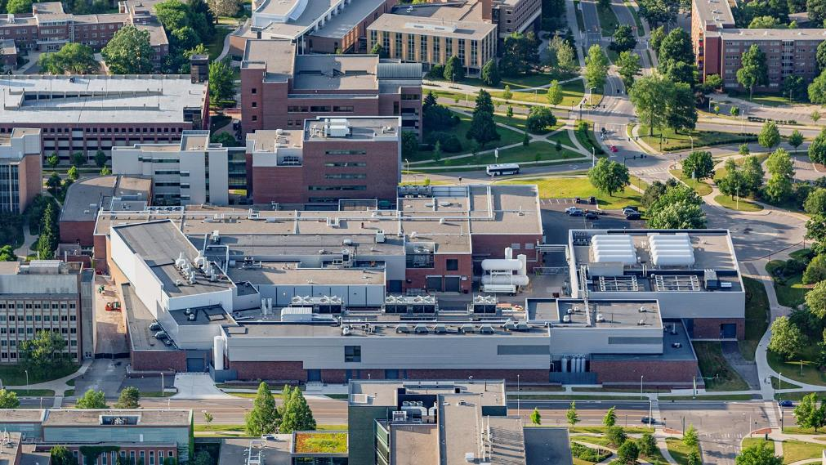
FRIB Is Located on the Campus of Michigan State University

Slide 4
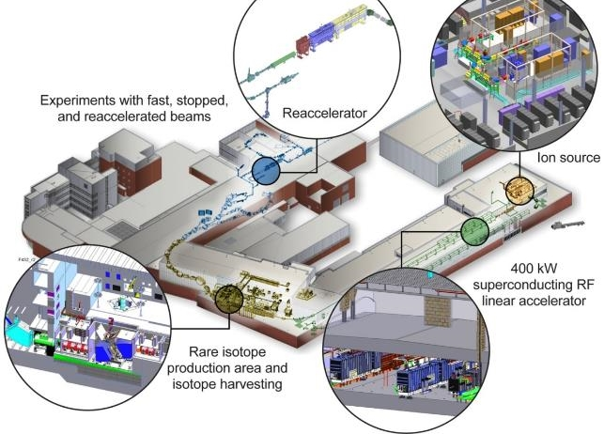
Key FRIB Features that Enable Discovery
FRIB’s key feature is 400 kW beam power
  8 p𝜇A or 5 x 10¹³ ²³⁸U /s
  42 p𝜇A or 2.6 x 10¹⁴ ⁴⁸Ca /s
Experiments with fast (200 MeV/u), stopped (trapped), and reaccelerated beams (0.6 to 10 MeV/u)
Separation of isotopes
in-flight provides
  Fast development time for any isotope
  Beams of all elements and short half-lives
Isotope harvesting capability from beam dump water)
Thomas Glasmacher, FRIB Laboratory Director

Slide 5




FRIB Enables Scientists to Make Discoveries in Four Areas
Properties of atomic nuclei
Develop a predictive model of nuclei and their interactions
Explore Many-body quantum physics: intellectual overlap to open quantum systems, mesoscopic science, quantum dots, etc.
H Crawford – next talk
Astrophysics: Role of nuclei and nuclear reactions in the Universe
Understand origin of the elements in the cosmos
Model Explosive environments: Novae, supernovae, X-ray bursts…
Infer properties of neutron stars, neutron-matter equation of state neutron-star mergers observations
Tests of laws of nature
Search for symmetry violations radioactive decay
Effects of symmetry violations are amplified in certain nuclei (1,000,000 enhancement for EDM Search)
Societal applications and benefits
  Medicine, energy, material sciences, national security
N Vassh, F Sprouse, C Drischler–Thur
B Tsang - Sat
J Singh - Wed
R Garcia-Ruiz – 3rd talk

Slide 6
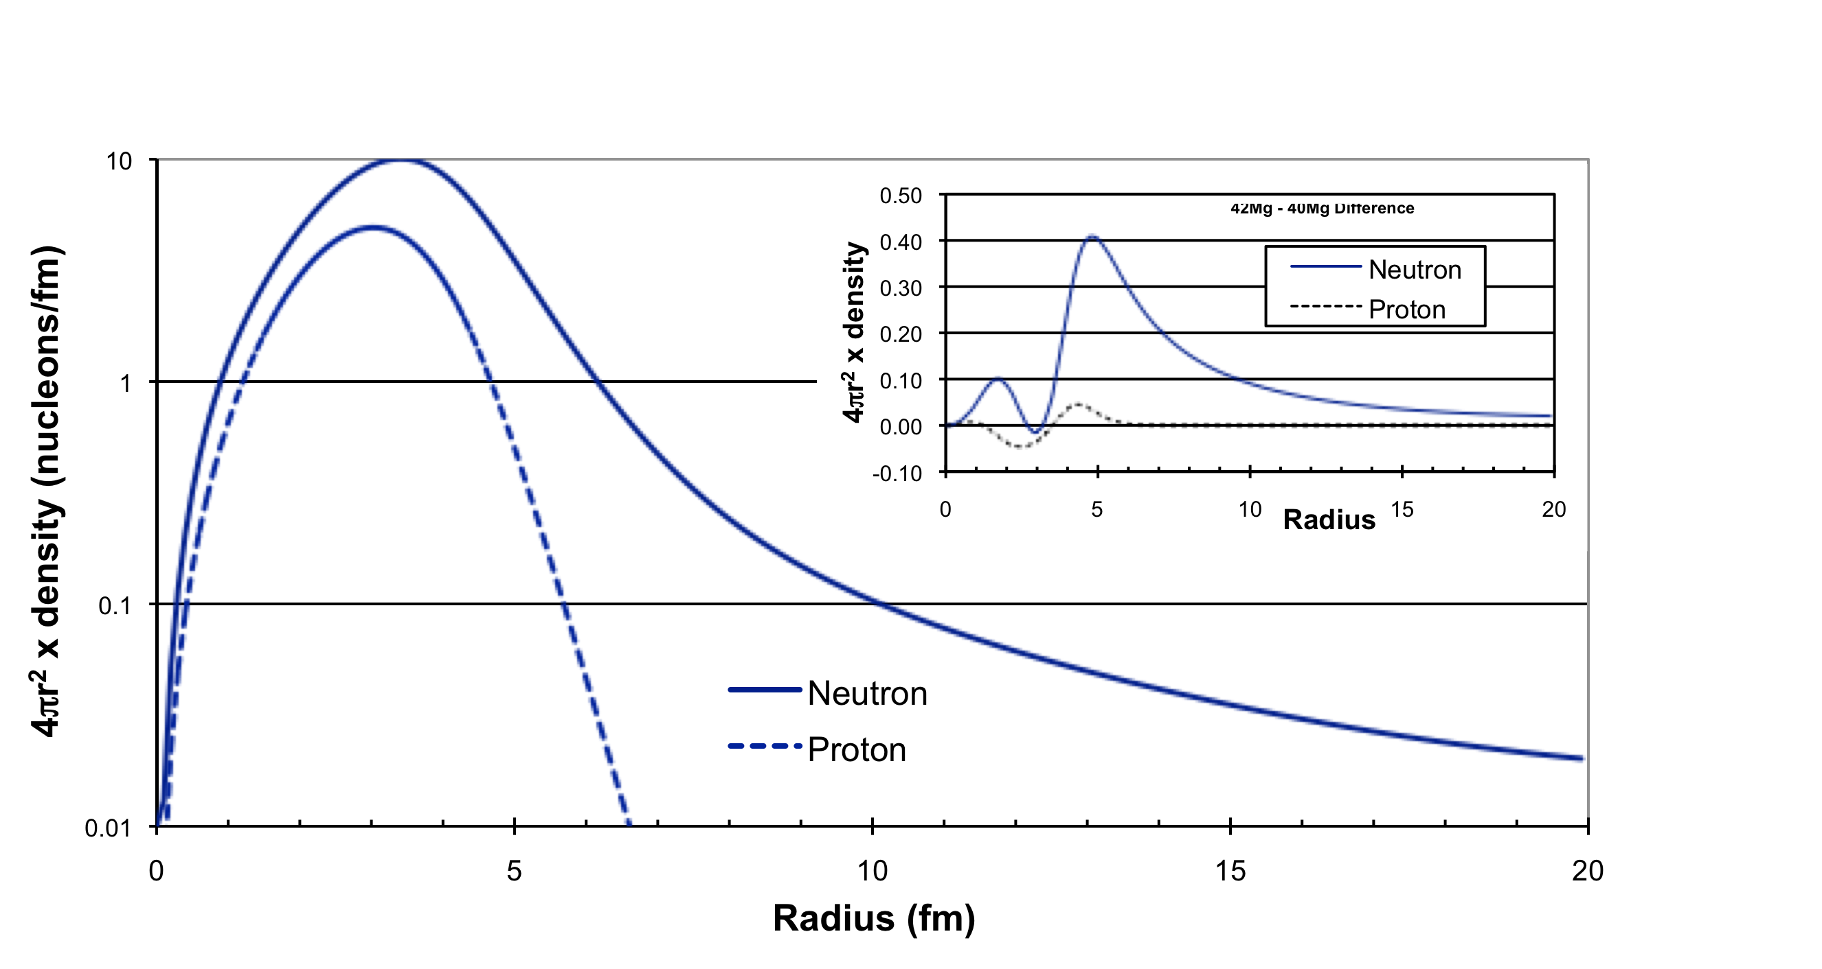
Example: New Insight and Physics from Extreme Halos and Skins: Open Quantum Systems
Example: ⁴²Mg (predicted to be produced at 10 atoms/day)
Theory - 100 keV S_{n} BA Brown
T
⁴²Mg – ⁴⁰Mg Difference
See talks by L Sobotka experiment - today, C Hebborn theory - Wed
Notes:
Very extreme isotopes can be studied at FRIB with unique features.

Slide 7
FRIB has a Focus on DEI, Training, and Public Engagement
Nearly 200 PhD students involved in FRIB research
Equal number of undergraduate students
Programs to involve underrepresented groups ranging from High School to Faculty
Accelerator Physics Training program with national laboratories (26 students), Cryogenic initiative program (5 students)
More than 10,000 public contacts each year, plus 100,000 at science museums, art programs, etc.
Physicists Inspiring the Next Generation
Campus Research + Professional Physics Societies Meetings
Undergraduate, Thesis Research
MSU/FRIB-Minority Serving Institution (MSI) Bridge
Two-Day Visit
Interest to MSU/FRIB
PING/NSF
Pegasus/NSF
INSIGHT/DOE
Fellowships/NSF

Slide 8
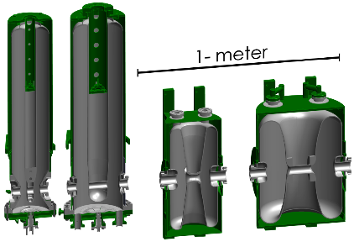
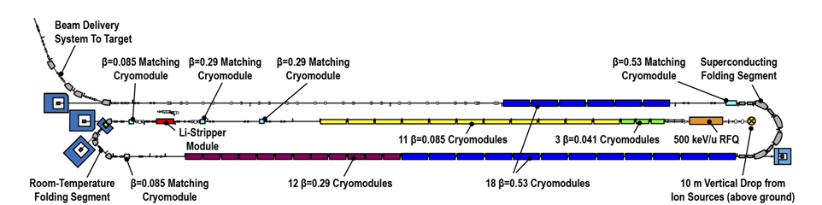
FRIB Superconducting LINAC
J. Wei (head of FRIB Accelerator Division), P. Ostroumov, et al.
4 Types of accelerating cavities arranged in 46 cryomodules (324 total cavities)
Liquid lithium stripping
Space for an energy upgrade to 400 MeV/u
Simultaneous 5 charge state acceleration
Beam can be developed in 12 hours
β = 0.08
β=0.53
β=0.04
β = 0.29

Slide 9
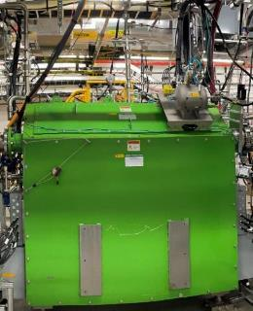
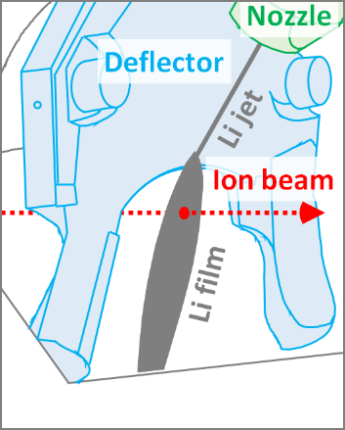
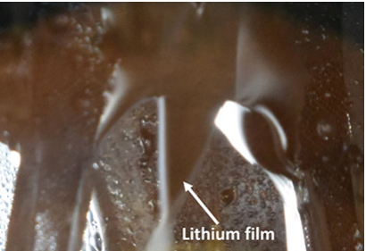
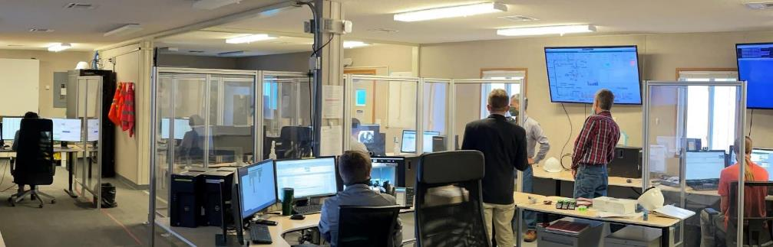
Liquid Lithium Charge Stripper is Operational
P. N. Ostroumov, et al., Phys. Rev. Lett. 126, 114801
Needed to achieve design-goal beam energies beyond 200 MeV/u and beam power up to 400 kilowatts (kW)
Conventional charge stripping foil can only last seconds under FRIB beam power
Liquid lithium charge stripper installed in FRIB tunnel
Xe²⁶⁺ charge state after stripping
On 17:22 8 April 2021 a ¹²⁴Xe²⁶⁺ beam was accelerated to 17 MeV/u and stripped

Slide 10
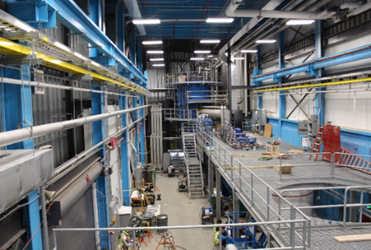
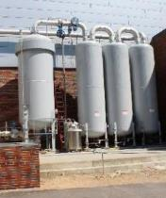
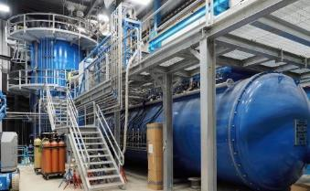
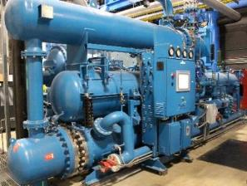
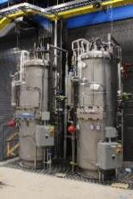
FRIB Built and is Operating One of Nation’s
Largest Helium Liquefaction Plant
FRIB built and runs its own helium cryogenic plant that operates at 2 K and 4.5 K
Equivalent 4.5 K capacity of 18 kW
Integrated design of the cryogenic refrigeration, distribution, and cryomodule systems allows energy-efficient operations
Operates on the Ganni Floating-Pressure Process Cycle that automatically optimizes the operation of the system
  Can stably regulate its capacity down to 30 percent of its maximum capacity
F. Casagrande, R. Ganni, P. Knudsen

Slide 11
Rare Isotope Production Techniques – Advantages for Each
Target spallation by light ions (TRIUMF ISAC/CERN ISOLDE)
Neutron induced fission (2-step target) (SPIRAL2/ARIEL/ANL ATLAS)
In-flight Separation following projectile breakup (FAIR,RIKEN,FRIB)
Target/Ion Source
Post Acceleration
beam
Accelerator
target
Neutrons/Photons
Accelerator
Post Acceleration
See M Carpenter - today
Accelerator
beam
Beam
Beams used without stopping
Fragment Separator
target
Post Acceleration
Gas catcher/ solid catcher + ion source
Notes:
Note how FRIB is unique in the world; in-flight separation and gas stopping with reacceleration.

Slide 12

Rare Isotope Beam Formation
Cartoon of the isotope production process – projectile fragmentation or fission (Coulomb breakup, transfer, …)
¹²²Zr production cross section (from ¹³⁶Xe) is estimated to be 2x10⁻¹⁸ b (2 attobarns, 2x10⁻⁴⁶ m² )
With a ¹³⁶Xe beam of 8x10¹³ ion/s (400 kW at 200 MeV/u) a few atoms per week can be made and studied
FRIB may be able to make 80% of all possible nuclides for elements up to Uranium
Discovery of isotopes: Michael Thoennessen Discovery of Nuclides Project https://people.nscl.msu.edu/~thoennes/isotopes/
projectile
target

Slide 13
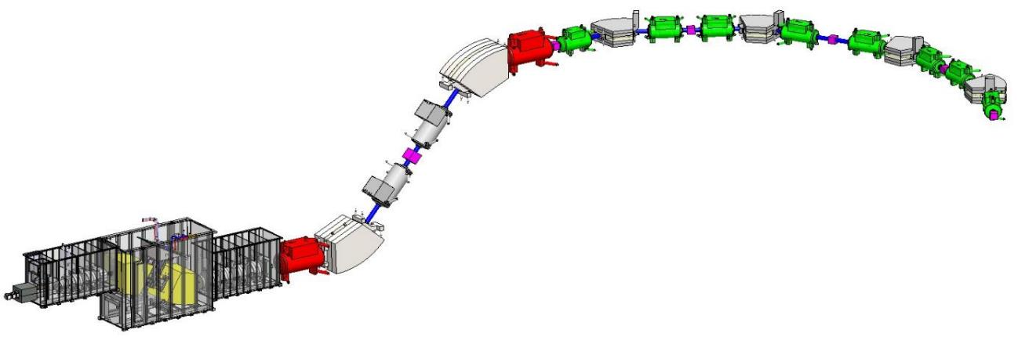
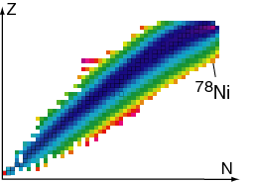
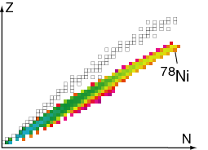
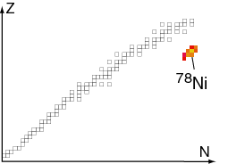
In-Flight Fragment Separation is Efficient and Selective
FRIB Advanced Rare Isotope Separator, ARIS
Three-stage separation approximately 90 m long
Two additional stages of separation for cleanup
Hausmann et al., NIM B317 (2013)
Target – carbon disk
10m
“Wedge”
Fragments after target
Fragments after wedge
Fragments at focal plane
Example:
⁷⁸Ni from ⁸⁶Kr at 200 MeV/u
90% efficient collection
D.J. Morrissey, B.M. Sherrill, Philos. Trans. R. Soc. Lond. Ser. A. Math. Phys. Eng. Sci. 356 (1998) 1985

Slide 14
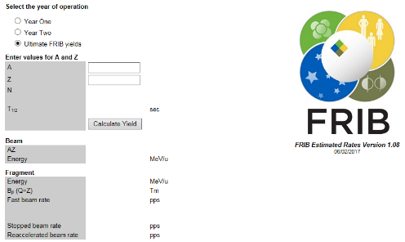
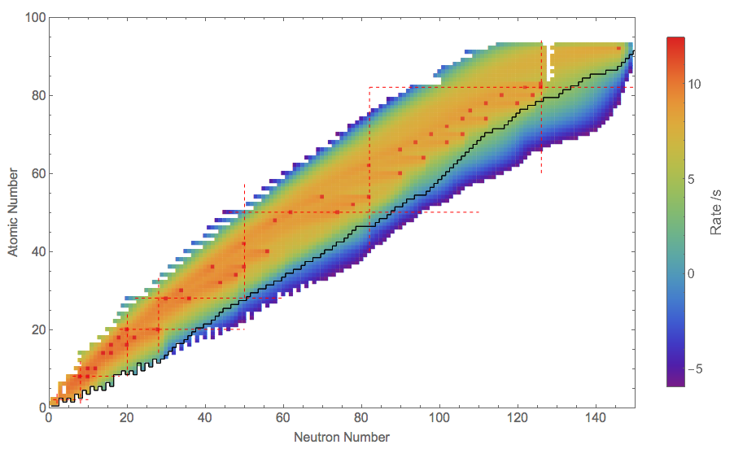
FRIB Estimated Beam Rates
https://groups.nscl.msu.edu/frib/rates/fribrates.html
Log
O. Tarasov, et al.
EPAX 2.15

Slide 15
Towards A Predictive Model of Atomic Nuclei and Their Reactions
Goal: Model and accurately describe nuclei and their reactions. The ability to calculate reactions like ⁷Be(p,γ) (responsible for Solar neutrinos) from first principles would be transformational. See talk by C Brune BBN
A Roadmap (see overview in Modern Physics Letters A 29(11)):
Step 1: Use ab initio theory and study of exotic nuclei to determine the interactions of nucleons in light nuclei and connect these to QCD by comparison to lattice calculations of NN and NNN forces. Exotic nuclei provide the best tests of how well these approaches work. See L Sobotka – today, M Piaulli - Wed
Step 2: For mid-mass nuclei use configuration space models (no-core shell model, EFT, …). Use RGM to regularize potentials. The degrees of freedom and interactions are tested using exotic nuclei. See E Epelbaum, H Hergert – Wed
Step 3: Use density functional theory to connect to heavy nuclei. Exotic nuclei help determine the form and parameters of the DFT.

Slide 16
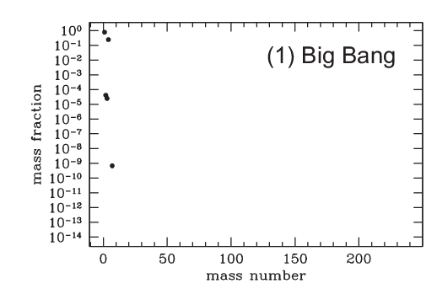
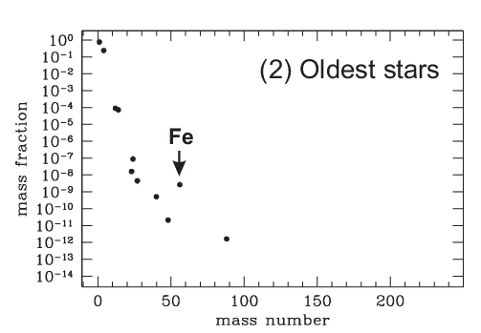
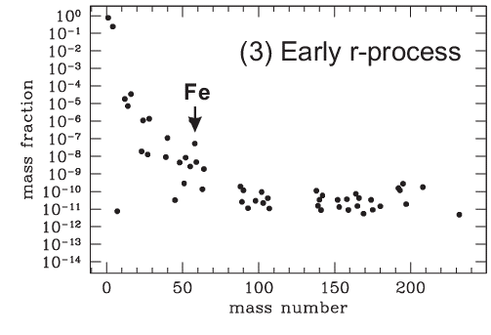
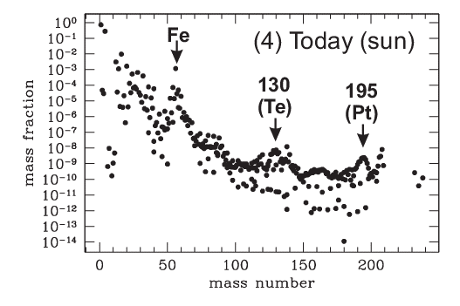
Evolution of Elemental Abundances
Adopted from: M. Weischer NDU
R Ezziddine - Thurs
Data from sky surveys and high resolution spectra and meteoritic composition

Slide 17
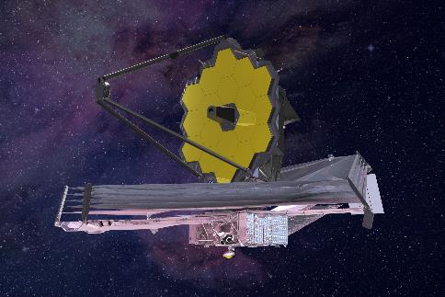
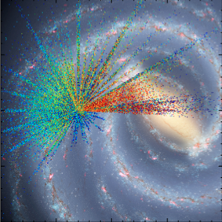
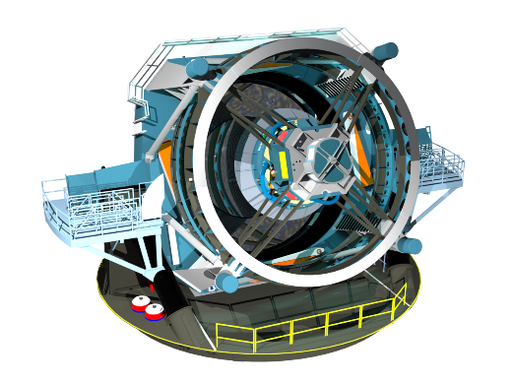
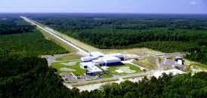
Elemental Abundances and Environments: Satellites, Surveys, Multimessenger Data, …
Gamma-ray observatories (e.g. Fermi), X-ray (e.g. CHANDRA, RTXE, NICER)
Large mirrors enable high resolution spectroscopic studies in a short time (Subaru, JWST, Hubble, LBT, Keck, …)
Optical surveys provide large data sets with detailed elemental abundances and transient phenomena (for examples, SDSS-V, Herschel, LAMOST, SkyMapper, WEAVE, 4MOST,Rubin Observatory, …)
Gravitational wave observations (LIGO, Virgo)
Meteoritic compositions
Hubble
Space
JWST
SUBAR
SDSS APOGEE stars
Vera C. Rubin
LIGO

Slide 18
Nuclear Processes To Be Modeled: Part of a Broader Effort to Interpret Observations
Big Bang Nucleosynthesis
pp-chain
CNO cycle
triple alpha
Helium, C, O, Ne, Si burning
s-process; i,r, weak r -process
rp-process
νp – process
p – process
α - process
fission recycling
Cosmic ray spallation
pyconuclear fusion
nuclear EOS
fission
Sample reaction paths
(α,γ)
(p,γ)
β⁻
(α,p)
(n,2n)
^{A}Z
(n,γ)
β⁺ , (n,p)
(γ,p)

Slide 19
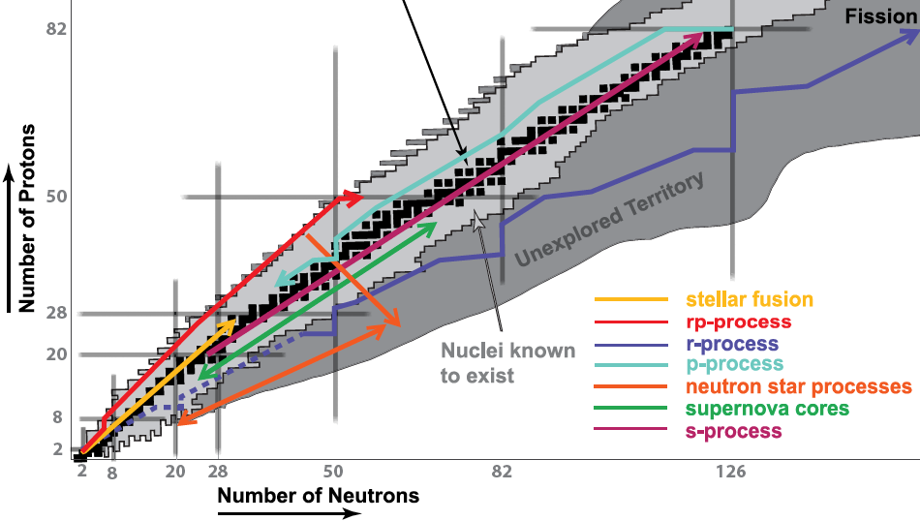
FRIB Addresses Key Questions
Related to the Origin of the Heavy Elements
What are the individual contributions
of the “zoo” of potential processes
synthesizing elements in the Ge – Cd range?
Main r-process
B Meyer isomers – Tues
S Pain
p-process
s-process
i-process
νp-process
Main r-process
What heavy elements do
neutron star mergers create?
Are there other r-process sites?
Weak r- process
T Sprouse - Thurs
Nuclear Astro in 2020s: 2205.07996.pdf (arxiv.org)

Slide 20
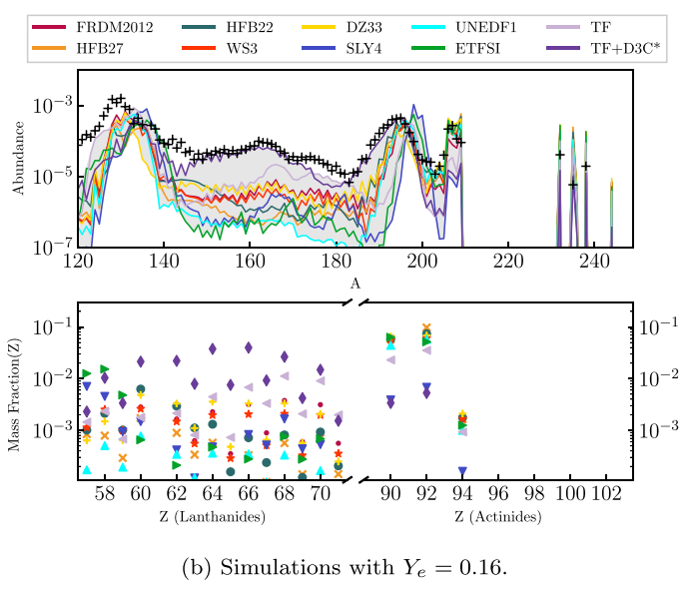
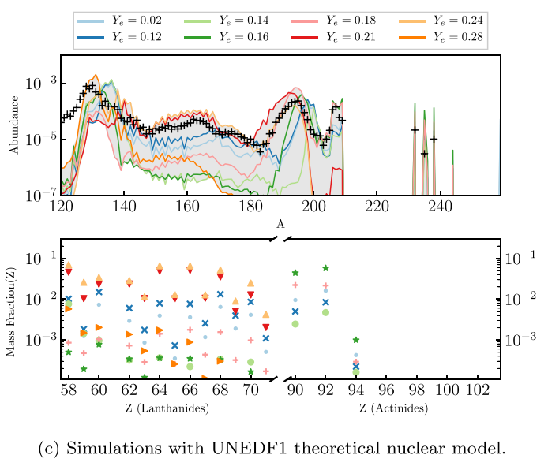
r-process Dependence on Model Inputs
YL Zhu et al., Ap J 906:94 (2021)
Neutron-star mergers may be the main source of gold in the universe, but we are not sure
There are nuclear, fundamental interaction, astrophysical model uncertainties to be addressed
Y_{e} – electron fraction
See talk of N Vassh

Slide 21

FRIB Reaches Critical Rare Isotopes for the i,r-Process(es)
FRIB reach for beta-Oslo method
R-process key region
(decays, FDSi)
T₁₂ theory predictions
for kilonova actinides
FRIB reach for new half-life 10 kW
FRIB reach for new half-life 400 kW
R-process key region
(n-capture, FDSi/SuN)
Defined in sensitivity studies
72
R-process key region
(n-capture, FDSi/SuN)
Defined in sensitivity studies
126
R-process key region
(decays, masses – FDSi
LEBIT, S800) +FRIB400
First data points to
understand A=195
abundance peak
and actinide production
R-process key region
(⍺,n-reactions, SECAR+LENDA,
HABANERO, MUSIC)
Key reactions for weak r-process
82
R-process key region
(masses – LEBIT, S800, HRS)
Rare earth peak diagnostics –
masses probe outflow dynamics
R-process key region
(decays - FDSi)
Progenitors of Nd-Dy region
Eu: normalization point for observations
Tb: potential kilonova signature
See talks by Z Xu, K Jones - today
H. Schatz

Slide 22
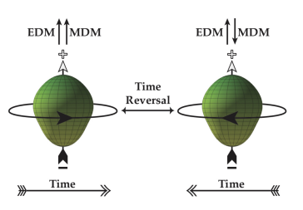
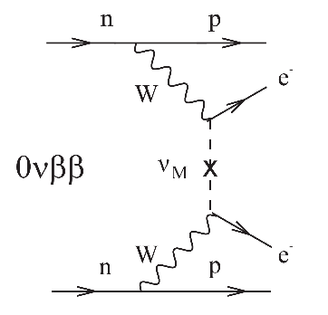
Tests of Nature’s Fundamental Symmetries
J Singh – Wed
D DeMille – today
R Garcia-Ruiz – 3rd talk
Angular correlations in β-decay and search for scalar currents
  Mass scale for new particle comparable with LHC
  ⁶He and ¹⁸Ne at 10¹²/s
Electric Dipole Moments
  ²²⁵Ac, ²²³Rn, ²²⁹Pa (30,000x more sensitive than ¹⁹⁹Hg; ²²⁹Pa > 10¹⁰/s)
Parity Non-Conservation in atoms
  Weak charge in the nucleus (francium isotopes; 10⁹/s)
  Anapole moment
Unitarity of CKM matrix
  V_{ud} by super allowed Fermi decay
  Probe the validity of nuclear corrections
Theory to guide and interpret measurements
e
γ
²¹²Fr
Z

Slide 23
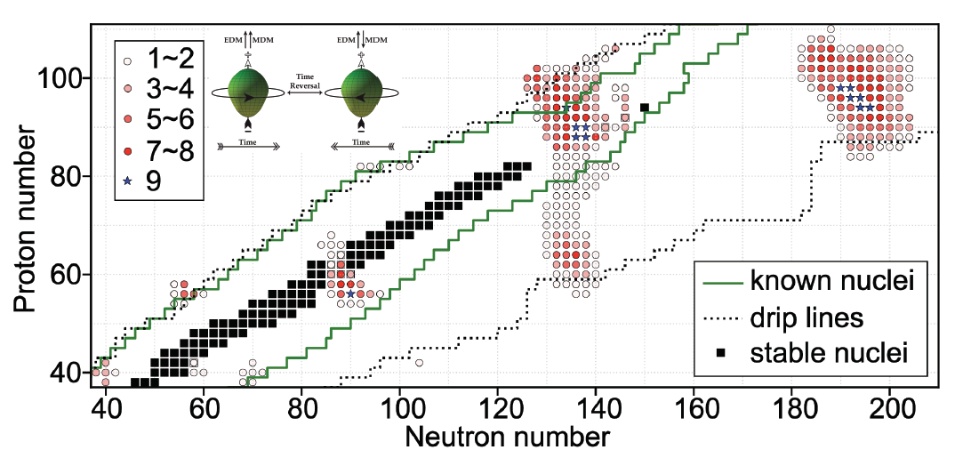
EDM Candidates
See talk of R Garcia-Ruiz
Under time-reversal transformations, the magnetic dipole
Octupole shape enhances the chance to see an EDM by 10³ to 10⁶
moment (MDM) changes sign while the electric dipole moment (EDM) does not
Y Cao et al. Phys. Rev. C, 102:024311, Aug 2020.
J Singh et al.

Slide 24
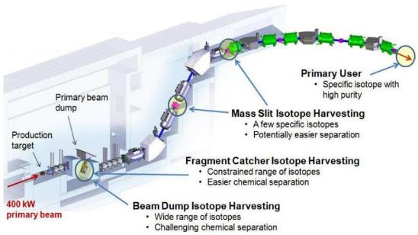
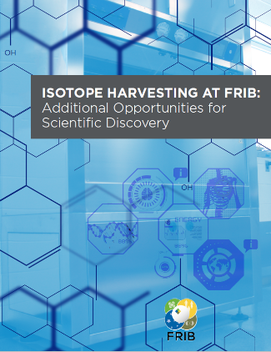
Isotope Harvesting at FRIB
Funded by DOE Isotope Program
Many rare isotopes are produced but only one isotope delivered to single user
  Often 1000 other isotopes are produced that could be harvested and used for experiments or applications
Isotope harvesting done during routine operation fro FRIB’s nuclear physics mission—without interfering with FRIB’s primary users
Medical tracers (⁵²Fe/^{52m}Mn), theranostics (Cu,Sc), biological catalysts, micro batteries, homeland security, fundamental symmetries tests
Isotope harvesting whitepaper published
  J. Phys. G: Nucl. Part. Phys. 46(2019) 100501
FRIB had provisions for isotope harvesting incorporated in the design
  Hot cells ordered with support from DOE Isotope Program and laboratory being prepared in MSU-provided building
  Implementing commensal isotope harvesting capabilities from FRIB beam dump water
  Operational in 2023
Contributors: MSU, LLNL, LANL, ANL, Missouri, Alabama, ND, ORNL, BNL, Iowa
Abel et al 2019 J. Phys. G: Nucl. Part. Phys. 46 100501

Slide 25
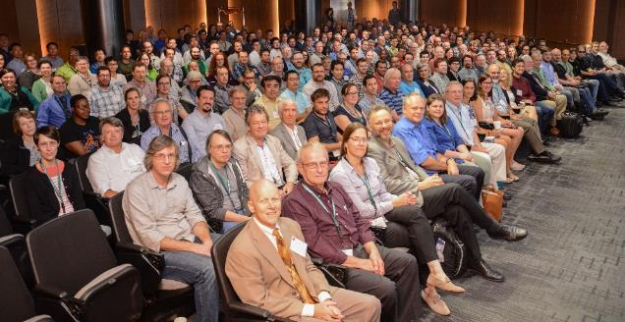

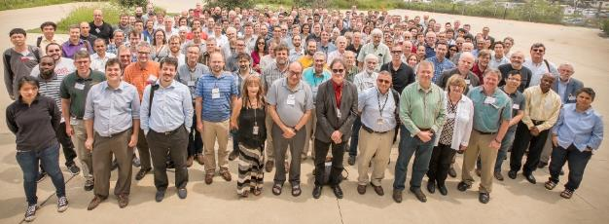
1,600 Users Engaged and Ready for Science fribusers.org
Users organized as part of independent FRIB Users Organization (FRIBUO)
  Chartered organization with an elected executive committee
  1,588 members (125 U.S. colleges and universities, 13 national laboratories, 52 countries) as of 25 August 2022
  21 working groups on instruments
Users are engaged in science
  February 2021: 82 proposals received representing 597 scientists
  August 2021: FRIB Program Advisory Committee (PAC1)
  May 2022: First user experiments
User needs and high user satisfaction are important to FRIB
  ISO 9001 quality systems to assess user satisfaction
Annual meetings
  User meeting (three days with 250-500 participants)
» August 2021: Virtual, jointly hosted by ANL and FRIB
» August 2022: Hosted at ANL
» TBD

Slide 26
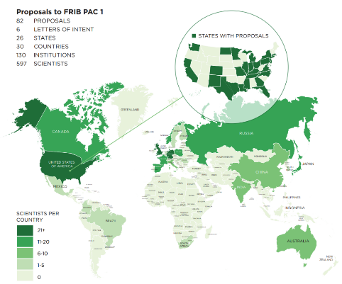
PAC-1 Recommended Experiments Deliver Balanced, Exciting Science Program
February 2021: Strong response to first FRIB call for proposals
  82 proposals and 6 letters of intent received
  9,784 science hours requested (12,412 hours facility use)
  30 countries
  130 institutions
August 2021: FRIB Program Advisory
Committee (PAC1) reviews, ranks proposals
PAC-recommended experiments represent
  34 out of 82 experiments proposed
  4,122 hours out of 12,412 facility-use hours
  25 out of 30 countries
  88 institutions
  15 of 17 National Academies benchmarks for FRIB
May 2022: First user experiments
  May-July: Three user experiments concluded successfully
  Paper on first experiment submitted to PRL
October 2022: Second Call for Proposals (PAC2 meeting in March, 2023)

Slide 27
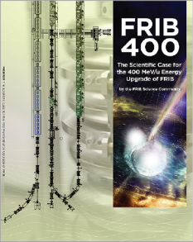
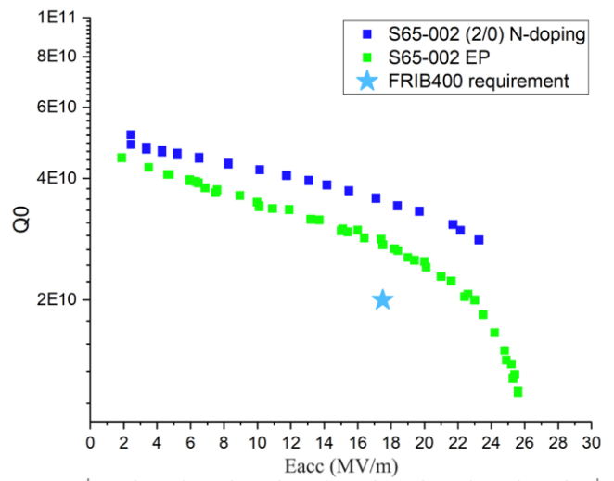
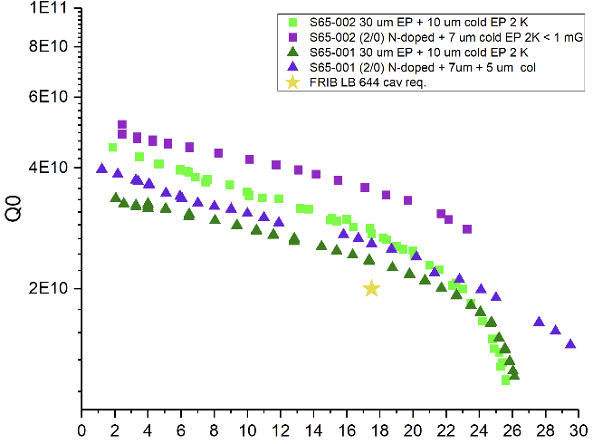
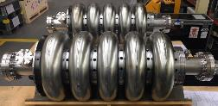
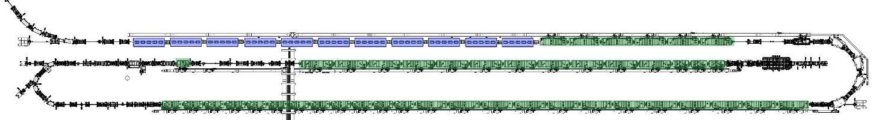
FRIB Energy Upgrade to 400 MeV/nucleon
Science Case Made, Technology Being Demonstrated
Community made science case
  Access to key regions needed to model nucleosynthesis in neutron-star mergers
  Luminosity gain over 50 for rarest isotopes
  Energy well-matched to exploring nuclear equation of state for neutron-star merger
  Energy better matched for knockout and charge-exchange reactions
FRIB400 SRF Cavity R&D Progress
FRIB400 Design goal
FRIB400 White Paper
LINAC Upgrade
  Add 11 cryomodules, each with five β=0.65 elliptical cavities operating at 644 MHz
Demonstrated that the design goal can be met with standard ILC EP. Pursuing R&D on advanced surface treatment such as nitrogen doping (see right)
P Ostromouv et al.
FRIB Linac Layout with Upgrade Cryomodules

Slide 28
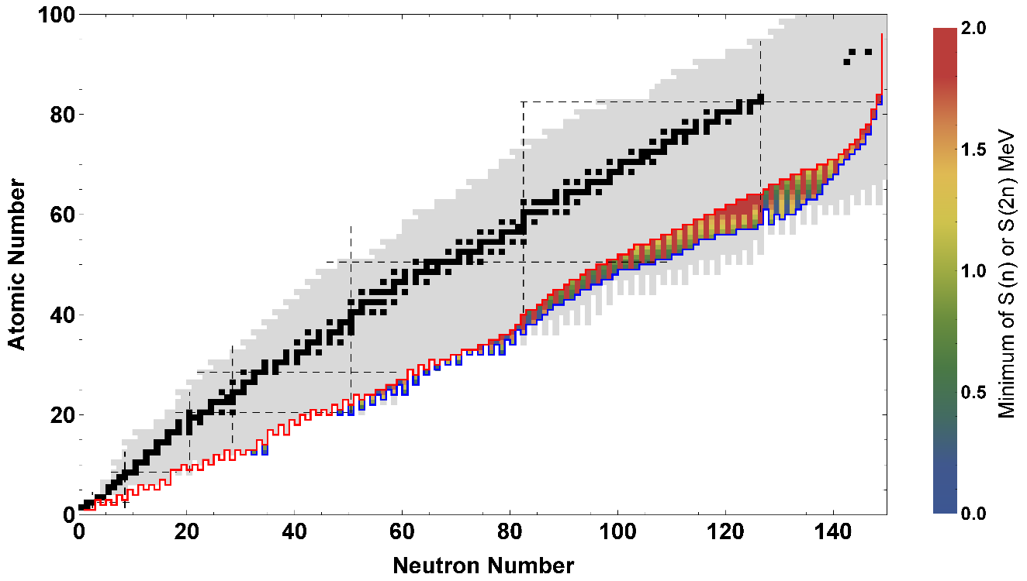
FRIB400 Scientific Reach Extended
Drip line extended to Z ≈ 60
Blue – FRIB400 reach
Red – FRIB200 reach

Slide 29
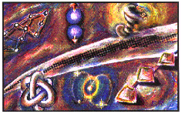
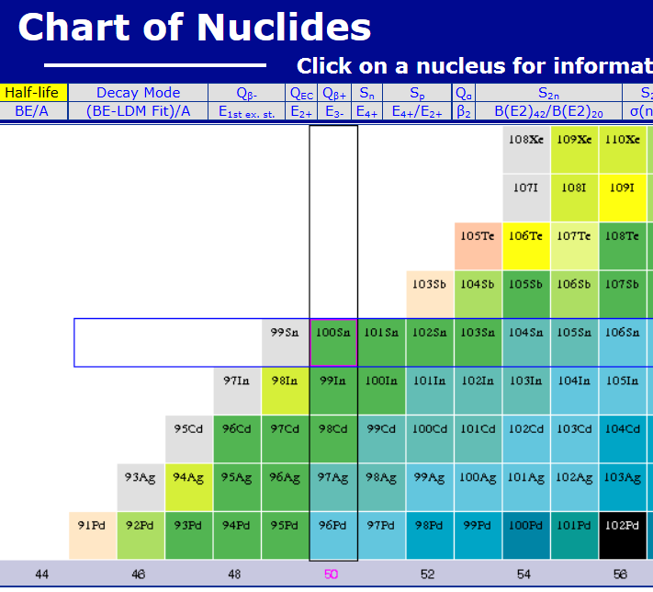
Remarkable Progress in Making Rare Isotopes – Grail Nuclide ¹⁰⁰Sn
1985 - my postdoc supervisor said “¹⁰⁰Sn will never be observed”
1994 - Observed by Schneider et al., Z. Phy. using the FRS at GSI and Lewitowicz et al., PLB at GANIL using LISE3
2008 14 decays observed, Bazin et al., PRL 101
2019 - 3000 ¹⁰⁰Sn produced at RIKEN for a detailed study D. Lubos et al. Phys. Rev. Lett. 122, 222502
Est 2023 - FRIB predicted ¹⁰⁰Sn separated beam rate of 1/s (see FRIB Rates online)
Hoped 203? – FRIB400 predicted rate of 200/s separated ¹⁰⁰Sn
http://www.nndc.bnl.gov/chart/

Slide 30







FRIB Completed with National Laboratories and International Partners
ANL
  Liquid lithium charge stripper (DONE)
  Beam dynamics verification (DONE); β=0.29 HWR
  processing and testing (DONE); SRF tuner validation (DONE);
  beam dump (DONE); SRF components development (DONE)
  RF couplers for multi-gap buncher (DONE)
  SOLARIS
BNL
  Plasma window & charge stripper,
  physics modeling, magnets (DONE)
FNAL
  Diagnostics, SRF processing (DONE)
JLab
  Cryoplant; cryodistribution design & prototyping (DONE)
  Cavity hydrogen degassing; e-traveler (DONE)
  HWR processing & certification (DONE)
  QWR and HWR cryomodule design and engineering support for production
LANL
  Proton ion source (DONE)
LBNL
  ECR coldmass; beam dynamics (DONE)
MIT
  CRIS
ORNL
  Remote handling, diagnostics; (DONE)
  large-vessel vacuum, cryoplant controls (DONE)
  FDSi
SLAC
  Cryogenics, SRF multipacting, (DONE)
  physics modeling (DONE)
RIKEN
  Helium gas charge stripper (DONE)
TRIUMF
  Beam dynamics design, physics modeling SRF, QWR etching (DONE)
INFN
  SRF technology
KEK
  SRF technology, SC solenoid prototyping (DONE)
IMP
  Magnets (DONE)
Budker Institute, INR Institute
  Diagnostics (DONE)
Tsinghua Univ. & CAS
  RFQ (DONE)
ESS
  Accelerator physics (DONE)
DTRA
  RFQ power supply (DONE)
CSNSM-JaNNUS
  Nuclear recoil damage to materials (DONE)
RaDIATE
  Nuclear recoil damage to materials
GANIL
  Rare isotope physics, target development
GSI
  Rare isotope physics, fragment separators
U Notre Dame
  Recoil implantation testing of materials (DONE)

Slide 31
Summary
FRIB is a new DOE-SC user facility to enable discoveries with beams of rare isotopes
A powerful, 400kW, Superconducting Linear Accelerator will produce nearly 4,500 rare isotopes, with experimental facilities for fast, stopped, and reaccelerated beams
Beams are produced by in-flight fragment separation
Science included
  Development of a predictive model of the atomic nucleus
  Understanding the role of nuclei and nuclear reactions in the cosmos
  Tests of Nature’s fundamental symmetries
  Applications of isotopes and related technologies
FRIB400 is an important future upgrade
DEI, Public Engagement, and Training are central

