Slide 1
An Overview of
Reactor Neutrino Experiments
Tulasi Subedi
CIPANP 2022

Slide 2
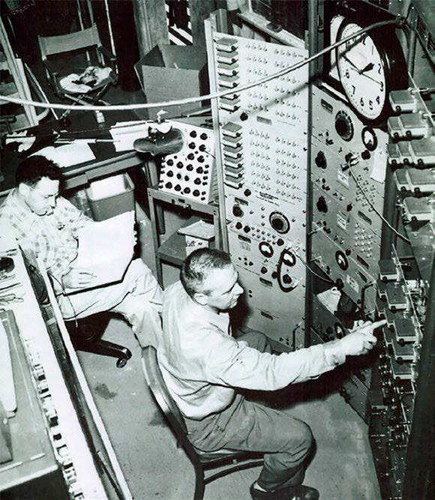
Discovery of Neutrino
Reines and Cowan first discovered antineutrinos from P Reactor at Savannah River in 1956.

Slide 3
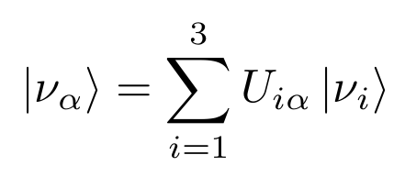
Neutrino Oscillations
Three flavors of neutrinos: electron neutrino, muon neutrino, and tau neutrino
Neutrinos change flavor through quantum mechanical mixing known as neutrino oscillation
Two neutrino oscillation probability is

Slide 4
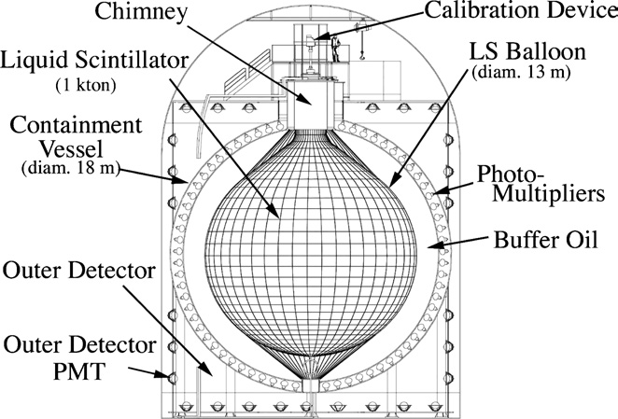
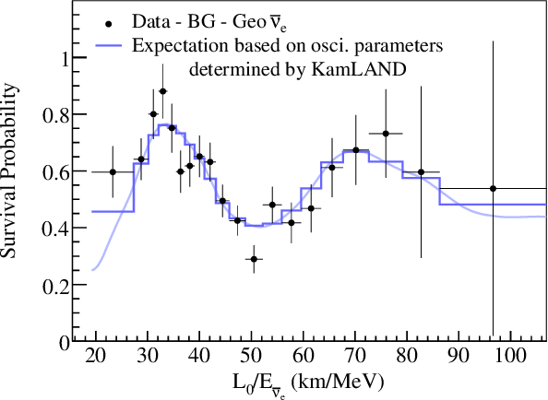
Neutrino Oscillations
The KamLAND experiment measured Δm₂₁² from reactor neutrino oscillations
Phys. Rev. Lett. 100, 221803

Slide 5
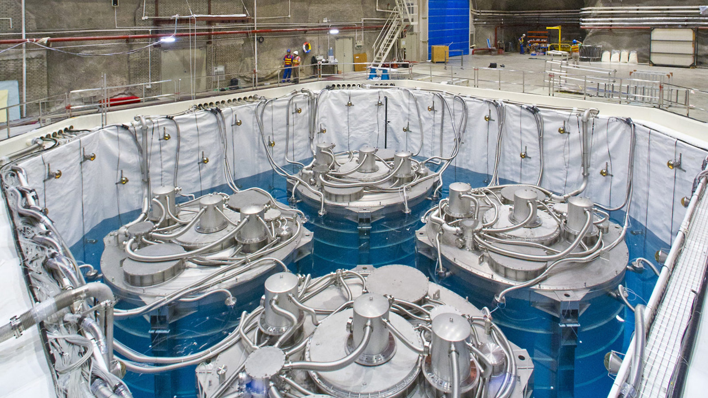
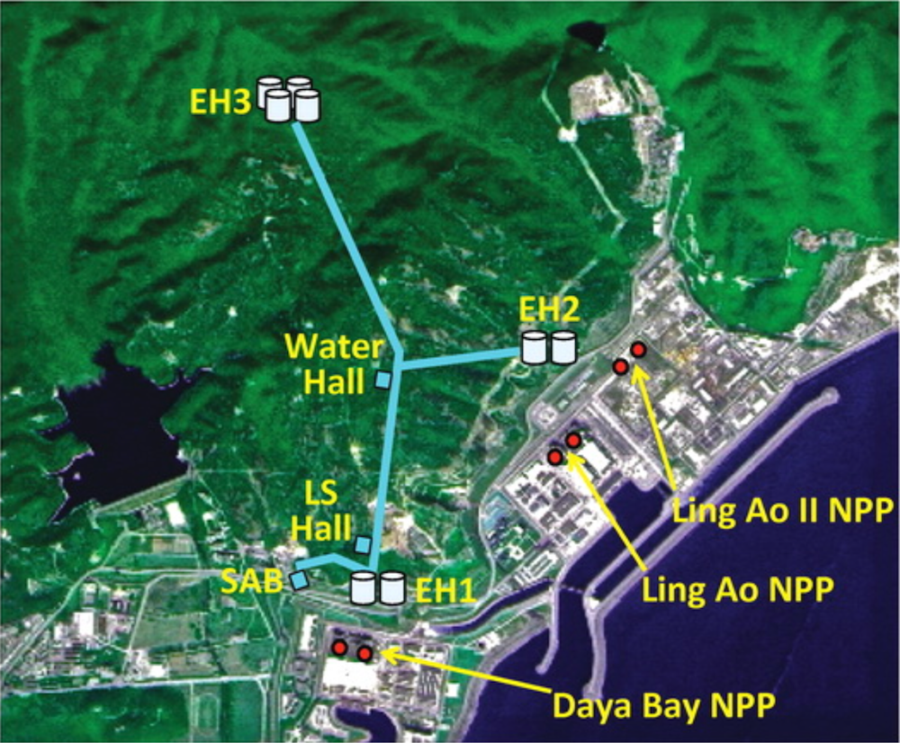
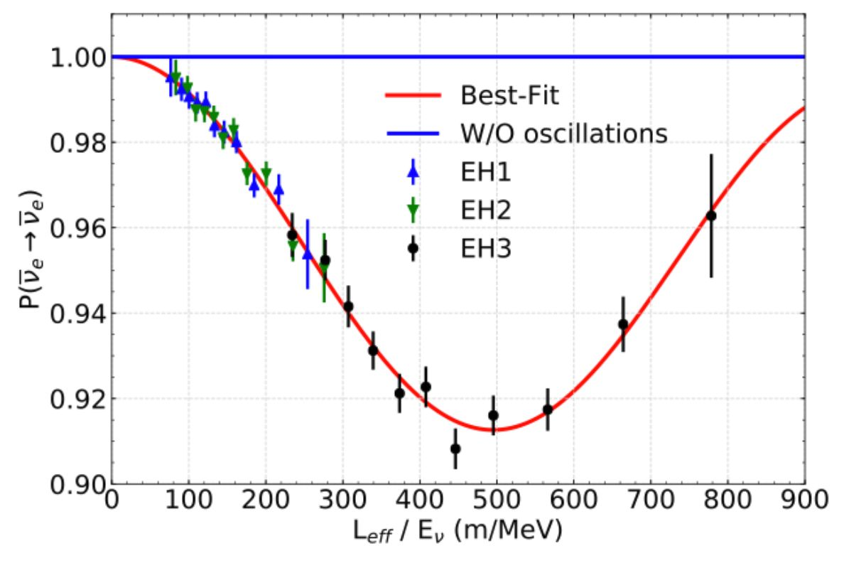
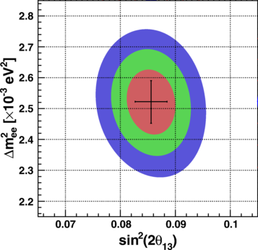
Daya Bay measured the mixing angle θ₁₃ and Δm₃₁²
Phys. Rev. Lett. 121, 241805

Slide 6
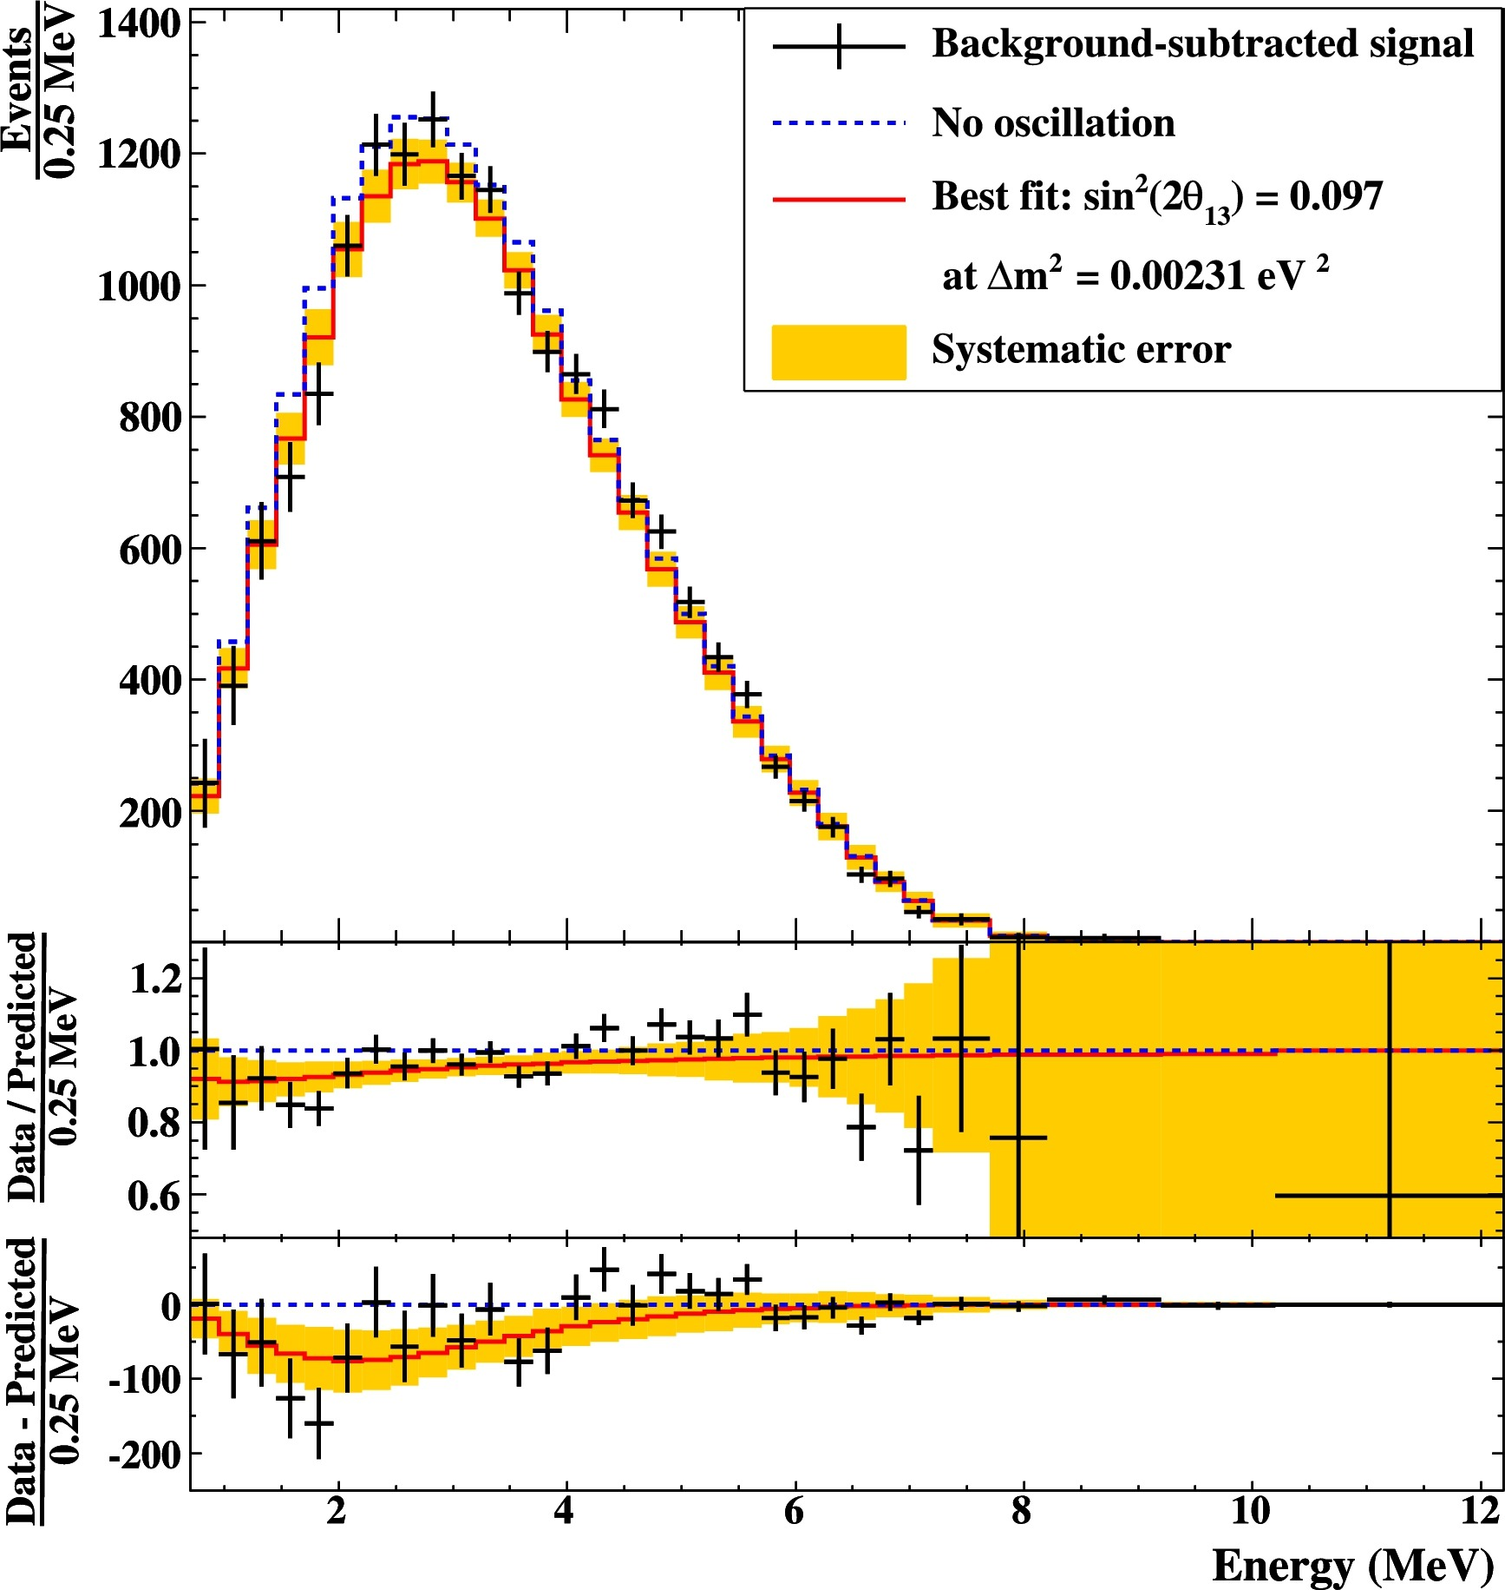
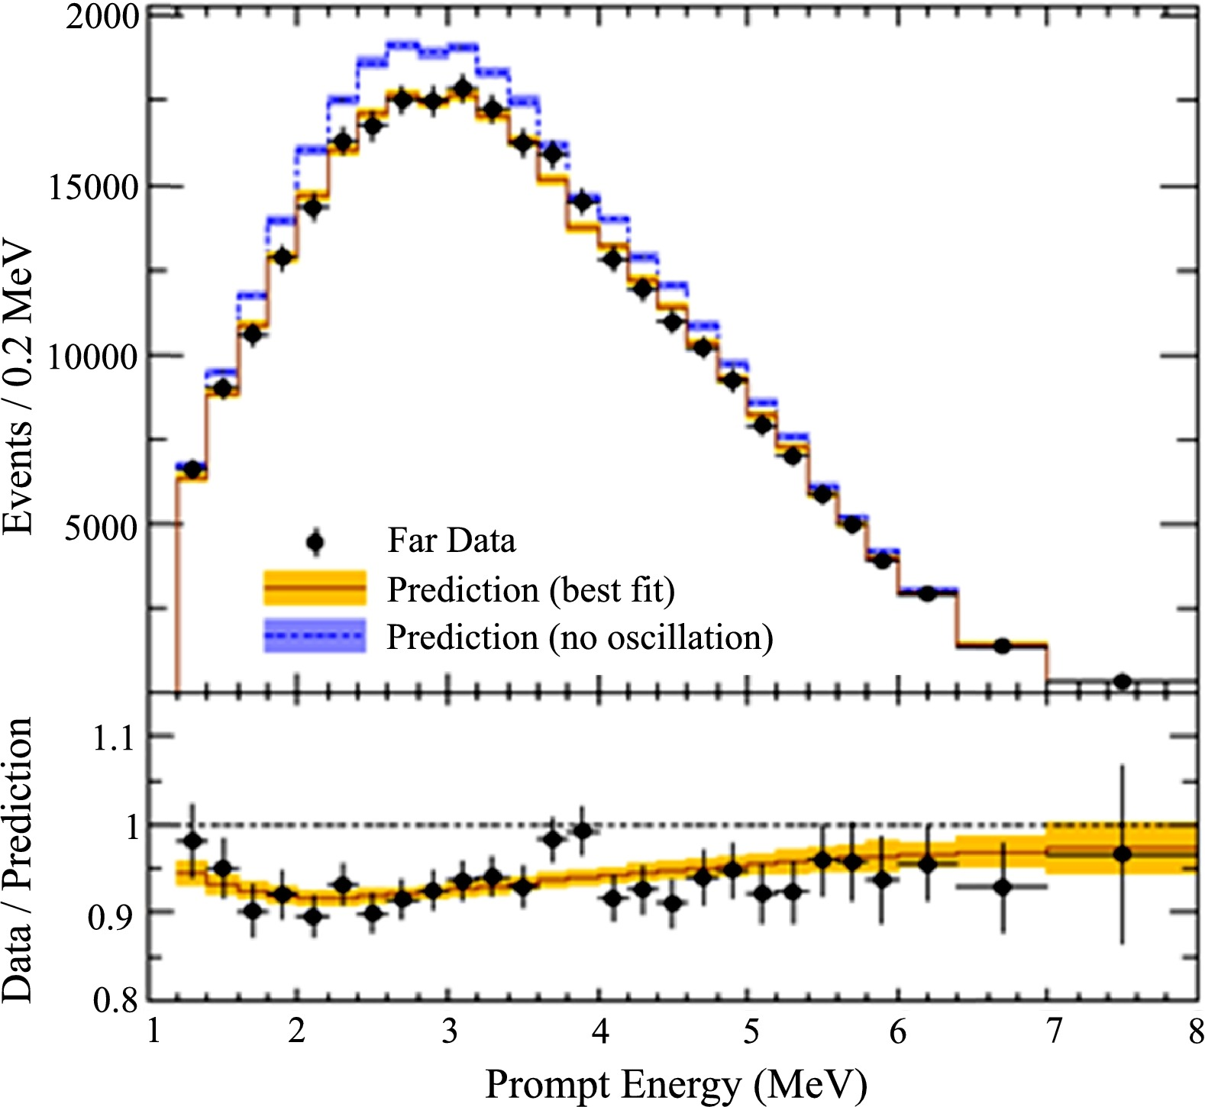
Double Chooz and RENO verified the parameter values
https://doi.org/10.1016/j.physletb.2013.04.050
https://doi.org/10.1016/j.nuclphysb.2016.02.036
Double-Chooz
Independent of the absolute reactor flux and spectrum
RENO

Slide 7
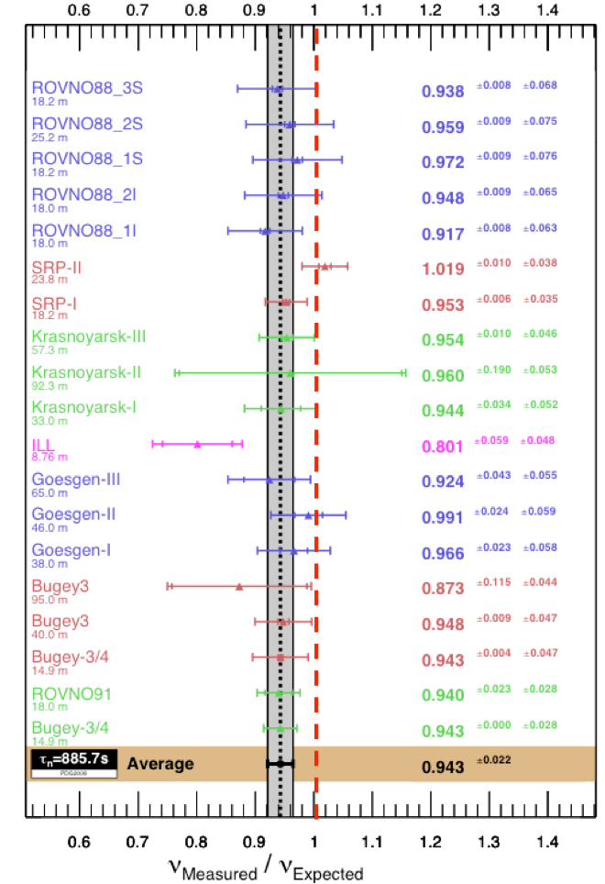
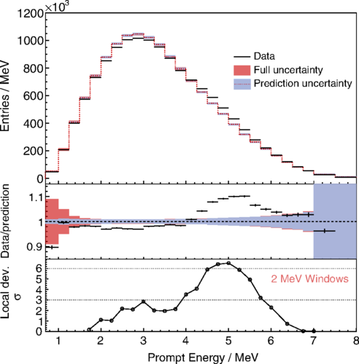
Flux and Spectral Anomalies
https://doi.org/10.1103/PhysRevLett.123.111801

Slide 8
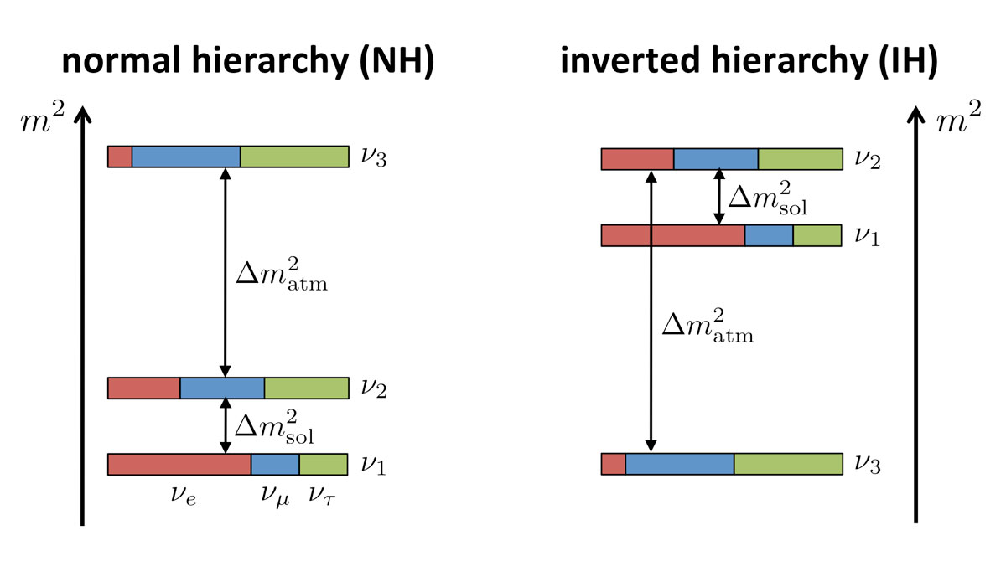
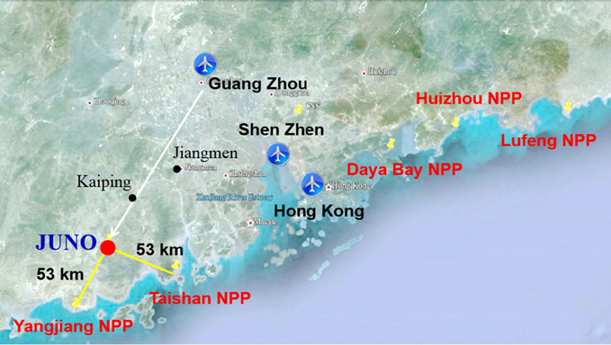
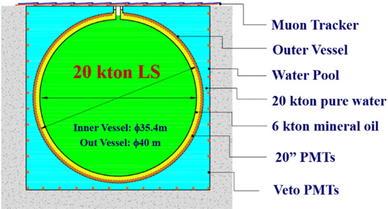
Jiangmen Underground Neutrino Observatory (JUNO)
Designed to resolve neutrino mass hierarchy
Will also:
Precisely measure oscillation parameters θ₁₂, Δm₂₁², and Δm_{ee}²
Study geoneutrinos, atmospheric neutrinos, solar neutrinos, and supernova neutrinos

Slide 9
Short Baseline Experiments
Experiment | Detector | Reactor | Baseline (m) | Segmentation | Energy resolution (%)
PROSPECT | LS | Research (HEU) | 7-12 | 2D | 4.5
NEOS | LS | Power | 24 | none | 5
Neutrino-4 | LS | Research (HEU) | 6-12 | 2D
STEREO | LS | Research (HEU) | 9-11 | 2D | 8
DANSS | PS | Power | 11-13 | 2D | 17
SoLid | PS | Research (HEU) | 6-9 | 3D | 14
CHANDLER | PS | Research | 8 | 3D | 6

Slide 10
Short Baseline Experiments Goals
Search for sterile neutrinos
Set limits in the oscillation phase space
Measure spectrum and flux
Resolve anomalies

Slide 11
CHANDLER Technology
$${\overline{ν}}_{e}$$
Inverse Beta Decay (IBD)
p
e⁺
n
Positron
(e⁺)
Neutron Capture
⁶Li
⁴He
³H
Detected Light
Time
10 ns
~90 μs
200 ns

Slide 12
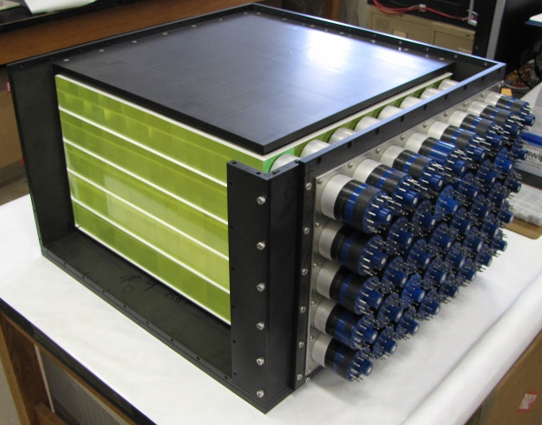
CHANDLER Technology
Light transported to the edges by total internal reflection
Detected by PMTs at the sides
Alternating cube and sheets layers
MiniCHANDLER

Slide 13
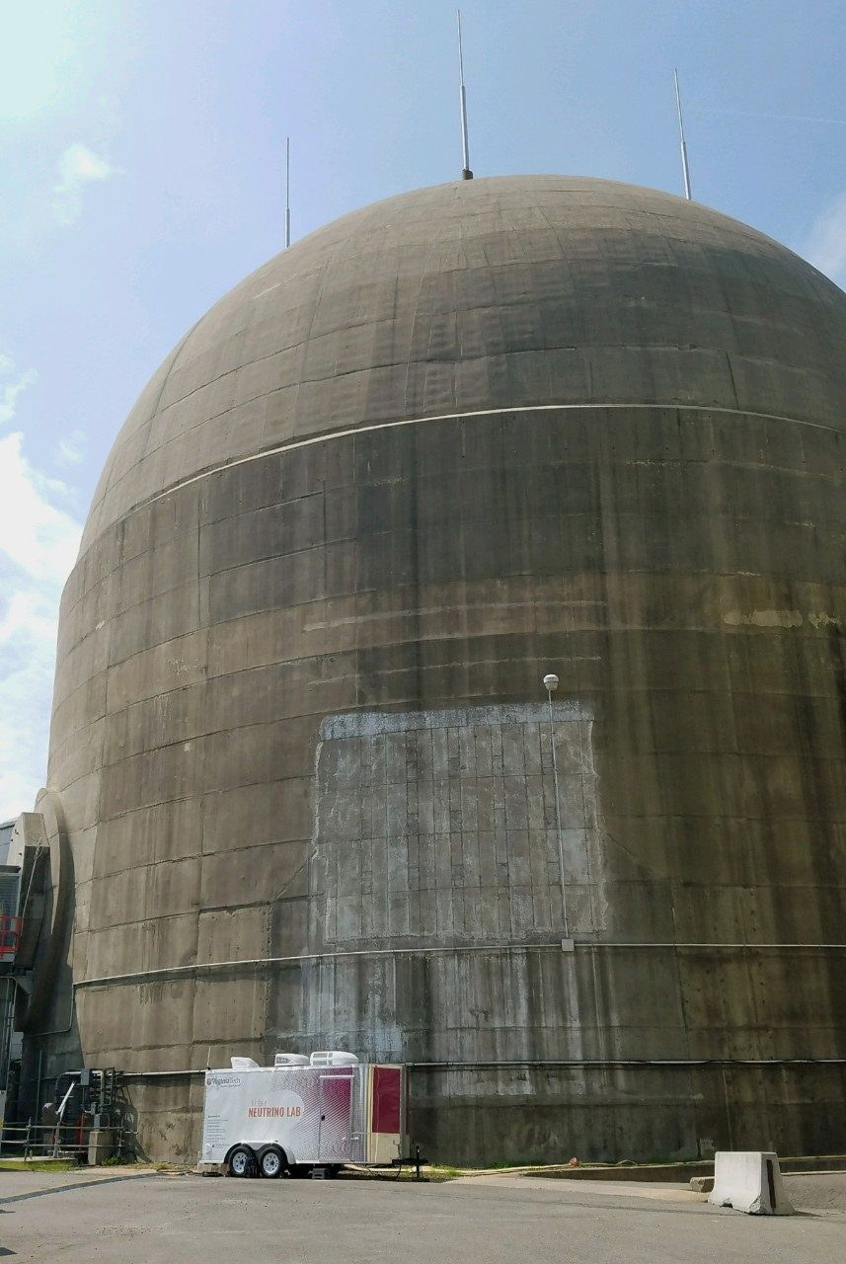
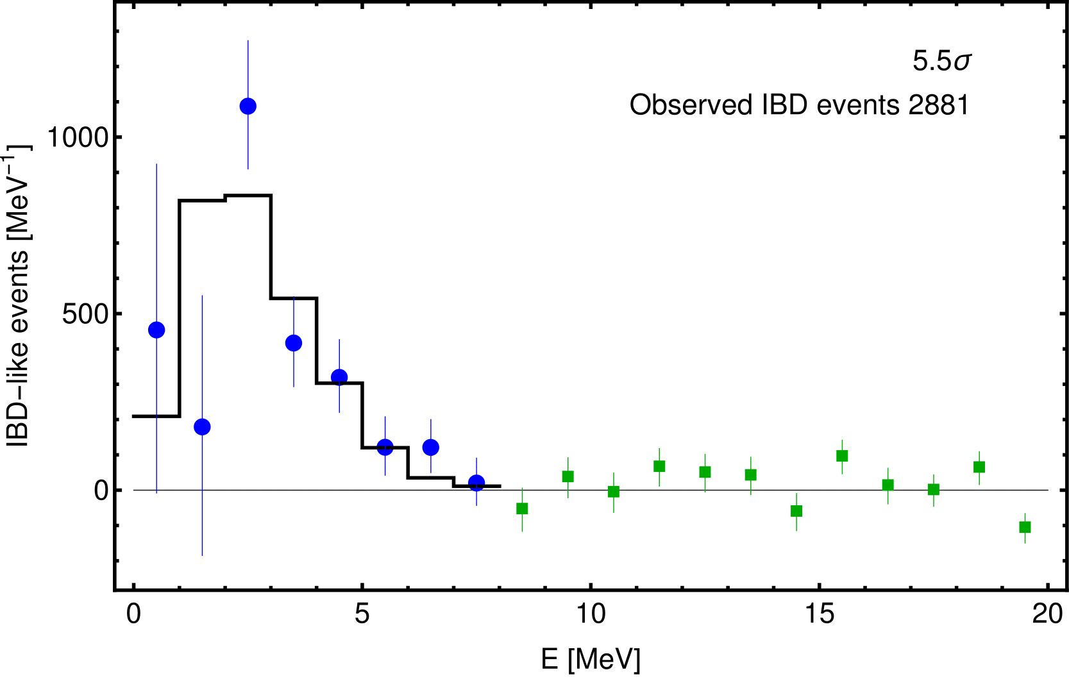
MiniCHANDLER Deployment
Deployed at North-Anna Nuclear Power Plant
Detected antineutrinos with minimal shielding in a mobile platform at surface level environment

Slide 14
Real World Applications: NuTools
NNSA commissioned a study called NuTools for the possible application of neutrinos.
Found the following use case scenario:
Advanced Reactors: Advanced reactors present novel safeguards challenges which represent possible use cases for neutrino monitoring
Future Nuclear Deals: There is interest in the policy community in neutrino detection as a possible element of future nuclear deals involving cooperative reactor monitoring or verifying the absence of reactor operations

Slide 15
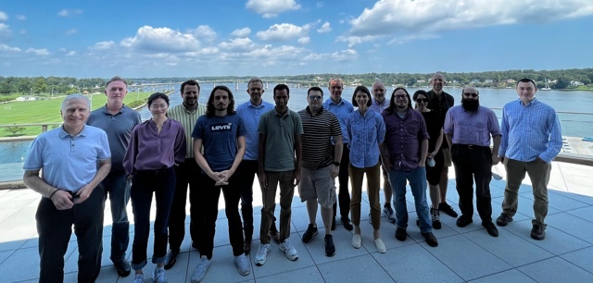
Mobile Antineutrino Demonstration Project
Construct ton-scale detector in a movable platform, coordinating with potential end-users, for future purpose of monitoring reactors with neutrinos
Demonstrate a realistically deployable system to address the areas of real need for reactor verification or advanced reactor safeguards

Slide 16
Thank You

