Slide 1
Using dHTC to Extend the HTC Cluster at IHEP
JIANG, Xiaowei
On behalf of Computing Team of IHEP CC
HTCondor Week 2022
2022/05/24
Notes:
I’m xiaowei , come from IHEP, Chinese Academy of Sciences. I do this report on behalf of system group. I will talk about a

Slide 2
Background
Status of Local HTC Cluster
dHTC design and implement at IHEP
Certification and Authentication
User Interface and Job Environment
Summary and Plan
OUTLINE

Slide 3

Motivations
IHEP is hosting or attending in >15 experiments around the field of high energy physics
  Most of experiments do the data processing in the local cluster
  Some domestic collaboration members are running small cluster
Extending the htc local cluster is the better way to find more resources
  The data processing has run for a long time and bounded with the local cluster
  Most of users have been used to do data analysis in a local cluster
    Closer to use a personal PC and would not like to change any habit
    Access data and software in anytime and anywhere by the shared file system
  Some experiments do not have official experiment software
    Users write their own data processing program in different ways

Slide 4
Clusters and Sites
More and more sites are built for scientific research in domestic China
Branches of IHEP
  Long-term resources provided，regarded as part of htc pool
  Limitation on network bandwidth and storage
Collaboration members
  Most are edge sites (not quite big)
  Without a pledged storage
Cooperation institutes (universities)
  All are dynamic (opportunistic)
  Nothing is pledged
Diverse requirements according to the conditions
  CPU & GPU & ARM & Cloud
  Structures of computing system are different
  Policies of job are different
 | CPU Cores | Disk Storage | Tape Storage | Network
IHEP-CC | 46000 | Lustre, >20 PB EOS, ~20 PB | 30 PB | 100G/10G/1G
IHEP-Dongguan Guangdong Province | ~6000 | Lustre 3 PB | 1 PB | 10G-100G to IHEP
IATAMS Shandong Province | ~15000 | Lustre 2.5 PB |  | 1G-10G to IHEP
IHEP-Daocheng Sichuan Province | ~3400 | EOS 1.6 PB |  | 2G to IHEP
USTC, Anhui Province | ~2200 | Lustre 4 PB |  | Internet
LZU Gansu Province | 1636 |  |  | Internet
PKU Beijing | 288 |  |  | Internet
Shandong Uni. Shandong Province | 720 |  |  | Internet
Dongguan DC Guangdong Province | ~30000 | 6 PB |  | 10G to Dongguan DC
IHEP Huairou Branch (ready by 2025) | ~10000 | Lustre 30 PB |  | 100G to IHEP

Slide 5
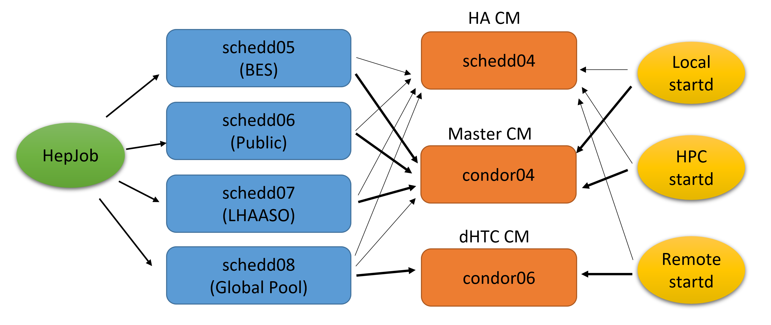
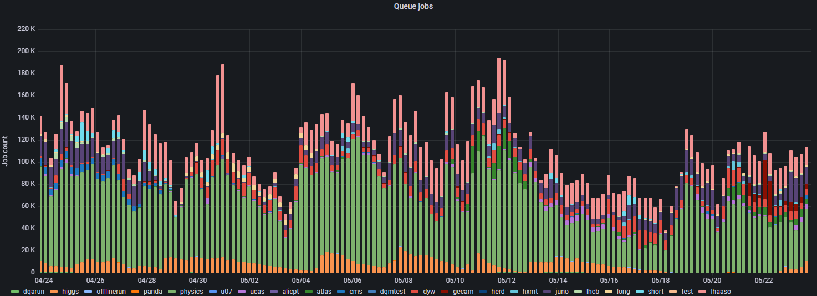
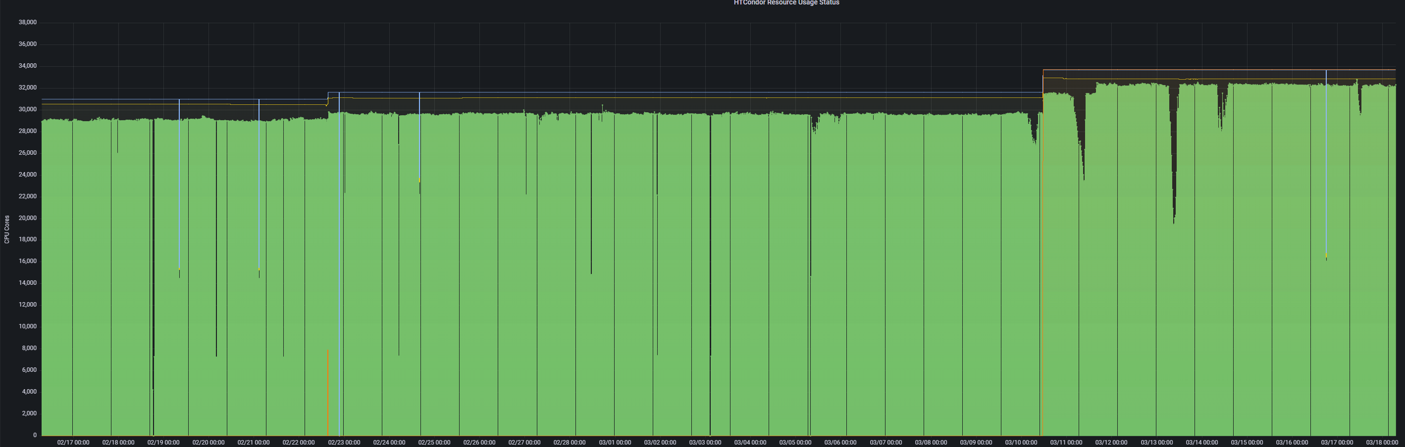
Status of IHEP Local HTC Cluster
HTCondor Cluster is getting bigger
  4 SchedDs: mapping by specific groups
    Maximum 10k running jobs for each schedd
  3 CMs: Main CM&HA CM
  CPU: >35k cores
    Most are single core slots
Finding more resources for the local cluster is becoming an urgent task
  Large amount of jobs are waiting for resources
    >100k jobs sitting idle in the local job queue
  The htc pool is quite busy
    >90% resource utilization rate (>35,000 CPU cores)

Slide 6
Basic Idea
The extended resources are likely added as direct worker nodes into the local htcondor
The users still keep the previous usage mode and interact with the computing system in a unified entrance
The solution is still based on HTCondor
HTC jobs
HTC jobs
Remote Cluster
HPC Cluster
HTC Cluster
Produce Glidein Jobs
Produce Glidein Jobs
Glidein Factory

Slide 7
Computing Structure
A typical dHTC computing structure but with the customized design
The design and implement is based on htcondor glidein
  Glidein Factory
    Produce the glidein jobs according to the defined policies
  Glidein Job
    Start the htcondor startd and report the worker node to the local htc pool
  Certification and Authentication
    IDTokens and Kerberos (Kerberos has served for many years in the local cluster)
  User Interface（Workflow & HepJob）
    Job and data workflow (some experiments have no standard software for data processing)
    Unified job interface (by extending the job submission tool - HepJob)

Slide 8
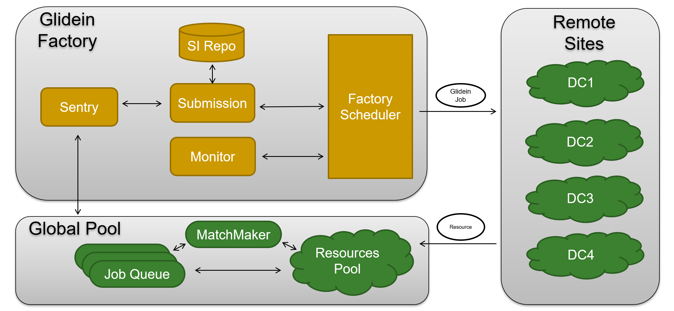
Factory Workflow
A central glidein factory can cover most sites or clusters
Glidein job will be submitted when the sentry finds new user jobs in the global job queue

Slide 9
Factory - Schedule Policies
A heterogeneous policy of resource share
Static-resource policy ( for self-owned and the pledged sites )
  Resource provider report the promised number of long-term resources to the pool
  All the resources have been ready and glidein job can be submitted at anytime.
Dynamic-resource policy ( for cooperation sites and HPC clusters)
  Resource provider report a specific number of short-term resources as the workload
  Site decides when and what resources will be reported
    A client on site side to take charge of glidein submission and removal
Job policies depend on the job requirements
  All the job can run in the local HPC cluster due to the same worker node environment
  The job with small data transfer can run in the edge sites without pledged storage
  The job with large data output can run in the big site with large storage and good network

Slide 10
Extending to Local HPC (1)
Several solutions were investigated and tested to share resources between HPC and HTC
  Overlap & Flocking & HTCondor-C
The problem is to bring too large amount of jobs to SLURM
Similarly as the overlap, glidein way can avoid submitting too many htc jobs to SLURM queue.
Metrics | Overlap | Flocking | HTCondor-C
Configuration | Scale up with worker nodes number. | Scale up with pools number. | Scale up with cluster number.
Customized job scheduling | Almost none, depends on HTCondor configuration. | Almost none, depends on the job queue status. | Rich : Job Router, Slurm spank plugins, blahpd
Reference: A Feasibility Study on workload integration between HTCondor and Slurm Clusters

Slide 11
Extending to local HPC (2)
The system software of local HPC WN is same as that of HTC WN
  With shared file system and same user namespace
The workflow is:
  ① submit htc jobs to htcondor queue
  ② submission API receives the job requirements
  ③ submission API submits glidein jobs to slurm queue
  ④ slurm schedules glidein jobs to slurm worker nodes
  ⑤ glidein startups startd and report to htc pool
  ⑥ matchmaker
  ⑦ htc jobs are sent to slurm worker node
The policy in submission API is quite easy
  Specific idle user jobs & empty worker nodes in slurm
HTC Jobs
HTC
Pool
①
⑥
HTCondor
Queue
⑤
⑦
SLURM
Worker Node
②
Submission
API
④
③
SLURM
Queue

Slide 12
Extending to Remote Sites
Currently, we are focusing on one of the remote sites – Dongguan DC
Dongguan Data Center is a typical remote site
  A HPC pool built with Slurm
  Without shared file system & different user namespace
The advantage of Dongguan site is that belong to the IHEP internal network
  Network bandwidth is 10Gpbs (dedicated)
  Data access and transfer has more possibilities
    Access data by EOS commands
    Read/write files in Lustre by XRootD gateway
Could CPU：9600 cores
X86 CPU：10000 cores
ARM CPU：9600 cores
GPU：80 Tesla V100
Storage：6PB

Slide 13



Glidein Job
Glidein Client
  Glidein Job
  Submission
Glidein Tarball
Config
Repo
Glidein
Job
Env Initialization
Startup
Program
Security (tokens)
Config Creation
StartD Start
Submission
API

Slide 14
Cert&Auth with Tokens
The aim is to migrate from CLAIMTOBE to Tokens
  CLAIMTOBE is used in the local cluster for years (not safe)
IDTokens for Daemon Certification
  All works are following htcondor manual (configuration level)
Kerberos tokens for jobs and other services
  First try based on htcondor configuration was failed
    It seems the same user namespace between submit side and execute side is necessary
  Current solution is to transfer token credential as a normal input file
    The token credential will be initialized and akloged in job wrapper
Submit Side
Execute Side
transfer_input_files = /tmp/krb5cc_10634
+HepJob_KRB5CCNAME = "krb5cc_10634"
$ ls /var/lib/condor/execute/dir_6412/
condor_exec.exe _condor_stderr _condor_stdout krb5cc_10634 tmp var

Slide 15
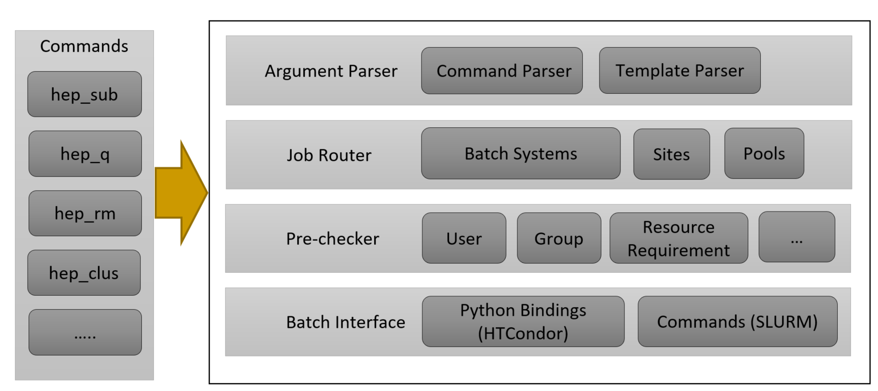
User Interfaces
User interface will fully respect the old usage mode
  Users would like to run job remotely without much change of the previous usage mode (especially the commands)
  All the new functions are wrapped and added by extending the job tool – HepJob
Job workflow is helpful to introduce dHTC to experiments
  Re-design and implement the process of job workflow and the structure of data storage

Slide 16
User Job Environment (Singularity)
Job environment in all solutions are based on singularity
Operating System
  Singularity images are published into /cvmfs/container…
  Glidein job starts up singularity as the given image
Software
  Managed and served by CVMFS (recommended)
  Transferred with job, as part of job input
Temporary storage
  The local scratch on the worker node
  The global storage shared in the whole distributed infrastructure
worker node
singularity
/cvmfs/lhaaso.ihep.ac.cn
load software
job
write
read
/scratch or /tmp

Slide 17
Application Cases
 | Corsika | Geant4(step1) | Geant4(step2) | Reconstruction | Analysis
input | tiny | middle | large | small | various
output | middle | large | small | small | small
persistent store? | No | Yes | No | Yes | No
CPU hours | long | Long | Short | Short | Various
users | Dedicate user | Dedicate user | Dedicate user | Dedicate user | Various user
LHAASO simulation
  Characteristics：small input and not large output
  Job submission policy is that user decides where the job will run
    No mature common software and users have their own software in the personal directory
    Still a simple command in HepJob: hep_sub job.sh -rmt
BES simulation
  Characteristics: mature software framework (BOSS) ; tiny input but big output
  Job policy is that job will be transparently scheduled to anywhere by scheduler policy
    Job type and data position can be easy to judge with BOSS job option file
    The simulation job will be selected and the data path will be remapped to the new path in the remote sites

Slide 18
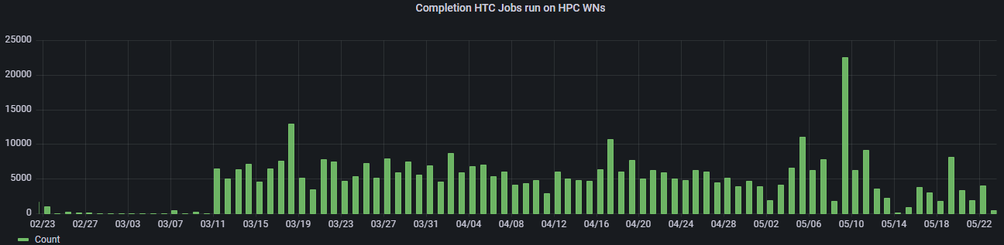
Current Status of Application
HTC jobs have been dispatched in the extended HPC resources for several months
Some specific jobs have been running at the Dongguan site
  LHAASO experiment: WCDA simulation job and LHAASO WFCTA simulation job
  BESIII experiment: official offline simulation job
    Filter all the simulation jobs submitted by users according to the specific attributes (on going)
  Other experiments: automatically schedule the jobs with small input/output data
    Plan to finish the work by the end of this year

Slide 19
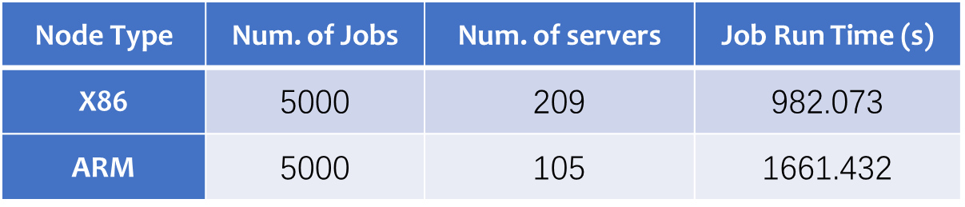
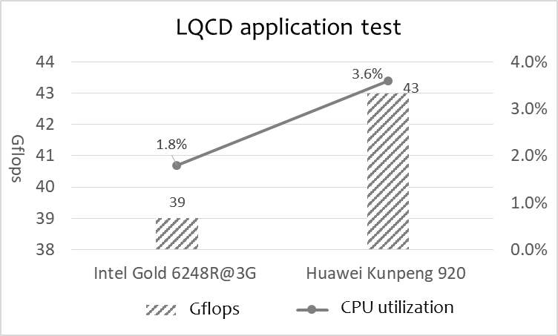
Trying to add ARM into dHTC
ARM computing cluster at Dongguan Data Center
  Huawei Taishan 200K server with Kunpeng 920 CPU
  100 worker nodes & ~10K CPU cores
Performance test (Corsika: Air Shower Simulation Program)
  5000 Corsika simulation jobs (htc jobs)
  X86 takes less time to complete the same number of jobs, but requires more servers
htcondor on arm machine
  Compile the htcondor glidein tarball
  Report arm resources to global pool via glidein
Experiment job on arm machine
  Help experiments to port and compile their software
  Succeed to run large-scale corsika jobs in dHTC (the results are still under verification)
↓199%
↑169.2%

Slide 20
Summary and Plan
Adding more resources by extending the local htc cluster is the better way currently
  Experiments at IHEP have been used to processing data in the local cluster for a long time and the local htc cluster is getting quite busy
With htcondor glidein, we have make a basic design of dHTC at IHEP
Two parts of resources have been extended into the local htc cluster and served in production
  The local HPC cluster and Dongguan site
Future plan
  Implement a complete glidein factory and make the whole process more automatic
  Introduce the dHTC to more experiments and migrate their jobs to the dHTC resources
Current Problems
  Kerberos Tokens: renew and prolong
  A better way to access and transfer data

Slide 21
Thanks
Q&A

