Slide 1
Using high throughput computing to investigate the
role of neural oscillations in visual working memory
Jacqueline M. Fulvio, PhD
Postle Laboratory
Departments of Psychology & Psychiatry
neurogenbb.com

Slide 2
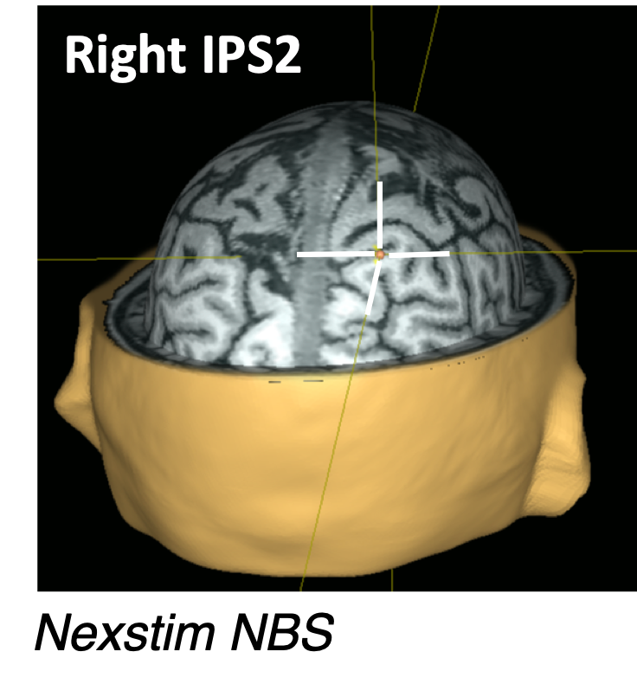
Visual working memory
allows us to temporarily maintain and manipulate visual information in order to solve a task
Double serial retrocuing (DSR) task
Prioritization
cue
TMS delivery
(50%)
“match” /
“non-match”
electroencephalogram (EEG)
transcranial magnetic stimulation (TMS)
brain vision solutions
Rose et al., 2016; Fulvio & Postle, 2020
Notes:
as an example of the type of task that requires working memory, I will introduce you to the task that gave rise to the data we have been analyzing with high throughput computing, which is the double-serial retrocue task.
TMS has been shown to have both behavioral and physiological consequences in the context of this task and therefore has been useful as a tool in probing prioritization processes in working memory.
There are many variations of this task, including variations in the type of stimuli used, the number used, the timings of the task, the relative proportion of switch and stay trials, etc. and whether the task is carried out with EEG recording, fMRI, or without imaging.

Slide 3
Visual working memory
the frequency of neural oscillations has been associated with distinct working memory processes
neural oscillations
raw signal: 60 channels
brain vision solutions
Notes:
in our case, with the concurrent EEG recording and TMS delivery as the participant does the task, specifically allows us to address questions related to the role of neural oscillations in working memory

Slide 4
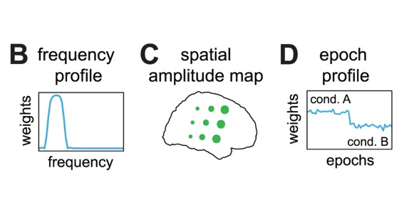
“SPACE-FSP” multi-way decomposition of
high-dimensional EEG data
Spatially distributed PhAse Coupling Extraction with
a Frequency-Specific Phases model*
Motivation: task-related frequency oscillations are ubiquitous in EEG, including during the DSR task; however, standard analyses do not adjudicate between the oscillations arising from the frequency modulation of a single oscillating network, or multiple oscillating networks at different frequencies
Goal of the analysis: extract phase-coupled oscillatory networks at
frequencies of interest (here, 4-40 Hz)
*van der Meij, et al. (2015; 2016)
Notes:
Specifically, in our current work, we proposed to leverage an analysis called Spatially… or “SPACE-FSP” - henceforth SPACE for short.
The reason why we were interested in this applying this method that standard analyses…
The standard analyses also do not discern between the possibility that TMS effects arise from the spark, if you will, of new oscillations arising from the pulse, or modulations of existing oscillations.
So, our goal in using this analysis was to extract…and to see how those networks arose or were modulated with various aspects of the task
Without going into detail about the method, I will point out that it still remains a largely unused approach in the estimation of phase-coupled networks, but it does offer significant advantages over other methods, in particular, that it is not subject to non physiological constraints as other methods are.

Slide 5
Why use HTCondor?
SPACE is a computationally-demanding analysis!
The number of oscillatory networks extracted cannot be determined analytically and therefore must be estimated through decomposition.
This is done iteratively by starting at a set number of networks and increasing the number incrementally until a preset statistical criterion is no longer achieved.
A single decomposition can take days to weeks to months depending upon the number of epochs (i.e., chunks) of data fed to the algorithm, the number of networks ultimately extracted, and the hardware.
Our planned analyses required decomposition of at least 186 data sets!
HTC offered the opportunity to run the decompositions in parallel on better hardware than our lab server was built upon…*
…with MATLAB parallel pool compatibility
Notes:
One likely reason why this approach has not taken off is because it is a computationally-demanding and very time-consuming analysis. So, this is where HTCondor came in for us.
The procedure comprises a parallel factor analysis (PARAFAC)-based signal decomposition method, but the number of oscillatory networks cannot be…
To find the optimal decomposition for the data set, we can make use of an index of the reliability with which the networks can be estimated from the data, as described by Maris et al. [2011]. The number of networks that are extracted can be increased incrementally until this reliability index drops below a preset level. To further add to the demand and amount of time it takes to complete the decomposition, the analysis adopts a conservative approach by splitting the data at each iteration into two halves, extracting networks from both halves, and stops increasing the number of networks when they start to differ between halves.

Slide 6
How we got started with HTC…
Lab (P.I. Dr. Bradley Postle) history of using CHTC resources
Initial consultation with staff to discuss planning and basic details about the system and helpful resources on the website
Most useful/helpful resource has been the online help guide (https://chtc.cs.wisc.edu/uw-research-computing/guides.html) with the sample code and detailed explanations
Also very helpful: CHTC office hours
visits were necessary for assistance with code compiling and parameter setting to take advantage of Matlab-based functionality
Notes:
I have a fairly extensive coding history, so I found the online help guides to be especially helpful in getting started. Indeed, though, I did take advantage of the office hours…

Slide 7
Submitting our first jobs…
Compiled a Matlab standalone executable including relevant code/toolboxes
Submitted jobs with the Matlab executable and the particular data file (e.g., from a particular subject+condition+pipeline) to be decomposed
Optimization: Took advantage of Matlab’s distributed computing as part of the Parallel Computing Toolbox
Requested the maximum number of “workers” in a parallel pool supported by the cluster (12) with equal number of CPUs requested
Used “LongJob” flag
Input data file size | Requested memory per job | Requested disk space per job | Total number of jobs completed | Typical job time
39 MB - 59 MB (Rose et al., 2016; two analysis “pipelines”) | 20-40 GB | 5 - 10 GB | 42 | 2 days - 2 weeks (compared to ~1 month on our lab server)
Notes:
In using the parallel processing, we could distribute the data processing load over CPUs to speed up processing time.
*we actually ran some test jobs prior to this on our lab server and on the high throughput to verify the code worked and a job could be completed. Then we ran our first official set…

Slide 8
Updating the analyses….
The initial results were promising, but the two data analysis pipelines we tried were insufficient to address some of our key questions
dataset did not contain “built-in” control conditions for more rigorous statistical analysis
Re-ran the analyses using a newer data set that I had collected (Fulvio & Postle, 2020) that overcame some of the limitations
Input data file size | Requested memory per job | Requested disk space per job | Total number of jobs completed | Typical job time
39 MB - 59 MB (Rose et al., 2016; two analysis “pipelines”) | 20 - 40 GB | 5 - 10 GB | 42 | 2 days - 2 weeks (compared to ~1 month on our lab server)
25 MB - 60 MB (Fulvio & Postle, 2020; same two analysis pipelines) | 20 - 40 GB | 5 - 10 GB | 72 | 2 days - 2 weeks

Slide 9
Updating the analyses…again…
Some tweaks to the data structure were still necessary
needed to extend data epochs from 500 ms to 1s
needed to include an additional fixation period (i.e., baseline) epoch
Input data file size | Requested memory per job | Requested disk space per job | Total number of jobs completed | Typical job time
39 MB - 59 MB (Rose et al., 2016; two analysis “pipelines”) | 20 - 40 GB | 5 - 10 GB | 42 | 2 days - 2 weeks (compared to ~1 month on our lab server)
25 MB - 60 MB (Fulvio & Postle, 2020; same two analysis pipelines) | 20 - 40 GB | 5 - 10 GB | 72 | 2 days - 2 weeks
200 MB - 500 MB (Fulvio & Postle, 2020; new combined pipeline) | 50 - 75 GB | 10 - 15 GB | 72 | few weeks - few months*

Slide 10
Summary of computing experience to date
From our final analysis, we obtained 1,690 components!
Positive points
Pain points
Helpful “hands-on” support from staff along with the ability to run independent jobs to test various aspects of the pipeline
Years of computing on lab machines (projected) were condensed to months (for each iteration of the analysis)
Still took longer than necessary because:
high throughput framework is not ideal for optimization problems like this: with the iterative nature, the problem/code cannot be further optimized (and jobs cannot be started where they left off if interrupted).
our jobs seemed to often be sent to slower machines or busy machines that would kick the job part-way through, which added many hours to the total time we used HTC.
Since have been able to generalize experience to carry out a different, more “HTC-friendly” analysis as a scientific control to back up claims about results from initial analyses
Notes:
All versions were ultimately successful and have benefited our research as I’ll discuss at the end, but I will point out that from our final analysis, we obtained 1,690 components. This was all thanks to the…
I will point out that the overall process took longer than necessary, particularly for a few jobs because…

Slide 11
Bigger picture
From the broad perspective of our research-group, OSPool resources have significantly expanded our computational capabilities
applying computationally-demanding, but better-suited, analysis methods to address questions not well-answered by more commonly used approaches.
From a more focused research-perspective, OSPool resources have provided the ability to adjudicate between different possible sources of common EEG findings
specifically, the source of changes in EEG in response to memory cues and TMS pulses appears to be modulations of existing oscillations
From a more personal perspective, OSPool resources have improved my skills and resume
early results were presented at the Cognitive Neuroscience Society 2020 (virtual) conference
latest results will be presented at the Society for Neuroscience 2022 conference
Notes:
allows us to help advance the field’s understanding, address key questions in the grant funding the research, and provides the opportunity to reconsider other established findings and fill in gaps in understanding of those studies as well.
I indicated that I had had previous coding experience, but interfacing with the HTCondor has taught me how to work with additional programming languages and in some ways how to optimize coding and analysis. Furthermore, having knowledge about and experience with these lesser-known methods expands my opportunities for collaboration with other great minds in our field. And finally, to help advertise our success, I have presented early results…and a manuscript is expected in upcoming months.

Slide 12
Thank you!
jacqueline.fulvio@wisc.edu
https://postlab.psych.wisc.edu/people/west/jacqueline-fulvio1/
neurogenbb.com
Notes:
With that, I want to thank all of the HTC staff and express our gratitude for the ability to rely on these resources once again and to thank you for taking the time to learn about our experiences to date.

