Slide 1

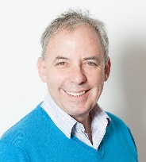
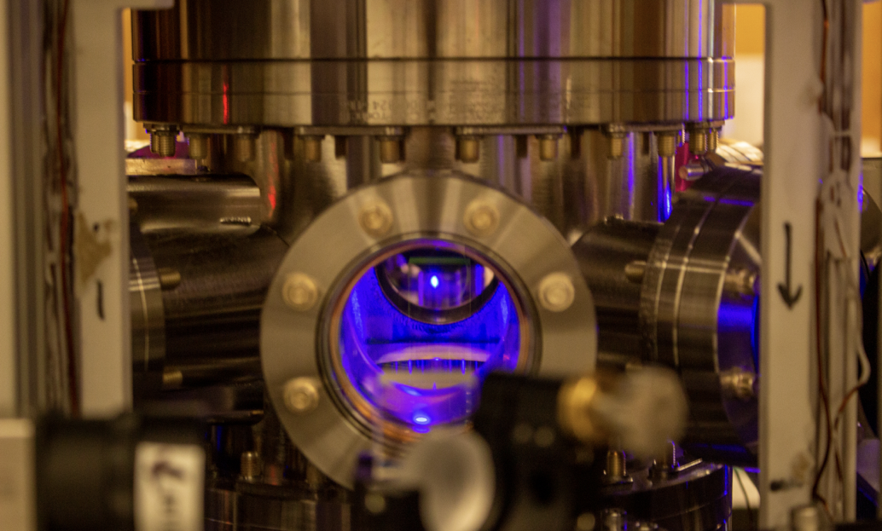
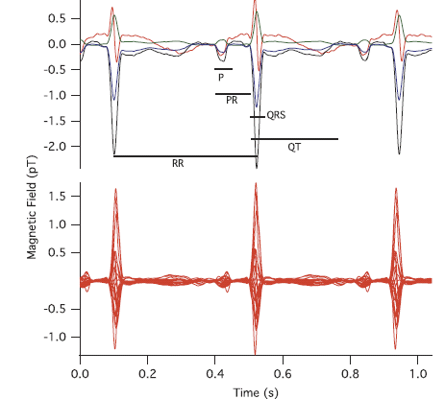
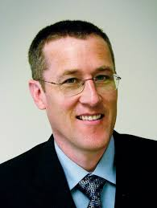
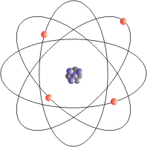
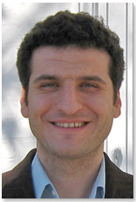
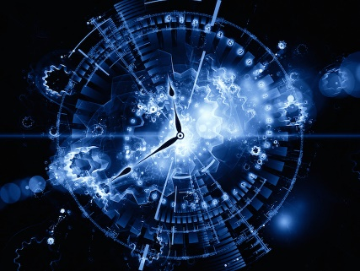
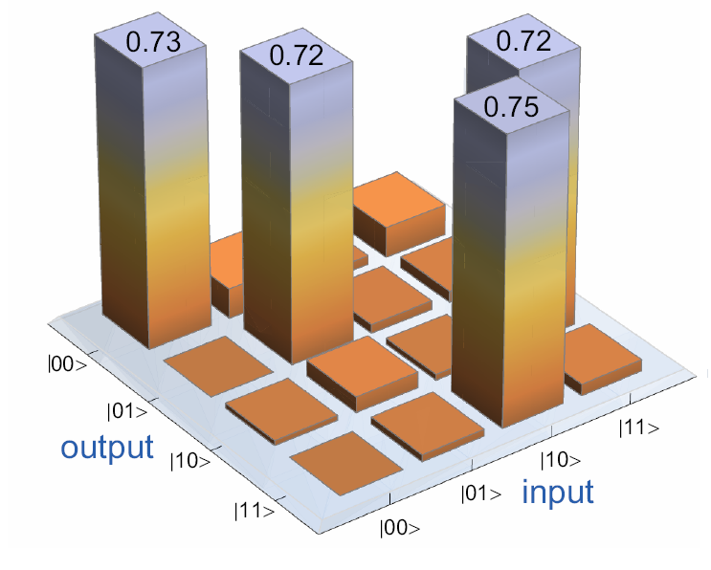
Atomic Molecular and Optical Physics
Laser cooling
Mark
Saffman
Sensing
Ultrafast
lasers
Thad
Walker
Deniz
Yavuz
Atomic
clocks
Quantum
information

Slide 2
Atomic Molecular and Optical Physics
Why get a PhD in AMO physics?
Mark
Saffman
It is an exciting field with many new discoveries
AMO is relatively small (< 10% of APS membership) yet ~5 of the last 20 Physics Nobel prizes in AMO.
You can work on experiment or theory or both.
Tabletop experiments, be your own master.
Quantum mechanics is your sandbox.
Lots of career path opportunities:
Academia, government labs, industrial R&D
UW-Madison recently joined 2 national quantum centers.
>5 new quantum startups based on AMO systems in just the last few years.
Thad
Walker
Deniz
Yavuz

Slide 3
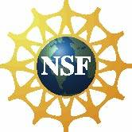





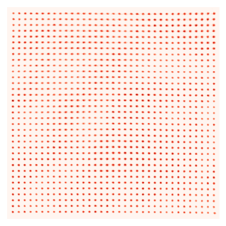
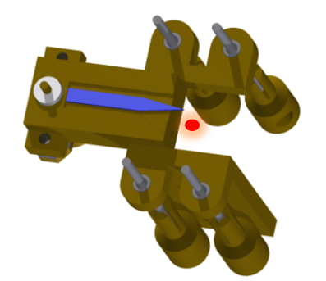
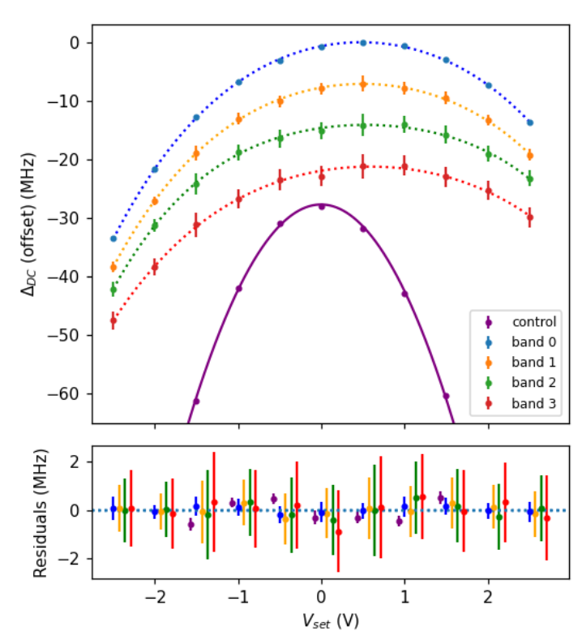
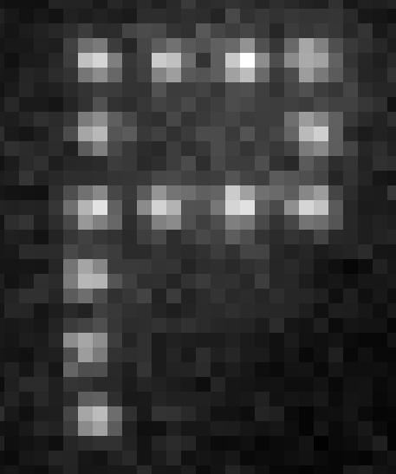
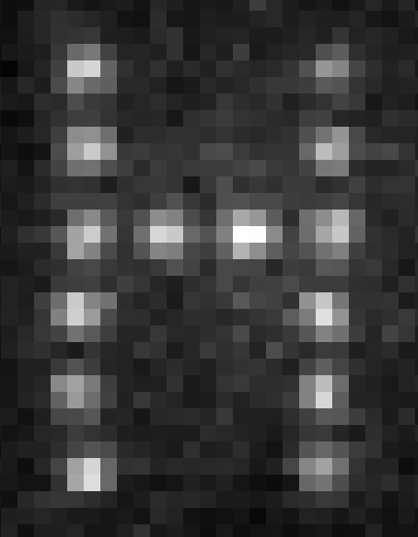
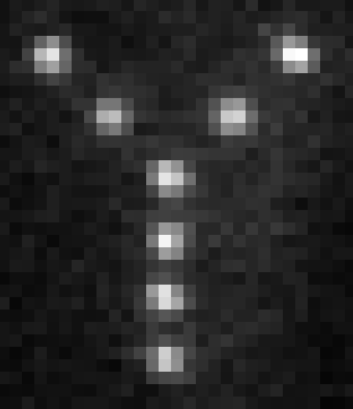
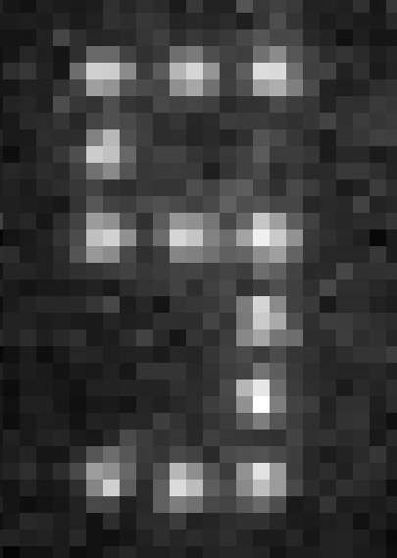
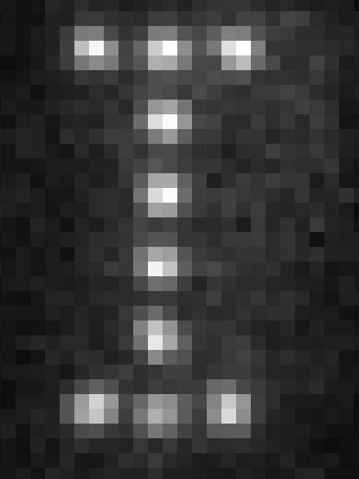
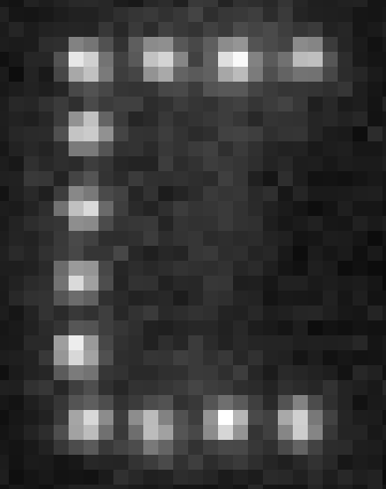
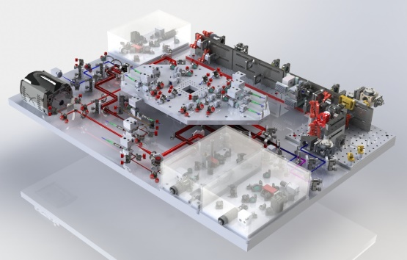
QPAL Quantum Physics with Atoms and Light
hexagon.physics.wisc.edu
Atom arrays: atom-light interactions
with Prof. Walker, Prof. Yavuz
PRX Quantum 3, 010338
Atom-superconductor
quantum interface
with Prof. McDermott
Quantum computing
Quantum networking
with Prof. Goldsmith(chemistry), Prof.Kats (ECE)
3 μm
Nature 604, 457–462 (2022)

Slide 4
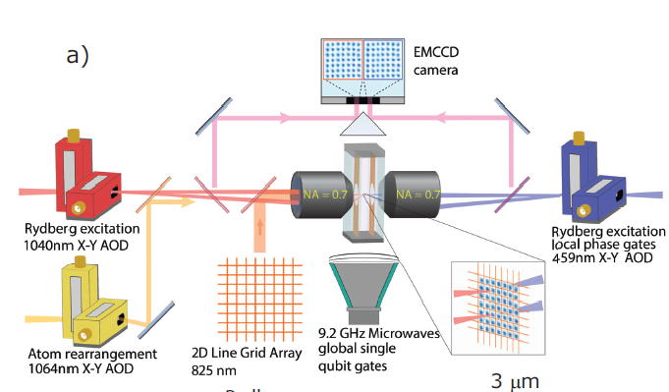
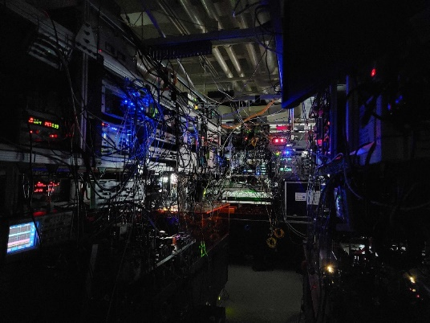
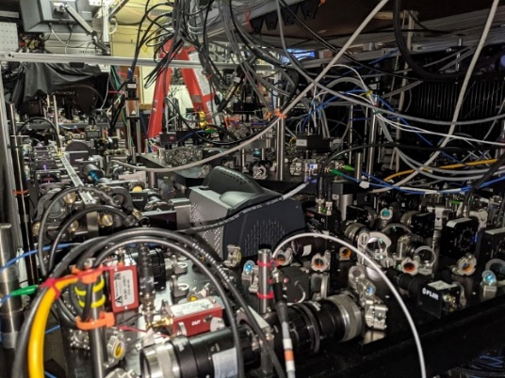
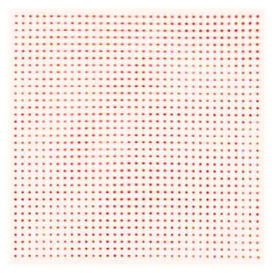
AQuA – Atomic Qubit Array
Rydberg CNOT gates in a 100 qubit scale array of Cs atoms

Slide 5
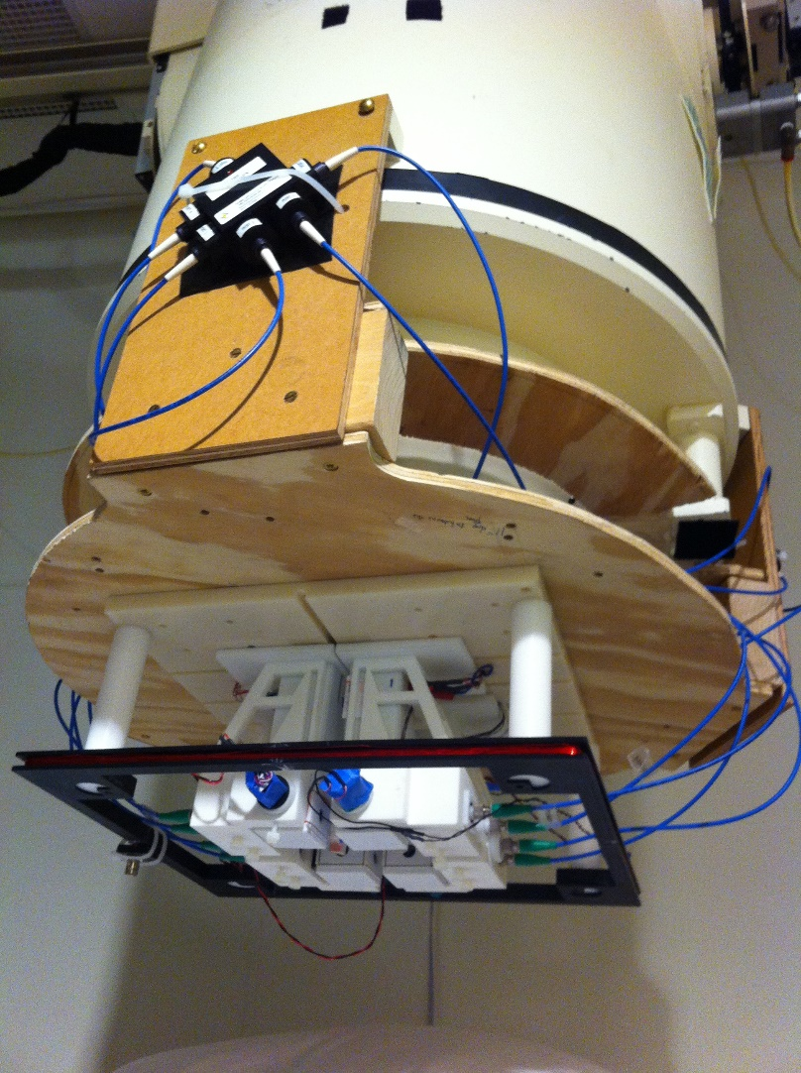
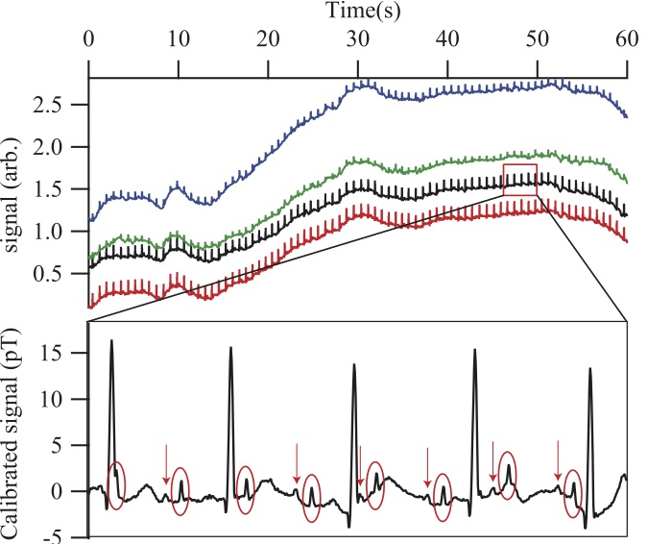
Walker Group: Quantum Sensors
Ultrasensitive magnetometry
Fetal heartbeats

Slide 6
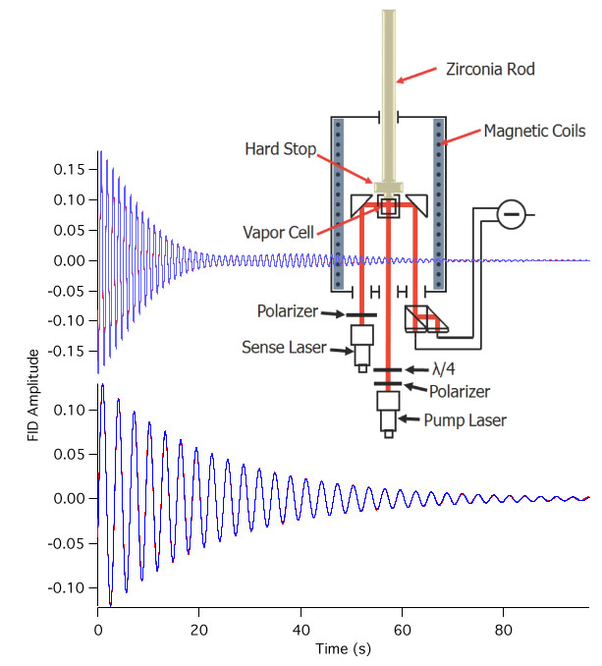
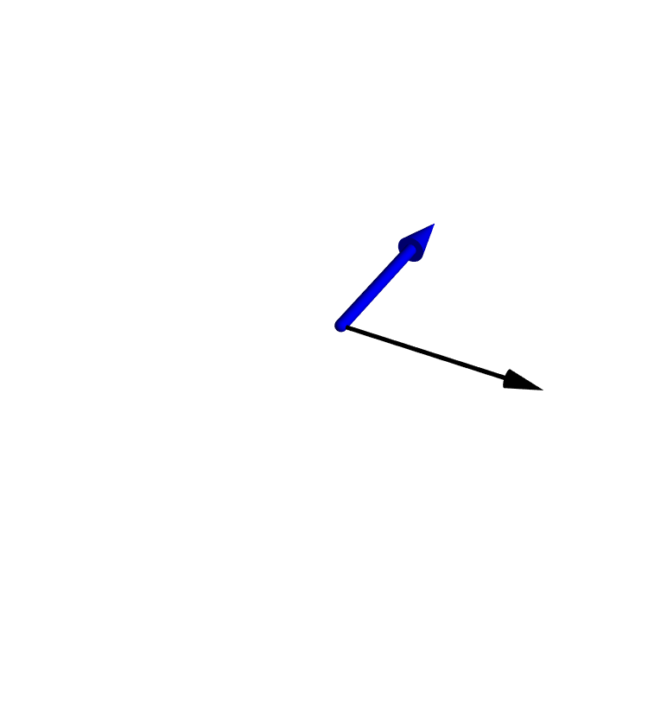
Walker Group: Quantum Sensors
Ultrasensitive NMR
Simultaneous measurement of 2 species to cancel magnetic noise, look for exotic forces
AXION Searches

Slide 7
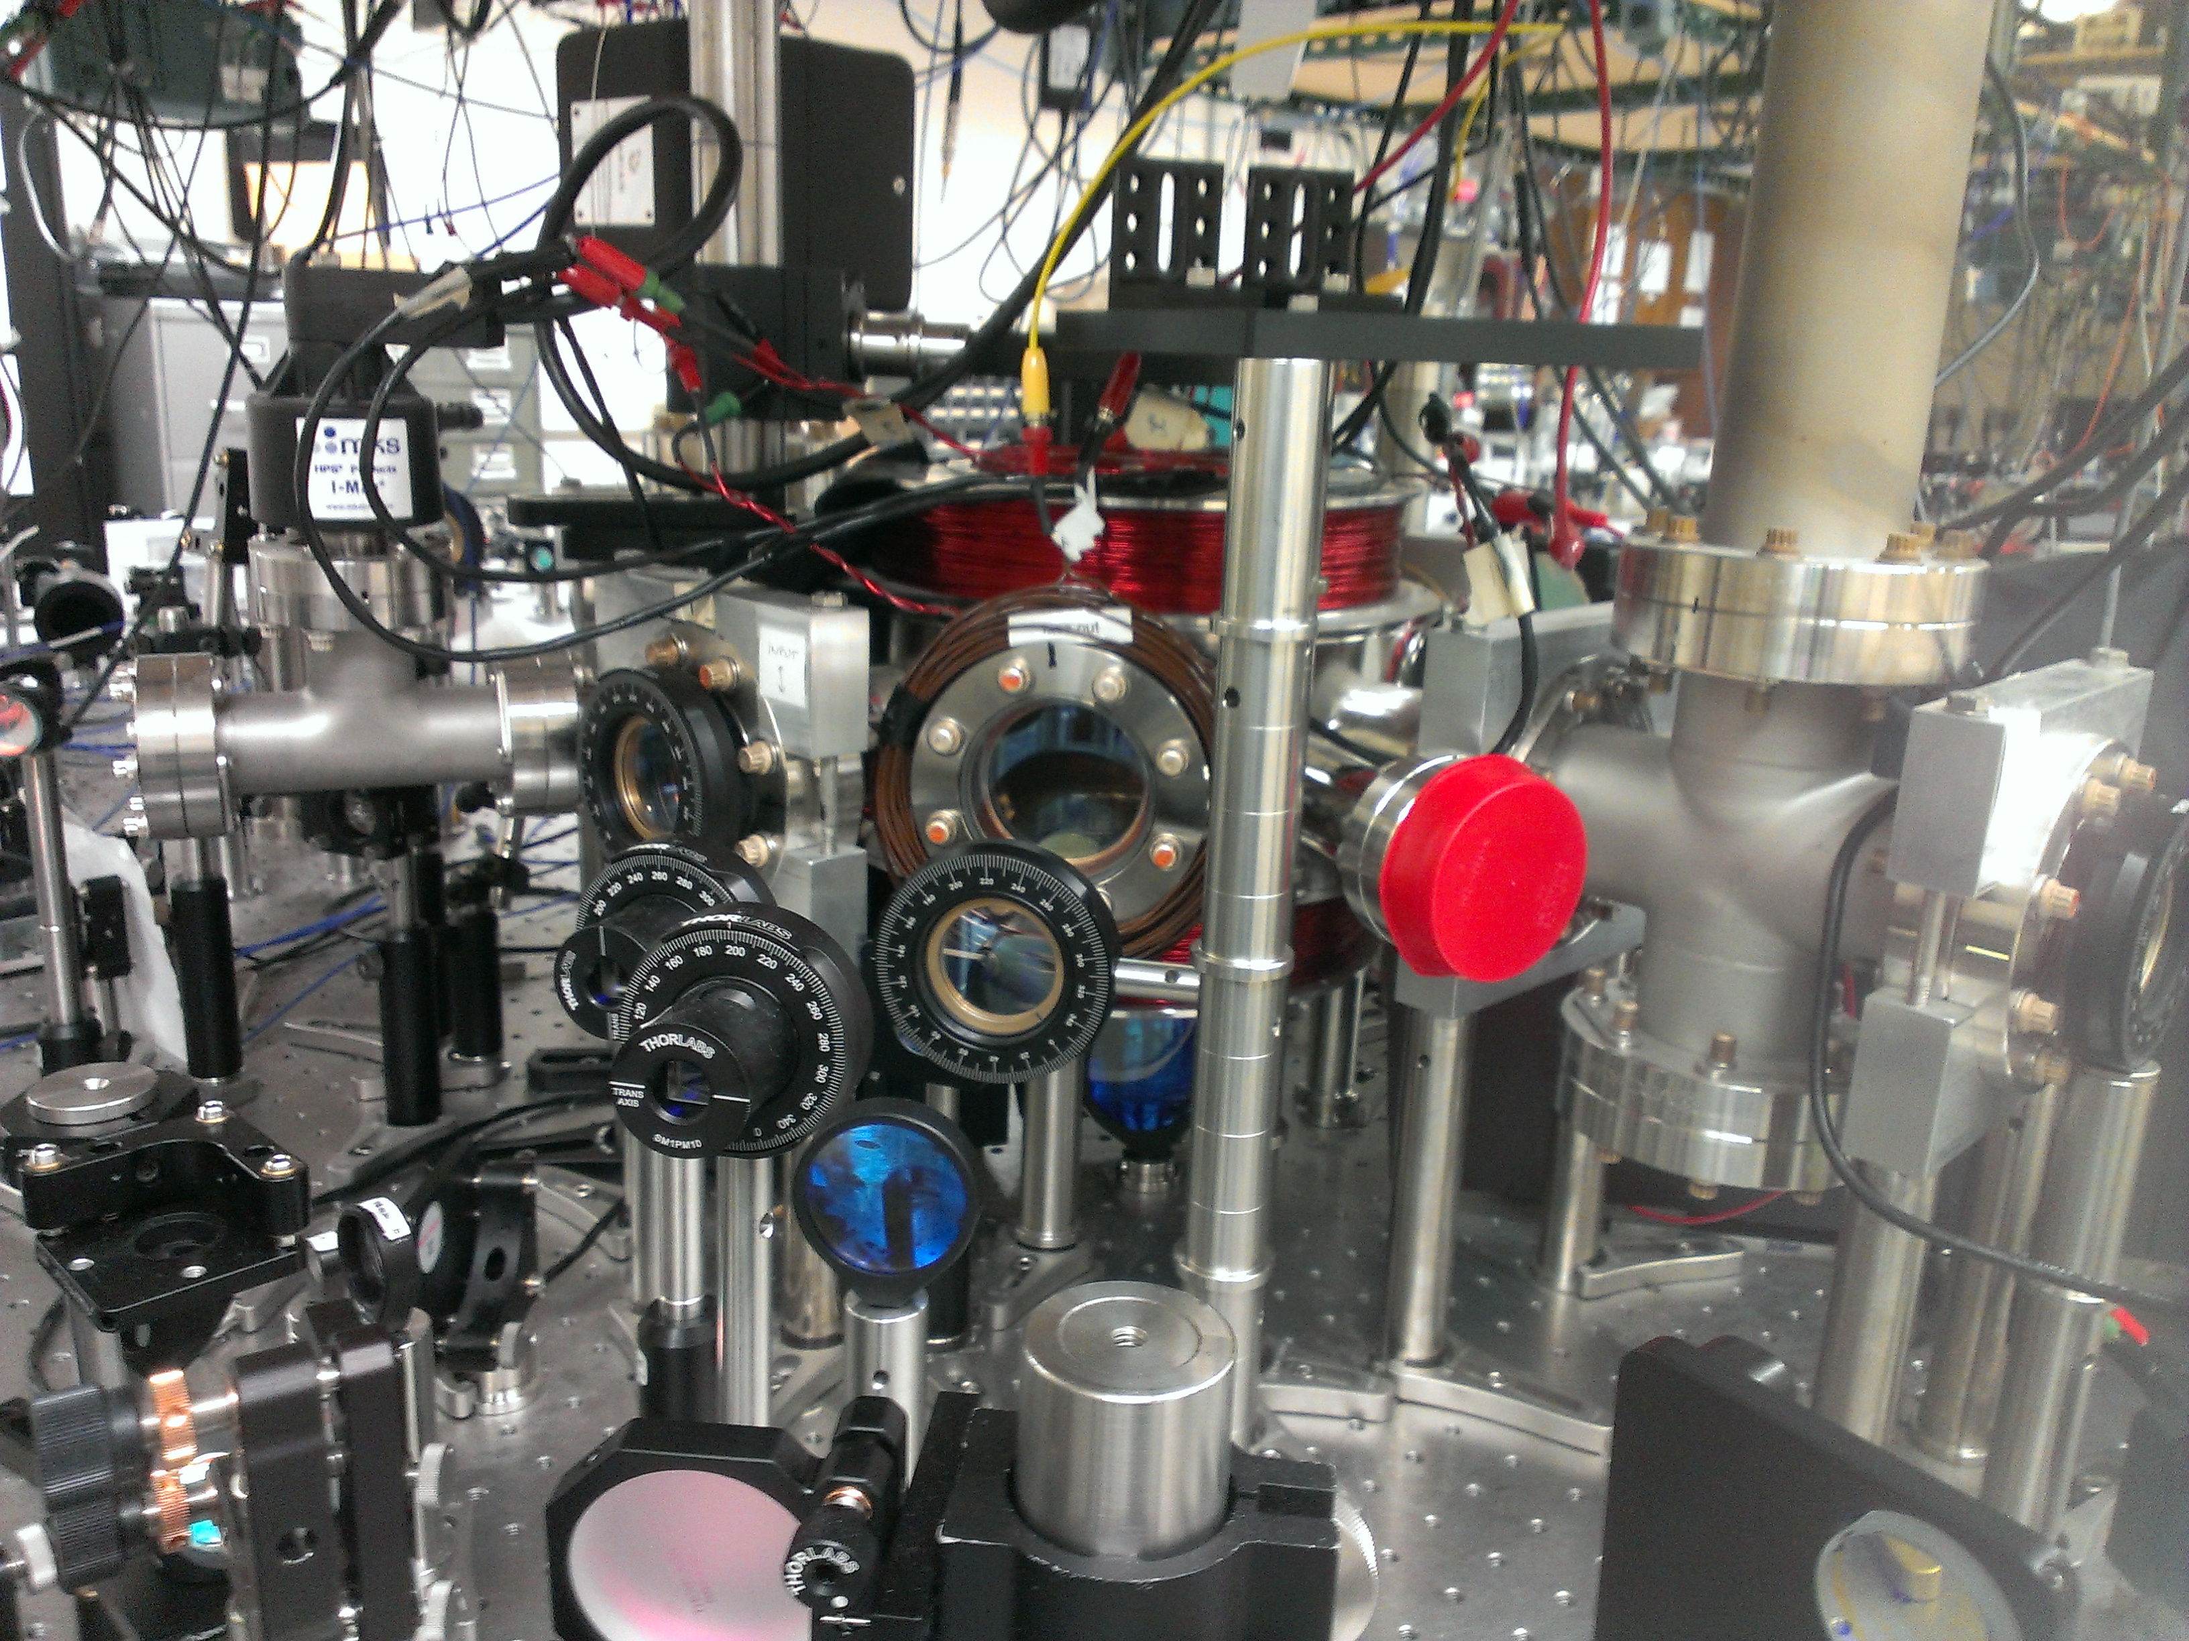
Current Projects In Deniz’s Group
Collective Spontaneous Emission
Ultrafast modulators
Axion detection using lasers

Slide 8

Collective Spontaneous Emission (With Profs. Saffman and Walker)
d
. . .
Superradiance
Subradiance
$$Γ$$
Directed emission
. . .
Dicke (1954)

Slide 9
Experiment: Time Domain Investigations
log (fluorescence)
Super-
radiant
Subradiant
Time/lifetime

Slide 10
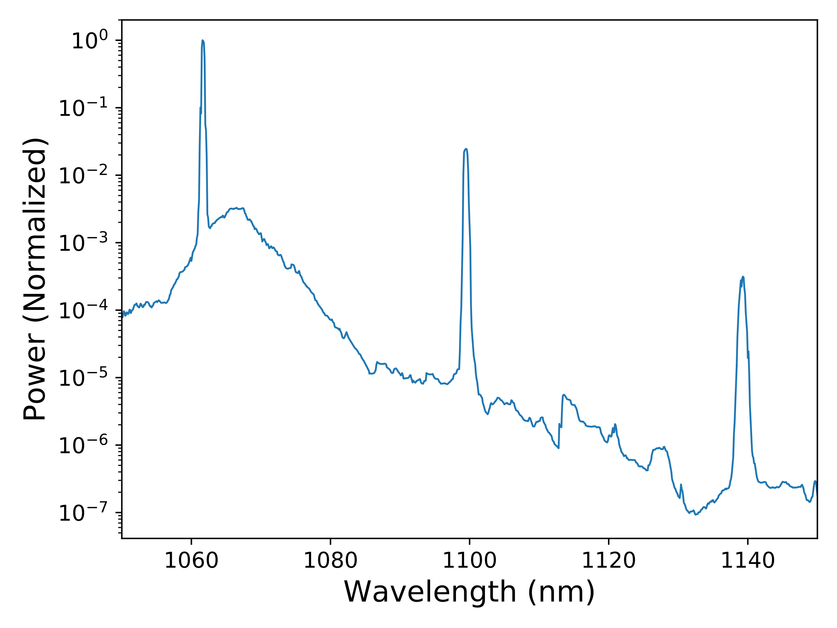
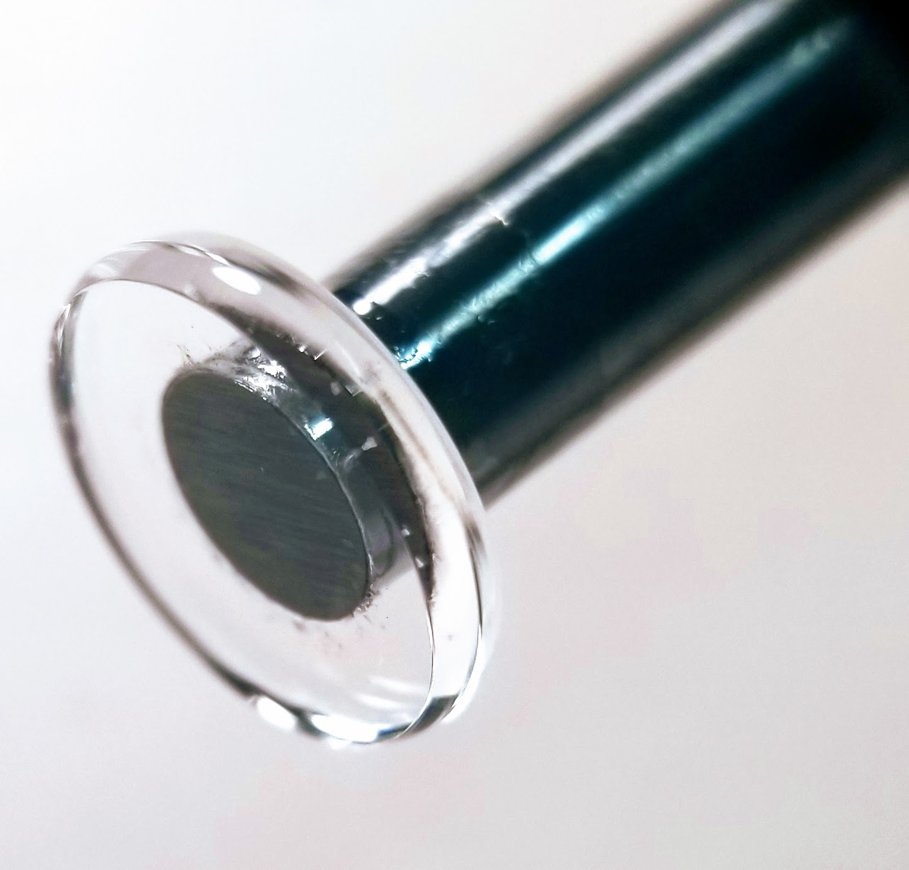
Light Modulation In Glass Disks
Pump
First
Stokes
10 THz
Second
Stokes
10 THz
1 mm

Slide 11
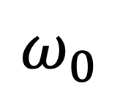
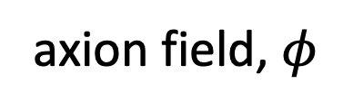
Axion generation and detection using lasers and fibers
axion field, $φ$
probe
detection
fiber
$$ω_{0}$$
mixing
Stokes
generation
fiber
pump

Slide 12
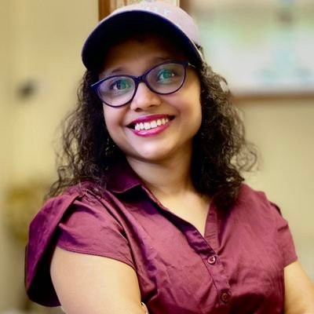
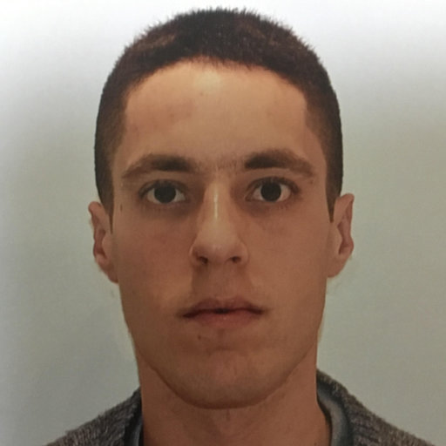
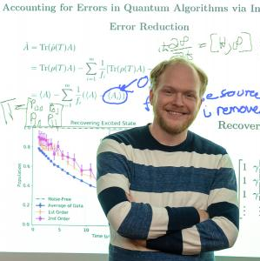
Prospective new AMO hires
Nancy Aggarwal—Quantum Optomechanics for high frequency GW detection
Or Katz—QI with Bosonic Excitation of Ion Strings
Matthew Otten—QI Theory and Simulation

Slide 13
Atom Trainers Alumni
Dan Thrasher-Sandia Natl Lab Elena Zhivun-Brookhaven Natl Lab Matt Ebert- Cold Quanta Zack Deland- Epic Systems Ibrahim Sulai-Bucknell U. Anna Korver-New Hope Tutorials Robert Wyllie-Georgia Tech Research Inst. Brian Lancor-Edgewood College Erich Urban- Aurora Oncology Erik Brekke- St. Norbert College Jason Day-DOD Basic Research Office Earl Babcock-Forshungszentrum Julich Jennifer Sebby-Strabley-Honeywell Ray Newell-Los Alamos Natl Lab Bien Chann-Founder, TeraDiode Ian Nelson- Columbia St. Mary’s Charles Sukenik-ODU Renee Nesnidal-Science from Scientists Steve Kadlecek-U Penn Samir Bali-Miami U. Joseph Tobiason-Mitatoyu R&D Paul Feng-IP, Stryker Robert Williamson-Daylight Solutions Dominik Hoffman- SAIC | Small Companies: 4 Research Universities: 3 Liberal Arts Colleges: 3 Research Institutes: 3 National Labs: 3 Large Corporations: 3 Medical Physics: 2 Science outreach: 2 Gov’t advisor: 1 Intellectual Property: 1

