Slide 1


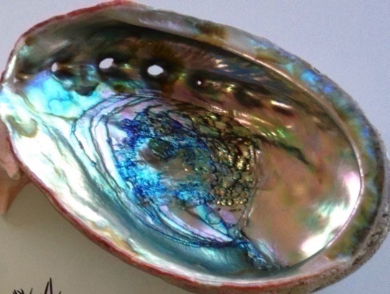


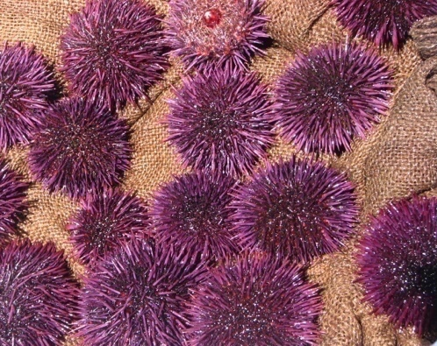
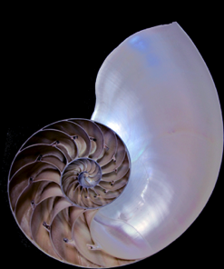


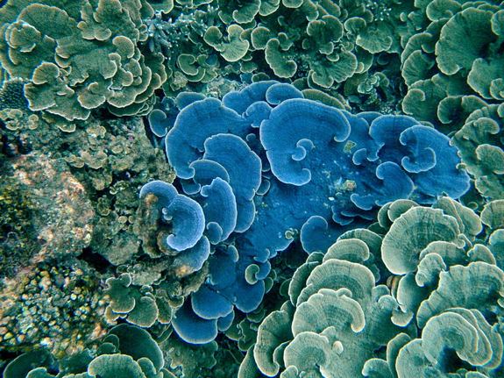
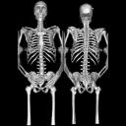
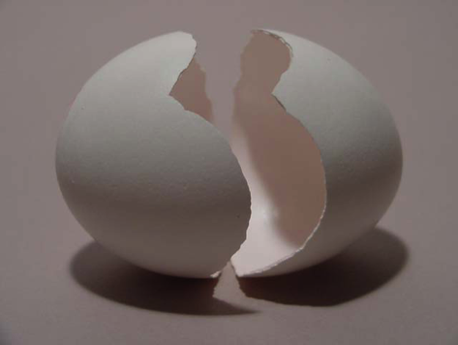


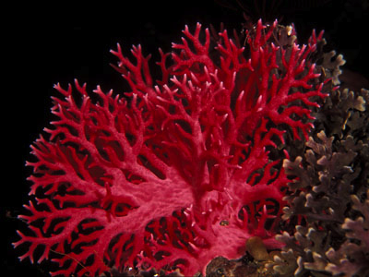
Biominerals
Pupa Gilbert
UW-Physics
Pupa Gilbert
E-mail: pupa@physics.wisc.edu
You can also meet with Pupa’s students and visit her lab
in Chamberlin Hall!

Slide 2

Great Barrier Reef, Australia, 2006
How corals form their skeletons matters for their survival in a changing climate
We revealed that corals deposit their skeletons one nanoparticle at a time, and eventually build entire reefs

Slide 3
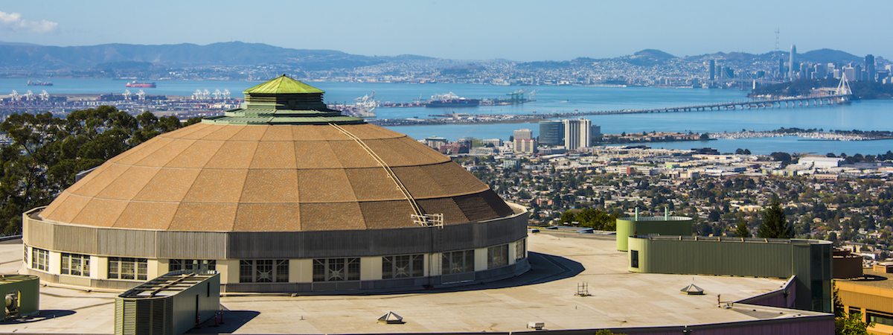
My group and I develop cutting-edge, high-resolution methods
to understand how biominerals grow:
Amorphous phases and phase transitions & Crystal orientations
(Component mapping & PIC mapping)
Advanced Light Source, Berkeley, CA

Slide 4
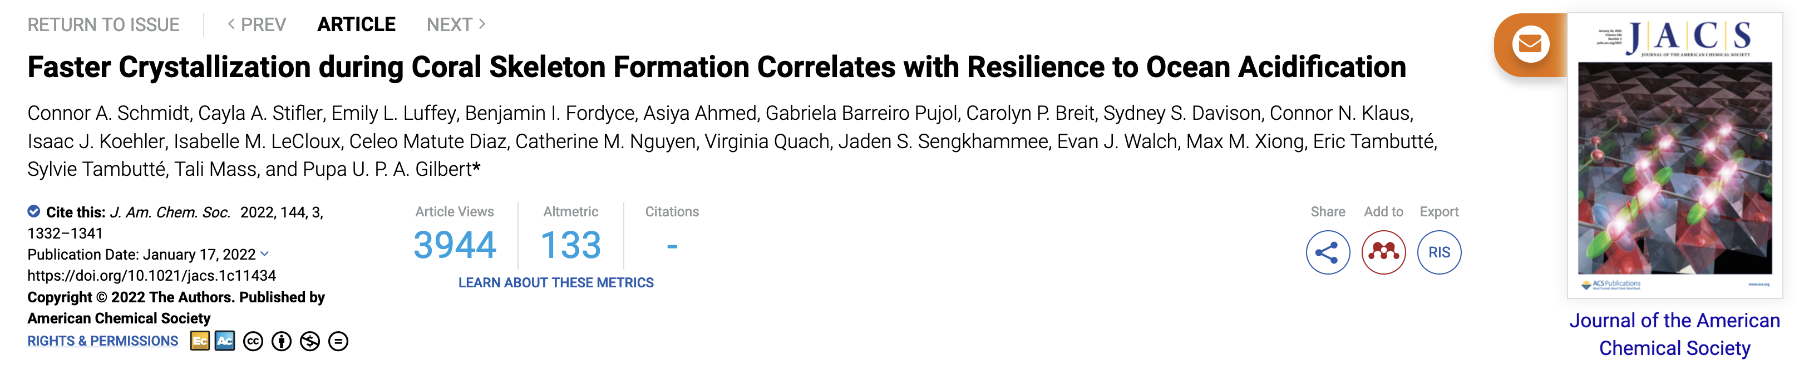
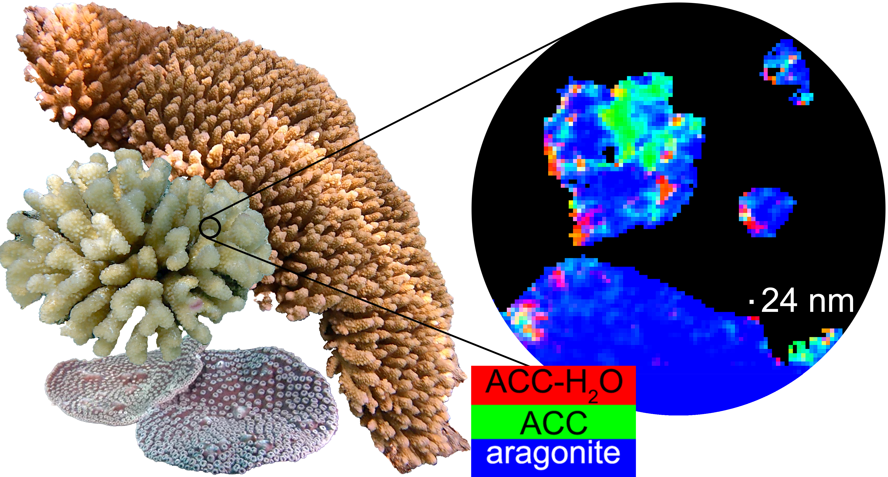

Slide 5

Thank you for your attention
Questions?
e-mail me at pupa@physics.wisc.edu
You can also meet with my students and visit my lab
in Chamberlin Hall!
work supported by
DOE: BES-Geosciences
NSF: DMR-BMAT
BSF, Radcliffe IAS

Slide 6











Exploring the World with X-ray Vision
We Harness the Power of X-rays to:
Investigate Nonlinear Phenomena and Develop New Methods
Follow Chemical Reactions and Structural Changes in Real Time
Uncover Secrets of Our Natural History and Cultural Heritage
Ryan Ash
Zain Abhari
Roberta Candela
Minhal
Gardezi
Noah Welke
Muneeza
Munawar
Sophie
Vogelsang
Caleb
Robinson
Rafaella
Georgiou
Masoud
Lazemi
(Utrecht)
https://bergmann.physics.wisc.edu

Slide 7
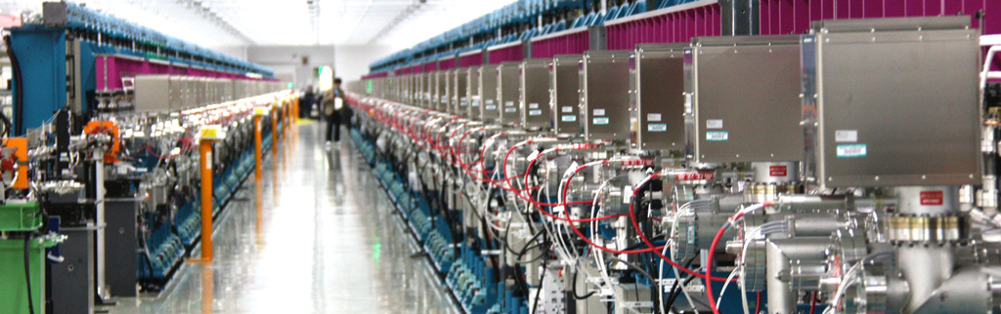
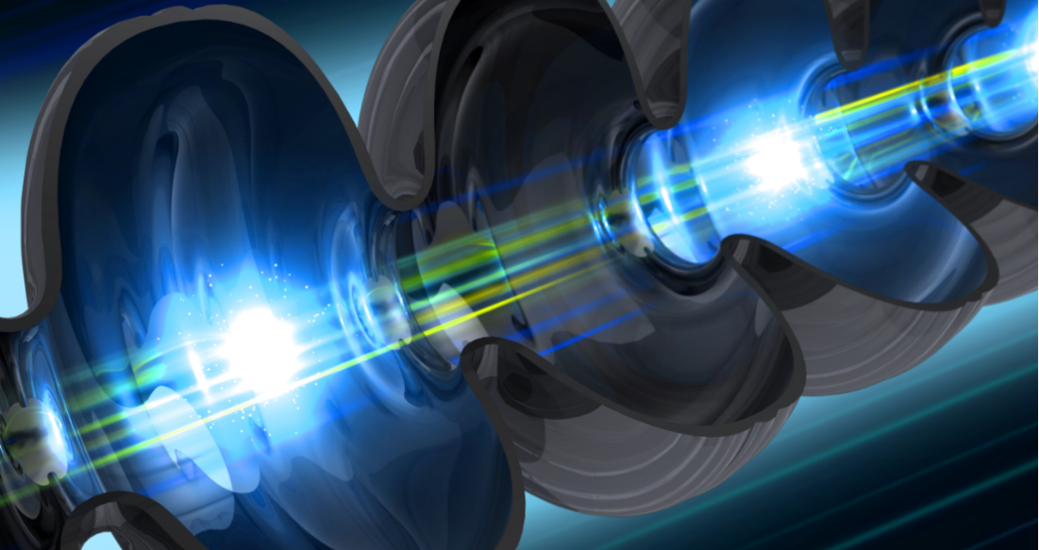
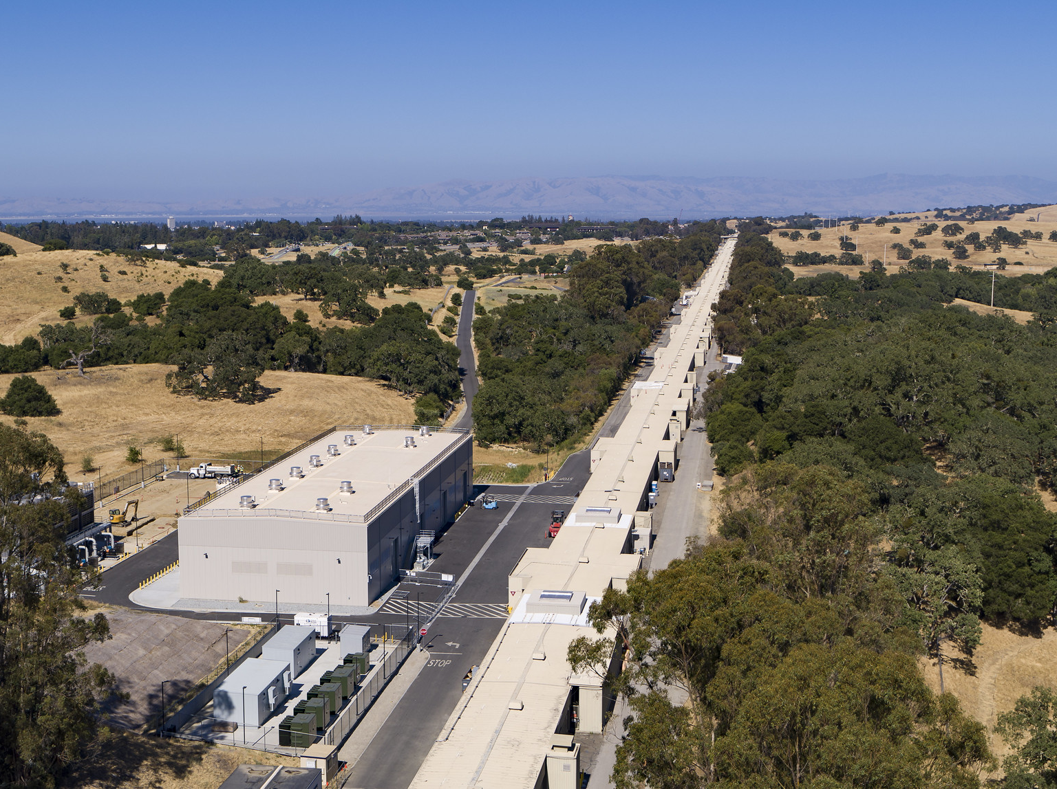
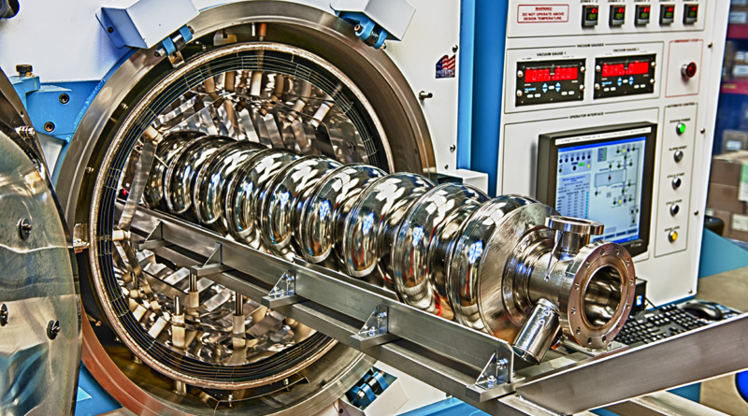
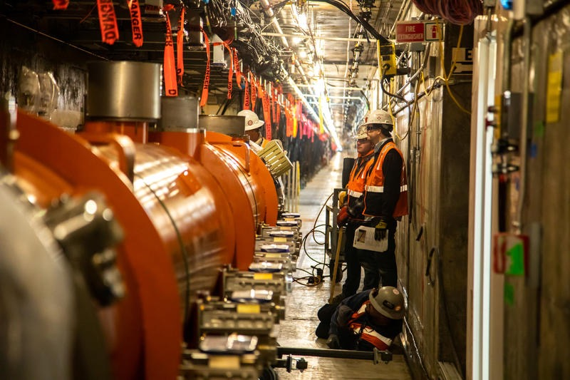
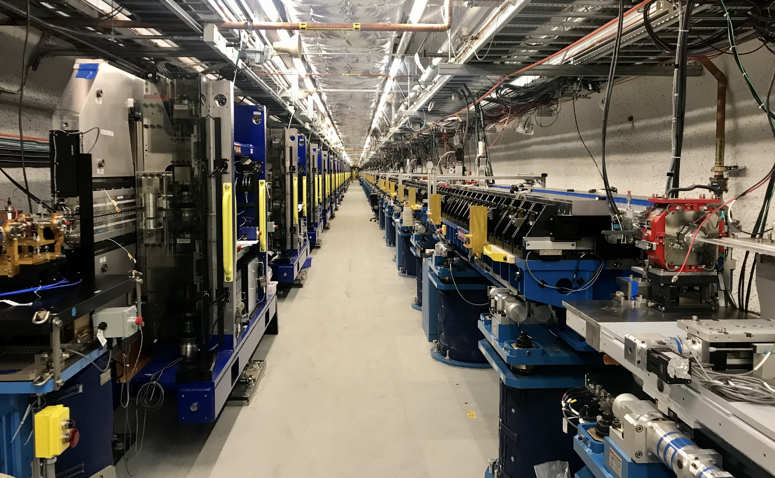
We use X-ray Lasers

Slide 8
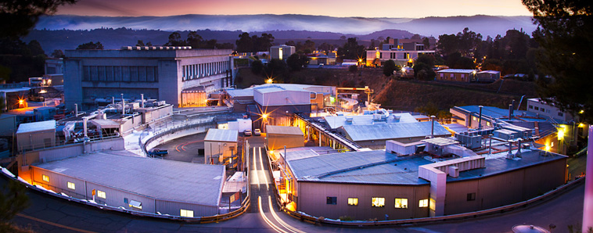
We use Synchrotron Facilities

Slide 9
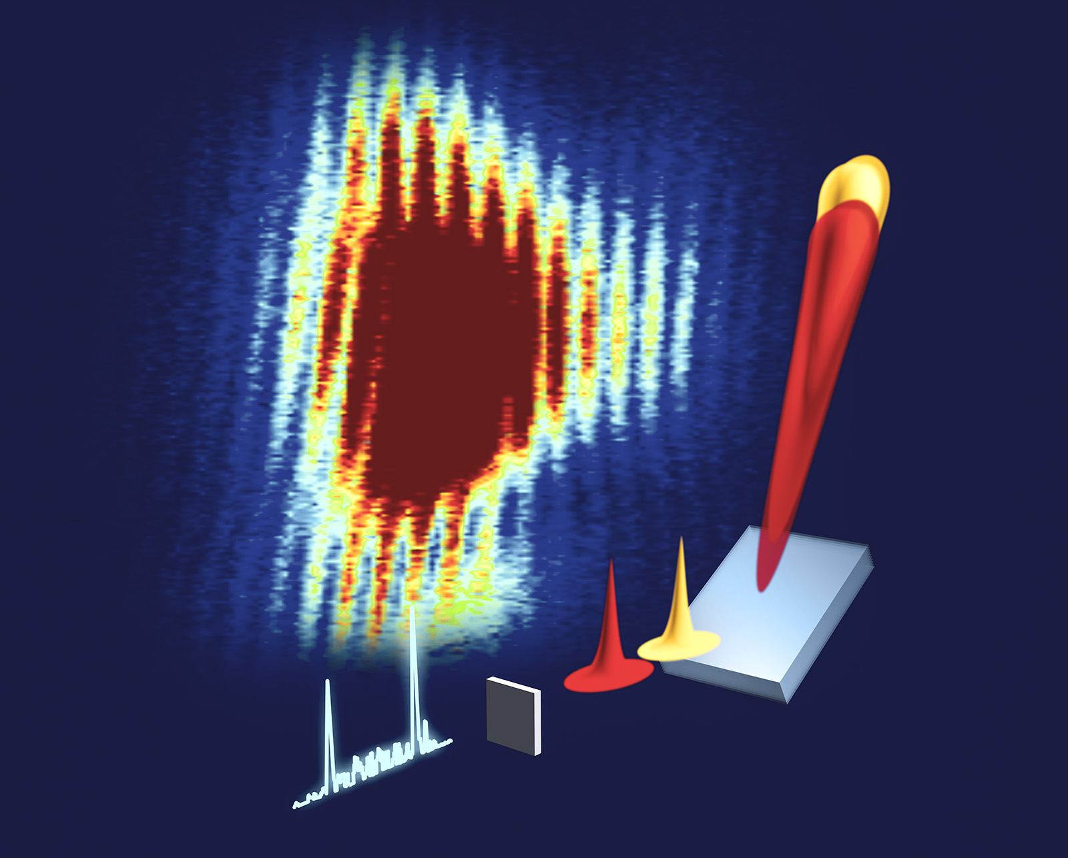
Animation: Greg Stewart, SLAC Infomedia

Slide 10

We make real-time movies of the molecules that plants use to split water

Slide 11

courtesy of SLAC
Fuller et al., Nature Methods (2017) doi:10.1038/nmeth.4195

Slide 12
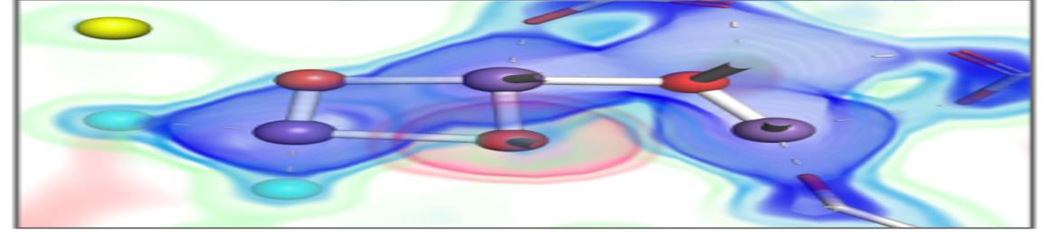
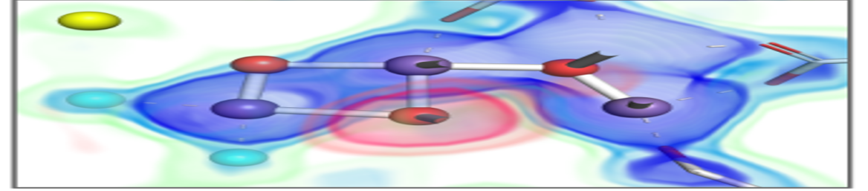
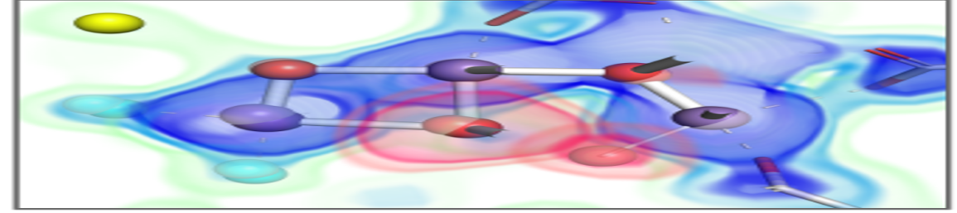
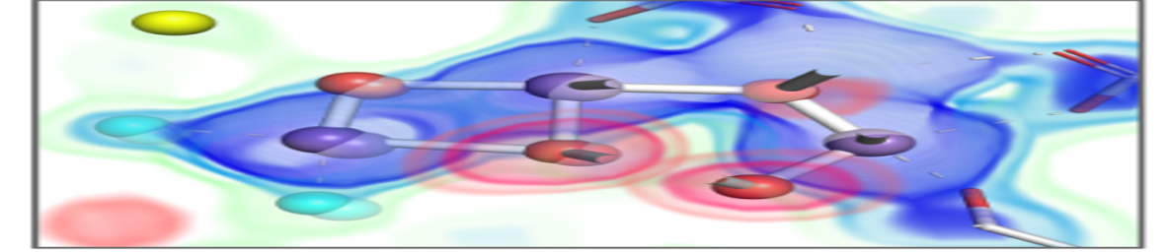
Manganese Cluster in Photosystem II at work

Slide 13
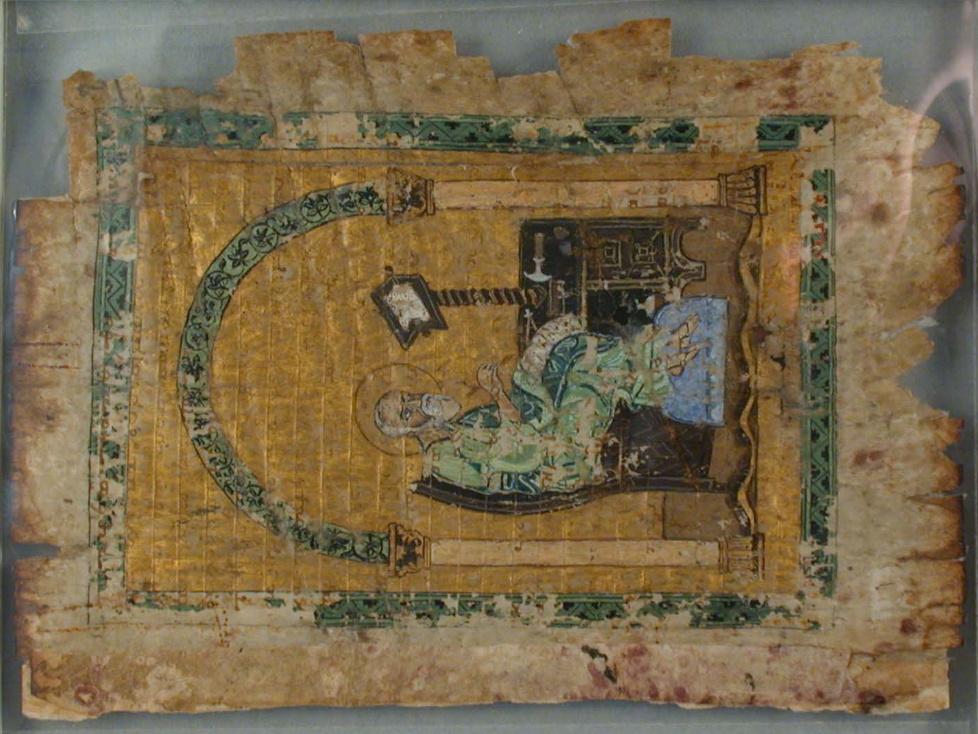
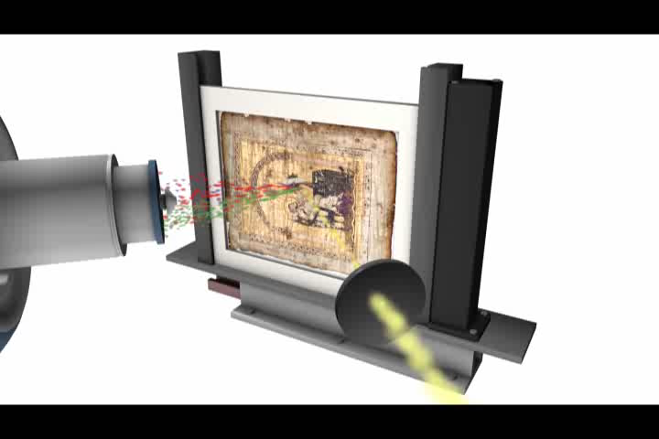
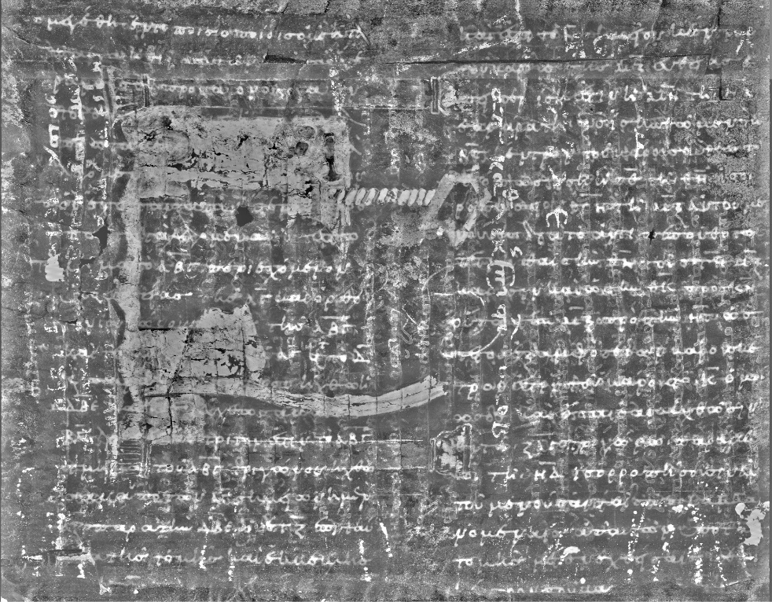
We use X-ray fluorescence to uncover hidden writings
in ancient books and trace elements in fossils

Slide 14

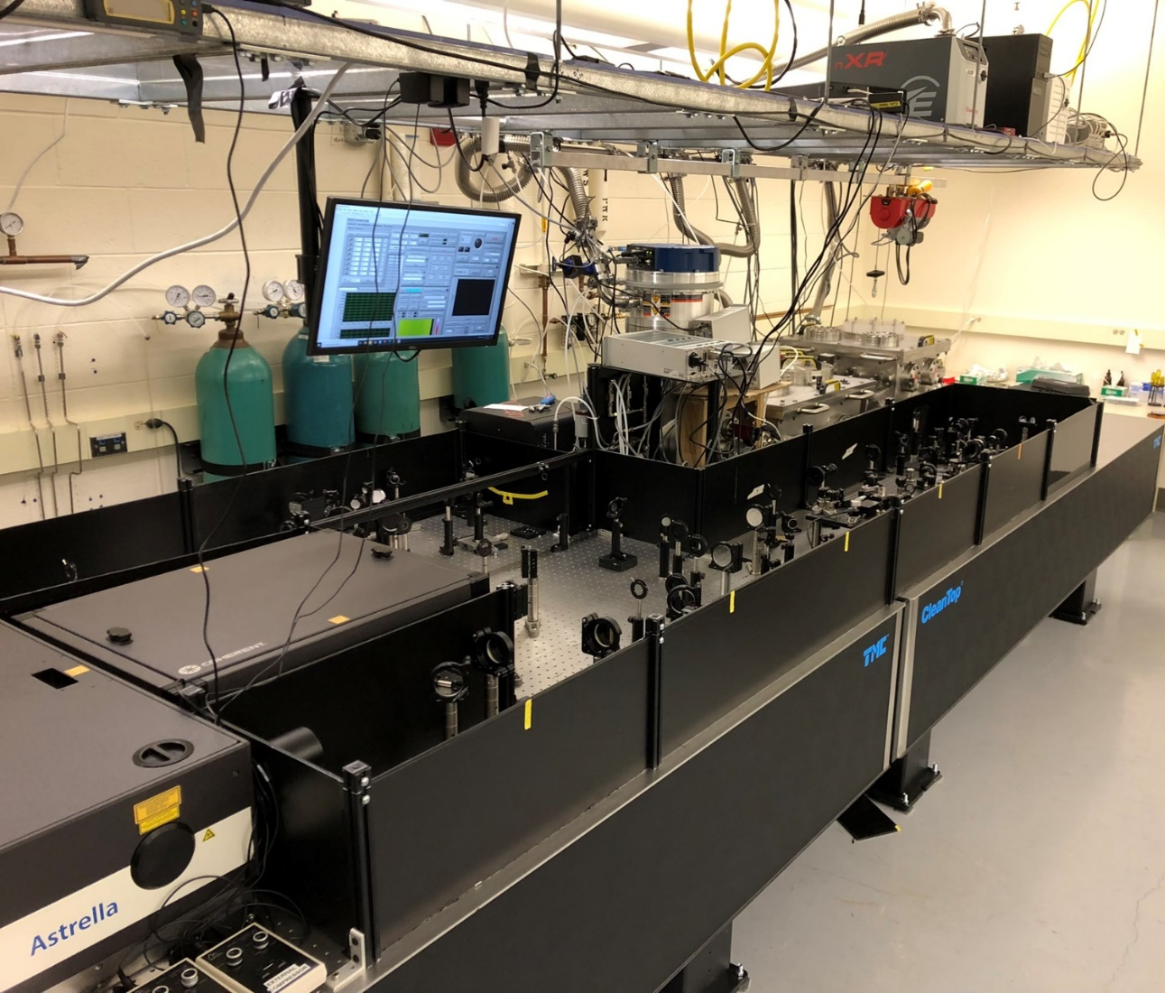
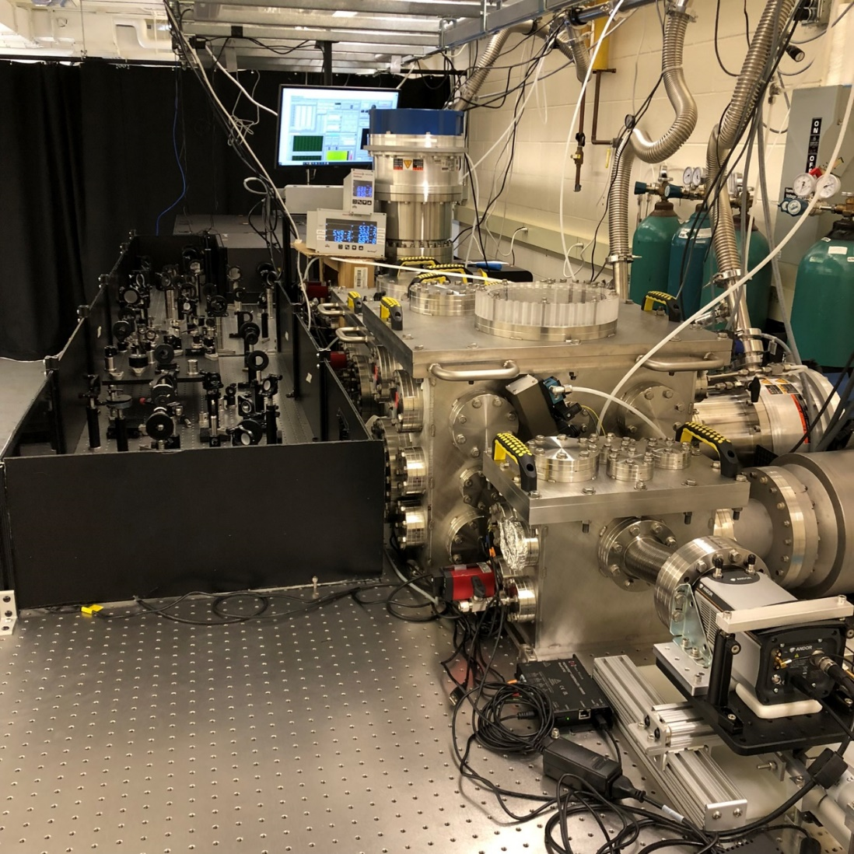
XUV Femtosecond Absorption Spectroscopy Tabletop
We use our new X-FAST instrument at Chamberlin Hall

Slide 15

Meet our group and visit our lab
at 1306, 1322, 1324, 1326 Chamberlin Hall
Contact us at:
ubergmann@wisc.edu
Check out our website at:
https://bergmann.physics.wisc.edu

