Slide 1

CMS
UW-Madison
High Energy Physics
ATLAS

Slide 2
Measuring Details of High Energy Physics
CERN
Large Hadron Collider
Geneva, Switzerland
Exploring the Fundamental Theories that Explain the Universe

Slide 3
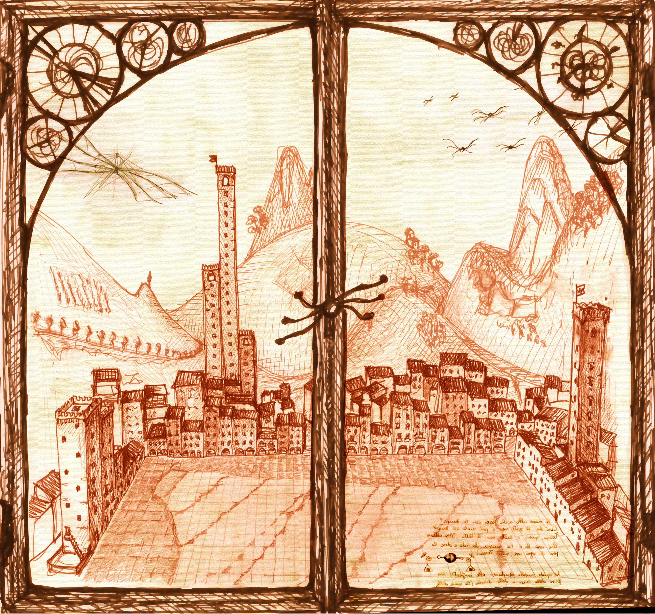
Opening Doors to New Exotic Physics
Courtesy of our resident Leonardo – Sergio Cittolin

Slide 4
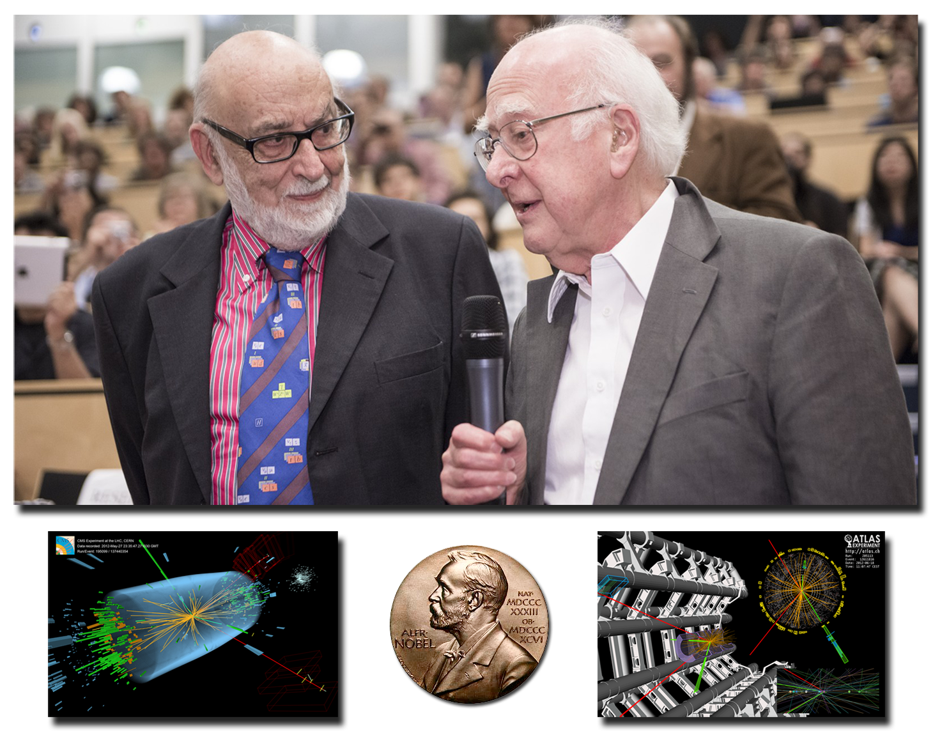
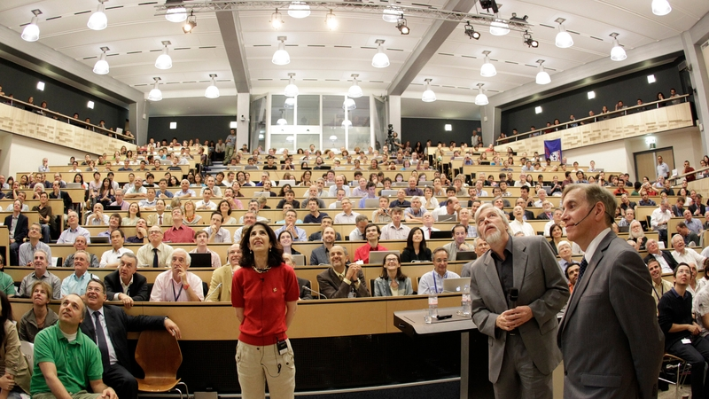
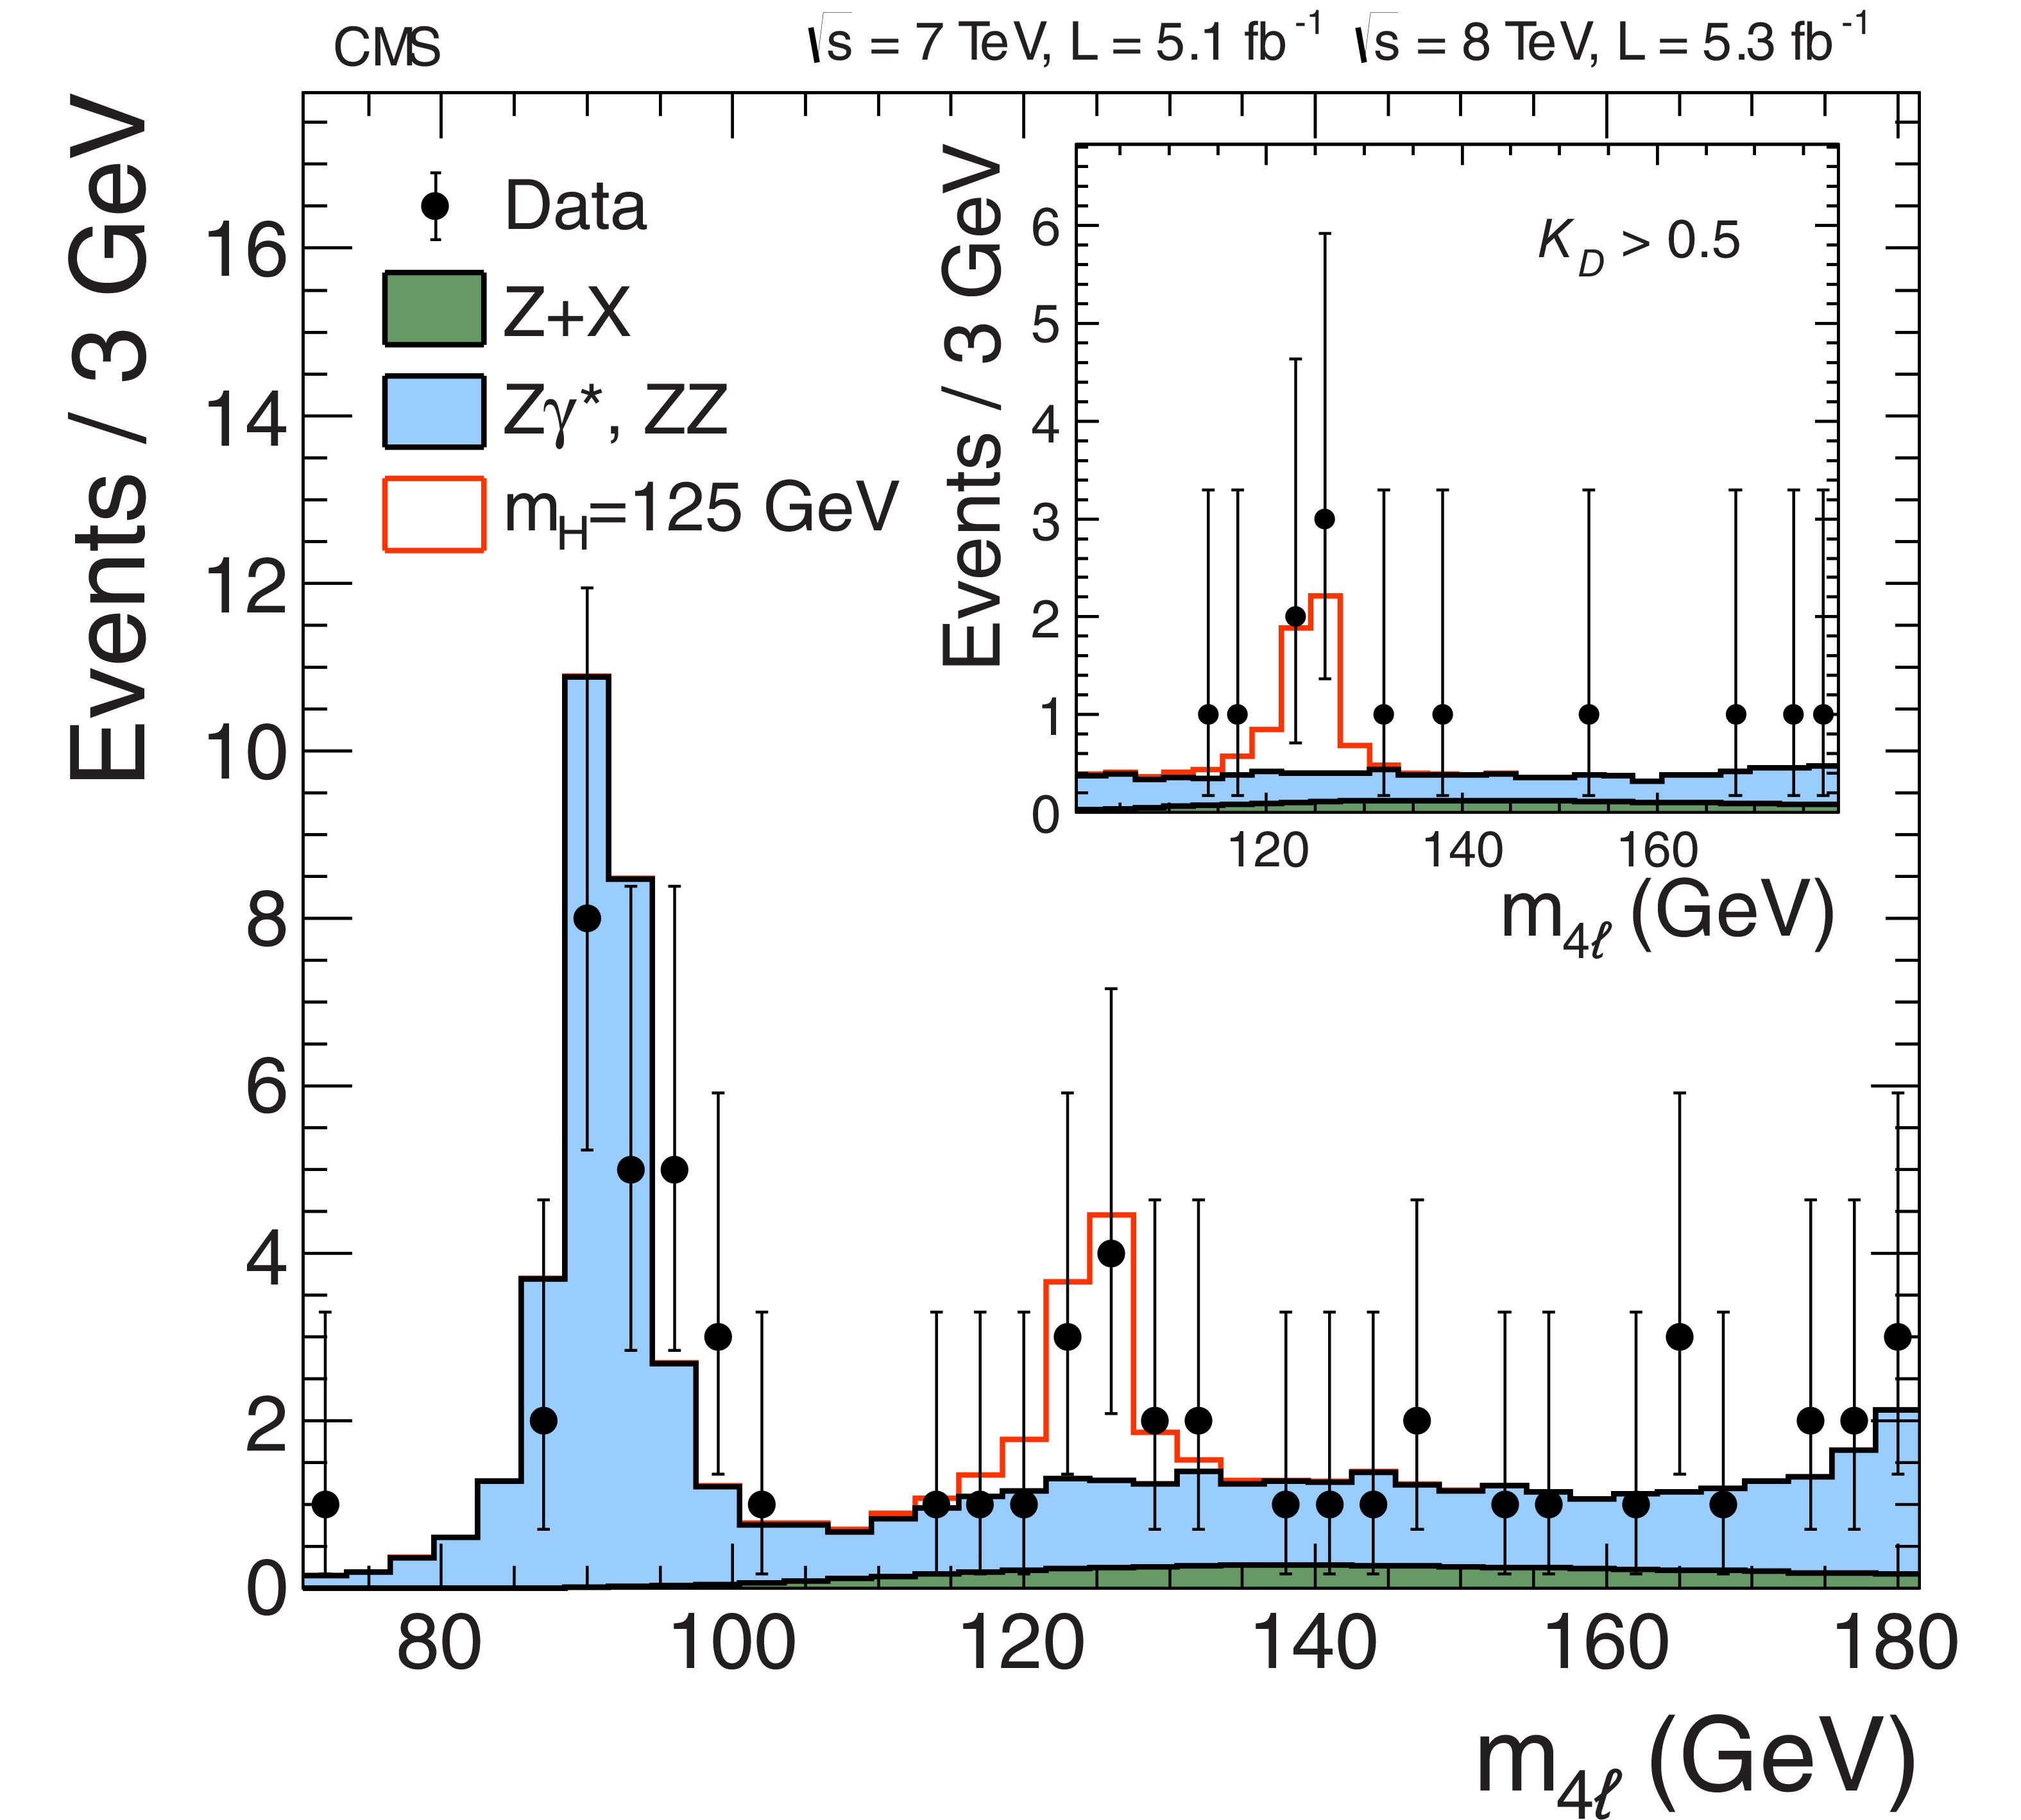
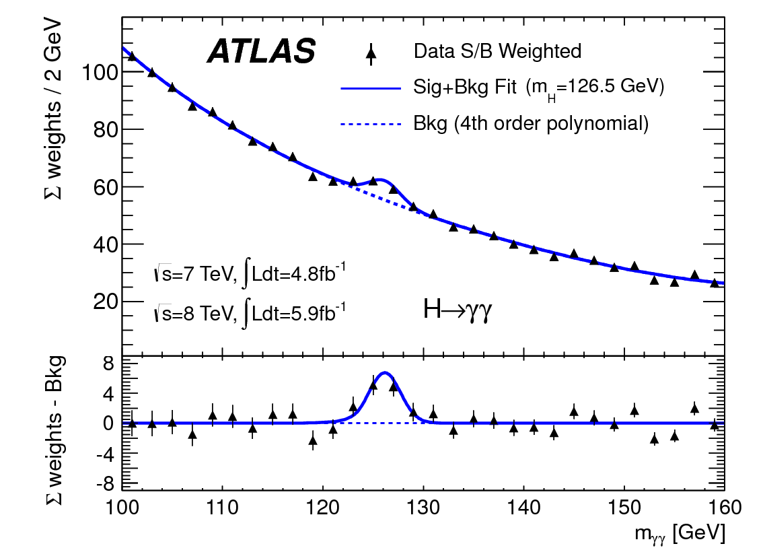
HEP Experiment
CMS
ATLAS

Slide 5
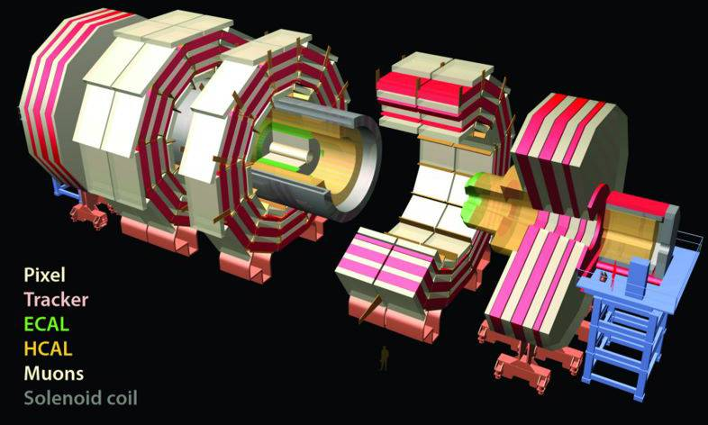
The CMS detector
Took ~2000 scientists and engineers more than 20 years to design and build
Is about 15 metres wide and 21.5 metres long
Weighs twice as much as the Eiffel Tower – about 14000t
Uses the largest, most powerful magnet of its kind ever made
100 meters underground
Notes:
This slide only works on PC. It uses a “flash” animation with a plug-in that can be found at: http://members.fortunecity.com/birbilis/QT4Delphi
When this is displayed yo
Equal to 40 large airplanes
u can put the mouse on the image and drag it around. The younger audiences in particular love this!
5

Slide 6
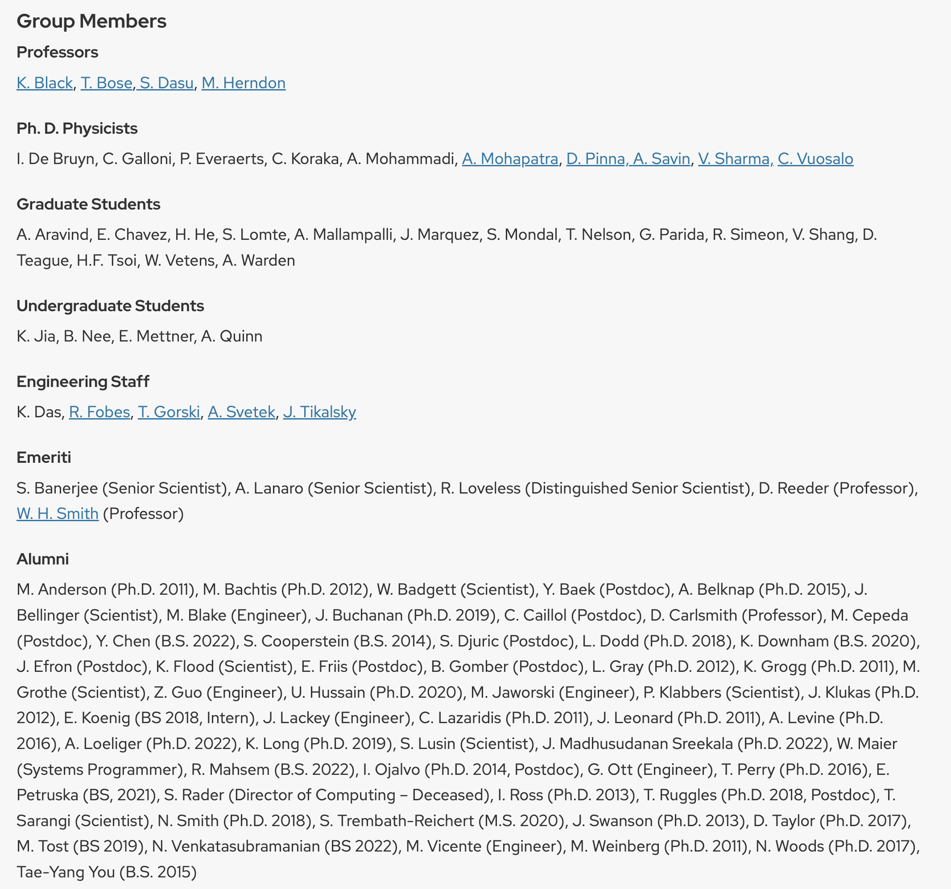
UW LHC Groups
CMS Bose, Black, Dasu, Herndon Group
Wu Group: ATLAS
Cranmer Group: ATLAS + data science
See backup for full details
Leading the field of Particle Physics!
Bose and Cranmer: members of P5 The Particle Physics Projects Prioritization Panel

Slide 7
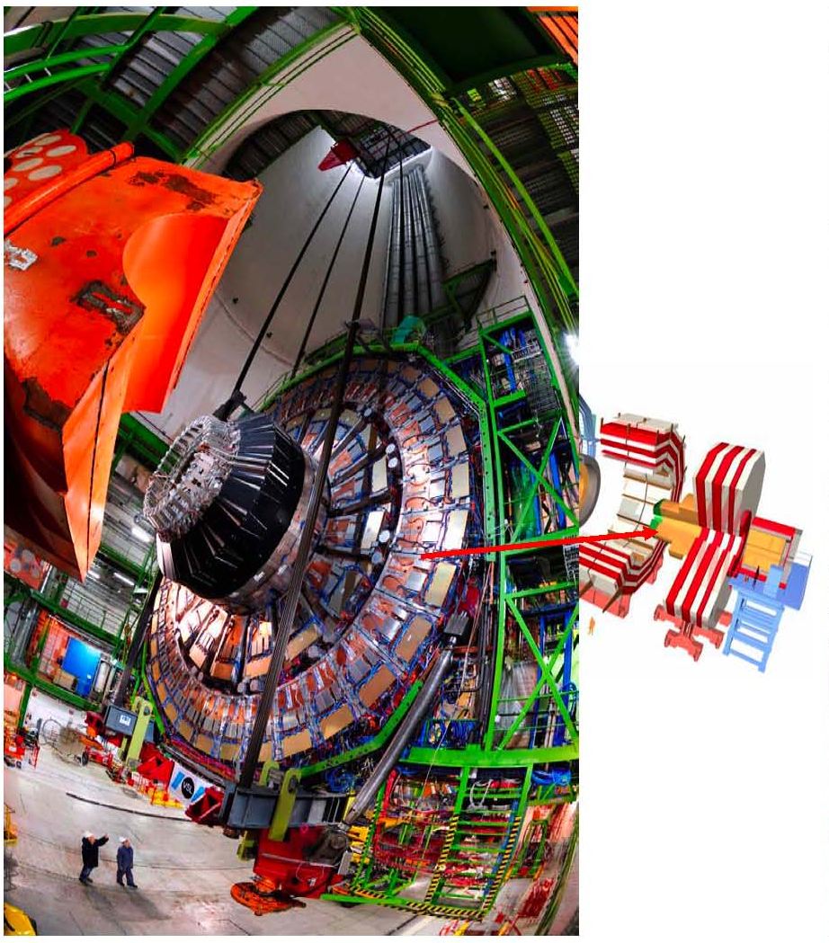
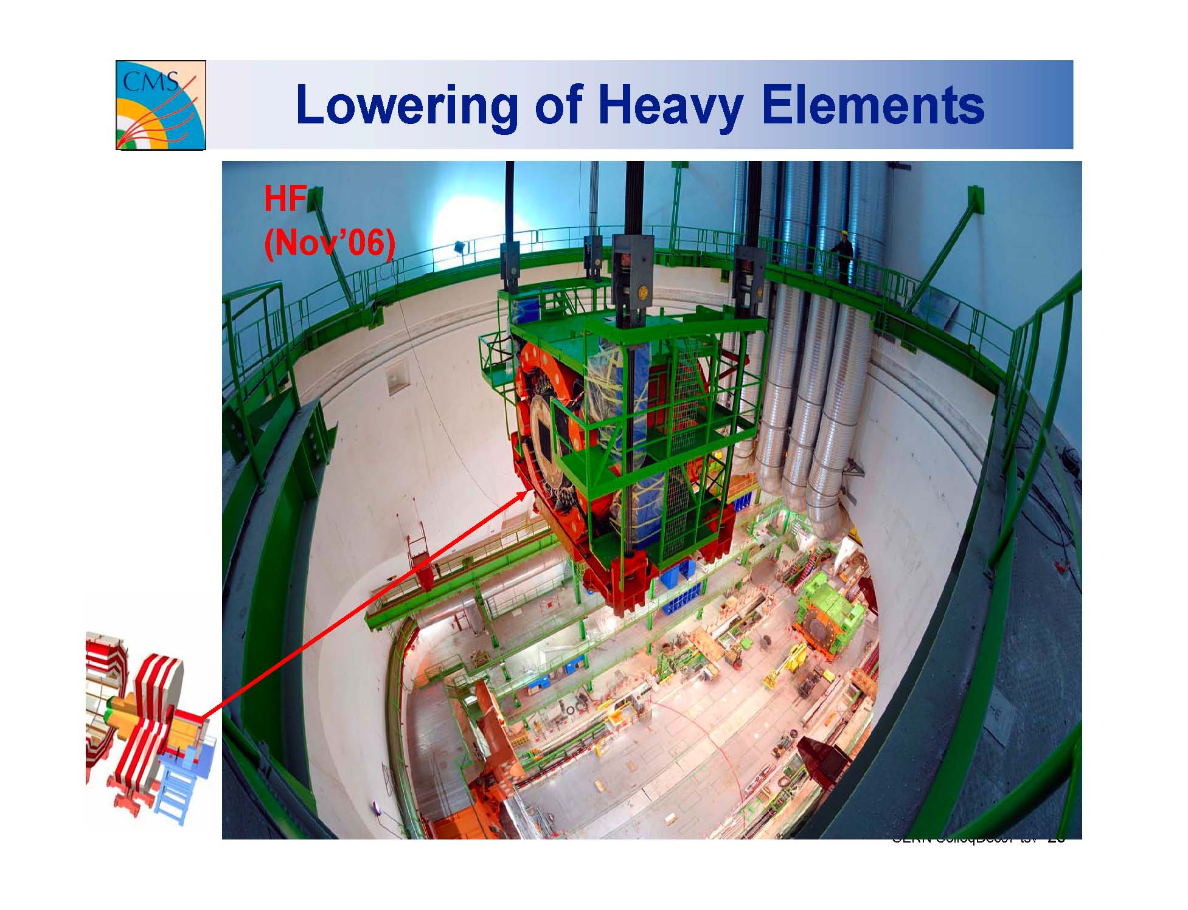
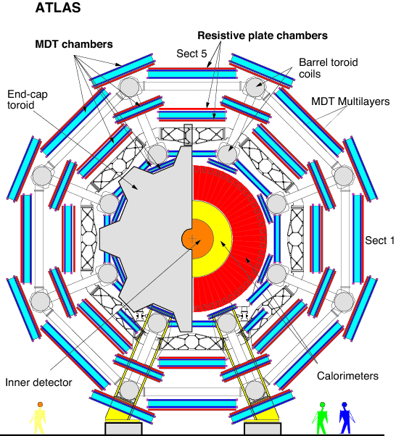
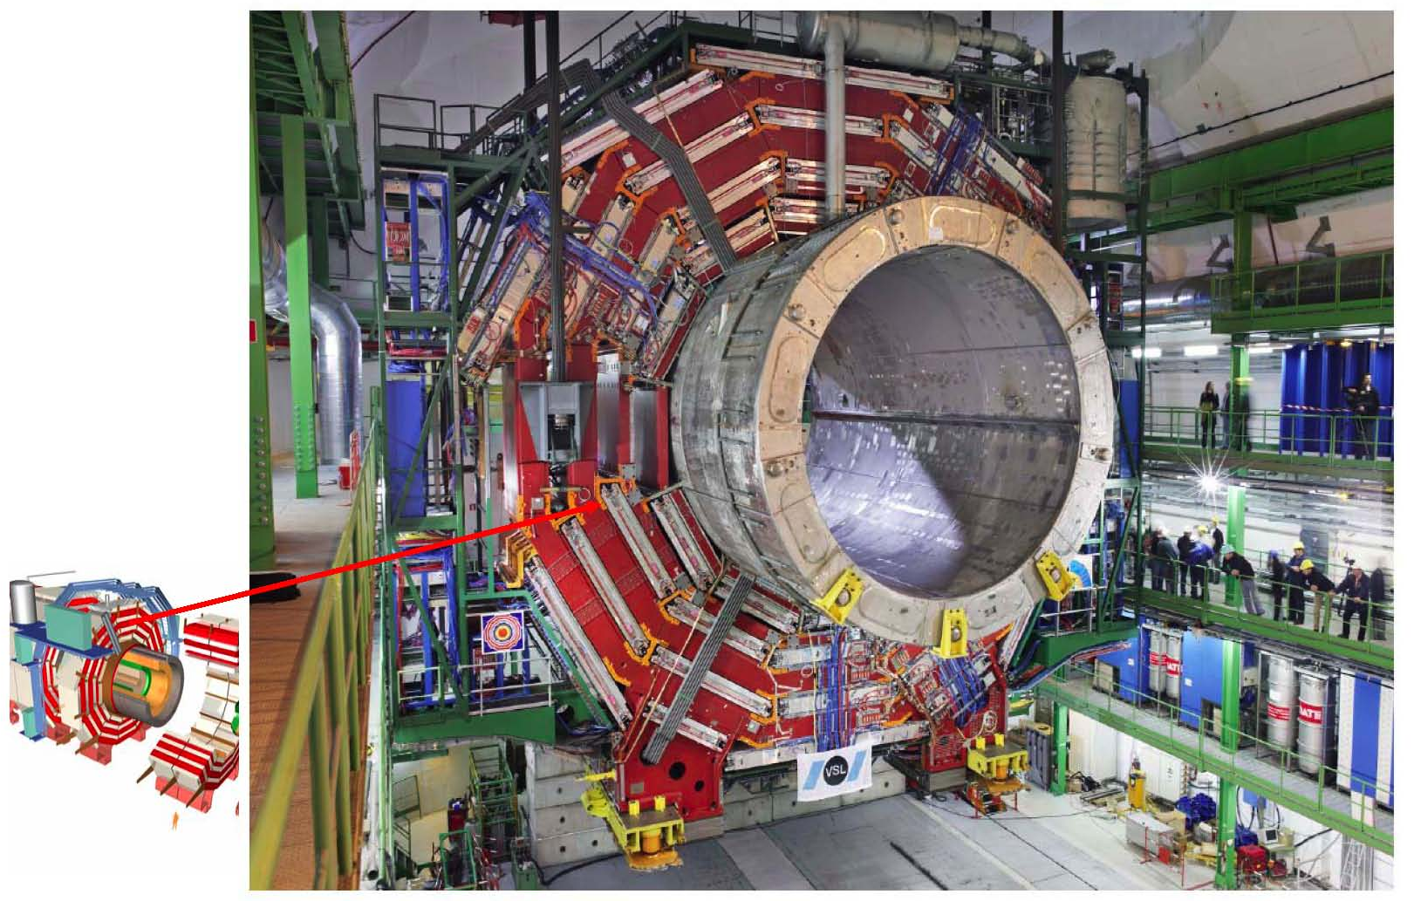
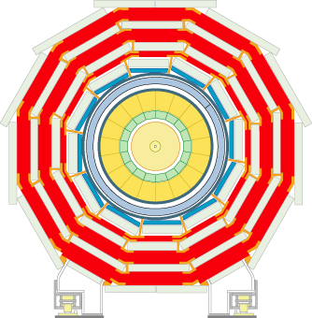
The CMS detector
That’s big and heavy!
Though compact compared to ATLAS
How did it get down there?
UW did it!
Notes:
This slide only works on PC. It uses a “flash” animation with a plug-in that can be found at: http://members.fortunecity.com/birbilis/QT4Delphi
When this is displayed yo
Equal to 40 large airplanes
u can put the mouse on the image and drag it around. The younger audiences in particular love this!
7

Slide 8
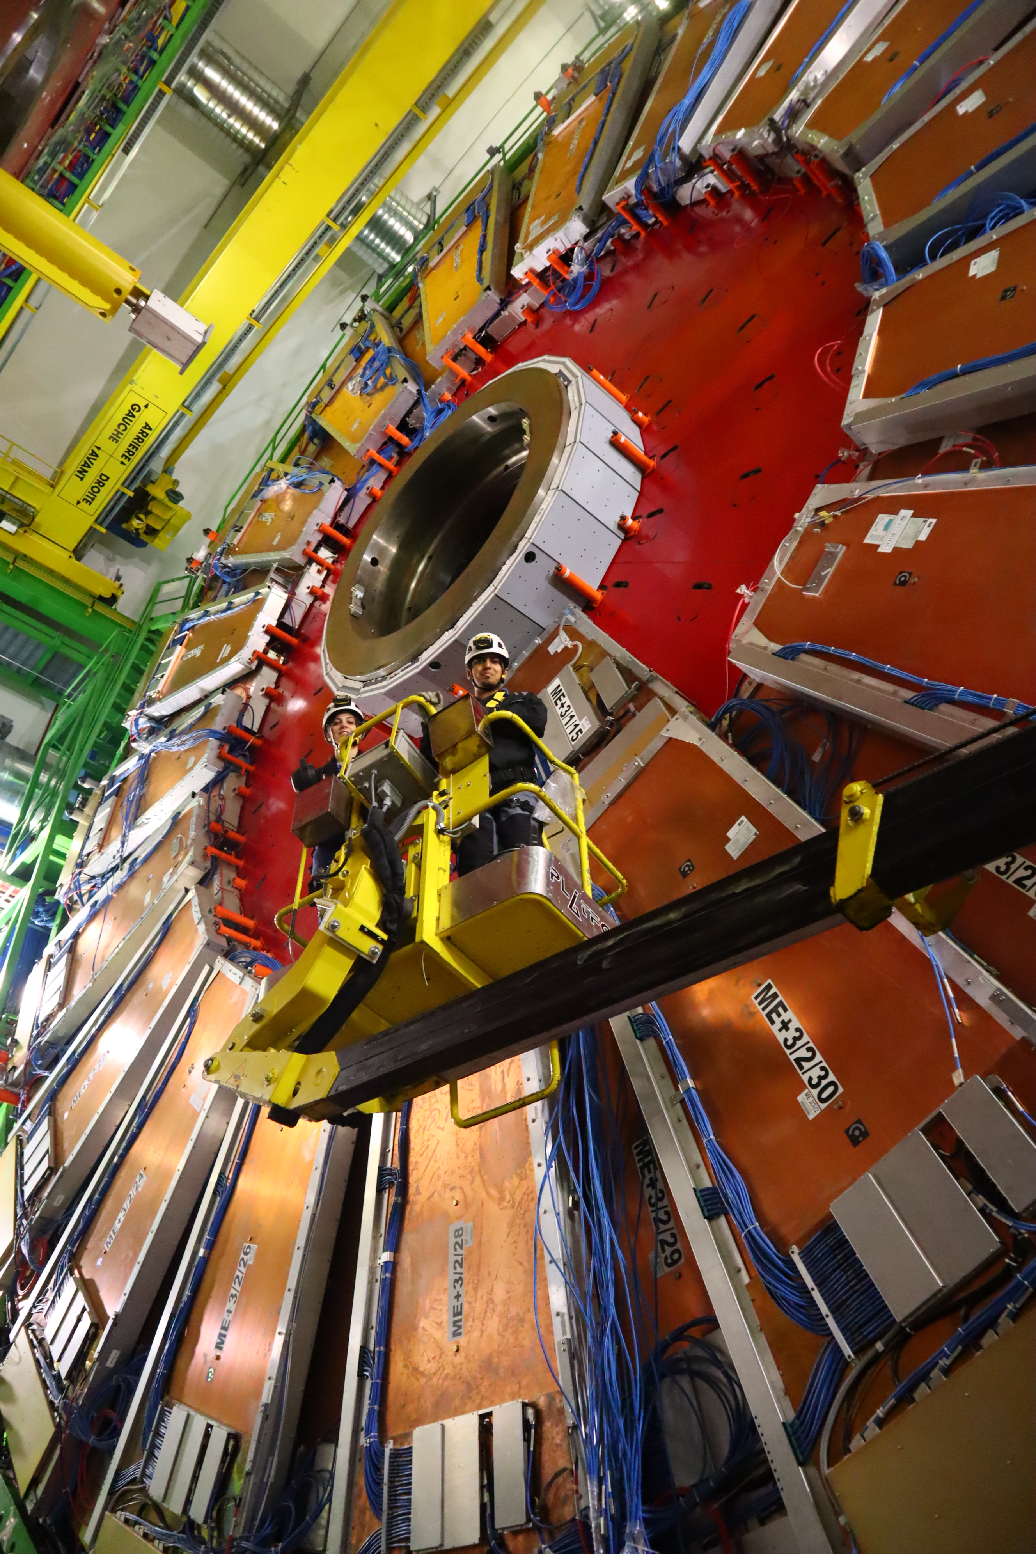
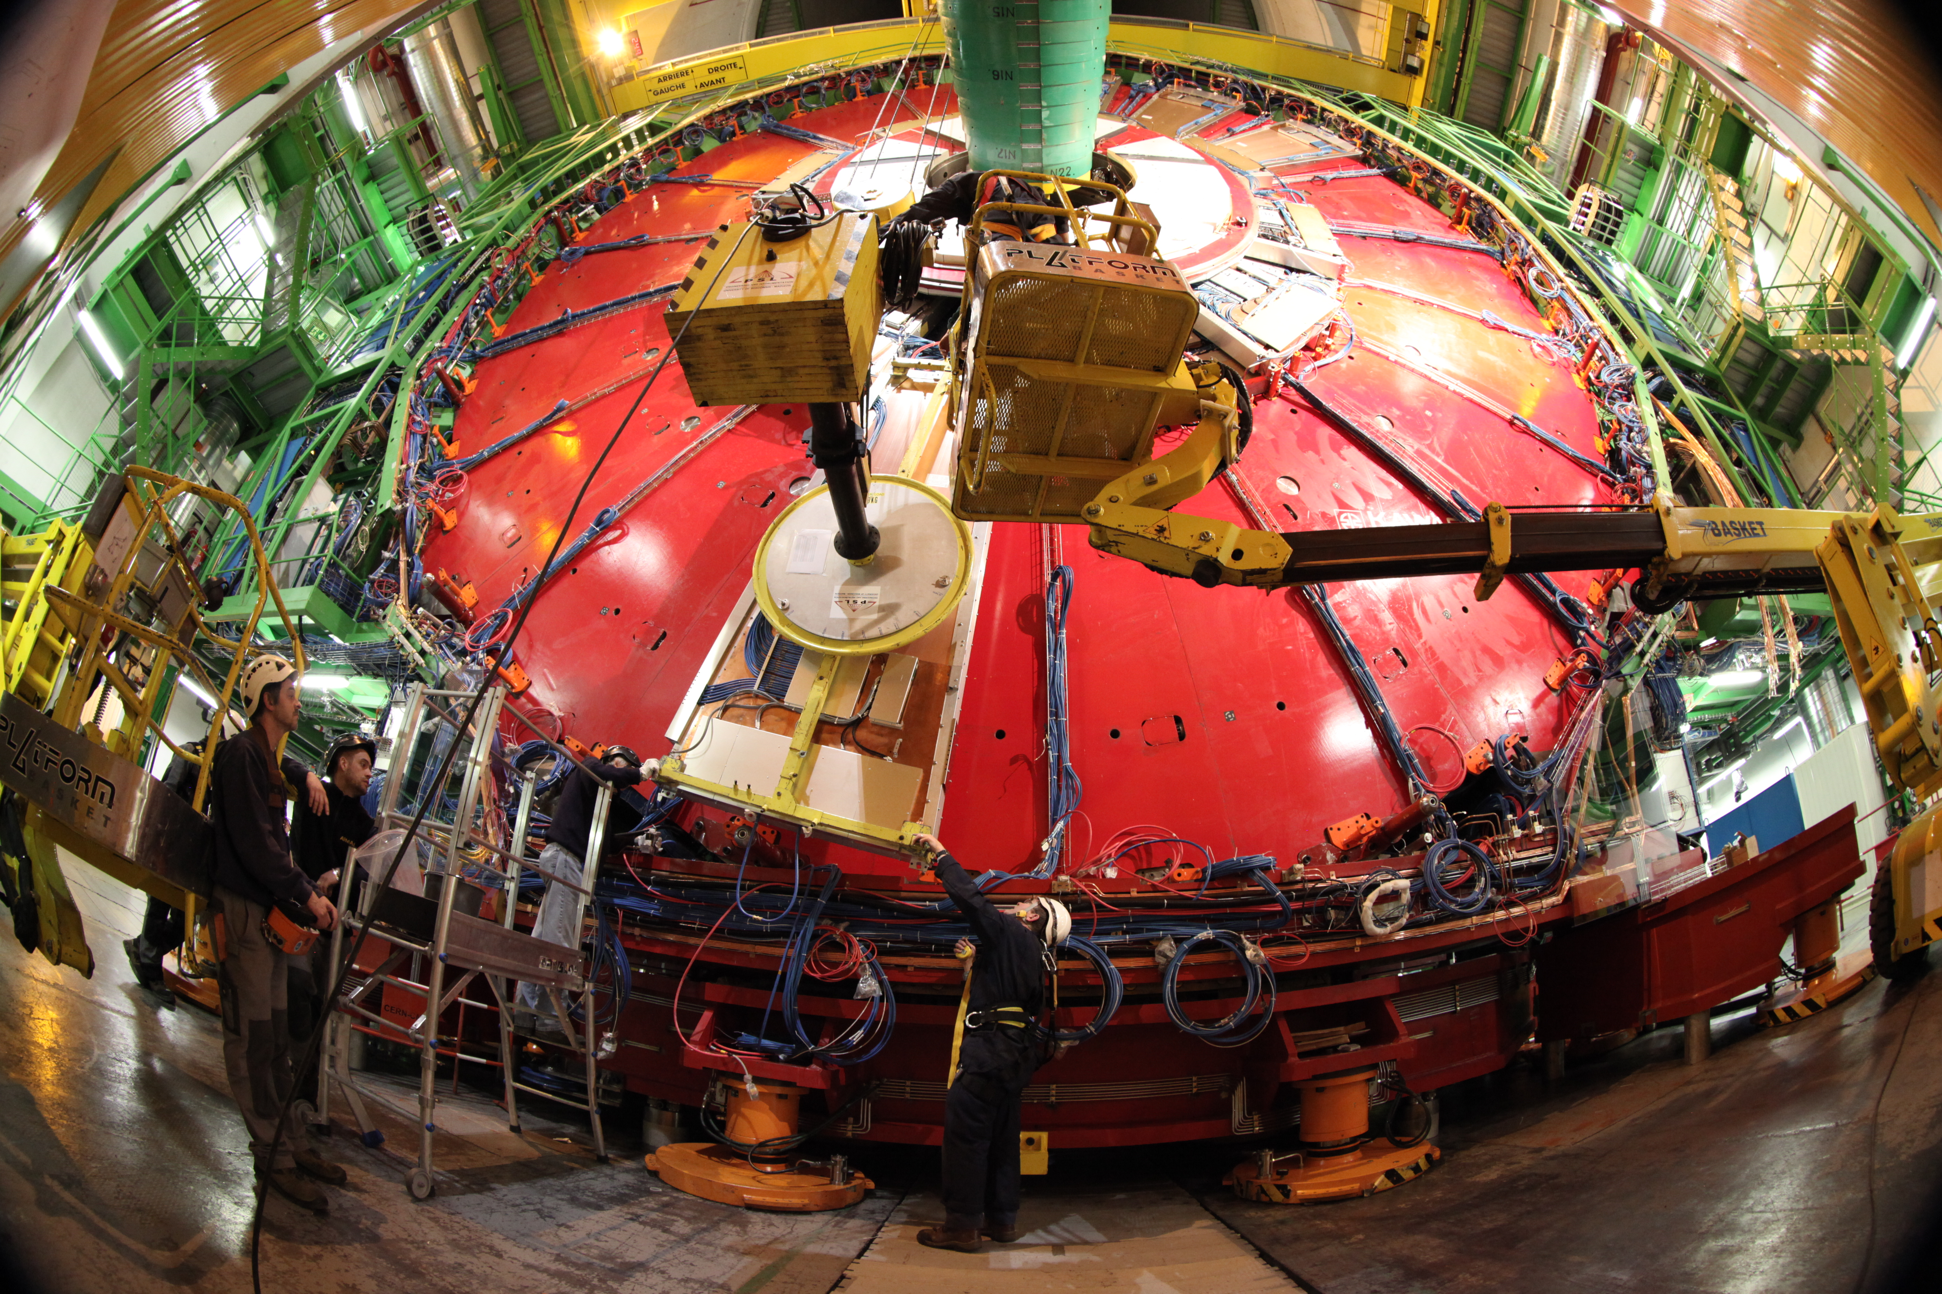
CSC Muon Detectors
PI: Matthew Herndon
Isa De Bruyn
5 Grad students and counting
Construction, Installation, testing, commissioning, monitoring, management
Installation of electronics upgrade for 8
CSC rings: 2019-2021
ME4/2 construction and installation: 2014
Installation fixture by PSL

Slide 9
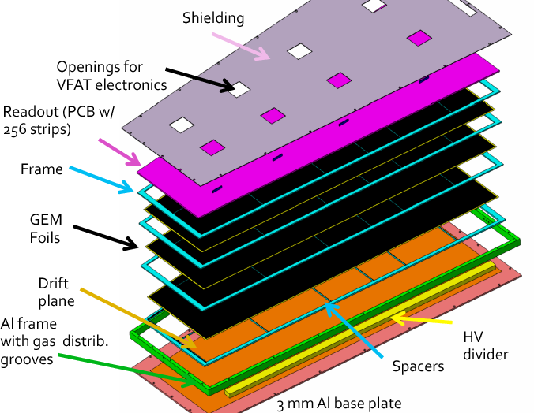
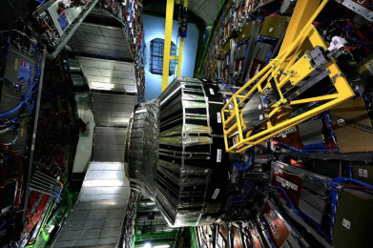
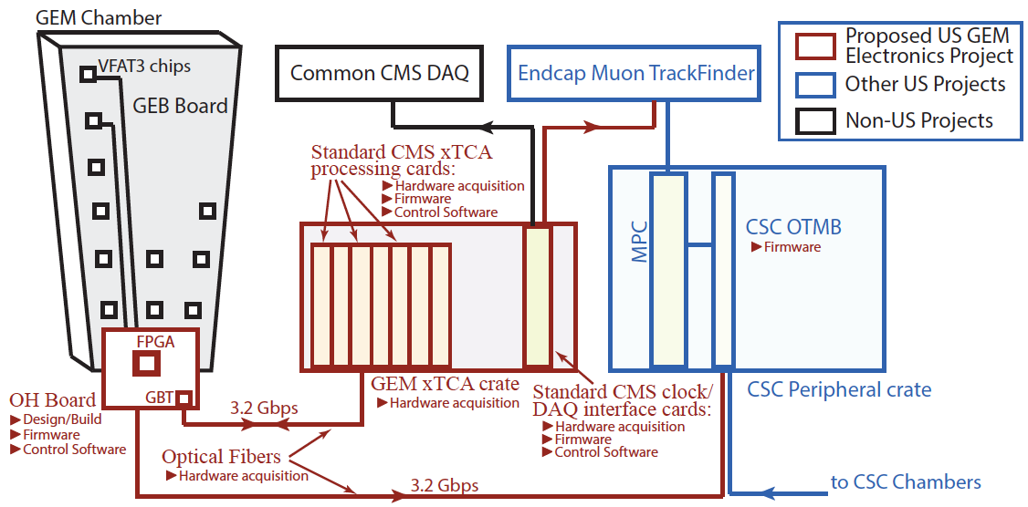
GEM Muon Detectors
PI: Kevin Black
Camilla Galloni, P. Everaerts
3 Grad students and counting
Backend electronics and data acquisition, related software, electronics project management
First station of Gem chambers installed!

Slide 10
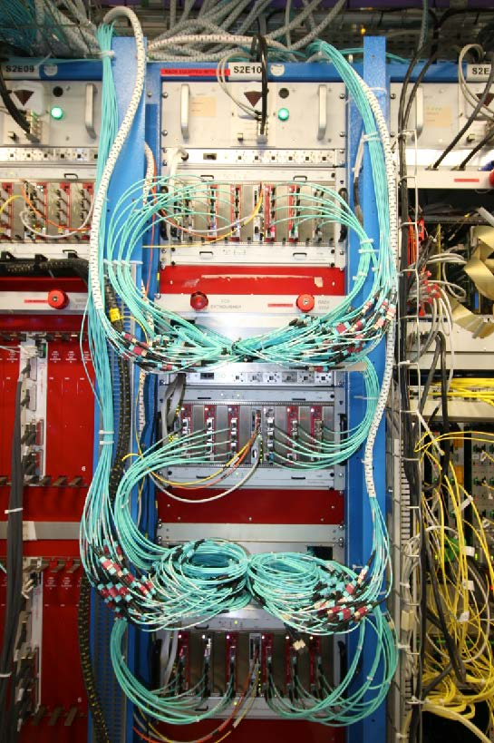
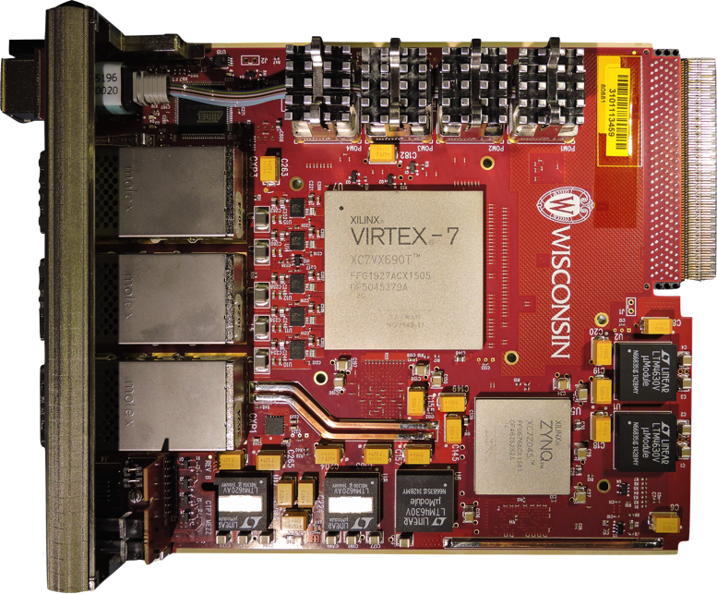
UW Upgraded Trigger Electronics
Tom Gorski, Pam Klabbers, Ales Svetek
Marcelo Vicente, Jes Tikalsky, Bob Fobes
Bhawna Gomber, Isobel Ojalvo, Varun Sharma, Abhishikth Mallampalli …
24 Graduate Students and counting!
PI: Sridhara Dasu

Slide 11
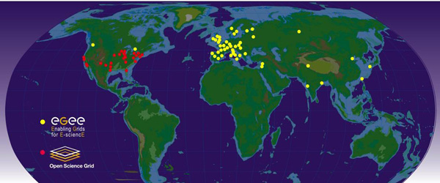
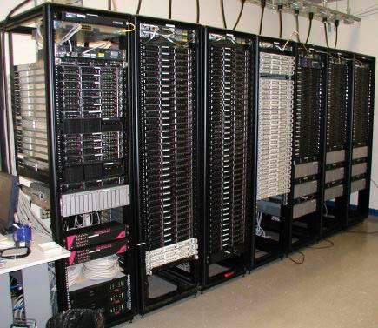
World-wide LHC Computing Grid
UW Tier-2 Computing Center
LHC experiments produce 90 peta of data per years, should have an exa byte soon!
Dan Bradley, Ajit Mohapatra, Carl Vuosalo, Tapas Sarangi, Will Maeir, Chad Seys
PI: Sridhara Dasu

Slide 12
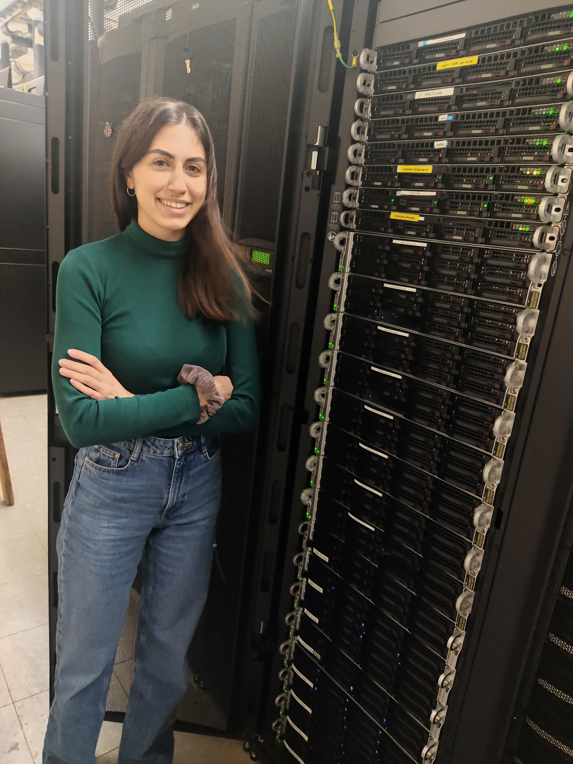
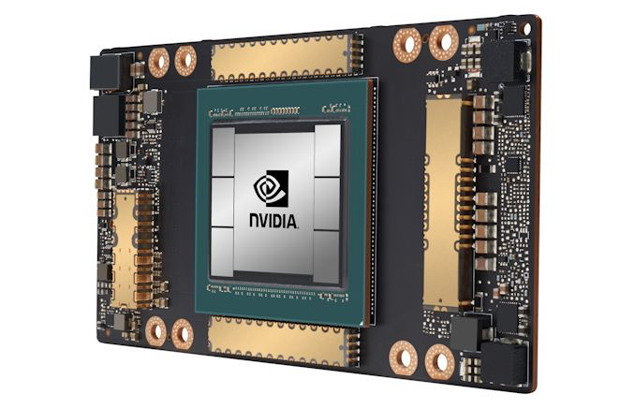
GPU Based Computing
Offloading significant parts of trigger and offline reconstruction to Graphics Processing Units (GPUs) to increase the efficiency and total computing power available for CMS data processing.
We provide opportunities to students to join the TAC-HEP: Training to Advance Computational HEP in the Exascale Era program and participate in cutting-edge R&D with Fermilab and other partners.
PI: Tulika Bose, Charis Kleio Koraka + students

Slide 13
Wisconsin CMS Physics Analysis
Electro-Weak Symmetry Breaking
Higgs Mechanism
Flavor Sector
B and Top
Fermion Masses
and Mixing
Elusive
Higgs Boson
Holds the Key
Cosmological
Connections
Dark Matter
Electro-Weak Physics
at High Energy
Diboson Production

Slide 14
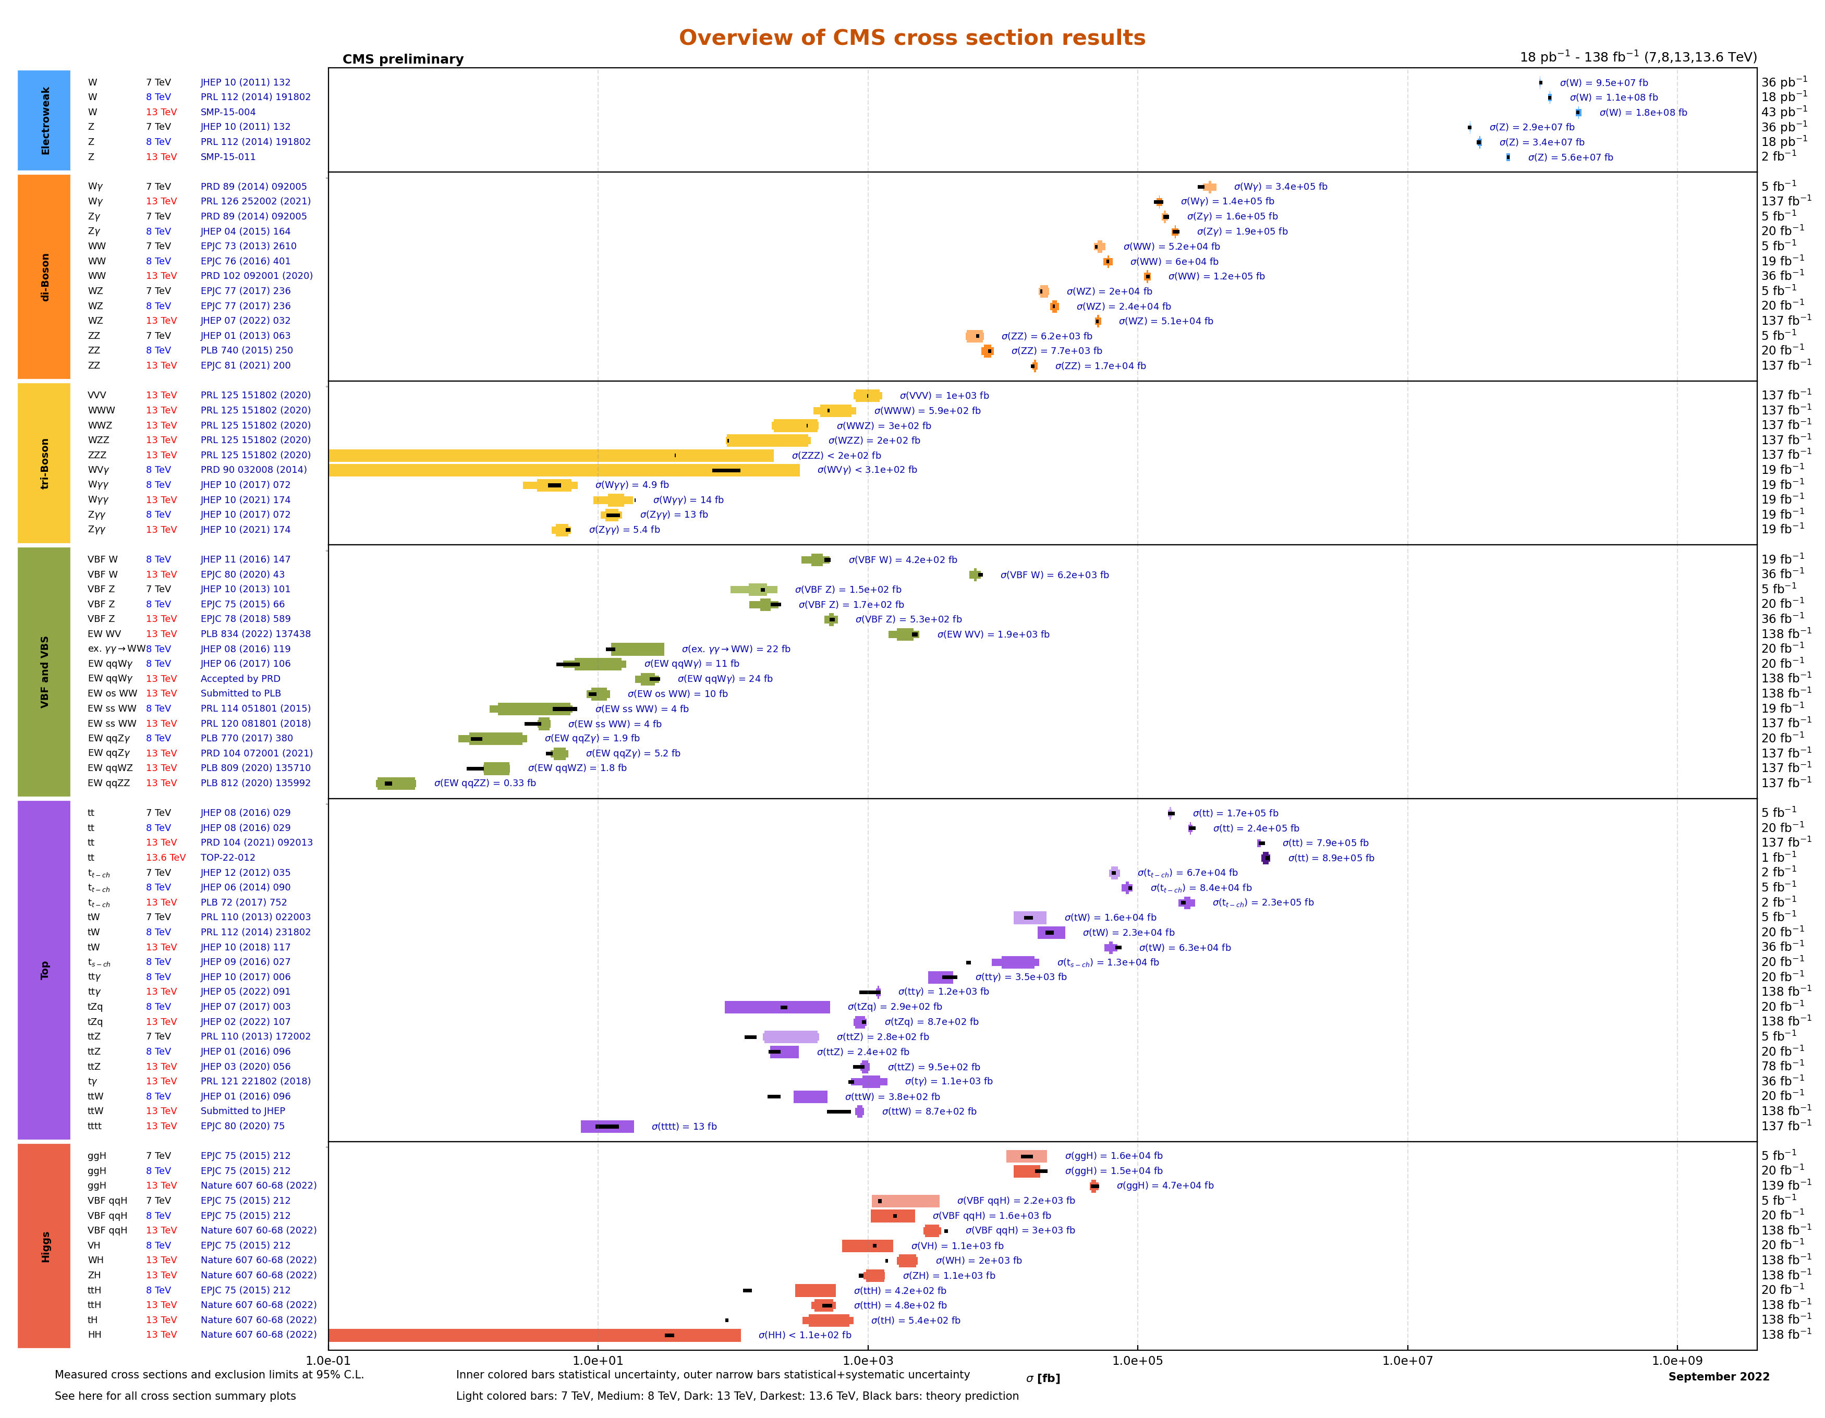
UW CMS Physics – 20 PhDs …Standard Model Measurements
Full CMS Experiment Physics Program. Managed by Tulika Bose in 2018-2019!
UW
UW
UW
UW
UW
UW
UW
UW
First 13.6 TeV Result!
UW H(ZZ), H(ττ)

Slide 15
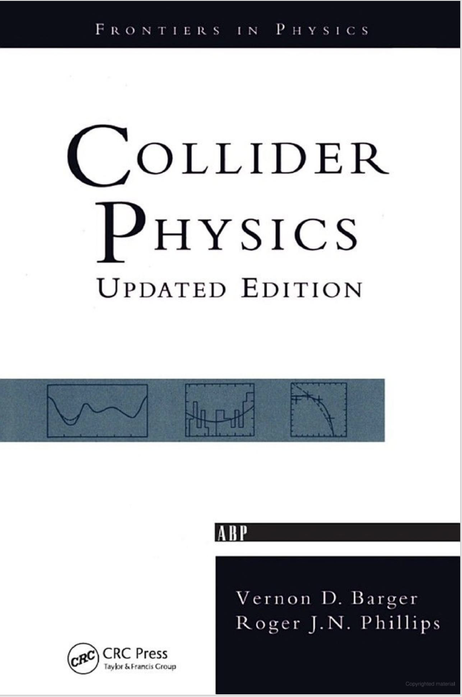
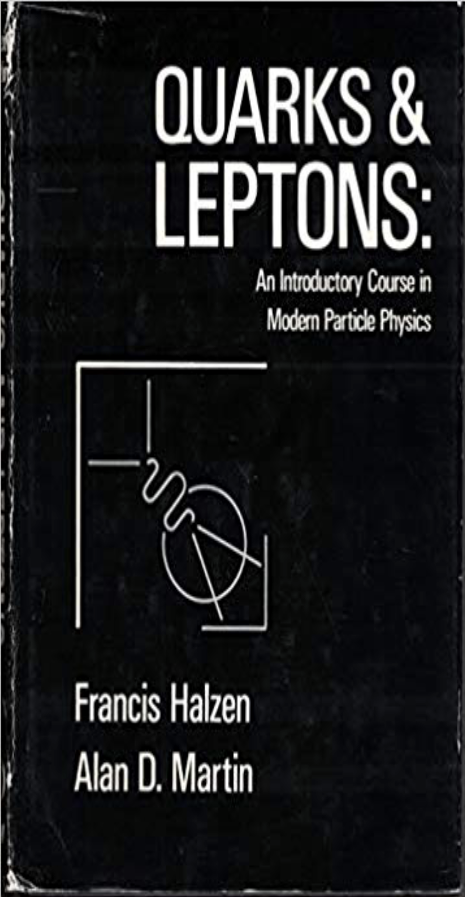

HEP Theory
They wrote the text books you use to learn particle physics. More in backup slides
Phenomenology and Theory: Bai, Barger, Everett, Chung, Hashimoto, Shiu

Slide 16

Summary
Study the fundamental physics and mysteries of the universe
- a fun and rewarding education
Welcome to the adventure!

Slide 17
Phenomenology
Mission
  High energy particle physics research at the interface of theory and experiment
Yang Bai
  Origin(s) and methods to search for dark matter
  Physics beyond the standard model using colliders
  Origin(s) of cosmic rays and new physics interpretation
Vernon Barger
  Supersymmetry at colliders
  Lepton flavor violation at HEP experiments
  Dark matter, cosmology, neutrino physics – places to look for new physics!
Lisa Everett
  Models of physics beyond the standard model
  Origin of EWSB and/or supersymmetry breaking
  Quark flavor puzzles, neutrino masses, lepton flavor violation – places to look for new physics!
Notes:
17
17

Slide 18
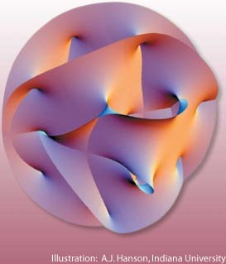
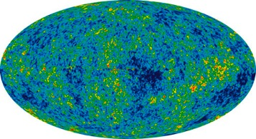
String Theory
Theoretical Cosmology
Daniel Chung
  Theoretical Cosmology
    Interface of high energy theory and cosmology
    Implications of axions for cosmology
    Inflationary cosmology, dark matter, and dark energy
Akikazu Hashimoto
  Formulational & formal aspects of string theory
    Gauge theory, QCD, Supergravity, AdS/CFT corresondence
    Recent Focus: Strange matter in condensed matter systems, supersymmetric boundary conditions, dynamical SUSY breaking
Gary Shiu
  String phenomenology & string cosmology
    Connect fundamental physics to particle phenomenology & cosmology
    Beyond the Standard Model Physics from String Theory & their experimental signatures.
    Inflation, Dark Energy, and Dark Matter from String Theory; CMB signatures of high scale physics, e.g., non-Gaussianity, gravity waves
    String Compactifications & their Low Energy Effective Action
Notes:
18
18

Slide 19
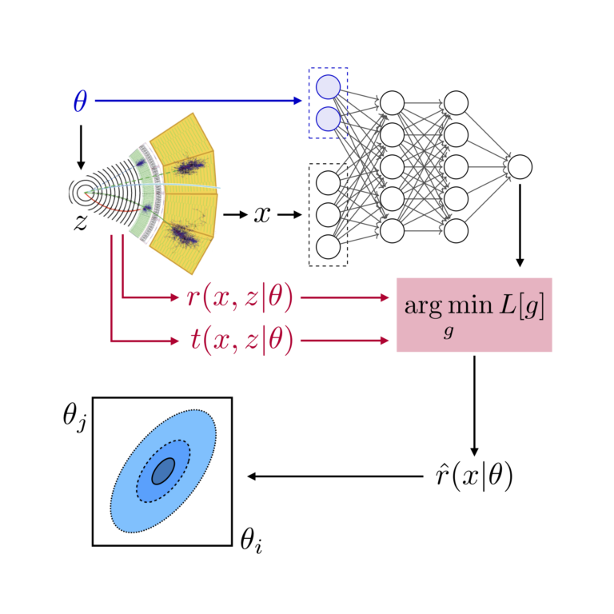
Cranmer’s HEP group
Moved last year from NYU. Also Director of UW’s Data Science Institute.
  Cranmer is a member of P5 (along with Tulika Bose)
ATLAS Group
  2 postdocs @ UW + 1 postdoc @ NYU + 4 students finishing @ NYU
  Long history of contributions to statistical tools and techniques, analysis tools, and AI/ML.
    Developed statistical tools used by ATLAS & CMS for Higgs discovery
  Physics focus on testing new physics through precision measurements of Effective Field Theory (mainly Higgs EFT, but not only)
    Developed MadMiner tool for AI/ML enhanced precision measurements using simulation-based inference
  Physics focus on analysis reinterpretation or “RECASTing” & analysis preservation, reproducibility, publishing statistical models, etc.
IRIS-HEP
  This is a large NSF institute developing the software
  and computing infrastructure for analyzing HL-LHC data
  Also funds exploratory AI/ML research

Slide 20
Cranmer’s HEP group
In addition to ATLAS:
Lattice Field Theory
  Collaborating with MIT and DeepMind on use of AI/ML techniques to accelerate calculations of lattice field theory (e.g. Lattice QCD)
  1 students finishing @ NYU
  11 papers published in top physics journals and AI/ML conferences
Scattering Amplitudes
  Grant from DOE to explore use of AI/ML (transformers) to help bootstrap the solution for scattering amplitudes in N=4 Super Yang-Mills
  In collaboration with Lance Dixon (SLAC), François Charton at Meta AI in Paris, and Matthias Wilhelm at the Niels Bohr Institute in Copenhagen.
  Recently hired a postdoc to focus on this topic
Astroparticle physics
  Miscellaneous projects focusing on advanced statistical analysis for dark matter indirect detection and substructure including simulation-based inference.

Slide 21
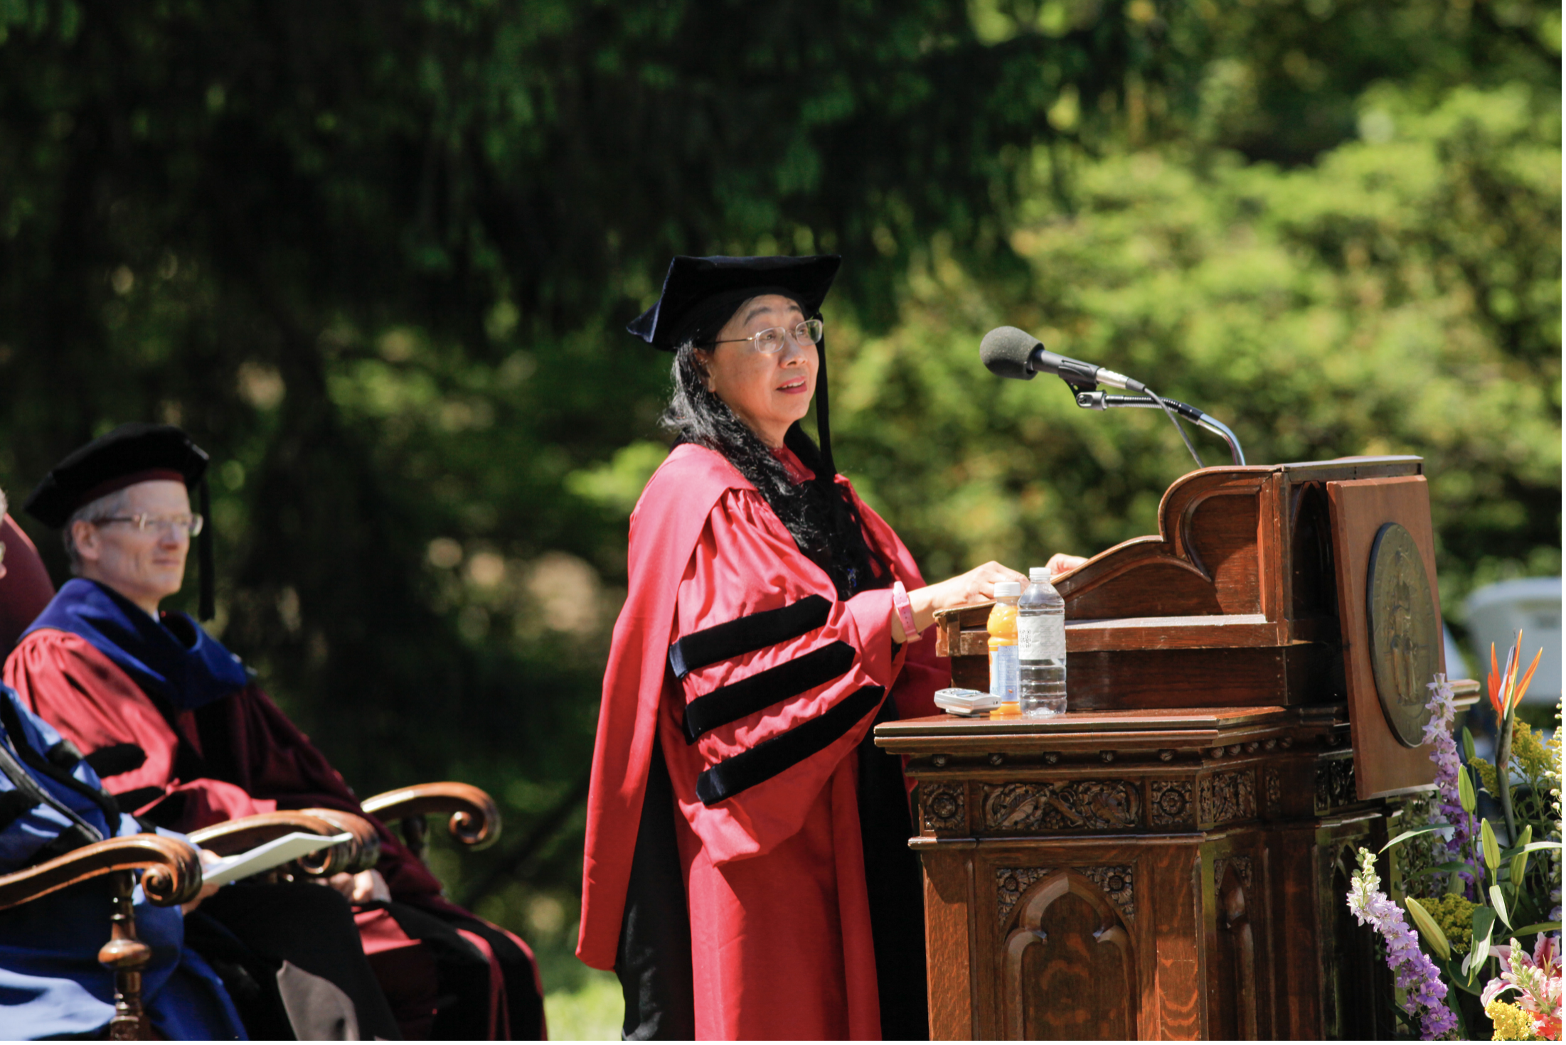
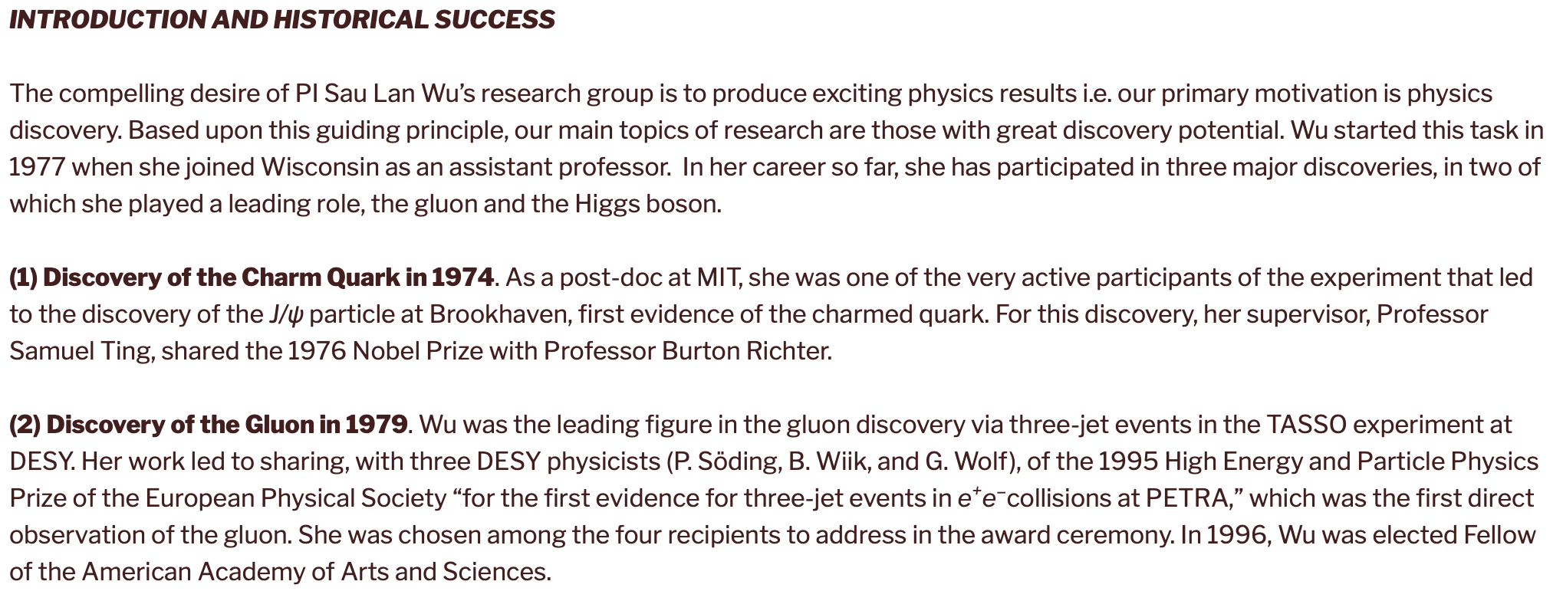
Prof. Sau Lan Wu
Charm, Gluon & Higgs
UW TASSO, ALEPH, ATLAS

Slide 22
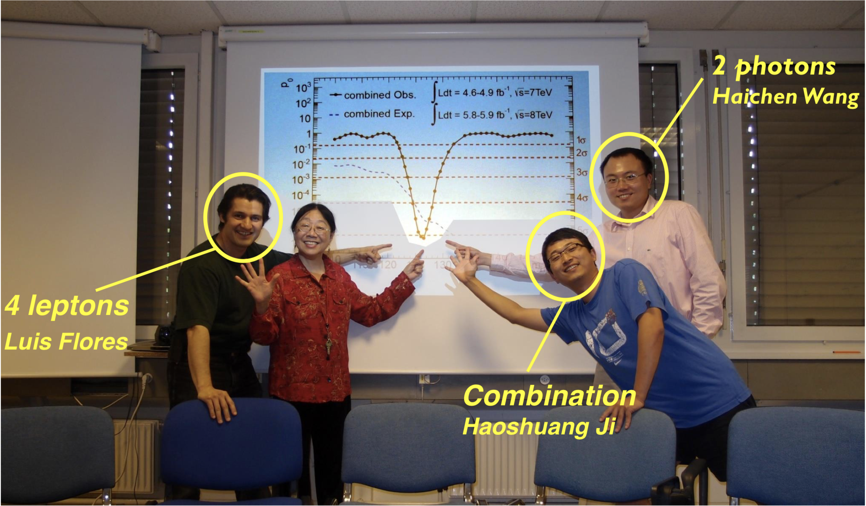
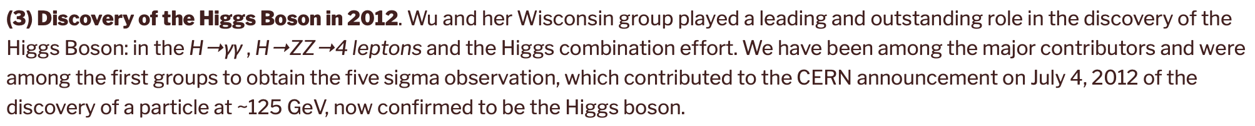
Discovery of Higgs

Slide 23

UW-ATLAS Higgs physics
Discovery ~125 GeV! significance: 7.0σ (December 2012)
Wisconsin critically involved in the main channels used (H→γγ, H→4 leptons), the combination of all Higgs channels, and the first measurements of its properties (mass, spin and coupling strengths)
Run 2 (13 TeV) - more exciting physics!!
Applying advanced machine learning technique to high profile data analysis to establish Higgs-top Yukawa coupling (with ttH production) and Higgs self-coupling (with di-Higgs production)
Observation of ttH production at ATLAS with a significance of $6.3σ$

Slide 24
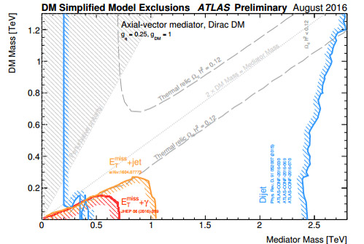
UW-ATLAS Dark Matter Searches
Finding Dark Matter is one of the principal goals of Run 2
Strong UW efforts:
  DM Search Models
  MET + Mono-Jet
  MET + Mono-Photon
  MET + Mono-Higgs
    H → bb bb (with the improvement of 200% using machine learning techniques)
    H → 2 photons
    H → ZZ → 4 leptons
  Di-jet + ISR Photon
  DM Search Combination
Figure 1: ATLAS Dark Matter summary for ICHEP 2016

Slide 25
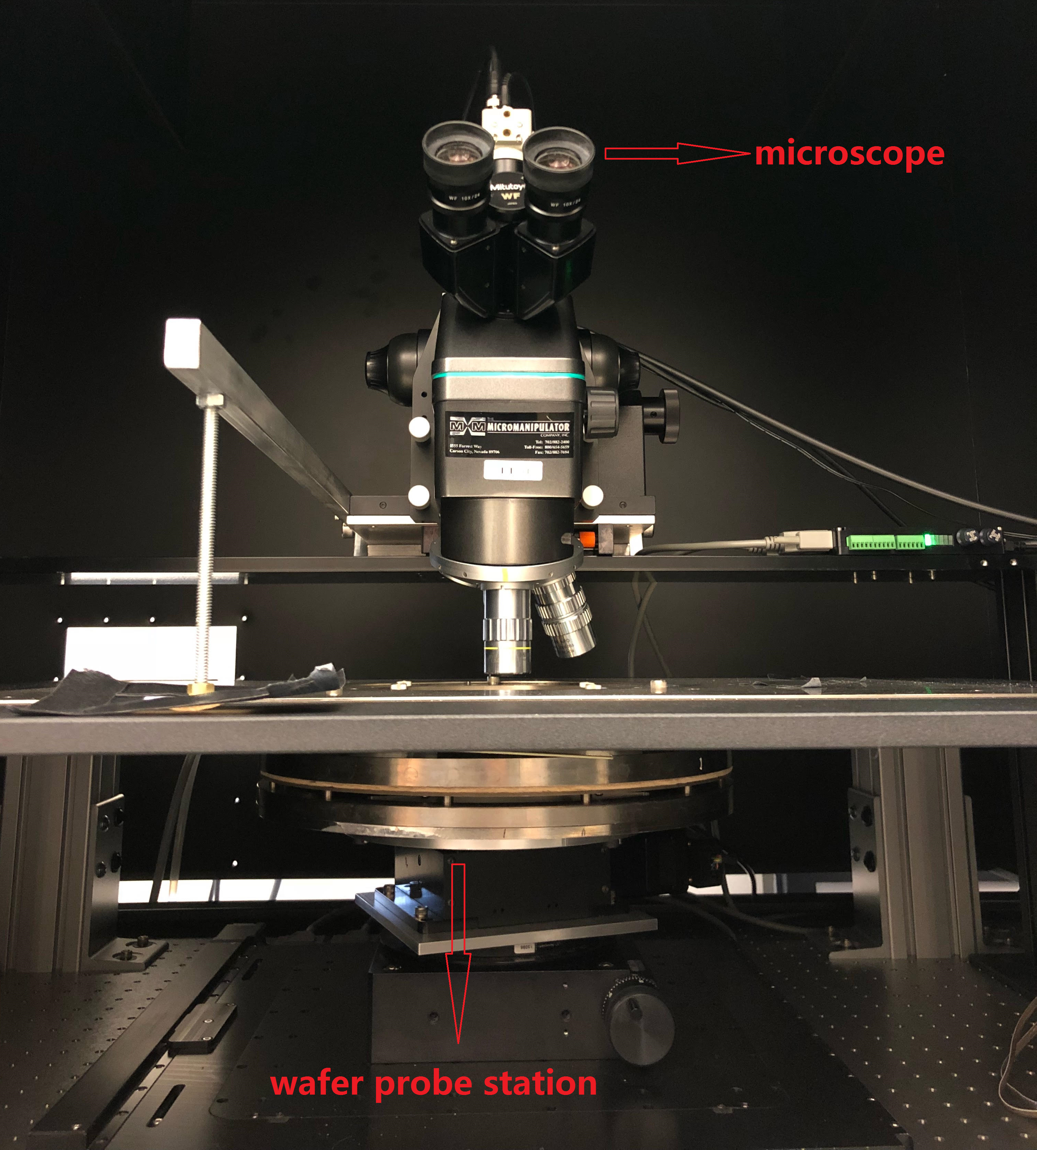
UW-ATLAS Pixel detector, Computing, Trigger and DAQ
ATLAS Pixel HL-LHC upgrade and operation - In collaboration with Berkeley (LBNL):
UW pixel contributions:
  pixel detector design, wafer probing, chip testing, pixel module prototype development, pixel multi-module prototype characterization, pixel module assembly, and pixel detector operation at CERN
ATLAS computing development and operation – in collaborationwith BNL
UW-ATLAS computing contributions:
  ATLAS event service and ATLAS Distributed Data Management
  ATLAS Central Services of PanDA (production and distribution analysis) system
  Development and operation of ATLAS cloud computing
ATLAS High Level Trigger (HLT) and Data Acquisition (DAQ) system: received “ATLAS Outstanding achievement award”
UW-ATLAS trigger/DAQ contributions:
  HLT Core Software, Trigger/DAQ Configuration Software, HLT selection

Slide 26
Quantum Computing
We are working to apply quantum computing to LHC physics analysis in collaboration with IBM and CERN Openlab
Using IBM Qiskit quantum computing simulator, we have successfully employed Quantum Support Vector Machine method for ttH (Higgs coupling to two top quarks) analysis
With 5 qubits, we reached similar performance compared with the classical machine learning method (BDT). Now investigating performance with 20 qubits
Using IBM Q Experience quantum computing hardware, we have also successfully applied Quantum Support Vector Machine method to ttH analysis

