Slide 1
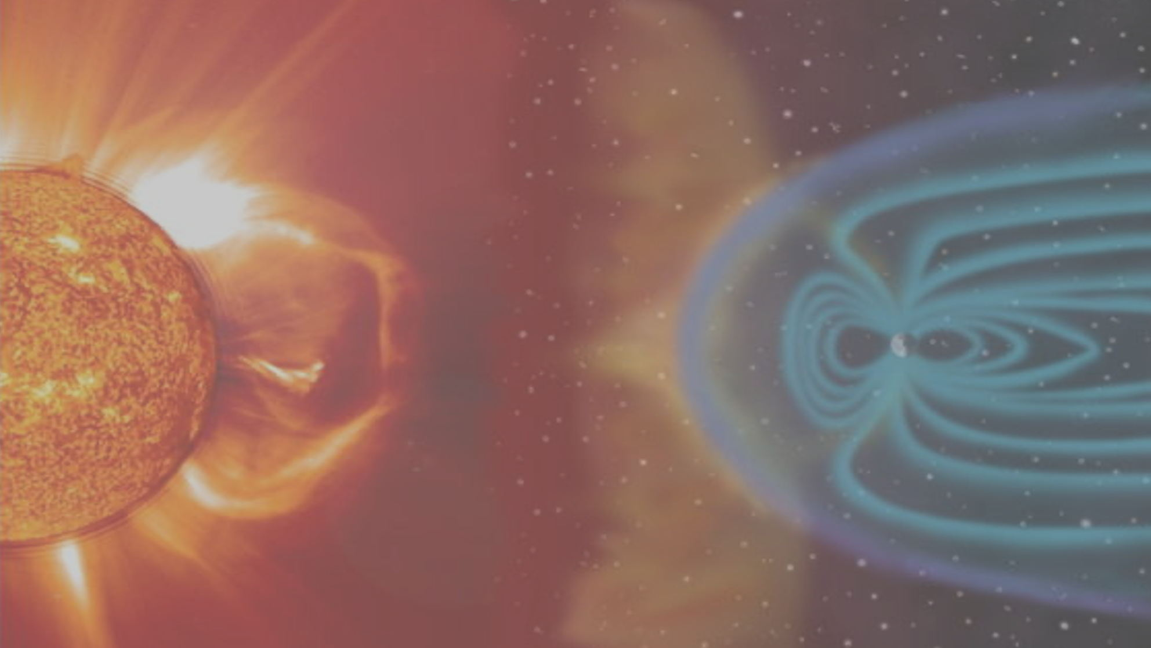
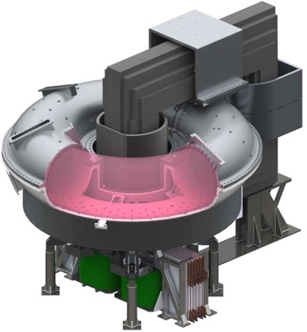
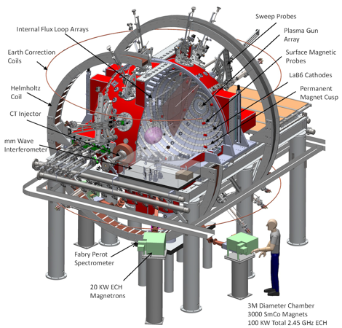
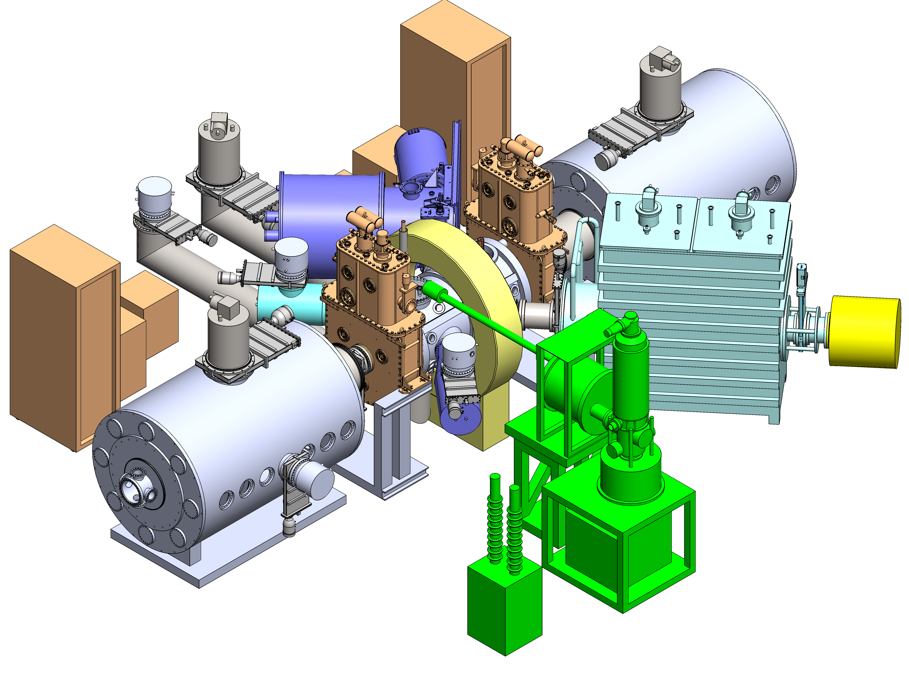
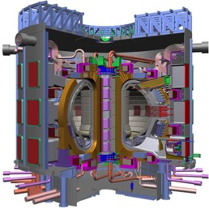
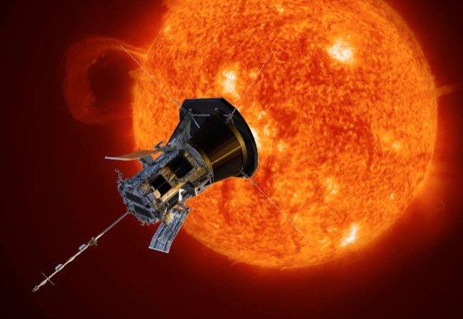
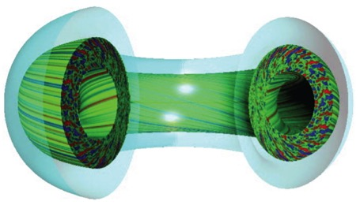

The Fourth State of Matter: Understanding the Magnetized Plasma Universe to Fusion Energy on Earth
Madison Symmetric Torus
Big Red Ball
Wisconsin HTS Axisymmetric Mirror
ITER
Parker Solar Probe
Theory and Computation

Slide 2
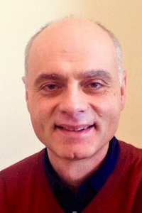
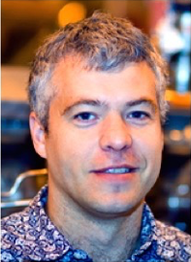
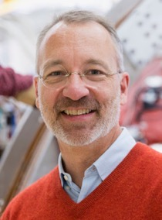






Plasma faculty in the Physics Department
Large group, with full-time scientists, engineering support, postdocs, undergrads
… and of course graduate students
Stas
Boldyrev
(Theory)
Jan
Egedal
(Expt)
Cary
Forest
(Expt)
John
Sarff
(Expt)
Paul
Terry
(Theory)
Ellen
Zweibel
(Theory)
(Astrophysics)
Affiliated Professors:
Chris Hegna, Eng. Physics (theory)
Carl Sovinec, Eng. Physics (theory & computation)
Oliver Schmitz, Eng. Physics (expt)

Slide 3
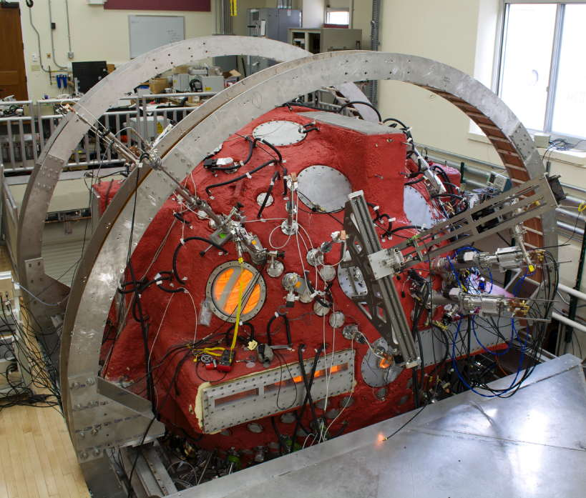
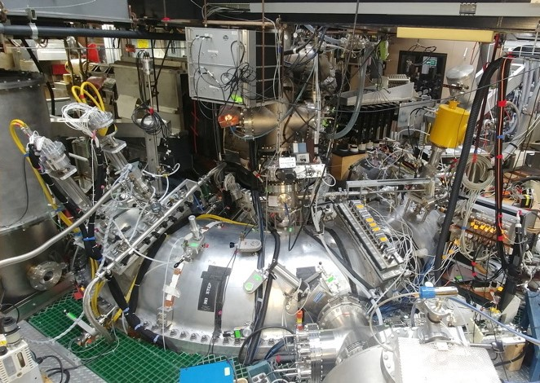
Wisconsin Plasma Physics Laboratory (WiPPL)
Medium-scale user facility funded by U.S. DoE (Egedal, Forest, Sarff et al)
Dedicated to understanding energy flows between fields and particles in a plasma
Fusion topics in tokamak and RFP plasmas
External users and UW home program
Big Red Ball
Madison Symmetric Torus

Slide 4

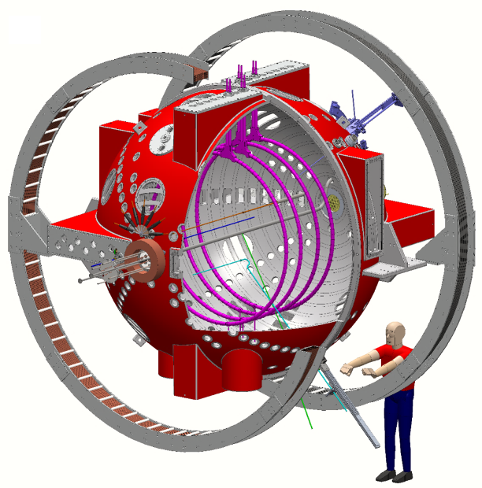
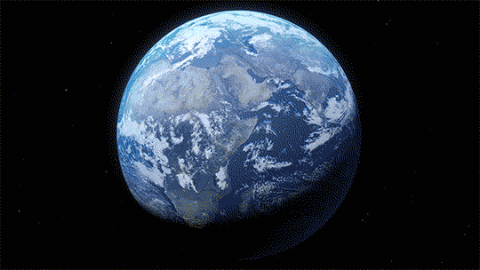
Magnetic reconnection studies in the Terrestrial Reconnection Experiment (TREX)
Magnetic Reconnection
Magnetic reconnection drive coils installed in BRB
Credits: NASA/Goddard/Conceptual Image Lab

Slide 5
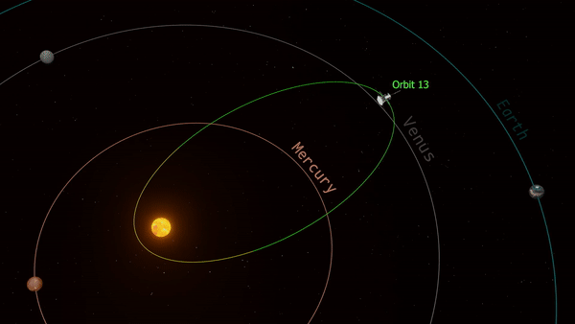

Space-based measurements of plasma processes
Only 9$R_{⨀}$ (9 solar radii) on closest approach
Solar Parker Probe (NASA)
“Mission to touch the Sun”
Science objectives
Trace the flow of energy that heats and accelerates the solar corona and solar wind
Determine the structure and dynamics of the plasma and magnetic fields at the sources of the solar wind
Explore mechanisms that accelerate and transport energetic particles

Slide 6
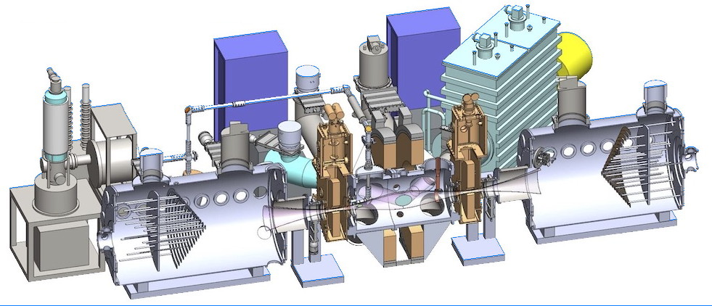
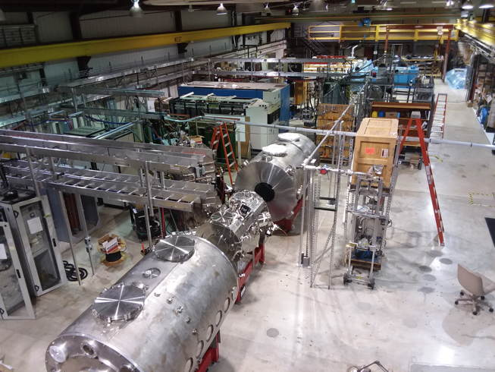
Wisconsin HTS Axisymmetric Mirror
New project funded by DOE ARPA-E:
  Develop the axisymmetric mirror for use as a fusion neutron source
  Leverage new high temperature superconducting technology (HTS) to confine a fusion-producing plasma
  Employ novel plasma heating methods
New laboratory under construction

Slide 7
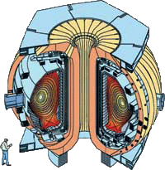
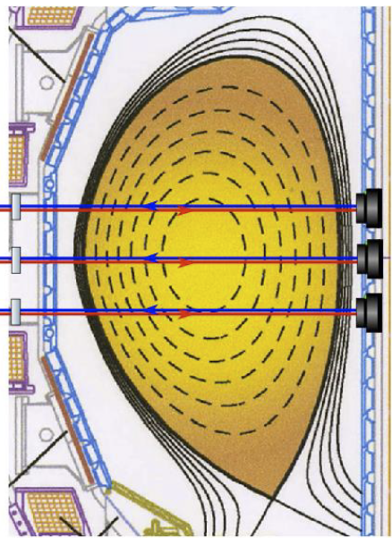
Research collaborations on large fusion facilities
Current activities:
  Physics of disruptions and self-generated plasma current on DIII-D
  Energy-resolving x-ray camera for measurement of electron temperature
DIII-D at General Atomics,
San Diego CA
Laser-based measurement of density and magnetic field
Z = +13.5 cm
Z = 0 cm
Z = -13.5 cm

Slide 8
Theoretical and computational plasma physics:
Fusion
Turbulence and transport in magnetic fusion plasmas (Terry et al)
Zonal Flow in Fusion Plasma Turbulence
Self-regulated turbulence
With imposed magnetic island
J. Candy & R. Waltz
Solar Wind

Slide 9
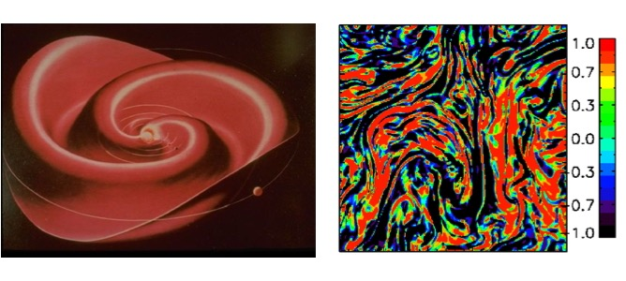
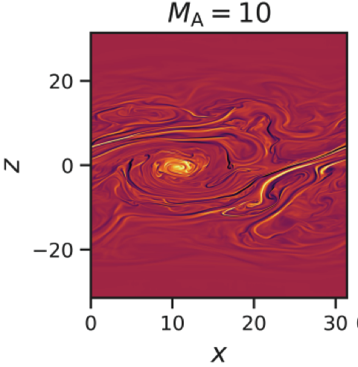
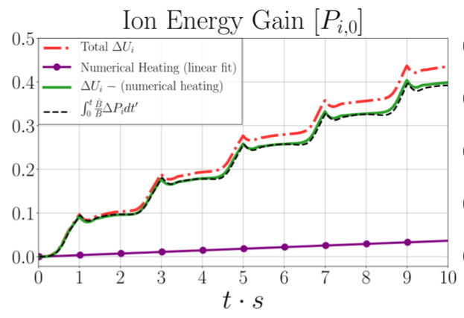
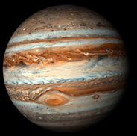
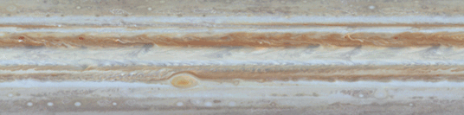
Theoretical and computational plasma physics:
Astrophysical Systems
Solar wind, MHD turbulence, dynamos, reconnection, particle heating and acceleration in astrophysical plasmas, cosmic rays (Boldyrev, Terry, Zweibel, et al.)
Sheared-flow instability and turbulence
B. Tripathi, P. Terry,
E. Zweibel et al
J. Perez, S. Boldyrev
Heating of the intracluster medium by magnetic pumping
Ley, Zweibel, et al
https://ui.adsabs.harvard.edu/abs/2022arXiv220900019L/abstract

Slide 10
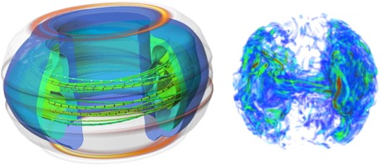
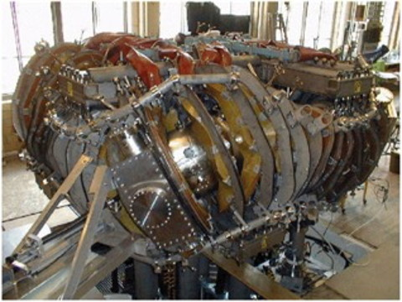
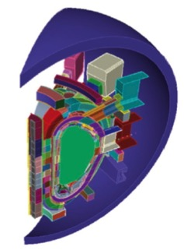
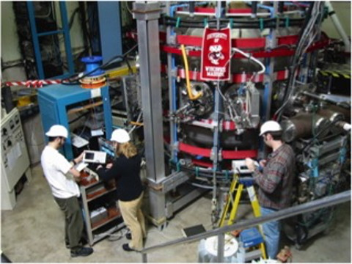
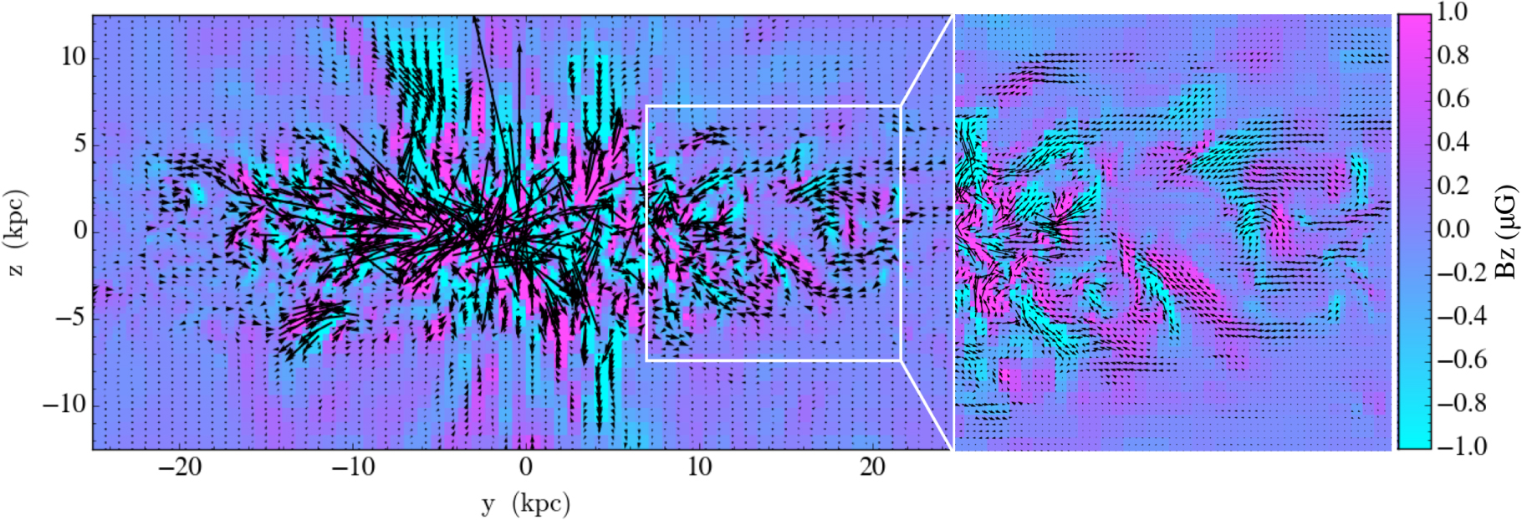
Large plasma physics community at UW
Advanced Computational Modeling (EP)
Helically Symmetric Stellarator (ECE)
Fusion Technology (EP)
Astronomy
Pegasus Spherical Tokamak (EP)

Slide 11
Highly developed plasma course curriculum
Instruction shared by Physics, Engineering Physics, Elect. and Comp. Eng.
  525 Introduction to Plasma Physics
  526 Plasma Laboratory
  527 Plasma Confinement and Heating
  528 Plasma Processing
  724 Waves & Instabilities in Plasmas
  725 Plasma Kinetic Theory
  726 Magnetohydrodynamics (MHD)
  Special topics courses, e.g., turbulence, chaos, nonlinear MHD
Plasma Seminar: 12:05 Mondays

