Slide 1
Rubin Observatory USDF-at-SLAC Update and HTCondor-at-NCSA 2023
Throughput Computing 2023, July 12, 2023
Greg Daues, NCSA

Slide 2
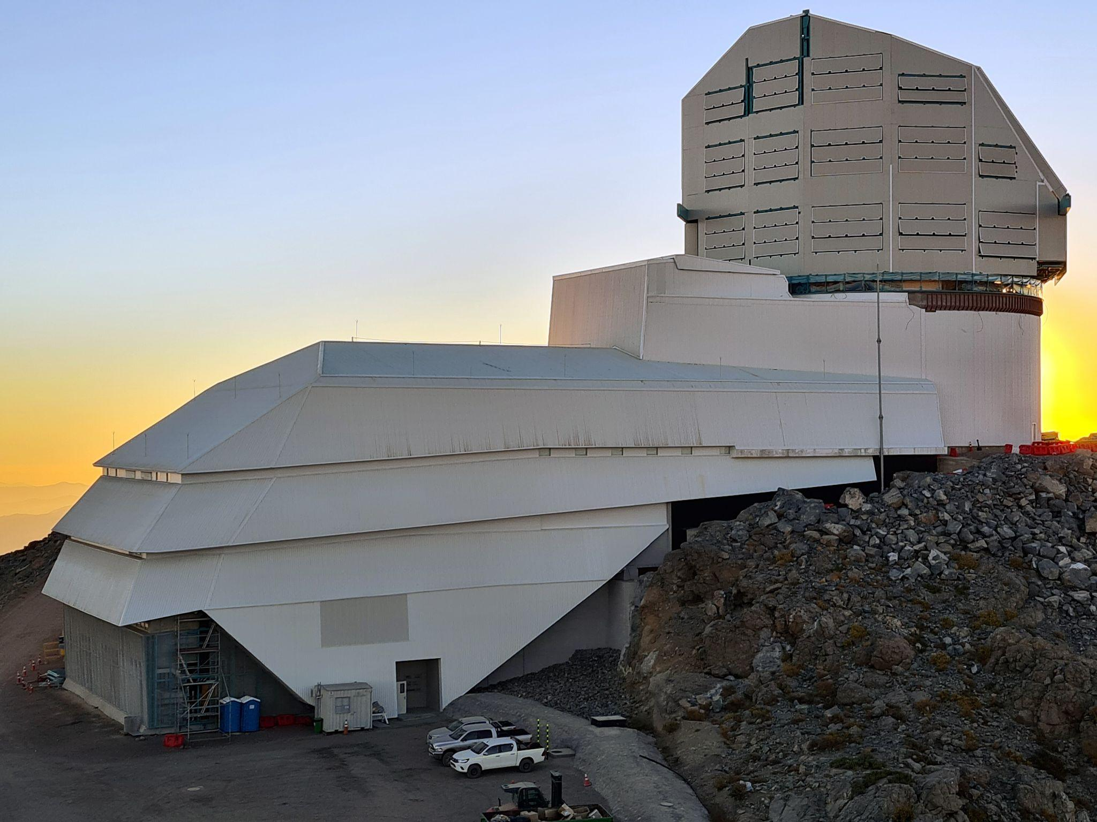
Vera C. Rubin Observatory Overview
Rubin Observatory construction continues
Installation at Cerro Pachon, Chile
`Telescope Structure’ complete
On track to receive the observatory’s 8.4-meter mirror, 3200-megapixel LSST Camera
Rubin Observatory will conduct the Legacy Survey of Space and Time (LSST)
First Photon: mid 2024; First Light: late 2024
Operations begins in 2025
10 year survey - 20 TB of data each night, 10 PB year

Slide 3
Data and Processing Overview
Data is transferred from Chile to:
USDF-SLAC
and then replicated [Rucio / FTS] to
FRDF-CC-IN2P3
UKDF-RAL
Multiple Types / Scenarios of Processing
Production / Data Release Processing (DRP)
Multi-Site (USDF/FRDF/UKDF) -> Panda
Support for Developers / Scientists at USDF - SLAC
Algorithm testing / devel at USDF -> HTCondor (Slurm)

Slide 4
LSST Batch Production Service (BPS)
BPS = Project software to support general Workflows
ctrl_bps https://github.com/lsst/ctrl_bps
https://arxiv.org/abs/2206.14941
Different workflow systems supported via Plugins
ctrl_bps_panda
ctrl_bps_parsl
ctrl_bps _htcondor
Utilizes DAGMan workflows

Slide 5
USDF at SLAC Resources
SLAC Shared Scientific Data Facility (S3DF)
LCLS, Rubin, and others
Slurm Cluster, multiple partitions
roma 40 nodes, 128 cores, AMD EPYC 7702
milano 134 nodes, 128 cores, AMD EPYC 771
From ctrl_bps_htcondor view, no persistent HTCondor pool
Glide-in solution for users =>
Rubin/lsst legacy packages
ctrl_execute, ctrl_platform_*
https://github.com/lsst/ctrl_execute
Supporting CM, scheds on devel login nodes

Slide 6
Glide-in Packages and allocateNodes
ctrl_execute provides the allocateNodes.py utility
% allocateNodes.py -n 20 -c 32 -m 4-00:00:00 -q roma,milano -g 900 s3df
% allocateNodes.py --help
positional arguments: platform node allocation platform
options:
-n NODECOUNT number of glideins to submit;
these are chunks of a node
-c CPUS cores / cpus per glidein
-m MAXIMUMWALLCLOCK maximum wall clock time; e.g., 10:00:00
-q QUEUE queue / partition name
-g GLIDEINSHUTDOWN glide-in inactivity shutdown time in seconds ….
ctrl_platform_s3df provides templates
glide-in condor config, Slurm submit file, bash script to srun

Slide 7
ctrl_execute Usage and Status
< 2013 TACC Lonestar, SDSC Gordon
2013 NCSA Blue Waters (PBS) => 10,000 cores exercise
2019 NCSA Slurm Cluster
2023 Mitaka NAOJ (PBS Cluster)
2023 S3DF - USDF at SLAC Slurm Cluster
Current status at USDF at SLAC: users running workflows across 1000’s of cores; so far so good
Problem/Limitations: ctrl_execute does not maintain glide-ins
Running workflows end-to-end problematic
users have to replenish if glide-ins expire (by hand, cron)
Possible development to have BPS workflow manage

Slide 8
Future Plans at USDF-SLAC
Decision Point for USDF work:
Continue to ‘tune’ ctrl_execute / allocateNodes, or
Should we try running ‘GlideinWMS’ ?
opensciencegrid/gwms-factory container
opensciencegrid/vo-frontend container
Test with docker; Running in k8s likely final target
Security infrastructure
Differences for users
Ownership of files (if factory uses service account)
One size of glide-ins from factory?
Use of HTCondor at USDF motivates Pool at Summit (k8s)

Slide 9
NCSA Activities 2023 with HTCondor
Support Rubin Obs USDF, Summit
Dark Energy Survey DM late stages
Illinois Campus Cluster DES pool, CAPS partition
FNAL (jobsub-lite)
Support South Pole Telescope (SPT) :
OSG Frontier Squid setup at Illinois Campus Cluster
Prototyping in FABRIC testbed for CMB-S4

Slide 10
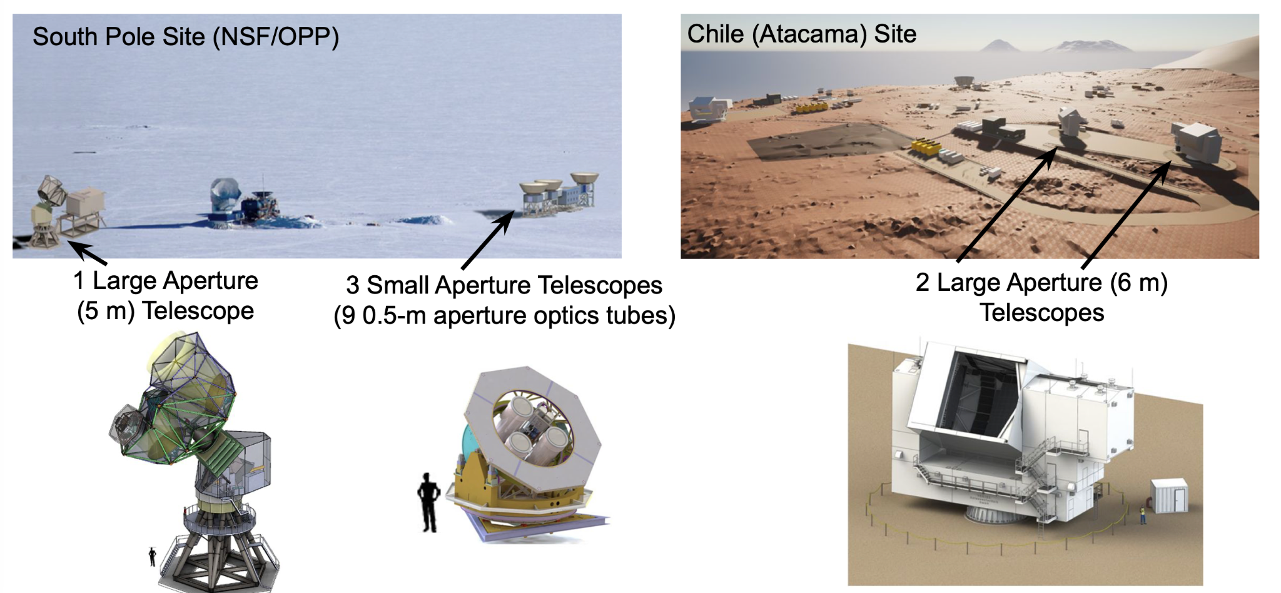
CMB-S4 Sites & Instrumentation
Notes:
CMB_s4 is a a mm-wave Survey and a Stage IV cosmology experiment. NSF (MREFC) and DOE involved.Billion dollar scale.

Slide 11
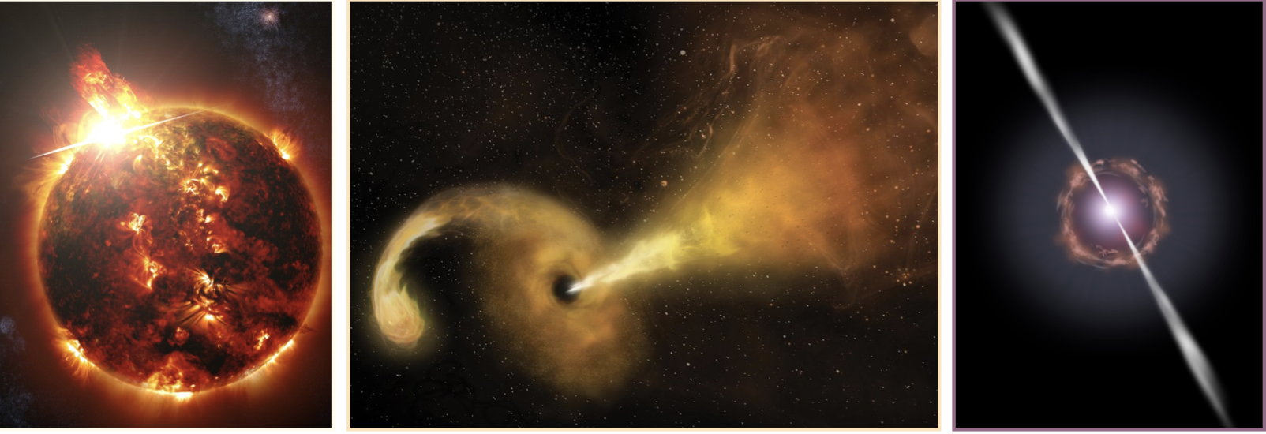
CMB-S4: Transient Phenomena
Astro2021: CMB_S4 will produce data sets of unprecedented sensitivity, cadence and spectral coverage…. Seek broad engagement with astronomers … maximize opportunities for transient science…..
Stellar Flares
Tidal Disruption Events
Active Galactic Nuclei
X ray Binaries
Classical Novae
Planetary Nebulae
SN Type 1 progenitors
Magnetars
Solar system Objects
The infrastructure we are prototyping in FABRIC its to detect and announce announce initial detections to the community. In era of CMB-S4 we are in “discovery space”
Notes:
Lets focus on the aspect of CMB-s4 where we are using FABRIC. What’s a transient? It’s New/significantly changes astronomical or astrophysical object.
Perhaps you first think of Super Novae, but there are other Transient events.
The driving science require wil enabel detection of these events.
The point of prompt detection is to allow follow ups (if our detection is initial) or add to observational body of Knowlege (if not initial )
Recall that LSST transient detection rate (10 million/ night).
The expected rate of initially detected transients for CMB-S4 is handfuls per day.
None the less -- There is a good deal of discovery potential because of sensitivity, observational footprint and cadence.
We think of each alert as Precious.
Perhaps it’s useful to think of (HEP -- hadrons v.s neutrinos)

Slide 12
FABRIC Testbed
Adaptive Programmable Research Infrastructure for CS and Science Applications
https://fabric-testbed.net
29 FABRIC sites with compute & storage interconnected by high speed, dedicated optical links
Users create Experiments with VMs, NICs, networks, routes, etc. via Python API: https://pypi.org/project/fabrictestbed-extensions/
Notes:
OUT goal is a successful production result for a review in September this year.
We are just beginning to use and think about the feature where nodes see the external internet.
As production people we want to use services which are exclusive IPv4, for example for configuratipn

Slide 13
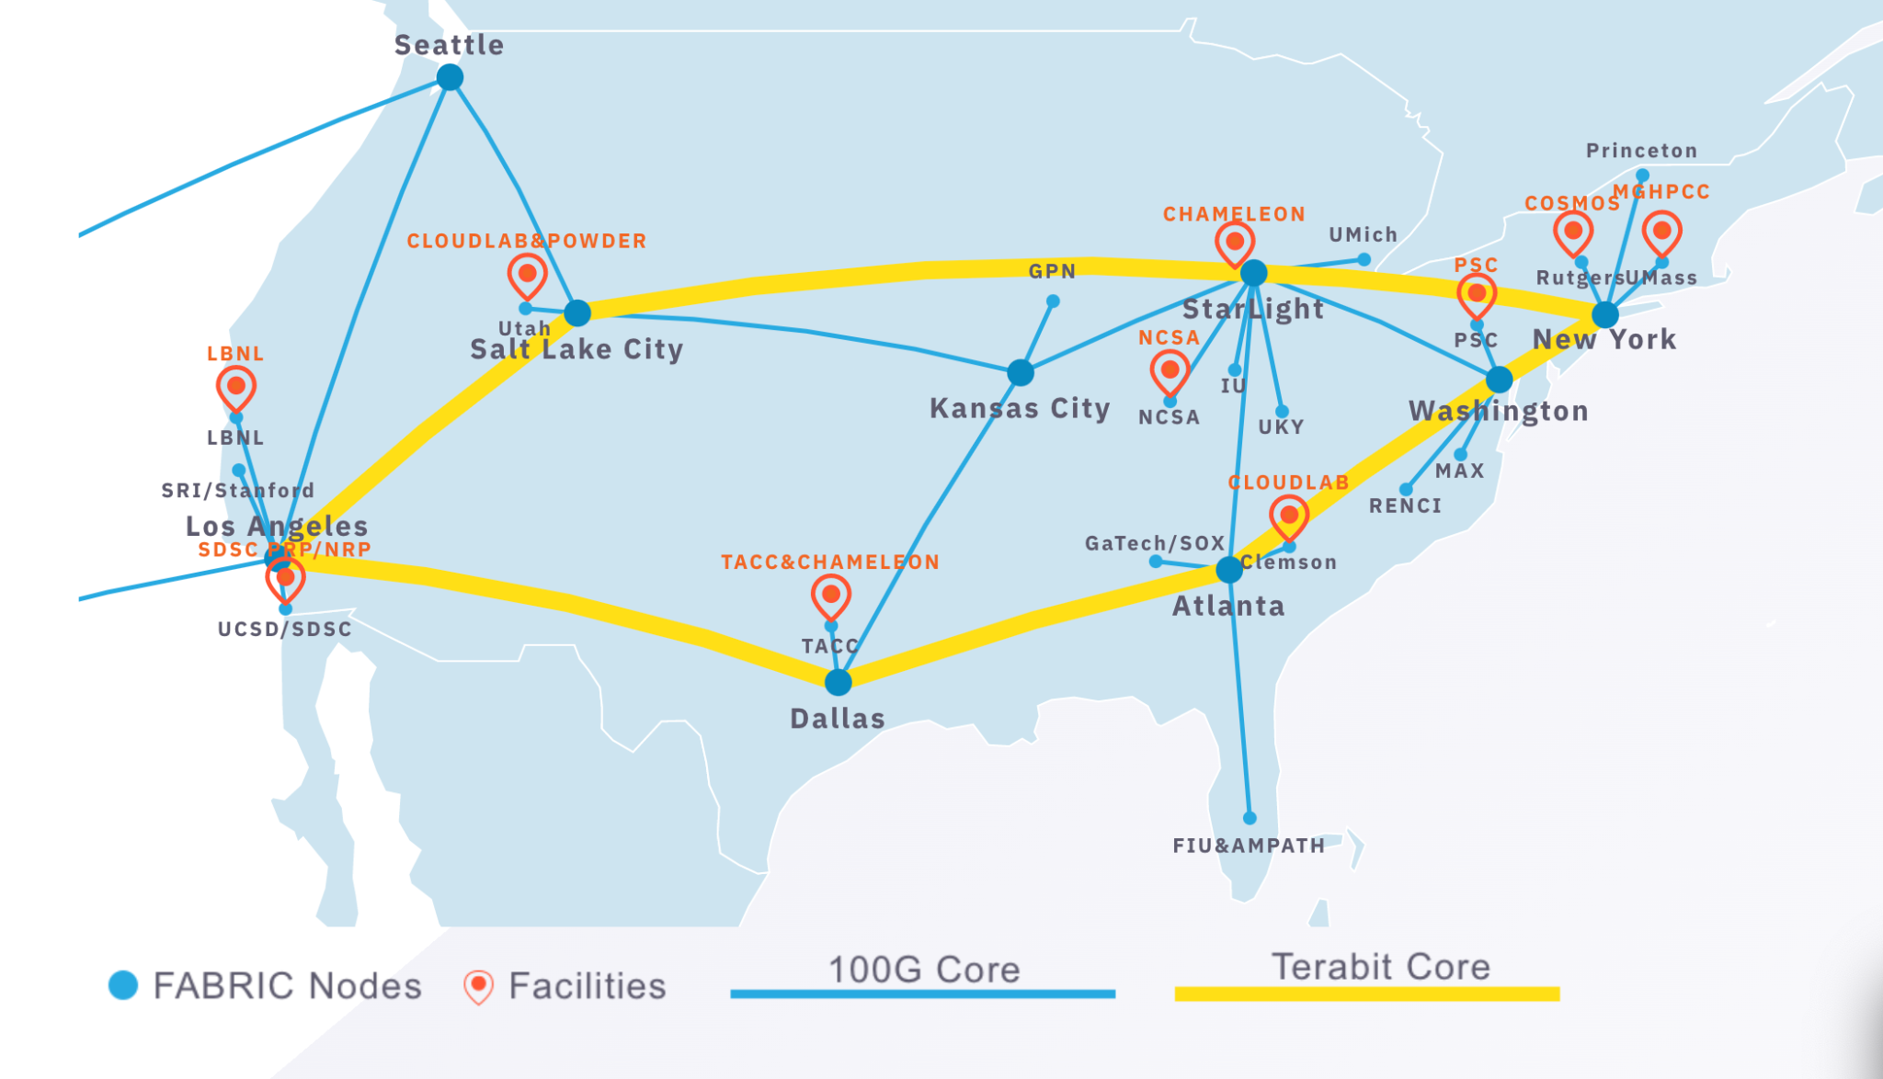
FABRIC Testbed
Notes:
OUT goal is a successful production result for a review in September this year.
We are just beginning to use and think about the feature where nodes see the external internet.
As production people we want to use services which are exclusive IPv4, for example for configuratipn

Slide 14
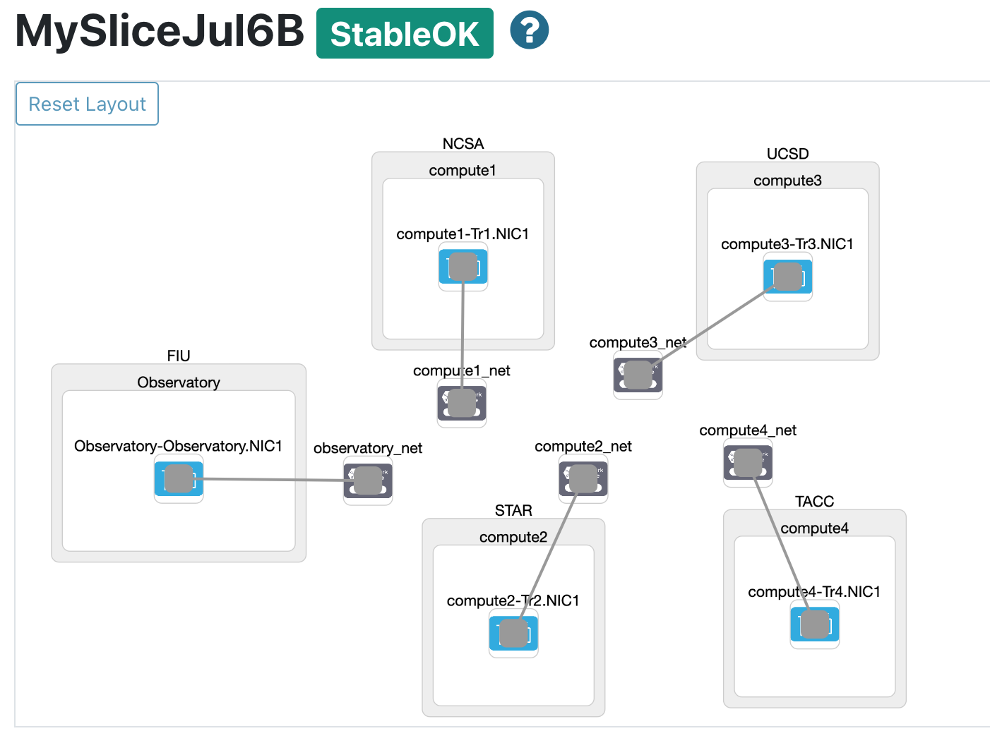
Multisite Slice on FABRIC
Notes:
In the current configuration, jobs are sent by a master running at NCSA to appropriate nodes.

Slide 15
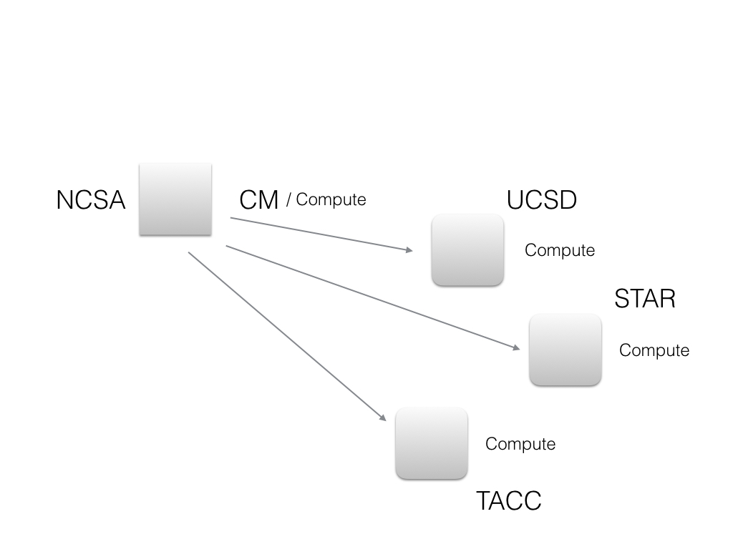
HTCondor Computing Pool on FABRIC
Create an L3 IPv6 network at each site, add site VM, add routes between all
All nodes configured for an HTCondor role (Manager, Execute)
COLLECTOR_HOST=<NCSA IPv6 IP#> NETWORK_INTERFACE=<Site IPv6 IP#>
Compute Nodes communicate with a CM using L3 networks/routes
Jobs submitted across pool
Jobs
Notes:
In the current configuration, jobs are sent by a master running at NCSA to appropriate nodes.

Slide 16
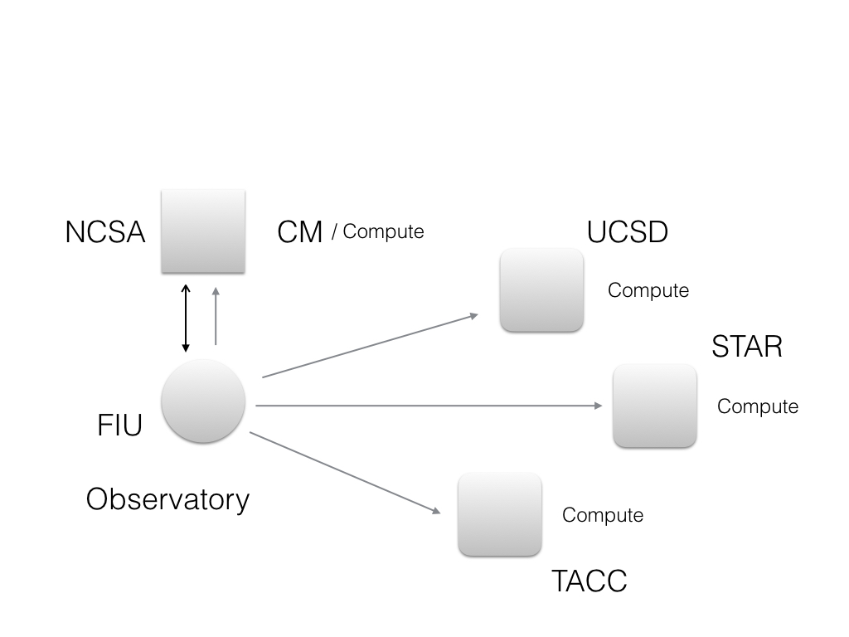
Data Flow
A main workflow on CM discovers available data at FIU / Observatory
All jobs on compute nodes copy data from persistent storage at FIU / Observatory using L3 networks/routes (data plane)
bbcp
Data
Notes:
We are modelin gprocessing data from the observatory data is pulled from persistent store at FUI.

