Slide 1
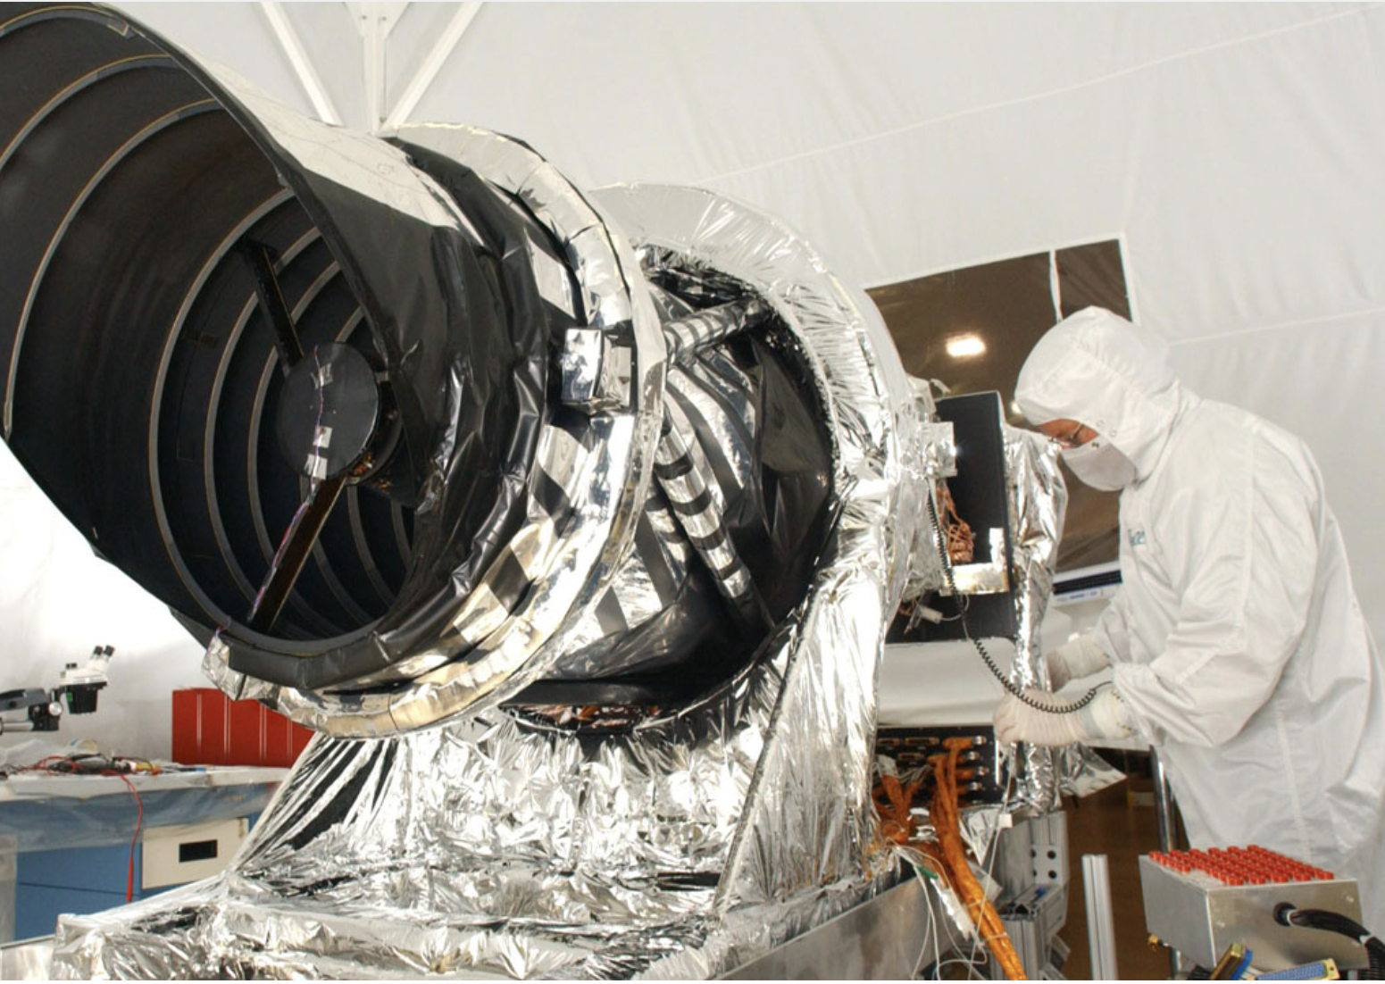
Orbiters and Clouds: Bringing Mars Reconnaissance Orbiter Data to the People
Mike Fienen¹, Sam Congdon², Jay Laura³, Brendan Wakefield²
¹ USGS Upper Midwest Water Science Center, Madison, WI
²USGS Cloud Hosting Solutions,
Bozeman,MT
³ USGS Astrogeology Science Center,
Flagstaff, AZ

Slide 2
Overview
Building on the legacy of condor_annex, we created an open-source, pool-on-demand AWS-based platform for high-throughput computing with HTCondor
We illustrate with an example of making
Mars Reconnaissance Orbiter HiRISE imagery data more
open and accessible for science

Slide 3
On Premises Resource Seems Ideal –
we have been running a large cluster for years
0. Can be difficult to buy and maintain on-premises computational resources
Consider the full costs on premises buying equipment the human cost of maintenance power/cooling carbon footprint of lacking efficiency
Who gets priority?

Slide 4
What about the cloud?
The Good Stuff:
0. Can scale big
1. Can configure things pretty much how you want
2. “Bring the compute to the data”
3. Everyone gets their own cluster
The Bad Stuff:
0. IT nerdery overload to get going 🤓
1. Ubiquity of error has a side effect
You get a cluster!
You get a cluster!

Slide 5
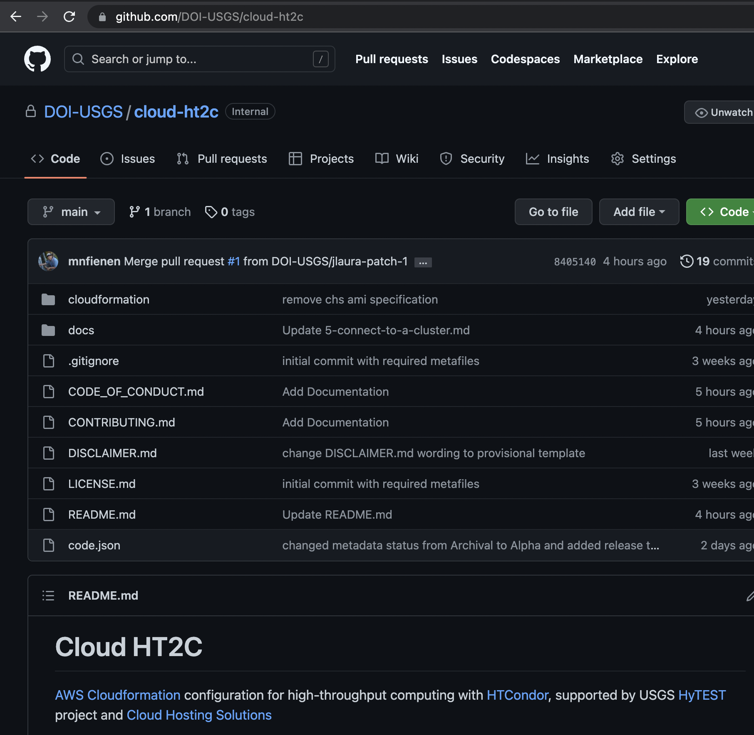
cloud-ht2c
Alpha Version 0.1

Slide 6
Architecture of cloud-ht2c
0. Configure an AMI (Amazon Machine Image)
AMI=blueprint.
Single running instance=one building from the blueprint
There are a few prereqs for the AMI
Spin up a cluster on demand using cloudformation yml configuration decide which AMI and architecture to base the control node and each worker on decide how many workers you want choose optional spot option assign timeout options
Cloudformation coordinates a flexible setup with a single central manager and workers can come and go HTCondor uses TCP/IP so port 9618 is open Also ports 9700-9710 are available for PEST/PEST++

Slide 7
Cloud-based hybrid of HPC and HTC
ami 0: with multiple cpus
Worker 0
Control Node
Worker m
ami n: with multiple cpus
S3
Worker m+1
EFS shared storage
Worker m
/mnt/condor_working

Slide 8
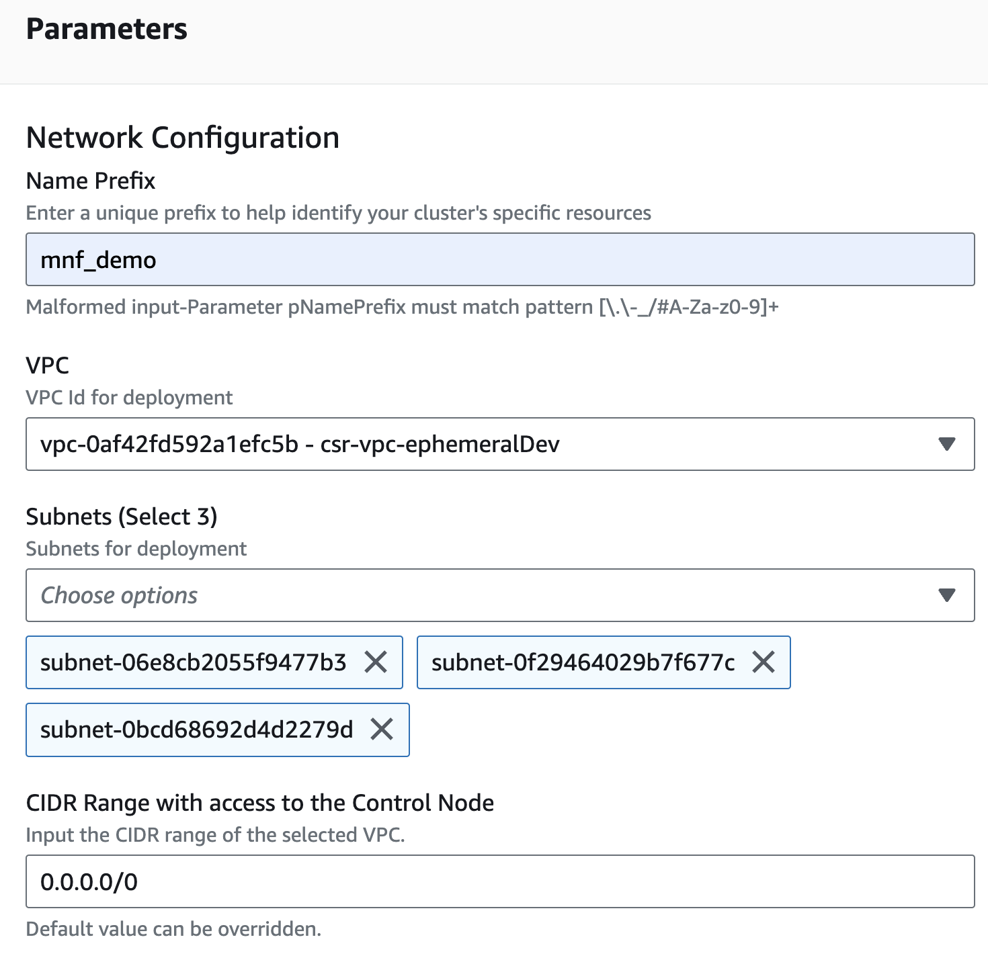
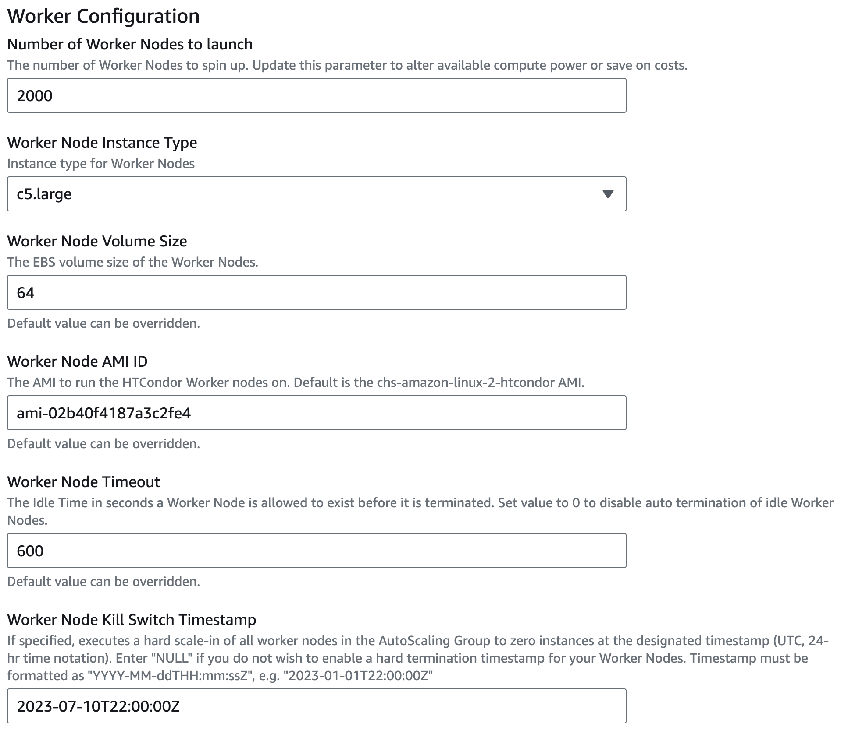
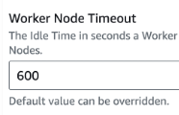
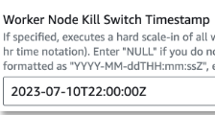
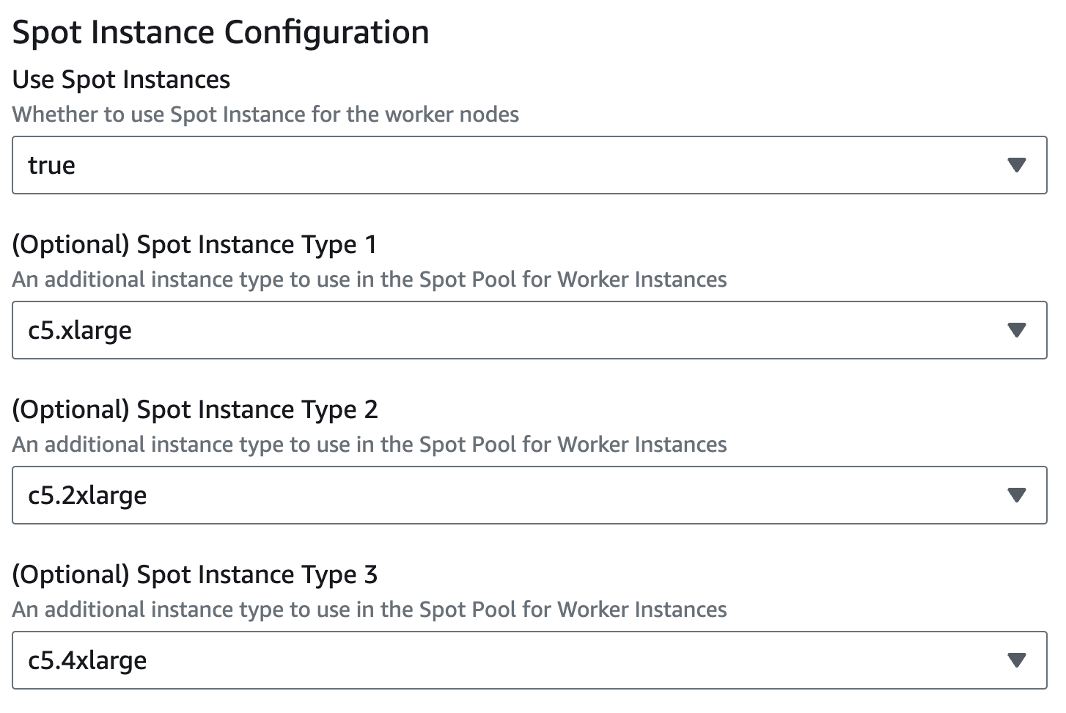
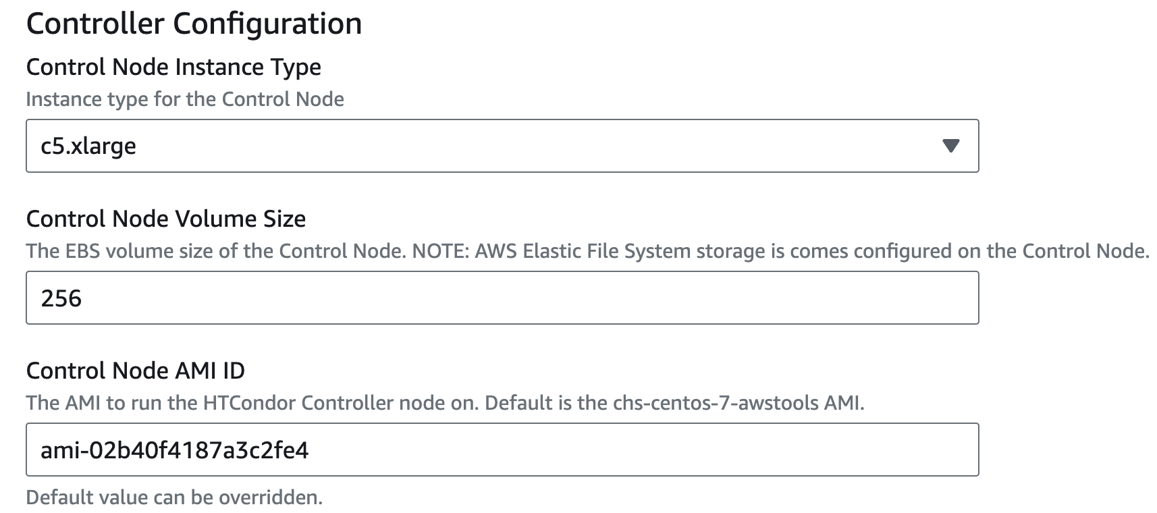
Configuring a cloud-based compute cluster
Thanks to
Todd Miller for the lowdown!
1.
3.
4.
2.

Slide 9
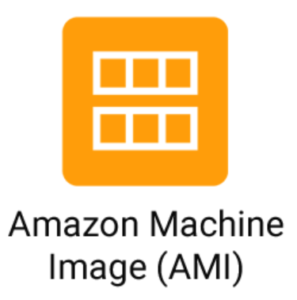
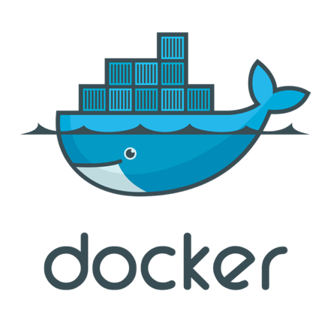
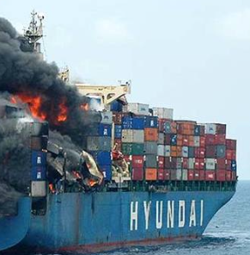
How to deploy dependencies and model files
“AMI is the OG Docker”
/mnt/condor_working
wine
Increasing complexity

Slide 10
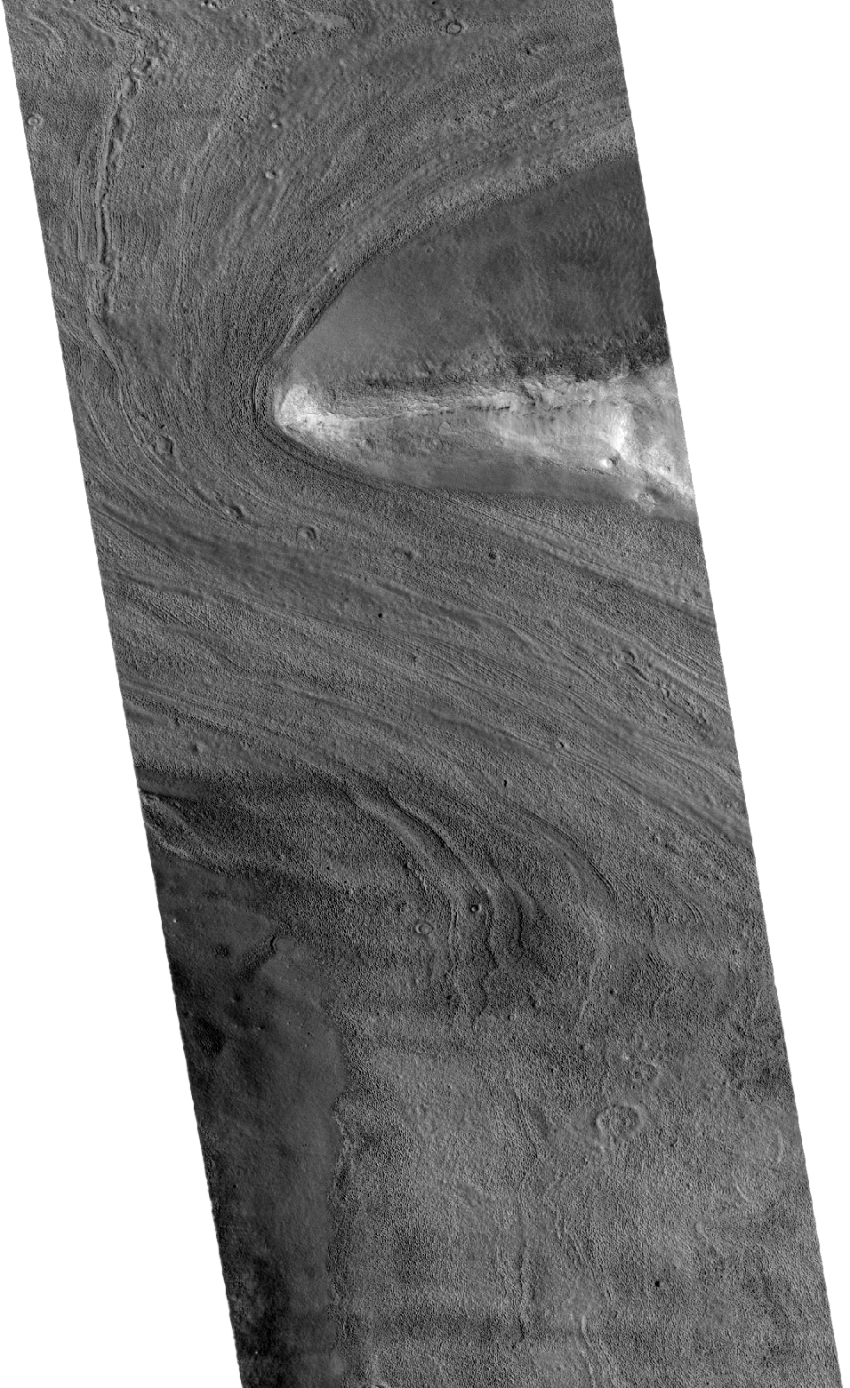
Mars Reconnaissance Orbiter
and Analysis Ready Data
Different missions have different specs/needs.
Big issues are image format (JPEG 2000 are not
registered in space so harder to find).
Cloud-optimized geoTIFF is explorable via browser.
Common projections enhance interoperability
Processing and serving the entire dataset
empowers scientists to focus on the science
rather than endless fussing with a complex
image/geo-processing workflow

Slide 11
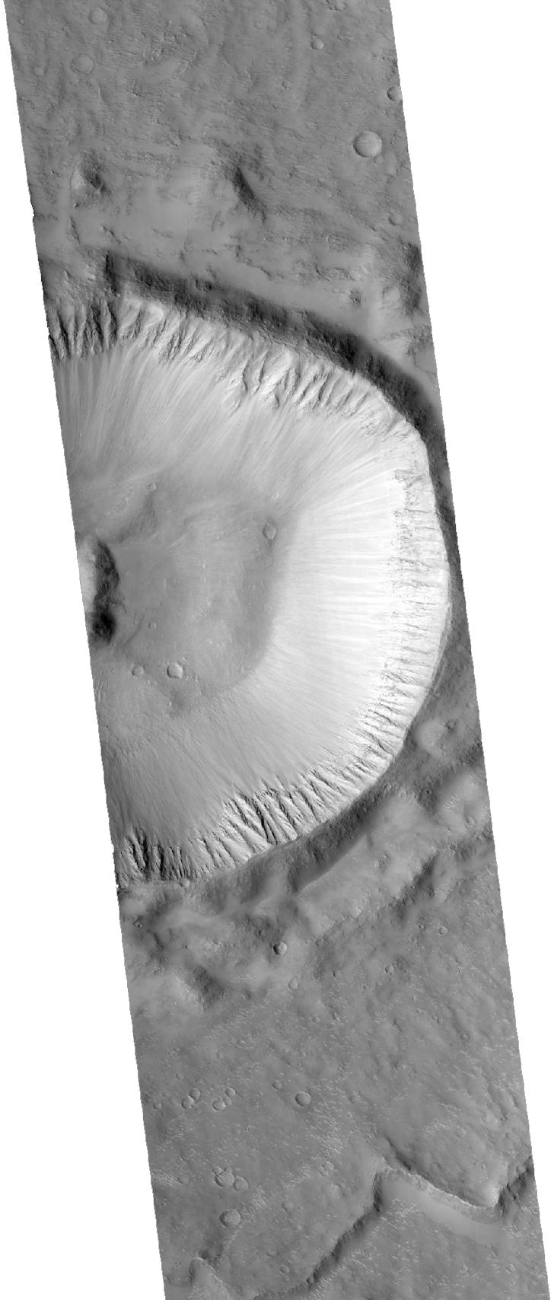
Mars Reconnaissance Orbiter and Analysis Ready Data by the Numbers
155,317 total images to process
Input from USGS/NASA S3 bucket: 100 TB
Output to NASA/Amazon Registry of Open Data S3: 114 TB
2,000 AMIs supporting 4,664 concurrent jobs
Total wall time: about 4 hours (not quite enough time to watch The Martian twice!)
Cost: about 10% of planned (#spotInstnaces)

Slide 13
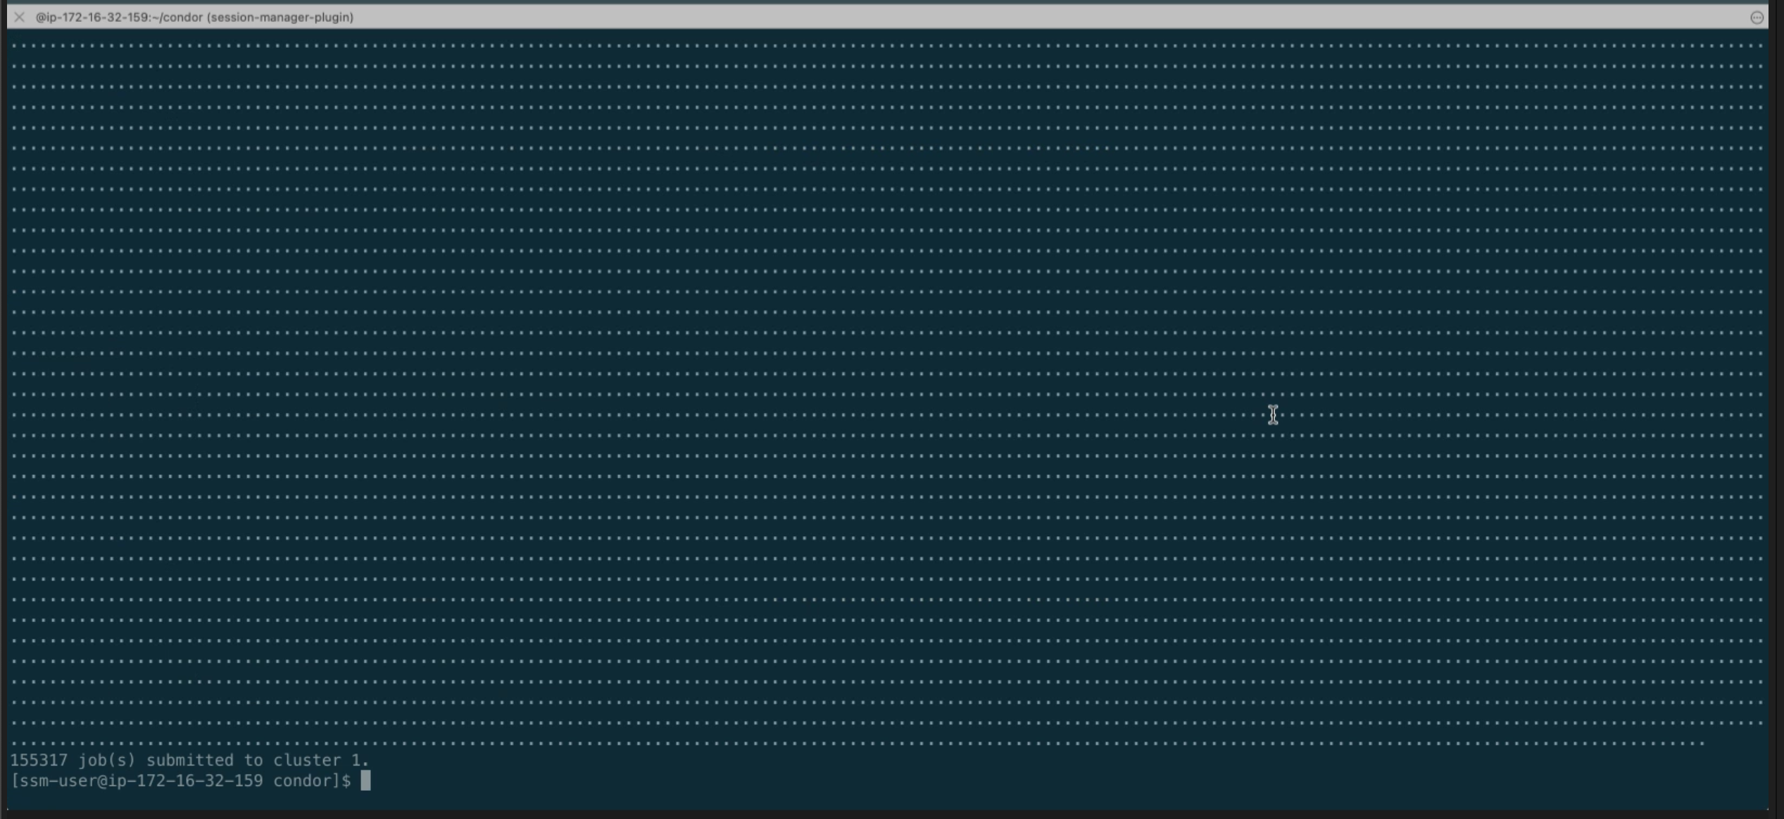
That’s a lot of dots!

Slide 14
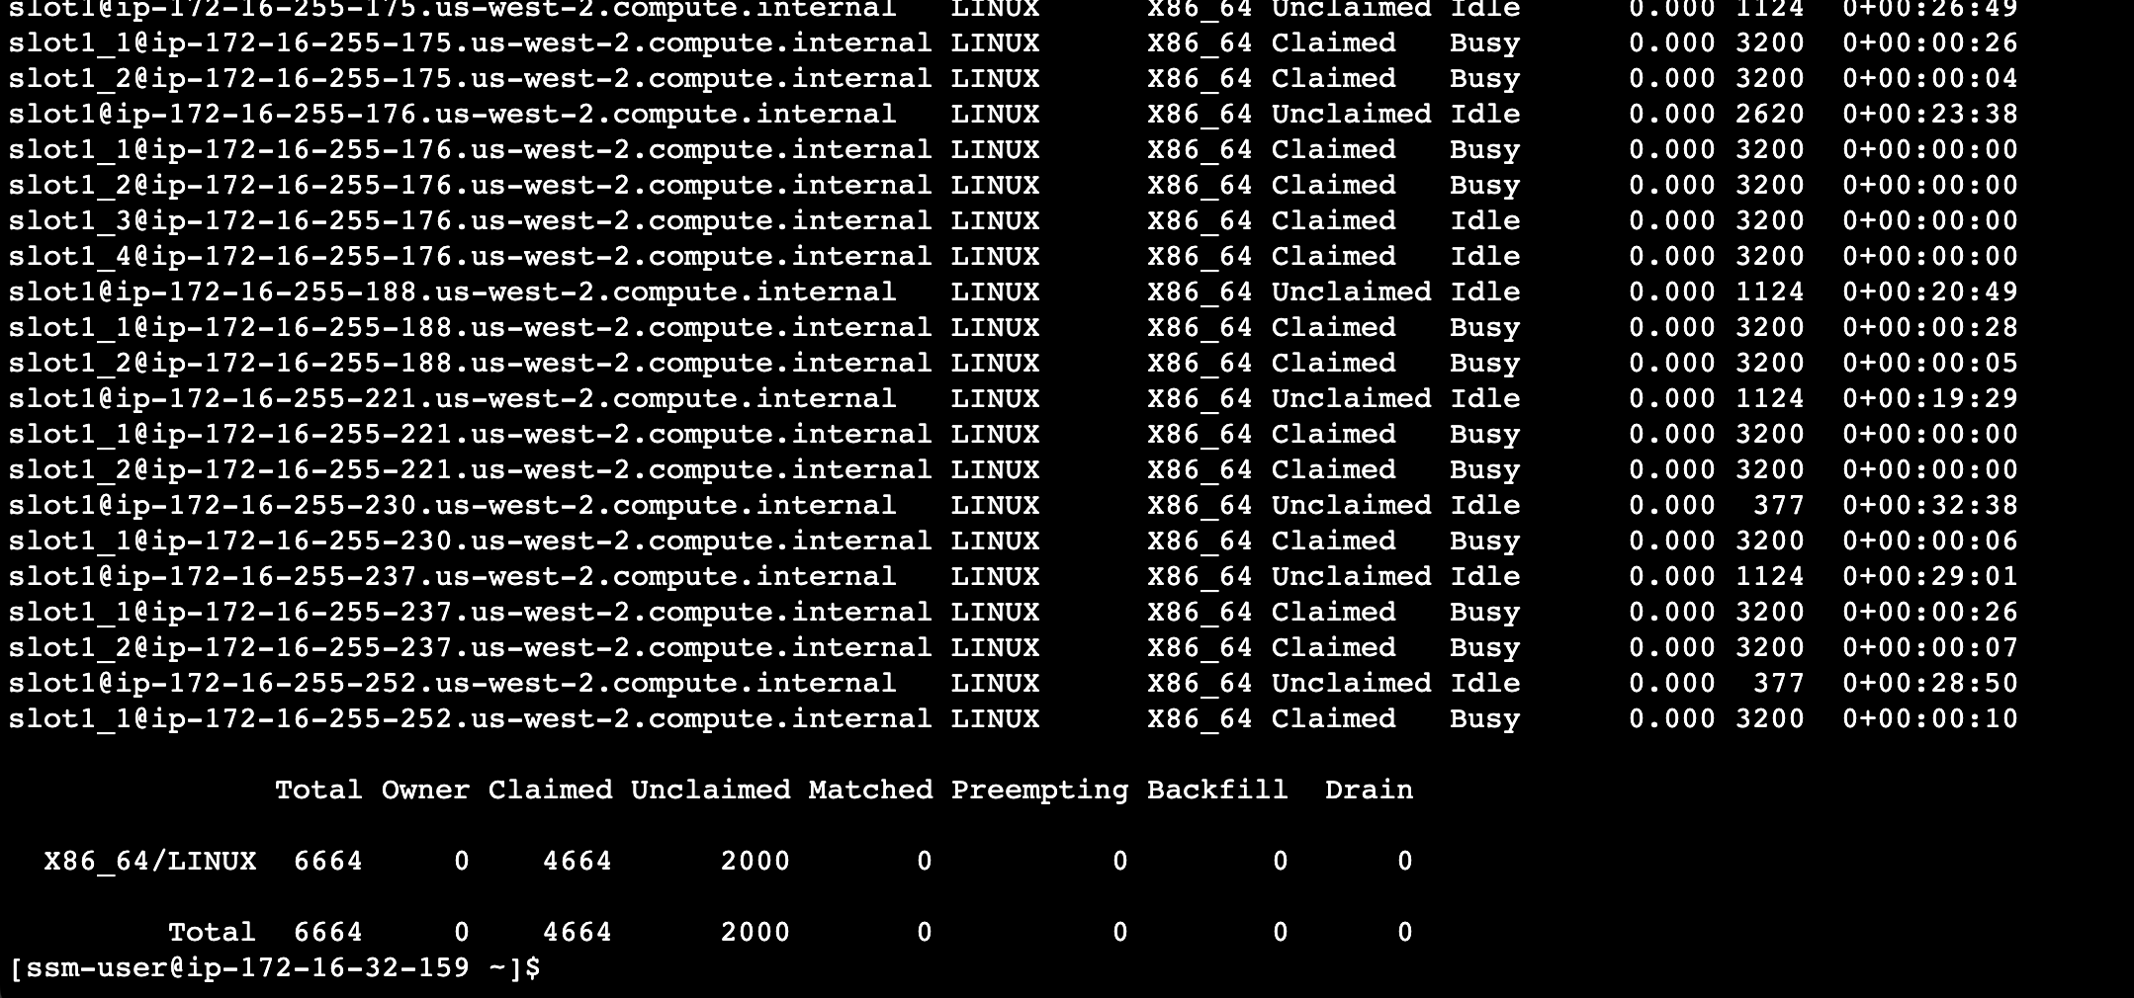

Slide 15
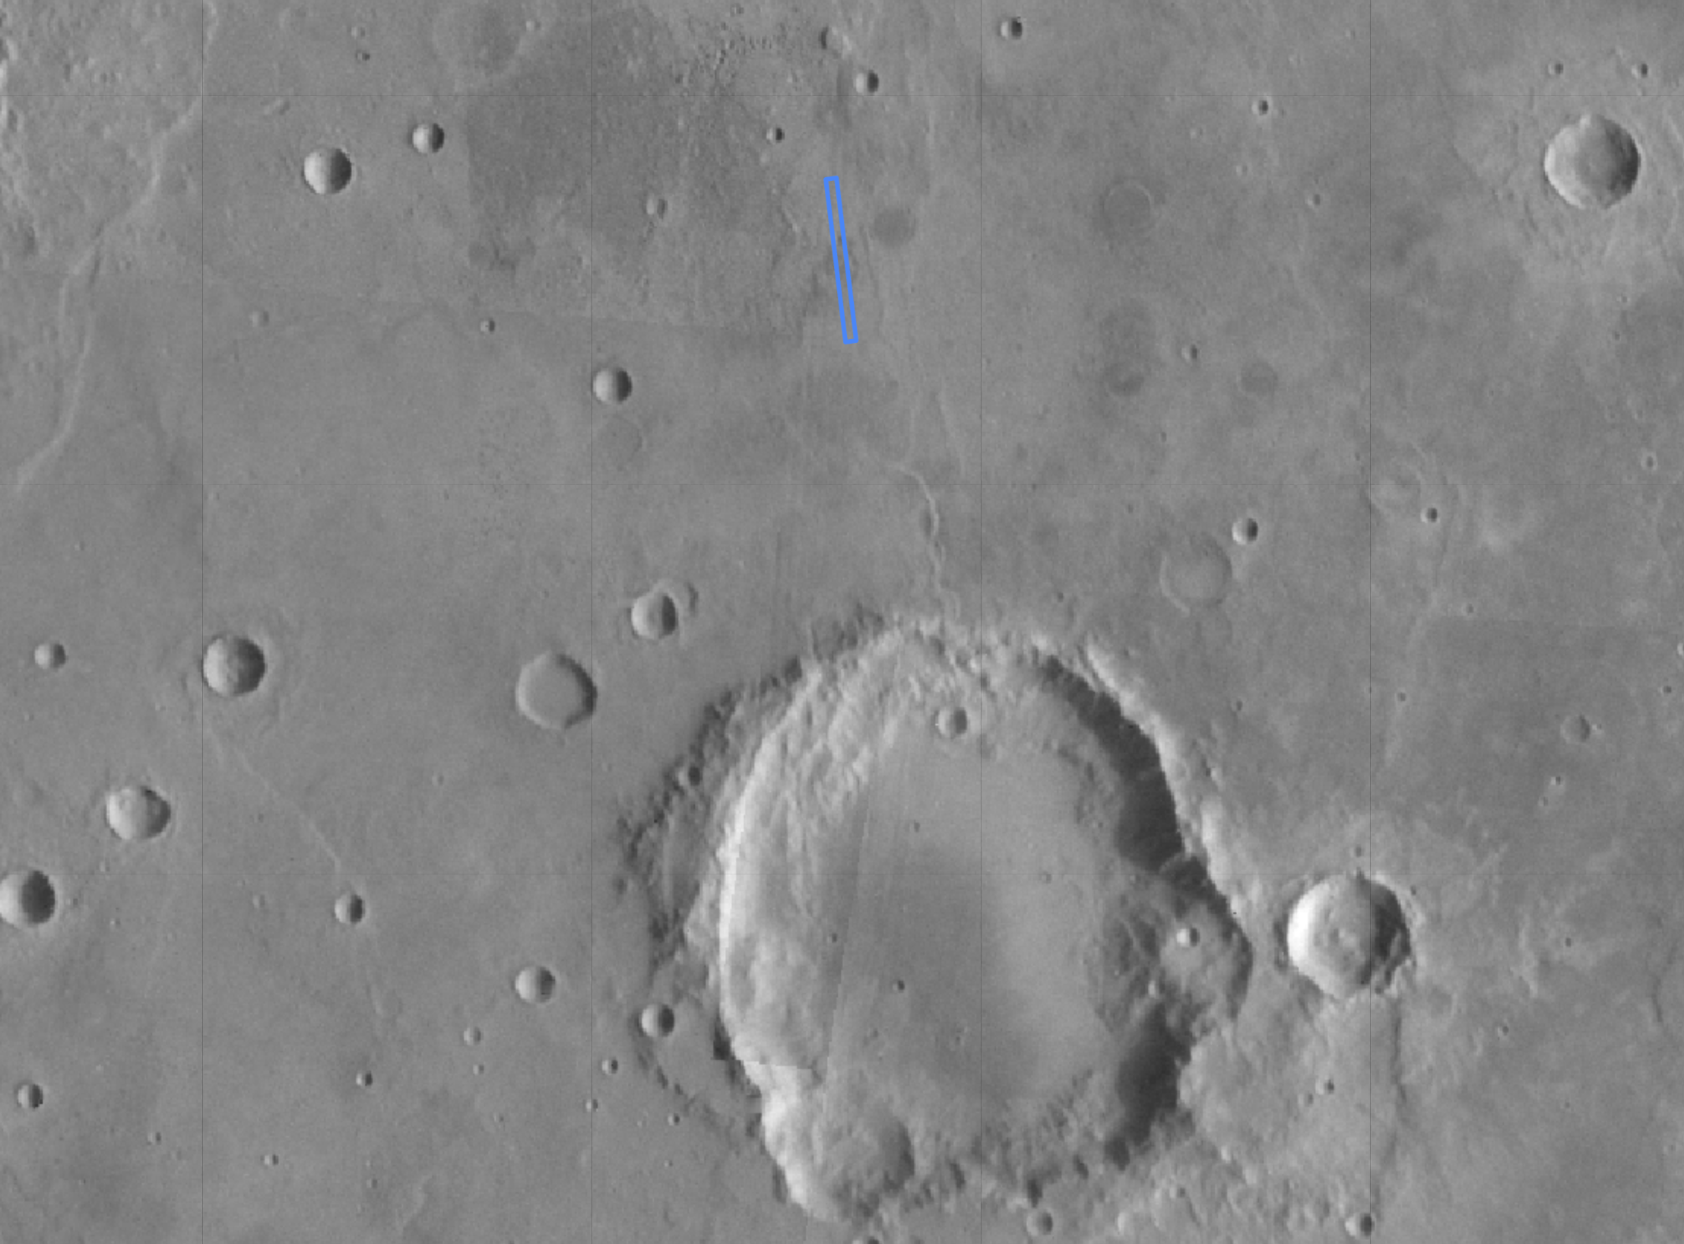
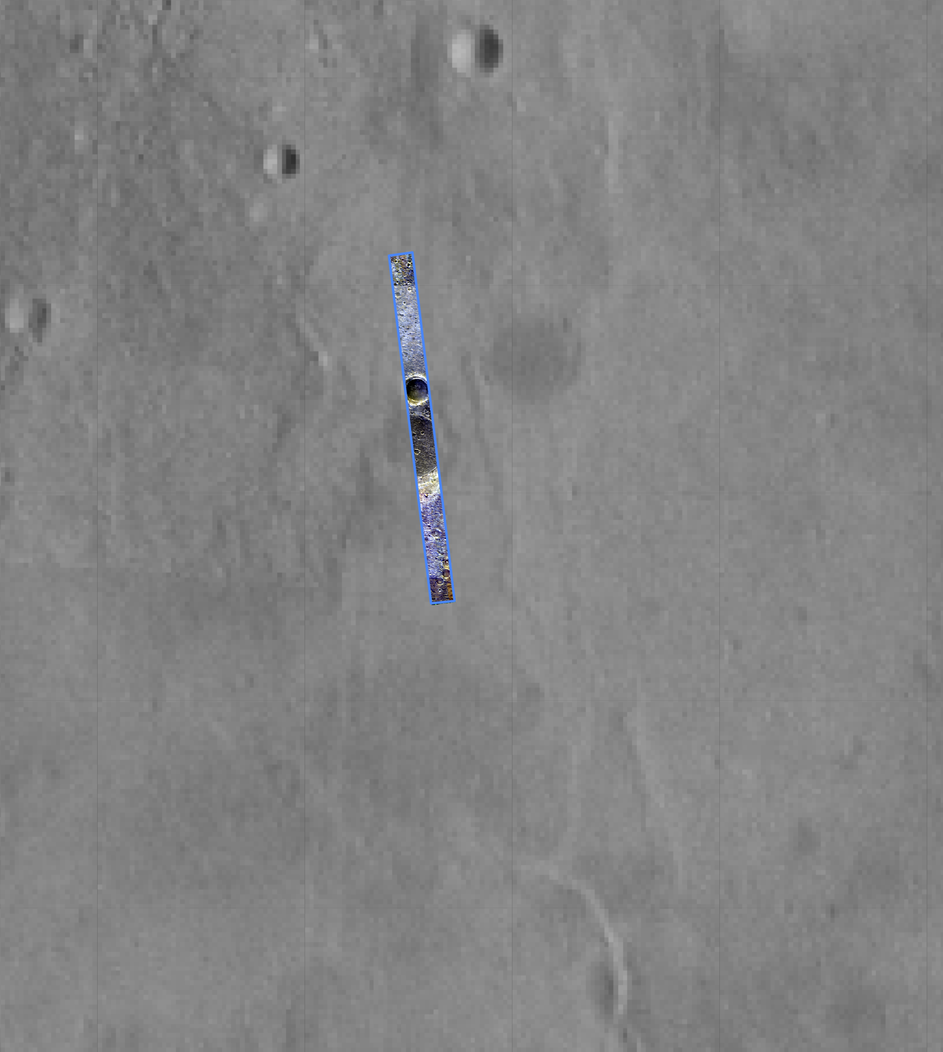
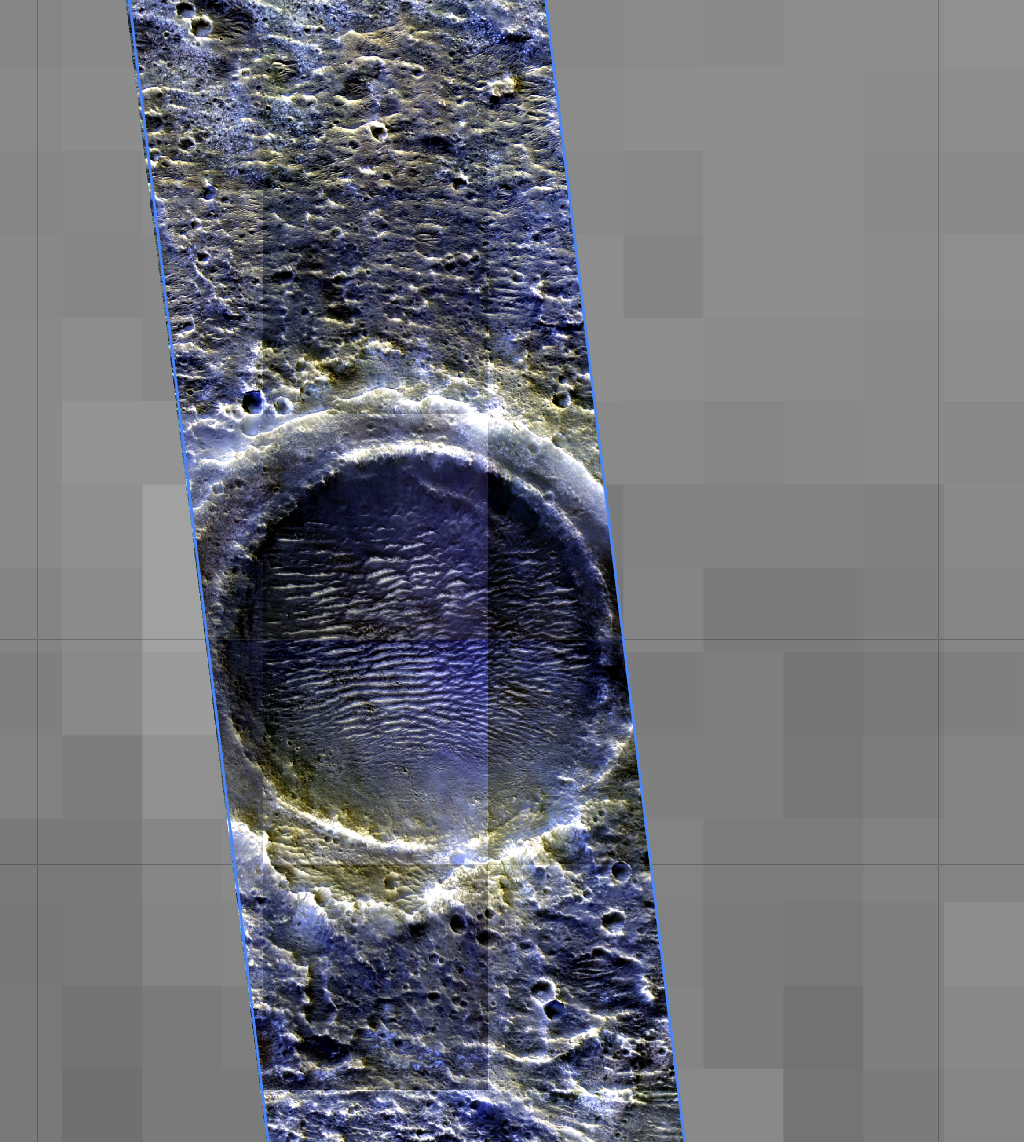

Slide 16
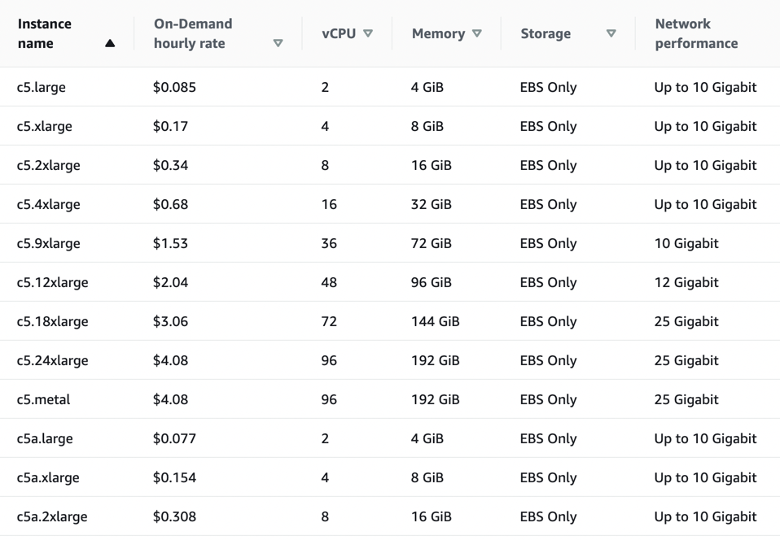
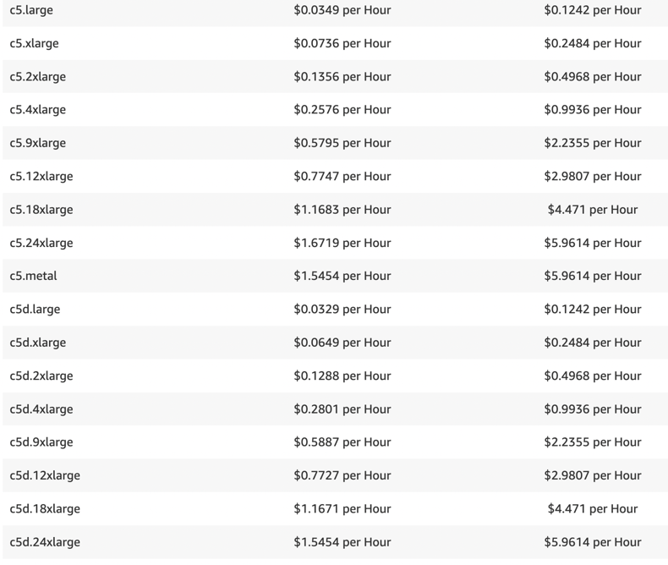
Let’s talk about MONEY
On-demand pricing
Spot pricing

Slide 17
Let’s talk more about MONEY
Break it down:
each CPU on-demand is ~$0.043/hr
but likely need to reserve some (25%?) CPUs for OS, so ~$0.057/hr
Spot market? Cost is often ~40%-50% so maybe $0.02-$0.03/hr?
BUT! If runs get dropped, can add up – think about forward runtimes
Spot is cheaper for AMIs with more CPUs, but that may hurt performance

Slide 18
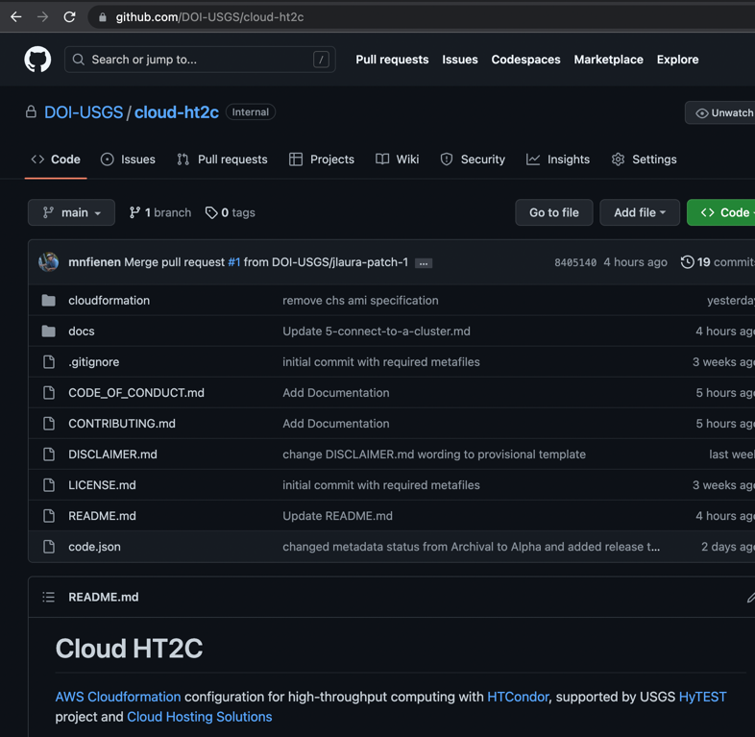
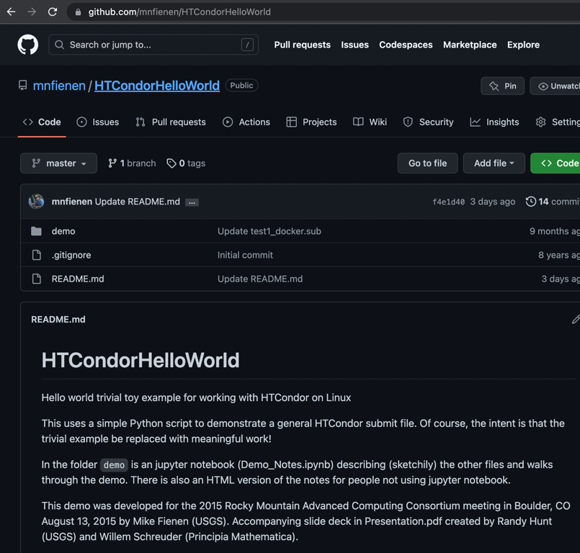
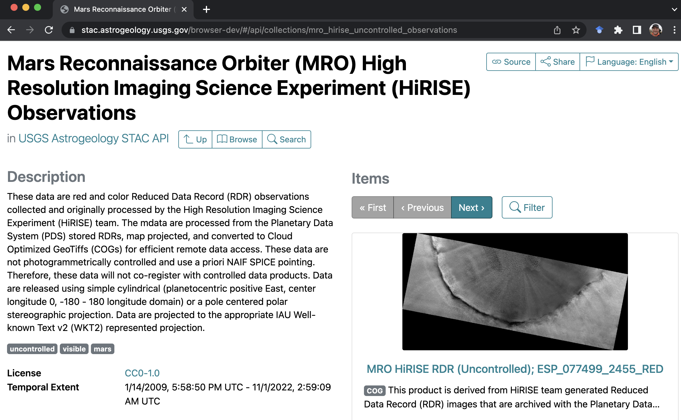
THANKS!
Go kick the tires on cloud-ht2c – just remember it’s
Alpha v 0.1 – let me know how it goes mnfienen@usgs.gov

