Slide 1
White title slide
Developing Machine Learning for Metadata Standardization with HTCondor and Snakemake
Throughput Computing 2023
Yuriy Sverchkov, Mark Craven, Colin Dewey

Slide 2
Text slide: 1 column
Funding and people
American Family Funding Initiative 2020 Award
Colin Dewey
Mark Craven
Yuriy Sverchkov
Jeremiah Yee
Abrar Majeedi
Tapanmitra Ravi

Slide 3
An abundance of (meta)data
The NCBI’s Sequence Read Archive (SRA)
The largest publicly available repository of high throughput sequencing data
Opportunity for aggregate analyses
Metadata are free-text key-value pairs composed by individual submitters
Total bases
Open access bases

Slide 4
Free-text metadata is hard to mass-process and query
Property | Property value
cell line | BJ
cell type | fibroblasts
harvest time | 72 hours post seeding
lentiviral transgenes | no
passage number | passage 5
source_name | Human forskin fibroblast, BJ (ATCC, CRL-2522)
References to external sources
Key derives meaning from value
Spelling errors

Slide 5
Metadata standardization task
Free-text key-value pairs
Relations to standardized terms
Property | Property Value
Cell type | PBMC
Disease state | Lyme disease
Individual | Patient 01-20
Source_name | PBMCs
Time | Acute Lyme pre-treatment (V1)
Relationship | Term ID | Term Name
Consists_of | CL:0000842 | Mononuclear cell
Consists_of | CL:2000001 | Peripheral blood mononuclear cell
Has_phenotype | DOID:11729 | Lyme disease
Has_phenotype | EFO:0000408 | Disease
Underwent | EFO:000727 | Treatment
Property | Property Value
Biomaterial_ provider | AllCells, 1301 Harbor Bay Parkway Suite 200 Alameda, CA 94502, USA
Bioproject_id | PRJDB3120
Cell_line | Peripheral blood mononuclear cells
Description | Healthy person 5
Sample_name | N5
Sample_title | Small cellular RNA
Relationship | Term ID | Term Name
Consists_of | CL:0000842 | Mononuclear cell
Consists_of | CL:2000001 | Peripheral blood mononuclear cell
Consists_of | EFO:0000322 | Cell line
Part_of | UBERON:0000187 | Blood

Slide 6
Ontologies provide a framework for standardization
An ontology formally represents entities, categories, and properties in a field of knowledge
The terms in an ontology are uniquely identified
Ontology relations relate specific terms to general terms that subsume them
www.ebi.ac.uk/ols4

Slide 7
MetaSRA is a rule-based system for metadata standardization

Slide 8
ML4Meta: a machine learning approach
Key-value pairs
Text matching
Based on MetaSRA
Uses ontologies and lexicons
Feature representation
Text features (bag-of-words)
Derivation step features
Produces a candidate term match and its derivation
Ontology relation features
Match goodness (edit distance and synonym level)
Relationship classifier
Assigns probabilities representing whether a term relates to a sample and how
Rule-based but domain-agnostic

Slide 9
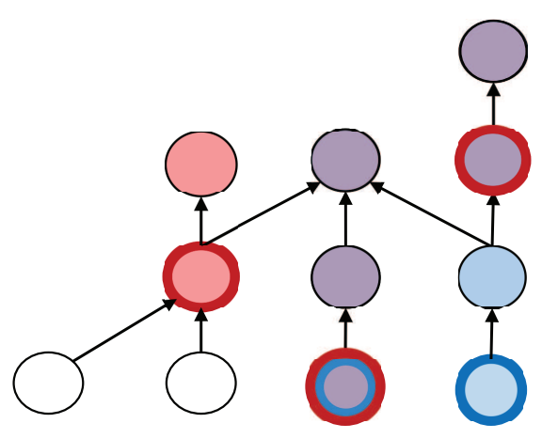
ML4Meta outperforms MetaSRA on SRA metadata

Slide 10
ML4Meta generalizes to other datasets

Slide 11
Development Workflow

Slide 12
Snakemake rule definitions
YAML configuration
rule collect_binary_curves:
output:
result = '{experiment_dir}/binary_curves.csv'
input:
input_to_collect_binary_curves
run:
import pandas as pd
pd.concat([
pd.read_csv(f, index_col=['model', 'threshold'])
for f in input
]).to_csv(output.result)
experiments:
workspace/2023-05-11_sra-to-sra-with-chebi-experiment:
run: true
results:
- binary curves
- multiclass curves report
models:
lr-l1: Logistic Regression (L1)
lr-l2: Logistic Regression (L2)
mlp1: Multi Layer Perceptron (1 hidden layer)
mlp2: Multi Layer Perceptron (2 hidden layers)
rf: Random Forest
xgb: XGBoosted Trees
evaluation ontology: workspace/ontology_graphs/v11/ontology_graph.pickle
training: workspace/sra-training-set_2023-05-11
testing: workspace/sra-to-sra-testing-set_2023-05-11
Workflow execution
Snakemake input functions
def input_to_collect_binary_curves(wildcards):
return expand(
f'{wildcards.experiment_dir}/binary_curves/{{model}}.csv',
model = config['experiments'][wildcards.experiment_dir]['models'].keys()
)

Slide 13
The HTCondor profile brings the power of HTCondor to Snakemake
Simple configuration and usage
Implemented using the HTCondor Python API
Each Snakemake rule becomes a Condor job

Slide 14
ML development with Snakemake and HTCondor: Strengths and weaknesses
Snakemake is backend-agnostic and portable
Avoids re-generating dependencies in subsequent executions
Python syntax
Input functions are powerful
Data-dependent workflow definition
Defining workflows with configuration files makes iterative development easy
Snakemake is file-based
The Snakemake HTCondor profile is harder to configure without a network share
Snakemake process needs to stay running on submit node throughout workflow execution
THANK YOU!

