Slide 1
What's new in the HTCondor Software Suite (HTCSS) ? What's coming up? HTC 23 – Madison, WI
Todd Tannenbaum
Center for High Throughput Computing
University of Wisconsin-Madison

Slide 2
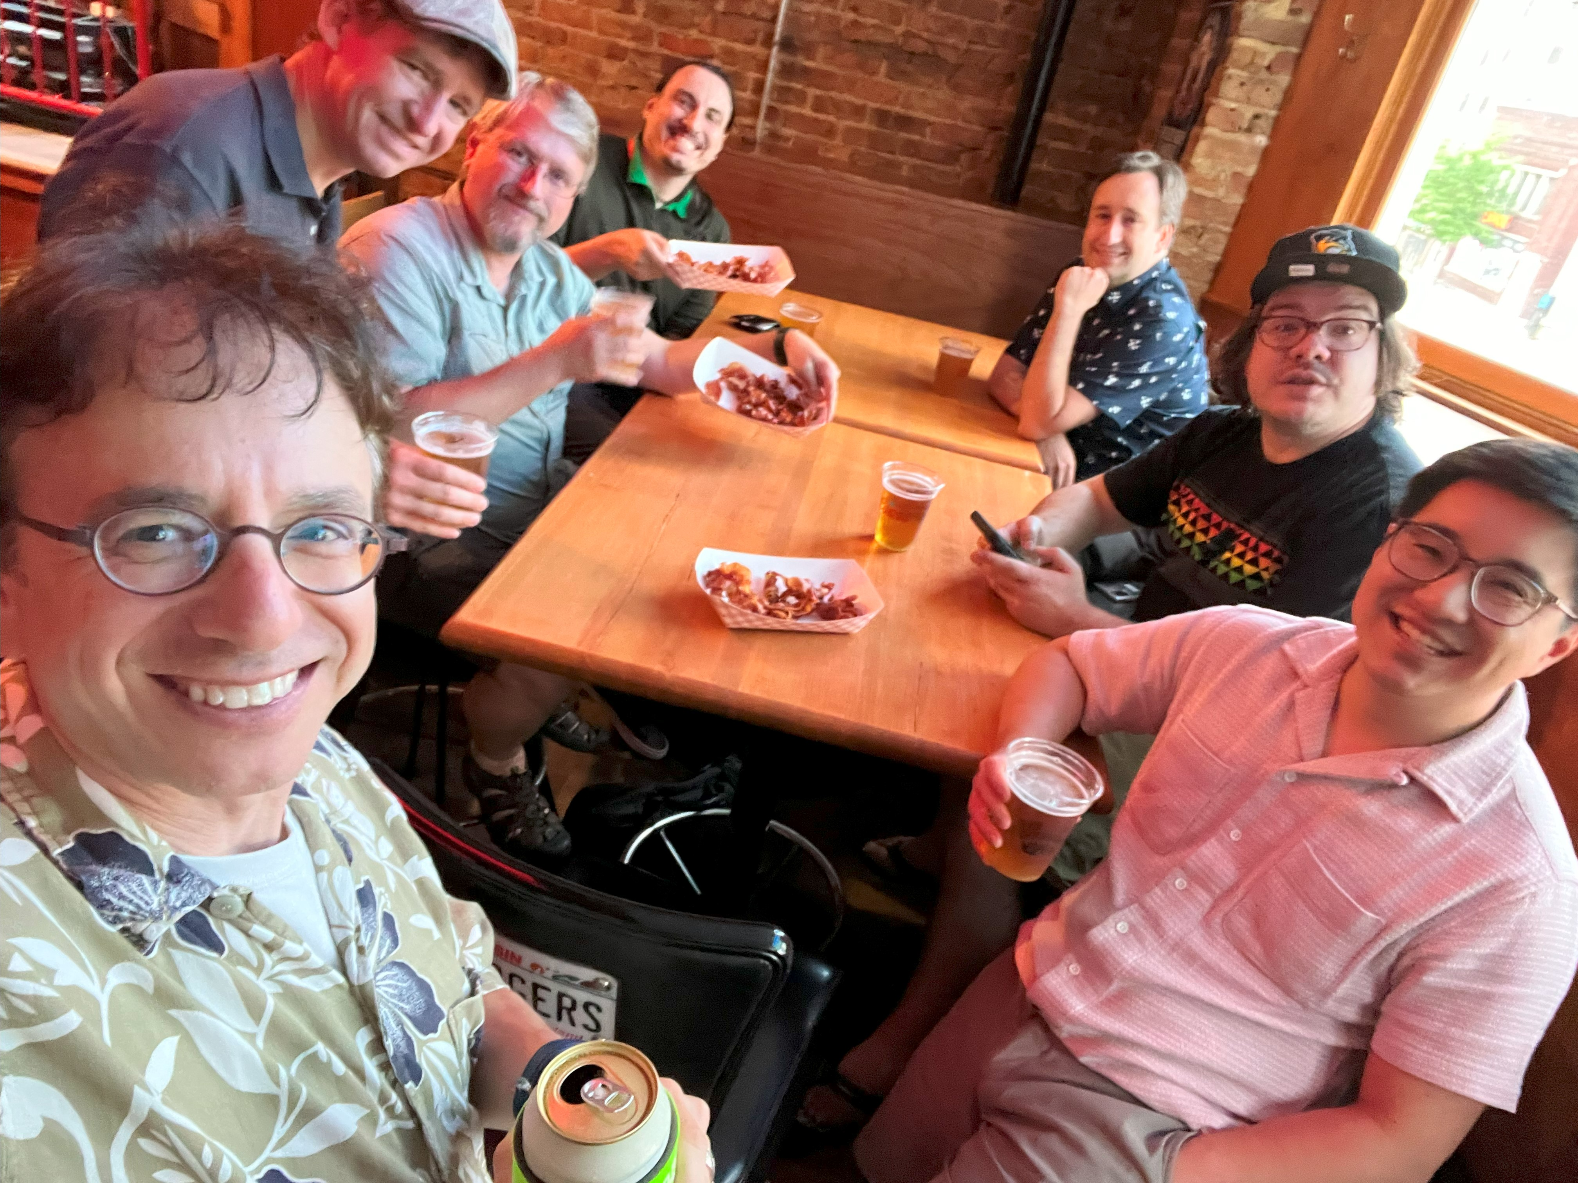

Slide 4
Release Channels
Long-Term Support (LTS) Releases (formerly 'stable series')
Only bug fixes
vMajor.0.Update (e.g. 10.0.0, 10.0.1, 10.0.2, …)
Today: HTCSS v10.0.6
Feature Releases (formerly 'developer series')
Bug fixes plus new features
vMajor.Minor.Update (e.g. 10.1.0, 10.2.0, 10.3.0 …)
Next month: v10.8.0 …. This is the v11.0.0 release candidate!

Slide 5
Release Channels
Long-Term Support (LTS) Releases (formerly 'stable series')
Only bug fixes
vMajor.0.Update (e.g. 10.0.0, 10.0.1, 10.0.2, …)
Today: HTCSS v10.0.6
Feature Releases (formerly 'developer series')
Bug fixes plus new features
vMajor.Minor.Update (e.g. 10.1.0, 10.2.0, 10.3.0 …)
Next month: v10.8.0 …. This is the v11.0.0 release candidate!
v23.0.0

Slide 6
Release/Versioning Change
Why?
To synchronize support and major release cycles with OSG Software
Allows HTCSS binaries to be the same between htcondor.org and OSG software (only build/package once)
New Major version each summer
Major Version number = year of release (23, 24, 25, …)
The two most recent LTS series will be supported e.g.
Summer 2025: Version 25.0.0 will be released. Support for v24.0.x and v25.0.x; support for 23.0.x will end.
HTCondor-CE version number will reflect HTCSS version.

Slide 7
Release/Versioning Change
Why?
To synchronize support and major release cycles with OSG Software
Allows HTCSS binaries to be the same between htcondor.org and OSG software (only build/package once)
New Major version each summer
Major Version number = year of release (23, 24, 25, …)
The two most recent LTS series will be supported e.g.
Summer 2025: Version 25.0.0 will be released. Support for v24.0.x and v25.0.x; support for 23.0.x will end.
HTCondor-CE version number will reflect HTCSS version.

Slide 8
Some New Terminology
I ♥ Open Science Grid
HTCondor Software Suite (HTCSS)
Access Point (AP)
Execution Point (EP)
HTCondor Pool =
Central Manager +
Execution Point(s) (EP)
HTCondor Compute Entrypoint (HTCondor-CE)
Now it is just OSG
I ♥ submitting jobs with HTCondor!
You mean placing jobs at an HTCSS Access Point
Arrrrgh!

Slide 9
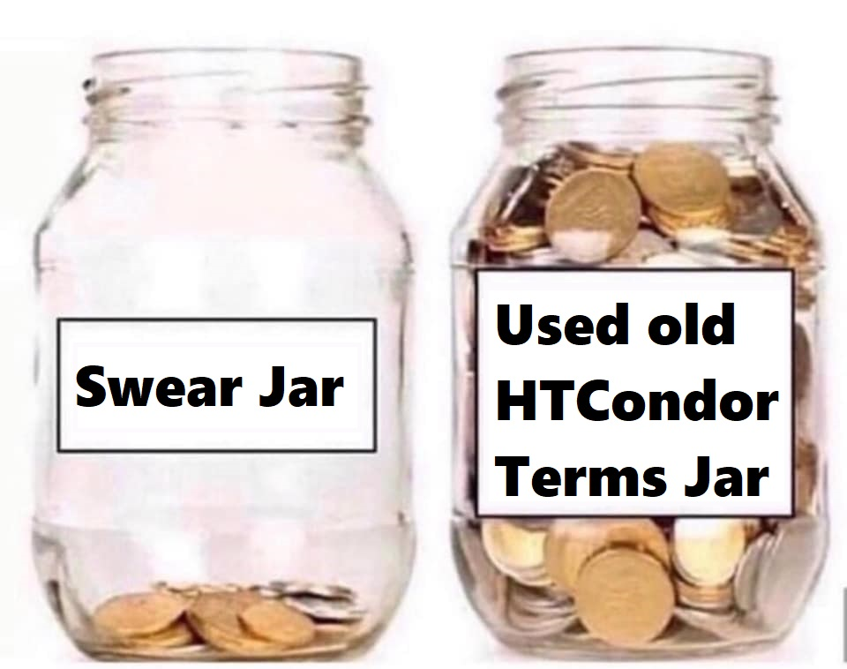
Some New Terminology
I ♥ Open Science Grid
HTCondor Software Suite (HTCSS)
Access Point (AP)
Execution Point (EP)
HTCondor Pool =
Central Manager +
Execution Point(s) (EP)
HTCondor Compute Entrypoint (HTCondor-CE)
Now it is just OSG
I ♥ submitting jobs with HTCondor!
You mean placing jobs at an HTCSS Access Point
Arrrrgh!

Slide 11
Since HTCondor Week 2022, there were 12 LTS releases and 10 Feature releases incorporating 140 enhancements and 162 bug fixes.

Slide 12
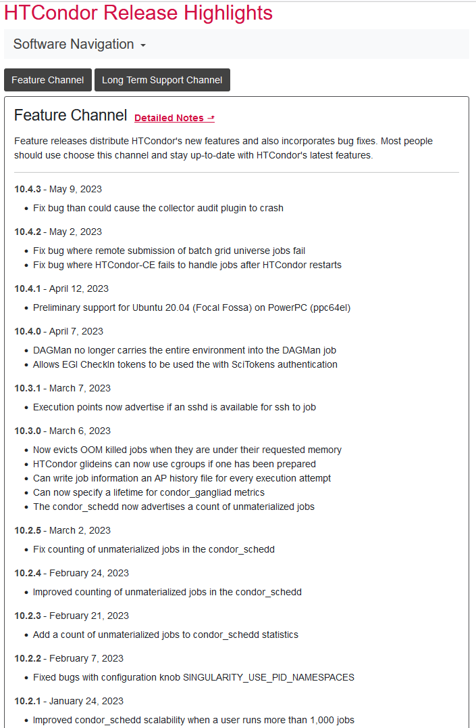
Since HTCondor Week 2022, there were 12 LTS releases and 10 Feature releases incorporating 140 enhancements and 162 bug fixes.
See "Detailed Notes" at
https://htcondor.org/htcondor/release-highlights/

Slide 13
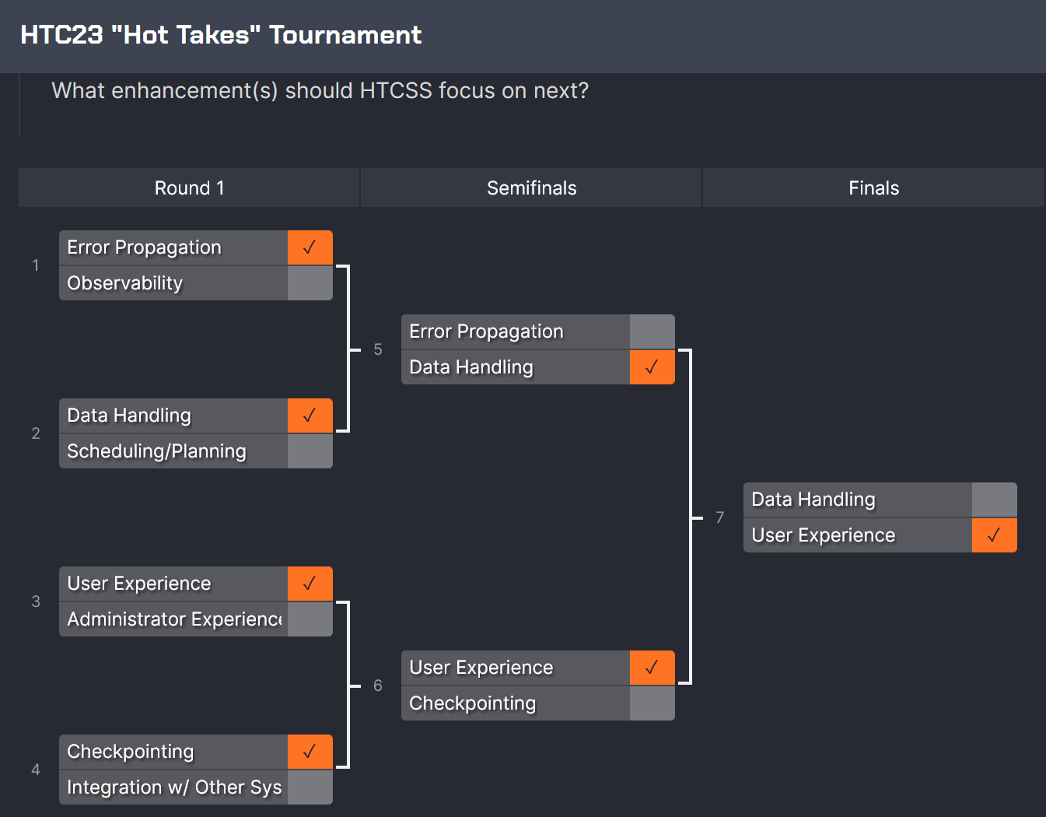
So, What's Cooking?
Let's start with some User Experience work at the Access Point…

Slide 14
Evolving new command line user interface
htcondor <noun> <verb>
"htcondor job submit", "htcondor job status", …
"htcondor dag submit", "htcondor dag status", …
"htcondor jobset submit", "htcondor jobset status", …
"htcondor annex create", "htcondor annex status", …
"htcondor eventlog read"
Legacy tools (condor_q, condor_submit, condor_history, …) not going anywhere…

Slide 15
condor_q - looking at one running job
$ condor_q 123.45
-- Schedd: login04.osgconnect.net : <192.170.231.217:9618?... @ 07/12/23 21:43:13
OWNER BATCH_NAME SUBMITTED DONE RUN IDLE TOTAL JOB_IDS
toddt ID: 123 7/12 21:37 _ 1 _ 10000 123.45
Total for query: 1 jobs; 0 completed, 0 removed, 0 idle, 1 running, 0 held, 0 suspended

Slide 16
condor_q - looking at the details
$ condor_q –l 123.45
AccountingGroup = "group_opportunistic.EvolSims.toddt"
AcctGroup = "EvolSims"
AcctGroupUser = "anushd"
AllowedExecuteDuration = 72000
Args = "44"
AutoClusterId = 3232
BytesRecvd = 0.0
BytesSent = 0.0
ClusterId = 36371245
Cmd = "/home/anushd/cluster_code/cwrapper.sh"
CommittedSlotTime = 0
CommittedSuspensionTime = 0
CommittedTime = 0
CondorPlatform = "$CondorPlatform: X86_64-CentOS_7.9 $"
CondorVersion = "$CondorVersion: 10.6.0 2023-06-26 PackageID: 10.6.0-0.656423 RC $"
CoreSize = 0
CpusProvisioned = 1
…

Slide 17
New Job Status
$ htcondor job status 123.45
Job 123.45 is currently running on host exec221.chtc.wisc.edu. It started running again 2.1 hours ago. It was submitted 3.6 hours ago. Its current memory usage is 2.5 GB out of 4.0 GB requested. Its current disk usage is 3.8 GB out of 5.5 GB requested. It has restarted 2 times.
Goodput is 80% (0.5 hours badput, 2.1 hours goodput).

Slide 18
New Job Status
$ htcondor job status 123.45
Job 123.45 is currently running on host exec221.chtc.wisc.edu. It started running again 2.1 hours ago. It was submitted 3.6 hours ago. Its current memory usage is 2.5 GB out of 4.0 GB requested. Its current disk usage is 3.8 GB out of 5.5 GB requested. It has restarted 2 times.
Goodput is 80% (0.5 hours badput, 2.1 hours goodput).

Slide 19
What about a DAGMan workflow?
$ htcondor dag status 223
DAGMan Job 223.0 [simple.dag] has been running for 52 days 04:12:46.
DAG has submitted 382 individual job(s), of which:
45 are running.
10 are idle.
0 are held.
162 have completed successfully
DAG has failed nodes but will continue until all possible work is finished: 5 nodes failed.
10 nodes waiting to begin.
24 nodes running.
Goodput is 92%
[###########=======----------------] 34% complete.

Slide 20
What is this "eventlog" noun?
htcondor <noun> <verb>
"htcondor job submit", "htcondor job status", …
"htcondor dag submit", "htcondor dag status", …
"htcondor jobset submit", "htcondor jobset status", …
"htcondor annex create", "htcondor annex status", …
"htcondor eventlog read"
Legacy tools (condor_q, condor_submit, condor_history…) not going anywhere…
Notes:
https://agenda.hep.wisc.edu/event/1733/contributions/25505/attachments/8274/9664/go

Slide 21
What is this "eventlog" noun?
See demo by Todd Miller
https://agenda.hep.wisc.edu/event/1733/contributions/25505/attachments/8274/9664/go
htcondor <noun> <verb>
"htcondor job submit", "htcondor job status", …
"htcondor dag submit", "htcondor dag status", …
"htcondor jobset submit", "htcondor jobset status", …
"htcondor annex create", "htcondor annex status", …
"htcondor eventlog read"
Legacy tools (condor_q, condor_submit, condor_history…) not going anywhere…
Notes:
https://agenda.hep.wisc.edu/event/1733/contributions/25505/attachments/8274/9664/go

Slide 22
What is this "eventlog" noun?
htcondor <noun> <verb>
"htcondor job submit", "htcondor job status", …
"htcondor dag submit", "htcondor dag status", …
"htcondor jobset submit", "htcondor jobset status", …
"htcondor annex create", "htcondor annex status", …
"htcondor eventlog read"
Legacy tools (condor_q, condor_submit, condor_history…) not going anywhere…
Notes:
https://agenda.hep.wisc.edu/event/1733/contributions/25505/attachments/8274/9664/go

Slide 23
Lots of info users/admins can get from AP and EP job history files
$ condor_history $ condor_history –file startd-hist $ condor_adstash
Notes:
There is a lot of information users and admins can get from the AP and EP job history files. Unfortunately, there a three problems with these 1) they are only written when the job leaves the queue, so a job that hasn't run, or is stuck in a restart loop is invisible
2) They generally only contain summary information about the sum of information over all execution attempts, or perhaps info about the last execution attempt, and this is per-attribute
3) There is one (unindexed) file that holds all the job histories, which makes it very slow to search (putting it in elastic search helps, but that requires setup and learning a new query language)

Slide 24
Different info in event logs
000 (076.000.000) 2023-07-06 16:29:23 Job submitted from host: <…>.
001 (076.000.000) 2023-07-06 16:29:23 Job executing on host: <…>...
005 (076.000.000) 2023-07-06 16:30:19 Job terminated.
(1) Normal termination (return value 0)
Usr 0 00:00:00, Sys 0 00:00:00
Usr 0 00:00:00, Sys 0 00:00:00
0 - Total Bytes Sent By Job
0 - Total Bytes Received By Job
Notes:
The job event logs, like breaking news, update as things happen, not just at the end of jobs, which means you can get info before the jobs exit

Slide 25
NEW info in event logs w/ v10.6
000 (076.000.000) 2023-07-06 16:29:23 Job submitted from host: <…>.
001 (076.000.000) 2023-07-06 16:29:23 Job executing on host: <…>... SlotName: slot1@example.com
CondorScratchDir = "/condor/execute/dir_123"
Cpus = 1
Disk = 27093557
Memory = 128
Notes:
In 10.6, we've added a very limited set of machine attributes into the execute events to help debugging, including the SlotName, scratch dir, and provisioned resources. THIS WILL HELP DEBUGGING A LOT (we think). But you only get these five attributes. We don't want to make the event log as big (and as slow) as the history file.

Slide 26
THERE'S A KNOB FOR THAT™
ulog_execute_attrs = GLIDEIN_Site
Notes:
Just kidding, we added a submit file command to add additional slot attributes, In the ospool APs, we added a job transform to always add this one

Slide 27
e.g. GLIDEIN info in event logs
000 (076.000.000) 2023-07-06 16:29:23 Job submitted from host: <…>.
001 (076.000.000) 2023-07-06 16:29:23 Job executing on host: <…>... SlotName: slot1@example.com
CondorScratchDir = "/condor/execute/dir_123"
Cpus = 1
Disk = 27093557
Memory = 128 GLIDEIN_Site = "BestOSPoolSite"
Notes:
And if you do that, this is what you get in your event log

Slide 28
Appears in all 3 event logs
Your per-job (workflow?) set by the log = some_log_file in the submit file
For a DAGMan job, in the DAGman nodes.log
If configured, the global AP events file which has events for all jobs from all users on that AP Using the most constrained file you need gives you efficiencies –faster to only query your own workflow log rather than global

Slide 29
Enter htcondor eventlog
Work in progress to read these with htcondor
e.g. $ htcondor eventlog read my_log_file
Note new noun "eventlog" in cli
Works on all three kinds of eventlog files

Slide 30
htcondor eventlog read …
$ htcondor eventlog read my_log_file
Job Host Start Time Evict Time Evictions Wall Time CPU Usage
79.0 foo 7/6 17:24 7/6 17:25 1 0+00:01:00 0+00:00:52
80.0 foo 7/6 17:35 7/6 17:36 1 0+00:01:00 0+00:00:52
81.0 foo 7/6 17:43 7/6 17:44 1 0+00:01:00 0+00:00:53

Slide 31
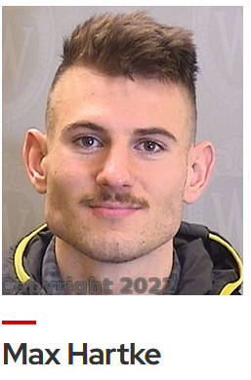
And with group-by
$ htcondor eventlog read –group-by GLIDEN_Site my_log_file Site CPU Usage Job Starts Job Successes Job Failures
MWT2 0+01:13:00 59 57 2
NWICG_NDCMS 0+00:50:20 2 1 0
UConn-HPC 0+00:05:00 2 1 0
UColorado_HEP 0+00:51:11 2 1 0
NMSU-Discovery-CE 0+04:24:01 7 5 0

Slide 32
Submit File Enhancements
Can make "+CustomAttributes" first class with knobs EXTENDED_SUBMIT_[COMMANDS|HELPFILE]:
Instead of: +SiteJobType = "analysis" queue Just:
SiteJobType = analysis queue
Define job submit templates:
use template: Matlab( mymatrix.m )
queue

Slide 33
File Transfer Error Propagation
Hold Reason and Reason Codes now useful
Example of "condor_q –hold" (output directory missing on the Access Point)
Old Message:
Error from slot1@TODDS480S: STARTER at 127.0.0.1 failed to send file(s) to <127.0.0.1:50288>; SHADOW at 127.0.0.1 failed to write to file C:\condor\test\not_there\blah: (errno 2) No such file or directory
New Message: Transfer output files failure at access point SUBMIT1 while receiving files from execution point slot3@NODE5. Details: writing to file C:\condor\test\not_there\blah: (errno 2) No such file or directory

Slide 34
File Transfer Enhancements
Submit macro preserve_relative_paths = True
transfer_input_files = result_data/x
ends up creating 'result_data/x' on EP job sandbox, not 'x'.
OSDF File Transfer Client comes with HTCSS, so can have out of the box
transfer_input_files = osdf:///foo/xxx/yyy

Slide 35
Saved DAG Progress
Added new saved progress file for a DAG in V10.5.0 that is kind of like a video game save
File is similar too a rescue file
Written at the first start of a specified node
Example Workflow Visualized
Setup
S1
Simulation 1
sample.dag
S2
…
SAVE_POINT_FILE S1
SAVE_POINT_FILE S2 post_simulation1.save
SAVE_POINT_FILE S3 ./post_simulation2.save
SAVE_POINT_FILE S4 ../../foo/mid_analysis.save
…
Simulation 2
S3
Analysis Part 1
S4
Analysis Part 2
Link to DAGMan Save Point File Documentation
Notes:
-Allows a DAG to be restarted from a certain part of progress.
-Good for rerunning a DAG from a certain part in the DAG

Slide 36
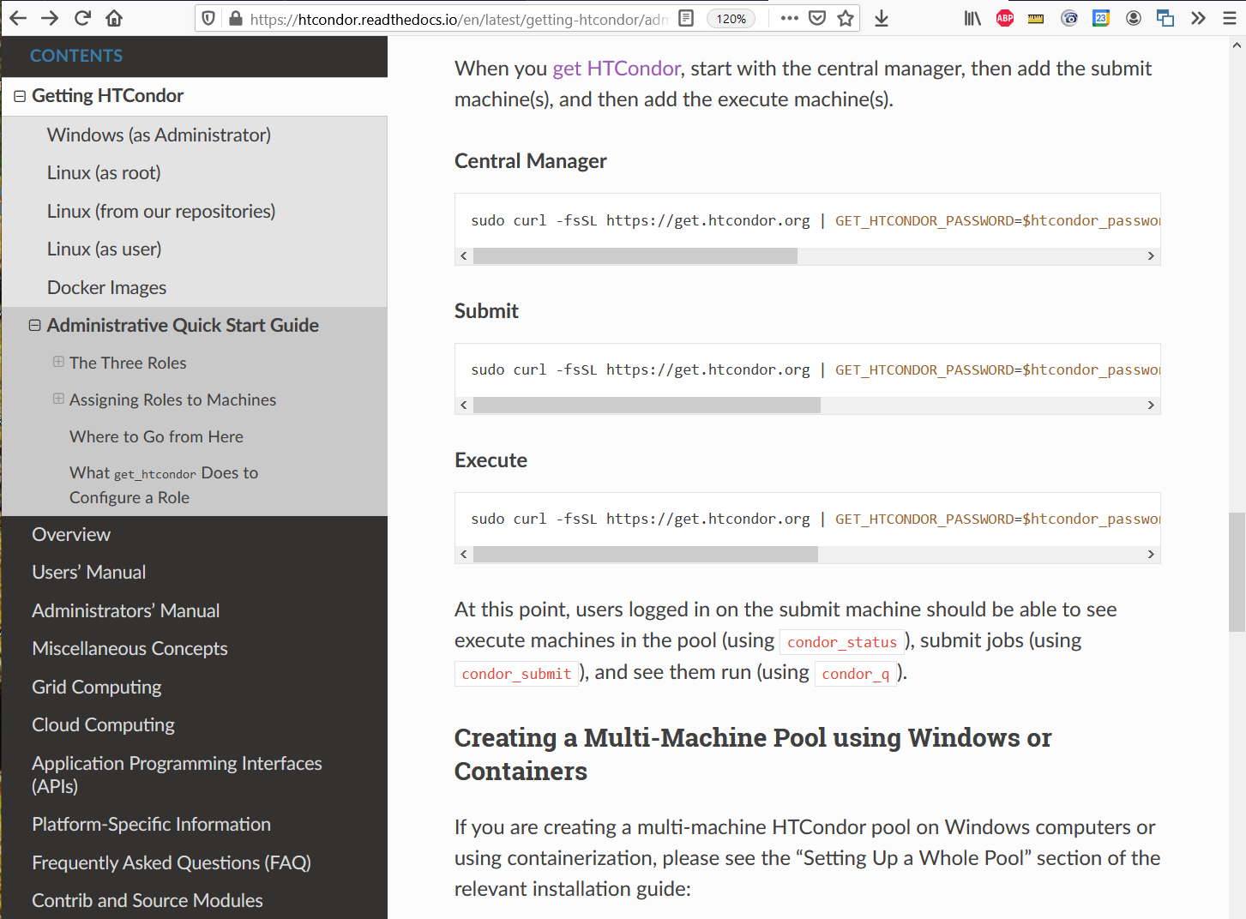
Improve life for administrators as well…
Administrative Quick-Start Guide
Fast "one-line" install and configure
Installs all needed packages
Configures a secure HTCondor pool using ID tokens
Install an up-to-date secure system including CM, AP, and EP in < 5 min

Slide 37
Execution Point Developments

Slide 38
P(artitionable) Slots Today
pslot is never claimed, which constrains AP planning.
AP claims a series of independent dslots made from the pslot
AP is dependent on CM for managing plsot resources
CM can take resources away and offer them to other APs

Slide 39
Pslot Claiming
AP can now claim entire pslots
For a set period of time
Minus resources still in use by previous claimant
This will allow improved resource management
AP can manage pslot resources without aid or hinderance of a pool CM
Intelligent draining for different sized jobs
Less work for CM negotiator
CM can be unaware of users at the AP

Slide 40
"Container Universe"
EP advertises container runtimes available, and uses whichever one can get the job done
Now EP does a lot of testing of container runtime
and the container image to determine if errors
are the systems fault or the jobs fault
New world order:
container_image = /cvmfs/my/image/dir/
# Or container_image = docker://Debian
# Or container_image = myImage.sif # Or container_image = http://xxx/image.sif

Slide 41
Sharing Compute — Optional Extras
Once integrated, extra software and services may increase usage
Apptainer (née Singularity) – extra software on each worker node
Container runtime without root privileges
If glide-in jobs detect a working install, will run payload jobs in containers
Some payload jobs require container support – thus you can run more
https://osg-htc.org/docs/worker-node/install-apptainer/
Frontier Squid caching proxy – extra service next to cluster
Caches HTTP and HTTPS fetches from worker nodes
May reduce WAN bandwidth and improve throughput
https://osg-htc.org/docs/data/run-frontier-squid-container/

Slide 42
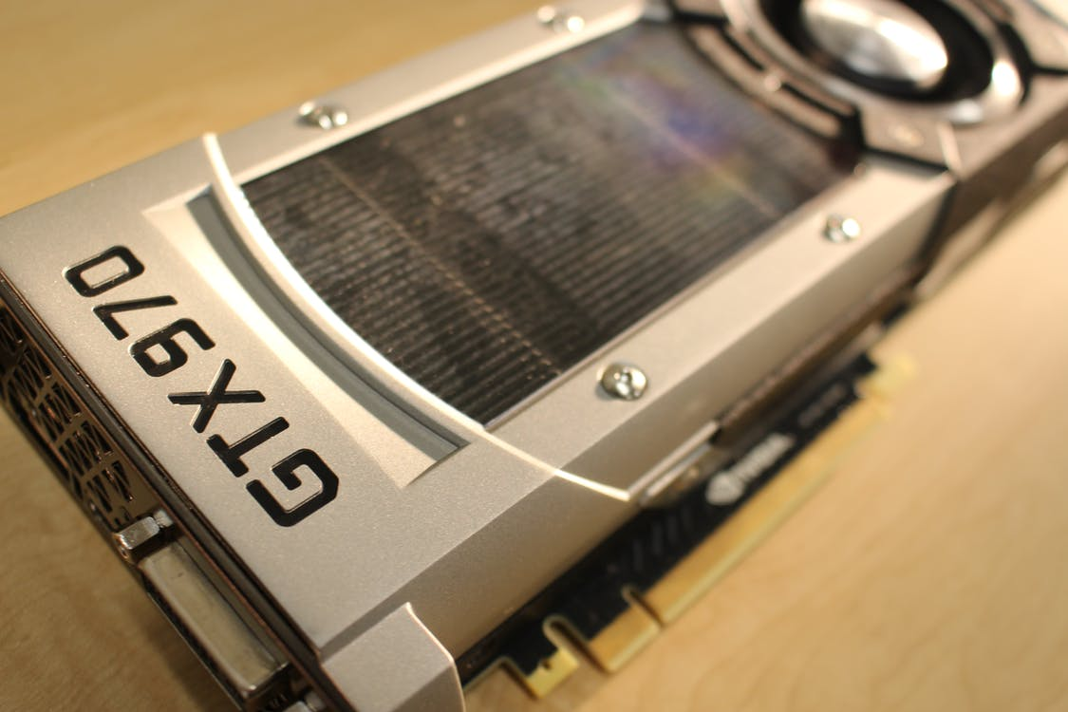
GPU Scheduling Activities
HTCondor has long been able to
detect GPU devices and schedule GPU jobs
monitor/report job GPU processor utilization
monitor/report job GPU memory utilization
Now also support for heterogenous GPUs in one server
E.g. a server with two different models of GPU cards
NVIDIA Multi-Instance GPU (MIG) partitioning
Currently on the radar:
Working on concurrent jobs on one device
User will specify a concurrency level per job set
Controlling exposure of GPU devices w/ device namespaces
Submit File Example:
Executable = foo.exe
RequestGPUs = 1
RequireGPUs =
Capability > 7.0
Queue

Slide 43
First-class Backfill pslots
Motivating Scenario: I want my GPU rich server to give priority to GPU jobs, but backfill with CPU-only jobs
A p-slot provisioned from a shadow set of resources that tracks contention with the primary set of resources
SLOT_TYPE_<N>_BACKFILL = TRUE
BACKFILL slots have special attributes
BackfillSlot = true
ResourceConflict = "Memory, GPUs, GPU-aabbccdd"
ResourceConflict given the names of the resources that contend with an active primary slot
Notes:
EXTENDED_SUBMIT_COMMANDS is a set of key = value pairs where the key is a new submit command and the value indicates the data type by example.
true/false = Boolean
quoted string = string
error = disallow an existing submit keyword

Slide 44
Ex: Backfill the CPUs on a GPU node
# make a TYPE_1 primary P-slot and give it all of the resources # use FEATURE : GPUs
use FEATURE : PartitionableSlot(1, 100%)
SLOT_TYPE_1_START = TARGET.RequestGpus > 0
# make a TYPE_2 backfill P-slot with 90% of the shadow resources and no GPUs
# SLOT_TYPE_2_BACKFILL = true
use FEATURE : PartitionableSlot(2, 90%, GPUs=0)
SLOT_TYPE_2_PREEMPT = size(ResourceConflict?:"") > 0 # The backfill slot should only run jobs that opt in as BackfillJob SLOT_TYPE_2_START = TARGET.BackfillJob
Will likely expose ☝ as "use FEATURE: PreferGPUJobs"
Notes:
EXTENDED_SUBMIT_COMMANDS is a set of key = value pairs where the key is a new submit command and the value indicates the data type by example.
true/false = Boolean
quoted string = string
error = disallow an existing submit keyword

Slide 45
Better Job Disk Space Management
Config knob STARTD_ENFORCE_DISK_LIMITS = True
Create an ephemeral filesystem for the job sandbox on the EP.
Uses LVM or makes a loop-back file system
Reserves space on disk for the job
Enables EP to perform fast usage queries and cleanup
Couple other bits of goodness
No longer "rename" job executable to condor_exec.exe w/ file transfer
Better OOM Killer handling

Slide 46
HTCondor-CE Activities
HTCondor-CE Dashboard. Admin can point their browser at the CE and see how their site is being used, e.g.:
Current number of active and idle glideins
Usage by project
Added ability to distinguish when the target batch system is unreachable or not functioning.
When this is the case, HTCondor marks the resource as unavailable instead of putting impacted jobs on hold.
Grid ads in the collector give details about why the remote scheduling system is considered unavailable. GridResourceUnavailableTimeReason, GridResourceUnavailableTimeReasonCode

Slide 47
Some Data Management Enhancements
See talk yesterday from Mat and Justin:
HTC 23 (10-July 14, 2023): Getting Your Data with HTCondor · UW-HEP Conference Agendas (Indico) (wisc.edu)

Slide 48
Recent OS and Architecture Additions
Enterprise Linux 8
Processors:
Intel/AMD ("x86_64")
ARM (“aarch64”)
Power PC (“ppc64le”)
Enterprise Linux 9 ☺ ☺ ☺
Required work to support cgroups v2 and OpenSSL 3
Processors:
Intel/AMD ("x86_64")
ARM (“aarch64”)
Future of Enterprise Linux rebuilds (aka Alma, Rocky) uncertain… ☹

Slide 49
Thank you! Follow us on Twitter! https://twitter.com/HTCondor
This work is supported by NSF under Cooperative Agreement OAC-2030508 as part of the PATh Project. Any opinions, findings, and conclusions or recommendations expressed in this material are those of the author(s) and do not necessarily reflect the views of the NSF

