Slide 1
HTCondor at BNL SDCC
Kevin Casella Tom Smith Christopher Hollowell
kac@bnl.gov tsmith@bnl.gov hollowec@bnl.gov
13 July 2023 – Throughput Computing 2023

Slide 2
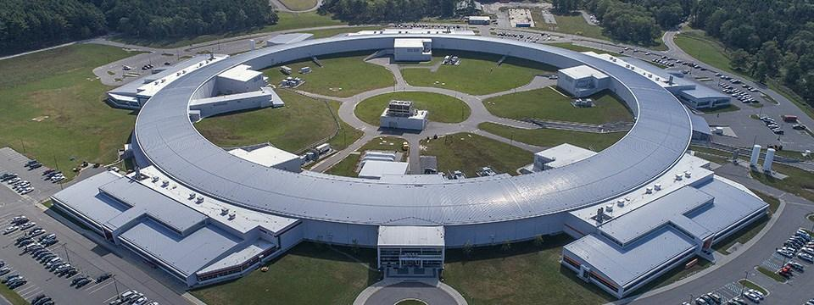
SDCC: The Scientific Data and Computing Center
Located at Brookhaven National Laboratory (BNL) on Long Island, New York
SDCC initially formed at BNL in the mid-1990s as the RHIC Computing Facility
Shared multi-program facility serving ~2,000 users from more than 20 projects
2

Slide 3
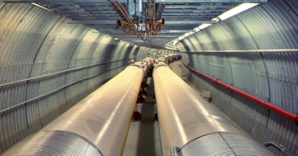
Scientific Data and Computing Center Overview
Tier-0 computing center for the RHIC experiments
US Tier-1 Computing facility for the ATLAS experiment at the LHC，also one of the ATLAS shared analysis (Tier-3) facilities in the US
Computing facility for NSLS-II
US Data center for Belle II experiment
Providing computing and storage for proto-DUNE/DUNE along w/ FNAL serving data to all DUNE OSG sites
Also providing computing resources for various smaller / R&D experiments in NP and HEP
Serving more than 2,000 users from > 20 projects
Developing and providing administrative/collaborative tools:
Invenio, Jupyter, BNL Box, Discourse, Gitea, Mattermost, etc.
sPHENIX - commissioning run has started
BNL was selected as the site for the upcoming major new facility Electron-Ion Collider (EIC/eRHIC)
3

Slide 4
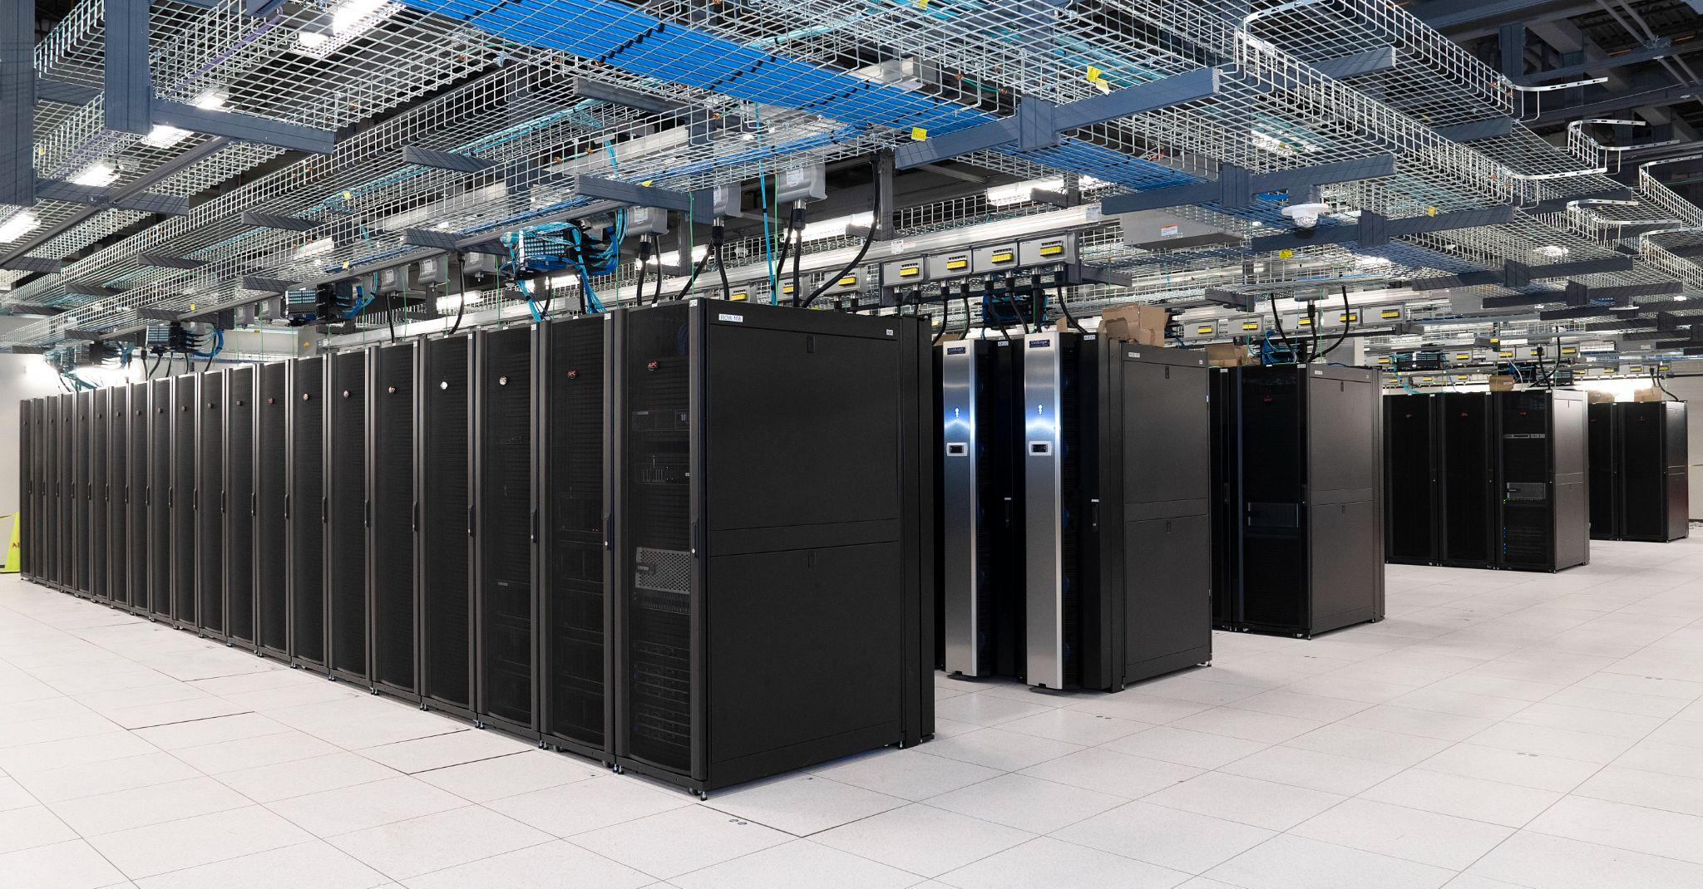
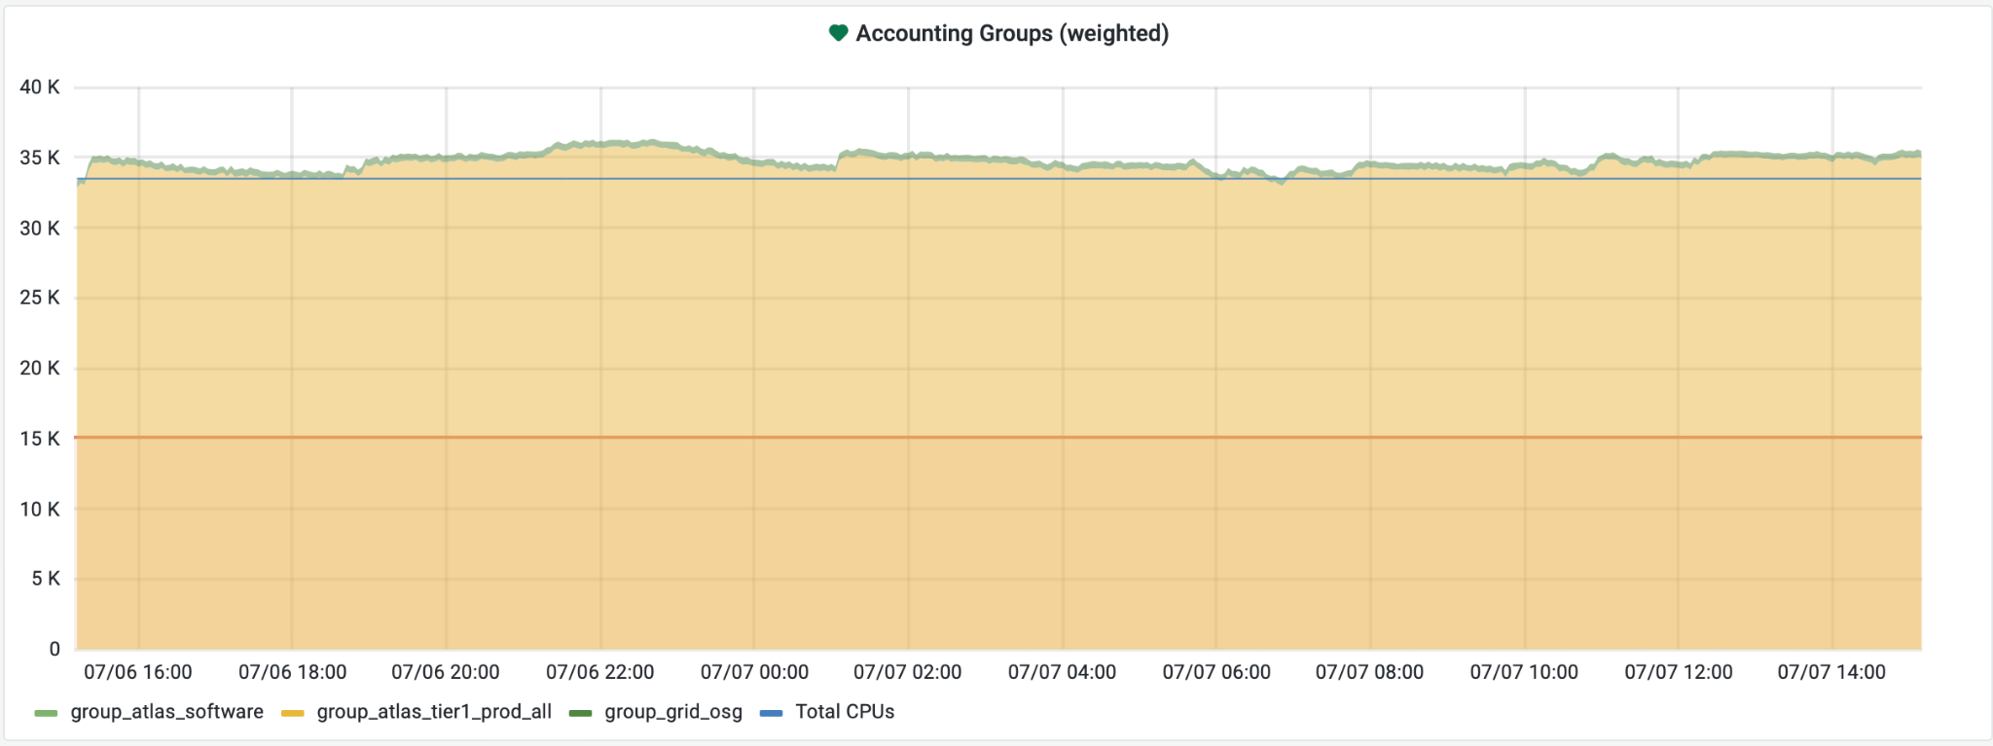
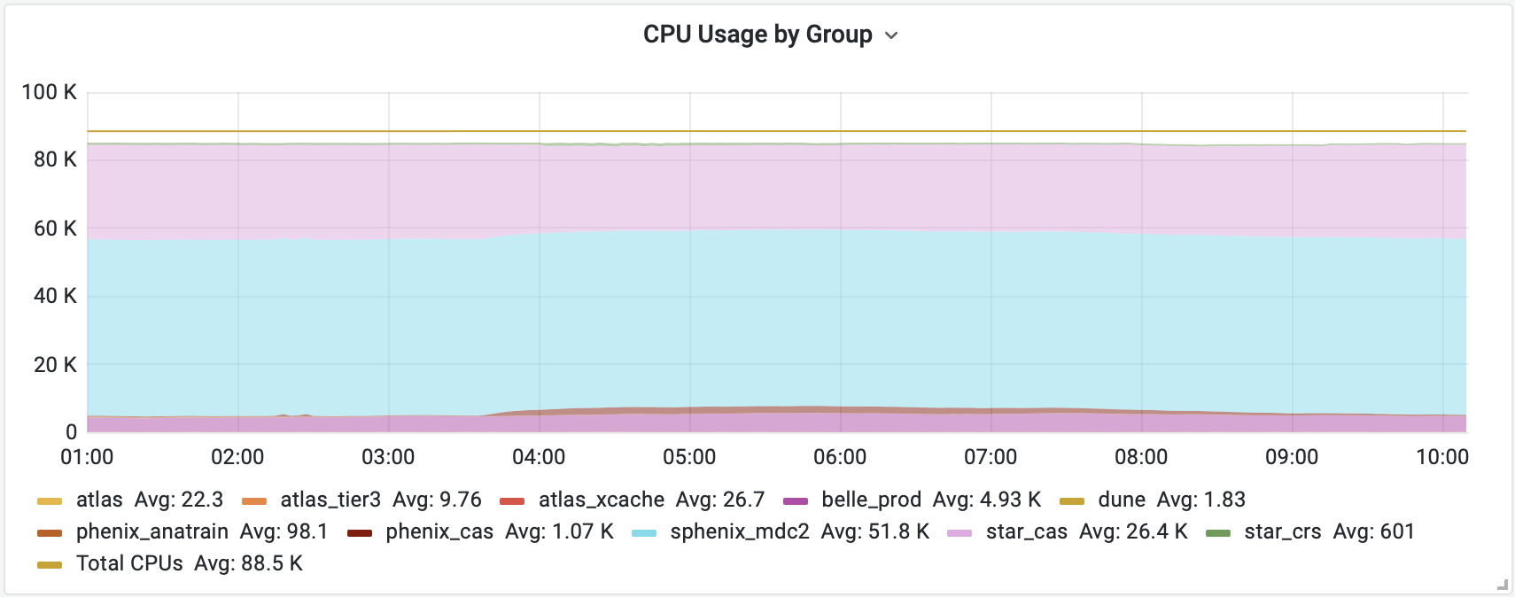
High Throughput Computing @ SDCC
Providing our users with ~1,700 HTC nodes:
~121,000 logical cores
Managed by HTCondor
All nodes running running Scientific Linux (SL) 7
Preparations for an OS upgrade to Alma Linux 9 in progress
HTCondor 9.0.X -> 10.0.X upgrade in progress
ATLAS Pool
~500 HTC nodes:
~35,000 logical cores
ATLAS tier 1 worker nodes upgraded to Condor 10.0.3
Shared Pool
~1,200 HTC nodes:
~86,000 logical cores
Large portion of this pool is new Supermicro nodes
Note: not all of ATLAS pool shown

Slide 5
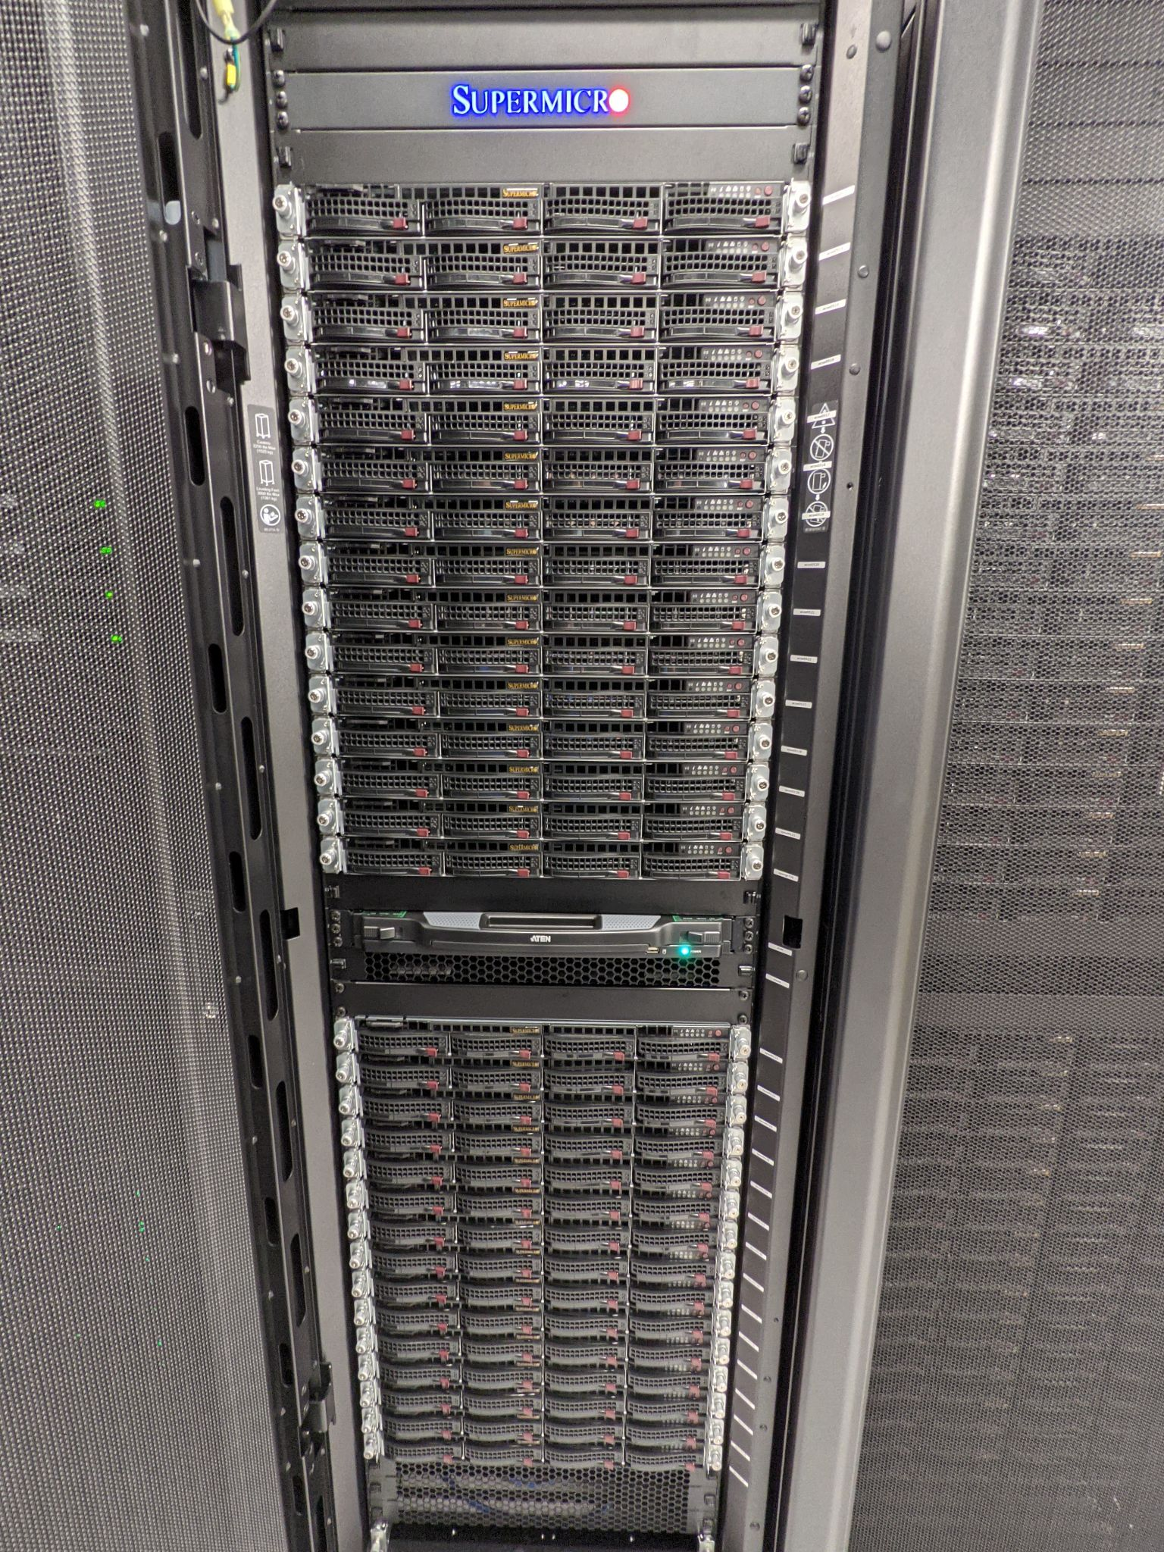
Computing Expansion (2023)
Largest computing expansion to date
Purchased 648 Supermicro SYS-610C-TR nodes for ATLAS and the RHIC experiments (~62k logical cores total)
Housed in 20 racks
System specs:
Dual Intel Ice Lake Xeon Gold 6336Y 24-core processors
12x32 GB 3200 MHz ECC DDR4 RAM (384 GB total)
4x2 TB SSD drives
1U form factor
10 Gbps NIC
Will be receiving some Supermicro ARM test nodes Aug/Sep
With Ampere Altra CPUs
All nodes running Scientific Linux (SL) 7
Condor 10.0.X installed
Supermicro SYS-6019U-TR4 Servers

Slide 6
Condor/ Condor CE Upgrade
Upgrade from Condor 9.0.x to 10.0.X and Condor CE from 5.1.5-1 to 6.X
To minimize downtime, we upgrade in systems in batches of several racks at a time
Worker/execute nodes upgraded first, then CEs and submit nodes, and collector/negotiator will be upgraded last
Cross-version compatibility was tested to ensure this would not impact production
Done: ATLAS Tier1 worker nodes, new Supermicro shared pool worker nodes, next generation CE test system
In Progress: ATLAS/grid CEs upgrade, shared pool worker nodes
To do: Shared pool CEs, all pool collector/negotiators, all interactive submit nodes
collector / negotiator | schedd (interactive submit) | schedd / Condor CE (grid submit) | startd (execute nodes)
9.0.x | 9.0.x | 9.0.x (condor) 5.1.5-1 (CE) | Both 9.0.x / 10.0.1
9.0.x | 9.0.x | 10.0.1 (condor) 5.1.6-1 (CE) | Both 9.0.x / 10.0.1
9.0.x | 10.0.1 | 10.0.1 (condor) 5.1.6-1 (CE) | Both 9.0.x / 10.0.1
10.0.1 | 10.0.1 | 10.0.1 (condor) 5.1.6-1 (CE) | Both 9.0.x / 10.0.1

Slide 7
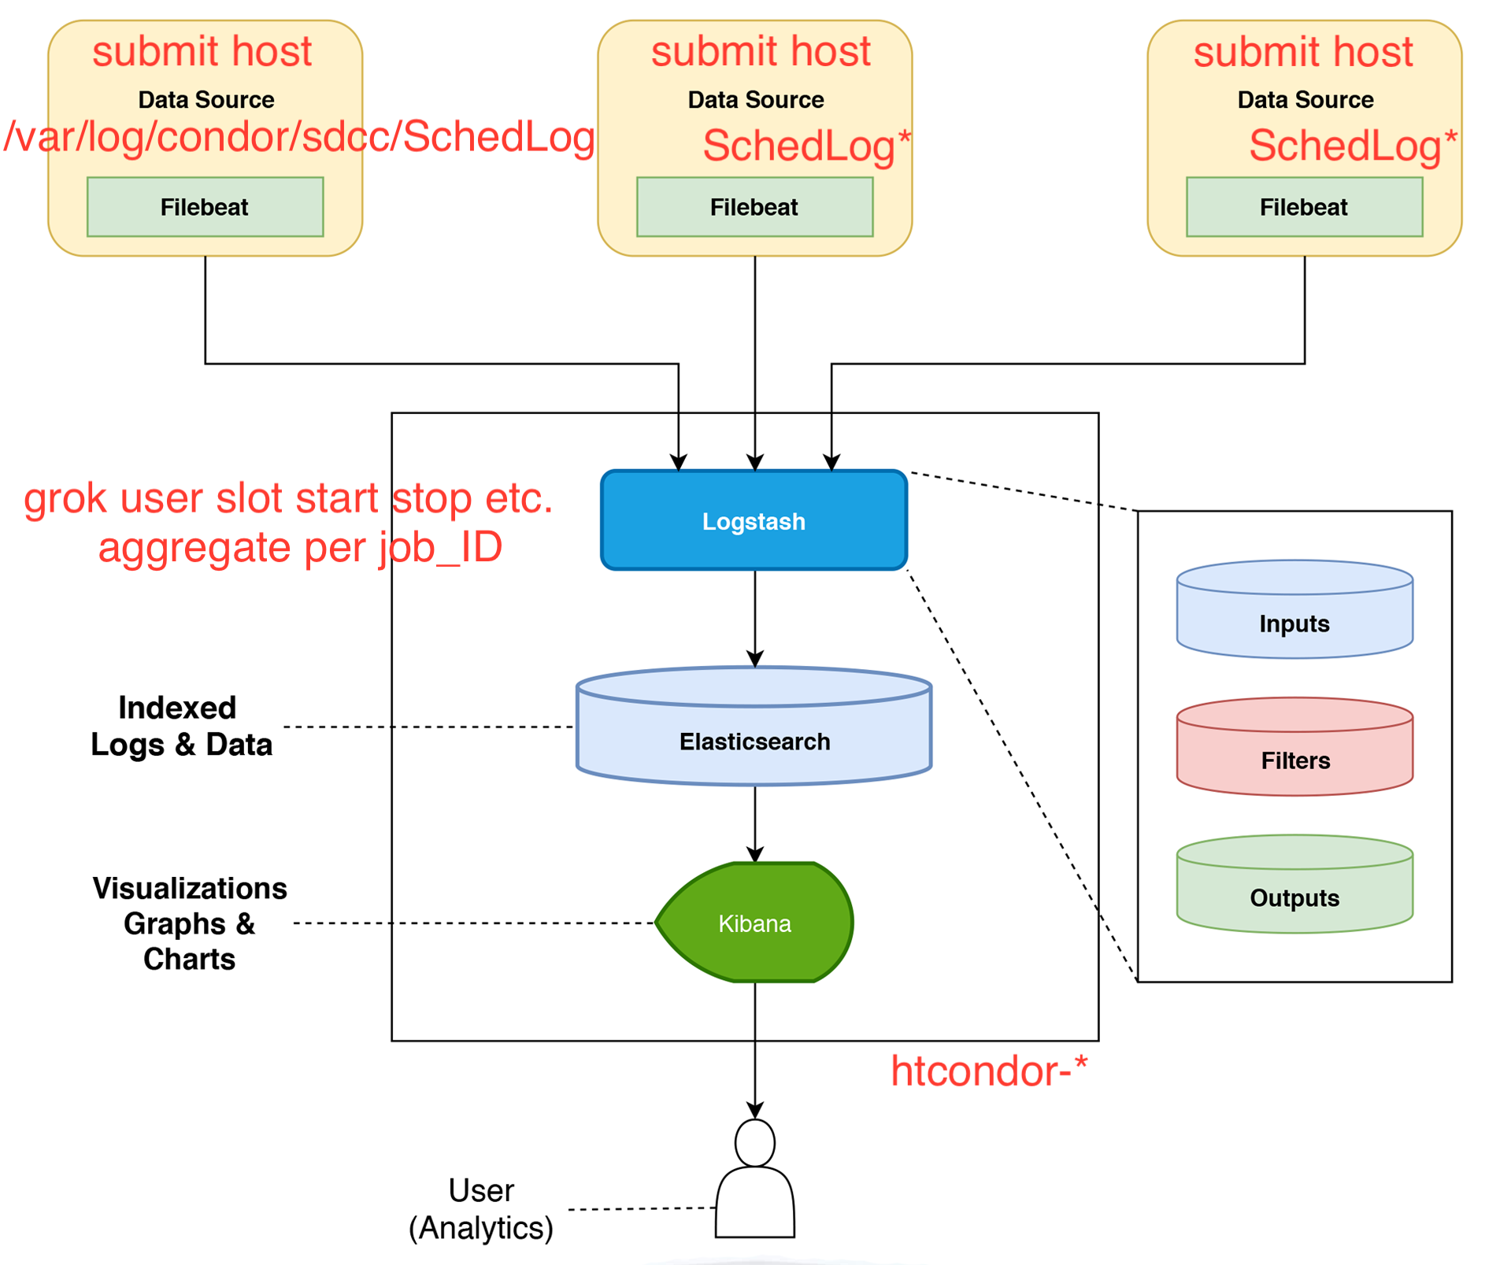
Monitoring Redesign for Scalability

Slide 8
Monitoring Redesign for scalability
Filebeat service runs on CEs and Submit nodes (~100 hosts)
A Logstash instance runs on one server
Input source is the log file /var/log/condor/sdcc/SchedLog
Output sent to 3 servers running Elasticsearch service
Filebeat service previously ran on workernodes (2,000+ hosts)
This required multi-Logstash and the Lumberjack plugin
Lumberjack transported events between Logstash instances

Slide 9
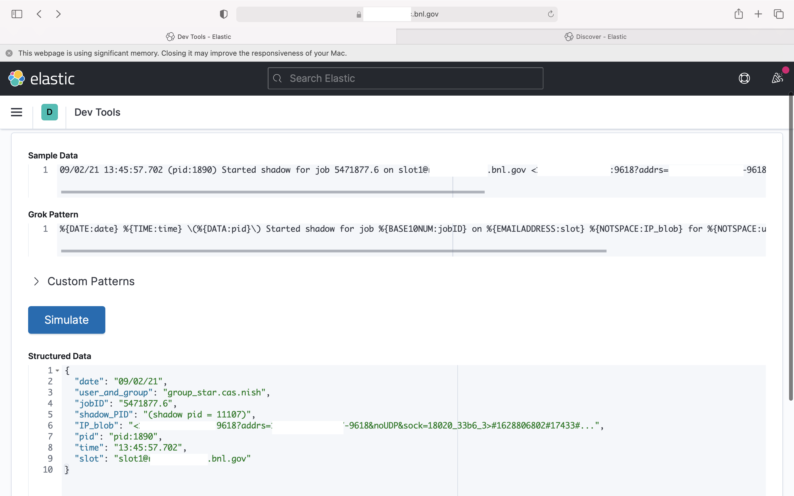
Grok Filter Plugin

Slide 10
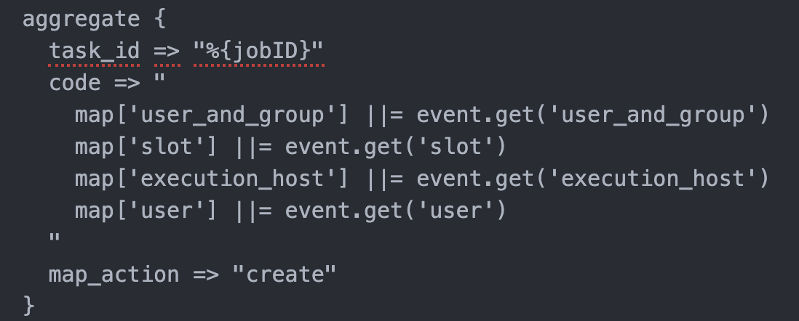
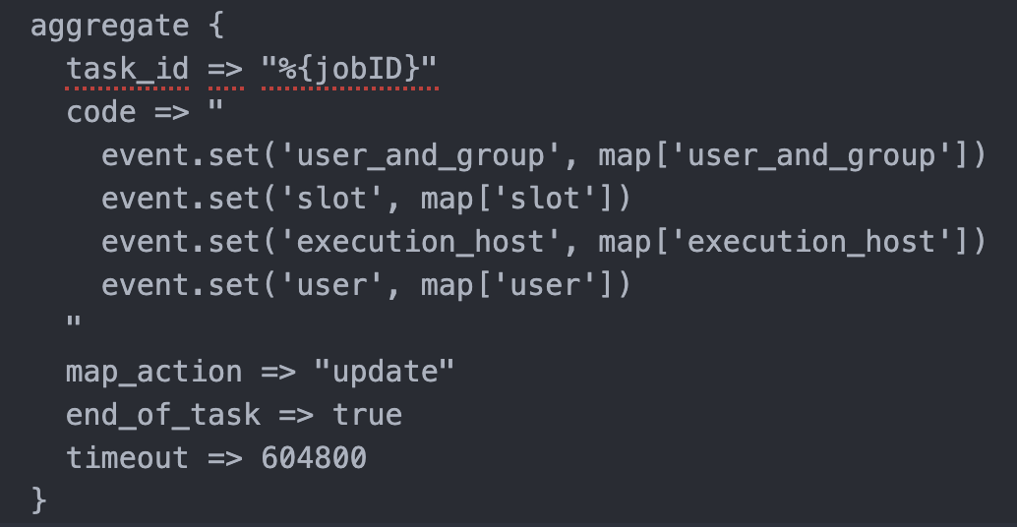
START of a job
Create a map
Map event data
END of a job
Set event fields
From the map
Delete the map
10

Slide 11
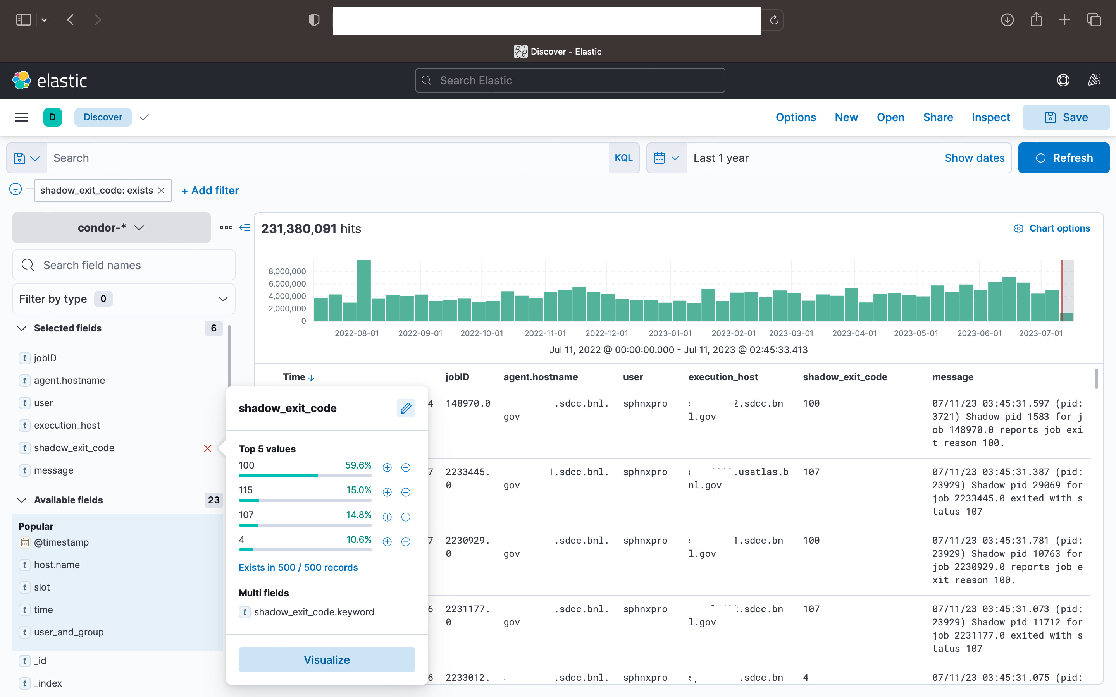
Kibana Discover

Slide 12
Conclusions
SDCC provides a batch computing capacity of over 120k cores to 2,000+ users in more than 20 projects
- We’ve been using HTCondor for nearly 20 years
HTCondor 10.0.x upgrade in progress
- Upgrading a rolling manner to minimize downtime
- Completed on all US ATLAS T1 compute nodes
We’ve implemented custom ELK monitoring of Condor jobs at our facility
- Recently re-designed to improve scalability
- Changed from collecting data on all workernodes to submit nodes only
12

Slide 13
Questions & Comments
Kevin Casella Tom Smith Christopher Hollowell
kac@bnl.gov tsmith@bnl.gov hollowec@bnl.gov
13 July 2023 – Throughput Computing 2023

