Slide 1
Transitioning Users to SciTokens and Getting them Closer to HTCondor with Jobsub_lite
Shreyas Bhat on behalf of the Jobsub Team
July 14, 2023
Throughput Computing 2023

Slide 2
Outline
Background on the jobsub project and issues
jobsub_lite
Tokens in jobsub_lite
Adoption of jobsub_lite
Wins and…opportunities
Lessons learned so far

Slide 3
Jobsub Project
Many Intensity Frontier experiments at Fermilab had their own wrapper scripts written on top of HTCondor
FabrIc for Frontier Experiments (FIFE) project, Jobsub project was meant to
Unify wrappers/software stack, provide common job submission interface
Load balancing/HA, credential management, job log management among multiple schedds
jobsub_tools, then jobsub_client/jobsub_server (circa 2013)
jobsub_client generally installed on experiment submit nodes
jobsub_server, alongside HTCondor schedd run on separate machines (3 in production cluster)
Interaction between two via REST API
Notes:
Maybe summarize this slide in speech, if not on the actual slide

Slide 4
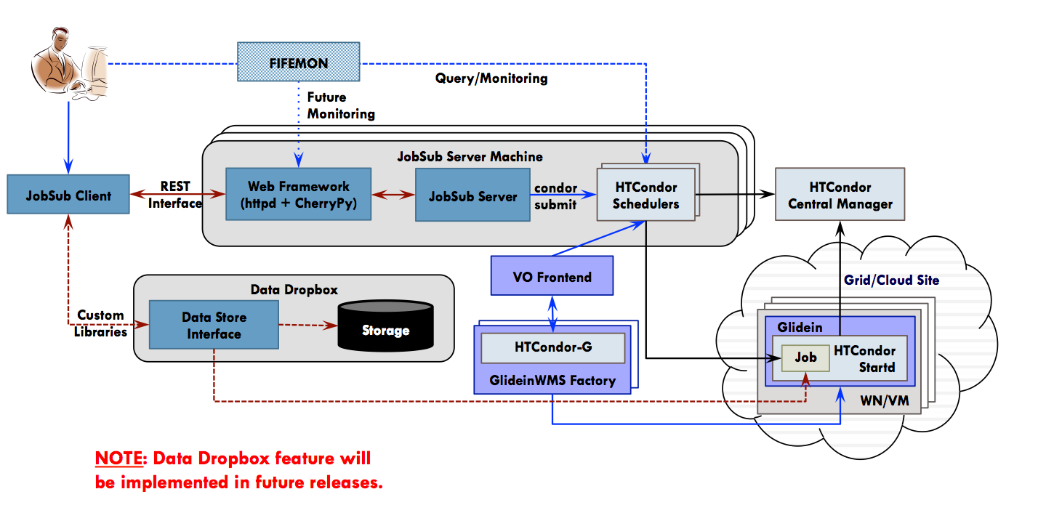
Jobsub the Old
Original Image Source: https://cdcvs.fnal.gov/redmine/projects/fife/wiki/Introduction_to_FIFE_and_Component_Services#Jobsub
Notes:
Spend no more than 5 seconds on this slide!
Perhaps move this slide to extras

Slide 5
Problems with Old Jobsub
Being too permissive with feature request acceptance (“Wouldn’t it be nice if jobsub did…..” ) led to
Lots of code customization for different VOs/experiments
→ Large number of “gotchas”/accidental behavior
Too many ways to do the same set of operations (e.g. tarball upload)
>21k lines of code (not including packaging scripts, tests, etc.)
Supporting current feature set too difficult for available effort
→ Also complicates building new features and fixing bugs
Used transition of OSG to SciToken auth and HTCondor dropping internal proxy auth to rewrite jobsub
Neatly avoids issues with proxies: e.g. have had instances of users accidentally deleting large swaths of data…

Slide 6
Heeeeere’s jobsub_lite!
New software for job submission and monitoring, built directly on top of Condor
Tried to keep the most-used pieces of jobsub_client, strip out unnecessary parts
Client-only, installed on experiment submit nodes
jobsub_* counterparts to condor_* commands (e.g. jobsub_submit, jobsub_q, etc)
Currently, submits jobs with both proxy and token, but will be phasing out proxy gradually
Remote submission to schedd

Slide 7
What happens
jobsub_lite takes user command,
Finds schedds
For submit: Converts user command to Condor submission file (Job Definition File), and uses Condor commands to remotely submit the job to schedd
For other commands: Gets credentials, converts user command to HTCondor command and runs it
jobsub_q -G fermilab 12345@jobsub01.fnal.gov
_condor_CREDD_HOST=jobsub01.fnal.gov /usr/bin/condor_q -global -schedd-constraint IsJobsubLite==True -name jobsub01.fnal.gov <formatting args> 12345

Slide 8
jobsub_lite and HTCondor
Idea is to keep jobsub_lite….light
Provide lightly-wrapped Condor executables (condor_submit, condor_q, etc.) on submit nodes
Provide DAG submission through jobsub_submit_dag (different DAG format called dagnabbit, which we translate to Condor DAG format)
Most users: jobsub commands
Advanced use-cases: Condor commands
To help with advanced use-cases, jobsub_submit has option to just create Condor Job Definition File to use with condor_submit

Slide 9
Lightweight condor wrappers
Idea from CMS LHC Physics Center (LPC) deployment at Fermilab
Parse a couple of arguments, get credentials, find correct collector/schedd, then hand the work over to Condor
condor_q -G fermilab 12345@jobsub01.fnal.gov
_condor_CREDD_HOST=jobsub01.fnal.gov /usr/bin/condor_q -global -schedd-constraint IsJobsubLite==True -name jobsub01.fnal.gov <formatting args> 12345

Slide 10
Infrastructure/Condor Versions
Schedds:
Development: Were using Condor 9 on schedds
Production: Condor 10.0.3
Currently deploying with shared schedds, but plan to transition to one schedd per large experiment, and a couple of shared schedds (use a SupportedVOList classad attribute on schedd)
Submit nodes:
Most running 9.0.17. (To be upgraded to 10 soon)

Slide 11
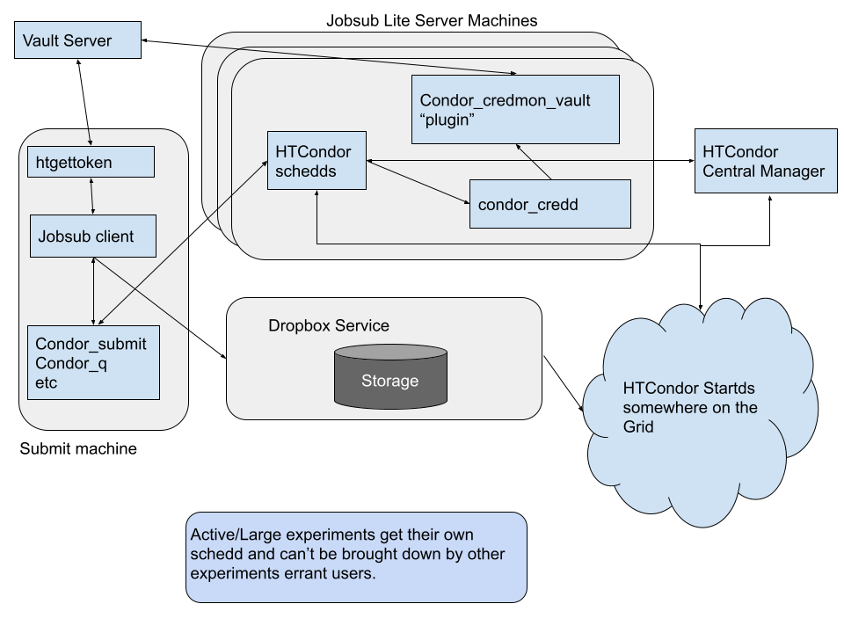
jobsub_lite Infrastructure with Tokens
This is all that jobsub_lite developers have to maintain!
Original Image Credit: J. Boyd

Slide 12
Tokens and Authentication

Slide 13
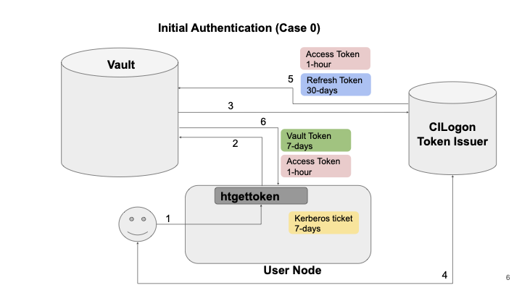
Token Authentication Flow
We use htgettoken to obtain vault and bearer tokens
Steps:
Kerberos ticket used to authenticate to Hashicorp Vault
Vault contacts token issuer - CILogon
First time, token issuer has user authenticate in browser
Refresh token stored in vault, Vault and Access token downloaded to user node
Image Credit: M. Altunay and D. Dykstra

Slide 14
jobsub_lite and Tokens
Fine-grained access control via SciTokens!
DUNE, for example, has many different capability sets (different sets of pre-defined token scopes) for different sets of users
Outsource these decisions to VOs/experiments
jobsub commands obtain Access token via htgettoken in case it’s needed
Leverage Condor to do token exchange at submission time: default tokens scopes include storage.read, storage.create, but not storage.modify → Users have to specifically request tokens with storage.modify

Slide 15
Robot Tokens and the Managed Tokens Service
Previously, Managed Proxies service periodically refreshed VOMS proxies on experiment interactive nodes for production activity
Stakeholders requested same for tokens
htgettoken supports use of robot kerberos creds to obtain vault tokens
Leverage this capability for new Managed Tokens Service (written in Go)
Push production vault tokens to interactive nodes, keep them refreshed:
Obtain kerberos credentials
condor_vault_storer for each schedd
rsync vault token to appropriate submit nodes

Slide 16
Managed Tokens Service (2)
Managed Tokens Service users should never have to authenticate in CILogon
“Onboarding” = operator running condor_vault_storer manually for all schedds, and authenticating (Managed Tokens Service has utility to do that)
The pushed vault token is used to obtain bearer token on submit node
User steps:
Set --credkey in HTGETTOKENOPTS in environment
In jobsub_* command, pass --role=production environment to set right service for condor_vault_storer/mappings
Has been running in production since November 2022 with very few issues

Slide 17
Adoption/Lessons Learned

Slide 18
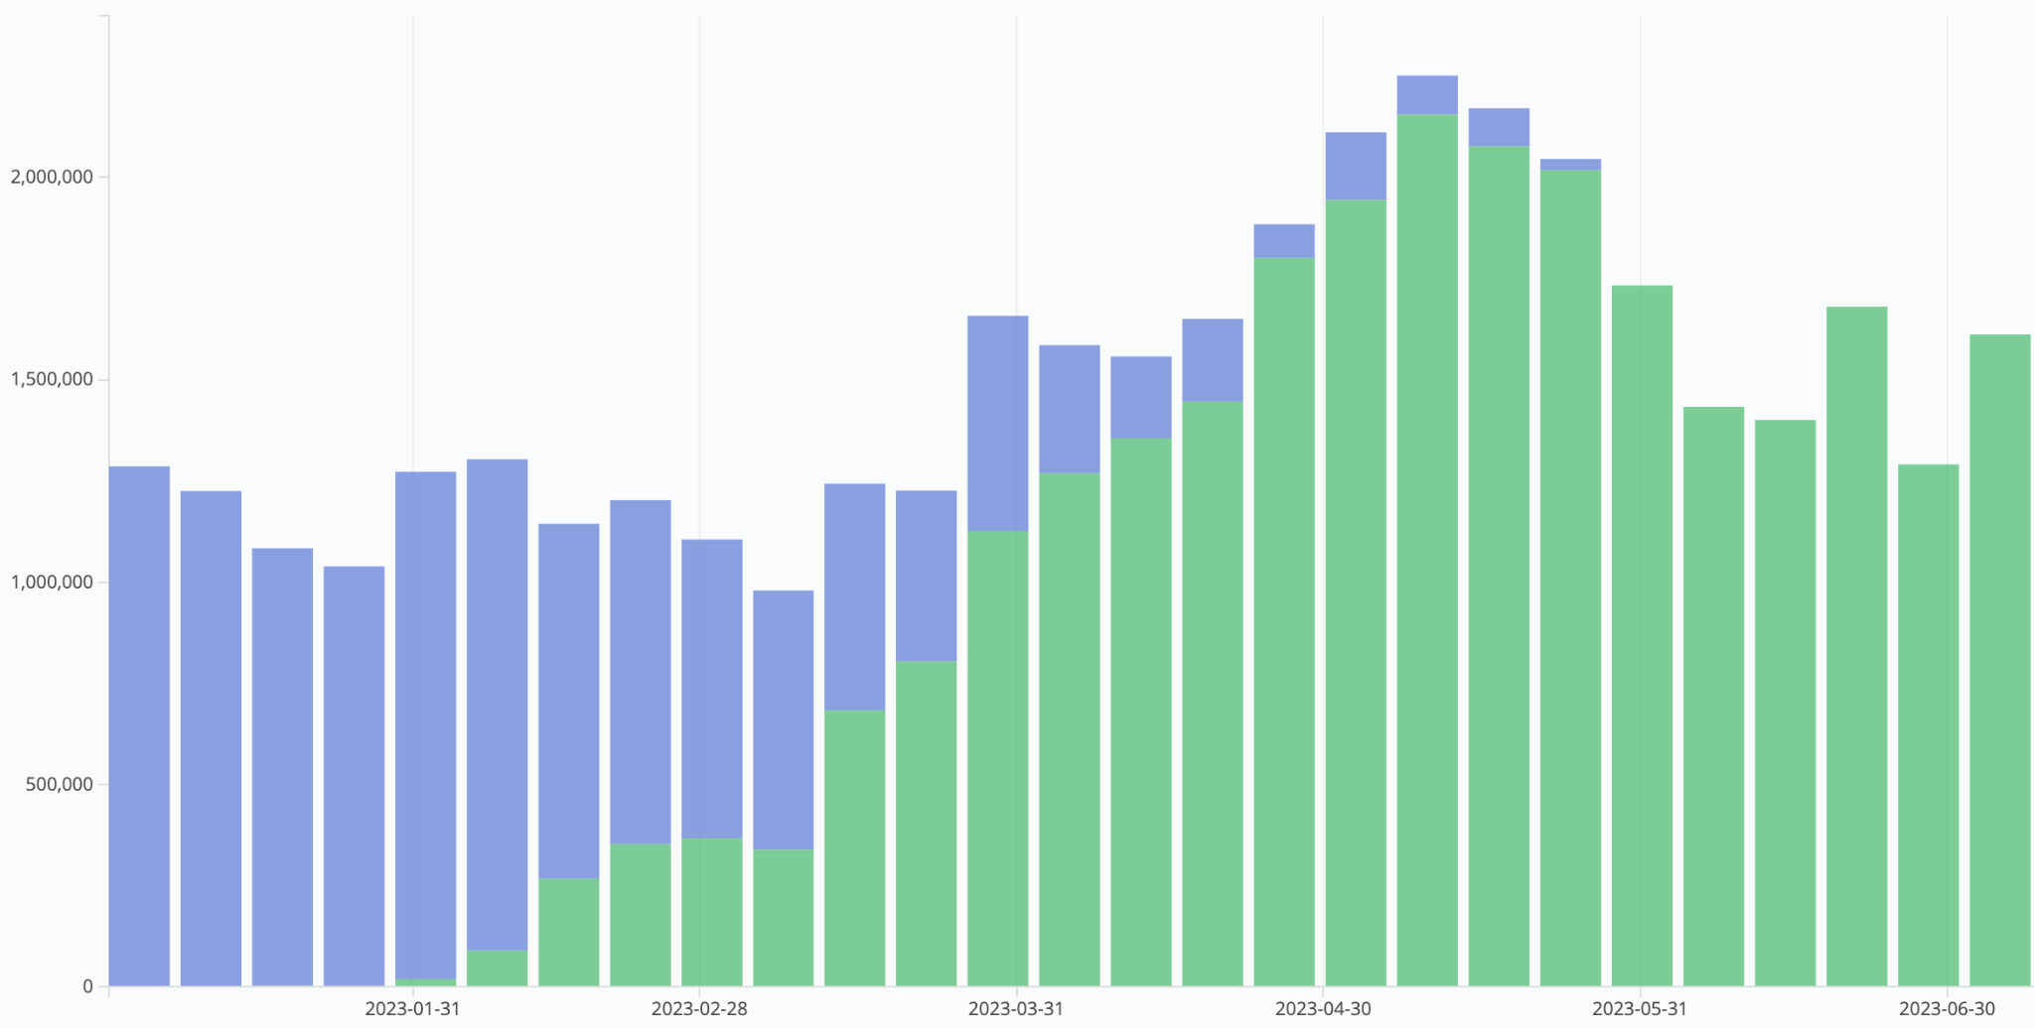
Jobsub_lite adoption
Disable jobsub_client
All jobsub_lite
jobsub_lite GA
jobsub_lite default
# Jobs per week
jobsub_client jobs
jobsub_lite jobs
Date

Slide 19
The Good News (For Users)
Users have full access to Condor commands, Condor JDFs
No more passing through constraints through jobsub
Don’t have to wrap Condor DAG commands if you don’t want
With more focused interface, easier to get new users started on jobsub_lite
Horizontal scaling (adding more schedds) much easier
Started with one schedd in production, have now scaled to four
Can do rolling upgrades to various components of system

Slide 20
The Good News (For Everyone)
Fine-grained access control via SciTokens!
Less code (6906 lines INCLUDING tests and templates) = less to maintain, easier to add features/fix bugs…but
Have had to be strict about feature requests
Decreases our support load
Users should be using Condor (for anything beyond basics)!

Slide 21
The Bad News - Infrastructure Issues
If credd has issues talking to vault, sometimes not enough info in the logs
If token expired in credmon, in certain cases, jobs would just fail to start, with no user notification until they went held for SHADOW exceptions (Fixed in 10.0.3)
Duty Cycle Issues on Schedds:
Above token issues → Tons of shadow starts (Fixed in 10.0.3)
With no jobsub_server throttling user submissions, had duty cycle issues when under heavy load →
Tweak MAX_JOBS_PER_SUBMISSION to limit cluster size
Tweak CURB_MATCHMAKING to throttle job matchmaking
HTCondor team SUPER helpful in assisting with/fixing these issues

Slide 22
The Bad News - Everything Else
Monitoring: FIFEMon didn’t fully support jobsub_lite until phase 2, which led to resistance to adoption
Remote submission with -spool → jobs didn’t leave queue for users to get logs PLUS our monitoring looks at condor_history
Resistance to adopting tokens - “But why do I have to do this when the old way just works?!”
Have had to be strict about feature requests, which didn’t make some happy → Users should be using HTCondor!

Slide 23
Lessons Learned
Inertia is real…
Better to delay a go-live of this magnitude if monitoring, fetching of logs, etc., not ready
Robust monitoring of old system allowed us to choose which features to implement in jobsub_lite
We looked at 6 months of command-line options used with jobsub_client to pick jobsub_lite flags
Running both systems in parallel for a time was helpful in transition in case there were issues
Classad mechanism for schedds allowed mixed cluster of jobsub_client/jobsub_lite submit nodes and jobsub_server/condor schedds (control which submit nodes submit to which schedds)
Users could fall back to old system with a single flag, giving us breathing room to fix bugs
Could migrate schedds one or two at a time

Slide 24
Lessons Learned (2)
Tokens ≠ Proxies → Training users is key
Heterogeneous environments → Need stakeholders from ALL parties to test, not just the willing…
But if you only have one test schedd, don’t ask everyone to test at once
Those who were willing to test early had a much easier transition, so that is KEY.

Slide 25
Future work
Phasing out use of X509 proxies in job submission:
Next minor release: Create opt-out flag for obtaining proxy
When we receive approval from experiments, convert to opt-in flag (probably in a couple of years)
Bugfixes
Usability features
Test with EL9 (Currently running on SL7 machines)
Shift to maintenance mode (try not to add any major features)
Notes:
\

Slide 26
References/Links
Jobsub_lite git repository/documentation: https://github.com/fermitools/jobsub_lite
Managed Tokens Service git repository: https://github.com/shreyb/managed-tokens
Original jobsub paper: Dennis Box 2014 J. Phys.: Conf. Ser. 513 032010 DOI 10.1088/1742-6596/513/3/032010 https://iopscience.iop.org/article/10.1088/1742-6596/513/3/032010

Slide 27
FNAL Report Number: FERMILAB-SLIDES-23-166-CSAID
Thank you!
The jobsub project team:
Shreyas Bhat, Joe Boyd, Vito Di Benedetto, Lisa Goodenough, Marc Mengel, Nick Peregonow, Kevin Retzke
This work was produced by Fermi Research Alliance, LLC under Contract No. DE-AC02-07CH11359 with the U.S. Department of Energy. Publisher acknowledges the U.S. Government license to provide public access under the DOE Public Access Plan: DOE Public Access Plan

Slide 28
Backup Slides

Slide 29
Token Authentication Flow
Image Credit: M. Altunay and D. Dykstra

Slide 30
First-time authentication
Authentication happens for most grid operations - now X509 Proxy, soon tokens (jobsub_lite, ifdhc commands)
Absence of vault or refresh token → Authenticate with CILogon
Attempting OIDC authentication with https://htvaultprod.fnal.gov:8200
Complete the authentication at:
https://cilogon.org/device/?user_code=_redacted_user_code
No web open command defined, please copy/paste the above to any web browser
Waiting for response in web browser
Will need to copy/paste that link into browser

Slide 31
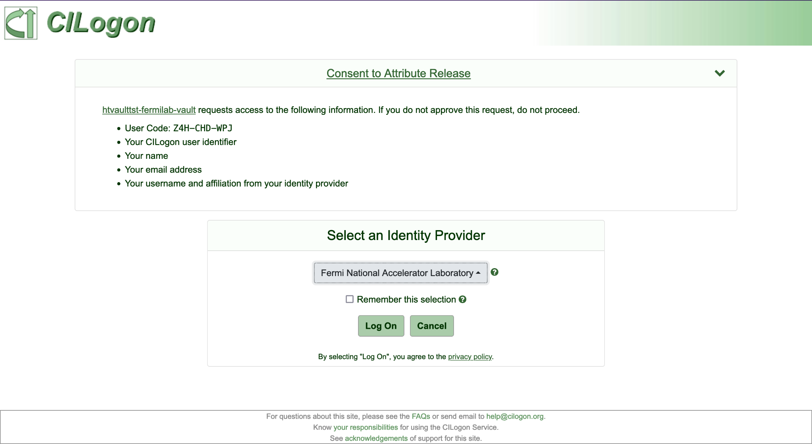
First-time authentication, continued
Select “Fermi National Accelerator Laboratory”
Then click “Log On”
Log in with Services Credentials

Slide 32
Further Notes about Authentication
After initial authentication, as long as you use token-enabled grid tools for the same experiment/role at least every 30 days, you should not have to reauthenticate
This is because refresh token (kept in vault) expires after 30 days of inactivity
Tokens downloaded to user machine:
Vault Token: Used to authenticate to vault
Access (or Bearer) Token: SciToken (JWT) that is actually used for grid operations
More information on SciTokens: https://scitokens.org/

Slide 33
Submit and Manage Simple Job

Slide 34
jobsub_submit
Much easier than before. Just login, and jobsub_submit
$ jobsub_submit -G fermilab file:///usr/bin/printenv
Attempting to get token from https://fermicloud543.fnal.gov:8200 ... failed
Attempting kerberos auth with https://fermicloud543.fnal.gov:8200 ... succeeded
Attempting to get token from https://fermicloud543.fnal.gov:8200 ... failed
Attempting OIDC authentication with https://fermicloud543.fnal.gov:8200
Complete the authentication at:
https://cilogon.org/device/?user_code=<code>
No web open command defined, please copy/paste the above to any web browser
Waiting for response in web browser
Storing vault token in /tmp/vt_u10610
Storing bearer token in /tmp/bt_token_fermilab_Analysis_10610
Submitting job(s).
1 job(s) submitted to cluster 57106734.
Use job id 57106734.0@jobsub01.fnal.gov to retrieve output

Slide 35
jobsub_submit, continued
Like before, -G/--group is required to submit job (and run all jobsub executables)
Group dictates which token issuer is used to get a bearer token
FOR NOW, jobsub will obtain a bearer token and VOMS-proxy (valid for ~one week) and send these to the job
Future - no VOMS proxy

Slide 36
Manage jobs
jobsub_q, jobsub_hold, jobsub_release, jobsub_rm, etc. written as lightweight wrappers around condor_* commands
Tried to keep backward-compatibility
Examples on following slides

Slide 37
jobsub_q
$ jobsub_q -G fermilab
JOBSUBJOBID OWNER SUBMITTED RUNTIME ST PRIO SIZE COMMAND
57106962.0@jobsub01.fnal.gov sbhat 11/30 14:59 0+06:00:10 C 0 1953.1 simple.sh
57106973.0@jobsub01.fnal.gov sbhat 12/01 13:48 0+06:00:27 R 0 0.0 simple.sh
$ jobsub_q -G fermilab 57106973.0@jobsub01.fnal.gov
JOBSUBJOBID OWNER SUBMITTED RUNTIME ST PRIO SIZE COMMAND
57106973.0@jobsub01.fnal.gov sbhat 12/01 13:48 0+06:00:27 R 0 0.0 simple.sh

Slide 38
jobsub_hold
$ jobsub_hold -G fermilab 57106973.0@jobsub01.fnal.gov
Job 57106973.0 held
$ jobsub_q -G fermilab 57106973.0@jobsub01.fnal.gov
JOBSUBJOBID OWNER SUBMITTED RUNTIME ST PRIO SIZE COMMAND
57106973.0@jobsub01.fnal.gov sbhat 12/01 13:48 0+06:00:27 H 0 0.0 simple.sh

Slide 39
jobsub_release
$ jobsub_release -G fermilab 57106973.0@jobsub01.fnal.gov
Job 57106973.0 released
$ jobsub_q -G fermilab 57106973.0@jobsub01.fnal.gov
JOBSUBJOBID OWNER SUBMITTED RUNTIME ST PRIO SIZE COMMAND
57106973.0@jobsub01.fnal.gov sbhat 12/01 13:48 0+06:00:27 I 0 0.0 simple.sh

Slide 40
jobsub_rm
$ jobsub_rm -G fermilab 57106973.0@jobsub01.fnal.gov
Job 57106973.0 marked for removal
$ jobsub_q -G fermilab 57106973.0@jobsub01.fnal.gov
JOBSUBJOBID OWNER SUBMITTED RUNTIME ST PRIO SIZE COMMAND

Slide 41
Singularity/Apptainer
By default, jobs run in fnal-wn-sl7:latest singularity image
Opt out by either:
Specifying singularity image: “--singularity-image=/path/to/singularity/image”
Passing “--no-singularity”: Site-dependent. To truly get outside a singularity container, pass --no-singularity and request a site that you know does not run singularity containers
Have --apptainer-image and --no-apptainer flags

Slide 42
DAGs

Slide 43
Submit DAGs
jobsub_lite supports dagnabbit syntax to describe DAGs
Example file mywork.dagnabbit:
<serial>
jobsub_submit --mail_on_error $SUBMIT_FLAGS file://jobA.sh
jobsub_submit --mail_on_error $SUBMIT_FLAGS file://jobB.sh
</serial>
<parallel>
jobsub_submit --mail_on_error $SUBMIT_FLAGS file://jobC.sh
jobsub_submit --mail_on_error $SUBMIT_FLAGS file://jobD.sh
</parallel>
<serial>
jobsub_submit --mail_on_error $SUBMIT_FLAGS file://jobE.sh
</serial>

Slide 44
Submit DAGs, continued
Submit DAG:
export SUBMIT_FLAGS="-G fermilab"
jobsub_submit $SUBMIT_FLAGS --dag file://mywork.dagnabbit

Slide 45
Tarfiles

Slide 46
-f and --tar-file-name
All use Rapid Code Distribution Service (RCDS) via CVMFS by default
--tar-file-name: specify TAR_FILE or DIRECTORY to be transferred to worker node
TAR_FILE will be accessible to the user job on the worker node via the environment variable $INPUT_TAR_FILE
The unpacked contents will be in the same directory as $INPUT_TAR_FILE
Successive --tar_file_name options will be in $INPUT_TAR_FILE_1, $INPUT_TAR_FILE_2, etc.
Use with dropbox:// for pre-made tarfile, tardir:// to specify directory to be tarred up

Slide 47
-f and --tar-file-name (2)
-f: Copy INPUT_FILE file at runtime
INPUT_FILE copied to directory $CONDOR_DIR_INPUT on the execution node.
Example :
-f /grid/data/minerva/my/input/file.xxx
copied to $CONDOR_DIR_INPUT/file.xxx
Specify as many -f INPUT_FILE_1 -f INPUT_FILE_2 args as you need.
To copy file at submission time use -f dropbox://INPUT_FILE to copy the file

Slide 48
Condor commands

Slide 49
Using Condor commands
One major change with jobsub_lite is that users have access to condor commands
We recommend users use the jobsub_lite-wrapped condor commands, as they handle authentication, but using HTCondor-provided condor commands is an option

Slide 50
Production Jobs and Managed Tokens

Slide 51
Roles in token-world
No VOMS-server signing proxies in the token-world
Role = entry in “wlcg.groups” entry of token
This entry is mapped to “capability set” in LDAP/FERRY, which defines your “scopes” entry
“scopes” controls authorization
Production tokens usually have access to read/write to ALL of an experiment’s dCache area, but this is configurable

Slide 52
Managed Tokens
New service to push production vault tokens to interactive nodes, keep them refreshed
Production users should never have to authenticate in CILogon
The pushed vault token is used to obtain bearer token
Set in environment:
export HTGETTOKENOPTS=”--credkey=<account>/managedtokens/fifeutilgpvm01.fnal.gov”
export X509_USER_PROXY=/path/to/production/proxy
Then, in jobsub_* command, pass --role=production (note lower-case “p”)

Slide 53
Deployment Overview
November 2022: Iron out deployment details with mu2e
December 2022:
Deploy to experiment “test” interactive nodes, get feedback
Announce to general users the go-live date
January 2023: Run two more demos of jobsub_lite
February 1, 2023:
Go-live of jobsub_lite (see next slide)
Plan changed from before
June 21, 2023: Turn off jobsub servers → jobsub_client will no longer work

Slide 54
COMING SOON:
Moving and Deleting Files from Grid Jobs
For a bearer token to authorize a user to move or remove a file, it must have the storage.modify scope on the path containing the file
Due to security concerns, this is not granted to users by default; it must be requested on the jobsub_submit command line
This is done with the “--need-storage-modify <path>” flag
jobsub_lite will evaluate whether the storage.modify request is valid
Similarly, “--need-scope <scope>” will request a scope be added to token

Slide 55
Moving and Deleting Files from Grid Jobs (2)
Examples:
Request storage.modify on /pnfs/mu2e/scratch/users/username
$ jobsub_submit -G mu2e --need-storage-modify /mu2e/scratch/users/username file:///bin/true

Slide 56
Go live!
Go live on February 1, 2023
Phased go-live:
Phase 1: Make jobsub_lite available
Phase 2: Make jobsub_lite default job-submission tool
Phase 3: Turn off job submission from old jobsub
Phase 4: Turn off old jobsub infrastructure
Phase 4 ended June 21, 2023

Slide 57
User Training/Support Efforts
4 training sessions for jobsub_lite
1 for power users
3 for anyone
First one well-attended
Second and third, not so much
Fourth was better
During Phase 1-2, “If there’s a problem either with tokens or job submission, we’ll help users directly”
Phase 3-4: Problems need to be brought up with VO power-users first

