Slide 1
Throughput Computing
Miron Livny
Vials Research Professor
John P. Morgridge Professor of Computer Science
Director UW Center for High Throughput Computing
Technical Director of the OSG

Slide 2
Welcome to HTC23

Slide 3
1986 – First deployment of (HT)Condor
1996 – High Throughput Computing (HTC) formulated
2005 – OSG Consortium established
2006 – Center for High Throughput Computing (CHTC) established
2020 – Partnership for Advanced Throughput Computing (PATh) funded by NSF
2023 – First Throughput Computing event

Slide 4
“The Partnership to Advance Throughput Computing (PATh) project will expand Distributed High Throughput Computing (dHTC) technologies and methodologies through innovation, translational effort, and large-scale adoption to advance the Science & Engineering goals of the broader community.”
PATh Proposal 04/21/2020

Slide 5
Translational Flow
Feedback Loop
Laboratory
(Innovate)
Locale
(Deploy)
Community
(Use)
www.zonkafeedback.com/blog/positive-feedback-loop

Slide 6
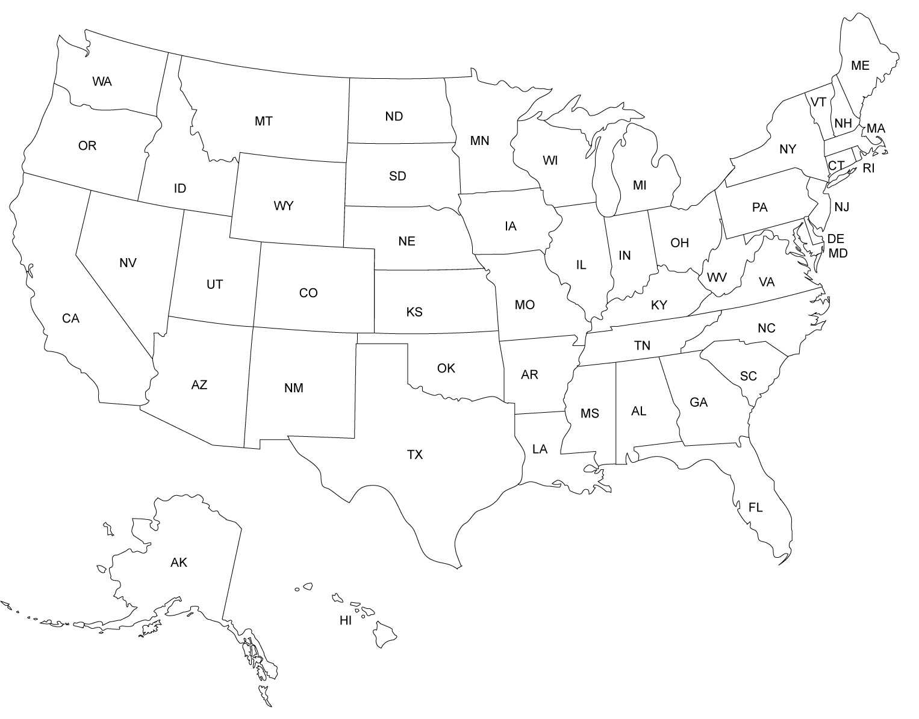
NSF-funded Advanced CI Ecosystem
(Highly Accessible Computing)
ACCESS PIs
Leadership-class
Innovative systems
HTC Services
NCAR
Cloud Resources
Shared Campus
Resources
PAWR Testbeds
Chameleon Lab (Chicago)
CloudLab (Salt Lake City)
FABRIC Network (Nationwide)
PATh/OSG (Madison)
CloudBank (San Diego)
Cheyenne (Cheyenne)
Frontera (Austin)
Jetstream, JetStream-2 (Bloomington)
Delta (Urbana-Champaign)
Ookami (Stonybrook)
Anvil (W. Lafayette)
Bridges-2, Neocortex (Pitt)
ACES (College Station)
Expanse, Voyager, National Research Platform (San Diego)
Stampede 2, Wrangler (Austin)

Slide 7
Throughput Commuting is all about scaling out and therefore about the rate of job handling
During the month of June 2023, the OSPool handled close to 18,000,000 jobs
600,000 jobs per day
25,000 jobs per hour
410 jobs per minute
7 jobs per second

Slide 8
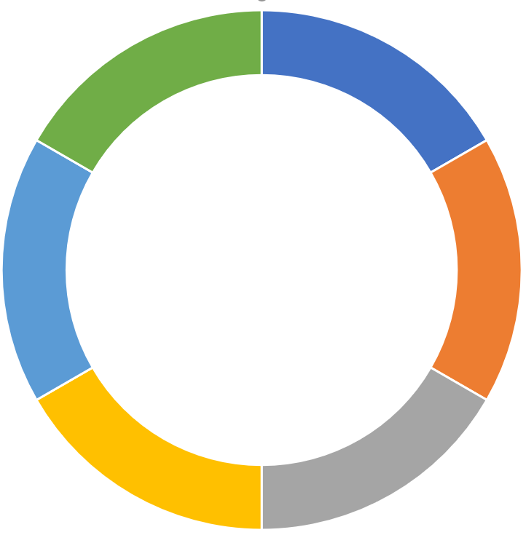
OSPool
PATh Facility
OSG
FAIR-Share
NSF
Awarded
Access
Point
NSF Awarded
Bring Your Own Capacity BYOC
Com. Clouds
My Campus
I Individual
Individual
RAMPS
Allocation
Personal
My Collaboration
Use it
Remotely
Deploy it
Locally

Slide 9
PATh services and technologies enable federation of computing capacity
More than 50 institutions contribute to the OSPool capacity provided by more than 70 sites
PATh services and technologies enable effective access to remote datasets
More than 160 datasets federated by the Open Science Data Federation (OSDF)

Slide 10
Scaling out with federated capacity and datasets means a lot of file transfers
In 2022, the OSDF executed more than 1B file transfers (32 transfers per second)
In June 2023, Jobs executed by the OSPool required 320M file transfers (120 transfers per second)

Slide 11
PATh Executive Summary
“Broader Impact – We firmly believe in dHTC as an accessible computing paradigm which supports the democratization of research computing to include researchers and organizations otherwise underrepresented in the national CI ecosystem. Our work is founded on universal principles like sharing, autonomy, unity of purpose, and mutual trust.”
PATh Proposal 04/21/2020

Slide 13
In June 2023 236 researchers from 90 projects placed OSPool Jobs. What can we do more/different to scale out adoption of Throughput Computing?

