Slide 1
PATh Facility:
Dedicated HTC Capacity
Brian Lin, OSG Software Area Coordinator
Center for High Throughput Computing
University of Wisconsin–Madison

Slide 2
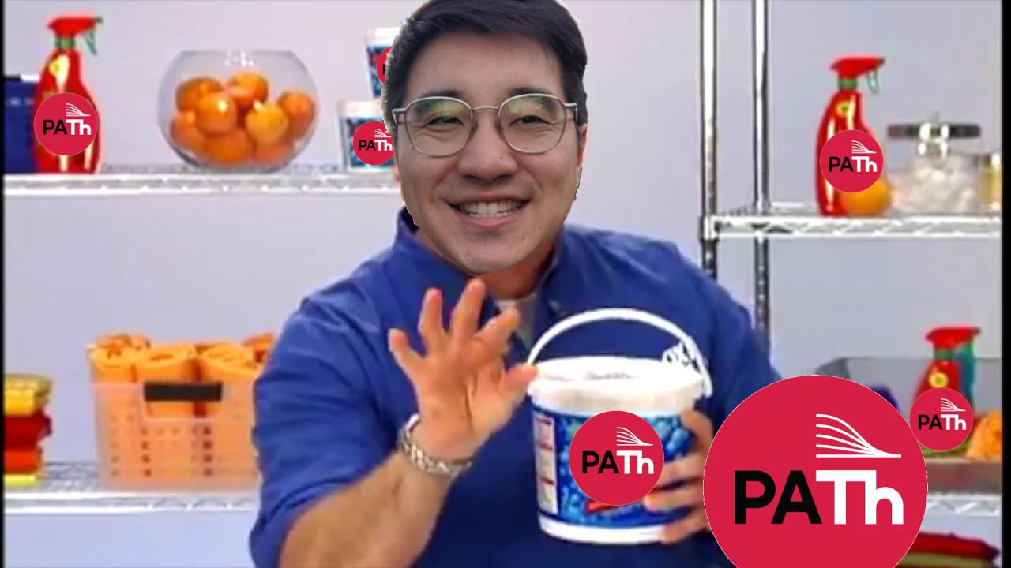
Pictured: poorly photoshopped image of a farcical PATh Facility informercial

Slide 3
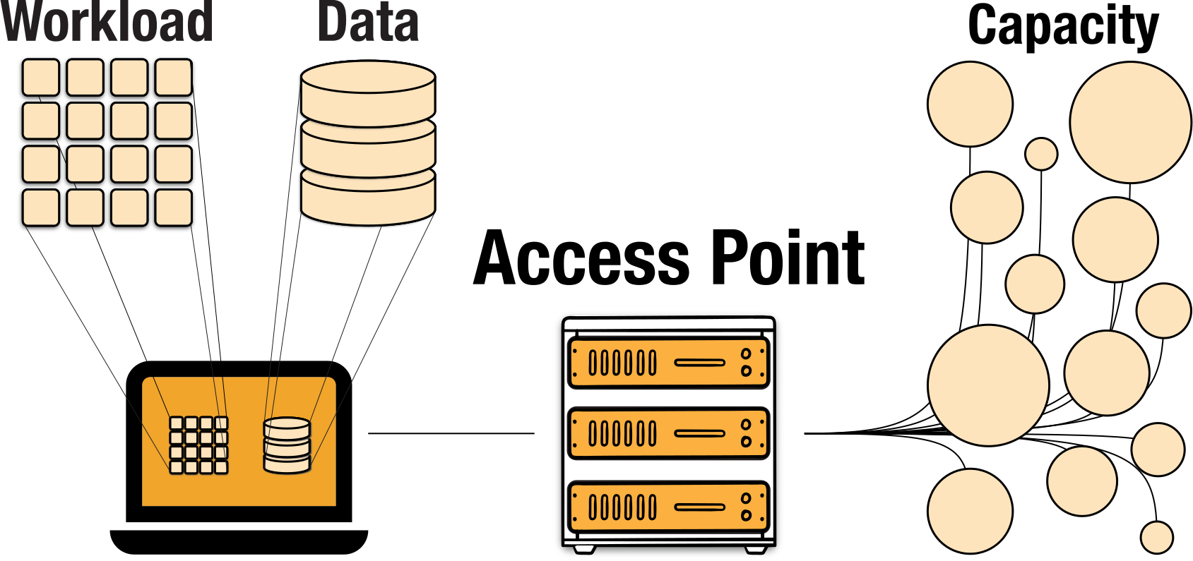
OSPool

Slide 4
OSPool

Slide 5
OSPool

Slide 7
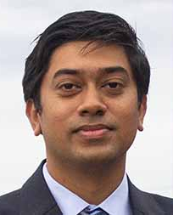
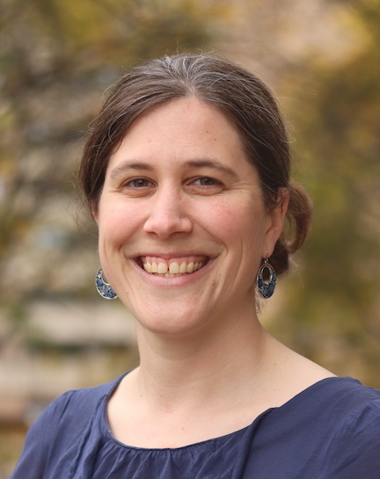
PATh Facility
Dedicated distributed High-Throughput Computing → Longer job run times!
Computational time charged to a credit accounting system
Same HTCondor-based system as the OSPool
Same friendly facilitators, operators, and developers that support the OSPool
Pictured: OSG/PATh Facilitation Team

Slide 8
Over 30,000 cores total!
128 and 80 cores per machine!
2-4 GB RAM per core!
More than 30 A100 GPUs!

Slide 9
Juggling too many requirements?
Real PATh Facility projects
Simulations using 24-32 cores on a single node
Modeling jobs needing only 1 core and 70 GB RAM
Pictured: man carrying a comical amount of equipment to wash a car, dropping it all and falling over

Slide 10
Tired of long jobs never completing?
Pictured above: condor_watch_q output indicating all of a user’s jobs being idle Pictured left: a skeleton wearing glasses, a lab coat, and a bowtie (Artur Tumasjan, Unsplash)

Slide 11
4
$0
Get a PATh Facility credit account for easy payments of -
https://portal.path-cc.io/application

Slide 12
Credit System
Computational time is charged to your credit account
To be eligible, your group must have a relationship with an affiliated NSF program:
Have an active or approved award,
Preparing a proposal,
Or have a proposal under review
Submit a credit request to your NSF program officer

Slide 13
Affiliated NSF Programs
Computational and Data-Enabled Science and Engineering
Cyberinfrastructure for Sustained Scientific Innovation
Innovation: Bioinformatics
Neural Systems
Collaborative Research in Computational Neuroscience
Astronomy and Astrophysics Research Grants
Chemical Theory, Models, and Computational Methods
Condensed Matter and Materials Theory
Atomic, Molecular and Optical Physics ‒ Theory
Nuclear Physics ‒ Theory
Geoinformatics (GI)
Geophysics (PH)
Arctic Research Opportunities
Antarctic Research

Slide 14
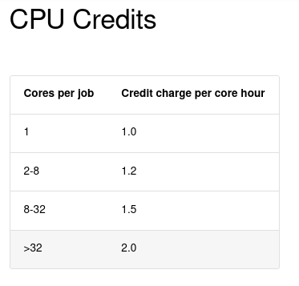
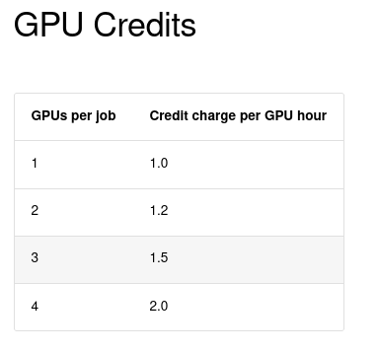
How many credits do you need?
Source: https://portal.path-cc.io/documentation/overview/references/credit-account-charges/

Slide 15
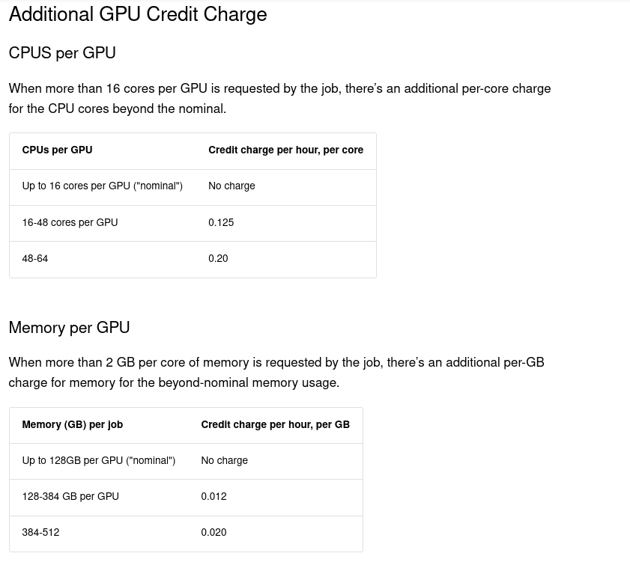
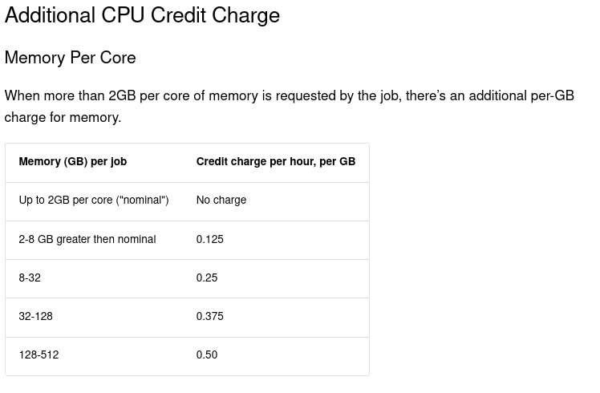
How many credits do you need?
Source: https://portal.path-cc.io/documentation/overview/references/credit-account-charges/

Slide 16
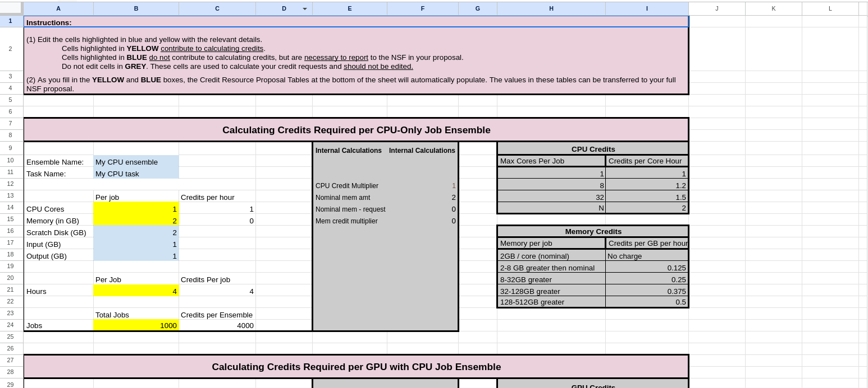
How many credits do you need?
Source: https://portal.path-cc.io/documentation/overview/references/credit-account-charges/

Slide 17
Pictured: Zach Galifianakis from the Hangover (2009)

Slide 18
Not sure if the PATh Facility is for you?
Request a free trial (aka starter credits)!
https://portal.path-cc.io/application

Slide 19
But wait, there’s more!
Call* in the next 20 minutes✝ and receive
of OSDF storage quota!!!
500 GB
* Actually, just visit and apply at https://portal.path-cc.io/application ✝ Offer available at all times

Slide 20
Schedule a consultation with our Facilitation Team today!
https://portal.path-cc.io/application

Slide 21
Pictured: poorly photoshopped image of a farcical PATh Facility informercial slogan

Slide 22
Questions
This material is based upon work supported by the National Science Foundation under Grant No. 2030508. Any opinions, findings, and conclusions or recommendations expressed in this material are those of the author(s) and do not necessarily reflect the views of the National Science Foundation.

