Slide 1
Introduction to Jupyter Notebook on the OSPool
Showmic Islam
OSG Research Facilitation
July 10, 2023
Notes:
Welcome,RL from UW, Showmic facilitators

Slide 2
Open an internet browser and enter:
https://notebook.ospool.osg-htc.org
https://tinyurl.com/jupyternote
Notes:
Hands-on

Slide 3
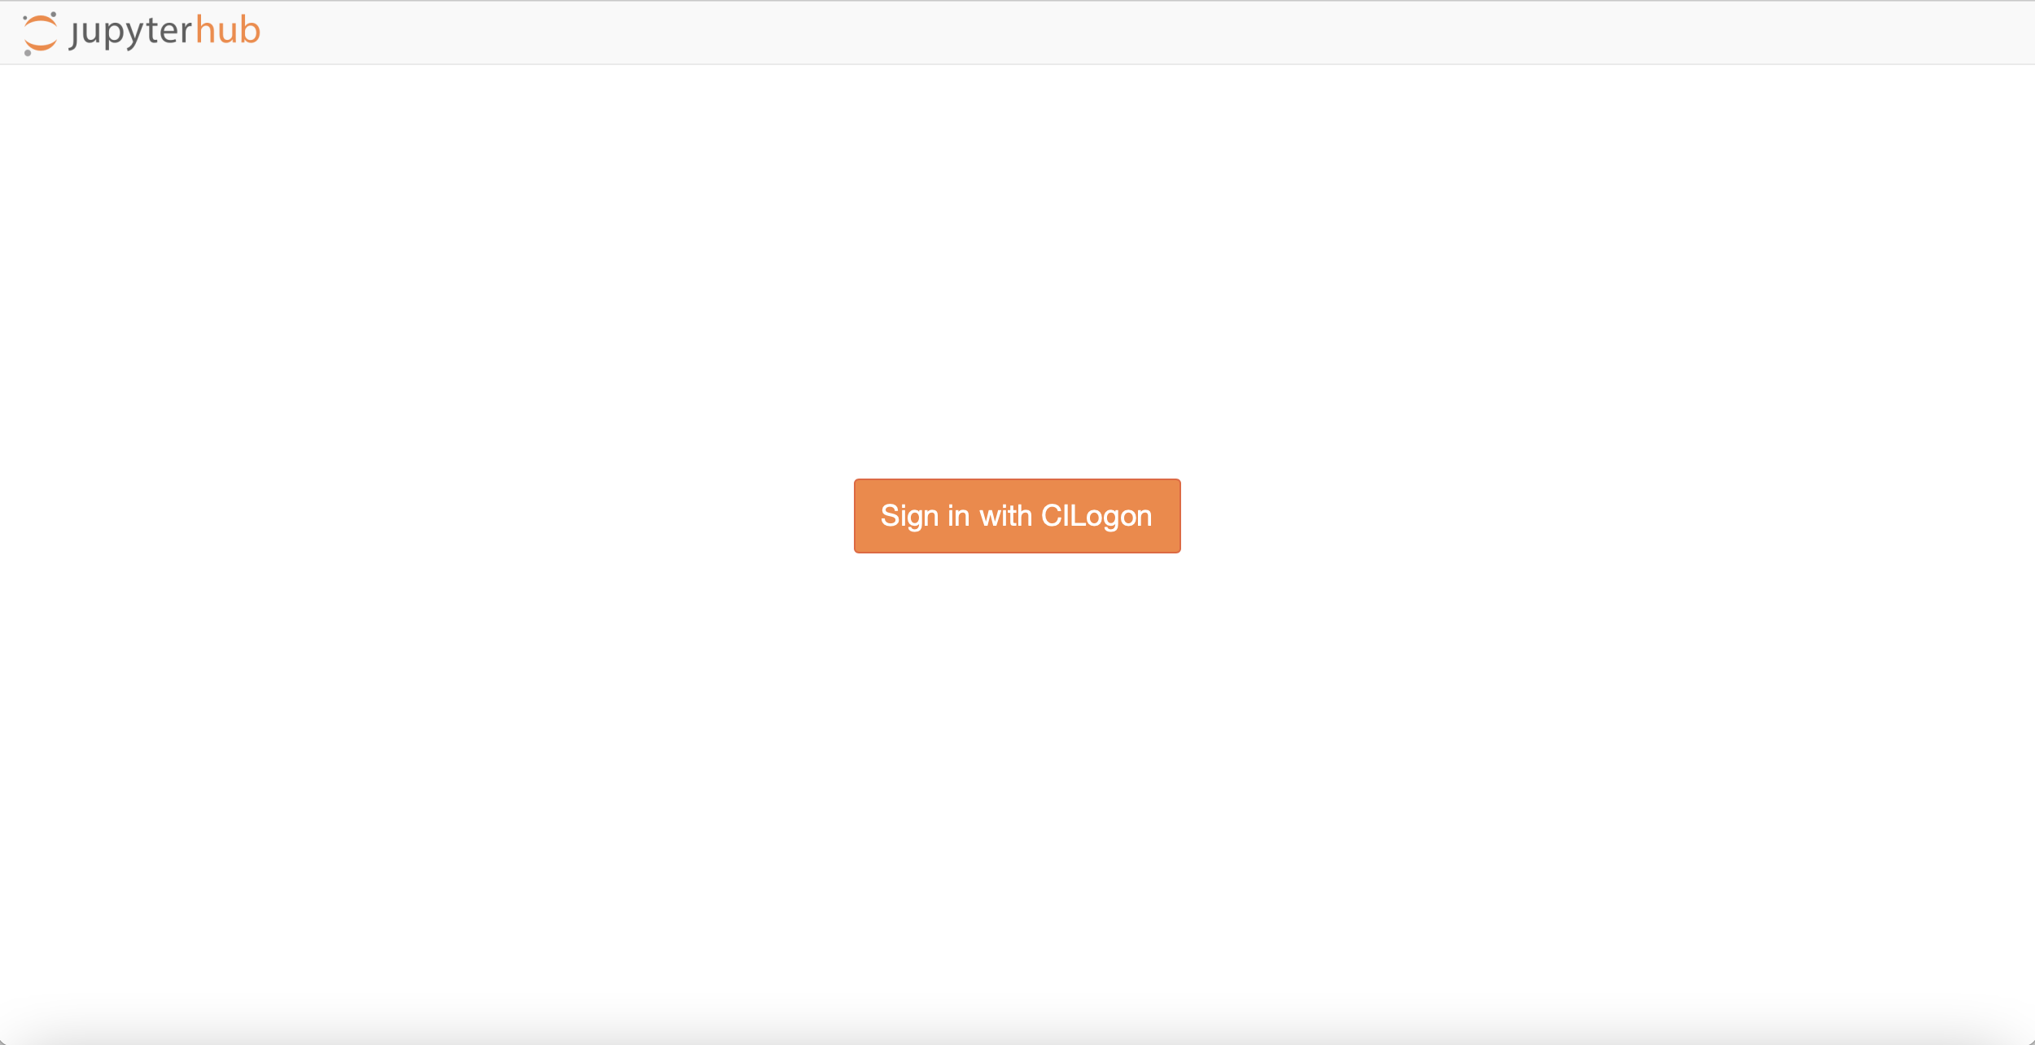
Log into Notebook
Notes:
Hands-on

Slide 4
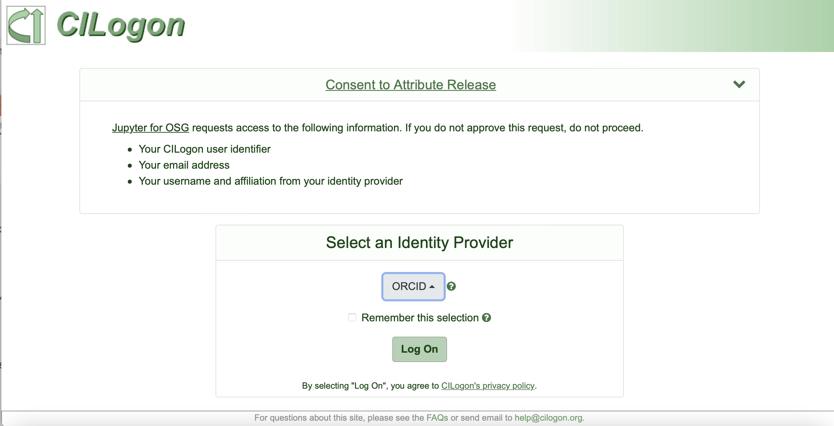
Log into Notebook
Login using any of the available authentication options. Some choices:
Institution account
Google (i.e. gmail)
GitHub
ORCID

Slide 5
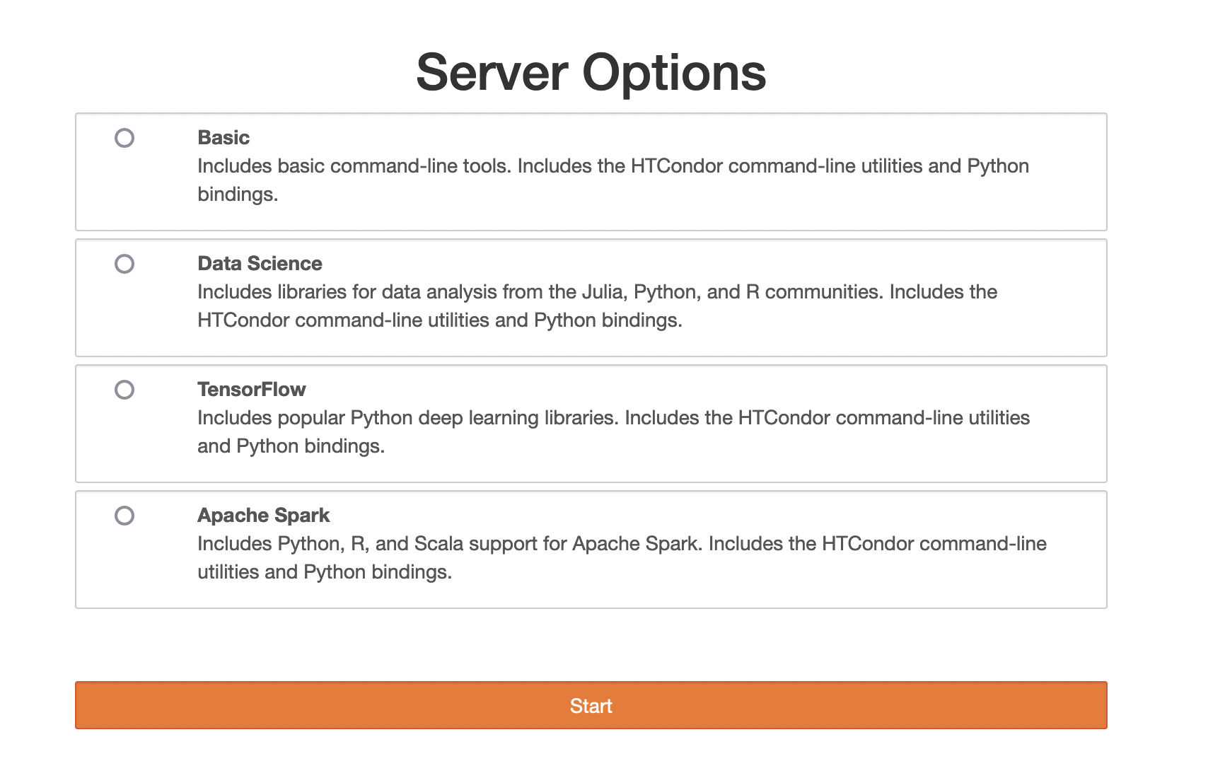
Launch Basic Notebook
1. Click the “Basic” box
2. Click orange “Start” button

Slide 6
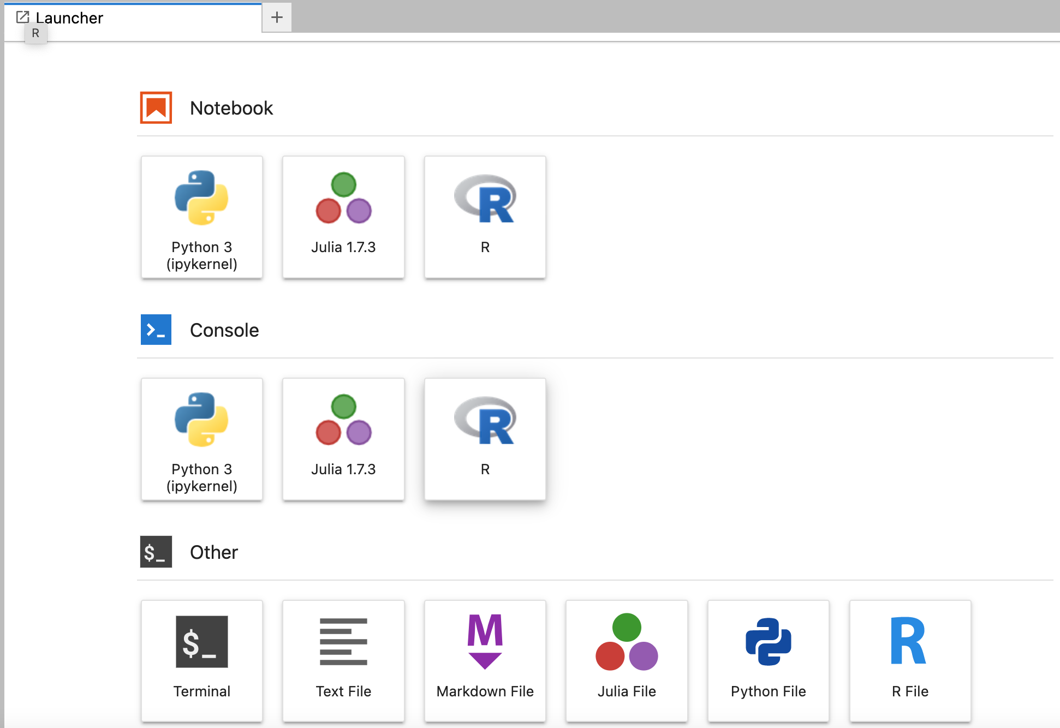
Log into Notebook
Open a Terminal

Slide 7
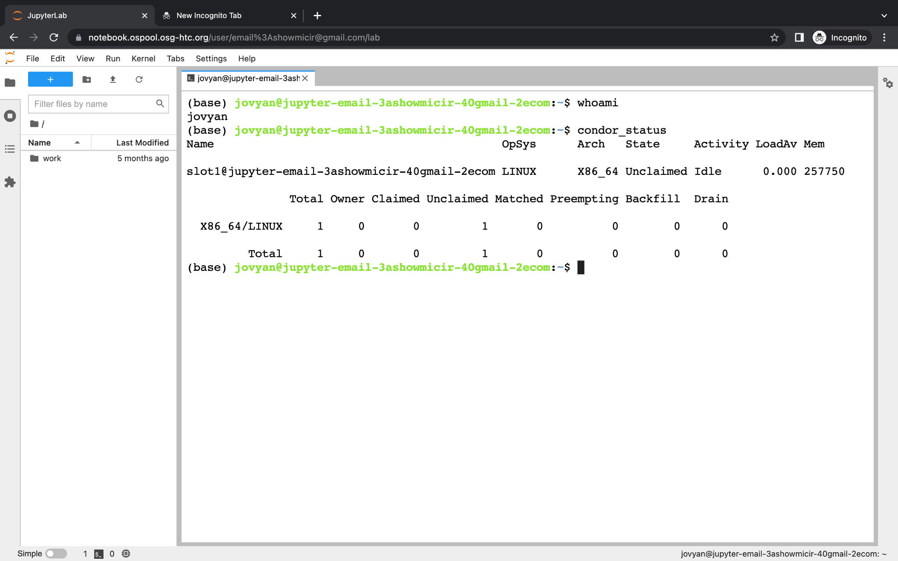
Navigating Notebook
Some key points about the notebook:
Every guest account is the same user ‘jovyan’.
Saved file may disappear as the guest notebook is for temporary use only
condor_status shows that only 1 node is available
More nodes Get a full account

Slide 8
Tutorial: R Script Example
1. Download the R tutorial materials
$ cd ~ $ tutorial ScalingUp-R
$ cd ScalingUp-R
2. Explore our work environment
$ ls
3. Submit a job to analyze all data files
$ condor_submit R.container.submit
Workspace
logs/
output/
mcpi.R
README.md
README.ipynb
R.container.submit
R.submit
8

Slide 9
Notebook on an OSPool user’s account
condor_status shows the capacity of the OSPool
Saved files are always there
Every user has their own account on the notebook

