Slide 1
OSG David Swanson Award Lightning Talks

Slide 2
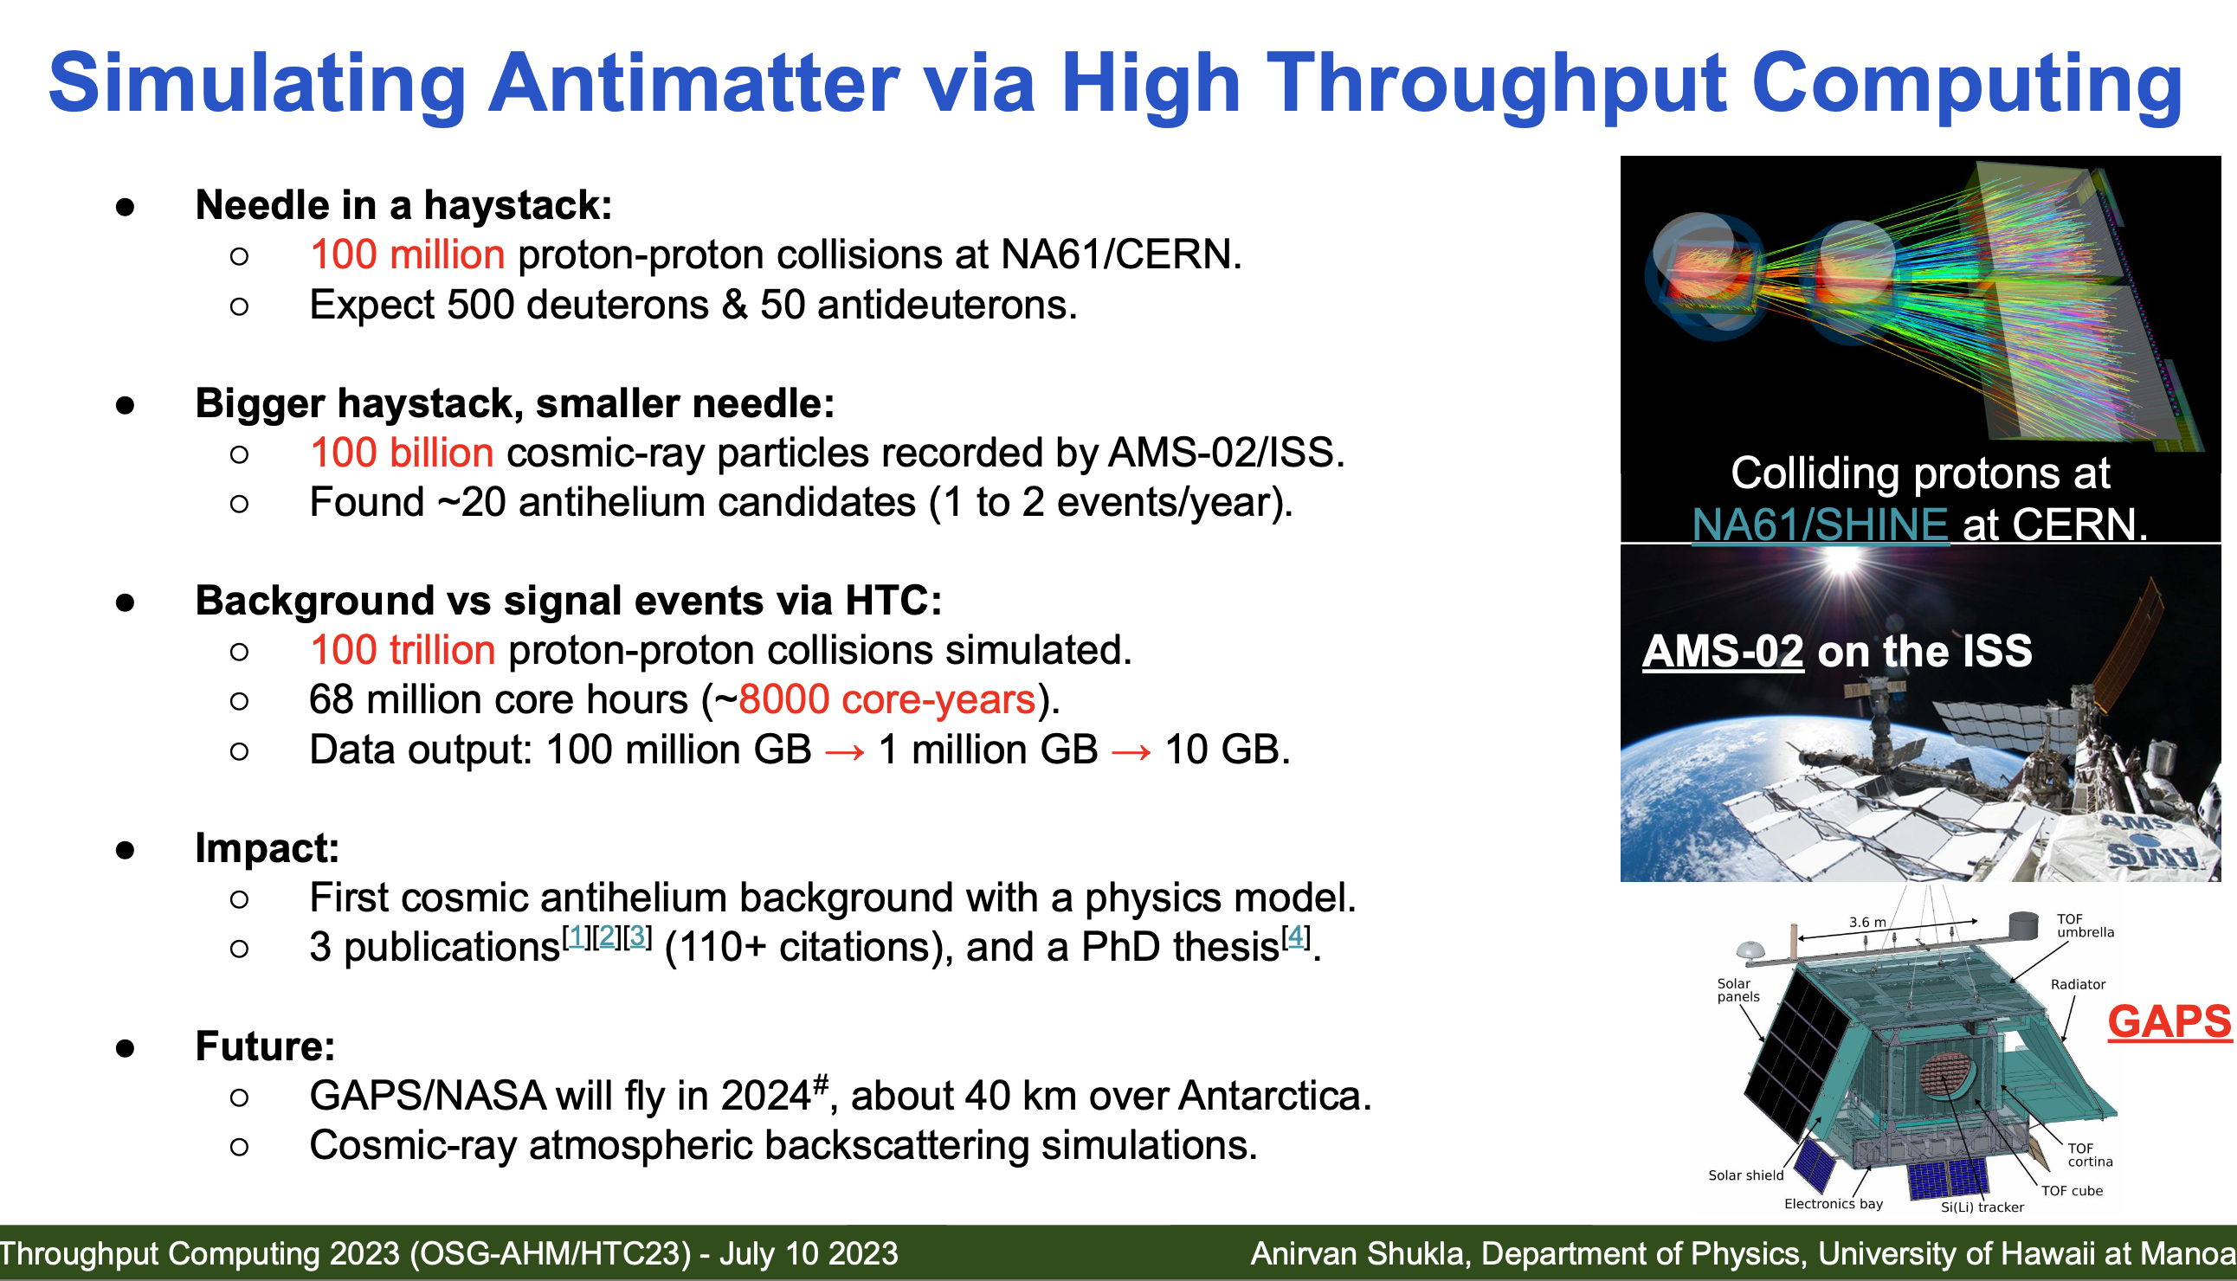
Anirvan Shukla, 2020

Slide 3
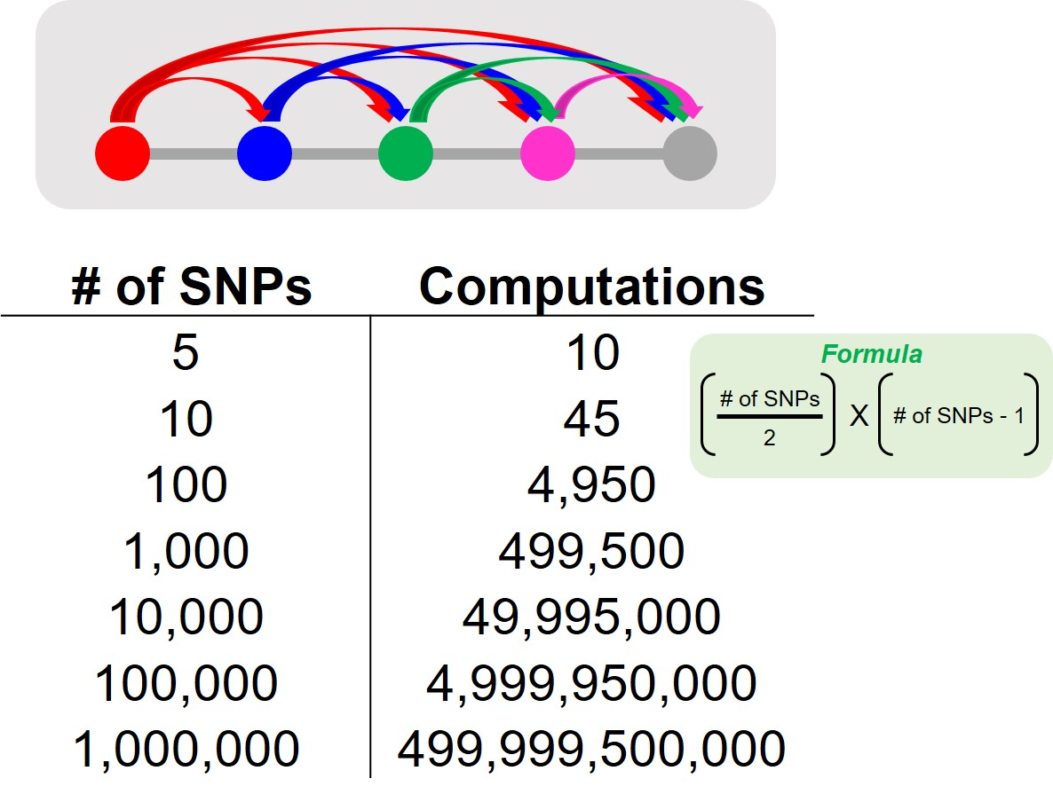
Zhonggang (John) Li, 2020

Slide 4
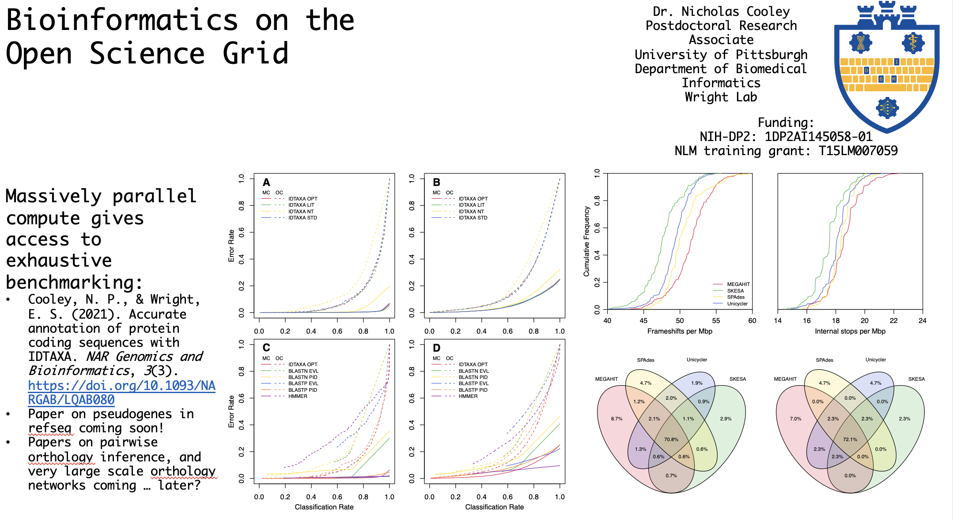
Nicholas Cooley, 2021

Slide 5
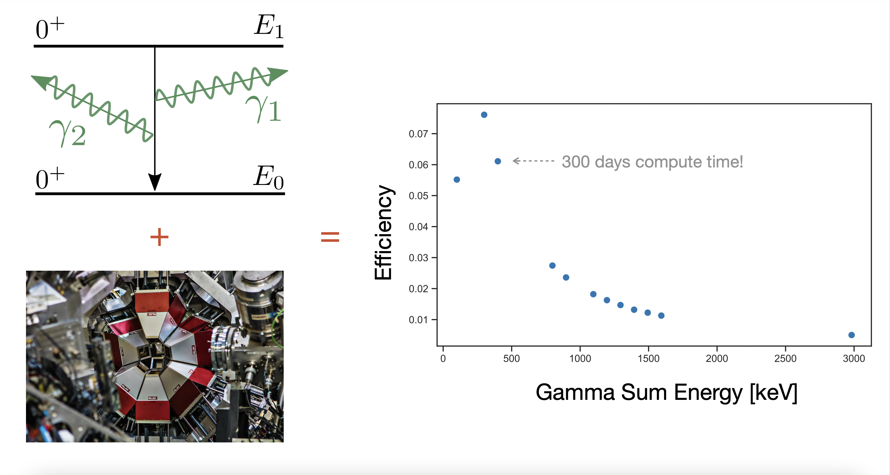
Connor Natzke, 2022

