Slide 1
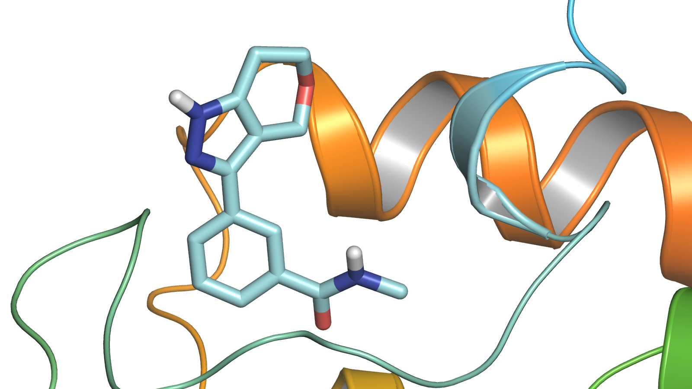
In Silico Screening of Natural Compounds as Novel Drug Targets for the Treatment of Multiple Myeloma
Rousselene Larson
Advisor: Dr. Rakesh Kaundal
Utah State University

Slide 2
Multiple Myeloma
Second most prevalent type of cancer in the US
34,920 new cases in 2021
12,410 deaths

Slide 3
Hypothesis
Toxicity and resistance are correlated with existing therapies for MM, emphasizing the need for novel, effective therapeutics.
Due to their biological activity, small molecules found in plant-based natural compounds provide therapeutic benefits that affect human protein expression.
Docking methods seem crucial in order to develop a comprehensive solution.

Slide 4
Objective
Mine literatures to identify M-proteins and generate their 3D structures.
Generate natural compounds dataset from various databases (ZINC, PubChem, NPCARE).
Perform docking and post-docking analysis.
Identify the binding sites where the protein interact with the natural compound (ligand).
Perform simulation to study the molecular forces acting on the complex.
Generate a list of potential drug candidates for MM.
Web server implementation: https://bioinfo.usu.edu/myDockDB

Slide 5
Molecular Docking
Rigid Flexible Semi-flexible

Slide 6
M-Proteins Collection
Gene types | # of genes collected
SPEP (serum) | 16
UPEP (urine) | 322
LCP1 (T-cells) | 41
Others | 15

Slide 7
Methods

Slide 8
Generate 3D Structure for the Receptor (Protein)
PDB structure
Homology Modeling

Slide 9
Preparation of the Receptor Molecule
Removal of the water molecules
Stabilizing charges
Filling in the missing residues

Slide 10
Identification of the Active Sites
When these protein cavities come into contacts with any foreign molecules, they become active and are referred to as active sites in the pocket.
The receptor may have many active sites but the one of the interest is selected.

Slide 11
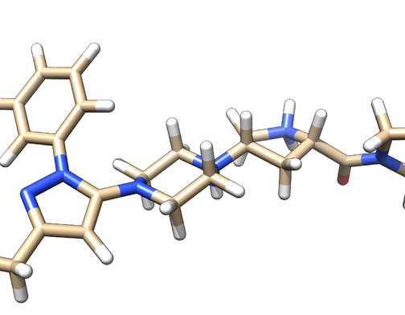
Natural Compound(ligand) Preparation
Ligands is obtained from various databases like ZINC, and PubChem.
While selecting the ligand, the LIPINSKY’S RULE OF 5 is applied.

Slide 12
Ligands Collection
*Initial Compounds
**Filtered Compounds
Filter Used | Natural Compound Databases
 | PubChem | Input | Output | Zinc | Input | Output
REOS |  | 15,970* | 5,387 |  | 224,205* | 123,223
PAINS 1 |  | 5,387 | 5,369 |  | 123,223 | 123,074
PAINS 2 |  | 5,369 | 5,365 |  | 123,074 | 122,938
PAINS 3 |  | 5,365 | 5,286** |  | 122,938 | 116,714**
Also duplicates found between ZINC and PubChem compounds were removed. 3,715 duplicates were found.

Slide 13
Result and Discussion
IL6 (PDB: ALU) produced by marrow stomal cells contribute to the overactivity of osteoclasts causing bone lesion in MM patients.
TP53 (PDB: 2BIP) is the most mutated protein in human cancers.
NRAS (PDB: 6ZIO) RAS mutations cause cells grow uncontrollably. They also make cells resistant to some available cancer therapies.

Slide 14
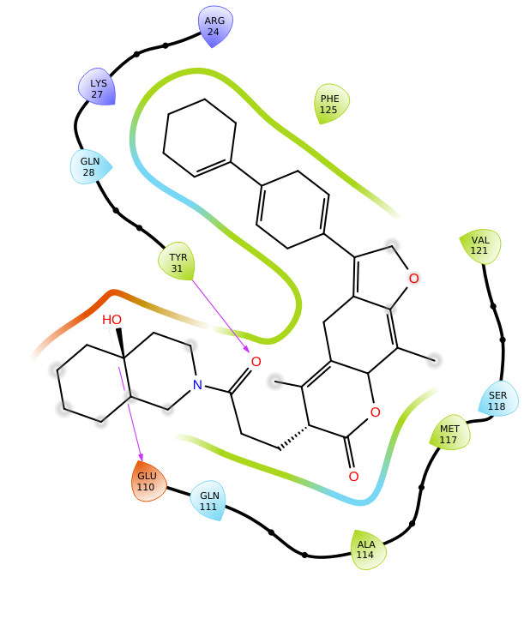
ALU_ ZINC000001900625 Complex Structure

Slide 15
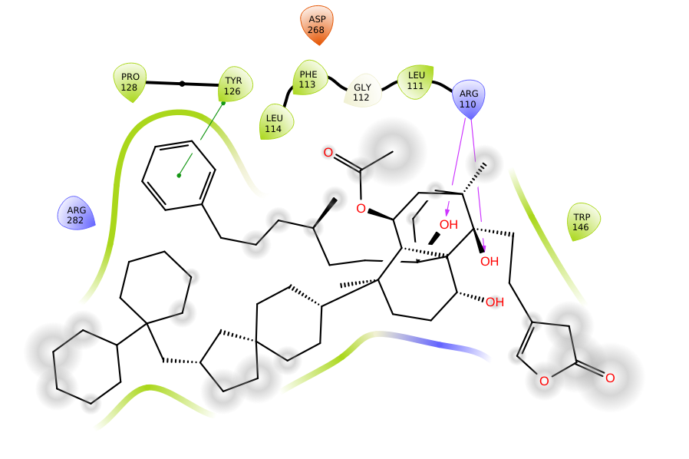
2BIP_ ZINC000150359959 Complex Structure

Slide 16
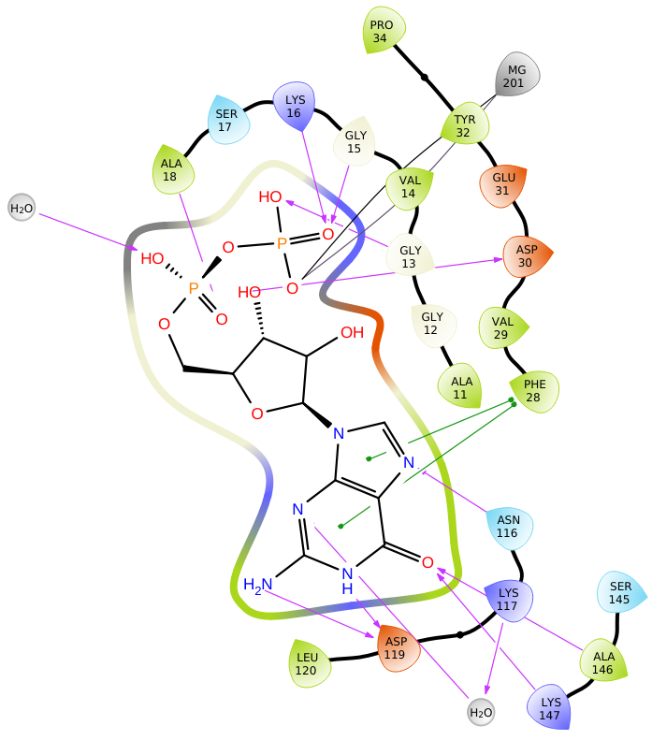
6ZIO_ ZINC000006142058 Complex Structure

Slide 17
Top 10 Lead Compounds and their Docked Inhibitors
Gene | PDB_id | Compounds | Binding affinity (kcal/mol) | Interacting Amino Acid | Types of Bonds | Bond Distance (A)
TP53 | 2BIP | ZINC000150359959 ZINC000150359969 ZINC000150359978 ZINC000150359935 ZINC000150359973 ZINC000085542224 ZINC000085541700 ZINC000150359931 ZINC000085594244 ZINC000095909362 2bip_CID_3213 | -8.0 -7.8 -7.4 -7.3 -7.2 -7.2 -6.8 -6.3 -5.8 -5.6 -6.1 | Arg110, Arg110, Tyr126 Tyr126 Asp268 Tyr220 Asp268 Tyr126, Leu111, Leu111 H2o, Gly262 Asp268 Glu258, H2o, H2o Tyr126 Thr211 | 2 H-Bond, pi-pi stacking 1 H-Bond 1 H-Bond 1 H-Bond 1 H-Bond 3 H-Bond 2 H-Bond 1 H-Bond 3 H-Bond 1 H-Bond 1 H-Bond | 1.92, 2.00, 4.64 1.96 2.00 2.14 2.08 2.05,2.64, 2.66 1.54, 2.25 2.32 2.01, 2.06, 2.41 2.15 2.36
IL6 | 1ALU | ZINC000001900625 ZINC000150359978 ZINC000276935046 ZINC000150359973 ZINC000150359959 ZINC000150359935 ZINC000150359969 ZINC000085541700 ZINC000085541935 ZINC000085594244 1alu_F_TLA | -7.8 -7.7 -7.5 -6.8 -6.8 -6.6 -5.9 -5.7 -5.7 -5.6 -4.7 | Glu 110, Tyr 31 Lys 66, H2o, H2o H2o Lys70, Phe74 Gln28 H2o Tyr31 Asn63 H2o Leu92, H2o, H2o Arg104, Thr43 | 2 H-Bond 3 H-bond 1 H-bond 1 H-Bond, 1 pi-pi stacking 1 H-Bond 1 H-Bond 1 H-Bond 1 H-Bond 1 H-Bond 3 H-Bond 2 H-Bond | 2.38, 2.18 2.19, 1.25, 2.08 1.54 2.26, 3.75 2.21 2.57 2.63 2.37 2.42 2.72, 1.58, 2.78 1.92, 2.34
KRAS | 6ZIO | ZINC000006142058 ZINC000011867065 ZINC000253499958 ZINC000150359959 ZINC000150359935 ZINC000150359978 ZINC000150359931 ZINC000150359973 ZINC000524729303 ZINC000085594244 6zio_G_GDP | -11.6 -10.2 -9.3 -8.4 -7.8 -7.7 -7.5 -7.3 -6.5 -5.7 -10.5 | Asp30, H2o, Ala18, Lys16, Gly13, Gly15, Asn116… Lys147, Lys117, Asn116, H2o, Phe28, Phe28 Arg68, Gln99 Tyr32, H2o, Phe28 Arg68, Gln99 Gly13, Asp30, Lys117 Arg102, H2o Thr58, Arg102, H2o, H2o, H2o, Tyr96 Lys170 Arg 68, Arg68, H2o, Gln99 Asp30, Asp119, H20 | 13 H-Bond, 2 pi-pi stacking 3 H-Bond, 2 pi-pi stacking 2 H-Bond 2 H-Bond, 1 pi-pi stacking 2 H-Bond 3 H-Bond 2 H-Bond 4 H-Bond, 1 pi-pi stacking 1 H-Bond 4 H-Bond 3 H-Bond | 1.75, 2.61, 1.95, 2.03, 1.87, 2.11, 2.35… 2.07, 2.60, 2.29, 4.74, 5.36 2.02, 2.14 2.15, 1.26, 4.70 2.02, 2.14 2.18, 1.76, 2.15 2.67, 2.72 2.47, 197, 2.73, 1.07, 3.96 2.30 2.16, 2.57, 2.49, 2.59 2.00, 2.07, 1.96

Slide 18
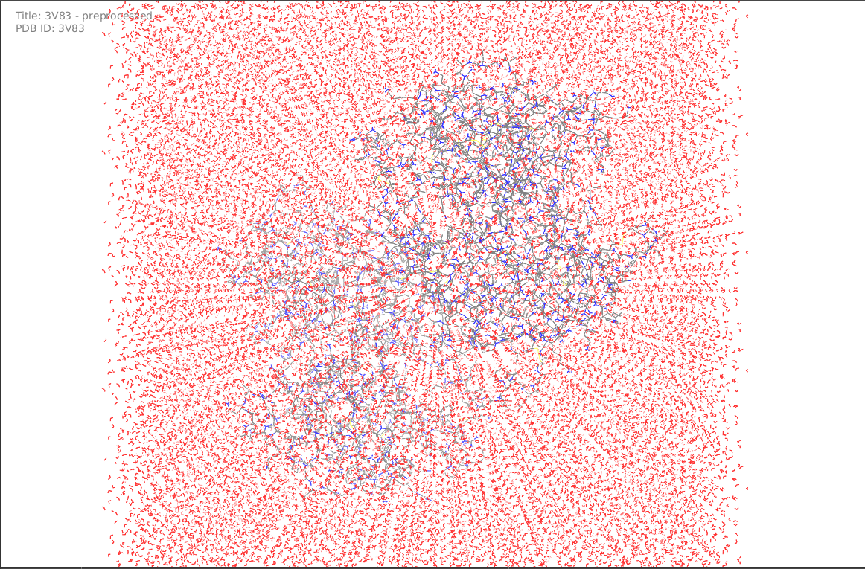
Molecular Dynamic Simulations
MD is performed to study the conformational stability of protein-ligand complexes and their changes.
Our system is simulated up to 100ns.
RMSD and RMSF values of the c-alpha atoms were calculated to reveal thermodynamic stability.

Slide 19
RMSD Calculation
The root mean square deviation (RMSD) indicates how stable the ligand is with respect to the protein and its binding pocket
Equilibrium is reached
Well within the range of acceptable RMDS ~2-3 A
Indicate the compounds are bound tightly within the cavity of the proteins

Slide 20
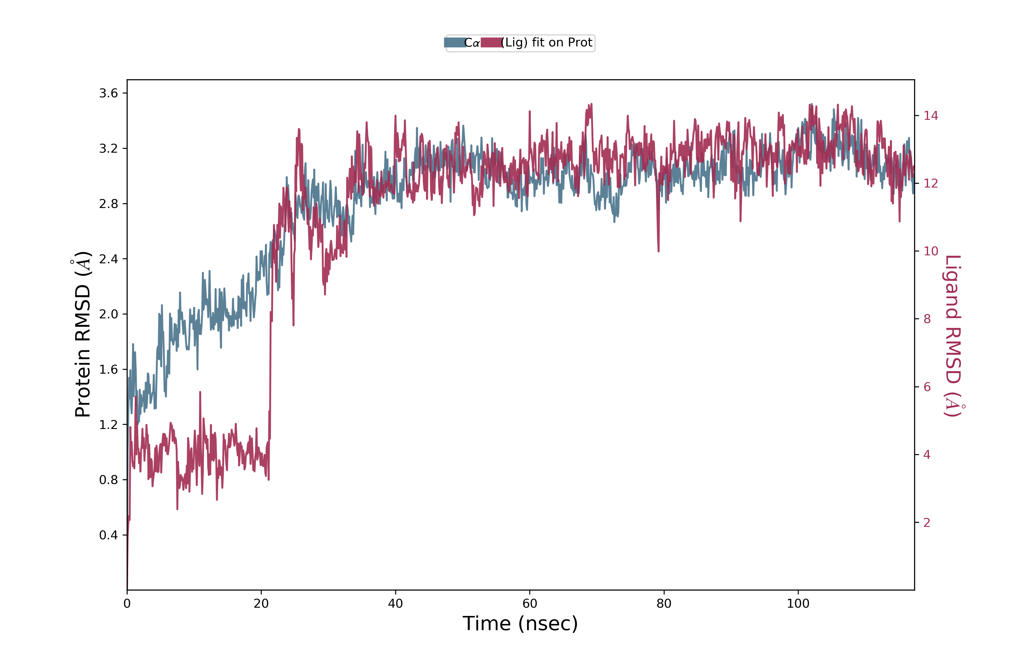
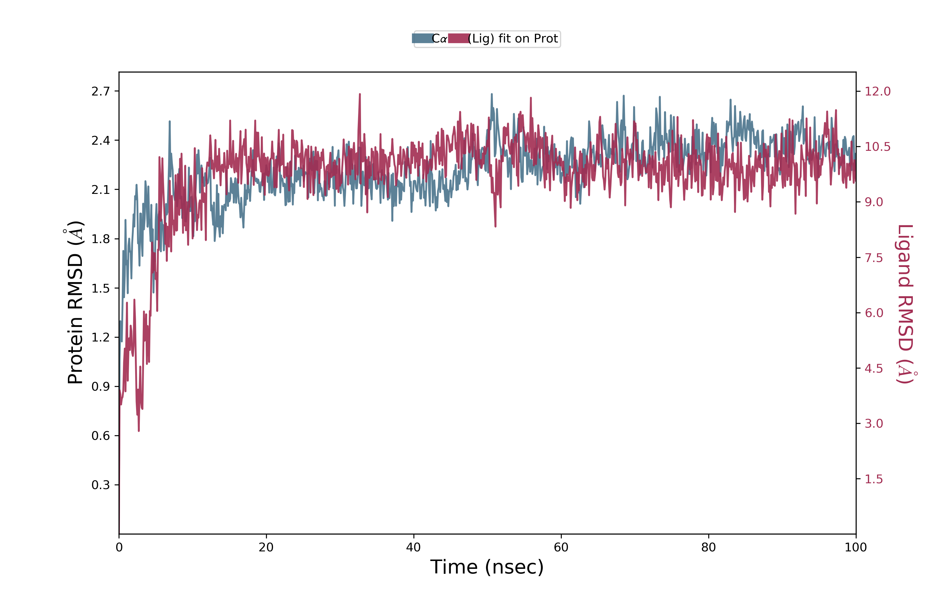
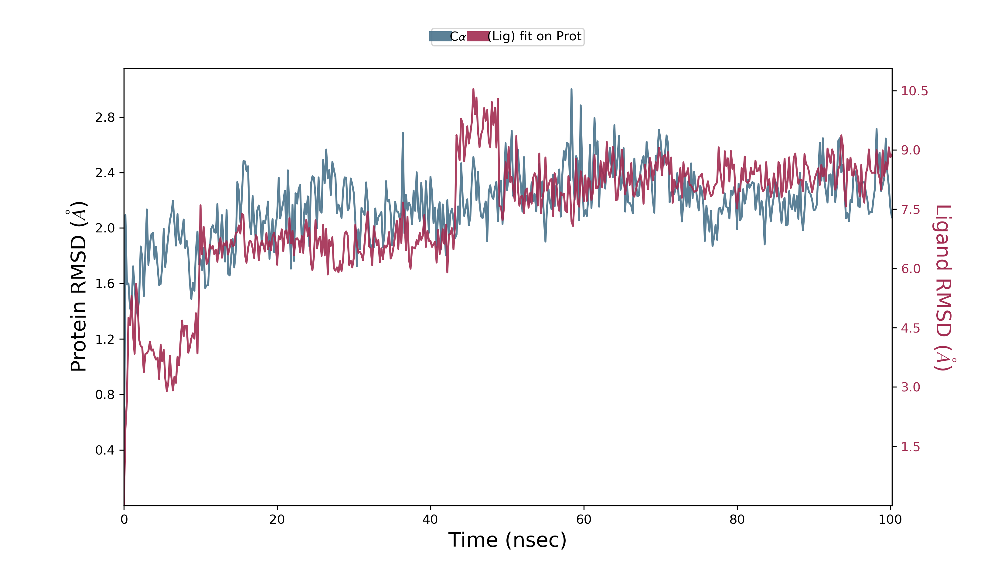
RMSD
1ALU
2BIP
6ZIO

Slide 21
RMSF Calculation
The root mean square fluctuation(RMSF) is used to examine the binding affinity efficiency of the lead compound with each gene
RMSF ~ 2 A
The binding pockets of each protein is quite stable during 100 ns period of MD simulation

Slide 22
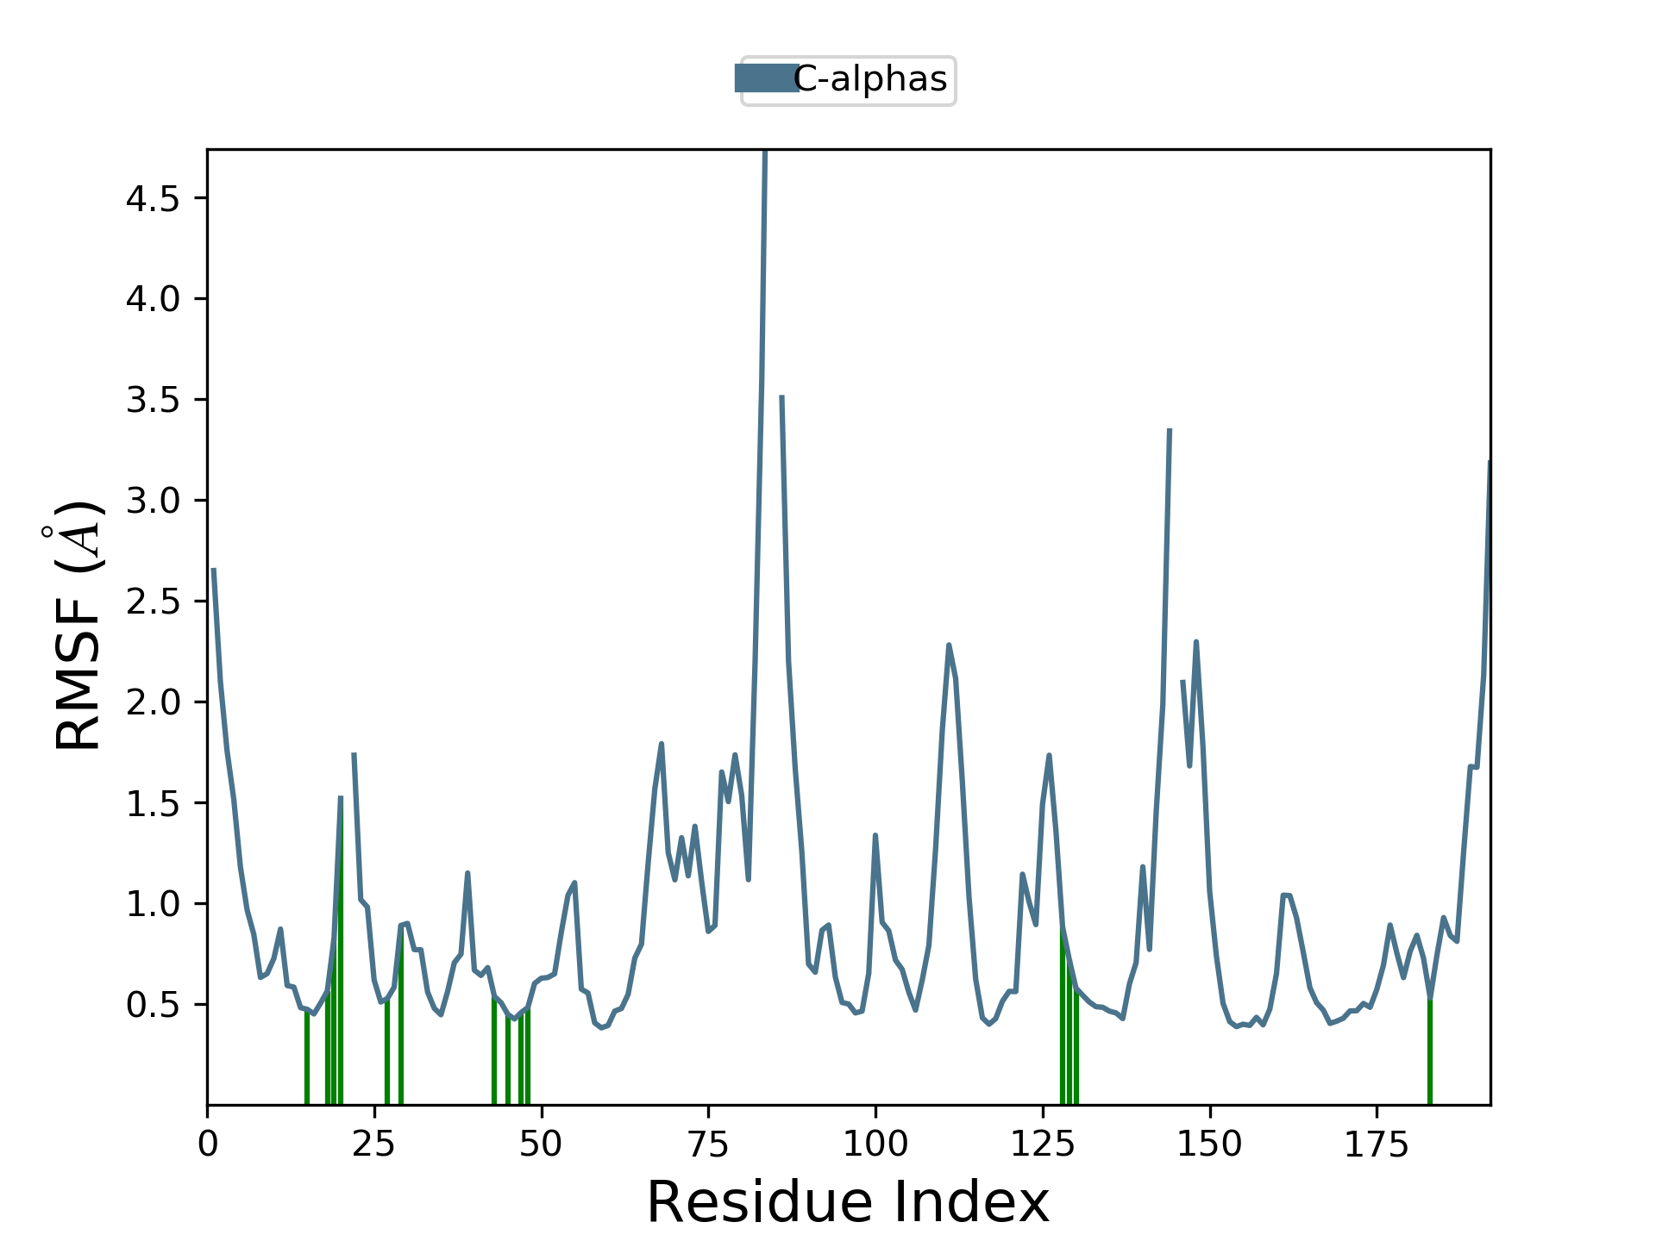
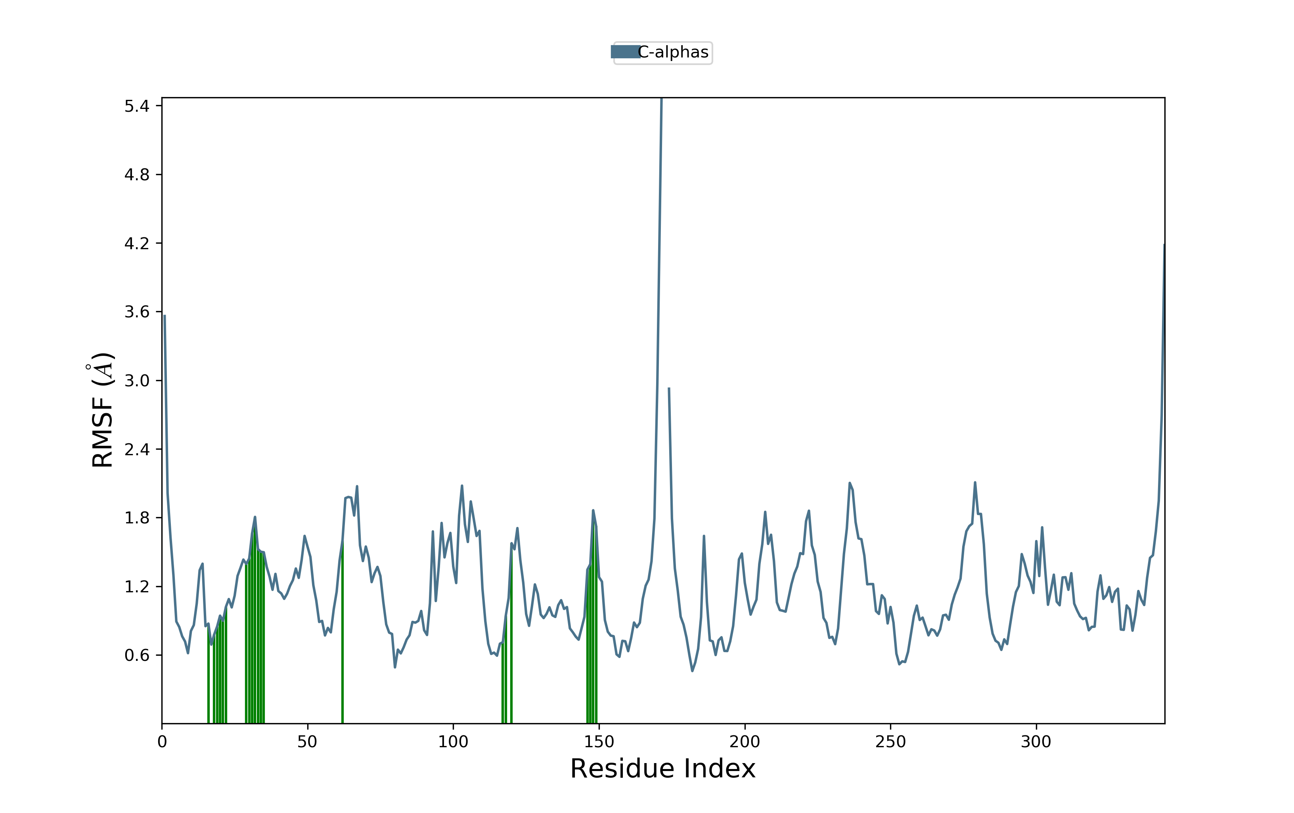
RMSF
1ALU
2BIP
6ZIO
**Peaks indicate areas of the protein that fluctuate the most during the simulation

Slide 23
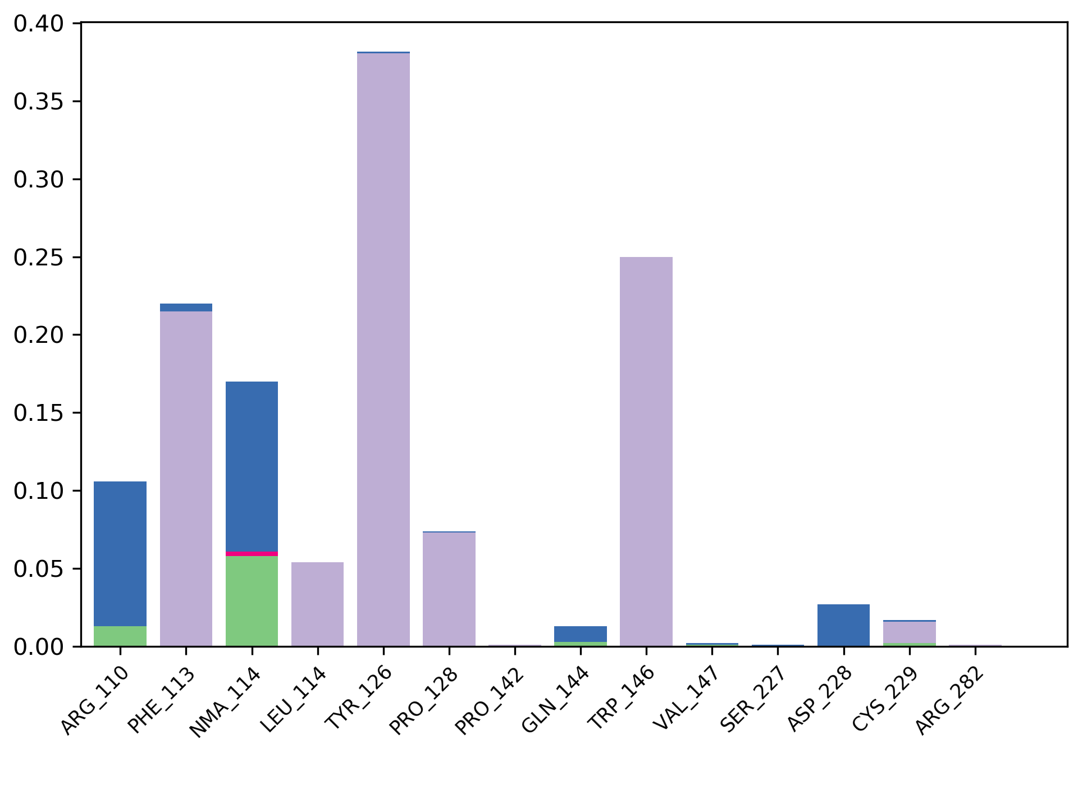
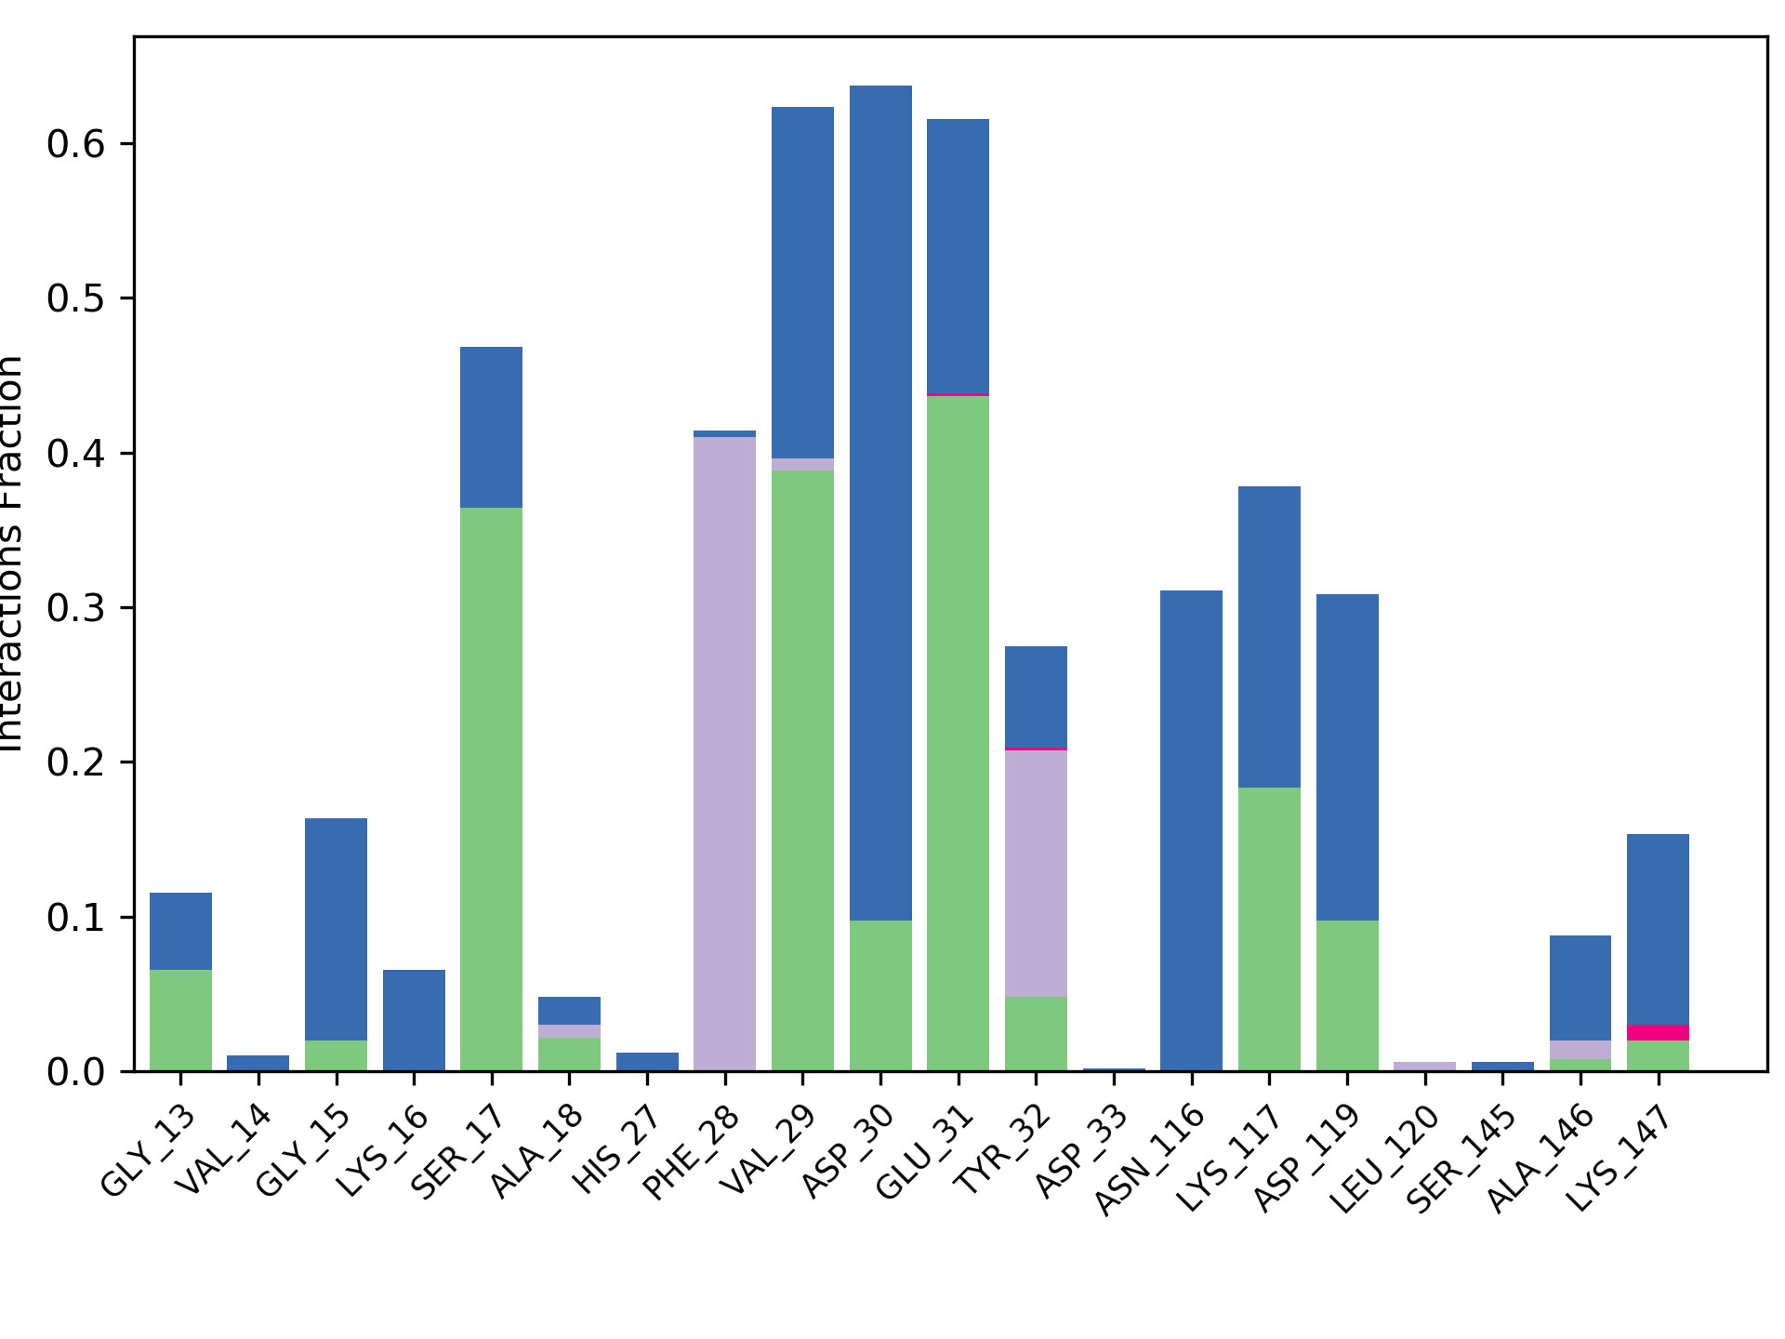
Binding Types
1ALU
2BIP
6ZIO

Slide 24
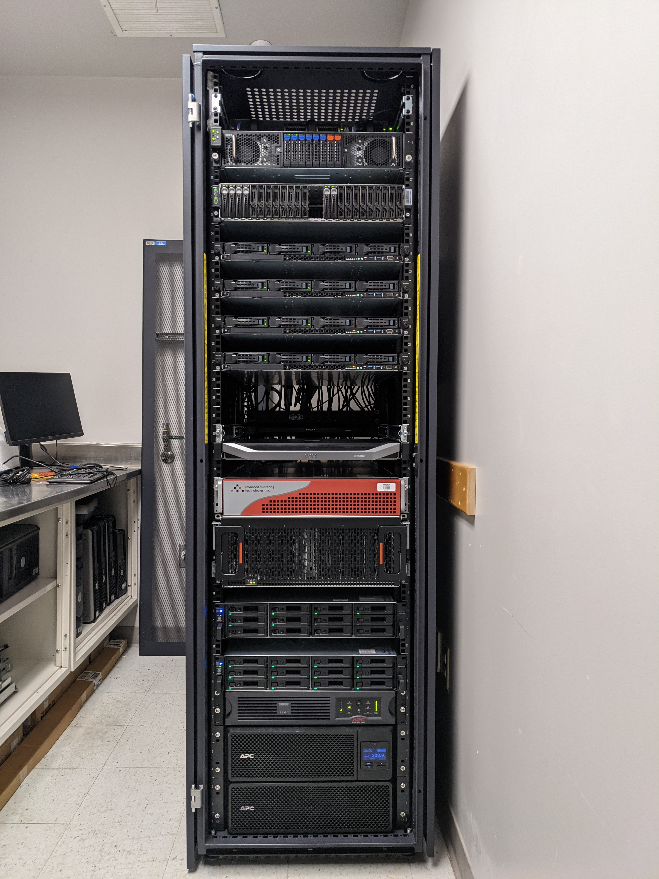
What we needed
342 proteins
118,285 ligands
40,453,470 total docking runs
Node 6,612 core
2.7 million core hours
1.3 TB of results
Database implementation

Slide 25
Computational Challenges
We simply did not have the time
We simply did not have the computing resources

Slide 26
HTCondor System
Excellent scheduling and computing power
Tasks distribution more powerful than what a GPU system can handle
Greatly increase computer capacity
Greatly reduces time Consumption
Perform 40,453,470 total docking runs in just a month.

Slide 27
my_HTC Docking Job
job1
job2
job3
job4
job5
job6
job…
1 Workflow
job3000
job4000
job5000
job6000
job7000
job…
job2,000,000

Slide 28
Web-Server Implementation
URL: https://bioinfo.usu.edu/myDockDB

Slide 29
Search result

Slide 31
Conclusion
At the present time, there is no known cure for Multiple Myeloma. Efforts to control the disease are therefore more focused on maintenance and rehabilitation.
In this research we use the strategy of drug repurposing to show how plant-based natural compounds can be very effective against Multiple Myeloma.
The RMSD and RMSF results we obtain show that the c-alpha atoms of these proteins reveal a strong thermodynamic conformational stability with these natural compounds.
HTCondor has made it possible to make this data available for our community.

Slide 32
Acknowledgment
Advisor: Rakesh Kaundal
Graduate students:
Naveen Duhan
Colin Bearnhart

