Slide 1
Dang Aah Grrr Managing Workflows is Difficult
An Intermediate HTCondor DAGMan Tutorial
By: Cole Bollig
Software Developer for CHTC
Throughput Computing 2023

Slide 2
DAGMan Introductory Material
Previous Tutorials/Presentations
HTCondor Week 2022 DAGMan Introduction Tutorial
HTCondor Week 2014 Advance DAGMan Tutorial
HTCondor Week 2014 Introductory DAGMan Tutorial
DAGMan Documentation
HTCondor DAGMan Documentation
HTCondor DAGMan Documentation (OLD)
Notes:
- This talk is geared more for intermediate DAGMan capabilities beyond the basics
- We have lots of useful presentations/tutorials given in the past for DAGMan introductory material
- Online manual/documentation is changing soon so I linked both current DAGMan docs link and the future link. All links later in this page will be using the future link which will be broken until the release of V10.7.0

Slide 3
Quick Refresher
DAGMan is a Directed Acyclic Graph (DAG) Manager that is used to help automate a workflow of jobs.
A DAG is comprised of Nodes and Edges.
A Job is the core of a DAG Node
diamond.dag
Diamond DAG visualized
JOB A job1.sub
JOB B job2.sub
JOB C job3.sub
JOB D job4.sub
PARENT A CHILD B C
PARENT B C CHILD D
A
B
C
D
Notes:
-Important for automating job submission where the output of one job is used as the input of the next
-Once node A completes nodes B & C will be submitted and ran concurrently in the queue

Slide 4
Important Knowledge
Submitting a DAG to HTCondor produces an HTCondor scheduler universe job for the DAGMan process (DAGMan job proper).
Lots of files produced:
Informational DAG files
*.dagman.out
*.nodes.log
*.metrics
DAGMan job proper files
*.condor.sub
*.dagman.log
*.lib.err
*.lib.out
= DAG progress/error output
= Collective job event log (Heart of DAGMan)
= JSON formatted DAG information
= Submit File
= Job Log
= Job Error
= Job Output
Notes:
- The * is replaced by the name of the DAG file submitted to DAGMan.

Slide 5
DAGMan Job Proper Classad Attributes
The DAGMan job propers classad also holds a lot of useful information:
Information About DAG Nodes
DAG_NodesDone
DAG_NodesFailed
DAG_NodesPostrun
DAG_NodesPrerun
DAG_NodesQueued
DAG_NodesReady
DAG_NodesUnready
DAG_NodesFutile
DAG_NodesTotal
Information About Submitted Job Processes
DAG_JobsSubmitted
DAG_JobsIdle
DAG_JobsHeld
DAG_JobsRunning
DAG_JobsCompleted
Information about general DAG status
DAG_InRecovery
DAG_Status
0 = Normal
3 = Aborted by ABORT_DAG_ON
To view attributes run: condor_q –l <JobId> | grep DAG_
Full descriptions of these attributes can be found in the HTCondor Job Classad Attributes Documentation

Slide 6
Rerunning a DAG
Notes:
- DAG can basically end in two different ways success or failure
- If failed the DAG should write a rescue file which DAGMan will use on a resubmit to prevent rerunning completed nodes
-What if the the DAG ran successfully and you want to rerun the workflow but not the whole thing?

Slide 7
Dataflow Jobs
Use the job submit command skip_if_dataflow to skip running the job again if one of the following is true:
Output files exist and are newer than input files
Execute file is newer than input files
Standard input file is newer than input files
Reduces the time executing jobs in large workflows
job.sub
executable = my_script.sh
arguments = foo
log = $(cluster).log
error = $(cluster).err
output = $(cluster).out
skip_if_dataflow = True
queue
Link to Dataflow Job Documentation
Notes:
- If you have a complex workflow of dataflow jobs and maybe a couple of nodes have updated input files then those jobs will be rerun and possibly any children node jobs that had their inputs updated by the reran jobs.

Slide 8
Saved DAG Progress
Added new saved progress file for a DAG in V10.5.0 that is kind of like a video game save
File is similar too a rescue file
Written at the first start of a specified node
Example Workflow Visualized
Setup
S1
Simulation 1
sample.dag
S2
…
SAVE_POINT_FILE S1
SAVE_POINT_FILE S2 post_simulation1.save
SAVE_POINT_FILE S3 ./post_simulation2.save
SAVE_POINT_FILE S4 ../../foo/mid_analysis.save
…
Simulation 2
S3
Analysis Part 1
S4
Analysis Part 2
Link to DAGMan Save Point File Documentation
Notes:
-Allows a DAG to be restarted from a certain part of progress.
-Good for rerunning a DAG from a certain part in the DAG

Slide 9
Saved DAG Progress cont.
Where are the save files written?
Nodes S1 & S2 write their save files to a new subdirectory called save_files. This directory exists in the DAG directory where all DAG files are written.
Nodes S3 & S4 write their save files to the specified path relative to the DAG directory.
S1 save will be written to a file named S1-sample.dag.save
sample.dag
condor_submit_dag –load_save [save_file] sample.dag
…
SAVE_POINT_FILE S1
SAVE_POINT_FILE S2 post_simulation1.save
SAVE_POINT_FILE S3 ./post_simulation2.save
SAVE_POINT_FILE S4 ../../foo/mid_analysis.save
…
If given a path then condor_submit_dag will use that path to look for the save file. Otherwise DAGMan looks in the save_files sub-directory for the save files

Slide 10
Oh Node! complicating nodes with scripts

Slide 11
DAGMan Node Scripts
Scripts provide a way to preform tasks at key points in a node’s lifetime. Each script type has different execution time.
Pre Scripts run before a Node Job is submitted to the Schedd.
Post Scripts run after a Node Job has finished as a whole cluster successfully or not.
Hold Scripts run when a Nodes job goes on hold.
Node
All DAGMan scripts run on the Access Point (AP) and not the Execution Point (EP).
PRE Script
JOB
POST Script
Link to DAGMan Scripts Documentation
Notes:
-Script tasks should not be computationally heavy (consider making a node)
-Managed by DAGMan and not the AP
-Used to help cut down unecessary tasks that create lots of overhead if the job ran it

Slide 12
Pre Script Example
diamond.dag
verify.sh
Node A Pre Script fails making the node as a whole fail.
JOB A job1.sub
JOB B job2.sub
JOB C job3.sub
JOB D job4.sub
SCRIPT PRE A verify.sh
PARENT A CHILD B C
PARENT B C CHILD D
Super cool script that verifies all input files for job are at least 10mb.
Input files < 10mb
Node A Pre Script succeeds, and the Node A job gets submitted.
Input files >= 10mb
Another possibility would be to have the script manipulate Input Files (Rename, Move, Condense)

Slide 13
Post Script Example
diamond.dag
loop.sh
JOB A job1.sub
JOB B job2.sub
JOB C job3.sub
JOB D job4.sub
SCRIPT POST C loop.sh $RETURN $RETRY
RETRY C 5 UNLESS-EXIT 2
PARENT A CHILD B C
PARENT B C CHILD D
#Takes job exit code & #node retry attempt
if (job exit == 0)
if (retry >= 4) { exit 0 }
else { exit 1 }
else
exit 2
Causes Node C loop and run 5 times.
Looping behavior can be added to SUBDAG workflows too.
Other possibilities for Post Scripts:
Verify output
Fake a node success even though node job failed
Produce a file that is to be used later by the DAG (job submit file, script, a subdag)
Notes:
- Maybe you need a job to be ran a certain number of times perhaps to run the same data multiple time with an internal randomizer
- Fake a node success. An example of this would be maybe you have a node that runs a simulation that fails for a specific reason every once in a while, but this failure is actually ok. So, you have a post script check for this failure of the job and return successful to have the DAG continue like normal.

Slide 14
Hold Script Example
diamond.dag
notify.sh
JOB A job1.sub
JOB B job2.sub
JOB C job3.sub
JOB D job4.sub
SCRIPT HOLD ALL_NODES notify.sh …
PARENT A CHILD B C
PARENT B C CHILD D
Script that texts user when a job various information.
Not considered part of the workflow’s node structure.
Is best effort.
Runs the risk of sending lots of messages if the DAG nodes are multi-proc.

Slide 15
Special Node Types
Link to DAGMan Node Types Documentation

Slide 16
Provisioner Node
VM with Quantum Computing and GPUs
Good for setting up unique resources to be used by nodes in a DAG
Always starts prior to other nodes
Runs for a set amount of time defined in the job itself
Can only have one provisioner node
Collector
diamond.dag
JOB A job1.sub
JOB B job2.sub
JOB C job3.sub
JOB D job4.sub
PROVISIONER QUANTUM cloud.sub
…
QUANTUM
Notes:
DAGMan submits this job but expects that the job will have to deprovision resources so the job itself sets the time it will run for

Slide 17
Service Node
Flask App
Webpage showing DAG Progress and Monitoring
The ‘sidecar node’ that runs along side the DAG and perform tasks
Begin running at the beginning of the DAG but isn’t guaranteed to run before other nodes.
Best effort. If the submit fails, the DAG will carry on.
Is part of the DAGMan workflow to be managed and removed
MONITOR
diamond.dag
An example is from James Clarks Grid-Exorciser talk using service nodes to wait for DAG node jobs to run and testing condor_ssh_to_job those jobs.
JOB A job1.sub
JOB B job2.sub
JOB C job3.sub
JOB D job4.sub
SERVICE MONITOR flask.sub
…
diamond.dag.nodes.log
Full of all the job events for the DAG.

Slide 18
Final Node
diamond.dag
JOB A job1.sub
JOB B job2.sub
JOB C job3.sub
JOB D job4.sub
FINAL END cleanup.sub
…
Always the last node to run whether the DAG has aborted or completed successfully
Good for cleanup and verifying output of previous node
Can only be one final node in a DAG
Diamond DAG visualized
A
DAG Aborting
B
C
D
END
DAG Success

Slide 19
Comprising a Workflow Using Workflows
Link to DAGMan Comprising Workflows with Workflows Documentation

Slide 20
SPLICE
A
Splices have their nodes merged into the parent DAG
Allows easy reusability
Low strain on the Access Point (AP)
All splice files must exist at submit time
Pre and Post scripts cannot run on splices as a whole
Splices can not use the RETRY capability
SPLICE X
X+A
X+B
X+C
X+D
X+E
JOB A job.sub
SPLICE X cross.dag
JOB C job.sub
PARENT A CHILD X
PARENT X CHILD C
sample.dag
C

Slide 21
SUBDAG EXTERNAL
sample.dag
JOB A job.sub
SUBDAG EXTERNAL SIM simulation.dag
JOB C job.sub
SCRIPT POST SIM …
RETRY 10 SIM
PARENT A CHILD SIM
PARENT SIM CHILD C
To the parent DAG it is just a single node
Can use RETRY
Can have Pre and POST Script
Submits as another DAG to the Schedd that has its own DAGMan job process and output files.
DAG file and nodes don’t need to exist at submission time of parent DAG
Good for running sub-workflows where the number of jobs is not predefined
A
SIM
SUBDAG That runs and manages its own DAG in the Queue to analyze some data.
C

Slide 22
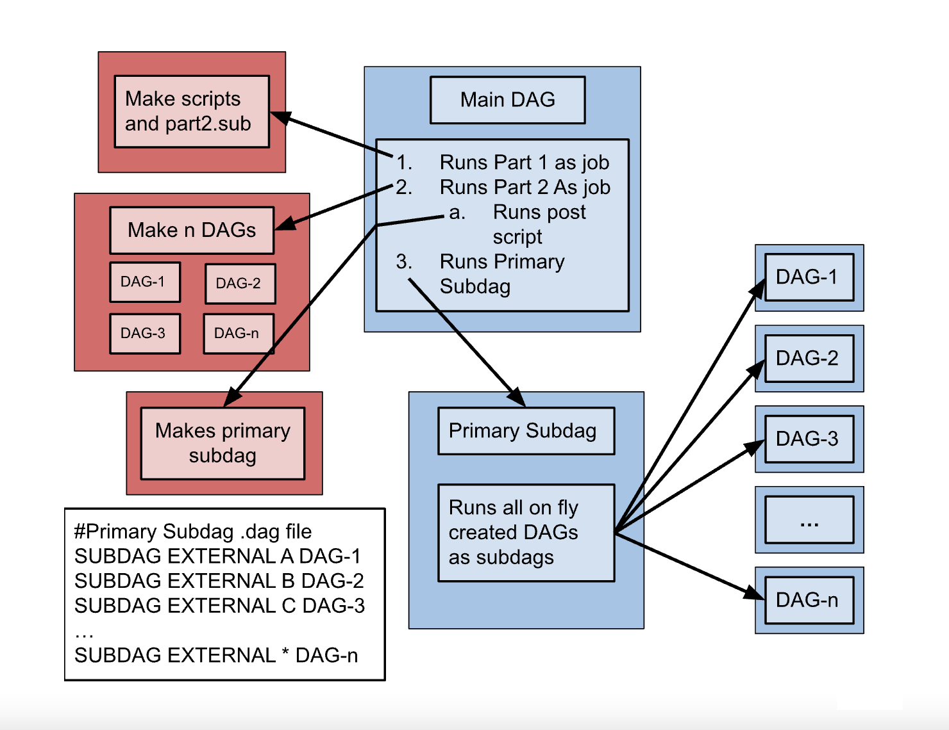
SUBDAG Example (DAG make DAG)
This is an example diagram to show a user how to set up a DAG that creates and unknown number of DAGs and subsequently runs them.

Slide 23
Miscellaneous Useful Features

Slide 24
Reuse One Submit Description with VARS
Using the VARS command in the DAG description file creates macros to be used by the job submit description.
Allows one job submit description to be used for many DAG nodes.
Can pass custom Job Ad attributes to Node jobs using My. syntax.
Also has special macros
$(JOB) becomes node name
$(RETRY) becomes current retry attempt
Use PREPEND/APPEND keyword to use VARS macros in submit description if/else conditionals
diamond.dag
same.sub
JOB A job1.sub
JOB B same.sub
JOB C same.sub
JOB D job4.sub
VARS B country=“USA”
VARS C country=“Canada”
PARENT A CHILD B C
PARENT B C CHILD D
executable = my_script.sh
arguments = $(country)
log = $(country)-$(cluster).log
error = $(country)-$(cluster).err
output = $(country)-$(cluster).out
queue
Link to DAGMan VARS Documentation
Notes:
Maybe talk about prepend and append option

Slide 25
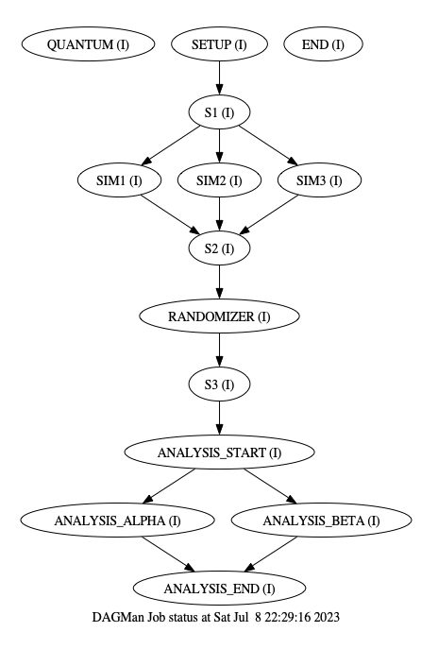
DOT File
DAGMan can produce a DOT file to easily help visualize a DAG utilizing the AT&T Research Labs graphviz package
sample.dag
…
DOT dag.dot
…
dot -Tps dag.dot -o dag.ps
Link to DAGMan Dot Files Documentation

Slide 26
Custom Config & Node Priorities
DAGMan has lots of configuration options that can be applied on a per DAG basis.
Only one config file can be added for a DAGMan process
Can help throttle various aspects of the DAG to reduce strain on the Schedd
Notable Config Options for Users:
DAGMAN_SUBMIT_DEPTH_FIRST
Has DAG prioritize submitting nodes depth first rather than default breadth first.
DAGMAN_NODE_RECORD_INFO=Retry
Automatically add the nodes retry attempt to the job ad.
DAGMAN_PUT_FAILED_JOBS_ON_HOLD
Resubmit a job in the hold state if all retries are used and job failed.
Link to DAGMan Custom Configuration Documentation
Link to DAGMan Configuration Options
One can specify the priority of a node in a DAG to prioritize that nodes start/submission. This way if multiple nodes become ready at the same time, then the nodes are run based on the node priorities set in the DAG.
Link to DAGMan Node Priotities Documentation
diamond.dag
JOB A job.sub
JOB B job.sub
JOB C job.sub
JOB D job.sub
PRIORITY B 100
CONFIG custom.conf
PARENT A CHILD B C
PARENT B C CHILD D

Slide 27
View Running DAG Information
Standard way to view a running DAG is with condor_q. Normally this will show a condense batch view of job process running under for this DAG.
The use of –nobatch -dag breaks out each individual job cluster into their own lines with the associated Node names.
$ condor_q 6
-- Schedd: COLES_AP@ : <127.0.0.1:49473?... @ 07/06/23 10:14:23
OWNER BATCH_NAME SUBMITTED DONE RUN IDLE TOTAL JOB_IDS
colebollig diamond.dag+6 7/6 10:14 _ _ 1 4 7.0
$ condor_q –nobatch -dag 6
-- Schedd: COLES_AP@ : <127.0.0.1:49473?... @ 07/06/23 10:14:25
ID OWNER SUBMITTED RUN_TIME ST PRI SIZE CMD
6.0 colebollig 7/6 09:18 0+00:00:11 R 0 0.5 condor_dagman ...
7.0 |-A 7/6 09:18 0+00:00:00 I 0 0.1 /bin/sleep 15
$ htcondor dag status 6
DAG is running since 0h1m14s
Of 4 total jobs:
2 are currently running
0 are idle
0 are held
1 completed successfully
Currently displays the following but may expand in the future. (Stay tuned for Todd’s talk of New Features Thursday Afternoon)

Slide 28
Questions?

