Slide 1
Whirlwind Tour of HTCondor Tools
Greg Thain
Center for High Throughput Computing
University of Wisconsin - Madison
Notes:
Tues 30 minutes

Slide 2
Rationale
In the past, we've started with a simple beginner's tutorial
The basics of job submissions, etc.
This is not that talk. That talk can be found on YouTube:
https://youtu.be/8jadQkAdU1k
This talk is a high-throughput talk trying to cover all the tools:

Slide 3
Every* HTCondor tool in 30 minutes
Greg Thain
Center for High Throughput Computing
University of Wisconsin - Madison

Slide 4
Commands for managing jobs
Condor_submit,condor_transfer_data, condor_submit_dag, condor_rm condor_suspend / Condor_continue,condor_hold / condor_release condor_q / condor_history, condor_qedit, condor_q -better
Commands for managing execution points
condor_off, condor_on, condor_restart, Condor_drain, condor_now, condor_vacate, condor_config_val-set,condor_reconfiig, condor_status,
Commands for working with running jobs
Condor_ssh_to_job, condor_tail, condor_evicted_files, condor_chirp, Condor_vacate_job
Commands for debugging and testing
Condor_version, Classad_eval, condor_who, condor_top, condor_fetchlog,condor_transform_jobs, condor_starter –classad, condor_gpu_discovery, condor_power_state
Command(s) for managing submitters
condor_userprio, condor_qusers
The new way (experimental)
htcondor tool

Slide 5
Commands for managing jobs

Slide 6
condor_submit
$ condor_submit submit
Submitting job(s).
1 job(s) submitted to cluster 62
Notes:
If you know only one htcondor command

Slide 7
condor_submit animation
executable = calculate
arguments = one two three
queue
…
condor_submit
Cmd = "calculate"
Qdate = 34056
Args = "one two three"
…
condor_schedd

Slide 8
condor_submit -dry-run classad_file
$ condor_submit –dry-run /dev/stdout submit
Dry-Run job(s)
ClusterId=1
In="/dev/null"
EnteredCurrentStatus=1664855180
Environment=""
PeriodicHold=false
…

Slide 9
condor_submit –i (interactive)
$ condor_submit –i
OR
$ condor_submit –i some_submit_file

Slide 10
condor_submit -batch-name experiment#
$ condor_submit –batch-name test-tube-7 submit
Submitting job(s).
1 job(s) submitted to cluster 62
$ condor_q
-- Schedd: gthain@chevre.cs.wisc.edu : <128.105.14.140?... @ 10/03/22 23:04:58
OWNER BATCH_NAME SUBMITTED DONE RUN IDLE TOTAL JOB_IDS
gthain test-tube-7 10/3 23:03 _ 1 _ 1 666.0
Notes:
If you know only one htcondor command

Slide 11
condor_submit -spool
$ condor_submit –spool submit…

Slide 12
condor_submit –remote sched_name
$ condor_submit –remote sched_name

Slide 13
condor_transfer_data
$ condor_transfer_data cluster.proc

Slide 14
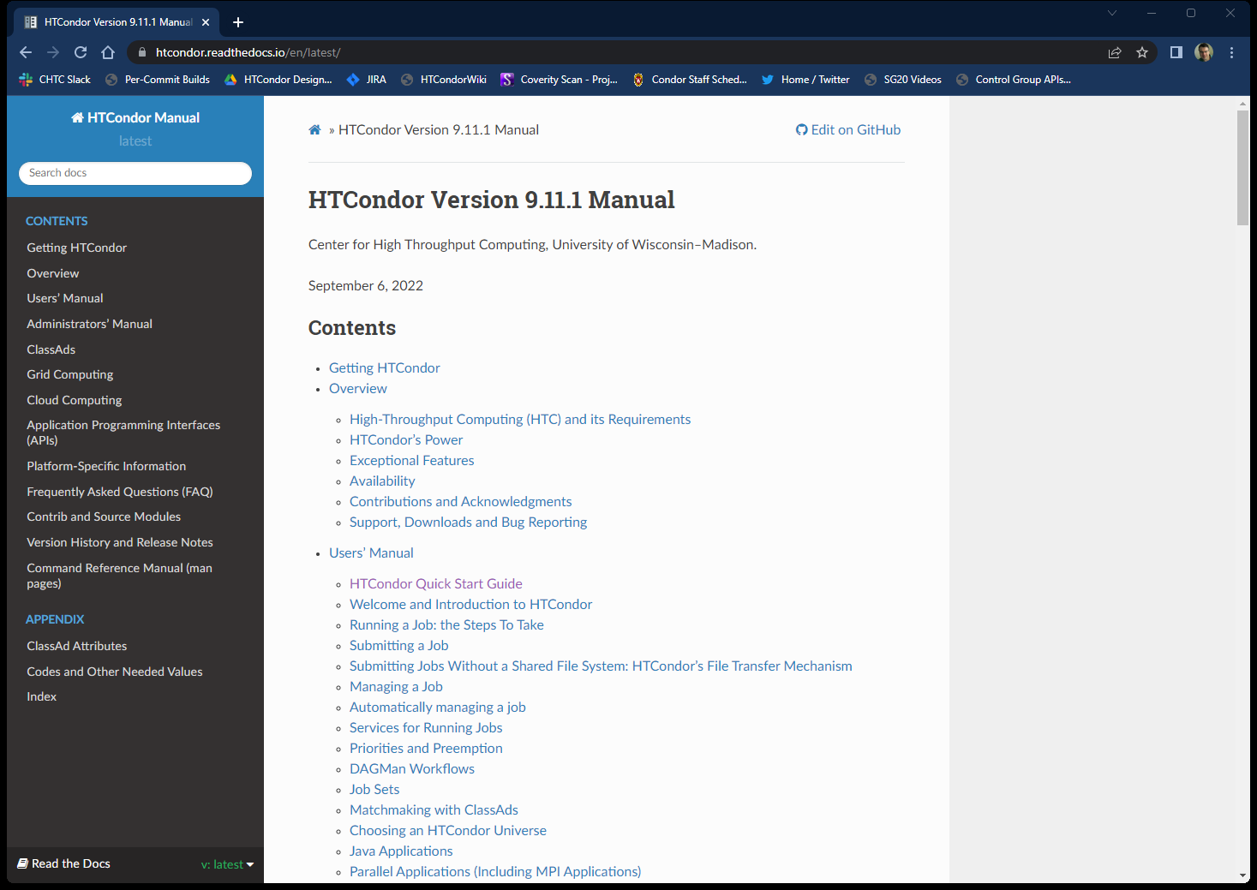
See condor_submit manual page for details

Slide 15
condor_submit one liners
$ condor_submit - <<EOF
Executable = /bin/sleep
Arguments = 3600
Request_memory = 1G
Request_Disk = 1000M
Queue
EOF

Slide 16
condor_submit one liners
$ condor_submit executable=/bin/sleep \
arguments=3600 –queue 1 - < /dev/null

Slide 17
Every* HTCondor tool in 30 minutes
(each)

Slide 18
condor_submit_dag
$ condor_submit_dag dag_file
Doesn't have options as condor_submit
Only option of interest is "-force"
See:
https://youtu.be/OuIBf6x24r0

Slide 19
If only one command, condor_submit
But if you know two, the second should be …

Slide 20
condor_rm
$ condor_rm cluster.proc
$ condor_rm cluster
$ condor_rm username
$ condor_rm -all

Slide 21
condor_rm -const
$ condor_rm –const 'some classad expr'
$ condor_q –const 'some classad expr'

Slide 22
condor_rm –reason "Reason String"
$ condor_rm –reason 'Call Greg – this exploded'

Slide 23
All of the "act on jobs" commands have these same options
$ some_condor_command cluster.proc
$ some_condor_command cluster
$ some_condor_command username
$ some_condor_command -all

Slide 24
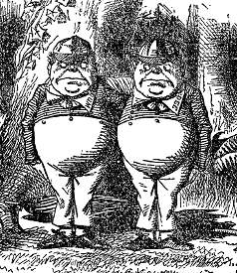
The rest of the "act on jobs" commands…
Three sets of twins
And an extra…

Slide 25
condor_suspend / condor_resume
$ condor_suspend cluster.proc (or username or …)
$ condor_resume cluster.proc (or username or …)

Slide 26
condor_hold / condor_release
$ condor_hold cluster.proc (or username or …)
$ condor_release cluster.proc (or username or …)
$ condor_hold –reason 'CALL GREG NOW'

Slide 27
condor_q / condor_history
$ condor_q cluster.proc (or username or …)
$ condor_history cluster.proc (or username or …)

Slide 28
condor_q -better
$ condor_q –better 673.0
The Requirements expression for job 673.000 is TARGET.Memory >= RequestMemory) && (TARGET.HasFileTransfer)
Job 673.000 defines the following attributes: RequestDisk = 1048 RequestMemory = 10485760 slot1@chevre.cs.wisc.edu has the following attributes: TARGET.Disk = 122394753536 TARGET.Memory = 2048 "The Requirements expression reduces to these conditions: Step Matched Condition ----- -------- --------- [0] 1 TARGET.Arch == "X86_64" [1] 1 TARGET.OpSys == "LINUX" [3] 1 TARGET.Disk >= RequestDisk [5] 0 TARGET.Memory >= RequestMemory

Slide 29
condor_q querying other schedds
$ condor_q –name other_schedd
$ condor_q –name other_schedd –pool remote_cm
$ condor_q –jobad file_with_ad

Slide 30
condor_q -better
$ condor_q –better –jobads job –slotads sl 673.0
Analyzes the job in the file "job"
Against the slot in file sl
Useful for "why job doesn't match this slot?

Slide 31
And a better condor_q for loops…
$ condor_watch_q
Instead of watch condor_q

Slide 32
condor_qedit
$ condor_qedit 10 'AttributeName = "StringValue" '
$ condor_qedit 10 'AttributeName = True'
$ condor_qedit 10 'AttributeName = 100.3'
$ condor_qedit 10 'AttributeName = someExpr > 100'
Quoting is Tricky! Both
classad AND
shell quoting in play!

Slide 33
condor_qedit –edits some_file
$ condor_qedit 10 –edits some_file some_file: StringAttribute = "StringValue"
NumericAttribute = 10.0
ExprAttribute = foo > 100
This avoids shell quoting headaches
But classad quoting still applies – be careful

Slide 34
What's the problem with condor_history?
Don't worry, I'll wait
And wait…
And wait…

Slide 35
Why is condor_history slow?
There's rather a lot of information about each job
And there's a huge number of jobs

Slide 36
Solving problem #2 first…
Add -match 1, if you know there's only one job, i.e.
$ condor_history match 1 –const "some constraint"

Slide 37
Going the right direction helps…
If you suspect the job is in the older half of the history..
$ condor_history –forwards –match 1 –const …
If you suspect the job is in the newer half of the history..
$ condor_history –backwards –match 1 –const …

Slide 38
Fastest to solve both problems!
$ condor_history –userlog logfile …
You do have a userlog (job log), don't you
Only a handful of attributes are in the logfile
(which is why it is so fast….)

Slide 39
Or read from a more constrained source…
Works with job eventlog dagman nodes.log or global event..
$ condor_userlog filename

Slide 40
But the real solution to slow history is…
Use a real database!

Slide 41
condor_adstash
$ condor_adstash –standalone –se_host host:port
Tool / daemon
Loops, copying job data from schedd logs into elastic search
Only historical jobs (can be from startd also)
Super useful for debugging, performance, etc.

Slide 42
Commands that only work on
already running* jobs
*Not all universes supported

Slide 43
condor_ssh_to_job
$ condor_ssh_to_job 673.0
Welcome to slot1@chevre.cs.wisc.edu
$
Doesn't work in all environment
Basis of condor_submit -i

Slide 44
condor_ssh_to_job -X
$ condor_ssh_to_job –X 673.0
Enables forwarding of X protocol
(if ssh'ing to AP, also add –X there)

Slide 45
condor_ssh_to_job –ssh <ssh program> here

Slide 46
Scp to job
$ condor_ssh_to_job –ssh scp 673.0 remote:from_ep to_ap
"remote:" placeholder for real machine name
Other way works too
$ condor_ssh_to_job –ssh scp 673.0 from_ap remote:to_ap

Slide 47
Rsync to job over condor_ssh_to_job
$ rsync –v –e "condor_ssh_to_job" 673.0:output .
"673:" jobid place holder for real machine

Slide 48
condor_tail
$ condor_tail 673.0
Copies last 1024 (or –maxbytes xx) from stdout
Or -stderr
Or optional filename
$ condor_tail –follow 673.0 some_interesting_file

Slide 49
condor_evicted_files
$ condor_evicted_files list 673.0
$ condor_evicted_files get 673.0 my_output_file
Allows inspection and fetching of files
From spool directories of evicted jobs.
Also works with checkpoint files

Slide 50
condor_vacate_job
$ condor_vacate_job 673.0
Helpful if you don't want to hold the job
But want it to start somewhere else
If worker node is slow or seems broken or…

Slide 51
condor_chirp
Chirp is the only command that MUST RUN IN THE JOB
On the EP!
Also have python bindings
Chirp commands run from the EP to the AP
Many subcommands of chirp, but the big ones are…

Slide 52
Get attribute from AP's copy of job ad
$ condor_chirp get_job_attr SomeAttribute
Prints to stdout the value of "SomeAttribute"
The job id is always the running job

Slide 53
Set attribute from AP's copy of job ad
$ condor_chirp set_job_attr JobAttr '"some_value"'
Sets the value of "JobAttr"
The job id is always the running job
CAREFUL WITH QUOTING! (as condor_qedit)

Slide 54
Append to job log
$ condor_chirp ulog 'Some message'
Appends 'some message' to the job log
Super useful for debugging, timing,
job progress

Slide 55
condor_wait
$ condor_wait job_log_file
Block until job in job log file exits

Slide 56
Commands for EPs and other
HTCondor services

Slide 57
condor_off
$ condor_off –startd
$ condor_off –negotiator
$ condor_off -schedd
Turns off named condor daemon
$ condor_off
Turns off every daemon, except master…
$ condor_off -master

Slide 58
condor_on
$ condor_on –startd
$ condor_on –negotiator
$ condor_on -schedd
Turns on named condor daemon
$ condor_on
Turns on every daemon, except master…

Slide 59
condor_restart
$ condor_restart –startd
$ condor_restart –negotiator
$ condor_restart -schedd
Restarts named condor daemon
$ condor_restart
Restarts every daemon, except master…
$ condor_restart -master

Slide 60
draining
$ condor_drain machine_or_slot

Slide 61
Cancelling draining
$ condor_drain –cancel machine_or_slot

Slide 62
Immediately running high priority job
$ condor_now idle_job_id running_job_id
Swaps out the running job for an idle job
must be from same submitter

Slide 63
Evict running job
$ condor_vacate machine_or_slot
Much like condor_vacate_job
Machine owner permission Can be just one slow Job goes to "I"dle

Slide 64
Knob management
$ condor_config_val -summary
Emits diff from defaults of all knobs (from disk)
# from /nobackup/gthain/personal-condor/condor_config.local
#
RunBenchmarks = true
STARTD_DEBUG = D_FULLDEBUG D_COMMAND D_JOB D_MACHINE
STARTER_DEBUG = D_FULLDEBUG D_COMMAND
SHARED_PORT_DEBUG = D_FULLDEBUG D_NETWORK
MEMORY = 819200

Slide 65
Knob management
$ condor_config_val –verbose SOME_KNOB
Emits current values of one knob
AND the file & line number where it is

Slide 66
Knob management
$ condor_reconfig
Tells HTCondor services to re-read config file

Slide 67
Collector querying
$ condor_status

Slide 68
Please don't run this…
$ condor_status –l | grep some_attribute
It works – usually
Did you get the regxep right?
Are you sure?
Is it anchored?
Did you remember case-insensitive attrs?
Can be slow

Slide 69
Rather, run this:
$ condor_status –af some_attribute
Evalutes by default (against itself, no match)
$ condor_status -af WithinResourceLimits
undefined
$ condor_status -af:l WithinResourceLimits
WithinResourceLimits = undefined
$ condor_status -af:r WithinResourceLimits
(MY.Cpus > 0 && TARGET.RequestCpus <= MY.Cpus &&…

Slide 70
Usually naked –af is good enough for literals
$ condor_status –af Name
slot1@chevre
$ condor_status –af:r Name
"slot1@chevre"
$ condor_status -af:lr Name
Name = "slot1@chevre"

Slide 71
condor_status – not just for slot ads
$ condor_status –submitters
$ condor_status –schedd
$ condor_status –master
$ condor_status -negotiator

Slide 72
Commands for debugging and testing
HTCondor services

Slide 73
Version
$ condor_version
$CondorVersion: 10.1.0 2022-09-30 BuildID: UW_development PRE-RELEASE-UWCS $
$CondorPlatform: X86_64-Ubuntu_18.04 $

Slide 74
ClassAd Debugging
$ classad_eval '[a = "b"; c = "d"]' 'a'
[ c = "d"; a = "b" ]
"b"
$ classad_eval '' 'regexp("abc", ".")'
[ ]
false
$ classad_eval '' 'regexp(".", "abc")'
[ ]
true

Slide 75
What's running on my EP?
$ condor_who
OWNER CLIENT SLOT JOB RUNTIME PID PROGRAM
alnammi@chtc.wisc.edu submit-1.chtc.wisc.edu 1_10 16662962.0 1+16:54:18 52132 /var/lib/condor/execute/slot1/dir_
alnammi@chtc.wisc.edu submit-1.chtc.wisc.edu 1_11 16662963.0 1+16:54:18 52173 /var/lib/condor/execute/slot1/dir_
alnammi@chtc.wisc.edu submit-1.chtc.wisc.edu 1_12 16662952.0 1+17:59:21 9960 /var/lib/condor/execute/slot1/dir_
alnammi@chtc.wisc.edu submit-1.chtc.wisc.edu 1_13 16662989.0 1+09:27:06 41850 /var/lib/condor/execute/slot1/dir_

Slide 76
Why is HTCondor slow
$ condor_top
DC status from 2022-10-04 16:33:56 to 2022-10-04 16:37:56:
Duty Cycle: -0.51% Ops/second: 0.017
Runtime stats from 2022-10-04 16:33:56 to 2022-10-04 16:37:56:
InstRt InstAvg TotAvg TotMax RtPctAvg InstRate AvgRate Item
1.3901 0.02958 0.0244 4.170 121.1784 0.195833 n/a Timer_poll_resources
1.3748 0.02864 n/a n/a n/a 0.200000 n/a ResMgrCompute
1.3309 0.00552 n/a n/a n/a 1.004167 n/a ResMgrWalkOther
0.1754 n/a n/a n/a n/a 0.000000 n/a RecentResMgrWalkOther
0.1744 n/a n/a n/a n/a 0.000000 n/a RecentResMgrCompute
0.1509 0.15093 0.1018 0.151 148.2647 0.004167 n/a Command_QUERY_STARTD_ADS
0.0410 0.00087 n/a n/a n/a 0.195833 n/a ResMgrWalkEvalState
0.0012 n/a n/a n/a n/a -0.004167 n/a RecentResMgrWalkEvalState
0.0006 0.00014 0.0002 0.083 92.9072 0.016667 n/a Timer_dc_touch_log_file

Slide 77
Remote fetching of HTCondor debug log
$ condor_fetchlog machineName startd
$ condor_fetchlog chevre STARTER.slot1_3
10/08/22 18:13:17 Now in new log file /nobackup/gthain/personal-condor/log/StartLog
10/08/22 18:13:17 Publishing ClassAd 'mips' to slot1 [InSlotList matches]
10/08/22 18:13:17 Publishing ClassAd 'kflops' to slot1 [InSlotList matches]
10/08/22 18:13:17 Publishing ClassAd 'mips' to slot1 [InSlotList matches]
10/08/22 18:13:17 Trying to update collector <128.105.14.141:4210>
10/08/22 18:13:17 Attempting to send update via TCP to collector chevre.cs.wisc.edu <128.105.14.141:4210>
10/08/22 18:13:17 slot1: Sent update to 1 collector(s)
10/08/22 18:13:37 Swap space: 24358084

Slide 78
Debugging schedd job transforms
$ condor_transform_ads -rules my_rules -in my_input
# Output:
DiskUsage = 2500000
Err = "/dev/null"
MemoryUsage = 5
NumCheckPoints = 0
RequestDisk = ( 5000000 / 1024 )
ResidentSetSize = 500

Slide 79
Wait, What's a Schedd job Transform?
https://research.cs.wisc.edu/htcondor/HTCondorWeek2017/presentations/TueKnoeller_Schedd.pdf
https://htcondor.readthedocs.io/en/latest/classads/transforms.html#classad-transforms

Slide 80
And, three commands to query machine

Slide 81
EP attributes
$ condor_starter –classad
CondorVersion = "$CondorVersion: 9.12.0 2022-09-13 BuildID: 605774 PackageID: 9.12.0-0.605774 RC $"
IsDaemonCore = True
HasFileTransfer = True
HasJobTransferPlugins = True
HasPerFileEncryption = True
HasReconnect = True
HasMPI = True
HasTDP = True
HasJobDeferral = True
..

Slide 82
GPU attributes
$ condor_gpu_discovery -extra
DetectedGPUs="GPU-9f77c691, GPU-b274f0bc, GPU-a7cbba7c, GPU-5595a8ea"
Common=[ Capability=6.1; ClockMhz=1582.00; ComputeUnits=28; CoresPerCU=128; DeviceName="NVIDIA GeForce GTX 1080 Ti"; DriverVersion=11.60; ECCEnabled=false; GlobalMemoryMb=11179; MaxSupportedVersion=11060; ]
GPU_5595a8ea=[ id="GPU-5595a8ea"; DevicePciBusId="0000:AF:00.0"; DeviceUuid="5595a8ea-4ecc-c632-9693-9fc819629157"; ]
GPU_9f77c691=[ id="GPU-9f77c691"; DevicePciBusId="0000:3B:00.0"; DeviceUuid="9f77c691-7ad2-bec7-e18c-e4c11c51ed24"; ]
GPU_a7cbba7c=[ id="GPU-a7cbba7c"; DevicePciBusId="0000:86:00.0"; DeviceUuid="a7cbba7c-5eaf-d432-1b4d-48c15f26b785"; ]
GPU_b274f0bc=[ id="GPU-b274f0bc"; DevicePciBusId="0000:5E:00.0"; DeviceUuid="b274f0bc-3168-a817-3807-596b8190514d"; ]

Slide 83
Power Saving detection
$ condor_power_state ad
HibernationMethod = "pm-utils"
HibernationRawMask = 8
HibernationSupportedStates = "S4"

Slide 84
Commands for submitters

Slide 85
condor_userprio
$ condor_userprio –all
Last Priority Update: 10/4 16:47
Name Priority Priority Factor In Use (wghted-hrs) Start Time Usage Time Ceiling
-------------------------------------------------------- ------------ -------- ----- ----
by 500.00 0.50 1000.00 0 48.67 9/27/2022 13:08 10/04/2022 09:06
jv 500.00 0.50 1000.00 0 0.95 5/28/2020 16:22 10/04/2022 00:49
dt 511.45 0.51 1000.00 1 2.39 10/04/2022 14:26 10/04/2022 16:47
ck 513.60 0.51 1000.00 1 75.35 2/26/2020 11:39 10/04/2022 16:47 20

Slide 86
Whole talk about prios, userprio, etc.
https://youtu.be/aPUztmJ0n2s

Slide 87
condor_userprio –setceil
$ condor_userprio –setceil user ceiling
Imposes a per-pool upper bound on
Cores a given submitter can get

Slide 88
condor_userprio –setfloor
$ condor_userprio –setfloor user ceiling
Imposes a per-pool lower bound on
Cores a given submitter can get

Slide 89
condor_qusers
$ condor_quser –disable tannenba
Bans a user from submitting jobs
Shows usage without options
Also has a -enable

Slide 90
The one new command…

Slide 91
htcondor <noun> <verb>
A fresh start
Written in python
Influenced by git, k8s, etc.
Extensible!
E.g. "htcondor job status"
We're looking for feedback – how can we improve tools?

Slide 92
Thank you and questions
Thank you – Questions?
This work is supported by the NSF under Cooperative Agreement OAC-2030508. Any options, findings,
conclusions or recommendations expressed in this material are those of the authors and do not
necessarily reflect the views of the NSF.

