Slide 1
Black Holes, High Throughput Computing, and User Experience Design - Creating a Science Gateway for the Event Horizon Telescope
Rob Quick
July 11, 2023
High Throughput Week
University of Wisconsin - Madison
Notes:
Hello, it’s good to be back at an in person OSG AHM. 10 years ago 2013 I hosted an OSG AHM at IU (it was a wonderful experience and i’m so happy i’m not doing it again).

Slide 2
The Science and Discovery we will Enable
How the EHT Gateway Project Came Together
User Experience Focus
Project Structure and Goals
The Event Horizon and Beyond

Slide 3
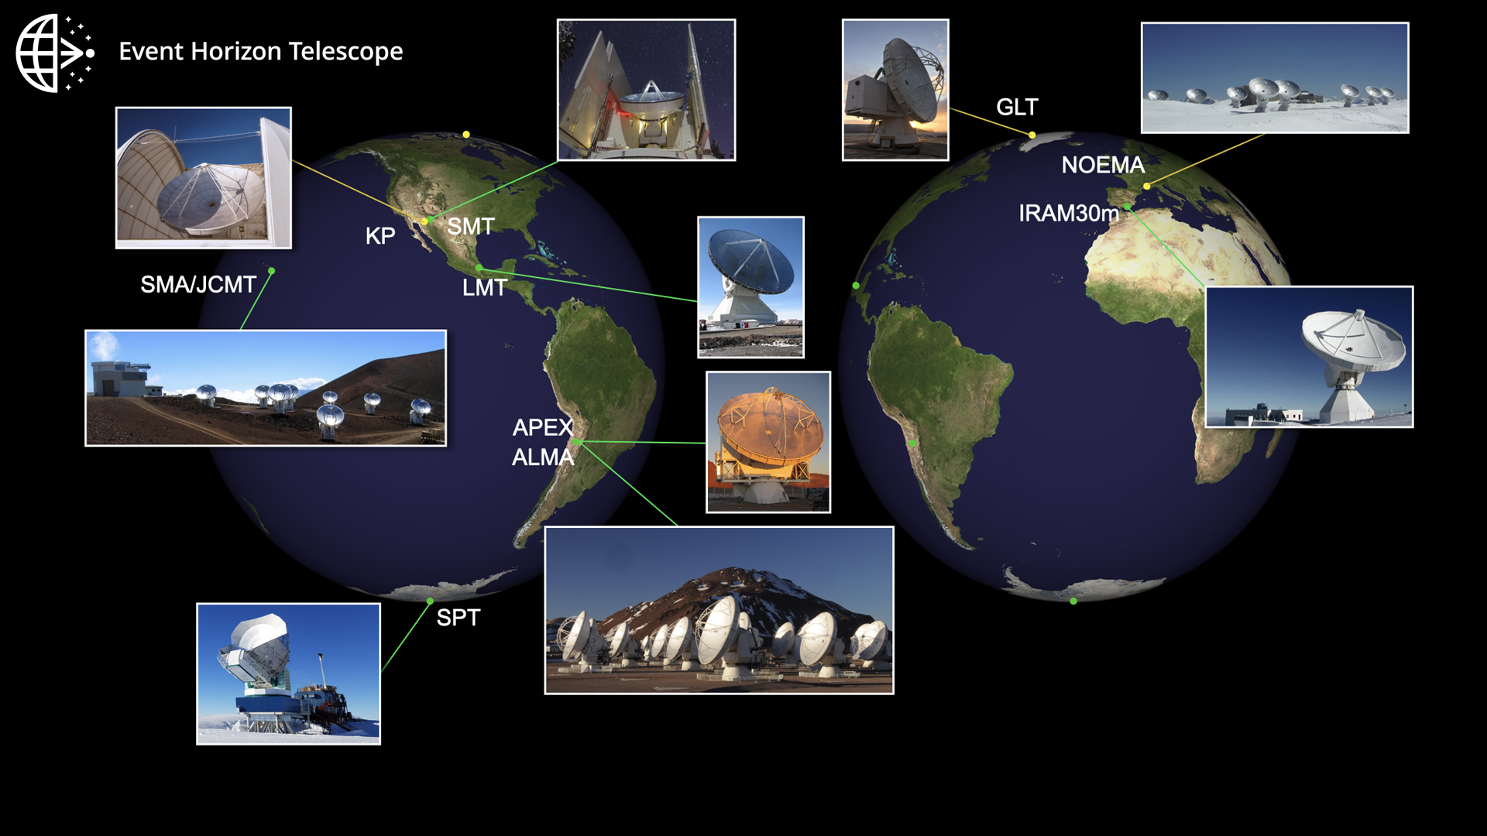
Notes:
The EHT is an international collaboration aimed to capture the first horizon scale images of black holes
It combines multiple radio telescopes all around the world to create a very high resolution interferometry array
It is the highest resolution instrument we have made to date

Slide 4
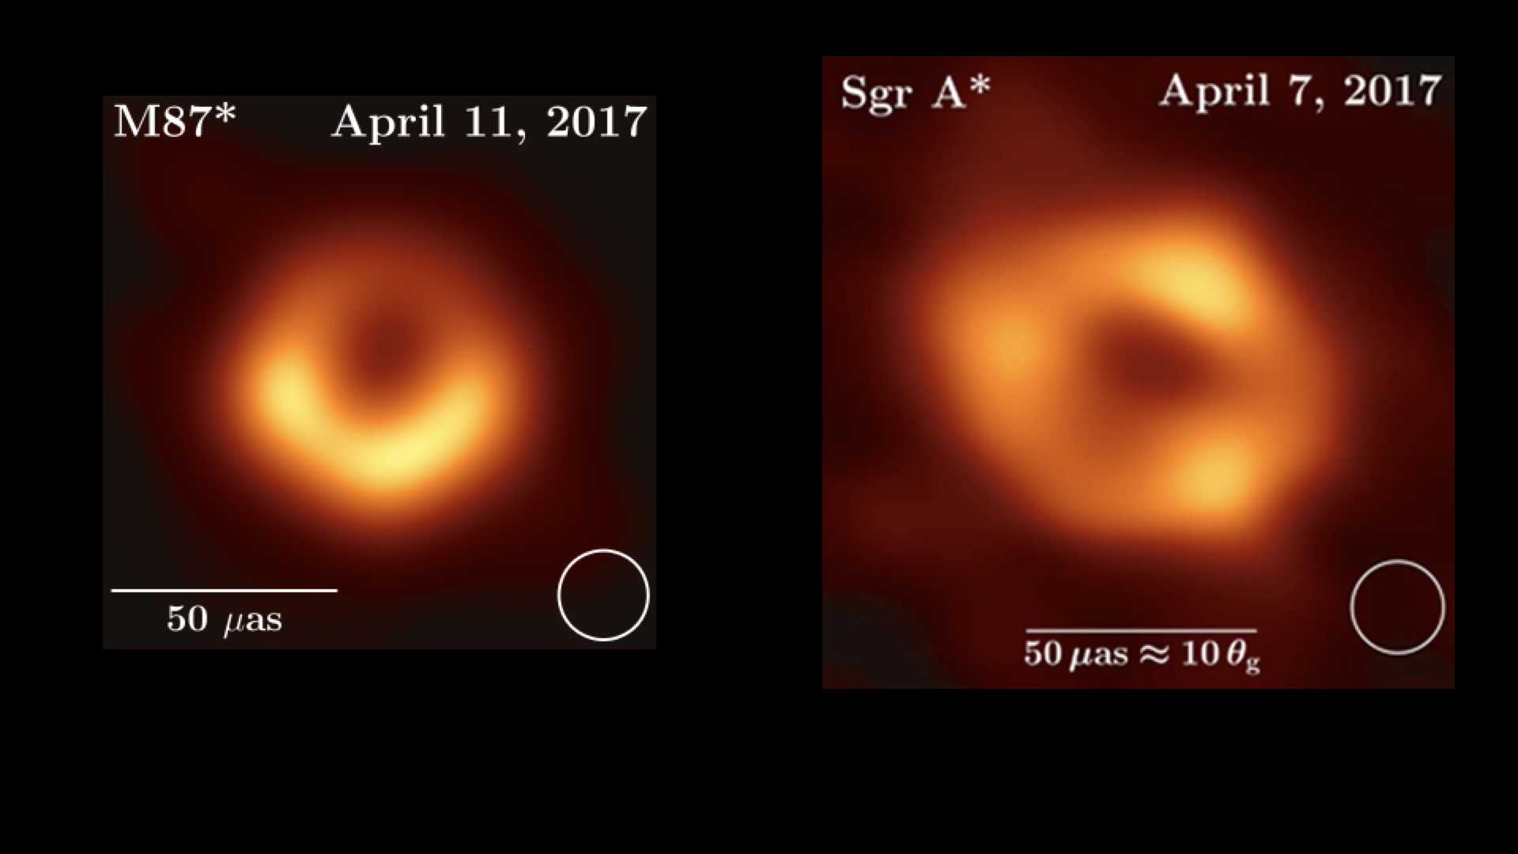
Notes:
By using 8 telescopes, in 2017, the EHT resolved the supermassive black holes at the center of the M87 and Milky Way Galaxies
While the observations are remarkable, in order to understand the plasma physics around black hole and test Einstein’s general theory of relativity, we need to compare these observations with numerical simulations
However, the parameter space of possible plasma configuration around black hole is very large. It is impractical to survey this parameter space with institutional computing resource
Even supercomputing centers are not ideal for our use case because we have so many files! (Millions of images)

Slide 5
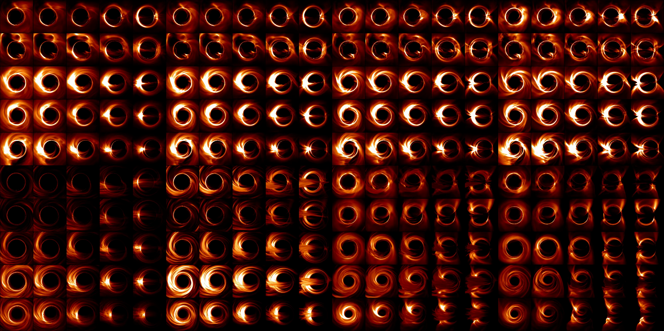
Notes:
Using the OSG, the EHT has created the large black hole image simulation library to date (over one million images)
Images in this large library have been compared with observations
By doing so, we learn about the plasma temperature around the black holes, the magnetic field configurations, etc
We also demonstrated that Einstein’s general theory of relativity is still correct in extreme gravity
However, very few people in the EHT are able to utilize the OSG, which slows down their scientific progress
This science gateway project will address this problem

Slide 6
How we got here…
Presented work with University of Nebraska (RNAMake) at OSG AHM 2022
Was contacted soon afterward by NSF
Identified EHT as a target
Worked with EHT team to create a demonstration project
Non-functional version can be seen at (https://eht.scigap.org/)
Not functional due transitioning OSG Access Point
Presented the demo at EHT Webinar and Science Gateways 2022
After several interactions we agreed to submit a one year EAGER project (EArly-concept Grants for Exploratory Research)
Submitted March - Award Notification May
Project start July 1

Slide 7
Notes:
Three important pieces that need to be integrated.
EHT Applications
Ipole (images from EHT with numerical simulations to create a library of simulation data)
Symba (To account for the noise of the instruments for accurate model comparison and theoretical interpretations, EHT needs to perform synthetic data
generation by simulating the full observation process.)
EHT-imaging (EHT image reconstruction is mathematically ill-posed there are many possible solutions. To reduce uncertainty, EHT uses large parameter surveys to check consistency.
Apache airavata (Science Gateway Framework)
Web interface that abstracts many CI aspects from the user
Workflow orchestration
Data management
User and group management (data and results sharing or privacy)
OSPool Access Point
HTCondor Queue to OSG resources

Slide 8
What we will do…
The goal of this exploratory work is to demonstrate the effectiveness of combining human-computer interaction design methodologies with science gateway technologies to better enable the EHT’s analysis of large astronomical data sets.
Objectives:
Provide the EHT project with a highly functional, UX-centric gateway that allows application integration for three existing workflows that leverage OSPool resources.
Address the technical hurdles to allow the full utilization of HTC resources from a science gateway environment within the Apache Airavata framework.
Provide strategically targeted outreach to astronomy researchers and the CI community to amplify the work done during the project.

Slide 9
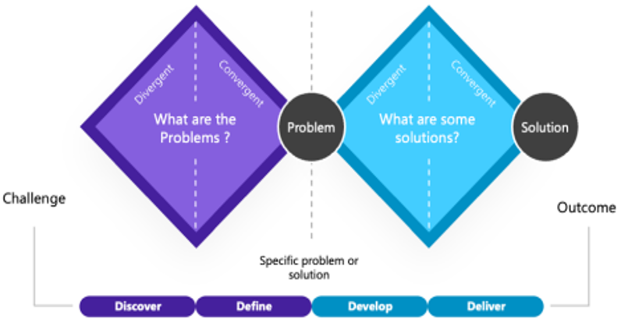
User Experience (UX) Focus
A UX-centric approach is leveraged within the Double Diamond design process to ensure user-centered solutions that address the challenges in the problem space while promoting iterative exploration, ideation, evaluation, and refinement.
Notes:
Presenter Note: To tackle this issue, we have adopted a user-experience (UX)-centric approach, implementing the Double Diamond design process. By doing so, we ensure that our solutions revolve around the needs and preferences of the users, effectively addressing the challenges they face. This approach also encourages continuous exploration, idea generation, evaluation, and refinement to create optimal outcomes.

Slide 10
Specifically….
The Double Diamond Design Process emphasizes the iterative nature of divergent and convergent thinking throughout both the problem-solving and solution phases.
Problem-Solving Phase:
Apply divergent and convergent thinking to address questions about current workflows and pain points of three identified EHT applications on the OSG platform.
Solution Phase:
Generate and refine design solutions based on insights gained during the problem-solving phase.
Notes:
Presenter Note: To be more specific, the double diamond design process is deeply rooted in the iterative nature of both divergent and convergent thinking, which plays a crucial role in both problem-solving and solution phases.
During the problem-solving phase, we employ divergent and convergent thinking techniques to delve into the current workflows and pain points associated with three specific applications within the EHT that rely on the OSG platform.
Moving on to the solution phase, we leverage the insights gained from the problem-solving phase to generate and refine design solutions. This involves incorporating user feedback, exploring various design possibilities, and iterating on potential solutions.
By embracing this iterative approach, we strive to develop effective and user-centered solutions that bridge the gap between the EHT community and the OSG resources.

Slide 11
Cognitive Task Analysis & User Interviews
Systematic understanding of how EHT users complete tasks to achieve their goals.
Observe and interview users & experts
Analyze tasks for details (quantity, sequence, hierarchy, complexity)
Identify patterns, dependencies, and areas of improvement in EHT workflows.
Utilize the user interviews as we bring the design solutions to life
Notes:
Presenter Note: Two methods we employ to unpack the double diamond design process are cognitive task analysis and user interviews. These methods provide a systematic understanding of how EHT users navigate tasks to achieve their goals.
Through observation and interviews with users and subject-matter experts, we’ll extract valuable insights into their goals, tasks, challenges, and motivations that influence their usage of OSG resources.
We’ll then analyze these tasks to reveal critical details like quantity, sequence, hierarchy, and complexity. This helps identify patterns, dependencies, and potential areas of improvement within the identified three EHT workflows.
During the prototyping phase, we’ll continue utilizing user interviews as we bring the design solutions to life. Seeking feedback from users, we will refine and iterate on the design of the gateway, ensuring alignment with the needs and preferences of EHT users.

Slide 12
What does that mean…
We will integrate three identified EHT tools within the Apache Airavata environment to lower the barrier for black hole researchers
Provide a roadmap for HTC usage for future gateways
Introduce these concepts in the astronomy community and beyond

Slide 13
Our timeline of deliverables…
July 2023 - Begin Design Phase - Throughput Computing 2023
September 2023 - Completion of Initial Design Phase—UX Cognitive Task Analysis and User Requirements Report (ipole, SYMBA)
October 2023 - Science Gateways Conference
December 2023 - Begin Implementation Phase—Initial Release of Gateway (ipole, SYMBA)
December 2023 - Tutorial at EHT Virtual Winter Collaboration Meeting
March 2024 - Completion of Design Phase—ehtim User Requirements Report and UX Review of Initial Release - Usability Report
April 2024 - Webinar for EHT’s software and data compatibility working group
June 2024 - Complete Implementation Phase—Final Gateway Release (ehtim)
June 2024 - Tutorial in EHT In-Person Summer Collaboration Meeting
July 2024 - PEARC Conference

Slide 14
What’s Next
The UX Design will reveal usability issues with the EHT Software, Airavata, and the OSPool
Are there other EHT adjacent projects that can benefit from the EHT gateway environment
What other existing projects could benefit from Science Gateway access to the OSPool
Can the OSPool be as accessible as other ACCESS resources from Science Gateways
Create many ‘skins’ for OSG APs
Notes:
Skins for APs?

Slide 16
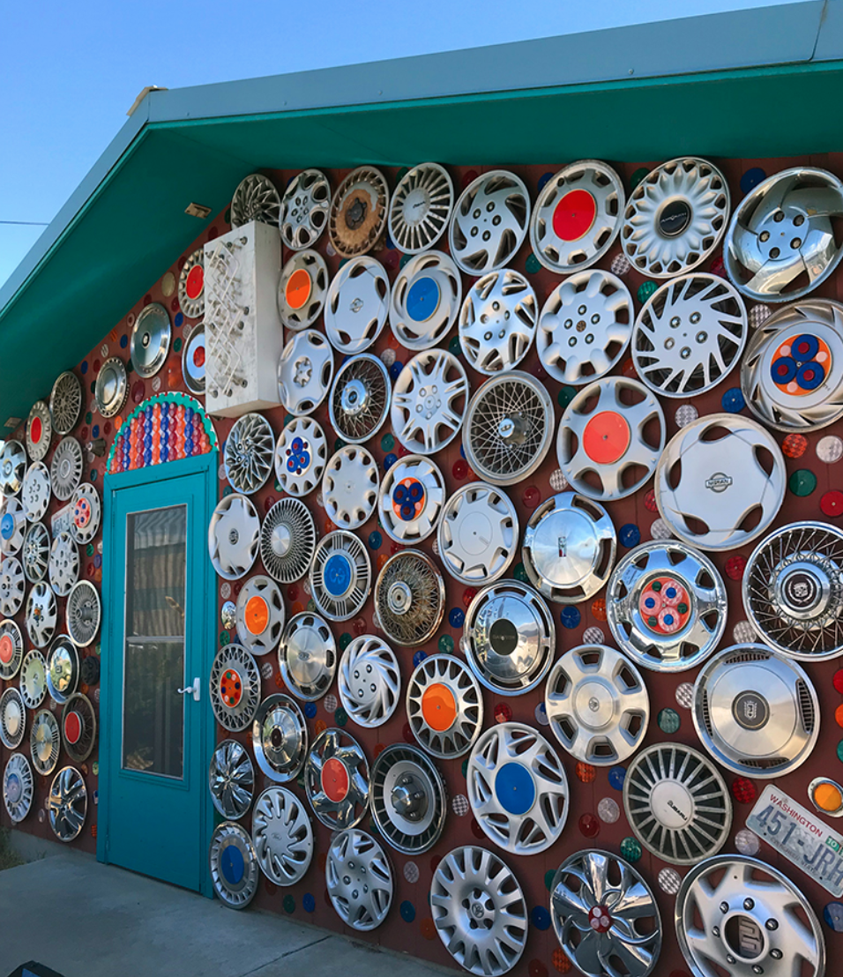

Slide 17
Who we are…
Rob Quick - PI
Chi-kwan Chan - Co-PI and Domain Expert
Isuru Ranawaka - Developer
Esen Gokpinar-Shelton - UX Designer
Eroma Abeysinghe - Project Management and Operational Advising
Post-doc at University of Arizona
Suresh Marru - Science Gateway Advice and Support
NSF Award 2324672

