Slide 1
Overview of the OSG 3.7 Release Series Plans
Brian Lin, OSG Software Area Coordinator
Center for High Throughput Computing
University of Wisconsin–Madison

Slide 2
Release Series Policy
We aim to provide a well-tested, integrated software stack for sites to contribute resources to the OSG
OSG Software Stack is distributed in “release series”
Major changes are made between release series
New series triggers the end-of-life of the previous series:
Previous release series receives 6 months of full support
Followed by 6 months of critical/security bug fix support
Historically each release series is supported for ~2.5 years

Slide 3
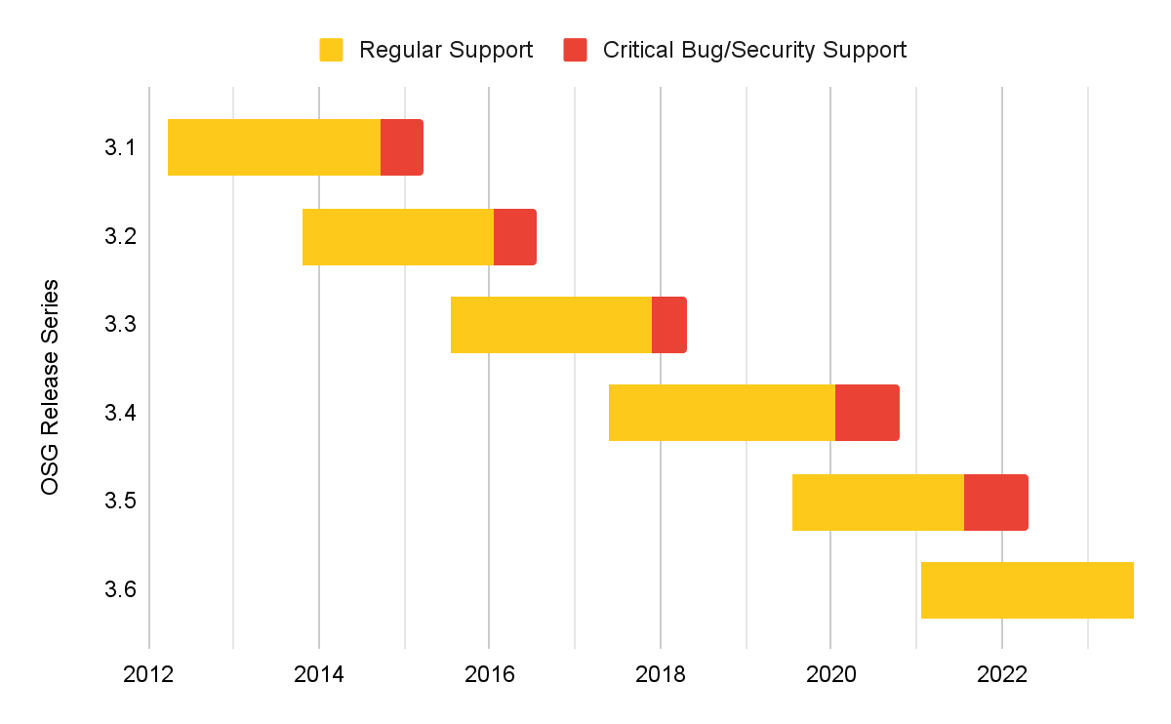
History of OSG Release Series

Slide 4
Release vs Upcoming
Release repository contains the bulk of the software stack
Upcoming repository contains software that may require manual changes upon upgrade
Automated integration tests
Production integration tests
osg-development
osg-testing
osg-release
osg-upcoming-development
osg-upcoming-testing
osg-upcoming-release

Slide 5
Where we are today
OSG 3.6 is the currently supported release series
Updates to OSG 3.6 are released in a rolling fashion
Software is available for Enterprise Linux 7, 8, and 9
Major packages
HTCondor 10.0 in release, 10.x in upcoming
HTCondor-CE 6
XRootD 5.5

Slide 6
OSG 3.7 plans
Release repository renamed to “main”
Expected major packages for the initial release
HTCSS 11.0.0 in main; HTCSS 11.1.0 in upcoming
XRootD 5.6 in main
Improved package signing security with hardware keys
OSG release series support timelines will align with HTCSS releases

Slide 7
Overview of the OSG 11 Release Series Plans
Brian Lin, OSG Software Area Coordinator
Center for High Throughput Computing
University of Wisconsin–Madison

Slide 8
Third time’s a charm…

Slide 9
Overview of the HTCSS and OSG 23 Release Plans
Brian Lin, OSG Software Area Coordinator
Center for High Throughput Computing
University of Wisconsin–Madison

Slide 10
HTCSS and OSG Software Stack
New OSG release series will be released with each major HTCSS version
HTCSS LTS versions (e.g., 23.0.x) → main
HTCSS Feature versions (e.g., 23.y.z) → upcoming
Major version numbers corresponding to the year will match between OSG and HTCSS
Annual releases, targeting Q3 each year
Two releases supported at any given time

Slide 11
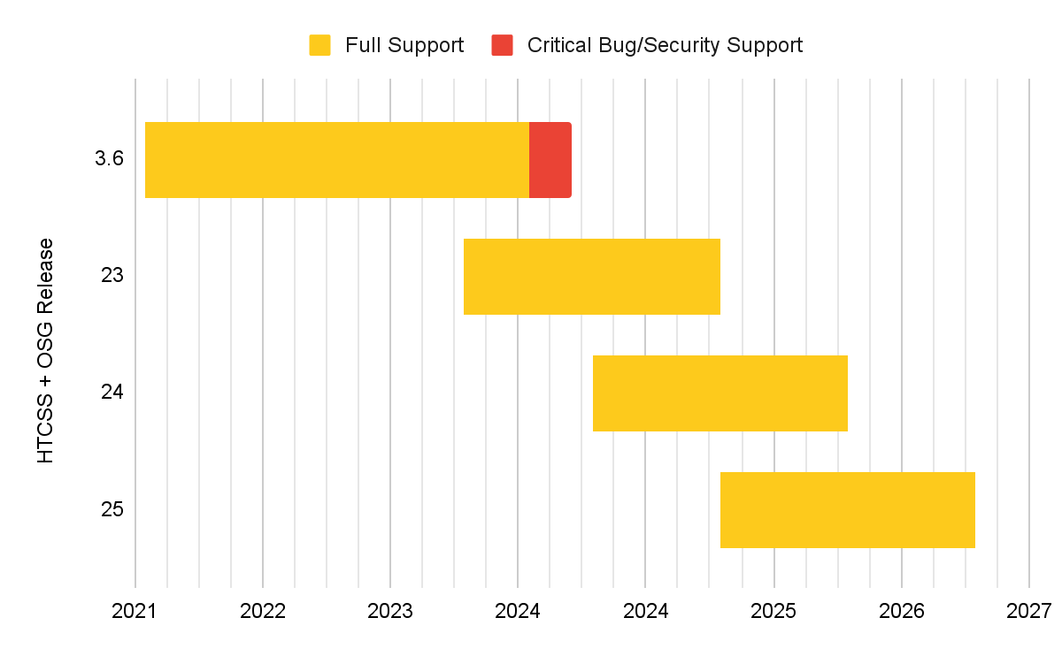
Proposed Timeline
?

Slide 12
OSG 23
Aiming for an August 2023 release
Expected major packages for the initial release
HTCSS 23.0.0 in main; HTCSS 23.1.0 in upcoming
XRootD 5.6 in main
OSG 23 will support Enterprise Linux 8 and 9
OSG 3.6 will be supported until at least June 2024

Slide 13
Questions?
This material is based upon work supported by the National Science Foundation under Grant Nos. 1836650 and 2030508. Any opinions, findings, and conclusions or recommendations expressed in this material are those of the author(s) and do not necessarily reflect the views of the National Science Foundation.

