Slide 1
Migrating to Token-based Authorization: Experiences & Lessons Learned
Jim Basney jbasney@ncsa.Illinois.edu HTC 23 Madison, Wisconsin July 11, 2023
This material is based upon work supported by the National Science Foundation under Grant No. 2114989. Any opinions, findings, and conclusions or recommendations expressed in this material are those of the author(s) and do not necessarily reflect the views of the National Science Foundation.

Slide 2
Why?
With the deprecation of GSI and proxy certificates, we have an opportunity to improve our authorization model
We don't want to simply reimplement GSI using JWTs
Improve security using least privilege capabilities
Improve usability and interoperability
Building on common JWT/OAuth technology
Coordinating across projects (LIGO, OSG, WLCG, etc.)
Maintain the reliability and security of our cyberinfrastructure
Our SciAuth project is focused on helping with this transition
https://sciauth.org/

Slide 3
How?
Bi-weekly coordination meetings with WLCG, LIGO, Fermilab, etc.
Hackathons & Interop Fests
Phase in tokens while we phase out GSI proxy certificates
Open Source SciTokens software
Token issuers operated by CERN, CILogon, and OSG
Using Hashicorp Vault for token management

Slide 4
How’s it going?
In 2022, OSG successfully transitioned from proxy certificates to tokens via the OSG 3.6 release
In February 2023, Fermilab began production with token-based authorization for their jobsub service. Now every payload job at Fermilab uses tokens.
In May 2023, LIGO migrated core services to tokens for the start of the O4 observing run
As of July 2023, both Virgo and LIGO have self hosted OSDF Origins providing SciTokens access to proprietary data via both OSDF and CVMFS
WLCG token issuers in production at CERN for Alice, Atlas, CMS, and LHCb, on track to retire proxy certificates in WLCG by March 2026

Slide 5
Experiences & Lessons Learned

Slide 6
Balancing Scalability, Reliability, and Security
Balance between shorter (security) and longer (scalability, reliability) token lifetimes
Improvements to refresh token handling
Refresh token grace period at token issuers
Client acceptance of new refresh tokens (oidc-agent, vault, etc.)
Timeouts and retries in token handling libraries (SciTokens)

Slide 7
Authorization Policies
Managing policies – revision control, LDAP
Personal directories ("write:/staging/${uid}“)
Robots
Access to “robot” tokens authorized via "Services:Robots:<robot-name>:SciTokens:authorized" groups

Slide 8
{
"Issuers" : [
{
"IssuerName" : "IGWN",
"Services" : [
{
"ServiceName" : "XRootD",
"Scopes" : [
{
"ScopeName" : "read:/frames",
"ScopeGroups": [
{
"EligibleGroup" : "cn=eligible_factor,ou=read-frames,ou=scopes,ou=SciTokens,ou=XRootD,ou=Services,ou=grouper,dc=ligo,dc=org",
"AuthorizedGroup" :"cn=authorized,ou=read-frames,ou=scopes,ou=SciTokens,ou=XRootD,ou=Services,ou=grouper,dc=ligo,dc=org",
"isMemberOf" : "Services:XRootD:SciTokens:scopes:read-frames:authorized",
"LDAP" : "ldaps://ldap.ligo.org"
},
{
"EligibleGroup" : "cn=CO:members:active,ou=groups,o=KAGRA-LIGO,o=CO,dc=gwastronomy-data,dc=cgca,dc=uwm,dc=edu",
"AuthorizedGroup" : "cn=CO:members:active,ou=groups,o=KAGRA-LIGO,o=CO,dc=gwastronomy-data,dc=cgca,dc=uwm,dc=edu",
"isMemberOf" : "gw-astronomy:KAGRA-LIGO:members",
"LDAP" : "ldaps://ldap.gw-astronomy.cilogon.org"
}
]
},
[…]

Slide 9
{
"ScopeName" : "write:/staging/${uid}",
"ScopeGroups" : [
{
"EligibleGroup" : "cn=LDGCITUsers,ou=CIT,ou=LDG,ou=LSC,ou=LVC,ou=Communities,ou=grouper,dc=ligo,dc=org",
"AuthorizedGroup" :"cn=LDGCITUsers,ou=CIT,ou=LDG,ou=LSC,ou=LVC,ou=Communities,ou=grouper,dc=ligo,dc=org",
"isMemberOf" : "Communities:LVC:LSC:LDG:CIT:LDGCITUsers",
"LDAP" : "ldaps://ldap.ligo.org"
},
{
"EligibleGroup" :
"cn=CO:COU:LDG Grid Account Holders:members:active,ou=groups,o=KAGRA-LIGO,o=CO,dc=gwastronomy-data,dc=cgca,dc=uwm,dc=edu",
"AuthorizedGroup" :
"cn=CO:COU:LDG Grid Account Holders:members:active,ou=groups,o=KAGRA-LIGO,o=CO,dc=gwastronomy-data,dc=cgca,dc=uwm,dc=edu",
"isMemberOf" : "CO:COU:LDG Grid Account Holders:members:active",
"LDAP" : "ldaps://ldap.gw-astronomy.cilogon.org"
}
]
}

Slide 10
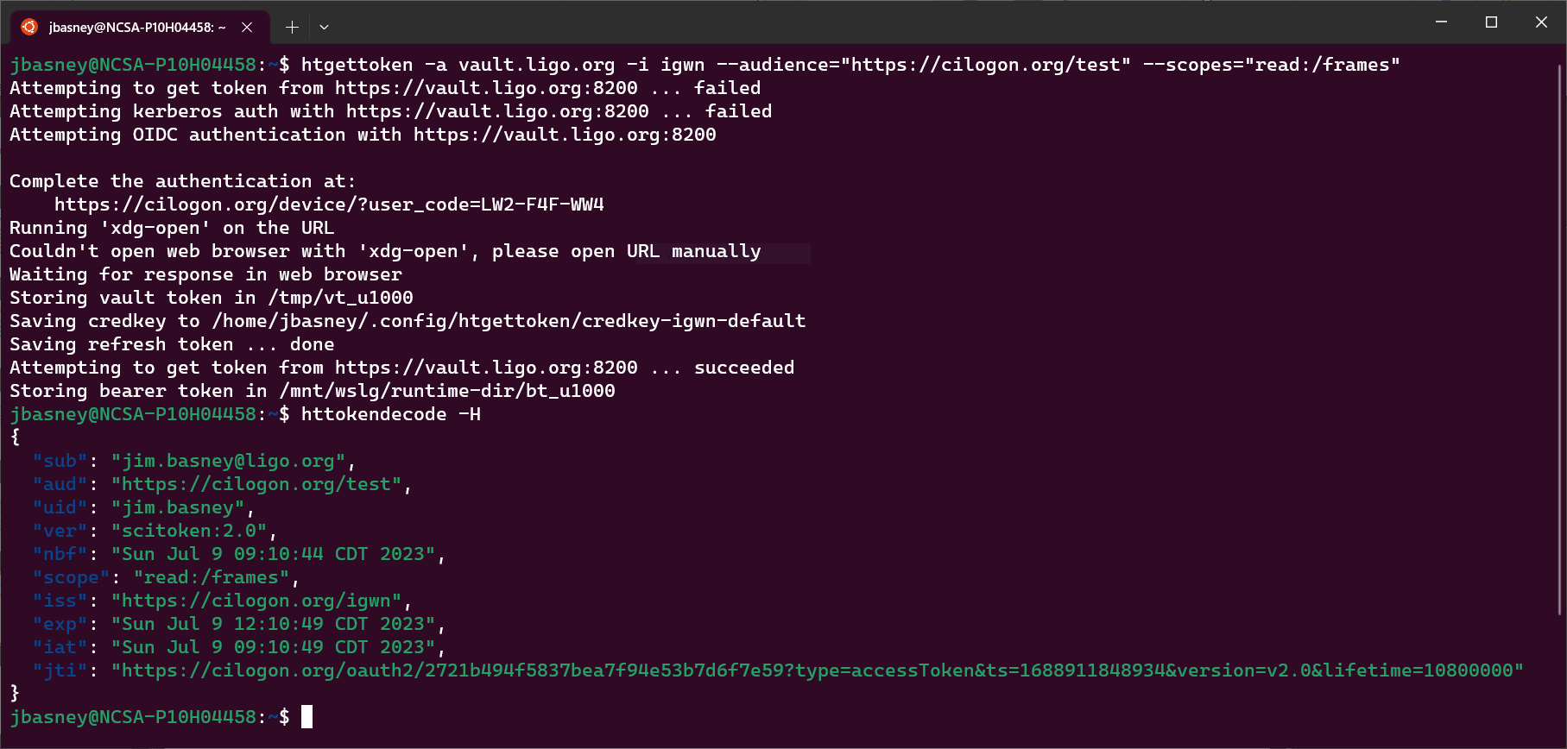
Supporting Command-Line Interfaces
OAuth Device Flow & Hashicorp Vault

Slide 11
What’s next?

Slide 12
Migration Continues
Completing phase-out of proxy certificates
CILogon plans to stop issuing X.509 certificates in 2025
WLCG on track to phase out certificates in 2026
Further developing authorization policies
Additional token integrations
CERN FTS – March 2024 WLCG data challenge
Harmonizing SciTokens, WLCG, and EGI token profiles

Slide 13
What have we accomplished?
Modernizing our authorization systems
Improving our security posture
A coordinated migration with minimal disruption
Thanks to the efforts of many people across many projects!

Slide 14
Thanks!
jbasney@ncsa.Illinois.edu
https://sciauth.org/

