Slide 1

NSF and Campus Cyberinfrastructure
HTC’23
Madison, Wisconsin
July , 2023
Kevin Thompson
National Science Foundation
Office of Advanced Cyberinfrastructure

Slide 2


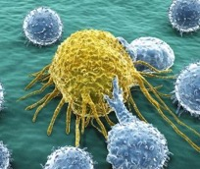
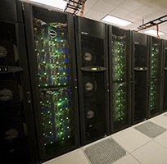
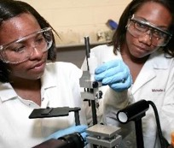

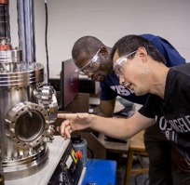


Programmatic directorates and offices supporting the NSF Mission: promote the progress of science; advance the national health, prosperity, and welfare; and to secure the national defense
Geosciences (including Polar Programs)
Engineering
Computer & Information Science & Engineering
Biological Sciences
Education &
Human Resources
Mathematical & Physical Sciences
Social, Behavioral & Economic Sciences
Technology,
Innovation and Partnerships
International Science & Engineering
Integrative Activities

Slide 3
NSF’s CISE/OAC and Scientific Cyberinfrastructure
Office of Advanced Cyberinfrastructure: Supports and coordinates the development, acquisition and provisioning of state-of-the-art cyberinfrastructure resources, tools and services essential to the advancement and transformation of science and engineering.
Cyberinfrastructure (CI): Compute, data, software, networking and people to facilitate scientific discovery and innovation.

Slide 4
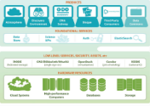


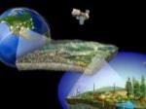




NSF Office of Advanced Cyberinfrastructure (OAC)
Foster a cyberinfrastructure (CI) ecosystem to transform science and engineering research… through Research CI and CI research
Observation
People, organizations,
and communities
Coordination
& User support
Gateways, Hubs,
and Services
Data Infrastructure
Software and
Workflow Systems
CI-Enabled
Instrumentation
Pilots,
Testbeds
Discovery
Cloud Resources & Services
Computing
Resources
R&E Networks,
Security Layers

Slide 5
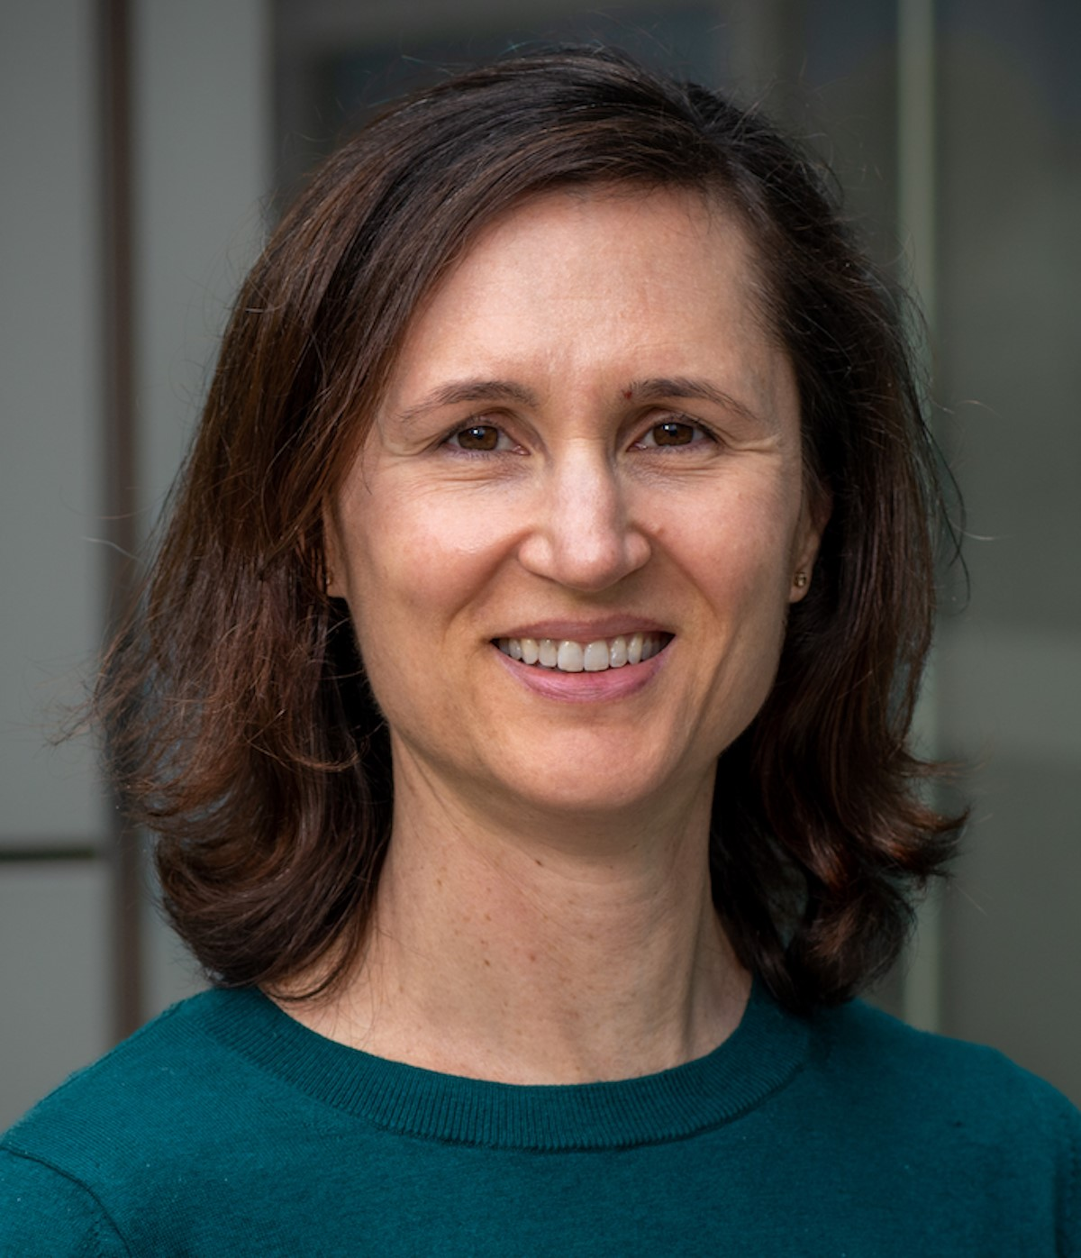



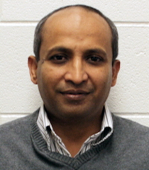
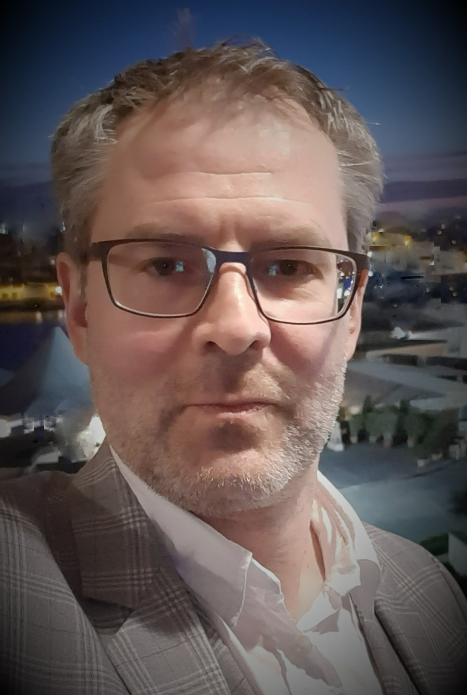

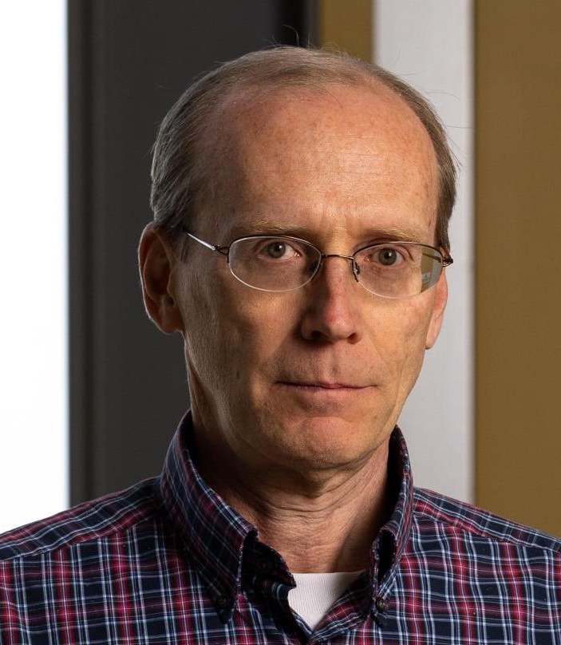


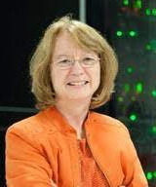
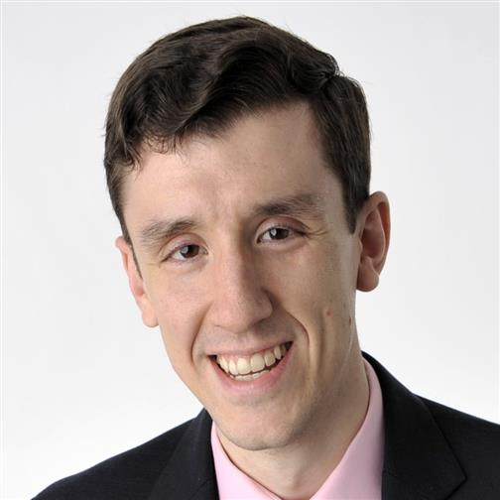
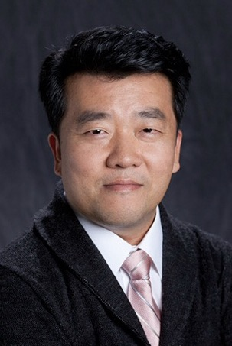
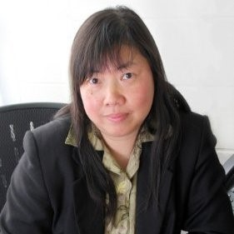

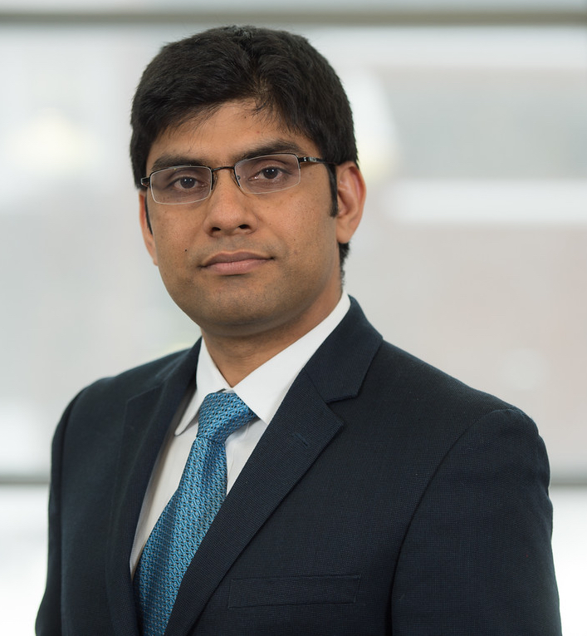
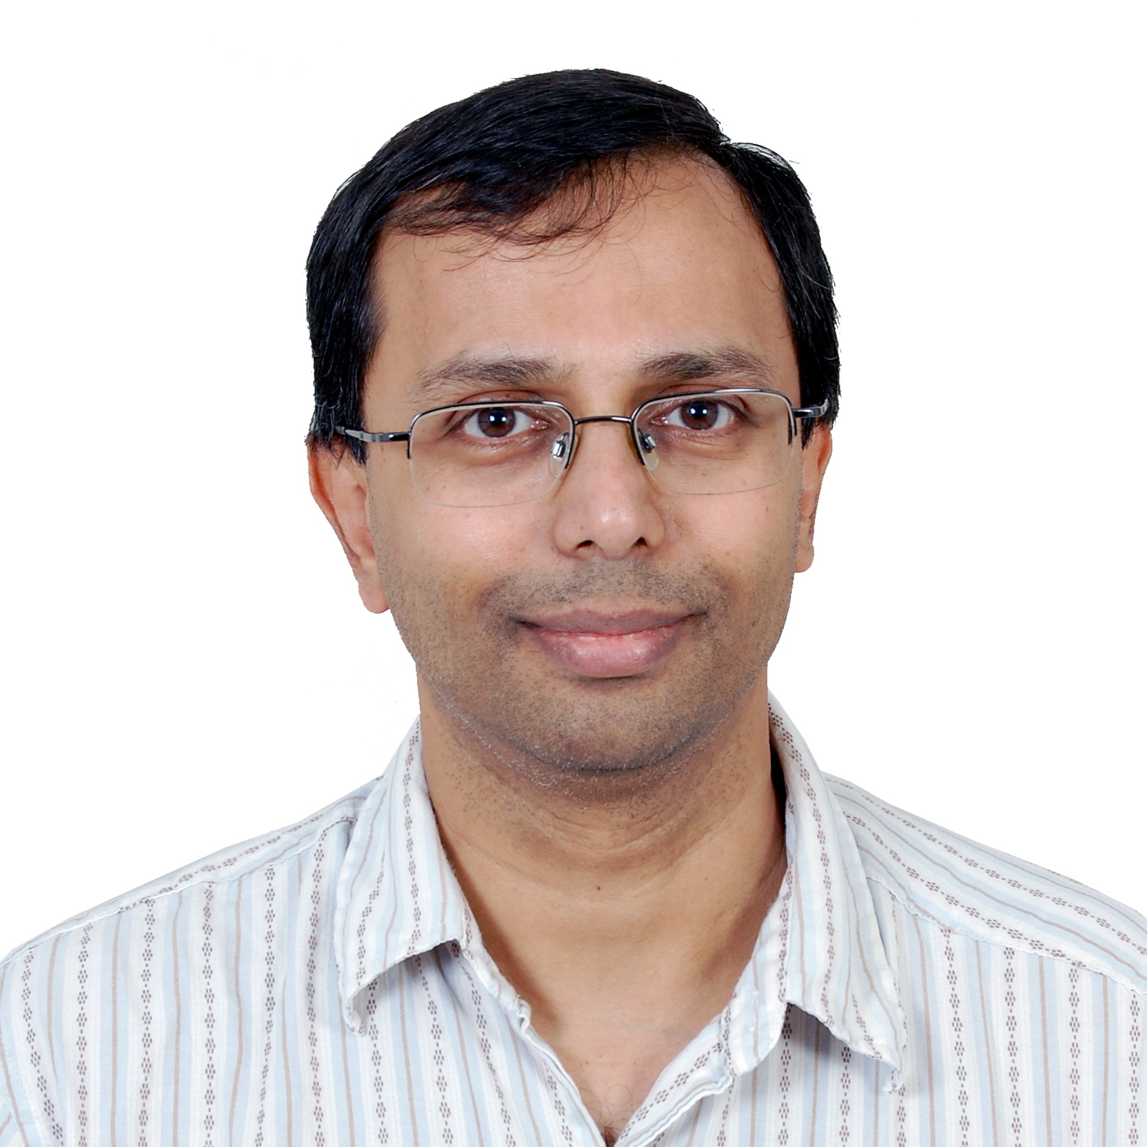
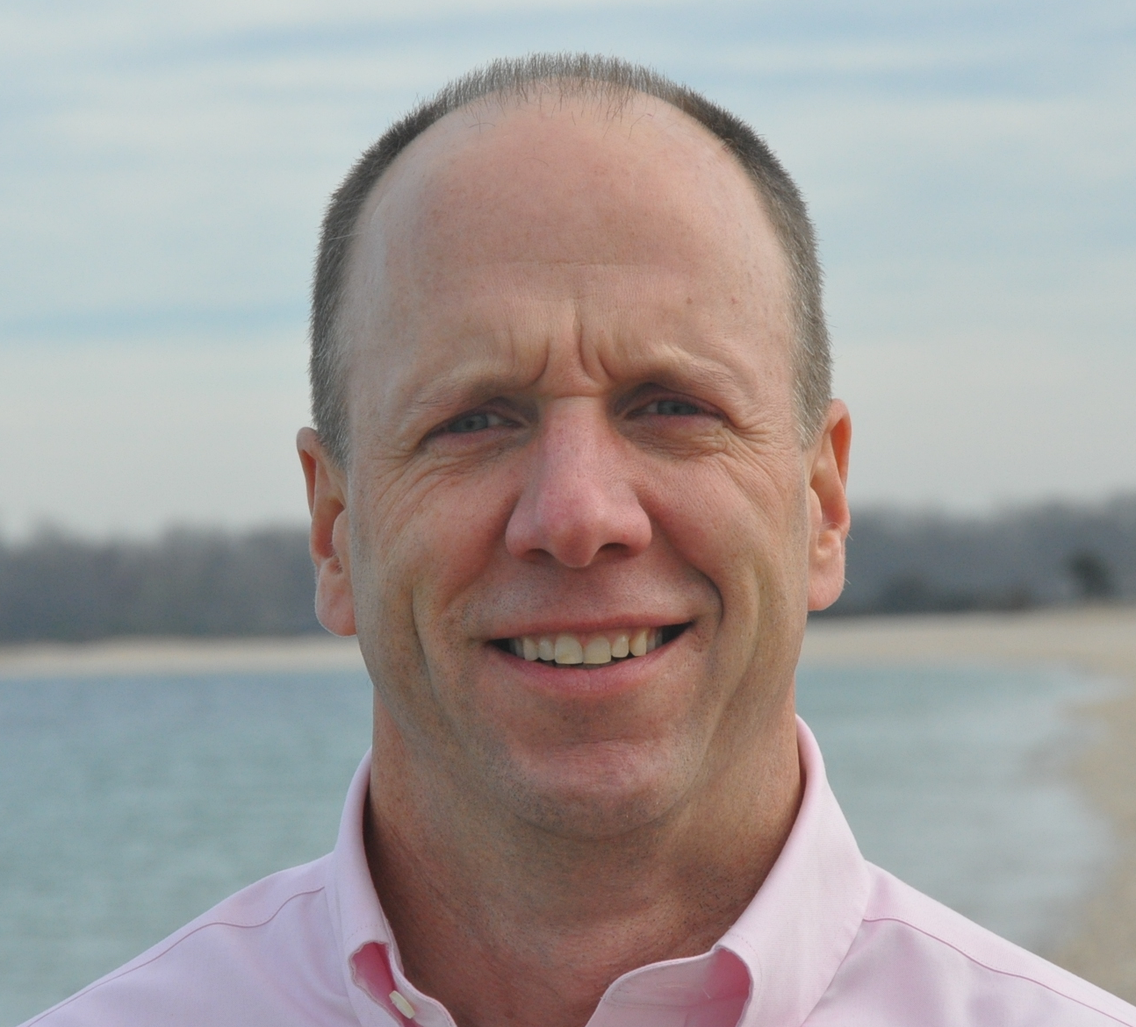
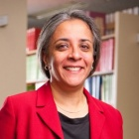
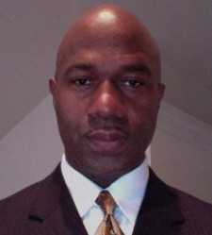
NSF Office of Advanced Cyberinfrastructure (OAC)
July 2023
Directorate for Computer and Information Science and Engineering
Katie Antypas
Office Director
Amy Walton
Deputy Office Director
*
Bob
Chadduck
*
Andrey Kanaev
Sharon
Geva
*
Bill
Miller
Sheikh
Ghafoor
Marlon Pierce
*
*
Juan (Jen)
Li
*
Seung-Jong (Jay) Park
Ed
Walker
Rob
Beverly
*
Amy
Apon
Alejandro Suarez
Kevin Thompson
*
*
Sharmistha
Bagchi-Sen
Varun Chandola
Ashok Srinivasan
Tom Gulbransen
Plato
Smith
*
*
* IPA Appointment
Notes:
Demand continues to grow, but is changing
Applications are evolving in numbers, scales and complexity
Computing and technology landscapes are changing
Value structures are different
E.g., Neil Jacob’s talk at the OSTP FACE Convening
Affinities in the COVID-19 HPC Consortium
More than 75% of all XSEDE jobs are now single node jobs (but still only about 25% of XD SUs)
Up to 50% of all jobs ON Frontera are single node jobs
Overall demand continues to grow, but is changing
Single node jobs dominating
Smaller jobs (i.e., using <= 8K cores) dominating
Gateway users dominating
Application needs are changing
Growing, broadening of domains
End-to-end workflows composing heterogenous components
Integration of analytics; use of AI/ML
Computing and technology landscapes are changing
Increasing heterogeneity / Proliferation of purposeful accelerators
Increasing use of high-level software stacks for packing, deployment, execution, tuning, etc. (e.g., containers)
Service model evolving to address a broad range of needs and customers
Deployment of exascale systems in 2021-2023
Value structures are different
Ease/speed of access and use V/S raw performance
Transparency, trust, robustness, etc., V/S raw performance
“Time to end result” more meaningful than performance of an individual code

Slide 6
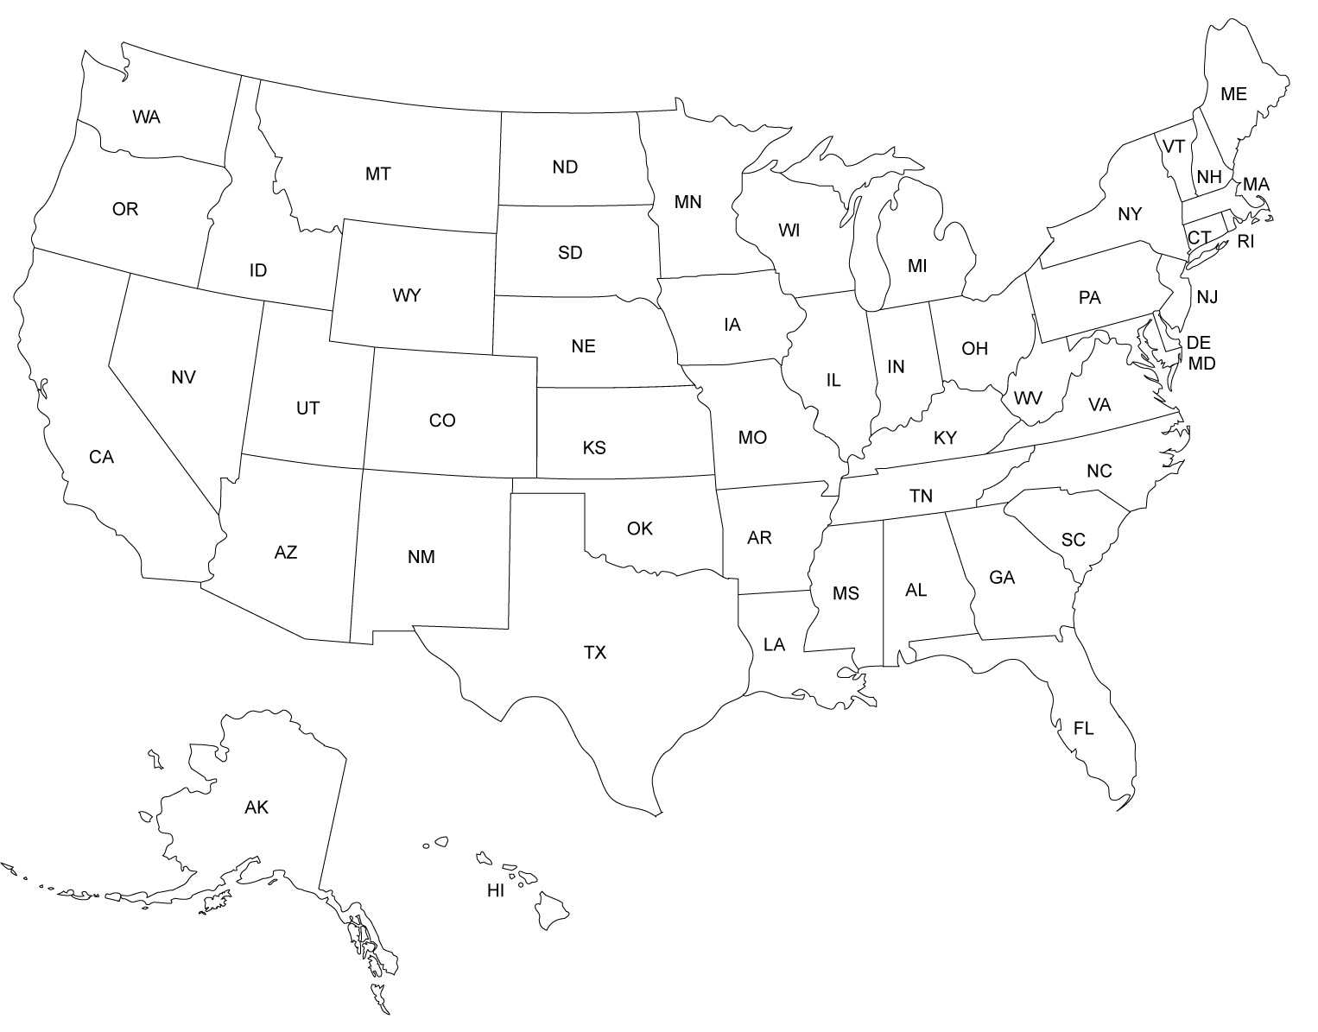

An Advanced CI Ecosystem for All
ACCESS PIs
Leadership-class
Innovative systems
HTC Services
NCAR
Cloud Resources
Shared Campus
Resources
PAWR Testbeds
Chameleon Lab (Chicago)
CloudLab (Salt Lake City)
FABRIC Network (Nationwide)
PATh/OSG (Madison)
CloudBank (San Diego)
Cheyenne (Cheyenne)
Frontera (Austin)
Jetstream, JetStream-2 (Bloomington)
Delta (Urbana-Champaign)
Ookami (Stonybrook)
Anvil (W. Lafayette)
Bridges-2, Neocortex (Pitt)
ACES (College Station)
Expanse, Voyager, National Research Platform (San Diego)
Stampede 2, Wrangler (Austin)
Notes:
NSF is largest single resource provider in consortium. 46% of projects, ~30% of cycles

Slide 7
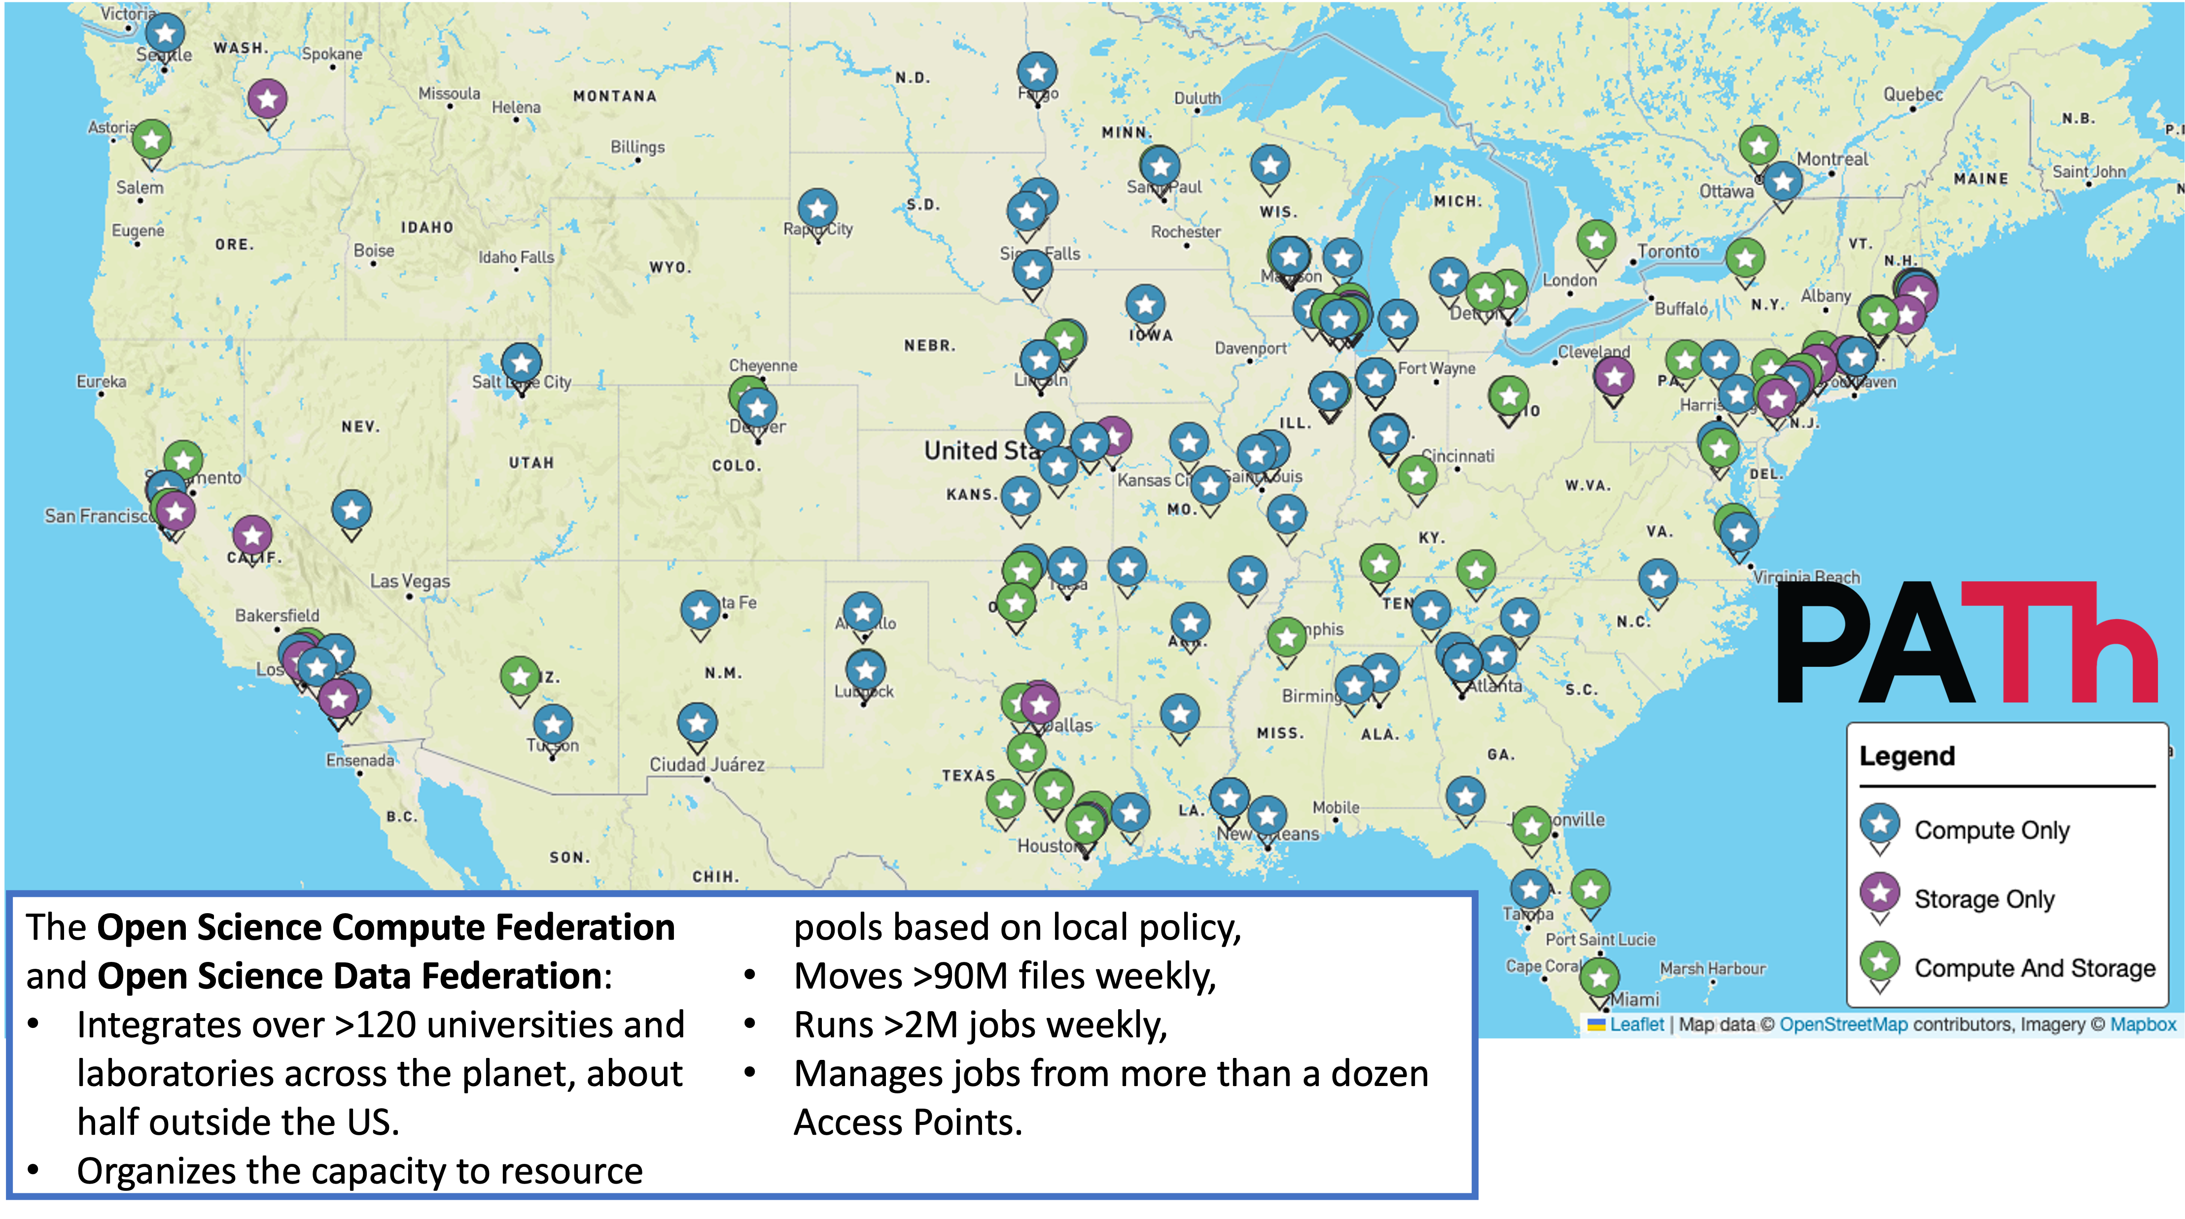
Federating Data and Compute (PATh/OSG, OSDF)

Slide 8
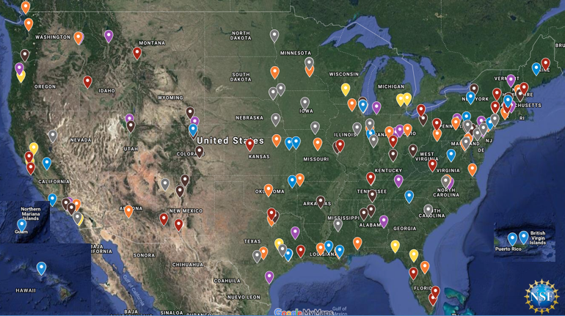
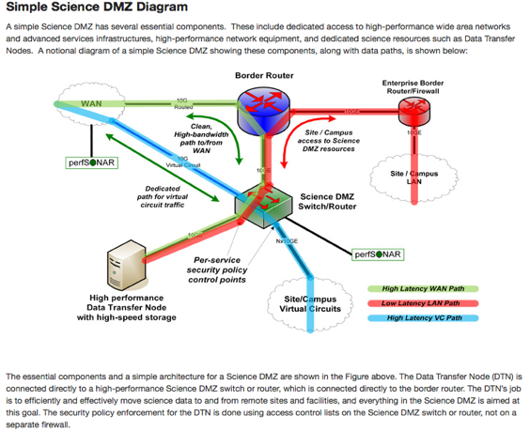
The Campus Cyberinfrastructure (CC*) Program
Networking as a fundamental layer and underpinning of Cyberinfrastructure, driven by scientific R&E needs
Most awards go to High Speed Campus networking upgrades, external connectivity to the national R&E fabric, and campus border redesign prioritizing science traffic.
Program is in its 12th year with different program areas expanding into other components of CI including computing and data
CC* emphasizes strong campus level partnerships between researchers/teachers and campus IT leadership

Slide 9
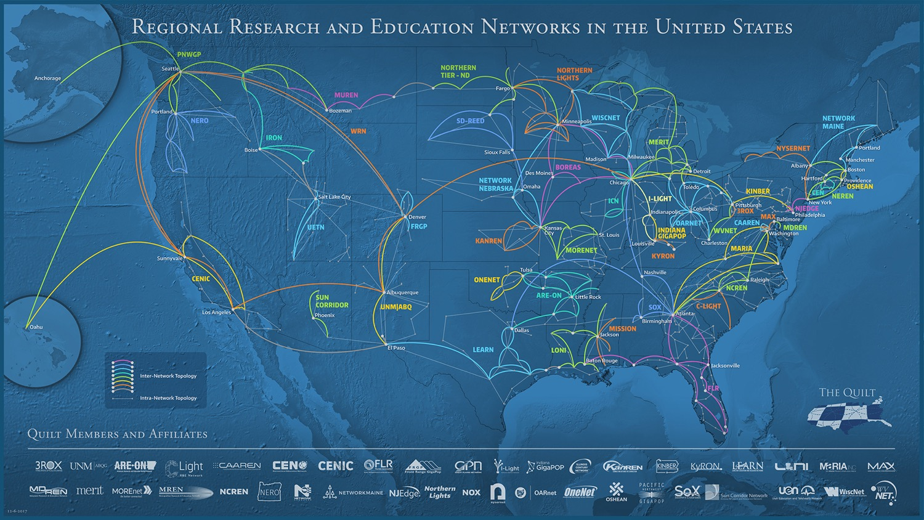
State and Regional R&E Fabric

Slide 10
CC* 23-526 - Campus Cyberinfrastructure
https://www.nsf.gov/pubs/2023/nsf23526/nsf23526.htm
$15M-$20M in expected award funding
30-50+ expected awards
Proposals due March 1 and September 11, 2023
Area #1 – Campus Network upgrades
Area #2 – Regional Connectivity for Small Institutions
Area #3 – Networking Integration and Applied Innovation
*Area #4 – Campus Computing
*Area #5 – Regional Computing
*Area #6 – Data Storage
Area #7 – Planning Grants and CI-Research Alignment
All 3 mention PATh/OSG/OSDF

Slide 11
Area 4: Campus Computing and Computing Continuum
This program area promotes coordinated approaches in scientific computing at the campus level and invests in the seeding of new and shared computing resources through investments in capacity computing in campus clusters. The program area promotes a coordinated approach.
It is expected that the campus-wide computing needs are addressed in the proposal.
All proposals submitted to this area must address:
Scientific and engineering projects and their research and education computing needs, describing project-specific scenarios for scientific computing tied to the proposed computing resources;
Features, capabilities, and software platforms representing the proposed computing resources; and
Scientific computing codes expected to run on the resources.
NSF encourages proposals in this program area from under-resourced institutions and strong preference will be given to proposals demonstrating a compelling need for access to campus/cloud resources

Slide 12
Excerpt from CC* Area#4 on Campus Computing
The Cluster as a Shared Resource Intra-campus and Inter-campus: Proposals should describe (1) their approach to sharing the proposed computing resource across the science drivers and researchers at their institution; (2) how the resource will be accessed by external research groups; and (3) how the resource is coordinated with external resources allowing the institution’s researchers to seamlessly access computing resources at other campuses, regional and national computing resources, and/or production cloud resources, if appropriate.
Proposals are required to commit to a minimum of 20% shared time on the cluster and describe their approach to making the cluster available as a shared resource external to the campus, with access and authorization according to local administrative policy. Conversely, the proposal should describe the approach to providing on-demand access to additional external computing resources for its targeted on-campus users and projects. One possible approach to implementing such a federated distributed computing solution is joining a multi-campus or national federated system such as the Open Science Grid. Whatever opportunistic, federated, scalable, distributed computing platform is chosen, the proposal is expected to justify the choice by including a discussion on the shared platform’s track record in the community, its current scientific computing production capability, and its scaling properties. Proposals are encouraged to include a letter of collaboration from the selected platform and describe how they will track and report on meeting the 20% extramural usage goal each year.

Slide 13
Area 5: Regional Computing
This program area promotes coordinated approaches in scientific computing at the regional level through investments in computing clusters serving scientific computing needs spanning a state’s or region’s small and under resourced institutions.
This area solicits proposals led by regional and state research and education leadership entities and universities. This area represents an opportunity as well for potential collaborations between EPSCoR and non-EPSCoR jurisdictions.
It is expected that multi campus-wide computing needs are addressed in the proposal. It is expected that the resources funded by this track will be primarily used by the targeted small and under resourced institutions.
All proposals submitted to this area must address:
Scientific and engineering projects and their research and education computing needs, describing project-specific scenarios for scientific computing tied to the proposed computing resources;
Features, capabilities, and software platforms representing the proposed computing resources;
Scientific computing codes expected to run on the resources; and
Approaches/mechanisms that will be used to ensure fair and equitable use of the resources by the targeted small and under resourced institutions.

Slide 14
CC* Area#6 Data Storage
Proposals must include in the Project Description:
  A summary table of the science drivers and their data storage environments - these requirements should be specified in clear terms reflecting a specific understanding of the required storage resources and environment, for example, storage type, data movement characteristics and data curation approach as part of a scientific workflow profile;
  The platform architecture and open-source software/platform, with under-resourced institutions allowed to include commercial software license fees for only the storage management platform;
  An open source-based approach to storage system monitoring, measurement, management, and instrumentation;
  A sustainability plan addressing the institution's commitment to providing an ongoing level of sustained access to storage resources;
  High-Performance Network Connectivity and Specification - see below for more details; and
  A description of the storage system as a Shared Resource Intra-campus and Inter-campus - see below for more details

Slide 15
CC* Area#6 Data Storage
The Storage system as a Shared Resource Intra-campus and Inter-campus: Interoperability is required with a national and federated data sharing fabric such as PATh/OSDF (see: <www.opensciencegrid.org/about/osdf>). At least 20% of the disk/storage space on the proposed storage system must be made available as part of the chosen federated data sharing fabric. Proposals should describe the interaction with data sharing fabric beyond simply naming it.
Staffing required to configure, operate, and support data management and access of the storage resource is an acceptable component of the budget at up to 25% of the overall budget request. Staff associated with training and facilitating adoption, integration, and use of the resource on campus may be included. Staff and user training costs may extend to the open source software platforms and federated data fabric sharing platform.
Tangible metrics addressing measures of success should be included.
Proposals should discuss the storage system in the larger context of campus CI and a vision inclusive of supporting shared resources and computing at the campus level.
Proposals should also address the long-term plan for archival storage and sustainability. Proposals may address these topics in the Project Description, Data Management Plan, or the Campus CI Plan.

Slide 16
2019 - 1st year of Campus Compute Awards (12)
Award# | PI | Institution | Title
1925558 | Hawkins, Ronald B | University of California-San Diego | CC* Compute: Triton Stratus
1925590 | Montes, Juan | American Museum Natural History | CC* Compute: High Performance Campus Computing for Institutional Research at the American Museum of Natural History
1925541 | Belgin, Mehmet | Georgia Tech Research Corporation | CC* Compute: Integrating Georgia Tech into the Open Science Grid for Multi-Messenger Astrophysics
1925596 | Fiske, Joshua A | Clarkson University | CC* Compute: Accelerating Computational Research for Engineering and Science (ACRES) at Clarkson University, A Campus Cluster Proposal
1925645 | Lannon, Kevin | University of Notre Dame | CC* Compute: CAML - Accelerating Machine Learning via Campus and Grid
1925467 | Cinabro, David A | Wayne State University | CC*: Campus Computing and the Computing Continuum: Campus Cluster Resource: Expanded High Performance Computing at Wayne State
1925603 | Skjellum, Anthony | University of Tennessee Chattanooga | CC* Compute: A Cost-Effective, 2,048 Core InfiniBand Cluster at UTC for Campus Research and Education
1925192 | Rampp, Carrie | Franklin and Marshall College | CC* Compute: Building a state-of-the-art campus compute resource at Franklin &amp; Marshall College
1925267 | Rossmiller, Zachary | University of Montana | CC* Compute: Improved Computing for Advanced Research and Education (ICARE)
1925716 | Jones, Richard T | University of Connecticut | CC* Compute: Shared Computing Infrastructure for Large-scale Science Problems
1925766 | Hauser, Thomas | UC Boulder | CC* Compute: A Hybrid Cloud Environment for the Rocky Mountain Advanced Computing Consortium
1925717 | Delaney, Kris | UC Santa Barbara | CC* Compute: A high-performance GPU cluster for accelerated research

Slide 17
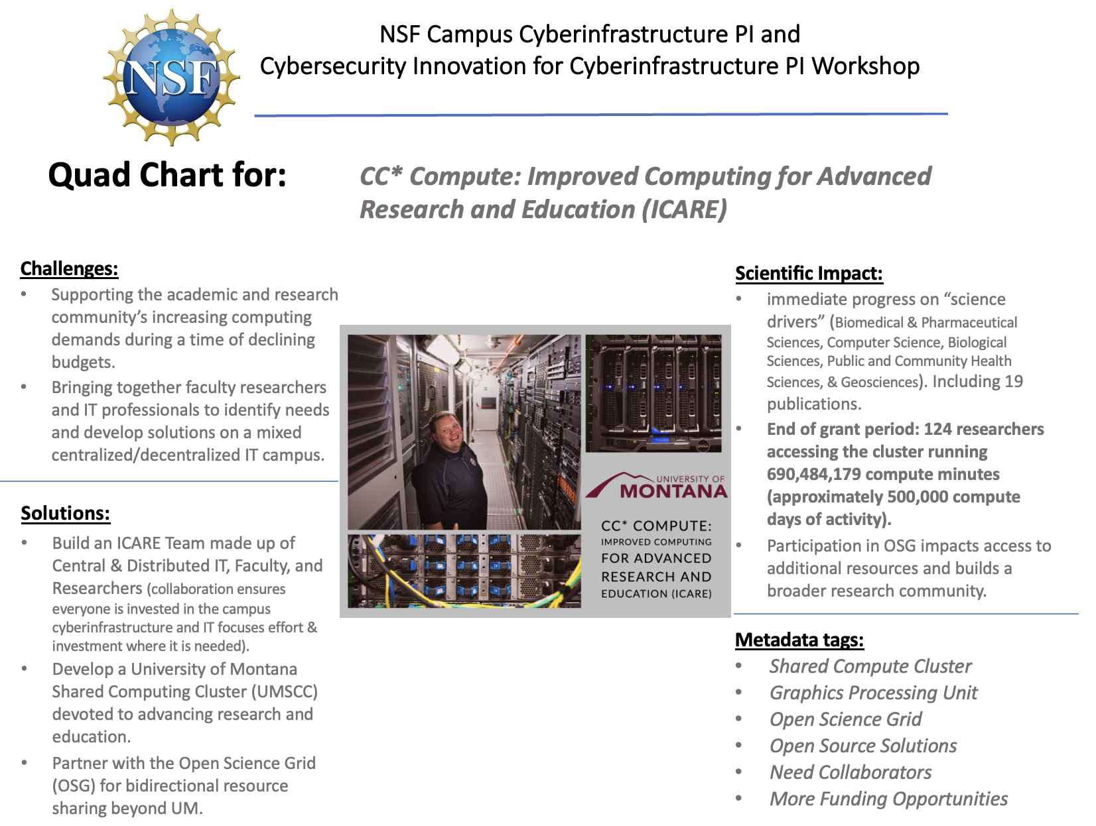
2019 award example

Slide 18
2020 – Year2 of Campus Compute area (19)
Award# | PI | Institution | Title
2018846 | Carver | U of Alabama Tuscaloosa | CC* Compute: Accelerating Advances in Science and Engineering at The University of Alabama Through HPC Infrastructure
2018149 | Sedore | Tufts University | CC* Compute: GPU Infrastructure to Explore New Algorithmic & AI Methods in Data-Driven Science and Engineering at Tufts University
2018766 | Andresen | Kansas State University | CC* Compute: GP-ARGO: The Great Plains Augmented Regional Gateway to the Open Science Grid
2020446 | Yan | LSU | CC* Compute: Deep Bayou: Accelerating Scientific Discoveries with A GPU Cluster
2018758 | Larkins | Rhodes College | CC* Compute: A high-performance computing cluster to accelerate research, education, and training at Rhodes College
2018551 | Chace | Southern Ill U Edwardsvill | CC* Compute: SIUE Campus Cluster
2018851 | Segee | University of Maine | CC* Compute: High-Memory Compute Resources for Maine
2019089 | Mandel | U of Colorado Denver | CC* Compute: Accelerating Science and Education by Campus and Grid Computing
2018926 | Smith | Purdue University | CC* Compute: Private Campus Cloud for Data Analytics and Machine Learning
2019007 | Jelinkova | William Marsh Rice Univ | CC* Compute: Interactive Data Analysis Platform
2019000 | Dugas | New Mexico St University | CC*Compute: From classroom to the lab: NMSU responds to the changing HPC landscape in New Mexico
2019216 | Liu | Portland State University | CC* Compute: GPU-based Computation and Data Enabled Research and Education (G-CoDERE) at PSU
2019035 | Webb III | Lehigh University | CC* Compute: Acquisition of a Lehigh University HPC cluster to enhance collaboration, research productivity and educational impact
2018936 | Taylor | LA St Univ Health Center | CC* Compute: Compute Cluster for Computational Sciences at Louisiana State University Health Sciences Center – New Orleans (LSUHSC-NO)
2018933 | Wemhoff | Villanova University | CC* Compute: High-Performance Computing Backbone for Accelerating Campus-Wide and Regional Research
2019220 | Kesselman | USC | CC* Compute: A Customizable, Reproducible, and Secure Cloud Infrastructure as a Service for Scientific Research in Southern California
2018822 | Scozzafava | Syracuse University | CC* Compute: A High Performance GPU Cluster at Syracuse University
2018841 | Pal | West Texas A&M University | CC* Compute: GROWTH - Gateway for Increased Research Output at a West Texas Higher-education Campus
2019194 | Castillo | San Diego State Univ Fdn | CC* Compute: Central Computing with Advanced Implementation at San Diego State University

Slide 19
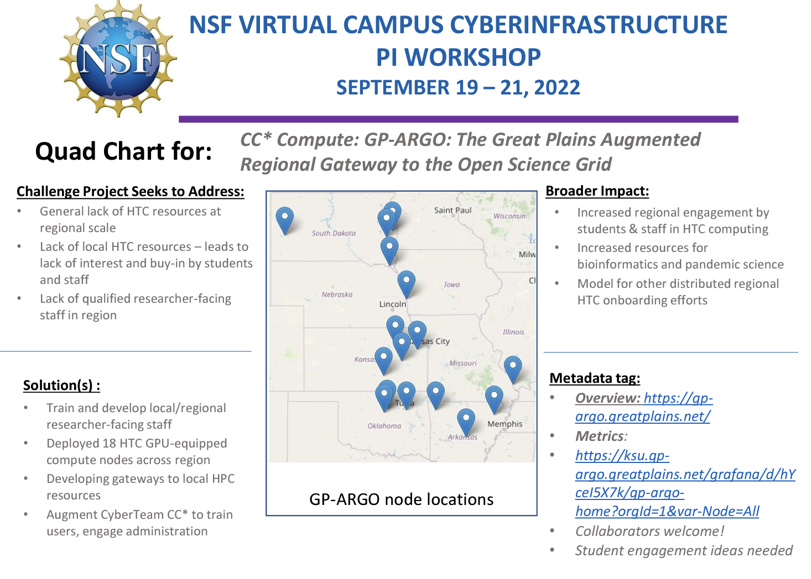
2020 Award example

Slide 20
2021/early FY2022 – 2 deadlines…17 awards
Award# | PI | Institution | Title
2127188 | Rogers, Michael D | Tennessee Technological University | CC* Compute: A HPC Cluster for Science Research and Education at Tennessee Tech University
2126303 | Jennewein, Douglas M | Arizona State University | CC* Compute: The Arizona Federated Open Research Computing Enclave (AFORCE), an Advanced Computing Platform for Science, Engineering, and Health
2125646 | Salathe, Eric | University of Washington | CC* Compute: A campus-wide computing resource for research and teaching at the University of Washington Bothell
2126229 | Chang, Philip | University of Wisconsin-Milwaukee | CC* Compute: A Balanced Cluster For Science and Engineering in the Great Lakes Region
2126253 | Liu, Jason X | Florida International University | CC* Compute: RAPTOR - Reconfigurable Advanced Platform for Transdisciplinary Open Research
Award# | PI | Institution | Title
2201561 | Neeman, Henry J. | University of Oklahoma Norman Campus | CC* Compute: OneOklahoma Cyberinfrastructure Initiative Research Accelerator for Machine Learning (OneOCII-RAML)
2201599 | Tavakkoli, Alireza | Board of Regents, NSHE, obo University of Nevada, Reno | CC* Compute: Nevada Bridge to AI-enabled Scientific & Engineering Computing (NvBAISEC)
2201497 | Skjellum, Anthony | University of Tennessee Chattanooga | CC* Compute: Augmenting a 2,560-core EPYC2 Computational Cluster with GPUs for AI, Machine Learning, and other GPU-Accelerated HPC Applications
2201428 | Cleveland, Sean B. | University of Hawaii | CC* Compute: Koa - A High Performance and Flexible Research Computing Resource
2201435 | Wheat, Stephen R. | Oral Roberts University | CC* Compute: GPU HPC Cluster Partition for Research, Education, and Student Success
2201479 | Fondjo Fotou, Franklin | Langston University | CC* Compute: Collaboration in Computing Infrastructure for Research and Education (CO-InResE)
2201538 | Pasricha, Sudeep | Colorado State University | CC* Compute: HPC Services for the Colorado State University System
2201106 | Zink, Michael H. | University of Massachusetts Amherst | CC* Compute: COllaborative Next-generation Technology In the Northeast: the UMassUnity Machine (CONTINUUM)
2201558 | Khan, Javed I. | Kent State University | CC* Compute: Accelerating Compute Driven Science Through a Sharable High Performance Computing Cluster in Kent State Multi-Campus System
2200792 | O'Shea, Brian W. | Michigan State University | CC* Compute: The MSU Data Machine - a high-memory, GPU-enabled compute cluster for data-intensive and AI applications
2201445 | Hanna, Chad | Pennsylvania State Univ University Park | CC* Compute: An Open Science Grid shared computing platform at Penn State
2201105 | Kneifel, Charles | Duke University | CC* Compute: NCShare Compute as a Service

Slide 21
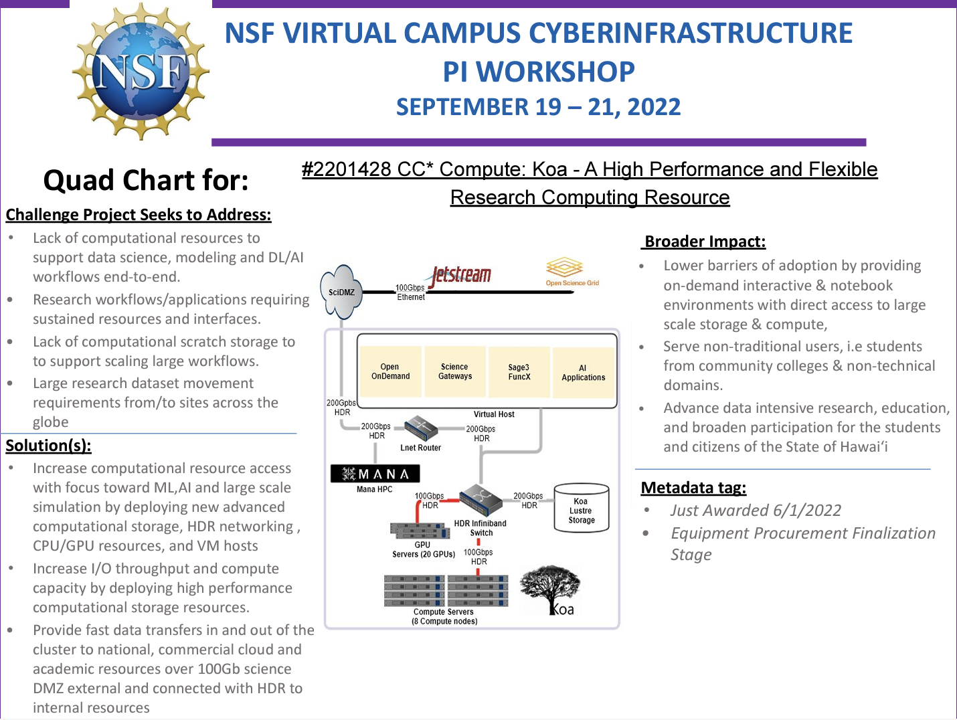
2021/2022 Award Example

Slide 22
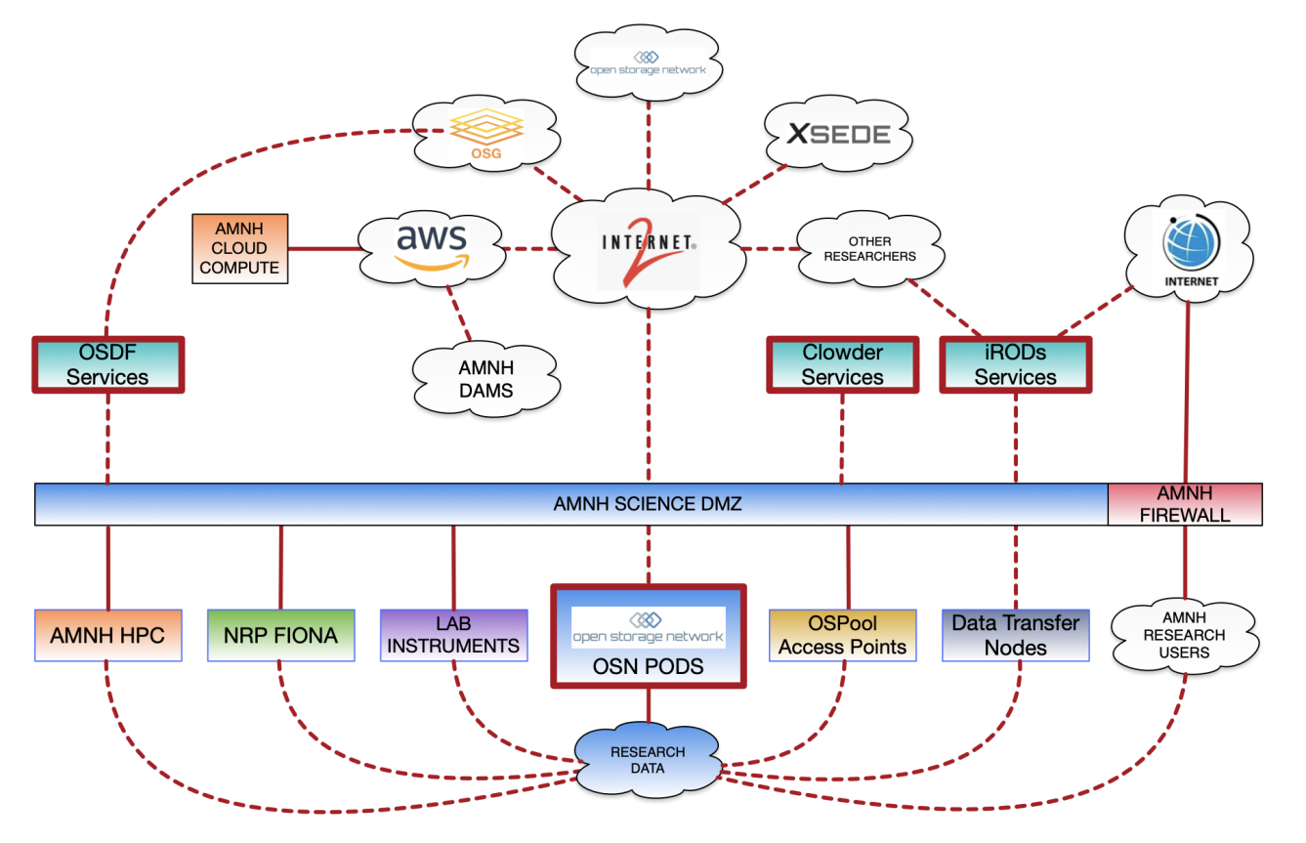
NSF Campus Cyberinfrastructure PI and
Cybersecurity Innovation for Cyberinfrastructure PI Workshop
September 19-22, 2022 | Minneapolis, MN
Quad Chart for:
CC* Data Storage: Multi-Petabyte Open Storage (MPOS) at the American Museum of Natural History
Challenges Project Seeks to Address:
Reduce or remove limitations on researchers arising from a lack of sufficient data storage.
Limit duplication of datasets across various systems by providing a centralized storage system.
Provide access to research data regardless of location (onsite, cloud, etc.)
Improve data management capabilities and adherence to FAIR principles.
Scientiﬁc Impact:
Provides researchers crucial storage resources accessible from a variety of onsite and remote computational and analytic systems.
Allows for local storage of large-scale data sets (source and derivative).
Enables the management and automation of research data ingest, tagging, indexing, and sharing..
Facilitates the curation of data across the Museum and drives compliance with FAIR principles.
Deliverables:
Installation of Open Storage Network (OSN) Pods providing 2.4+ petabytes of storage for active research data.
Provisioning of 20% of the total OSN pod storage to the national data storage cloud.
Provide interconnects between local and remote computational services and the OSN pods.
Deployment iRODS Data Management Platform and the Clowder Framework at AMNH.
Metadata Tag:
Museums
Data Storage
Data Management
Open Storage Network
iRODS
Clowder
Science DMZ
Science Engagement
GLOBUS
Contact: nsf-ci@amnh.org

Slide 23
Late FY2022 New Areas: Data Storage (9) and Regional Compute (5) Awards
Award# | PI | Institution | Title
2232810 | Kneifel, Charles | Duke University | CC* Data Storage: Flexible Affordable Scalable Technology for Research Storage (FAST-Research Storage)
2232816 | Aygun, Ramazan S | Kennesaw State University Research and Service Foundation | CC* Data Storage: High Volume Data Storage Infrastructure for Scientific Research and Education at Kennesaw State University Shared as Open Science Data Federation Data Origin
2232803 | Nabrzyski, Jaroslaw | University of Notre Dame | CC* Data Storage: Institutional Storage for the University of Notre Dame (NDStore)
2232817 | Sun, Qi | New York University | CC* Data Storage: Distributed, Fast, Scalable Infrastructure for Emerging Media Research Data
2232872 | Gough | Purdue University | CC* Data Storage: Software Defined Storage for Composable and HPC Workflows
2232601 | Li | University of Washington | CC* Data Storage: Supporting Big-Data Edge Computing using Hybrid and Cloud-Native Storage Infrastructure
2232862 | Cleveland | University of Hawaii | CC* Data Storage: KoaStore: A High Performance and Flexible Research Storage Resource
2232857 | Montes | American Museum Natural History | Research Infrastructure: CC* Data Storage: Multi-Petabyte Open Storage (MPOS) at the American Museum of Natural History
2232851 | Weitzel | University of Nebraska-Lincoln | CC* Data Storage: NRDStor: Nebraska Research Data Storage
2232895 | Chakravorty, Dhruva | Texas A&M University | CC* Regional Computing: Launch: Advancing Cyberinfrastructure at Minority Serving Institutions
2232860 | Kramer, William T | University of Illinois at Urbana-Champaign | CC* Regional Computing: Taylor Geospatial Institute Regional AI Learning System
2232917 | Kesselman, Carl F | University of Southern California | CC* Regional Computing: Building Cyberinfrastructure to Forge a Regional Research Computing Alliance in Southern California
2232873 | Florinski, Vladimir | University of Alabama in Huntsville | Research Infrastructure: CC* Regional Computing: A Regional Computing Hub for Alabama Universities
2232628 | McKee, Shawn | University of Michigan | CC* Regional Computing: Helping Our Researchers Upgrade their Science (HORUS)

Slide 24
2023+
CC* is making awards this summer off 23-526’s 1st deadline
49 campus compute awards and counting
7 regional compute awards
12 data storage awards and counting
There will be another CC* solicitation in 2024
Looking for ways to broaden participation (MS-CC)
Looking for ways to increase scientific usage in OSPool from CC* awardees

Slide 25
Thank You
Kevin Thompson
Office of Advanced Cyberinfrastructure
kthompso@nsf.gov
To subscribe to the OAC Announce Mailing List
Send an email to: OAC-ANNOUNCE-subscribe-request@listserv.nsf.gov
25

