Slide 1
Adventures in Communicating the Value of Campus CI Investment
Preston Smith
Throughput Computing 2023 – July 11, 2023

Slide 2

Plug: This is the abridged version!
Catch me in Chicago this fall for the full version!

Slide 3


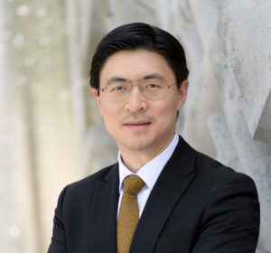

Campus Cyberinfrastucture
A Coordinated Investment by Many Stakeholders
NSF and other agencies
Campuses
CIOs
VPRs
Faculty
My talk will focus mostly on the latter!

Slide 4

Communicating Value
Hot Take: Our Community is Immature at Communicating Value
Questions heard at Purdue from finance leaders:
“What do they keep spending all that money on for supercomputers?”
“Who even uses these things? Are they just vanity toys for a couple of people?”
“Why is that recharge center not covering its costs?”

Slide 5
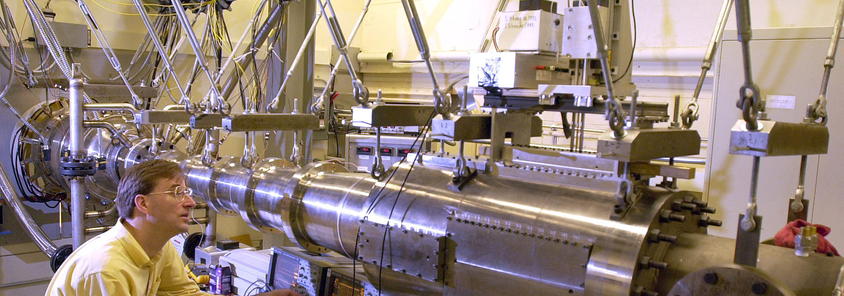
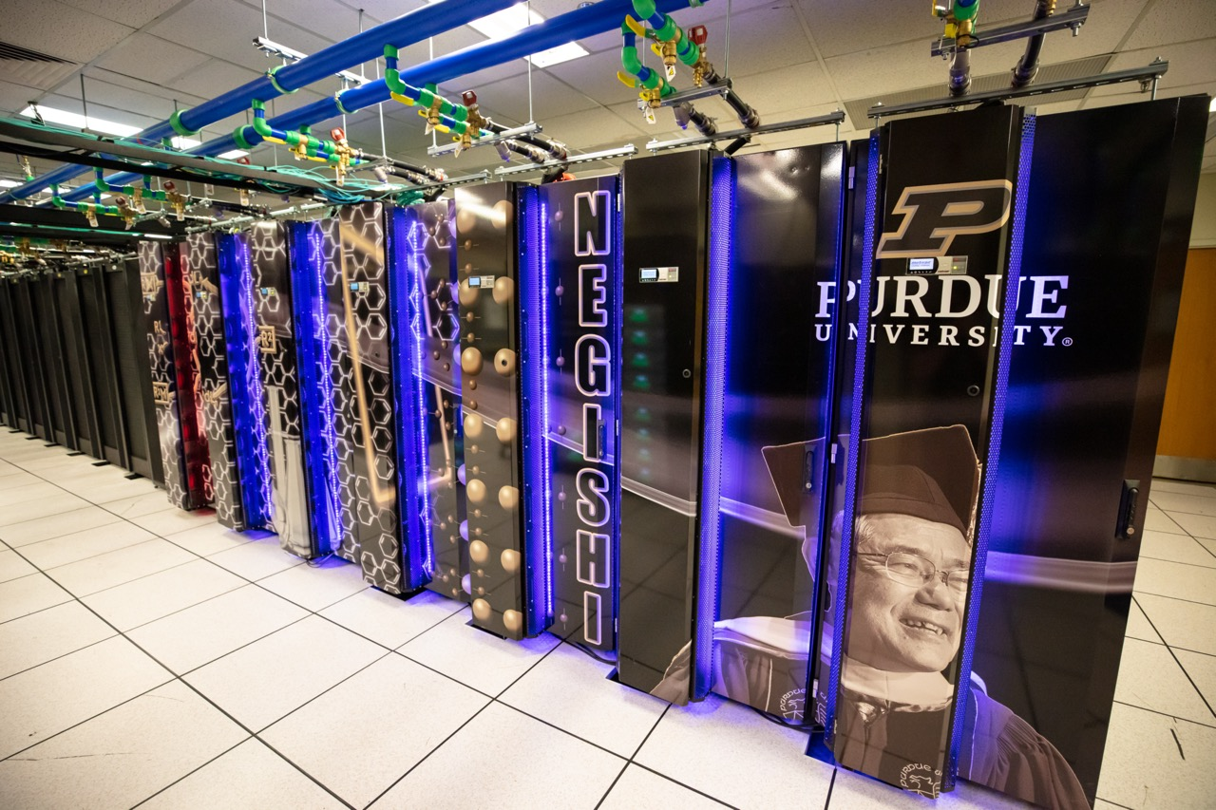
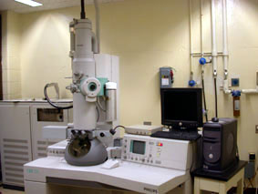
Motivation
Value of HPC investments
Computing systems are critical pieces of research infrastructure
Administrators have to manage competing priorities of infrastructures in which to invest:
  Supercomputers
  Wind tunnels
  Electron Microscopes
  Enterprise IT vs research IT
  Etc
How to demonstrate that computational research is a good investment?

Slide 6
Step 1: Know your Stakeholders
Which specific stakeholders are you communicating value to?
What is important at the institution at this point in time?

Slide 7
Personas
Faculty: getting next grant, publishing, graduating students
Deans, Heads, Chairs: Students, educational outcomes, Faculty recruitment and retention, Having appropriate infrastructure for their units to succeed
VP for Research: Competitiveness for funding, winning major grants and contracts, growing R&D expenditures, tech transfer, IP
Provost: Students, educational outcome, happy faulty
CFO: $$$ - ROI, efficiency, reduction of expense, increase of revenue
CIO: Contributing to the mission
Stakeholder Interests

Slide 8
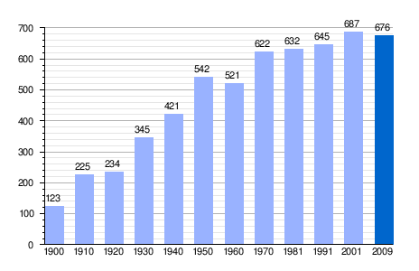
Step 2: Have Quantitative Center Metrics
Telling your story
.. based on the interests of the specific stakeholder, given the institution’s priorities in the current context
Notes:
I’m not going to go into a detail here except to refer back to the stakeholder personas before – frame your metrics to address their interests

Slide 9
To All Stakeholders:
We are addressing the ~2001 lack of capacity and driving costs down
Hardware Investment:
$ per CPU Hour

Slide 10
To All Stakeholders:
The capacity that we’ve invested in is well-used
124% average annual growth on the number of
computational hours used by Purdue faculty
Grid computing: 30M↑
from 18M hours (2008)
Storage: 2,588 TB↑
from 1,904 TB of capacity (2009)
HPC: 113M↑
from 67M hours (2009)

Slide 11
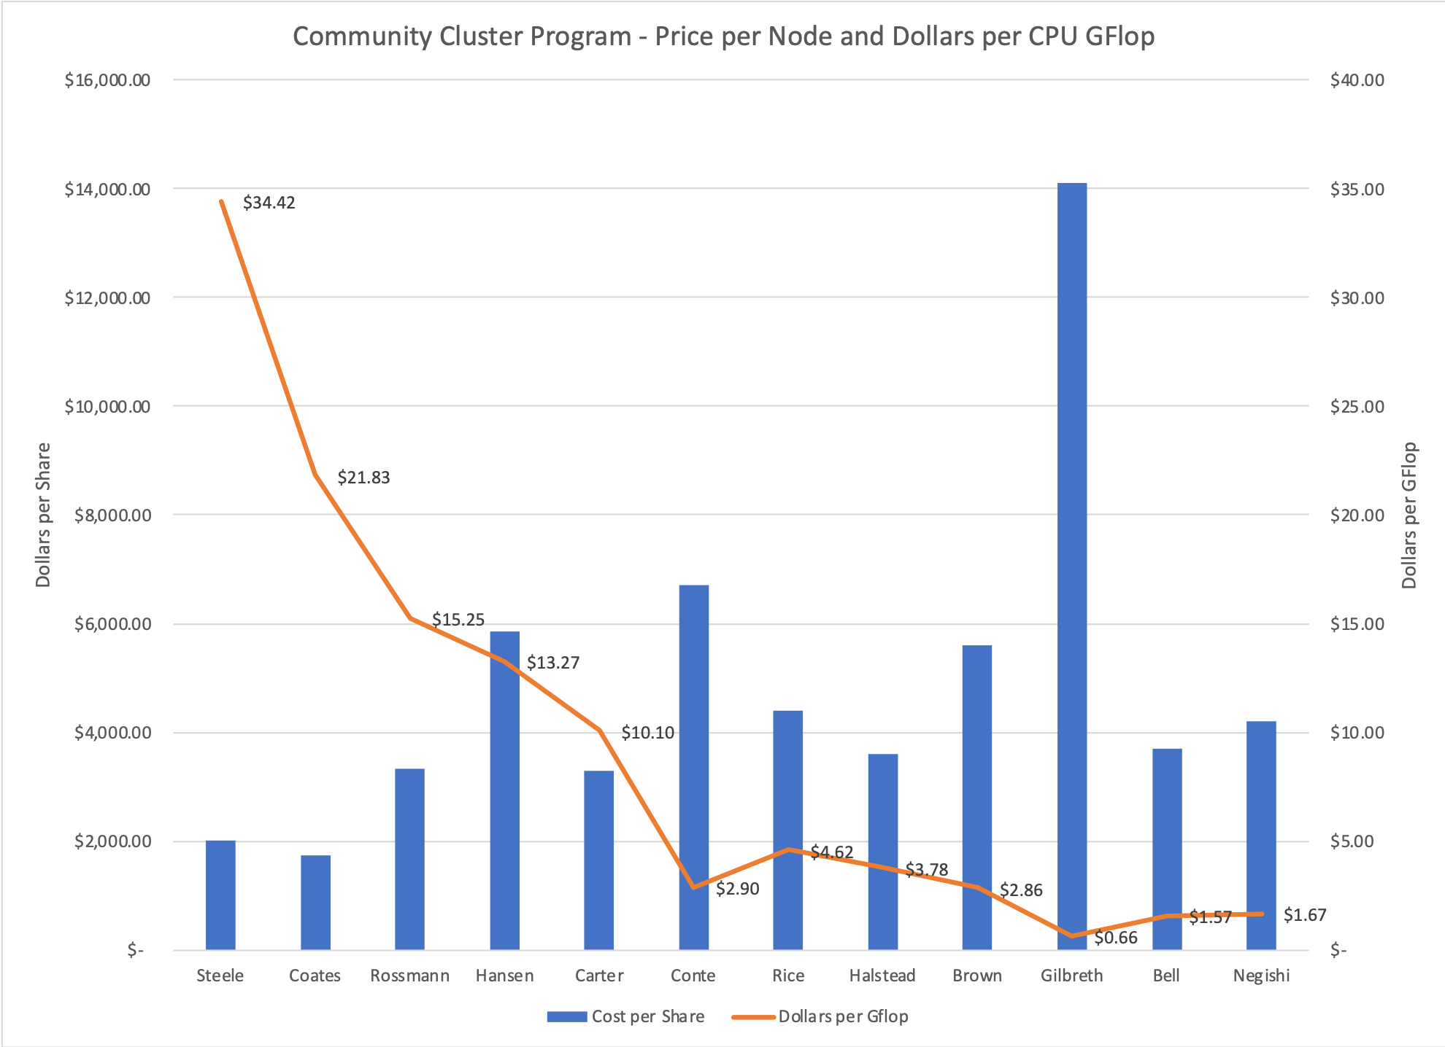
To Faculty and CFO:
Each iteration gets us more capability per dollar

Slide 12
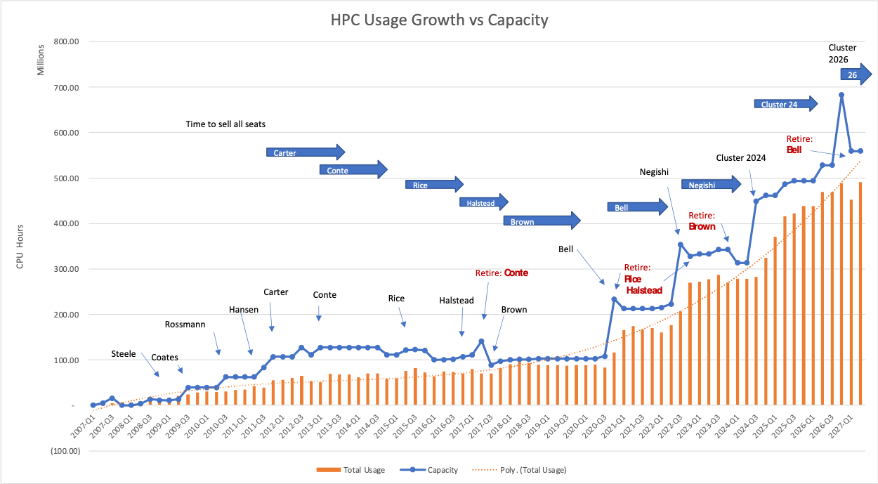
To CIO and CFO:
We understand our sales and usage patterns well enough to plan our lifecycle needs

Slide 13
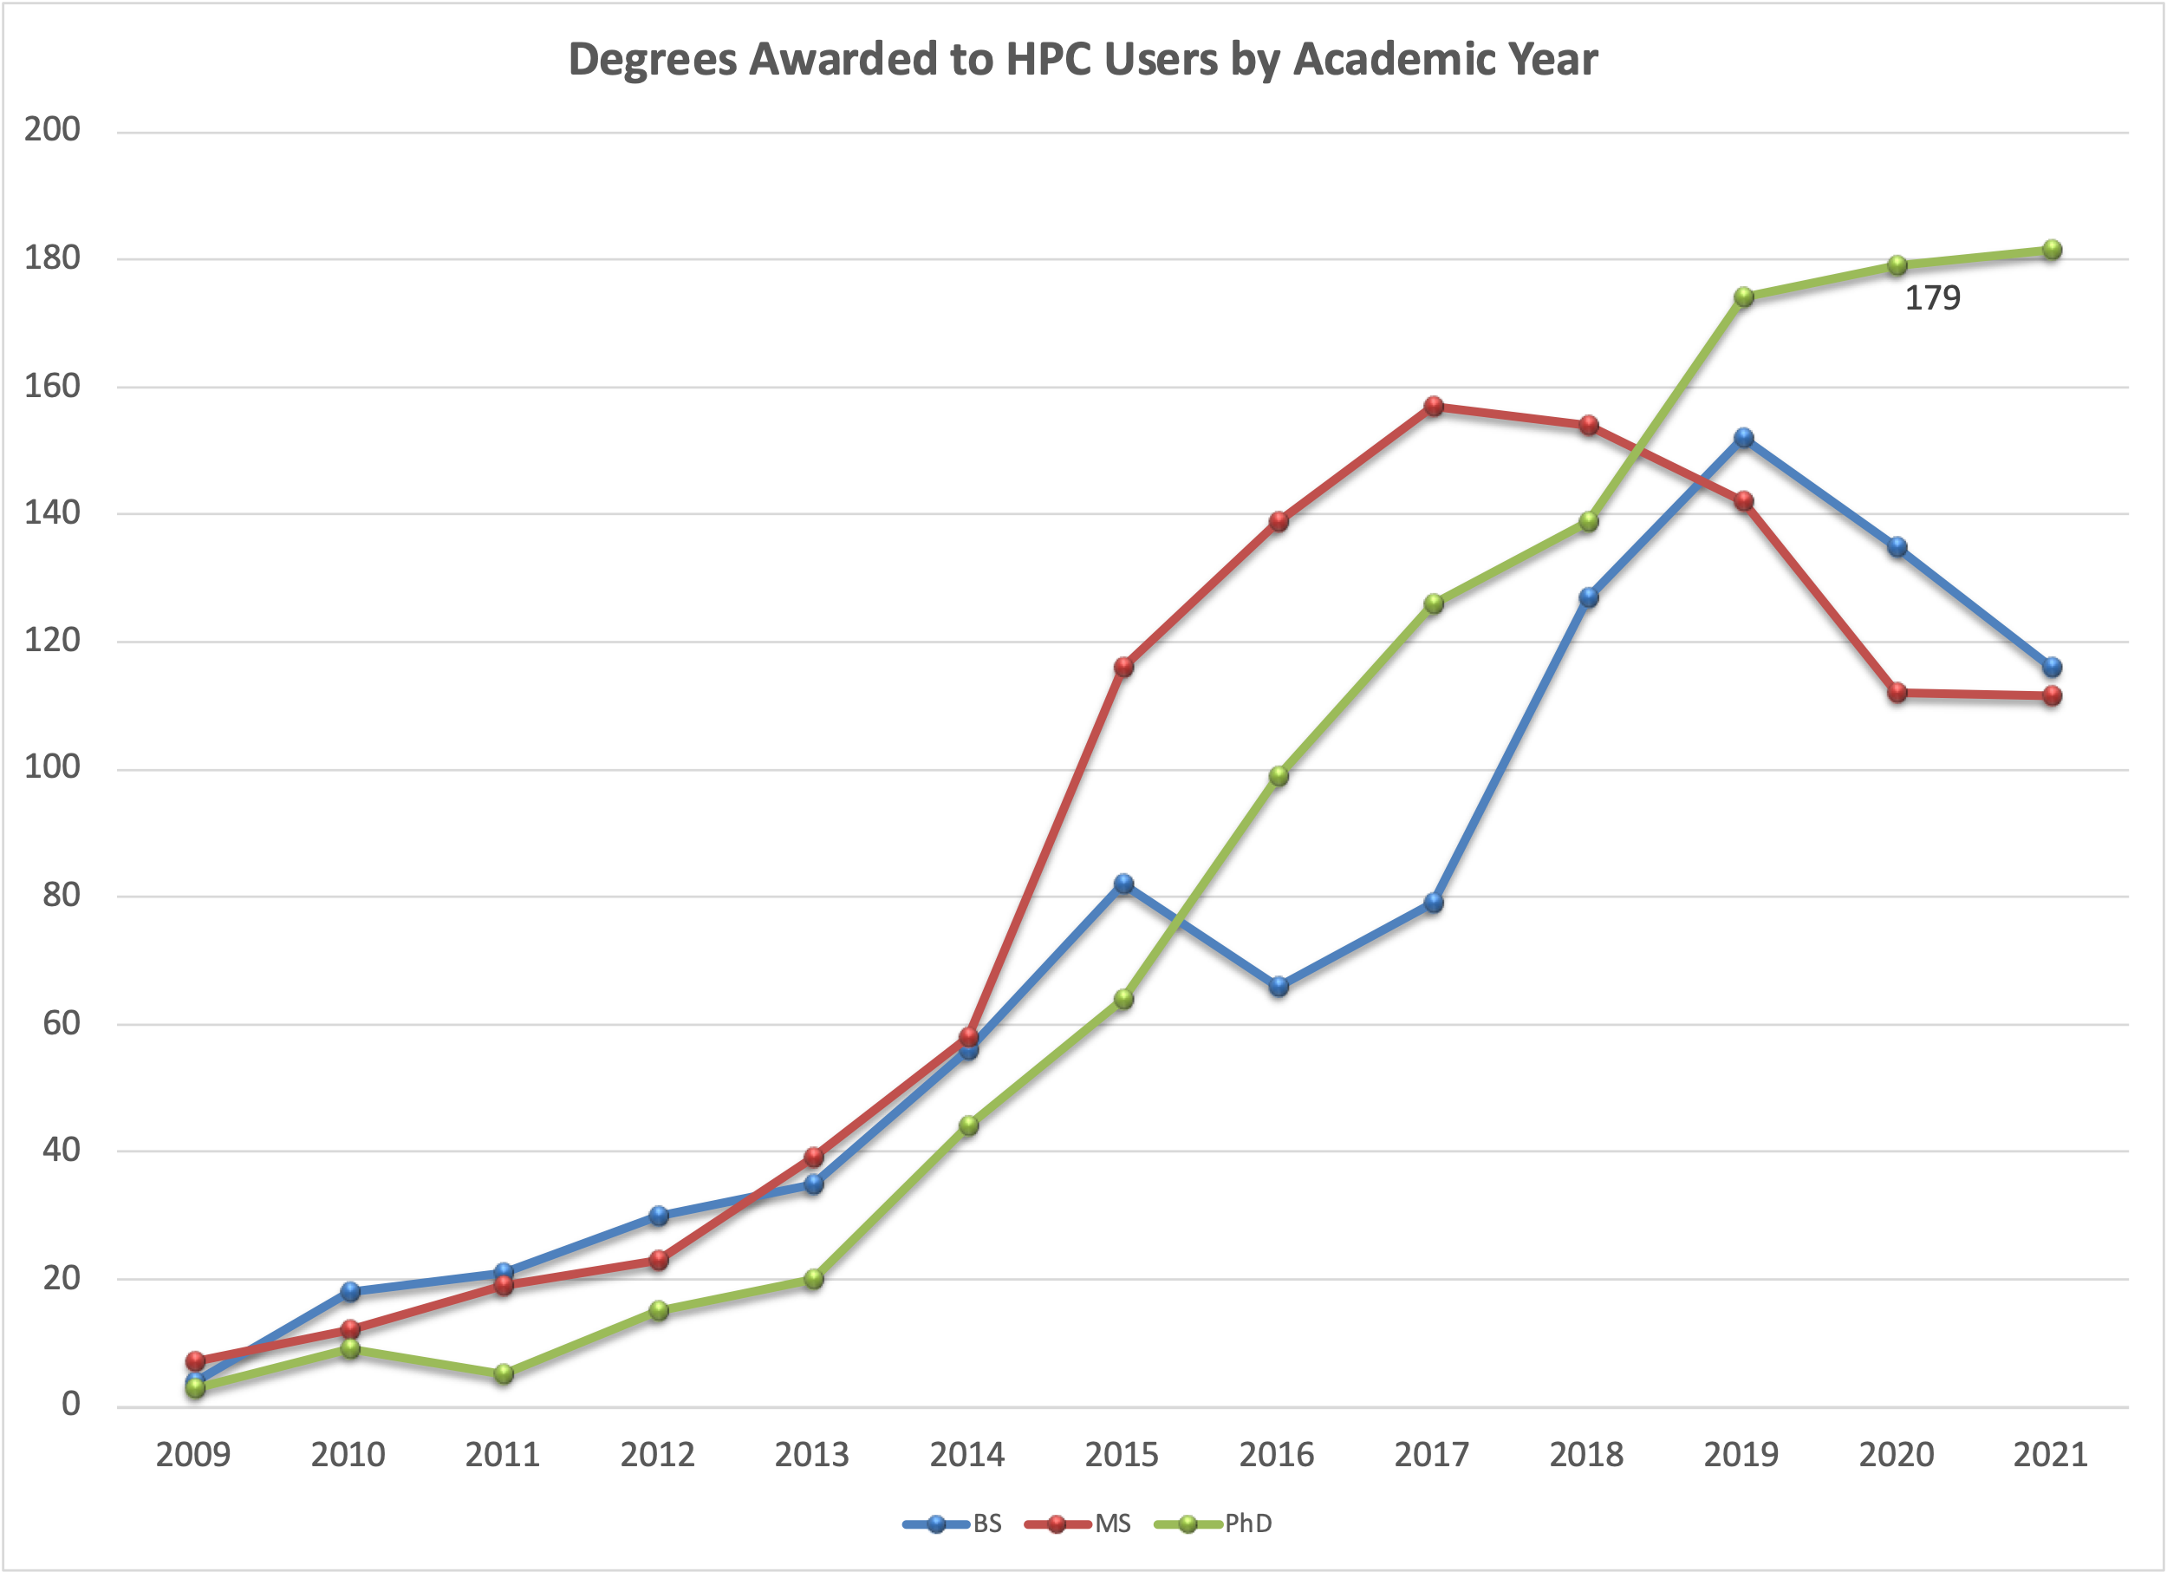
To Faculty and Academic Leaders
To train students, CI resources are critical tools to have available

Slide 14
To the CFO:
The general fund costs for campus CI enable research expenditures have a high ROI

Slide 15


Step 3: Get Testimonials
Don’t underestimate the power of qualitative data
Notes:
These people are the ones who will be your advocates to your provost, president, deans

Slide 16
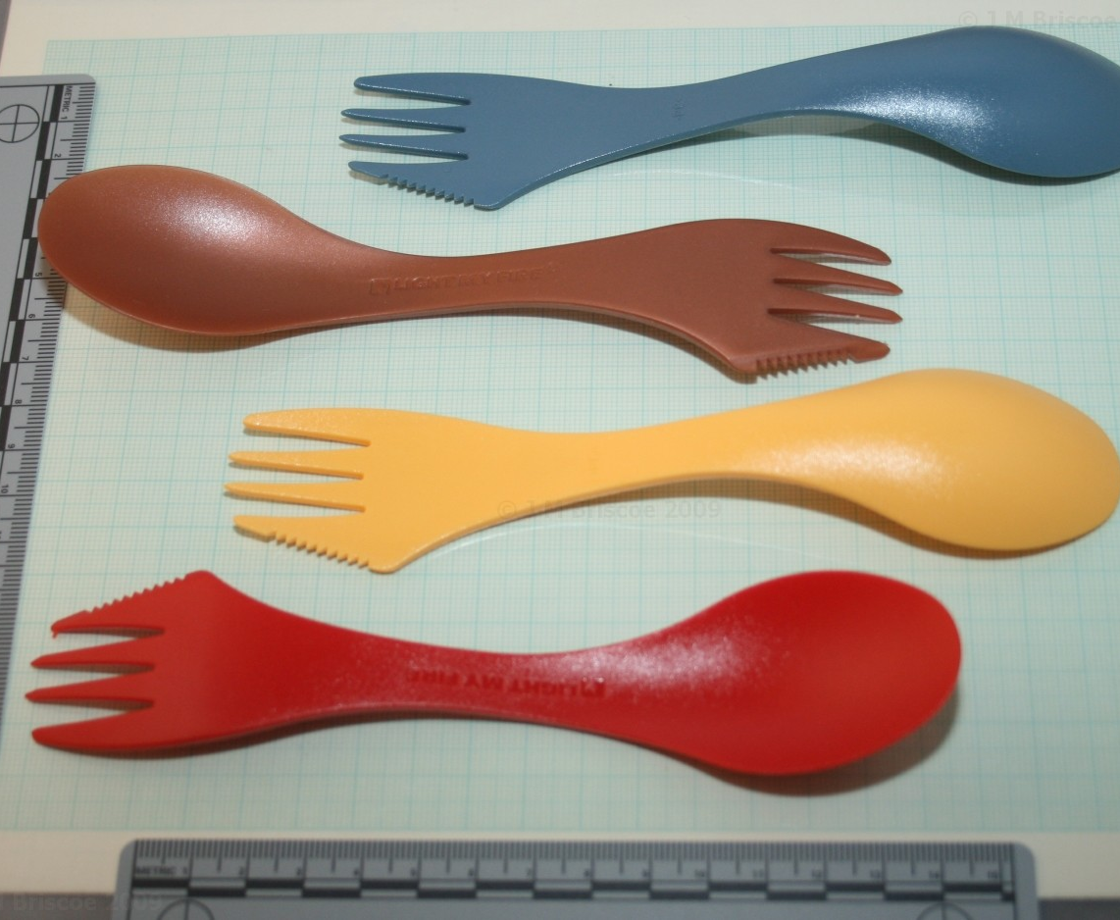
Before: (~2006)
“I’d rather remove my appendix with a spork than let you people run my research computers.”

Slide 17
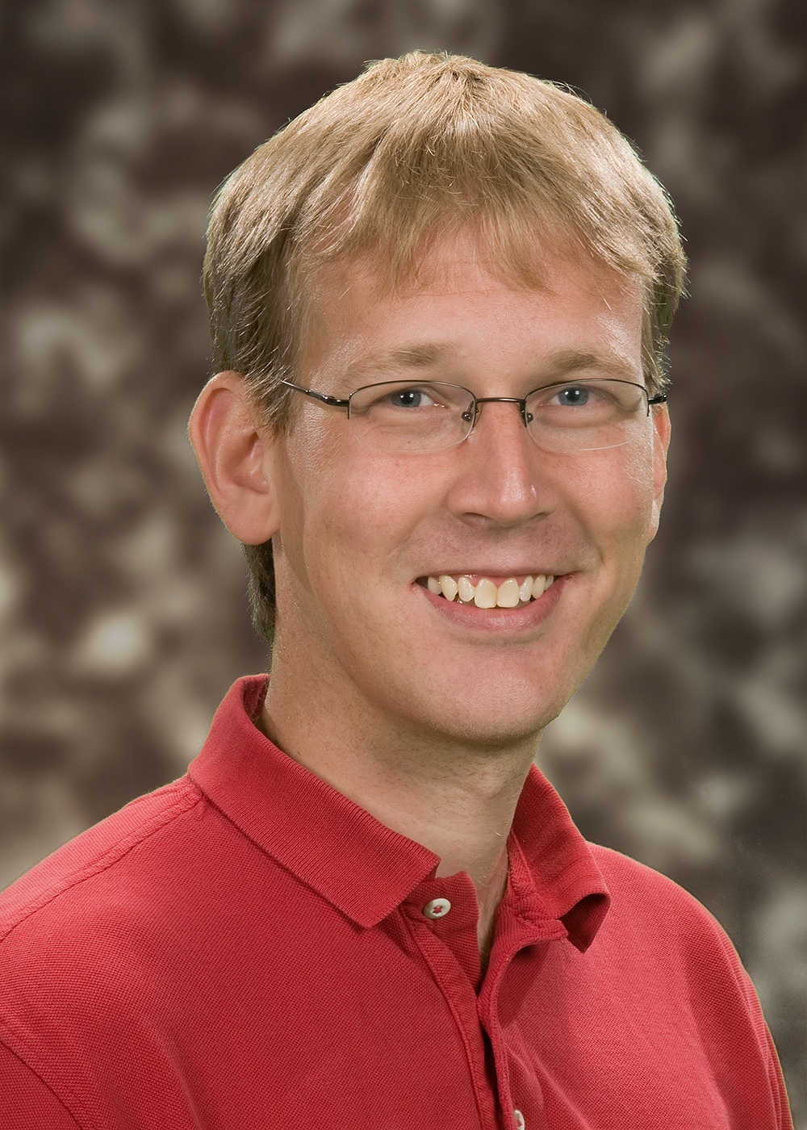
Recruitment:
  “Knowing there was a good group of experienced professionals I could rely on for support and establishing the computational infrastructure that I needed was very comforting when I was considering coming to Purdue. It frees up my time and the time of my graduate students and post-docs. We can focus on the scientific problems, which are our primary interest.”
  — Jeffrey Greeley
  Charles and Nancy Davidson
  Professor of Chemical Engineering

Slide 18
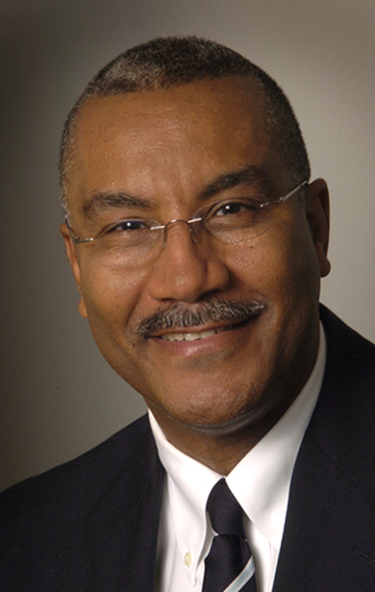
Enable Top Faculty
"I wouldn't have been elected to the National Academy of Sciences without these clusters. Having the clusters, we were able to set a very high standard that led a lot of people around the world to use our work as a benchmark, which is the kind of thing that gets the attention of the national academy."
— Joseph Francisco
William E. Moore Professor of Physical Chemistry,
member of the National Academy of Sciences and past president of the American Chemical Society

Slide 19

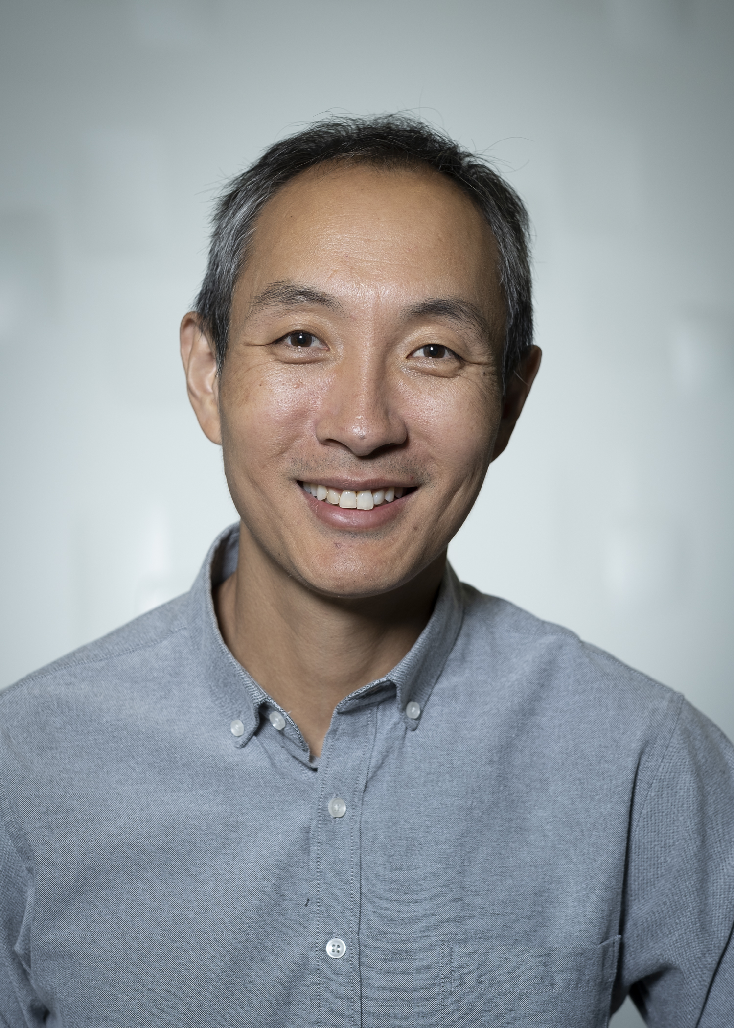
Enable the Impossible
“We've been running things on the Conte cluster that would have taken months to run in a day. It's been a huge enabling technology for us.”
— Charles Bouman
Showalter Professor of Electrical and Computer
Engineering and Biomedical Engineering
"It’s great to have world-class HPC systems like Bell at Purdue. Without these systems, we would not have been able to finish this study estimating the total number of tree species worldwide.”
  — Jingjing Liang
  Assistant Professor of Quantitative Forest Ecology

Slide 20

Production Function Model
Some guy did some research on the value proposition…

Slide 21
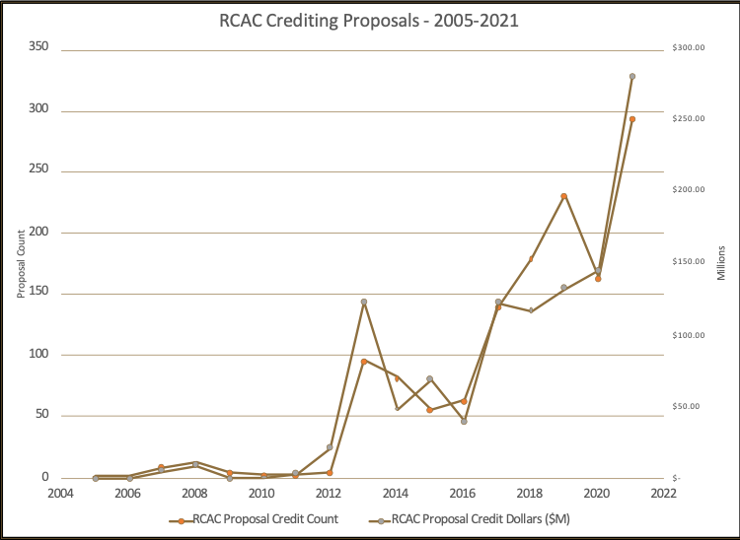
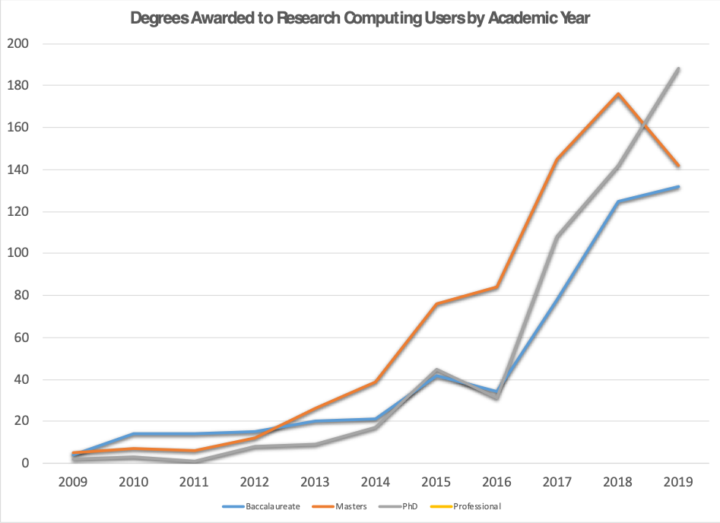
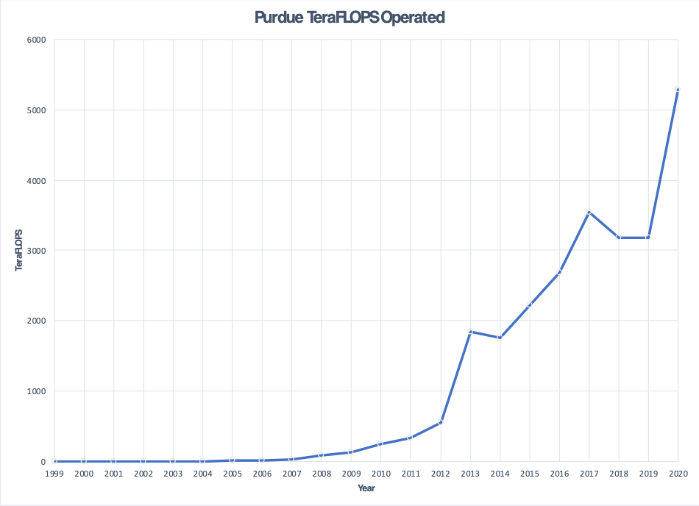
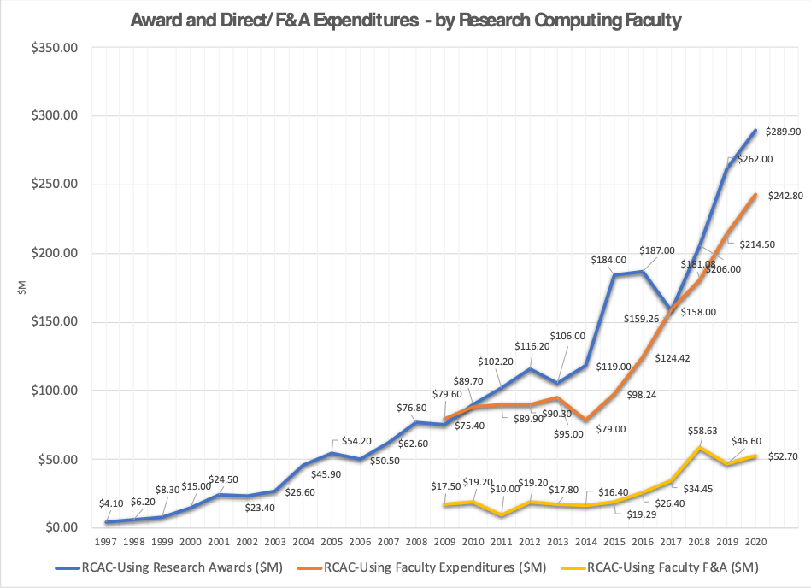
Motivator: Metrics at Purdue
CI-using awards, degrees, proposals all take huge jumps in 2012-2014
What happened there?
Carter (our first big cluster) came online in late 2011.
Conte (#28 on Top 500) in
early 2013
This prompted questions to me – did these investments contribute to increase in outputs?
Understanding these relationships is critical to modeling the impact of the investment!

Slide 22



Research Questions
Does institutional investment in campus CI facilities lead to a measurable impact on institutional output?
If so, what are the key factors for investment that lead to returns on institutional outputs?
What is a model for quantifying the impact of campus cyberinfrastructure investments?

Slide 23


Background
Work by Amy Apon
(2010): Presence of a Top 500 supercomputer on a campus (an input) positively impacts research output at the institutional level.
(2015): Departments in Chemistry, Civil and Environmental Engineering, and Physics are more productive in universities with local cyberinfrastructure.
Downsides: Top 500 is no longer a viable proxy for investment.
How to add a labor dimension in model? No cross-institutional data available as to investment.

Slide 24
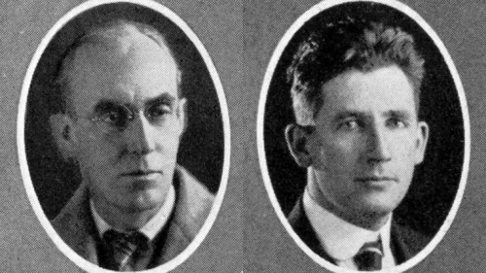
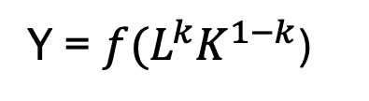
Production Function Model
In the 1920s, theories of production described the amount produced depended upon the level of technological knowledge and the quantities of the factors of production.
Cobb and Douglas (1927) described a least squares regression equation that predicts production (Y) based on inputs of capital (K) and labor (L),
Y = ${f(L}^{k}K^{1−k}$)
“We found the values of k and 1-k by the method of least squares to be .75 and .25…”
Paul Douglas, Autobiography (1971)

Slide 25
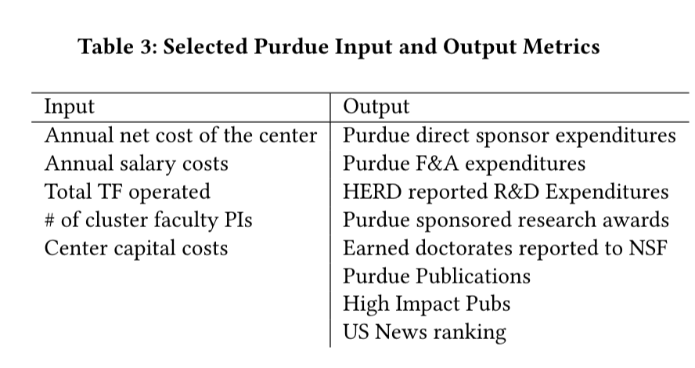
Inputs and Outputs
What to use for Labor, Capital, and Outputs?

Slide 26
Correlation Analysis
For Single Inputs TF and Salary
Output | Kendall Tau (TF) | Kendall Tau (Salary)
HERD Exp | 0.92 | 0.88
Awards | 0.83 | 0.75
Earned Doctorates | 0.90 | 0.77
Purdue Pubs | 0.90 | 0.32
Hi Impact Pubs | 0.85 | 0.87

Slide 27



Regression Models
With Multiple Inputs Predicting an Output
With the proxies for labor and capital identified, use the production function form (labor + capital) to model the various outputs.
For example, TeraFLOPS + staff salaries to predict outputs

Slide 28
Output – HERD Expenditures
Input | HERD Exp ($M) | % Variance Explained
100 TeraFLOPS | 2.59 | 25%
$100k Salaries | 9.04 | 43%
$100k RCAC Grants | 2.34 | 28%

Slide 29
Output – Earned Doctorates
Input | Earned Doctorates | % Variance Explained
100 TeraFLOPS | 2.55 | 31%
$100k Salaries | 7.36 | 42%
$100k RCAC Grants | 1.27 | 22%

Slide 30
Implications for Policymakers
Results, Summarized
Investments in both systems and people lead to measurable returns to the institution
Labor accounts for the largest amount of the variation in all models
When optimizing for publication-based outputs, salary investment yields strong returns
Allowing (or encouraging) HPC center staff to be PIs on their own grants or with faculty yields dividends to the institution

Slide 31
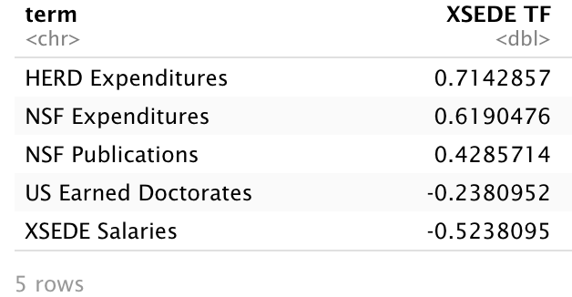
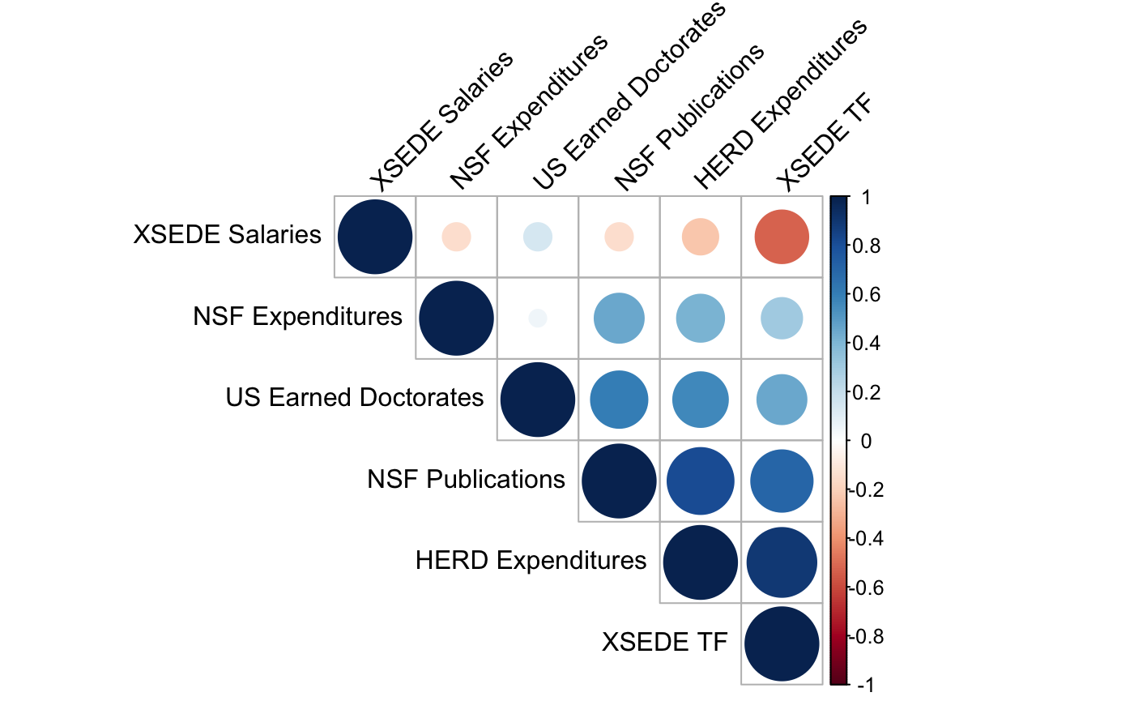
Broader Applications
How can this framework be applied to other CIs?
Work ongoing to apply model to other campus’ data.
  Can I talk to you about your data?
Work ongoing to apply model to NSF XSEDE infrastructure
  Using all NSF expenditures, US Earned Doctorates, NSF-funded pubs in Scopus, etc.
  Gap: only have XSEDE2 data, and lack staff costs that are in resource awards
Q: How could we adapt this model for OSG?
Proxies for capacity?
How to measure labor?
Is there a quantifiable value to making your resources a part of the shared national CI?

Slide 32
Thank You
psmith@purdue.edu

