Slide 1
Campuses and OSG Services
Tim Cartwright
University of Wisconsin–Madison
OSG Campus Coordinator
OSG Deputy Executive Director
OSG School Director

Slide 2
Introduction
Yesterday: talked about services we provide to researchers, e.g.,
Open Science Compute Federation (OSCF), esp. Open Science Pool
Open Science Data Federation (OSDF)
Today: how we help campus IT organizations (writ large) share their compute and storage capacity
Why might campuses share?
Join a larger ecosystem and contribute beyond their borders
Connect with and learn from other campuses
Maximize usage of capacity

Slide 3
Sharing Compute

Slide 4
Sharing Compute — Overview
Campuses provide raw compute capacity
Any batch system
Any “shape” of capacity
OSG services create a consistent, usable runtime environment
We call this an Execution Point (EP)
Gathered into pools
Available via Access Points

Slide 5
Sharing Compute — Options
OSG Glide-in jobs via a Hosted CE (Compute Entrypoint)
Nearly all new campus integrations use this method
Will detail next
OSG Glide-in jobs via a CE that you run
But don’t do this!
Extra work on your end, only necessary in uncommon situations
OSG Backfill Container
May be useful if you manage computing with, e.g., Kubernetes
Few campuses use this approach but contribute a lot

Slide 6
Sharing Compute via Hosted CE
Campus IT/cluster requirements
An OSG account that can submit into your cluster
SSH access to that account (using public/private keys)
Shared user home directories between submit and worker nodes
Scratch space, either on each node or shared using, e.g., BeeGFS
Unrestricted outbound network connectivity from worker nodes
We host and operate the remaining required services
OSG GlideinWMS Factory sends glide-in jobs to Hosted CE
Hosted CE uses SSH connection to submit those jobs to your cluster
When run, the glide-in job sets up the EP environment and joins a pool

Slide 7
Sharing Compute — Optional Extras
Once integrated, extra software and services may increase usage
Apptainer (née Singularity) – extra software on each worker node
Container runtime without root privileges
If glide-in jobs detect a working install, will run payload jobs in containers
Some payload jobs require container support – thus you can run more
https://osg-htc.org/docs/worker-node/install-apptainer/
Frontier Squid caching proxy – extra service next to cluster
Caches HTTP and HTTPS fetches from worker nodes
May reduce WAN bandwidth and improve throughput
https://osg-htc.org/docs/data/run-frontier-squid-container/

Slide 8
Sharing Storage

Slide 9
Sharing Storage — Overview
Open Science Data Federation (OSDF) – our storage services
OSDF Origins – where data are placed
OSDF Caches – where data are accessed
Appears as one global namespace
Note: Newer set of services than OSCF
Integration of campus capacity is particularly new
Don’t let that be a deterrent – we will find ways to make things work!

Slide 10
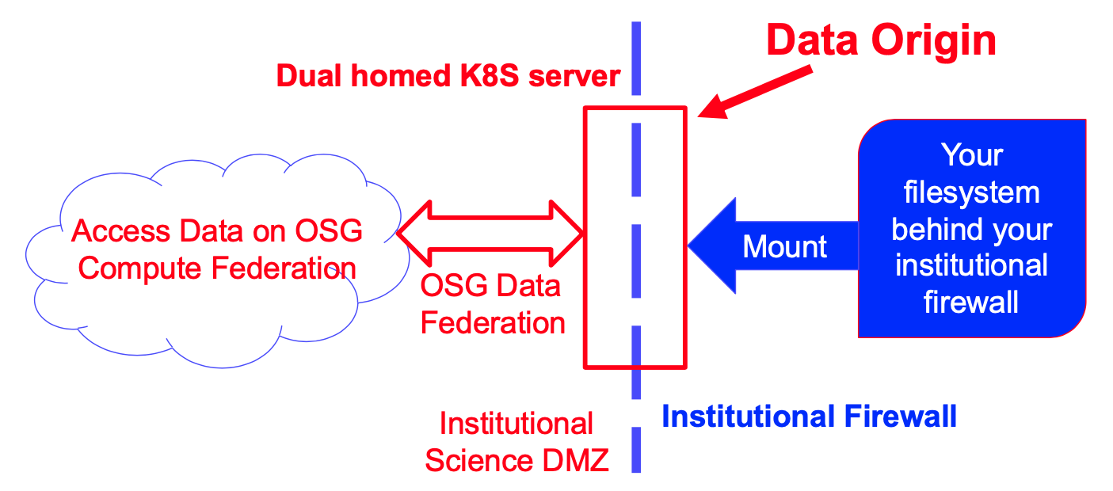
Sharing Storage — Export Your Data
Export your data, read-only, into the OSDF
You provide access to one or more parts of your filesystem
You choose whether data are public or protected
We manage an OSDF Origin for you – makes data accessible via OSDF
Can support writing back to Origin for your users (you provide auth)

Slide 11
Sharing Storage — Other Options
Donate storage capacity to us, and we manage user access
Still exploring and experimenting with this option, but it is likely the future
Interested? Contact us (support@osg-htc.org) and let’s figure it out!
Provide storage capacity as OSDF cache
You provide storage capacity
We manage the OSDF Cache service that uses it

Slide 12
Collaborating

Slide 13
Collaborating — Overview
Typical phases of a Campus/OSG collaboration:
Planning – Before proposal, order, or integration
Integration – Technical and human aspects
Operations – Monitoring, accounting, and support
Recently added a Campus Coordinator role (me!)
Single point-of-contact throughout the lifecycle
Can connect to all PATh teams

Slide 14
Collaborating — Planning
We provide guidance on how to integrate campus capacity with a national CI ecosystem (e.g., OSPool, OSDF)
Consult on topics like the ones covered here, with more details
Options for integration with PATh services
CI architecture and system requirements
We provide letters of collaboration for proposals, incl. NSF CC*

Slide 15
Collaborating — Integration
Meet once to understand goals and form technical plans
Carry out the integration plan
Recent improvement (OSCF): Aim for first jobs in just 1 working meeting
We provide detailed technical documentation
https://osg-htc.org/docs/
Reviewed and updated periodically, plus ad hoc as needed
Support you throughout process
Contact us at any time: support@osg-htc.org
Always have Campus Coordinator to turn to

Slide 16
Collaborating — Operations
We proactively monitor our services and accounting for issues
When we find issues in our services, we resolve and let you know
When we find issues that may be yours, we let you know and follow up
Check in with active campuses
Listen for new opportunities, including pain points we should address
Identify potential connections with other campuses, etc.
Continue to provide support
Respond to questions, concerns, requests
Provide software and service updates
Improve documentation

Slide 17
Collaborating — Your Responsibilities
Notify us of changes to your infrastructure, especially:
Downtime, scheduled or otherwise (when you can)
Major software changes (e.g., to OS, batch system, etc.)
Networking changes, esp. firewall updates that could affect us
Significant changes to hardware
Respond to our operational requests in a timely manner
In the rare case of campus-specific security concerns, we will provide desired response time
For big changes, we can start with planning again, etc.

Slide 18
Summary
We strive to make integration of compute and storage capacity as painless and effective as possible
Tell us where it hurts, so at least we have the opportunity to fix it
To get started: support@osg-htc.org
Or to me, OSG Campus Coordinator: Tim Cartwright <cat@cs.wisc.edu>

Slide 19
Questions?
This material is based upon work supported by the National Science Foundation under Grant Nos. 1836650 and 2030508. Any opinions, findings, and conclusions or recommendations expressed in this material are those of the author(s) and do not necessarily reflect the views of the National Science Foundation.

