Slide 1
Integrating Great Plains Network Capacity into the OSPool Derek Weitzel University of Nebraska-Lincoln

Slide 2
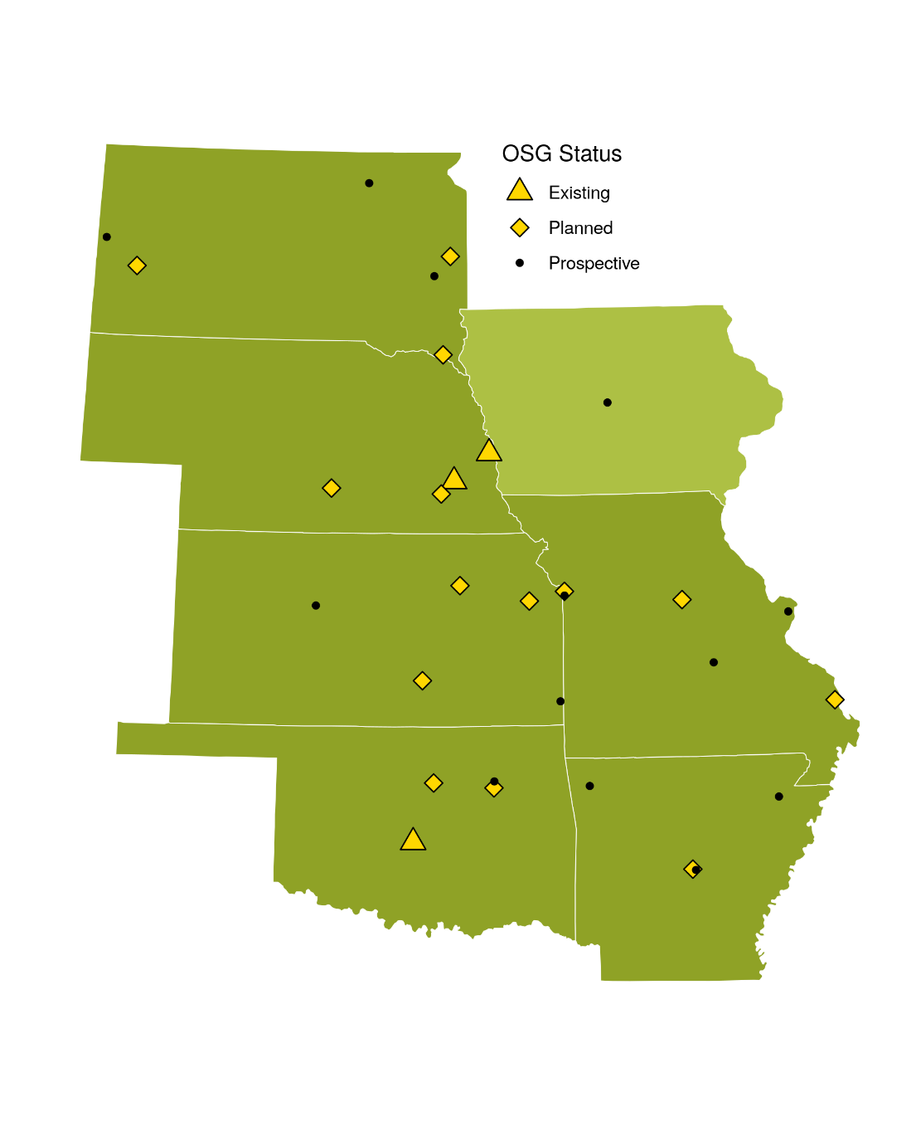
Introduction to GP-ARGO
You get a node, you get a node… everyone gets nodes!
Evolved over the lifetime of the project.
How to manage all these nodes?
How to get “buy-in” to GP-ARGO: Visualization and Monitoring
Nodes with NVIDIA A100 GPU

Slide 3
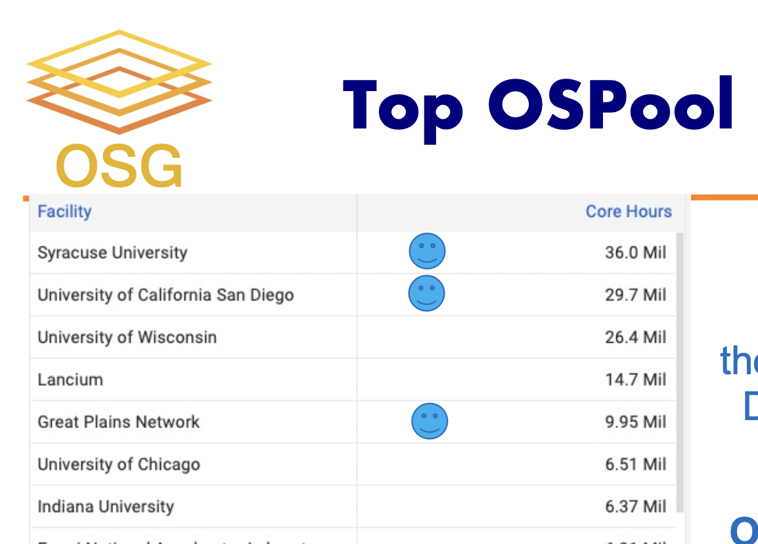
Introduction to GP-ARGO
GP-ARGO (Under the name of Great Plains Network) is a major contributor to opportunistic usage
(Credit: Frank’s slide)

Slide 4
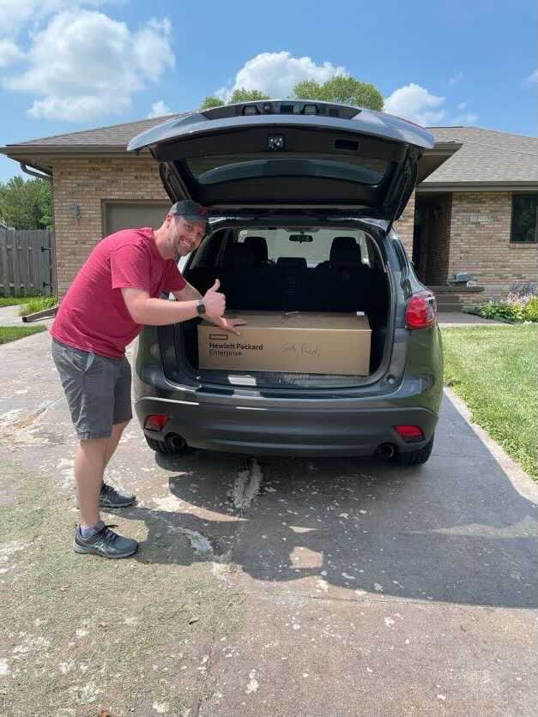
GP-ARGO Distribution
Initially configured nodes at KSU with input from local admins
Shipped nodes to sites, sometimes by dropping off and storing at my house
Configured with disk imaging and local scripts, with a wireguard VPN set to connect back to KSU.
Ryan Johnson (University of South Dakota) picking up their node from my house

Slide 5
Ansible Playbooks
Deployed nodes initially by hand, then with Ansible.
Deploy the OSG pilot container with ansible
Working on contributing the recipe back up to OSG for others to use.
Ansible deployed:
OSG Pilot Container
CVMFS
NVIDIA Container Driver
Chrony (Time synchronization)
Grafana (visualization, more on that later)

Slide 6
OSG Deployed on GP-ARGO
OSG runs on the GP-ARGO through the OSG Pilot Container
It is a docker container that once started, will accept OSPool jobs.
Self-registration to get a token allowing the container to join the OSPool
Supports GPU jobs if the node has a GPU

Slide 7
Monitoring and Visualization
It was important to provide information to the stakeholders so they can ask?
What science is using GP-ARGO?
How utilized is my institution’s node?
Who is using my institution’s node?

Slide 8
Monitoring and Visualization
https://gp-argo.greatplains.net/

Slide 9
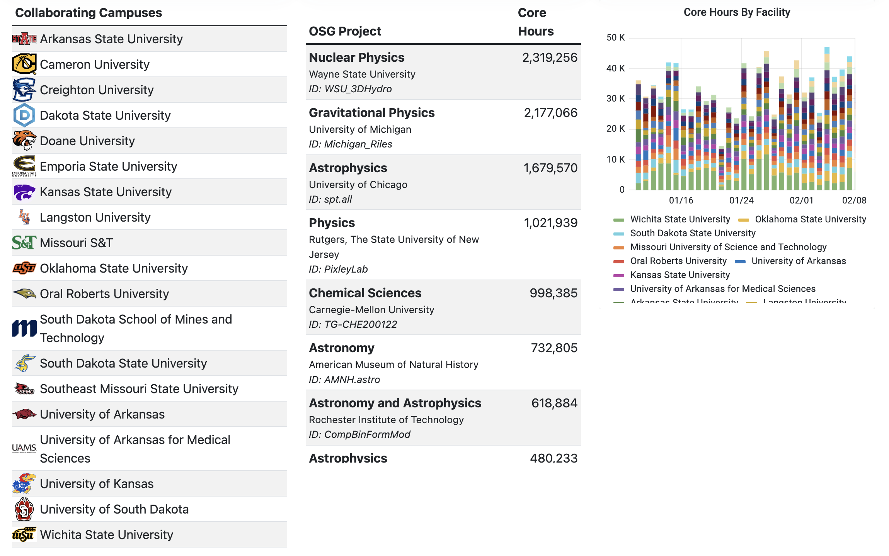
Monitoring and Visualization
https://gp-argo.greatplains.net/

Slide 10
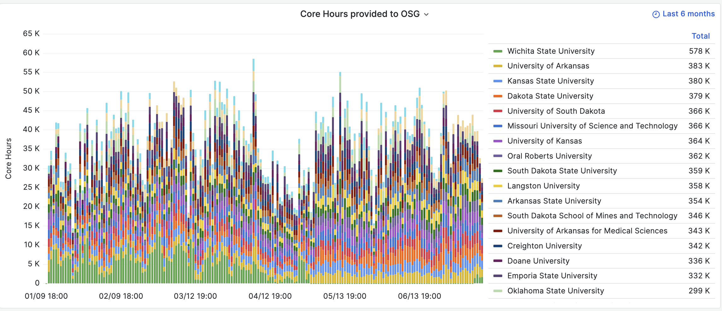
Monitoring and Visualization

Slide 11
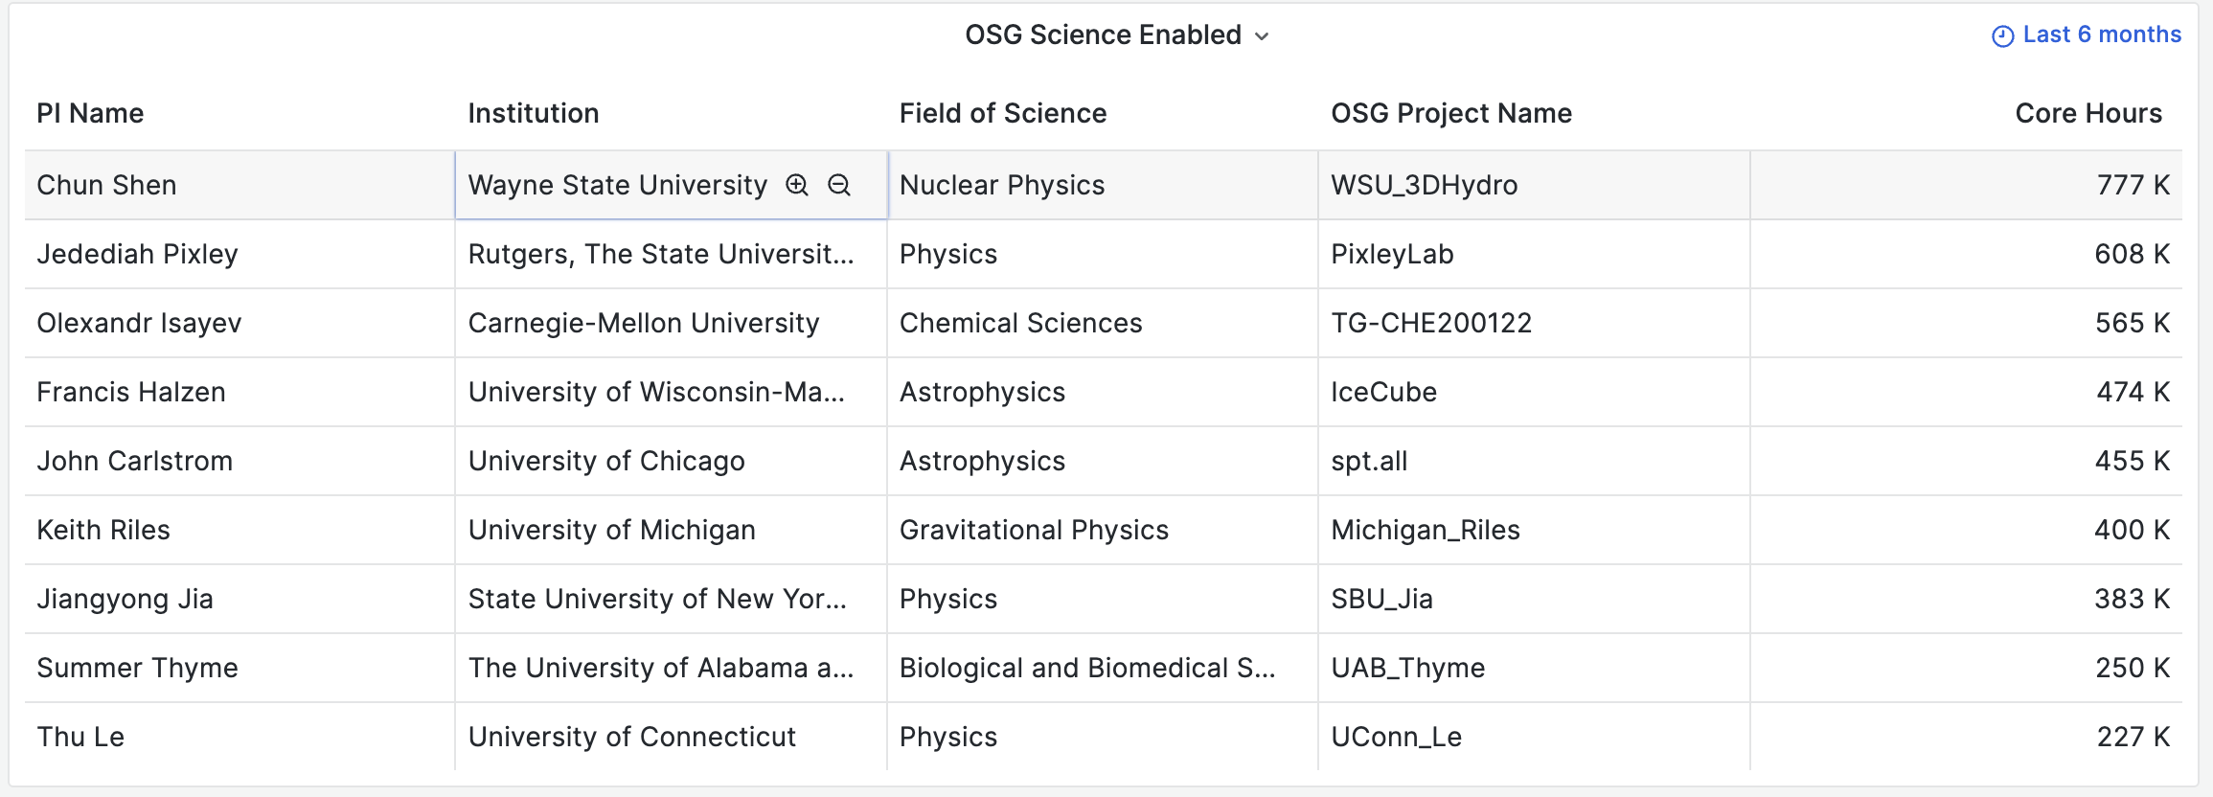
Monitoring and Visualization

Slide 12
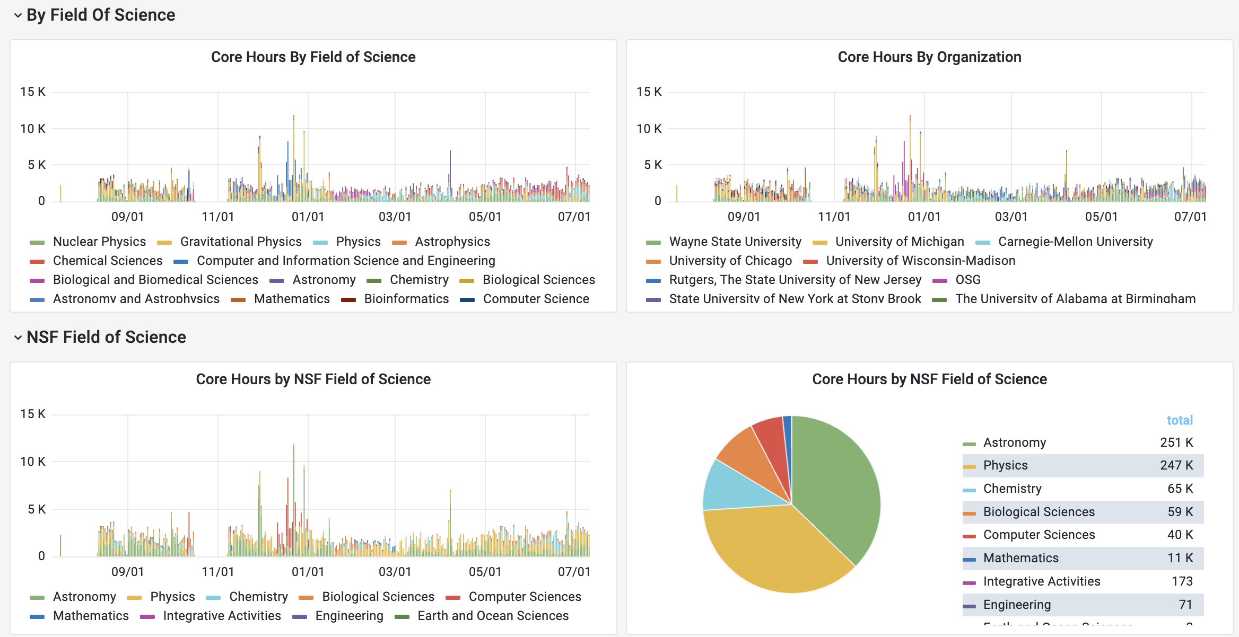
Monitoring and Visualization
What ran at my institution? Example is University of Arkansas

Slide 13
Difficulties
Working with many different universities
Differing policies– Especially with networking
For example, one university (who shall be unnamed) blocked all outgoing connections.
The OSG requires outgoing connections for data transfers, monitoring, management of resources
The site offered to whitelist IPs, which is very difficult for OSG with arbitrary users

Slide 14
Difficulties
GPUs from host all the way to container
OSG Pilot Container already had GPU support ✅
NVIDIA software to export container changed during the project ❌
Originally, if running on a GPU-enabled node, only GPU-enabled jobs would run, frequently leaving the node idle.
Now the pilot container can optionally run non-GPU jobs, if there are no GPU jobs available.

Slide 15
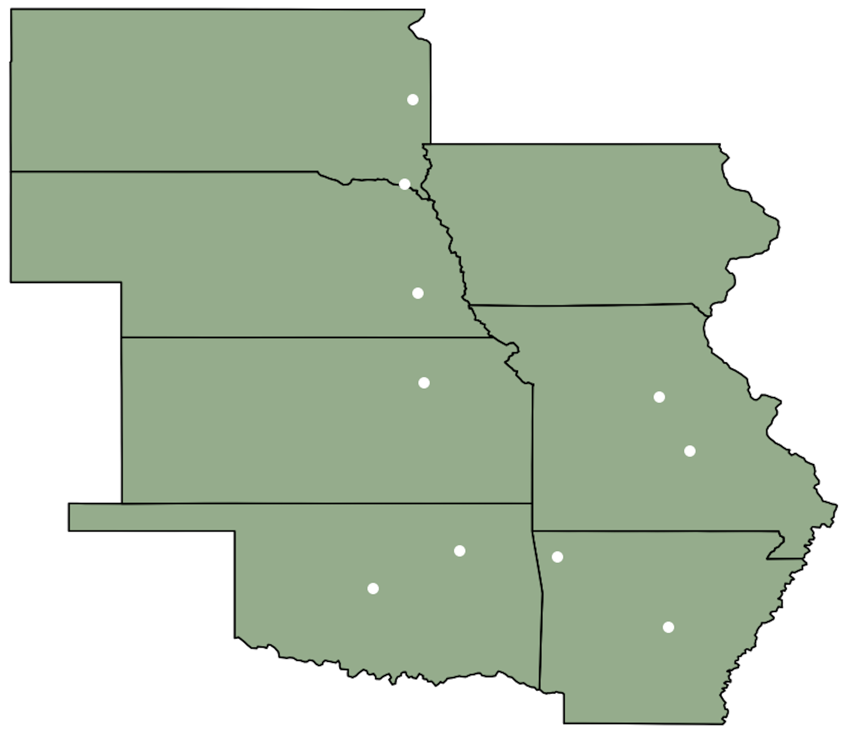
The Future
Great Plains Extended Network of GPUs for Interactive Experimenters (GP-ENGINE)
CC* Regional Computing award #2322218
Just starting July 1, 2023
Integrate resources with the National Research Platform
Contribute to the OSG through the integration of the NRP

