Slide 1
The Oklahoma-Arkansas-Kansas (OAK) Consortium for Regional Supercomputing
Throughput Computing 2023, July 11th
Pratul K. Agarwal, Ph. D.
Associate Vice President of Research (Cyber-Infrastructure) and
Director of High-Performance Computing Center
Oklahoma State University, Stillwater OK

Slide 2
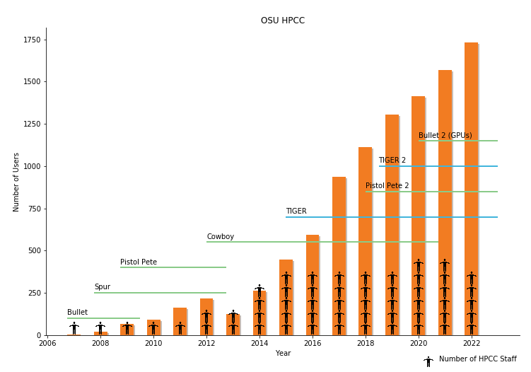
High-Performance Computing Center (HPCC)
Located in Stillwater OK
Oklahoma State University main campus
Over 1,800 users
Internal and externally funded
Pete: Traditional Linux cluster
Bullet2: GPU-enabled Linux cluster
High-performance storage
MRI: “New Supercomputer” Under development
Dedicated Staff
6 Fully funded positions
Vice President of Research
Operations and Science Projects
https://hpcc.okstate.edu/

Slide 3
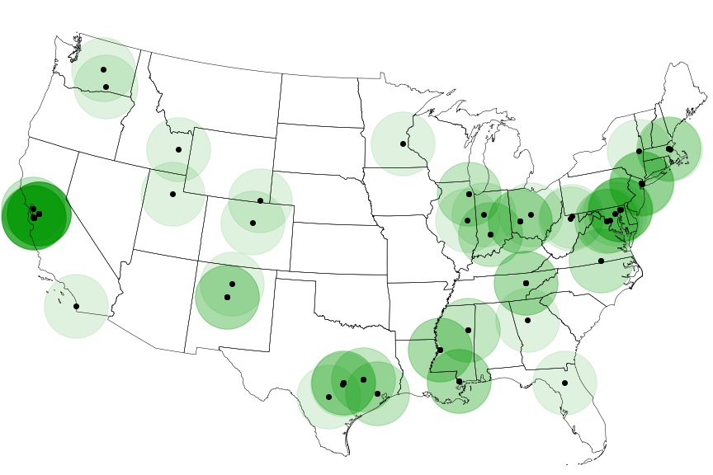
Where are the supercomputers located?
Top500.org
List of the fastest supercomputers around the world

Slide 4
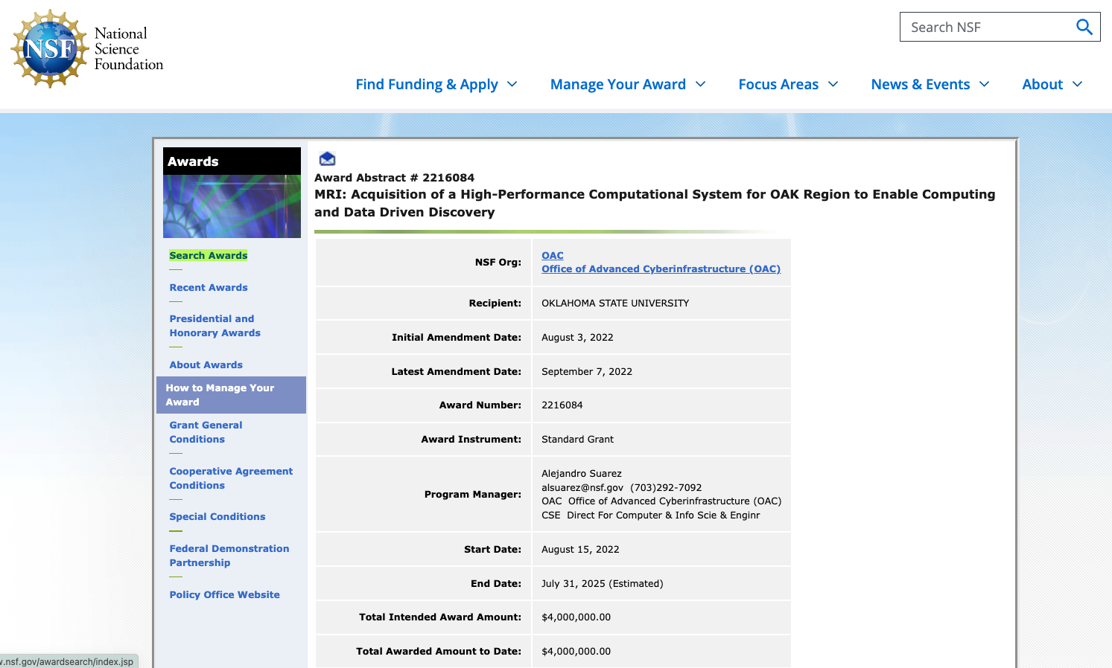
Oklahoma-Arkansas-Kansas “Supercomputer”

Slide 5
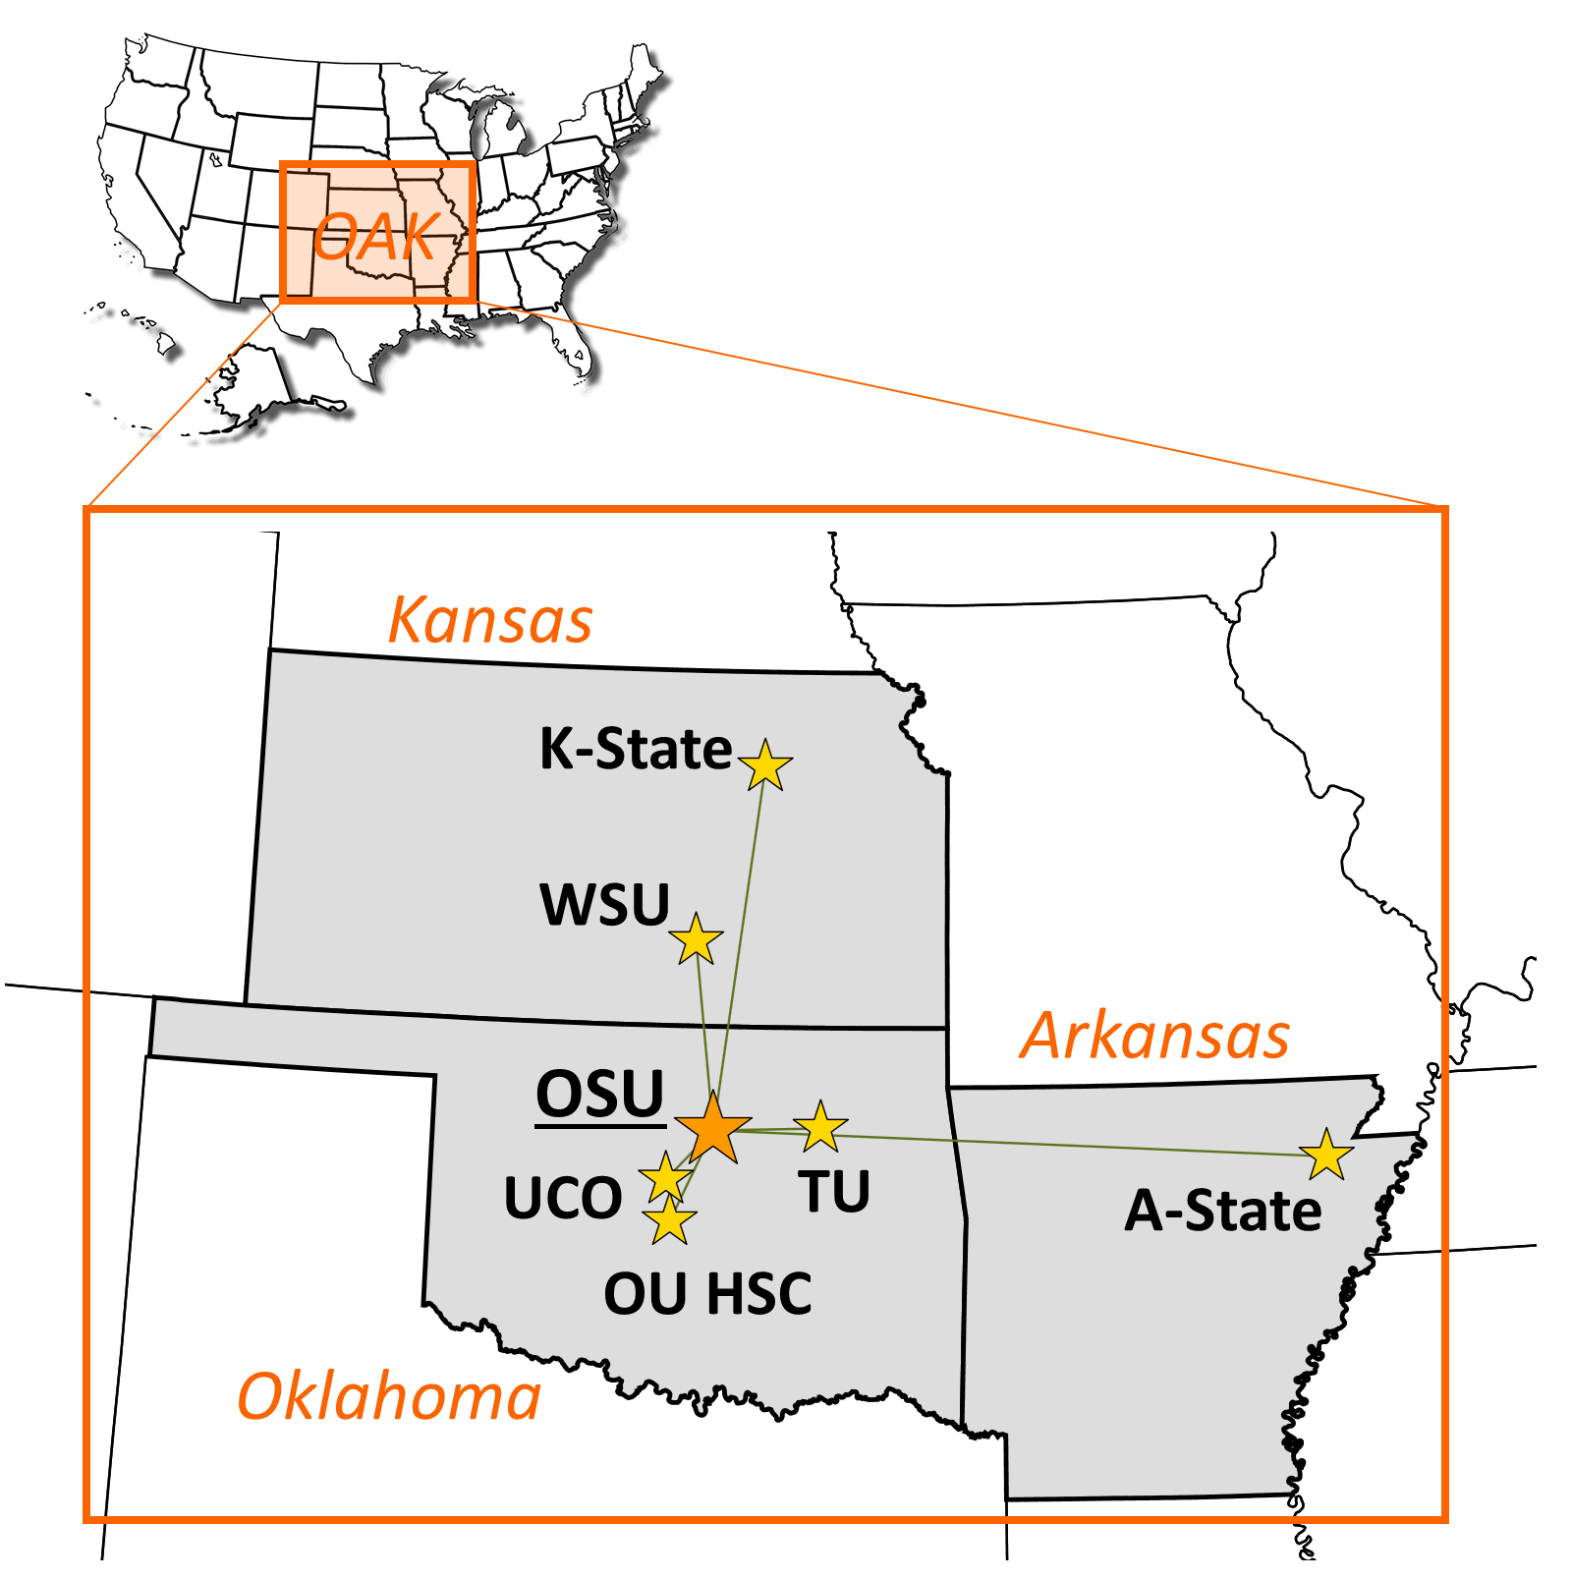
OAK Supercomputer
NSF MRI Award: “Acquisition of a High-Performance Computational System for OAK Region to Enable Computing and Data Driven Discovery”
2nd largest investment made by NSF’s MRI program
Original Partners
OSU, Central Oklahoma, University of Tulsa,
University of Oklahoma Health Sciences Center
Arkansas State
Kansas State, Wichita State
Open to ALL educational/non-profit institutions
Heterogenous: CPUs and GPUs

Slide 6
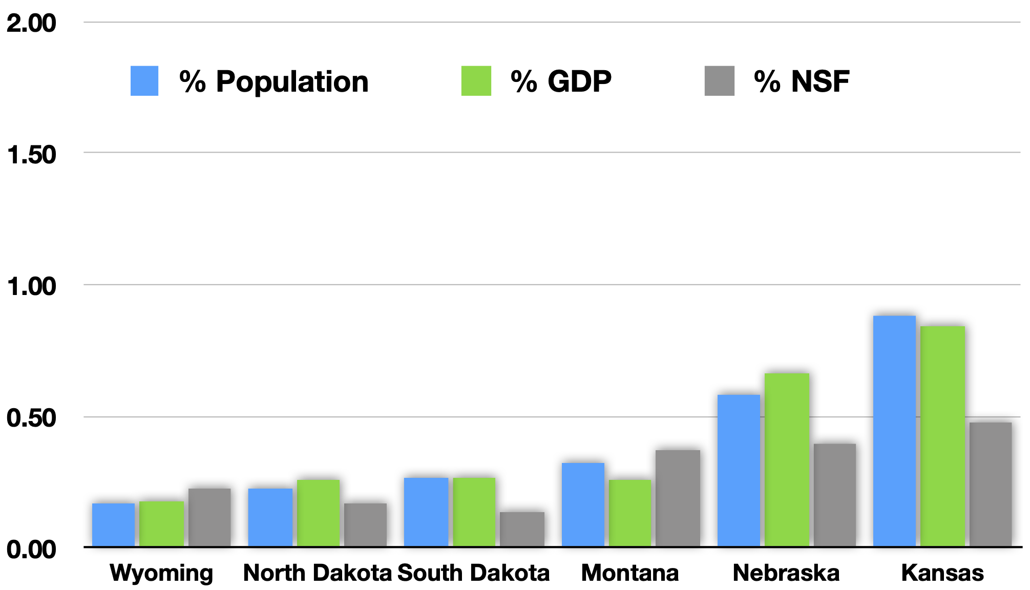
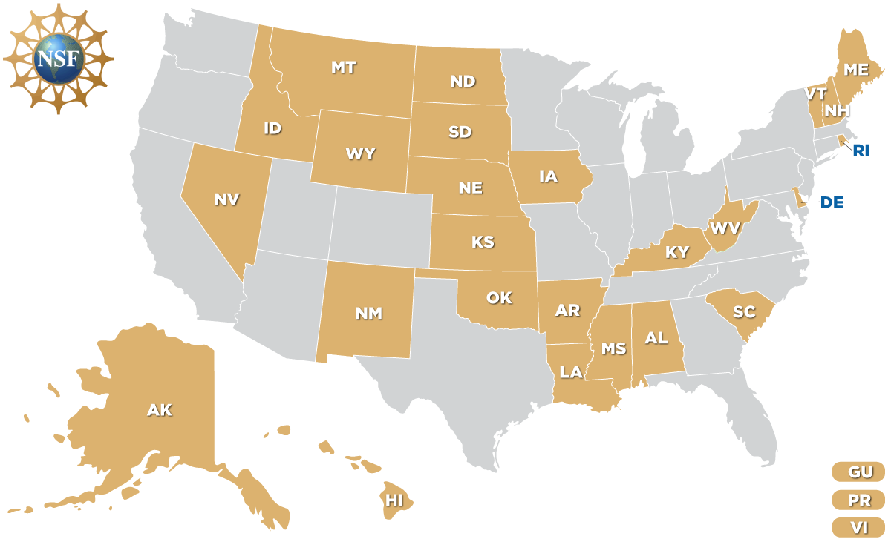
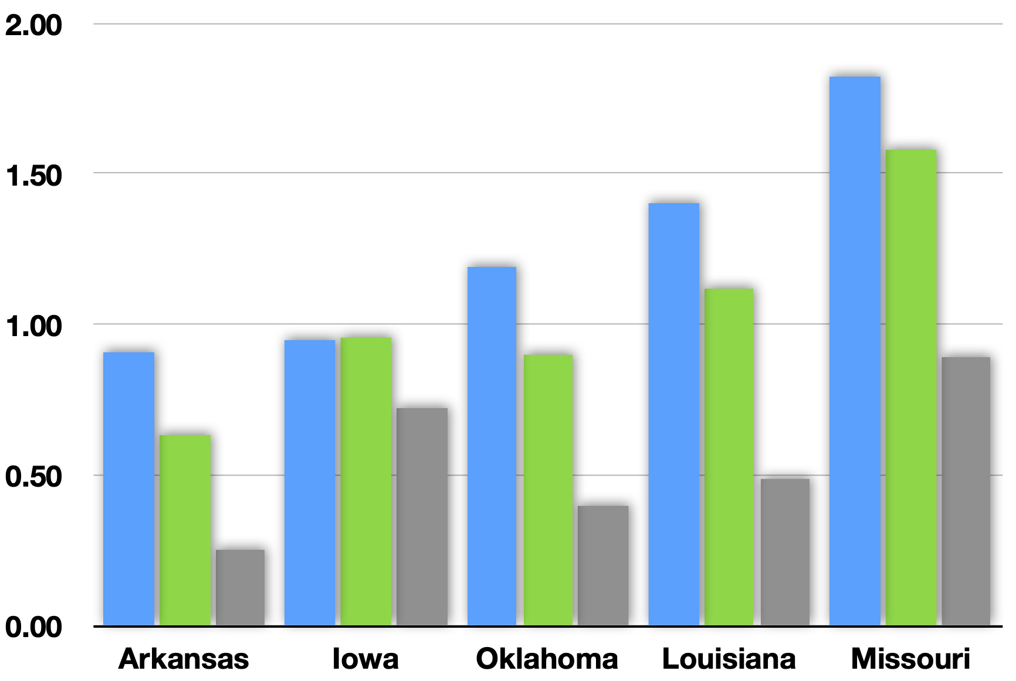
OAK region is part of EPSCoR states

Slide 7
OAK Supercomputer Commitment
Other
10%
Oklahoma
30%
OSG/PATh
20%
Kansas
20%
Arkansas
20%

Slide 8
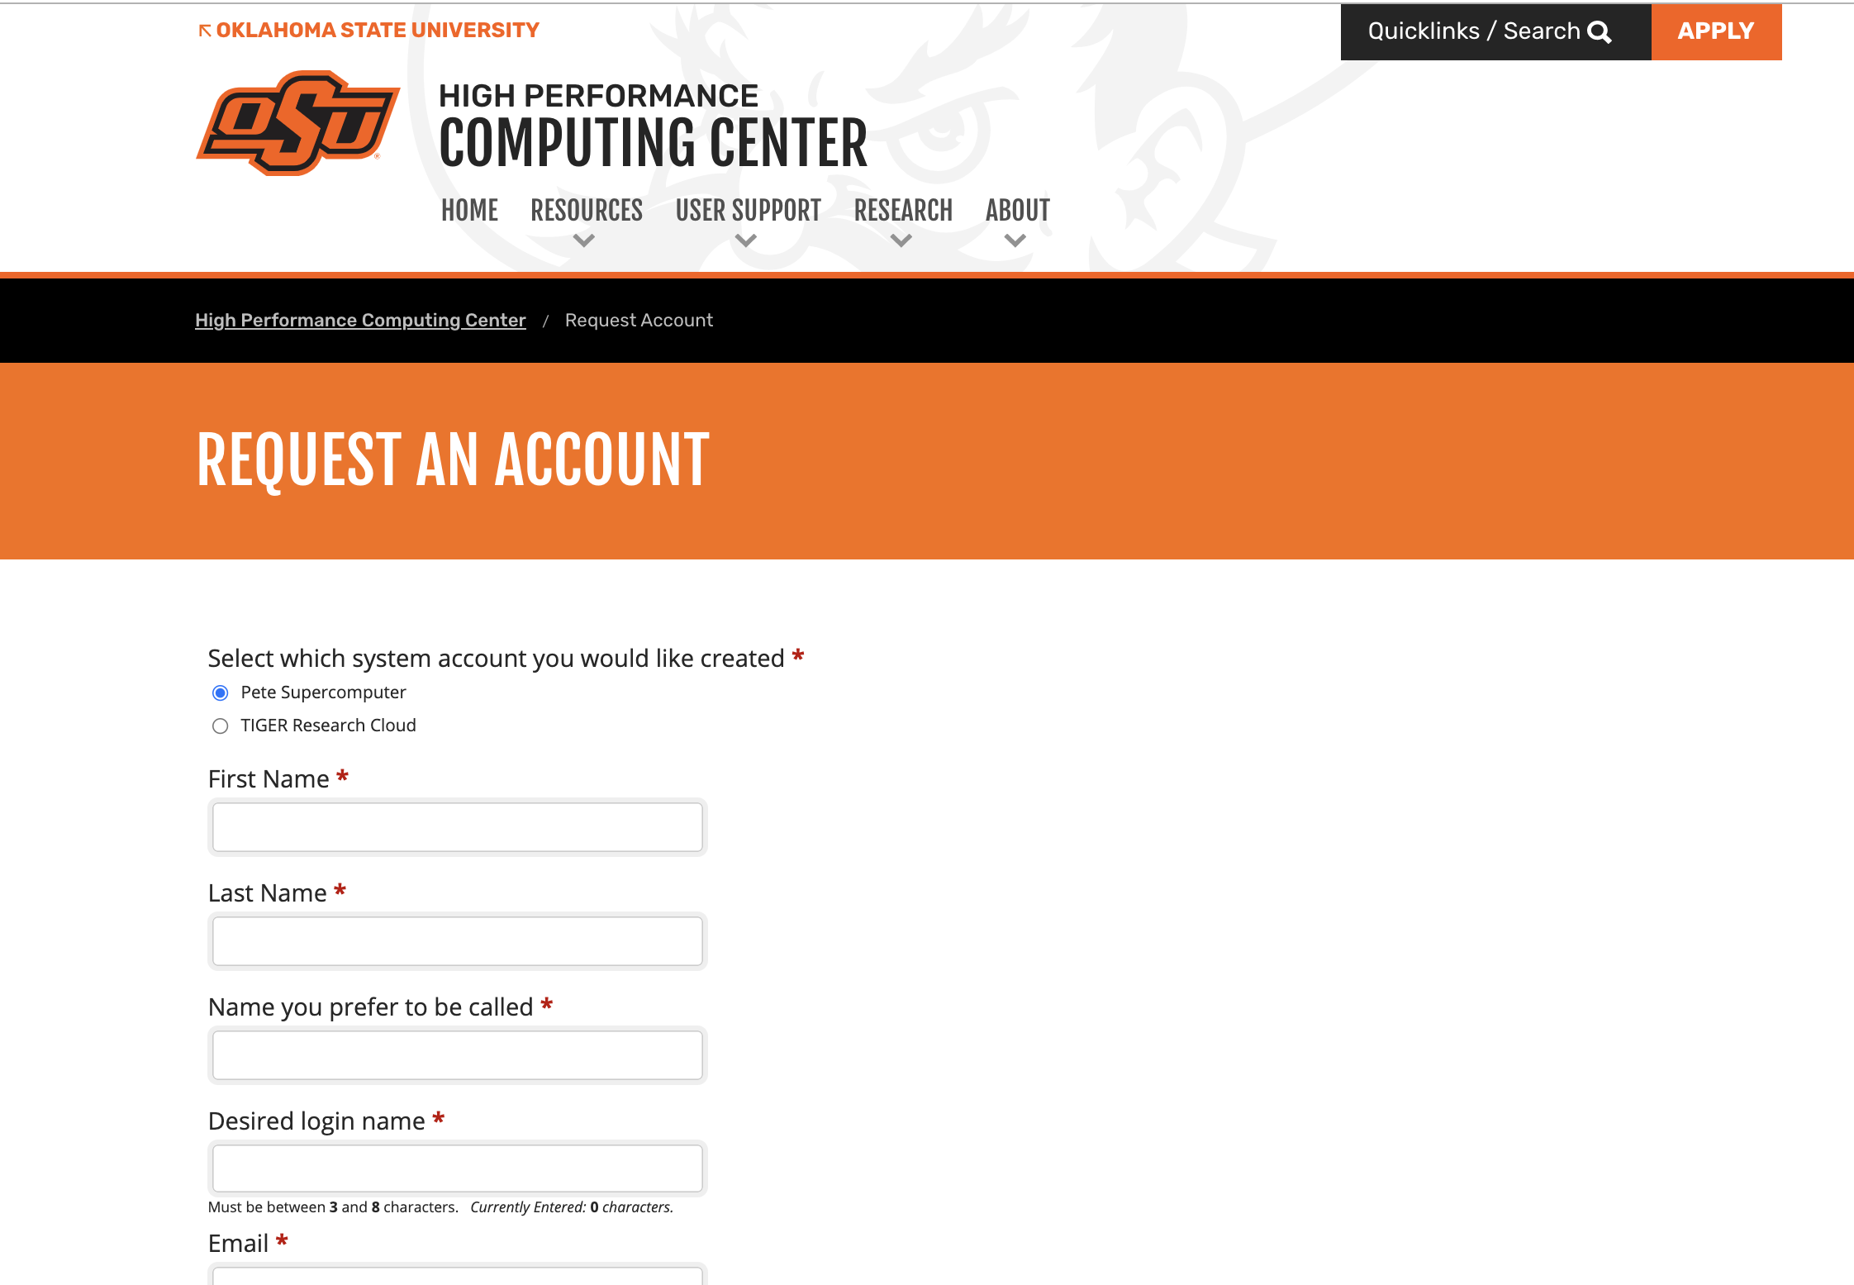
Accounts to OAK members
High-Performance Computing Center
Pete: 200 node supercomputer
New Machine: 5-10X faster, coming 23/Q4-24/Q1
Eligibility
All Faculty, Researchers, Students are eligible
Oklahoma, Arkansas and Kansas
Educational or non-profit institutions
Post-docs, Graduate/Undergraduate students: Approved by a faculty
Funded and non-funded projects
No amount charged for computing
(only for large-scale storage)
Funding is not a requirement
https://hpcc.okstate.edu/
https://hpcc.okstate.edu/account-request.html
Getting an account is straight-forward

Slide 9
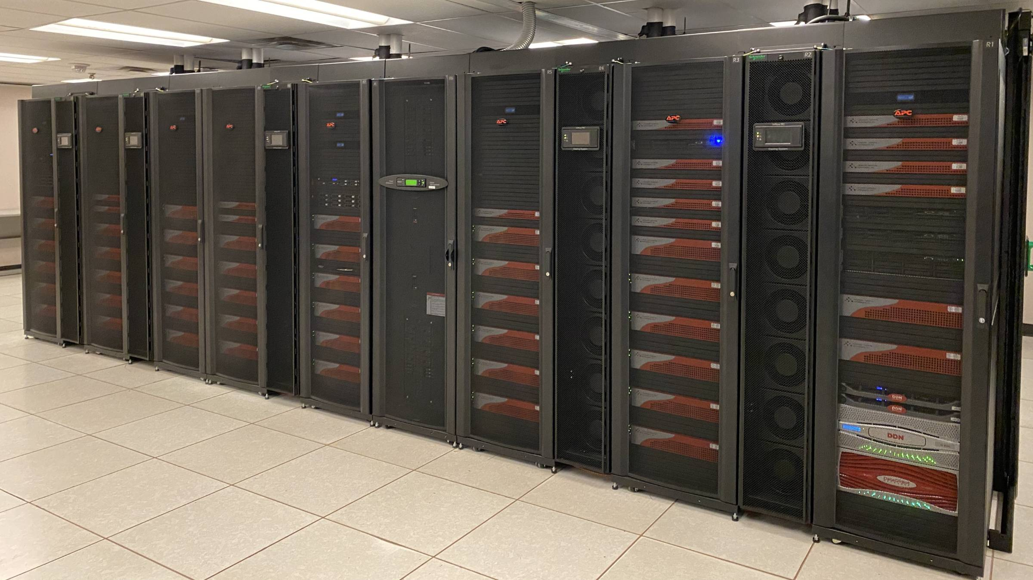
Supercomputer: Pete
“Pete” (Pistol Pete 2)
164 original nodes dual Intel Skylake 6130 CPUs
96 GB RAM (up to 768 GB)
2018, NSF funded
36 nodes added in 2022, total to 200 nodes
Omni-Path network
Storage allocations
Small allocations – free
Large allocations - paid
Available immediately
All OAK researchers
No cost - Computing is completely free
Apply on the website: Non-OSU approved by campus coordinator
Award # 1531128

Slide 10
MRI Supercomputer: “OAK”
Currently being designed
5X cores than Pete
CPU-only, mid-range and high-end nodes
InfiniBand Interconnect
Free: Regular priority
Elevated priority can be purchased at a cost
Large projects or individual groups
Award # 2216084

Slide 11
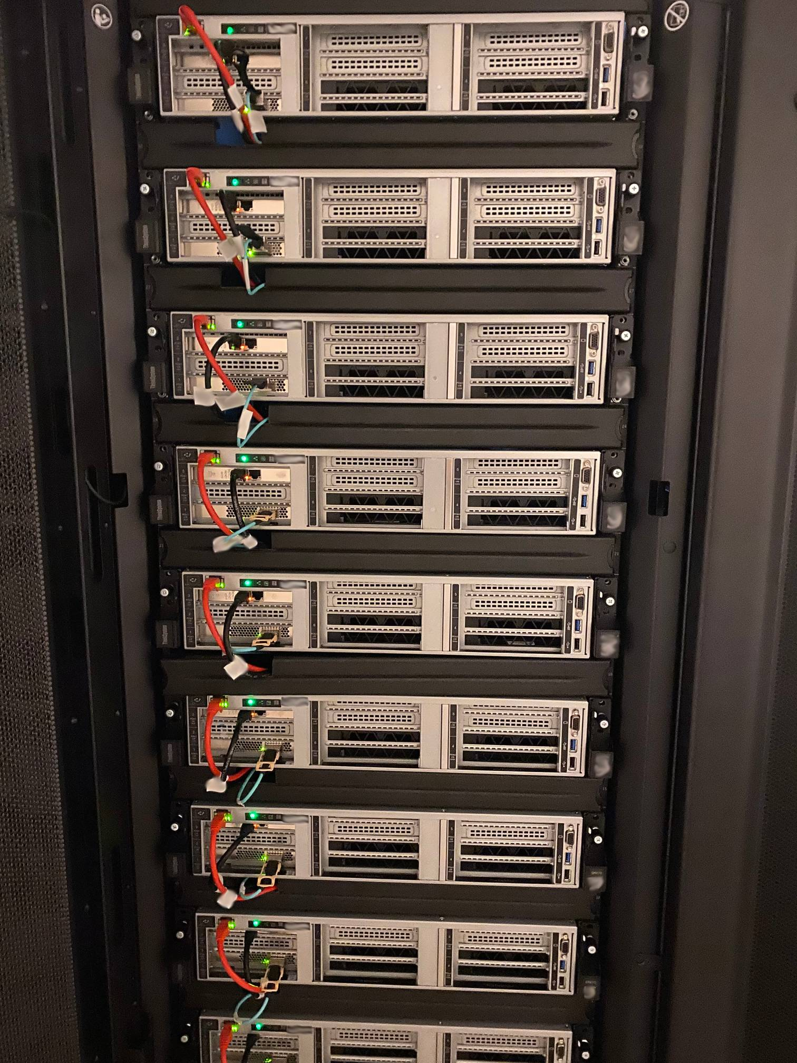
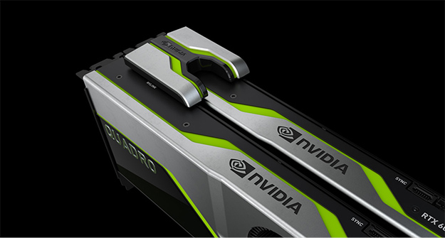
Supercomputers: Bullet
Bullet 2
GPU-enabled 10 nodes: 2 x NVIDIA Quadro RTX6000
2020, Funded by VPR’s Core Facilities
Suitable for dense computing simulations
Optimal for ML/AI (machine learning, artificial intelligence, data analysis)

Slide 12
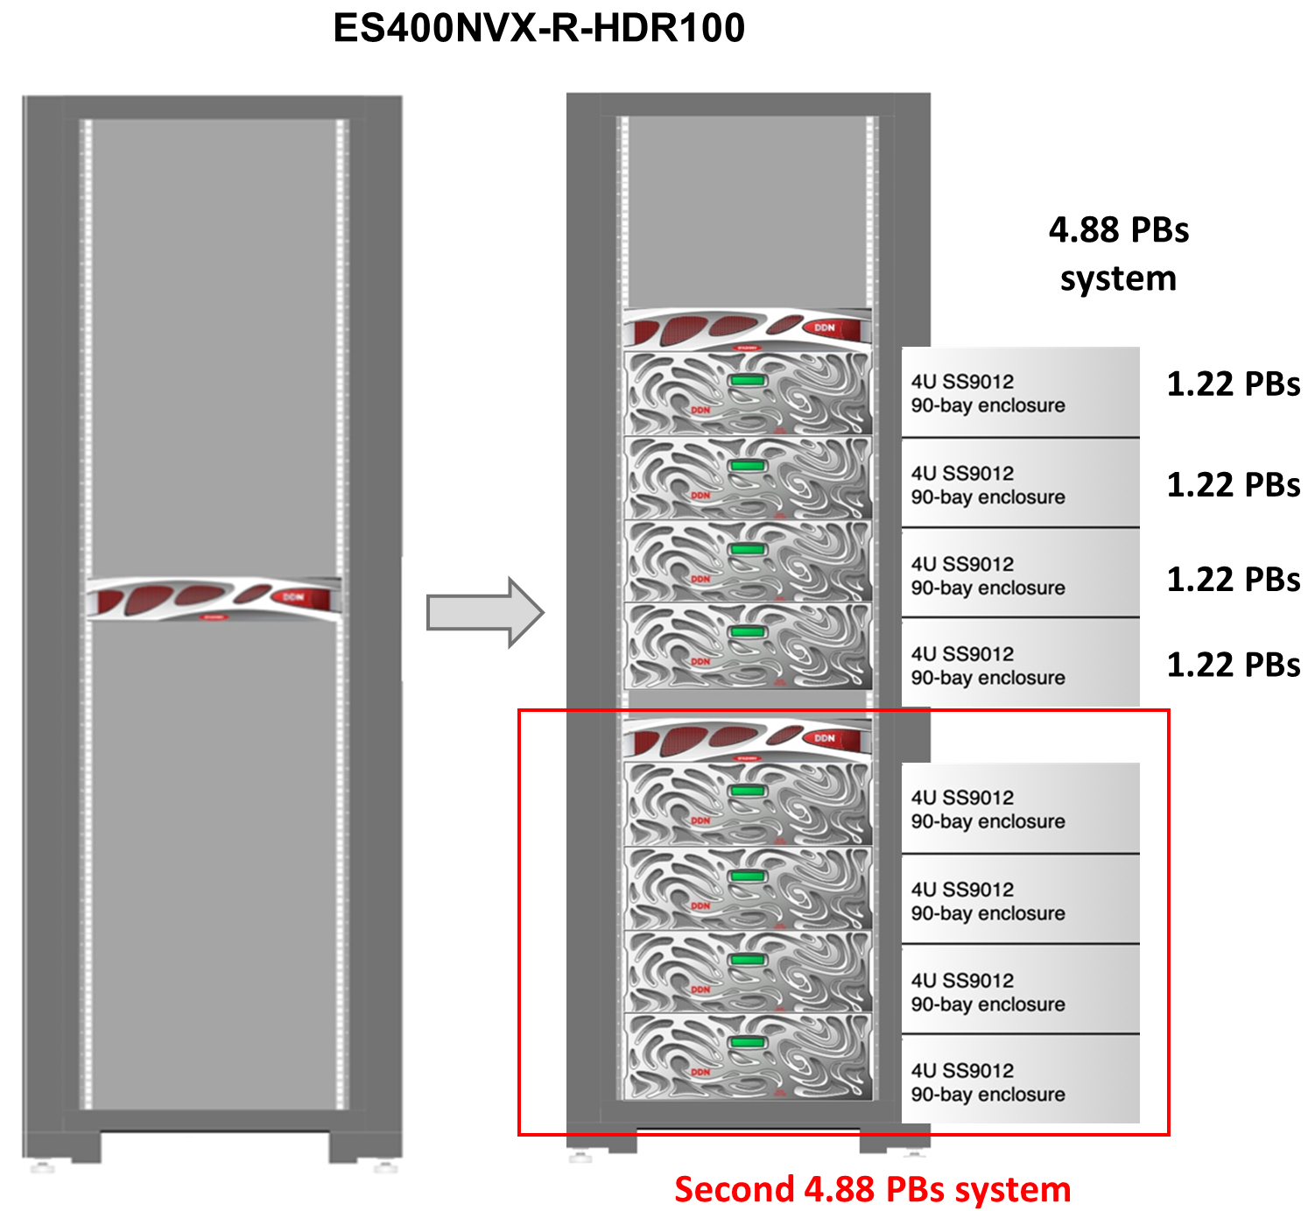
High-Performance Storage
DDN lustre storage
Exascalar ES400NVX
High-performance storage
30 GB/s read and 20 GB/s write, sustained
Support large number of users simultaneously
4.88 PBs at present, expandable
Future proofing
Takes away the pain associated with data migration
One place for project storage
Large allocation available at cost
$1800 for 10 TBs
One-time fee: 5 years

Slide 13
Supercomputers: TIGER
TIGER/TIGER2 research cloud
Windows or Linux environment
Access to various software applications: ArcGIS, MATLAB, SAS and more
Programming platforms: Python, R, git and more
Multi TB shared storage
Customized configurations to meet researcher needs when a desktop platform is not quite enough
Good match for Project Needs
Project Page or Wiki
Collaborative environment: Shared data
Computing through web-page

Slide 14
OAK Mission and Plan
To leverage critical computing and data infrastructure and expertise in the OAK region and bring together experts from different domains, for long-term research and training opportunities.
Semi-annual meeting for all OAK region members
1st Stillwater OK, OSU April 5-7th 2023
2nd Arkansas, A-State October 17-19th 2023
3rd Kansas, Wichita Spring 2024
4th Oklahoma Fall 2024
https://hpcc.okstate.edu/oak-conference-spring-2023.html
https://www.astate.edu/a/abi/oakhpc/

