Slide 1
WLCG SOC Motivation
Shawn McKee / University of Michigan

Slide 2
Why WLCG SOC?
AGLT2 has been concerned about operational security for a long time
Limited manpower at a Tier-2 and overloaded
Would like to benefit from the broader community actively involved in operational security
USATLAS has also discussed how best to implement security monitoring for its distributed facilities.
WLCG Security Operations Center effort seemed like a good opportunity
Provides example best practices, tools and docs

Slide 3
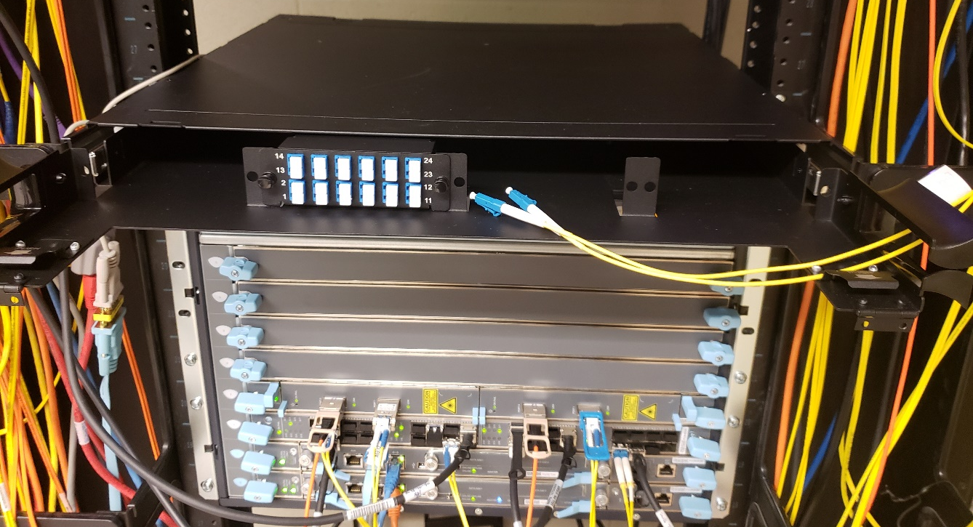
Original Optical Splitter / Bro / MISP
bro.aglt2.org
misp.aglt2.org
Was inexpensive to enable (~$1.2K). Splitter and shelf was $300, Intel XL710-Q2 40G nics $400 x2, $100 in cables (reused worker node for server)
Bro (now Zeek) has been running at AGLT2 since August 10, 2018
Monthly avg of 63.1 billion packets captured and 266 million packets lost (0.4%)

Slide 4
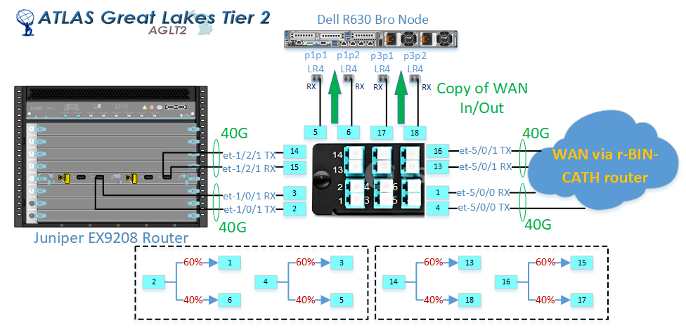
Fiber Splitter Connection Details

Slide 5
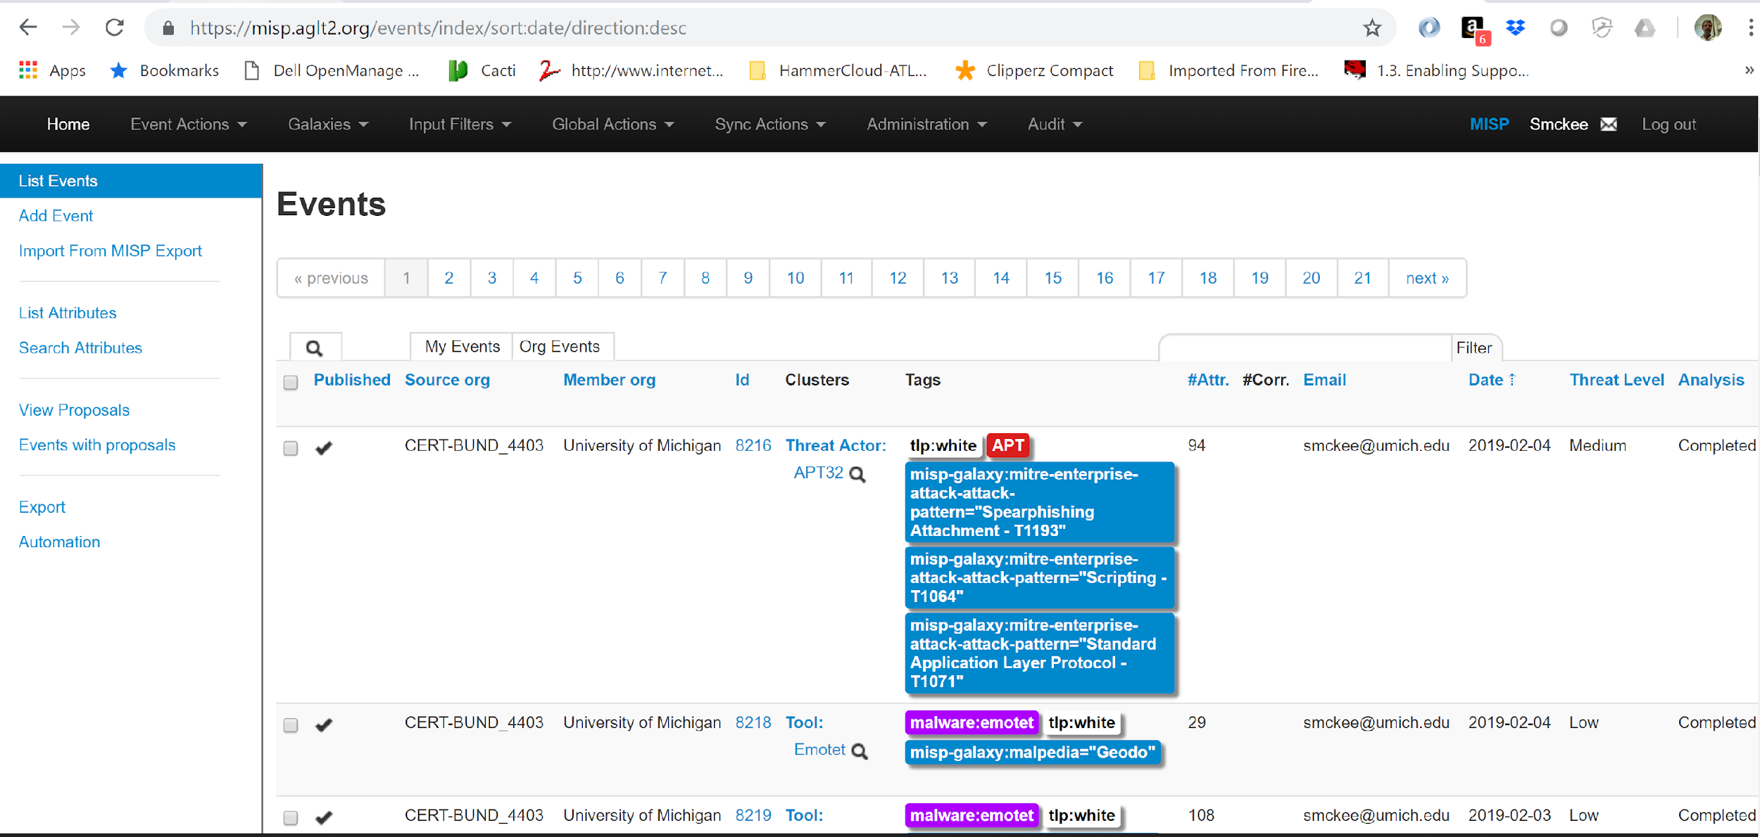
MISP UI

Slide 6
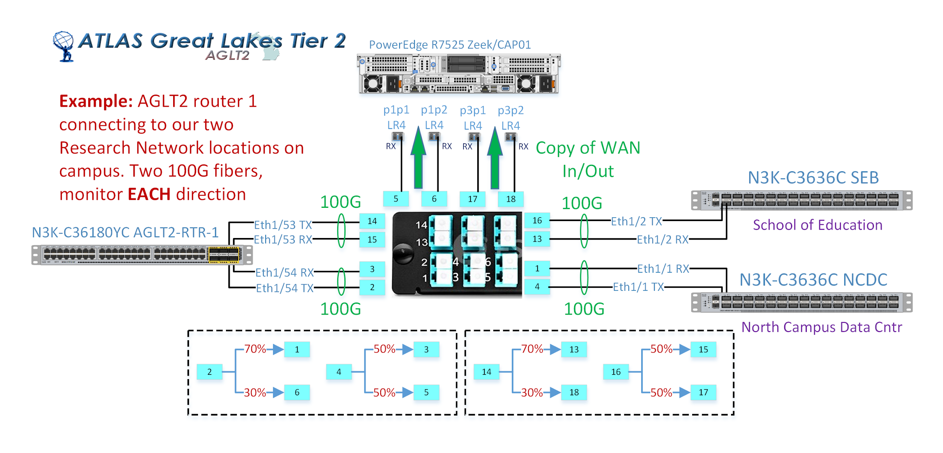
Network Security
AGLT2 has been working with the WLCG SOC effort to help secure our networks while maintaining performance
Our original network had a Zeek+MISP+Elasticsearch setup for dual 40G. Cost to set up was about $2K plus repurposing an R630
Our new network is 4x100G
We have purchased two “network capture” nodes (Dell R7525) each with two Bluefield-2 NICs (each 2x100G)
Have a milestone for July 2023 to get it into production…
CAP01/RTR-1 diagram ( similar for CAP02/RTR-2 )

Slide 7
Additional Slides

Slide 8
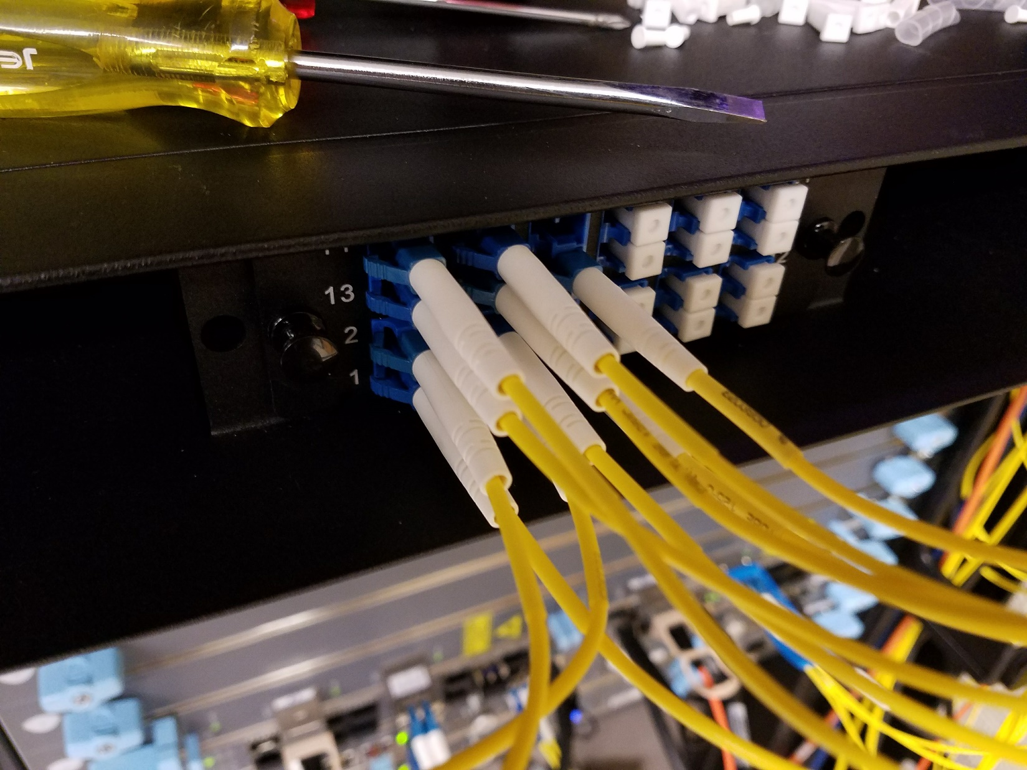
Fiber Optical Splitter Connections

Slide 9
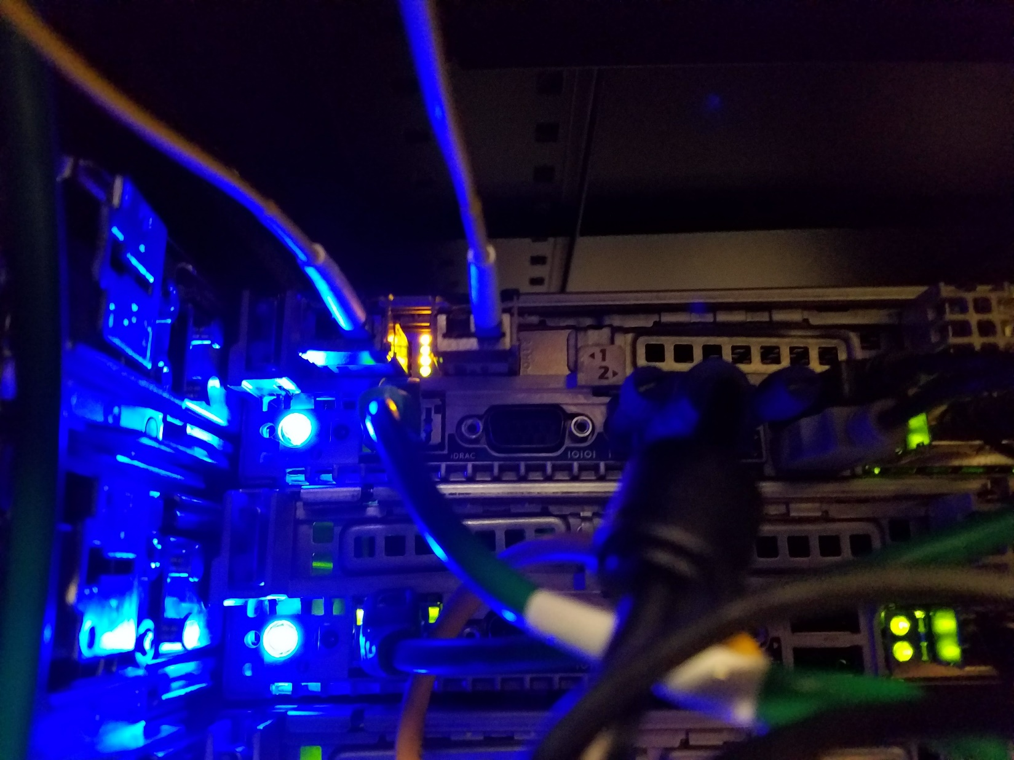
Connecton to Bro Node (1 NIC)

Slide 10
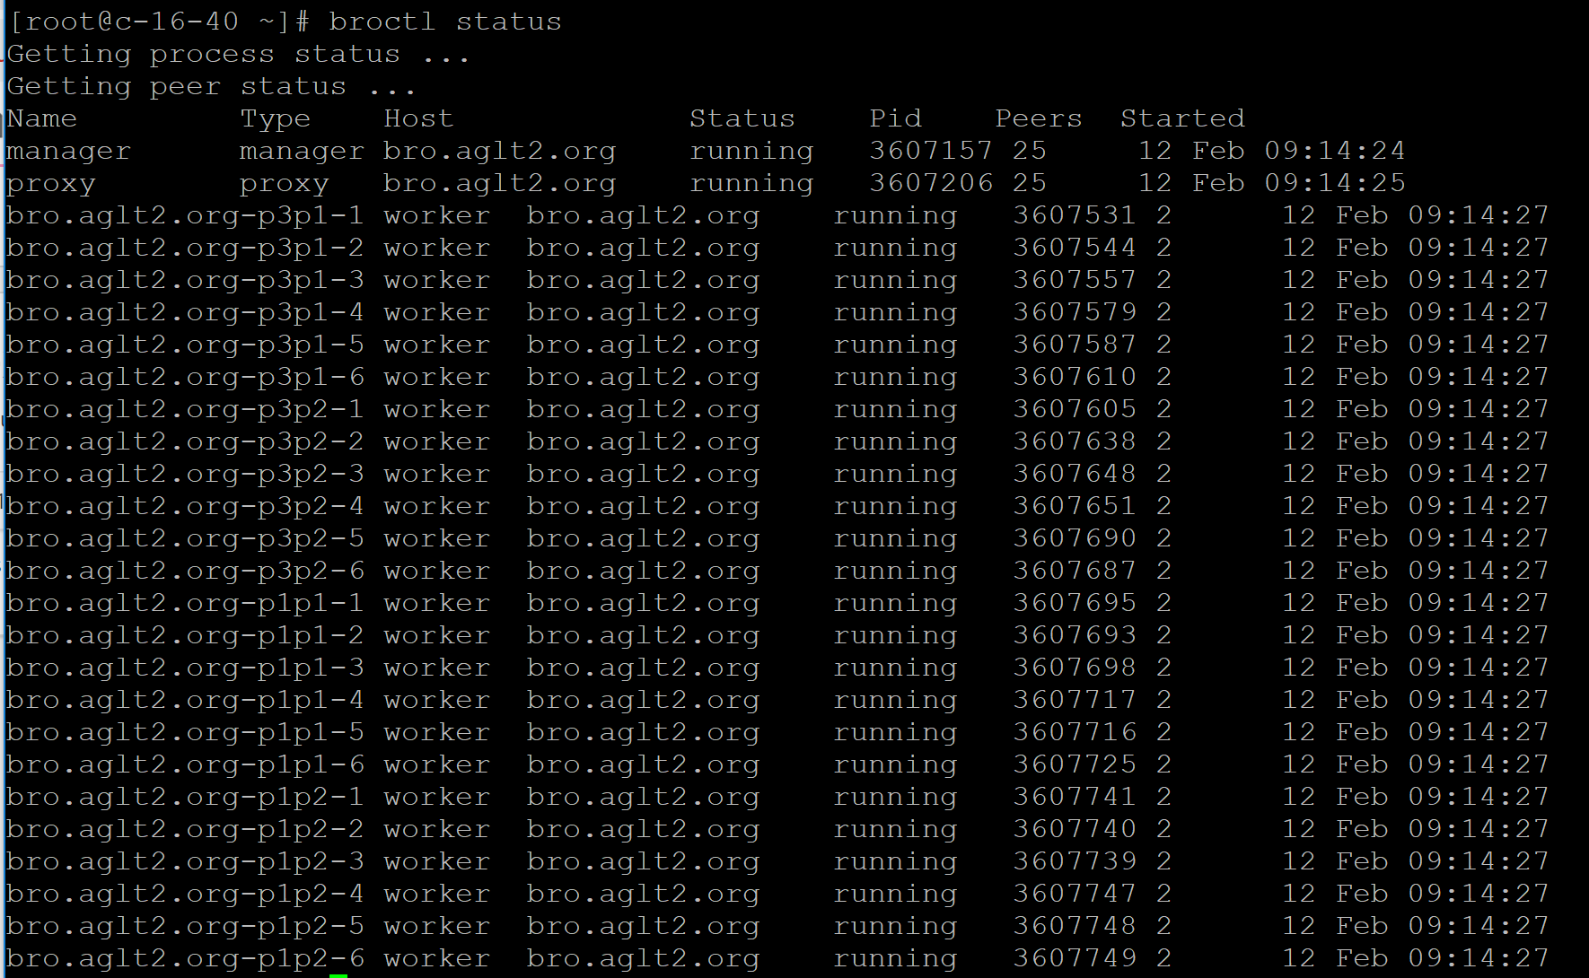
Bro Performance

Slide 11
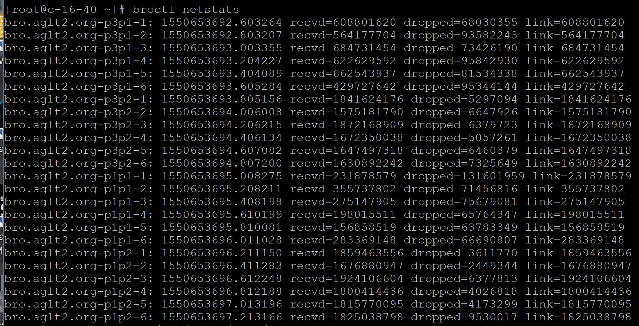
Bro Performance(2)
Capture of packets is reasonably efficient but highly variable
Lost packets varies from 0.1% to 57%, depending upon which process is involved

Slide 12
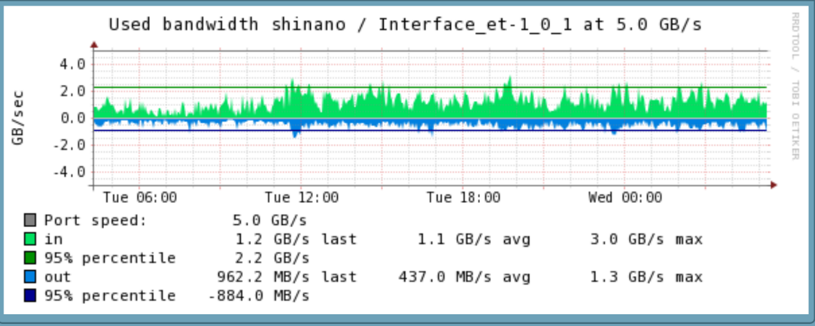
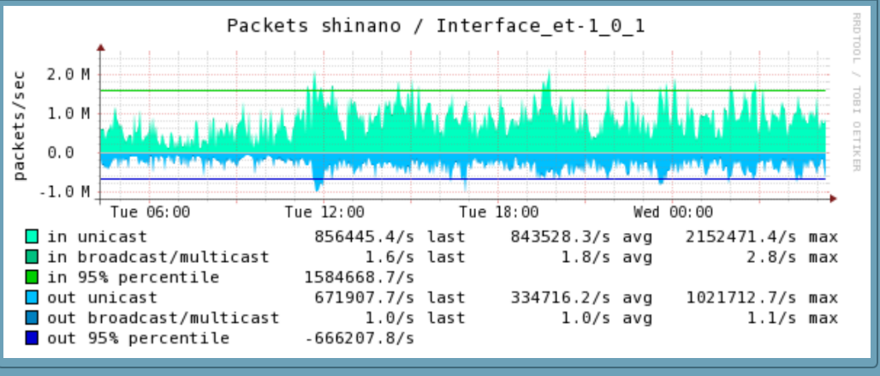
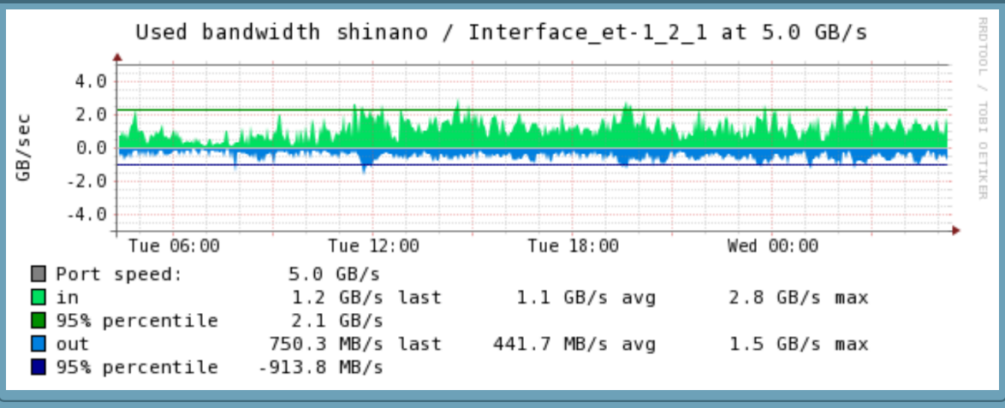
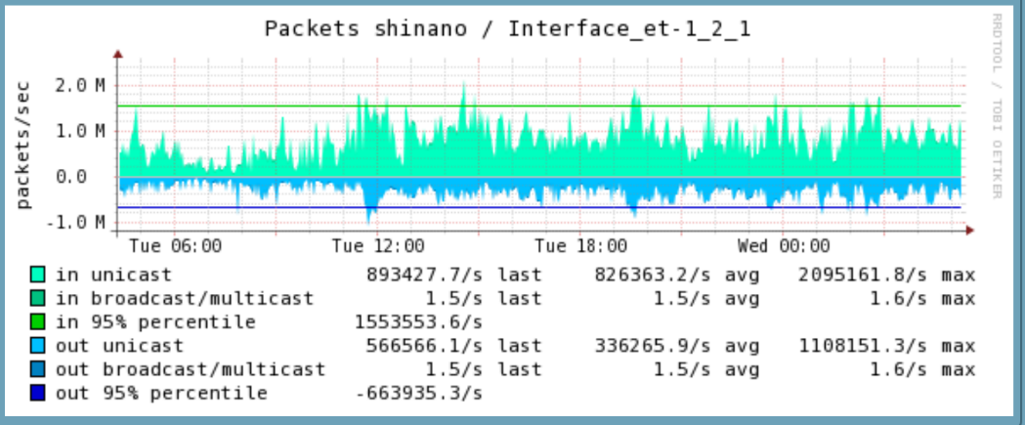
AGLT2 Net Traffic (1 week)

Slide 13
ELK at AGLT2
AGLT2 has been using Elasticsearch, Logstash and Kibana for a few years, primarily to host a central syslogging service
Currently we have a 3 node (all VM) cluster running Elasticsearch 6.5.4 (upgrading to 6.6.0 ASAP)
The VMs are hosted on VMware
The primary node (atgrid) has 16GB of RAM and 12 cores and runs Logstash and Kibana (avg load 0.66)
The secondary nodes (es-1, es-2) are only running Elasticsearch and have 12 GB of RAM and 6 cores
Total space available is 3.1 TB (% 69.78 in use)
Elastic search has 584 indices, 2.477 billion documents and 2544 primary and replica shards as of today (Feb 20, 2019)
The main data sources are 1) syslogging from all our devices, 2) dCache logs, 3) Netflow/Sflow and 4) Bro log files

Slide 14
Netflow/Sflow Monitoring via ELK
In addition to Bro monitoring we wanted to have better visibility into our network traffic.
Because we already had an ELK stack, when we heard about ElastiFlow we were intrigued
https://github.com/robcowart/elastiflow
Install https://github.com/robcowart/elastiflow/blob/master/INSTALL.md
It was pretty easy to setup. Some challenges getting the sflow-codec and the Kibana elastiflow index imported (maybe better now?)
Contact me if you want details!
Once it was setup we just needed to point our Juniper router to it

Slide 15
Netflow/Sflow Monitoring via ELK (2)
sflow {
agent-id 10.10.1.2;
polling-interval 1;
sample-rate {
ingress 100;
egress 100;
}
source-ip 10.10.1.2;
collector 10.10.1.9 {
udp-port 6343;
}
interfaces xe-0/0/3.0 {
polling-interval 1;
sample-rate {
ingress 100;
egress 100;
}
}
Setting up our Juniper EX9208 was pretty simple
The configuration on the right is the bulk of what is needed
Add additional interfaces as need (those interfaces that connect to the WAN)

Slide 16
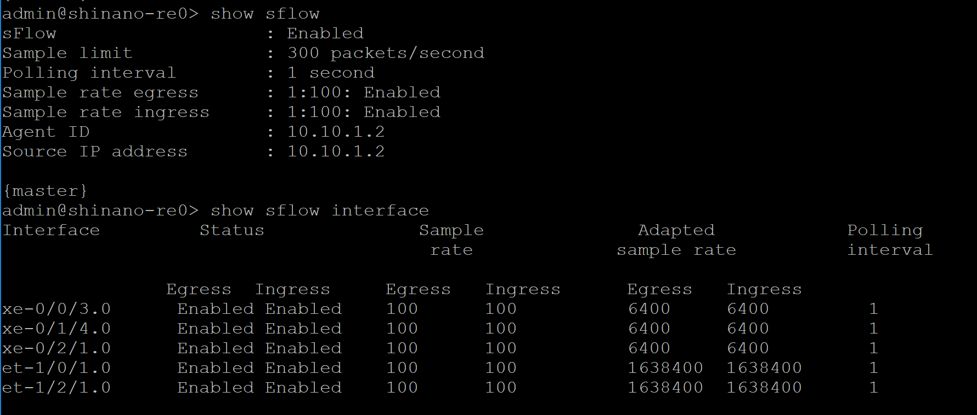
Verify Sflow Setup
NOTE: Missing IPv6! Need to determine the right setup to also send IPv6 from our border router. (I suspect our EX9208 does NOT support IPv6 SFLow…MX would)

Slide 17
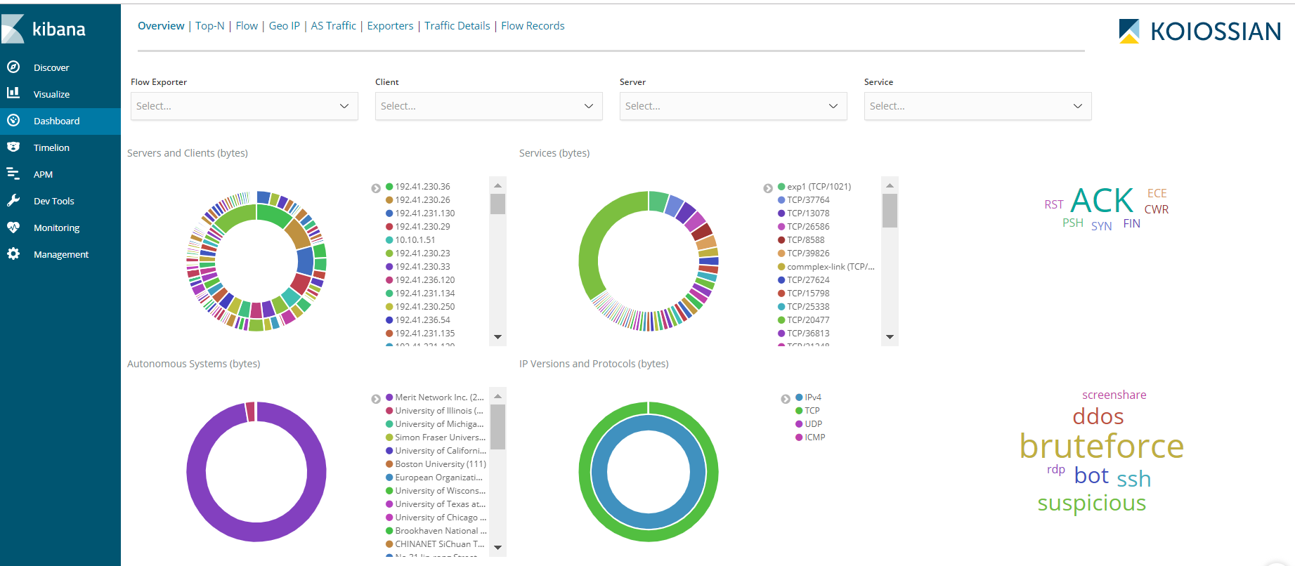
ElastiFlow @ AGLT2 Examples

Slide 18
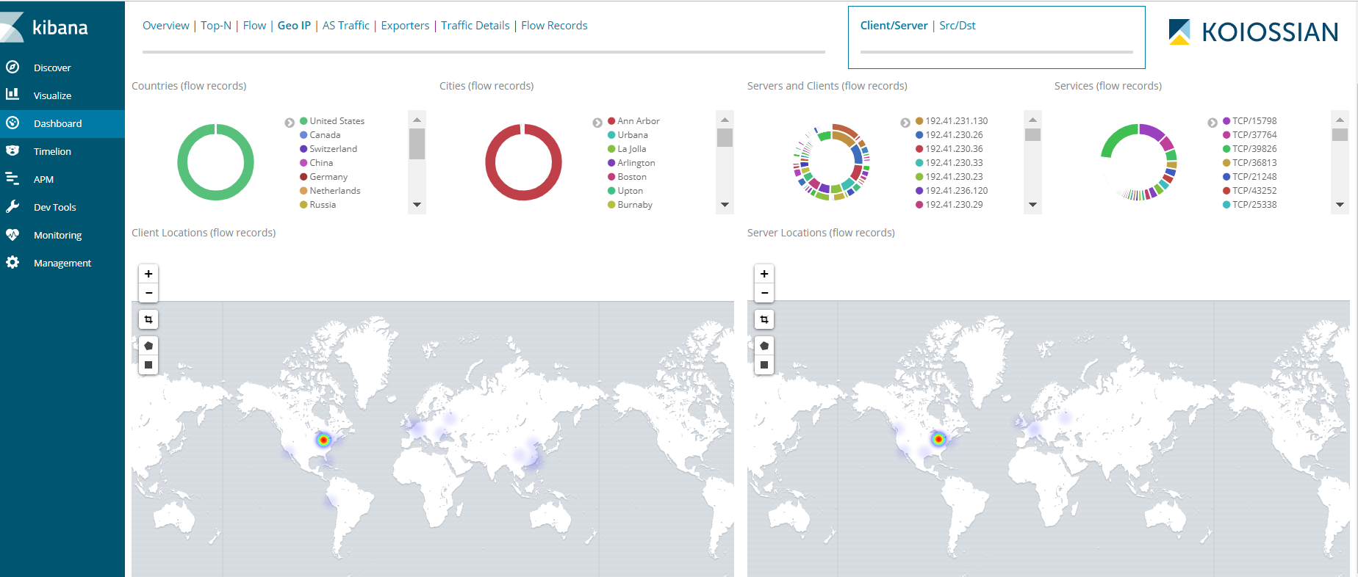
ElastiFlow @ AGLT2 Examples

Slide 19
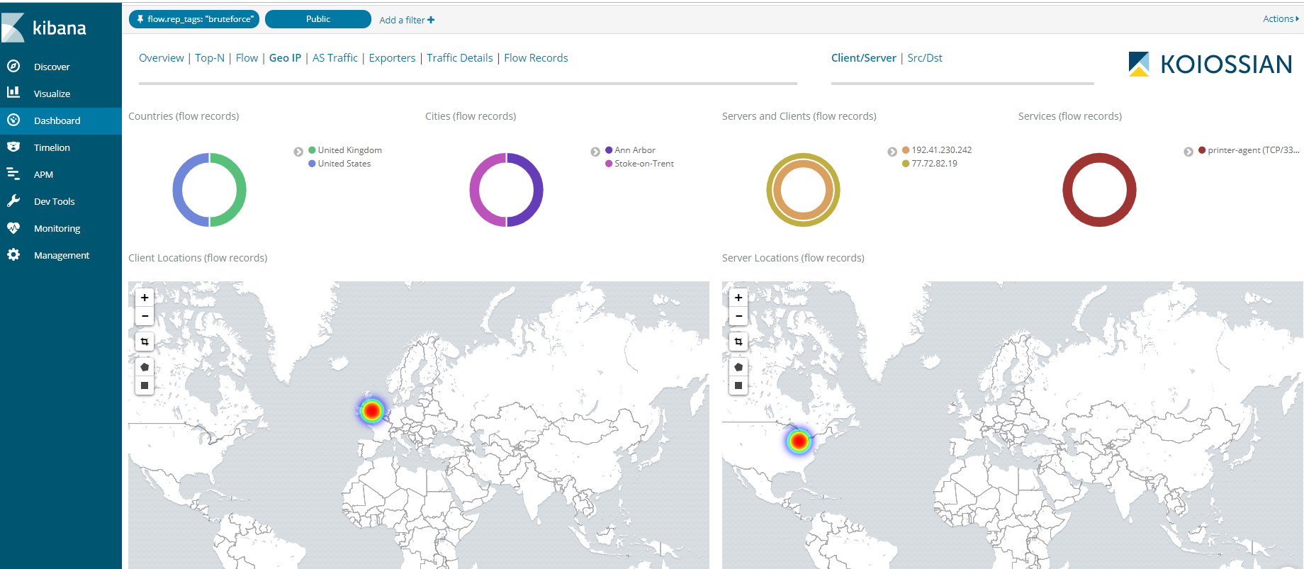
ElastiFlow @ AGLT2 Examples

Slide 20
Summary
Conclusion
New network monitoring with Bro and ElastiFlow providing us with new info; we need to incorporate it into our operations
Our main interest is in configuring some level of alerting when attacks are occurring.
Some way to create a report summarizing identified attacks would also be a great addition
Questions ?

Slide 21
OSG SOC Participation
A starting point for discussion…

Slide 22
Rising tides
Immediate benefit to OSG Security from receiving threat intel feeds from the WLCG SOC MISP Instance
OSG can benefit from working with WLCG SOC efforts to learn what is effective and avoid likely pitfalls
This is a great tool

Slide 23
What does OSG’s participation look like?
The ET and Council are still discussing but…
OSG Security will continue to function as a central point for coordinating action between WLCG sites and OSPool
Short term - consumer of threat data and a revised incident response/coordination role
Long term - ???

Slide 24
Questions
What benefits can the other US-ATLAS sites, US-CMS sites, and OSPool sites gain from threat intel?
Where will effort come from?
Will small sites be left behind?
pDNSSOC - low cost SOC effort using only dDNS data that anyone can participate in
Working with campus SOCs
beyond?

