Slide 1
HTCSS "Hot Takes" Discussion Session
HTC 23

Slide 2
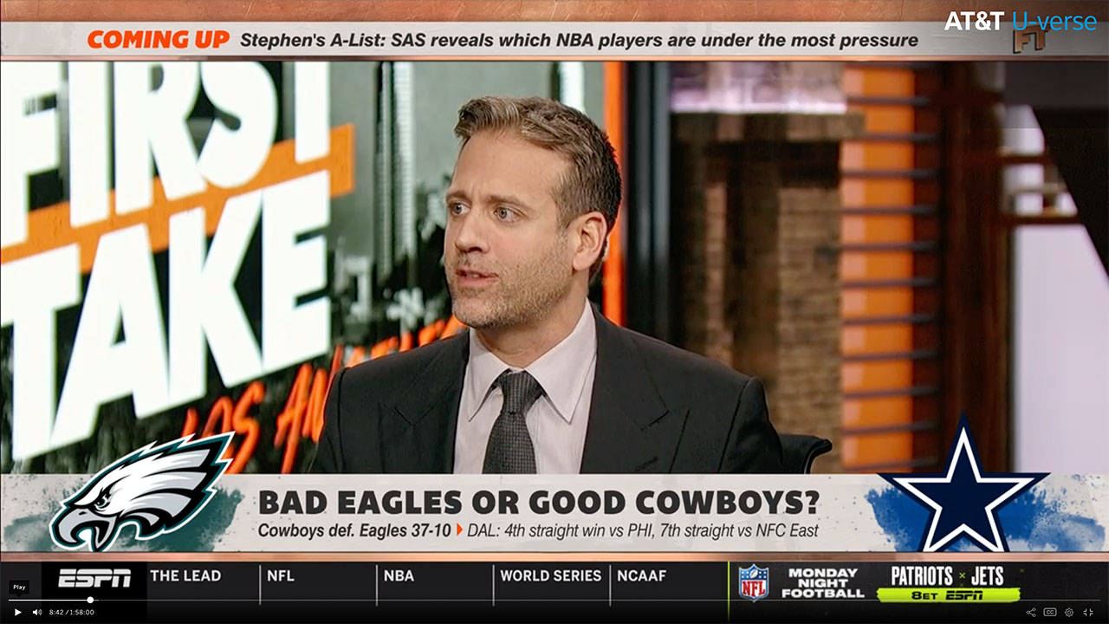
In journalism, a hot take is a "piece of deliberately provocative commentary that is based almost entirely on shallow moralizing" popularized on sports talk programs. -Wikipedia

Slide 3
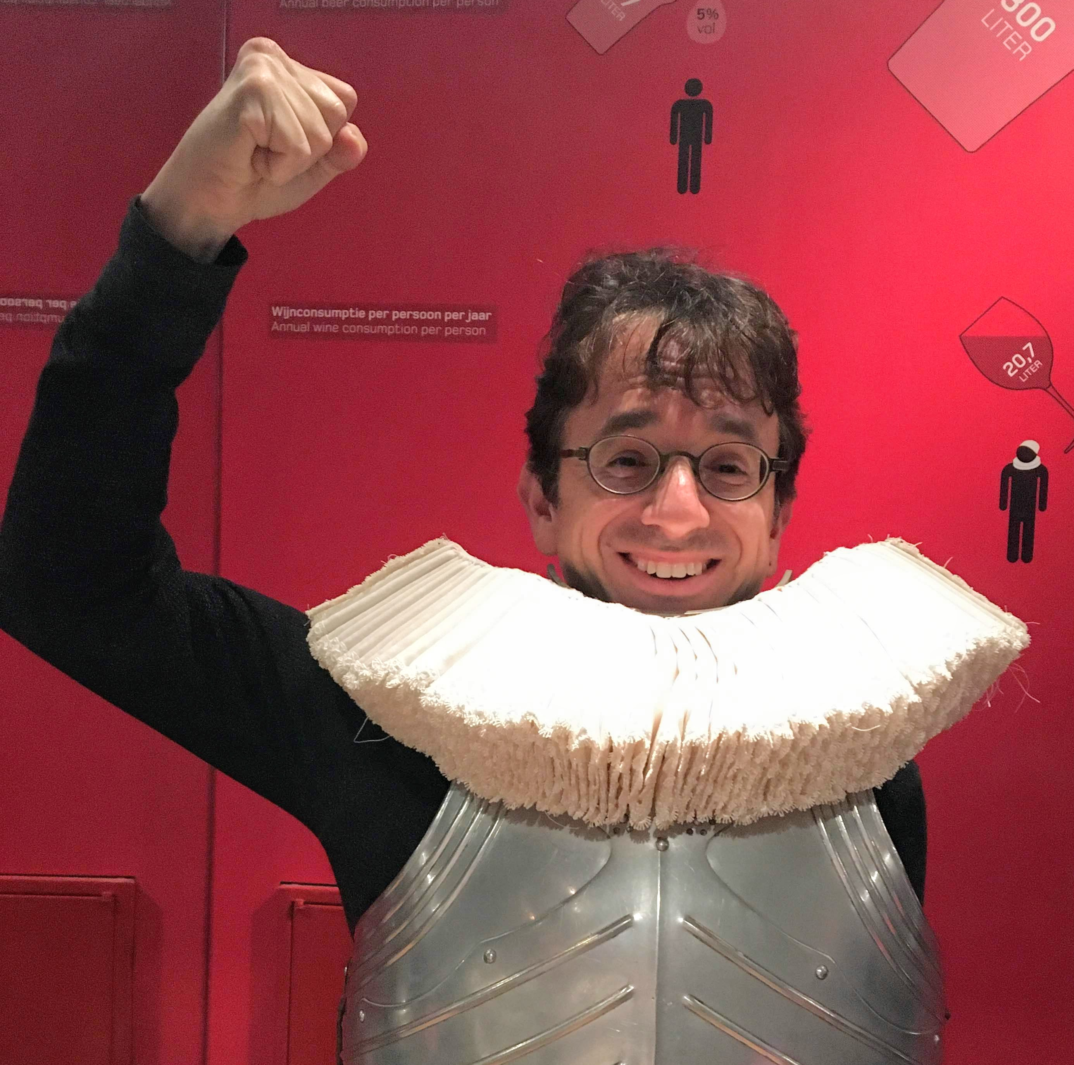
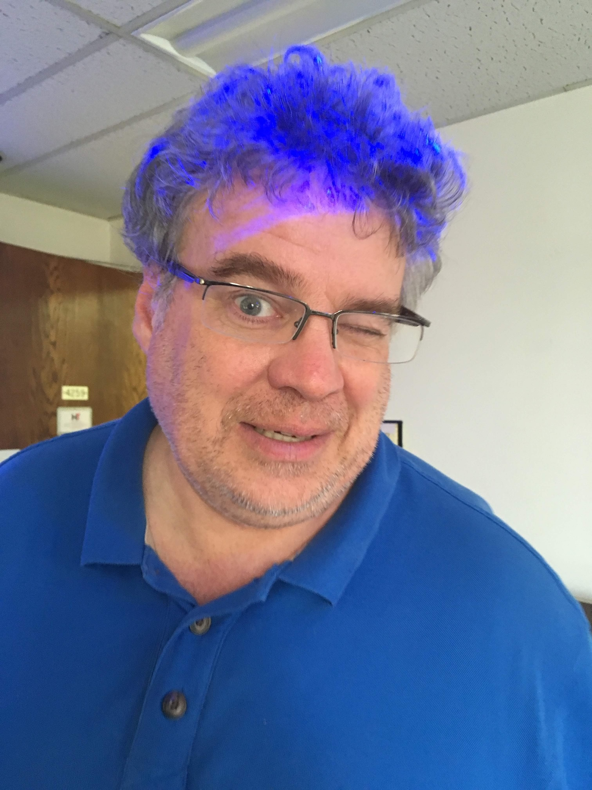
We picked up some ESPN commentators from the recent layoffs
"Coach" Todd Throughputbaum
"Uncle" Greg Cyclemasterthain

Slide 4
Discussion Format
A series of matches; in each match, two potential HTCSS enhancements go head to head!
- Hot Takes from Coach Throughputbaum and Uncle Cyclemasterthain
Community Discussion. (hopefully more thoughtful than a 'hot take'!)
Community Vote. Can only vote of one.
Winner of each match moves up in the playoff bracket!
Like any playoff, you can try to predict the winners!
Go to https://challonge.com/htc23/predictions/
and click CREATE A PREDICTION

Slide 5
Bracket Game #1
Improve Error Propagation
Understanding what failed running a specific job, workflow, or job set.
Improve Observability
Understanding what is happening across my entire pool – what is working, what is not.
-vs-

Slide 6
Bracket Game #2
Improve
Data Handling
Improve how job input and output is transferred / managed.
Improve Scheduling/Planning
Improve job scheduling to maximize resource utilization and minimize job starvation.
-vs-

Slide 7
Bracket Game #3
Improve User Experience
Improve and simplify the end-user interface and toolset for people placing jobs, workflows.
Improve Admin Experience
Improve and simplify life for system administrators doing tasks such as system upgrades, customizing scheduling policy, pool monitoring.
-vs-

Slide 8
Bracket Game #4
Improve
Job Checkpoint Mechanisms
Checkpoint to OSDF, leverage operating system (CRIU) for transparent checkpoints, ...
Improve
Integration w/ Other Systems
Improve integration with Slurm, HPC systems, Cloud, k8s.
-vs-

Slide 9
Lets bring out our ESPN Commentators!
"Coach" Todd Throughputbaum
"Uncle" Greg Cyclemasterthain
DISCLAIMER: The views of Coach Todd and Uncle Greg do NOT necessarily reflect the views the CHTC, PATh, NSF, Regents of UW-Madison, Todd Tannenbaum, Greg Thain, or anybody else.

Slide 10
Preseason Game
Improve User Experience
Improve and simplify the end-user interface and toolset for people placing jobs, workflows.
Improve Admin Experience
Improve and simplify life for system administrators doing tasks such as system upgrades, customizing scheduling policy, pool monitoring.
-vs-

Slide 11
Bracket Game #1
Improve Error Propagation
Understanding what failed running a specific job, workflow, or job set.
Improve Observability
Understanding what is happening across my entire pool – what is working, what is not.
-vs-

Slide 12
Bracket Game #2
Improve
Data Handling
Improve how job input and output is transferred / managed.
Improve Scheduling/Planning
Improve job scheduling to maximize resource utilization and minimize job starvation.
-vs-

Slide 13
Bracket Game #3
Improve User Experience
Improve and simplify the end-user interface and toolset for people placing jobs, workflows.
Improve Admin Experience
Improve and simplify life for system administrators doing tasks such as system upgrades, customizing scheduling policy, pool monitoring.
-vs-

Slide 14
Bracket Game #4
Improve
Job Checkpoint Mechanisms
Checkpoint to OSDF, leverage operating system (CRIU) for transparent checkpoints, ...
Improve
Integration w/ Other Systems
Improve integration with Slurm, HPC systems, Cloud, k8s.
-vs-

Slide 15
Follow us on Twitter! https://twitter.com/HTCondor
This work is supported by NSF under Cooperative Agreement OAC-2030508 as part of the PATh Project. Any opinions, findings, and conclusions or recommendations expressed in this material are those of the author(s) and do not necessarily reflect the views of the NSF.

