Slide 1
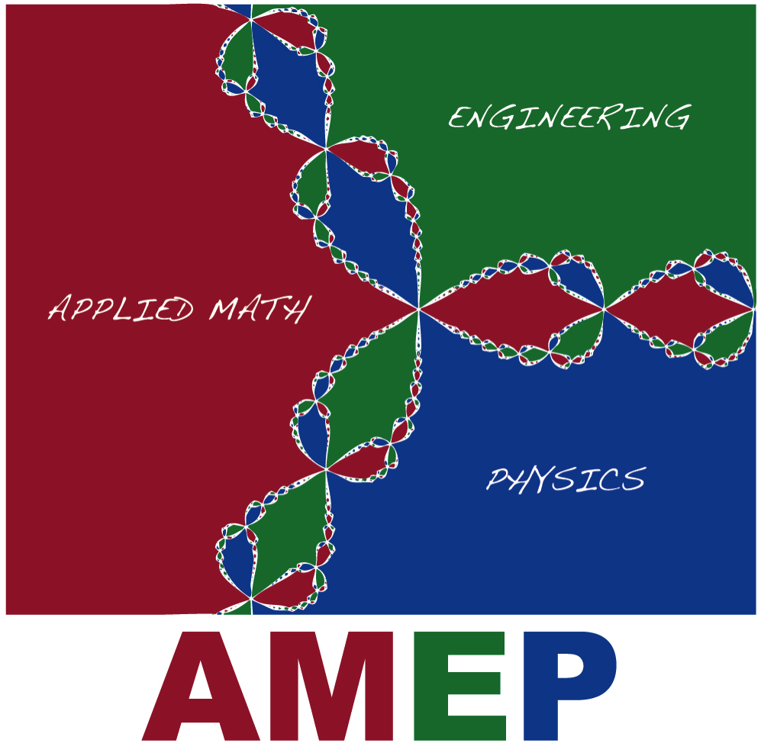

Slide 2
AMEP is:
Independent undergraduate degree program under L & S.
More than 50 years old.
Truly interdisciplinary STEM degree.
Provides a broad background in:
Applied Mathematics
Physics
Engineering focus area (ECE, ME, CEE, …)
Great for motivated students who are clearly STEM oriented.
Important in attracting top high-school students to UW-Madison.

Slide 3
AMEP is a small gem!

Slide 4
Updates over the last 6 months
AMEP get together over Pizza on May 3.
AMEP leadership prize in 2023 was awarded to Ayo Lawal.
Morgan Adams, Undergraduate Academic Advisor in the Math
Department has joined the AMEP team and is providing staff support.
AMEP program review will be done during the next academic year.

Slide 5
AMEP program review
Formal review of the program by L & S, performed once every 10 years.
Self-study report due May 2024
Mitch Keller (Associate Director of Undergraduate Studies in Math) has teaching
relief in Spring 2024 to work on the self-study report.
External committee is formed (Fall 2024). They read the self-study report, conduct
interviews of faculty/staff/students and perform outside evaluation of the program.
The self-study report and outside evaluation go to the Dean (end of Fall 2024).

Slide 6
AMEP enrollment
Physics
Number of students
AMEP
Year

Slide 7
AMEP curriculum
Calculus + Introductory Physics Sequence
Applied math core:
Math 320: Diff. eqns. and linear algebra
Math 321: Vector and complex calculus
Math 322: Linear PDEs, Fourier series
Physics core:
Physics 311: Mechanics
Physics 322: Electromagnetism

Slide 8
AMEP curriculum, cont’d
Lab + advanced physics courses
Computational + advanced math courses
21 credits of intermediate/advanced courses in an engineering focus area

