Slide 1
UNIVERSITY PHYSICS SOCIETY
University of Wisconsin-Madison
Notes:
NOTE: Want a different image on this slide? Select the picture and delete it. Now click the Pictures icon in the placeholder to insert your own image.

Slide 2
About Us
Our goal is to provide both academic and professional resources, as well as social opportunities, to undergraduate students majoring or interested in physics.
We currently have over 30 members, with interest growing each semester
Our structure:
President: responsible for assigned club duties, oversees event planning and schedule
Vice – President: guides club outreach and collaboration with other student organizations
Treasurer: manages club finances and inventory
Secretary of Marketing: advises on fundraising opportunities and club promotional materials
Secretary of Social Media: updates club social media, including Discord server
Secretary of Education: oversees club tutoring and graduate opportunities

Slide 3
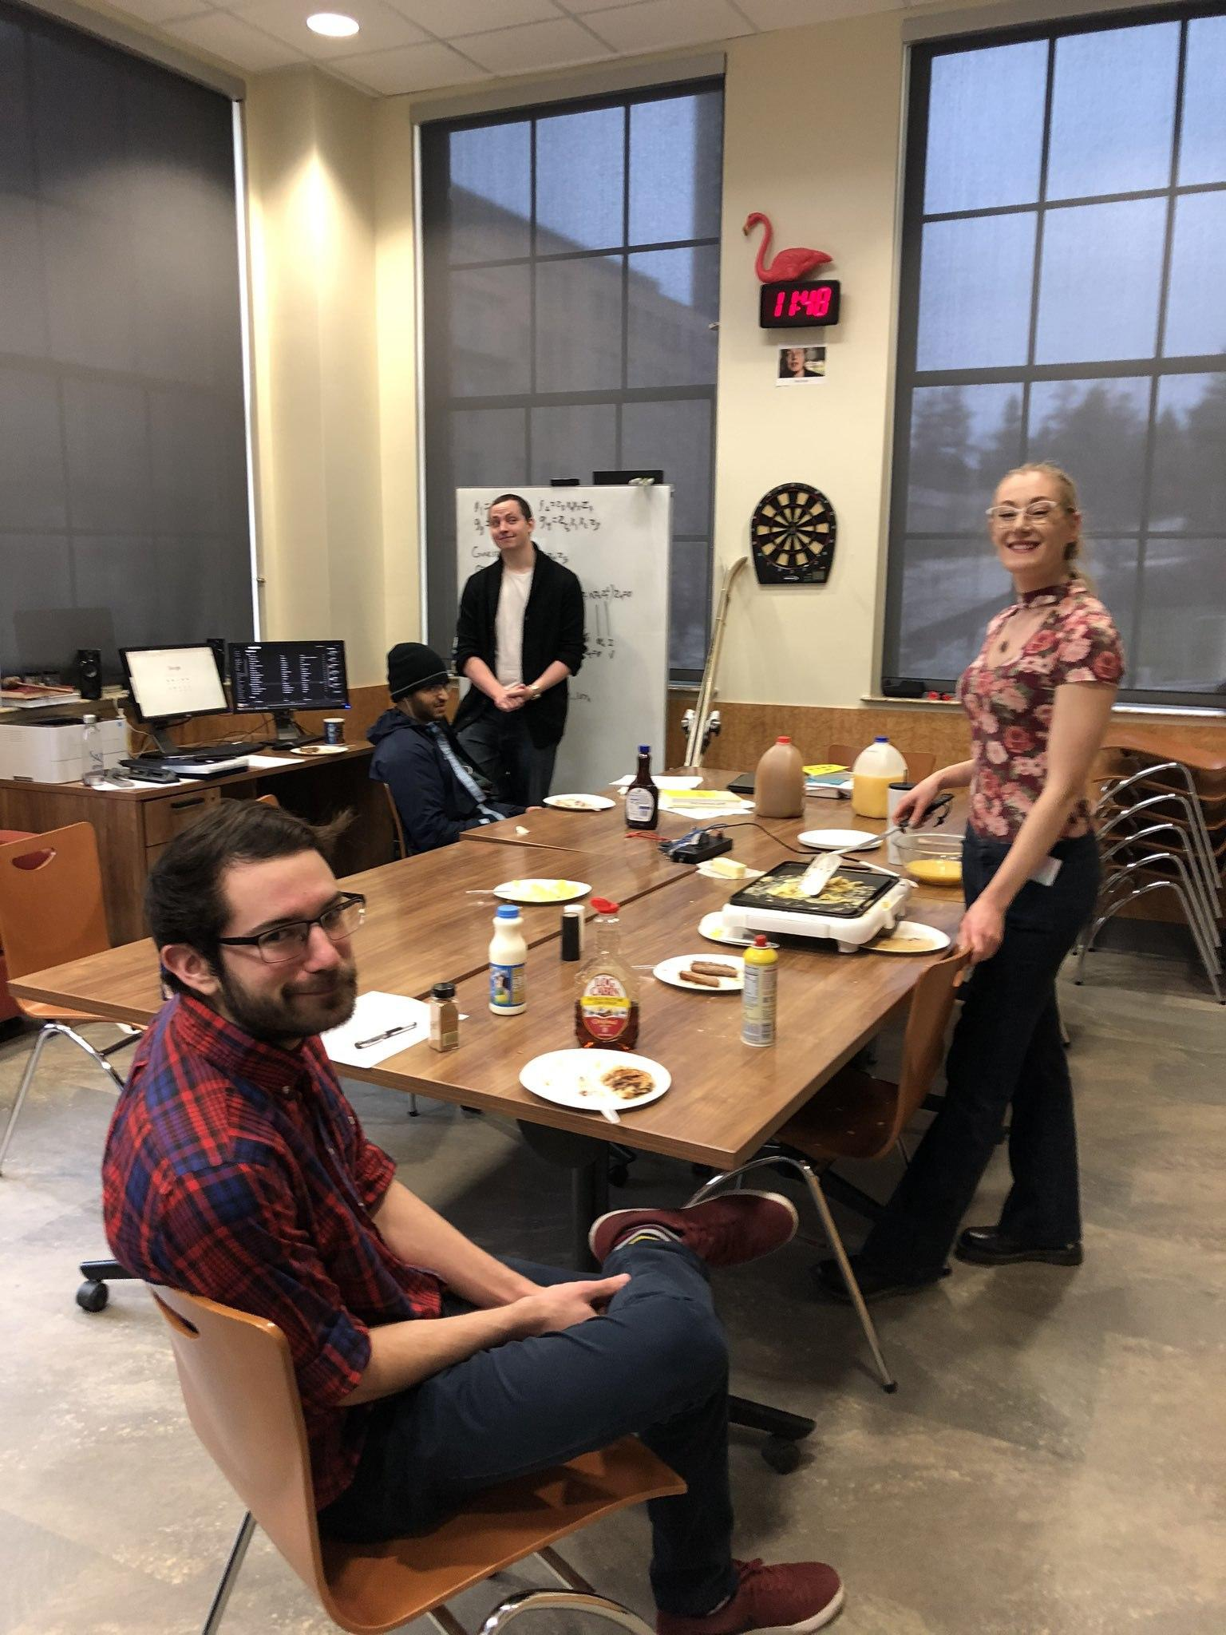
Our Facilities and Resources
Club lounge in Chamberlin Hall, which serves as a study space, kitchen, and printing services for members
Tutoring services and a Discord server for member collaboration
Field trips to Midwest laboratories, including Fermilab
Monthly social events
This month: Board Game Night
Last month: Pizza Party Semester Kickoff
Next month: Collaboration with Math and Astronomy Clubs

Slide 4
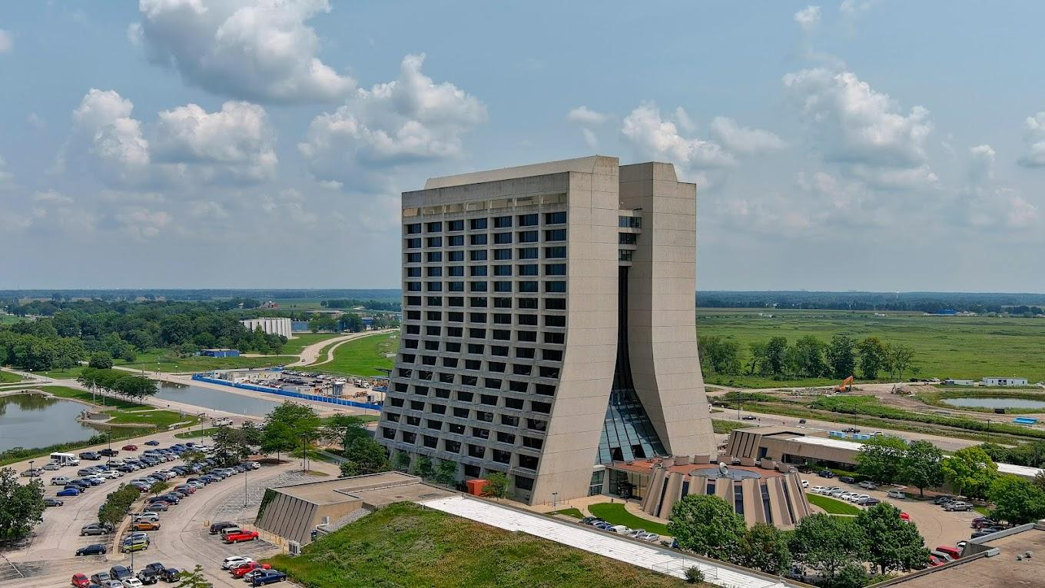
Recent Years
We've existed for decades - maybe you remember us!
The pandemic took a toll on our structure, but high student interest has returned us to normalcy
Post-pandemic restrictions at laboratories have limited our ability to tour facilities and organize trips

Slide 5
Future Club Goals
Broaden our services from social to academic and career
Support more networking opportunities with researchers and alumni,
Host panels discussing careers and research opportunities in physics
Revisit laboratories in the Midwest, as well as tour new facilities

Slide 6
Picture with Caption Layout
Caption

Slide 7
THANK YOU!

