Slide 1


The Path to an Energy Frontier Muon Collider
Hamilton
Colloquium
Mark Palmer
Director, Accelerator Science and Technology Initiative
Member, 2023 Particle Physics Project Prioritization Panel
February 22, 2024
ATRO – Accelerator Facilities Division

Slide 2
Acknowledgements
US Muon Accelerator Program (MAP)
International Design Study for a Neutrino Factory (IDS-NF)
International Muon Ionization Cooling Experiment (MICE)
International Muon Collider Collaboration (IMCC)
Participants in this Princeton Muon Collider Workshop
______________________________________________________
Snowmass Multi-TeV Collider Topical Group & Contributors
European Laboratory Directors Group – Accelerator R&D Roadmap
Snowmass Muon Collider Forum
2023 Particle Physics Project Prioritization Panel (P5)
Princeton University Physics Department Colloquium - February 22, 2024

Slide 3
Themes of this Talk
High Energy Colliders
A Brief Perspective
Why Muons?
A Vehicle for Discovery
The Physics Challenges
A Muon Collider
Machine Concepts
Charting a Path Forward
Princeton University Physics Department Colloquium - February 22, 2024

Slide 4
Themes of this Talk
High Energy Colliders
A Brief Perspective
Why Muons?
A Vehicle for Discovery
The Physics Challenges
A Muon Collider
Machine Concepts
Charting a Path Forward
Princeton University Physics Department Colloquium - February 22, 2024

Slide 5
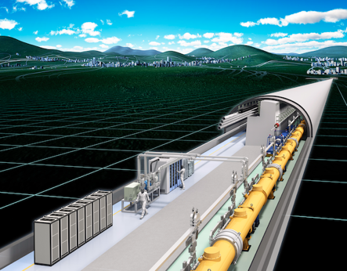
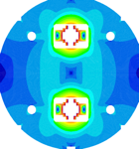

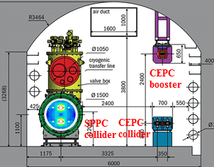
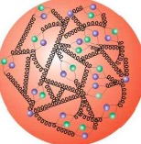
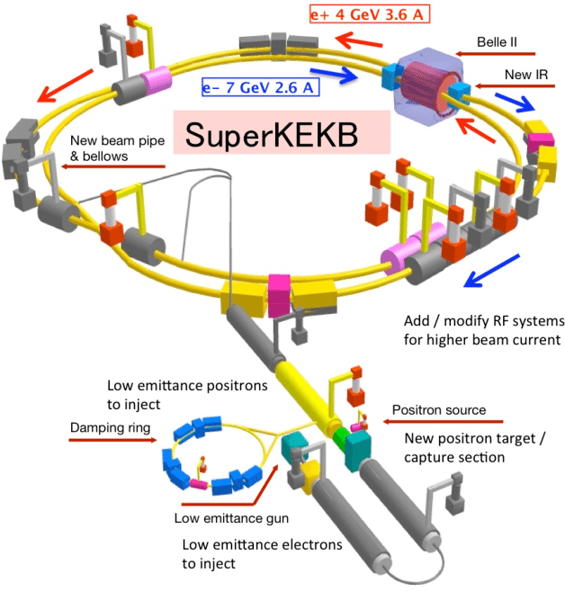
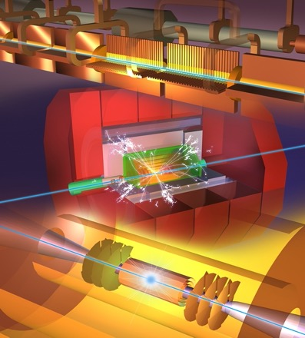

HEP Particle Colliders
CepC & SppC
p or
anti-p
p (uud)
Proton-proton (or anti-proton) Collisions:
Offer highest achievable center-of-mass collision energies
Collisions of composite particles
Discovery potential via Electroweak and Strong Interactions
e⁻
e⁺
Electron-Positron Collisions:
Collision of point-like fermions with well-defined initial state
Precision measurements via Electroweak Interactions
At multi-TeV energies – de facto electroweak boson colliders

Slide 6
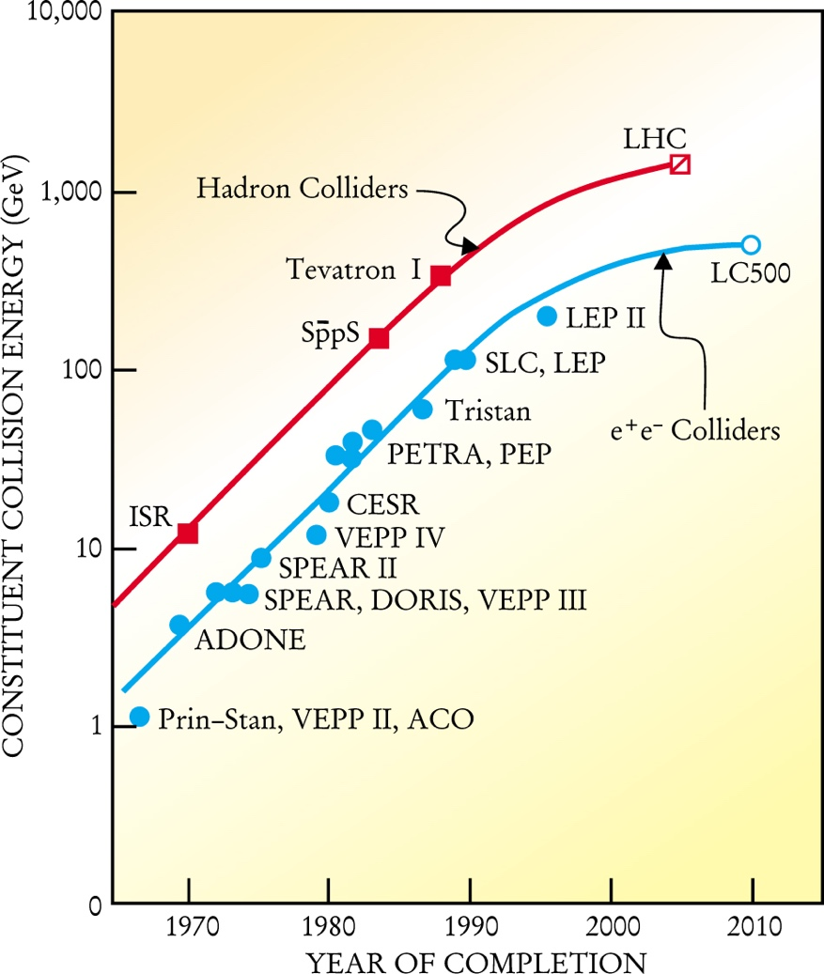
A Look at Where We Are
Today
Livingston Plot in 2001
[M. Tigner, Physics Today 54 , 1, 36 (2001)]
  Through the 1900s, progress
  driven by critical technology
  developments for many decades
  (1940s –)
  CoM Energies increasing by
  ~2 orders of magnitude every
  25 years
Where are we now?
  Progress has become much
  more challenging
    Machine Complexity
    Costs (R&D and capital)
  What are our options and
  priorities for the next HEP
  machine?
100,000
The “Livingston Plot”
at the turn of the century…
~100 TeV pp Machines
Muon
Colliders
Linear Colliders
Advanced Linear Colliders (WFA)
Large Circular e⁺e⁻ Colliders
All dates are
(extremely) speculative
Note: ECFA, for the European
Strategy Update, labeled eras as:
2020-2040: HL-LHC era
2040-2060: Z/W/H/top-factory era
2060-2080: Energy Frontier era
2020 2030 2040 2050 2060

Slide 7
Overview oF Multi-TeV Machine Concepts
TeV-class Conventional Linear Colliders
  CLIC
  ILC 1-TeV Nb
  CCC
  ILC Multi-TeV
  RELIC
Proton-proton Energy Frontier Machines
  FCC-hh
  SppC
  Collider-In-Sea
Lepton-Ion Machines
  FCC-eh
  MuIC
Lepton Collider Energy Frontier Machines
  MuC
  WFA
Potential Paths to
the Energy Frontier

Slide 8
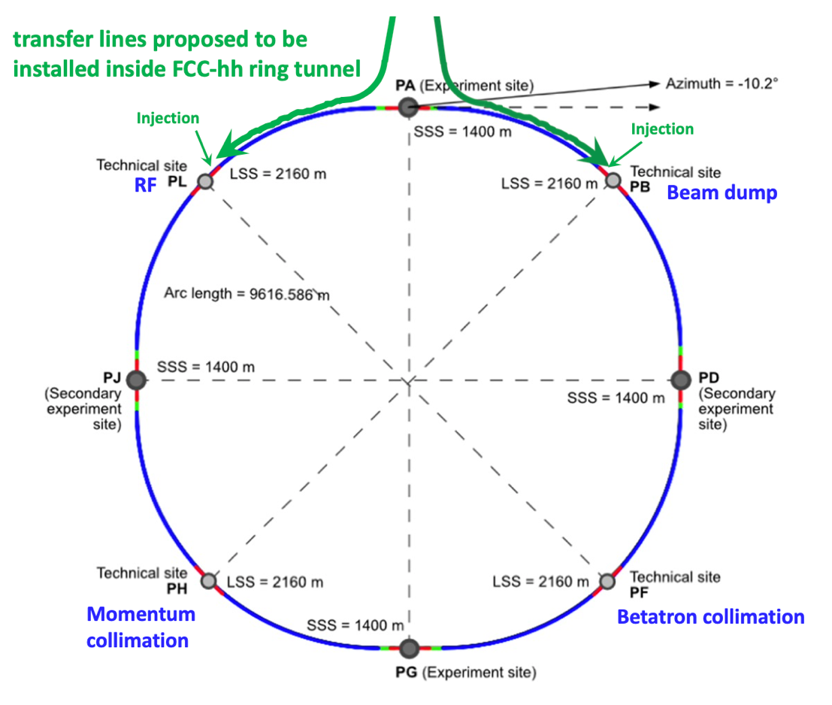
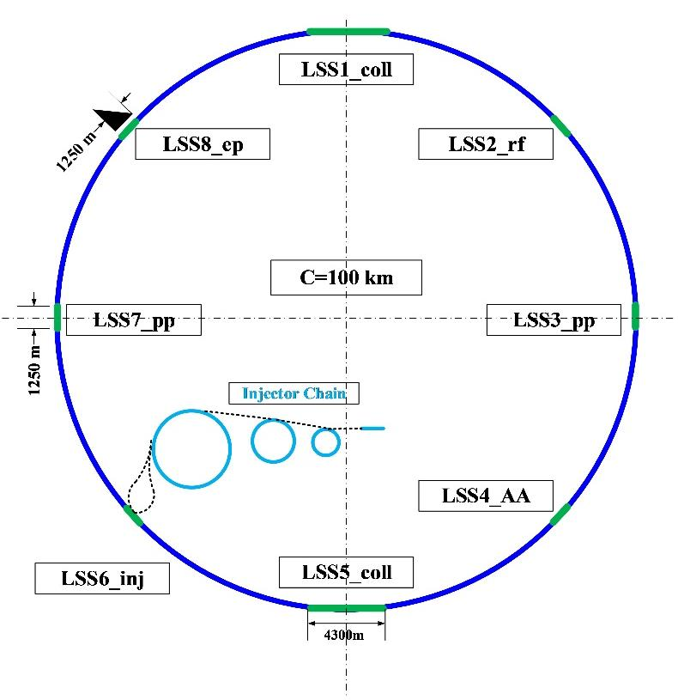
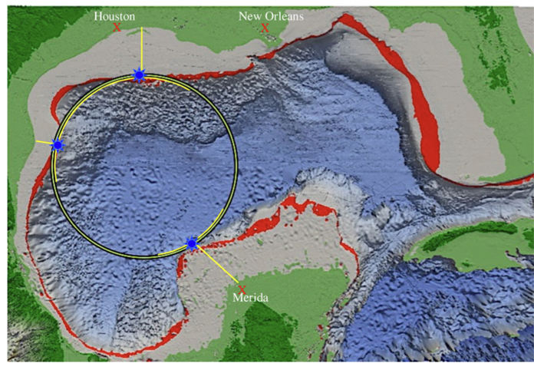
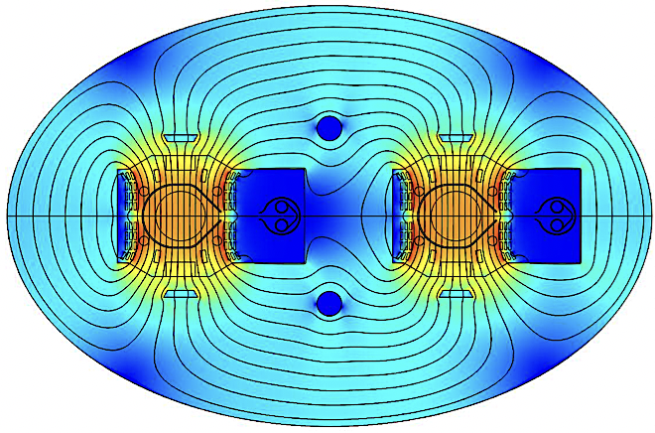
Proton-Proton
Energy Frontier Machines
FCC-hh
SppC
Collider-in-Sea
FCC-hh
100 km
100 TeV
16T Dipoles
SppC
100 km
125 TeV
20T Dipoles
Collider-in-Sea
1,900 km
500 TeV
3.5T Dipoles
Princeton University Physics Department Colloquium - February 22, 2024

Slide 9
Energy Frontier
Lepton Collider
An Energy Frontier
Muon Collider
Currently being pursued
by the International Muon
Collider Collaboration
Emerging Options
  Muon Collider with strong dependence on advanced magnet technology
  Wakefield Acceleration
    Laser-Driven Plasma
    Beam-Driven Plasma
    Beam-Driven Structure
LWFA
PWFA
SWFA
9
Princeton University Physics Department Colloquium - February 22, 2024

Slide 10
Multi-TeV Concepts From Snowmass
The AF4 evaluation of the maturity level of various concepts. Further details for the evaluation of the various concepts can be found in the “Concept Assessments” Section. The color code is that the concepts shown in blue offer a path to constituent center-of-mass energies >10 TeV, while those shown in orange are electron-hadron machines, and those shown in black are lepton collider concepts which will reach only into the 1-few TeV range.

Slide 11
Themes of this Talk
High Energy Colliders
A Brief Perspective
Why Muons?
A Vehicle for Discovery
The Physics Challenges
A Muon Collider
Machine Concepts
Charting a Path Forward

Slide 12
Why Muons?
Physics
Frontiers
Intense and cold muon beams a unique physics reach
Precision sources of neutrinos
Colliders
Opportunities
Collider Synergies
High intensity beams required for a long-baseline Neutrino Factory are
readily provided in conjunction with a Muon Collider Front End
Tests of Lepton Flavor Violation
Anomalous Magnetic Moment (g-2)
Next generation lepton collider
s-channel production of scalar objects a strong coupling to Higgs
Reduced synchrotron radiation (E⁴/m⁴) a multi-pass acceleration feasible
Beams can be produced with small energy spread
BUT the accelerator complex and detector must be able to handle the impacts of μ decays
Beamstrahlung effects (E⁴/m⁴) are suppressed at the collider IP relative to e⁺e⁻ colliders
Such overlaps offer unique staging strategies to guarantee physics output
while developing a muon accelerator complex capable of supporting
collider operations
Applications beyond HEP

Slide 13
μ⁺μ⁻ Collider Luminosity
Detector and Physics Performance at a Muon Collider
N. Bartosik et al 2020 JINST 15 P05001
For a muon collider, we can write the luminosity as:
For the 1.5 TeV muon collider design, we have
  N = 2×10¹² particles/bunch
  σ_{x,y} ~ 5.9 μm, β* = 10 mm, ε_{x,y}(norm) = 25 μm-rad
  n_{turns}~10³ ∝ 150 ⟨B[T]⟩
  f_{bunch}=15 Hz (rate at which new bunches are injected)

Slide 14
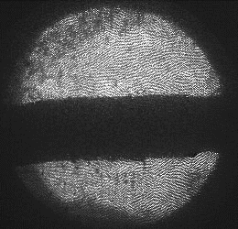
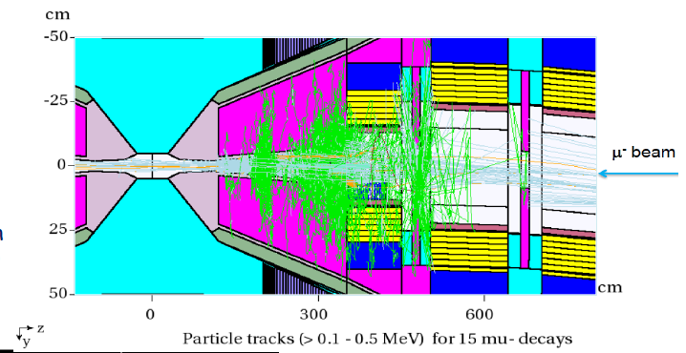
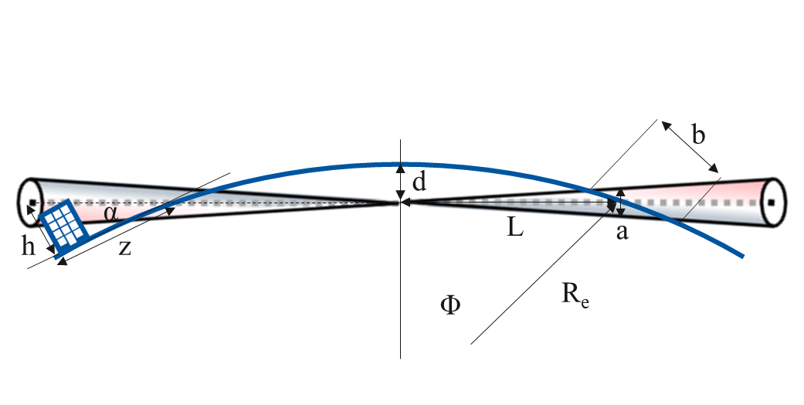
The Physics Challenges
MERIT Experiment – CERN
Liquid Hg Target
Muons are difficult to produce
  Most effective route is tertiary production from a multi-MW proton beam on a target: p → π → μ
  Beams must be bunched and cooled to produce luminosity in a collider
Muons decay
  All beam manipulations must be rapidly carried out to deliver useable beams to a collider
    Bunching
    Cooling
    Acceleration
  Electrons from the muon decays deposit significant energy in the accelerator components and physics detector
  Neutrinos from the muon decays can produce ionizing radiation far from the accelerator complex
1 cm
ν Radiation Fan

Slide 15
High Energy Physics
A Brief Perspective
Why Muons?
A Vehicle for Discovery
The Physics Challenges
A Muon Collider
Machine Concepts
Charting a Path Forward

Slide 16
Proton-Driven MC Concept
Short & intense proton
bunches to deliver
hadronic showers
p→π◊μ
◊ bunched
beams
Ionization cooling reduces
the transverse &
longitudinal emittance
Rapid acceleration to
high energy to avoid
μ losses. Multi-pass
acceleration offers
energy efficiency.
Accelerator design is driven by the short muon lifetime

Slide 17
After the 2014 P5, the MAP effort concluded.
What has changed?
The Physics Landscape
Muon Collider R&D Progress

Slide 18
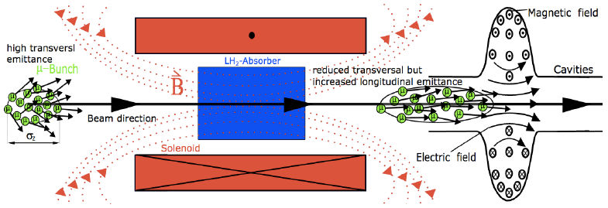
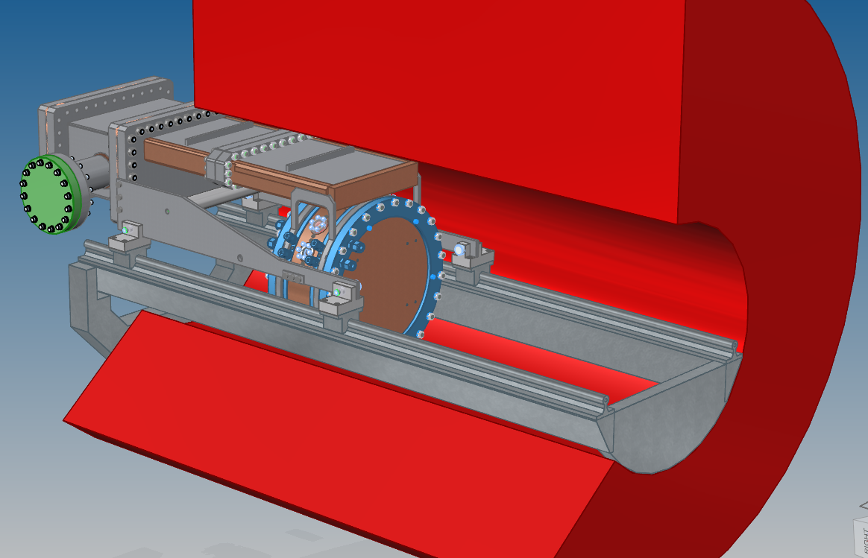
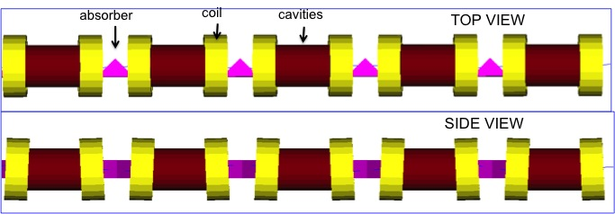
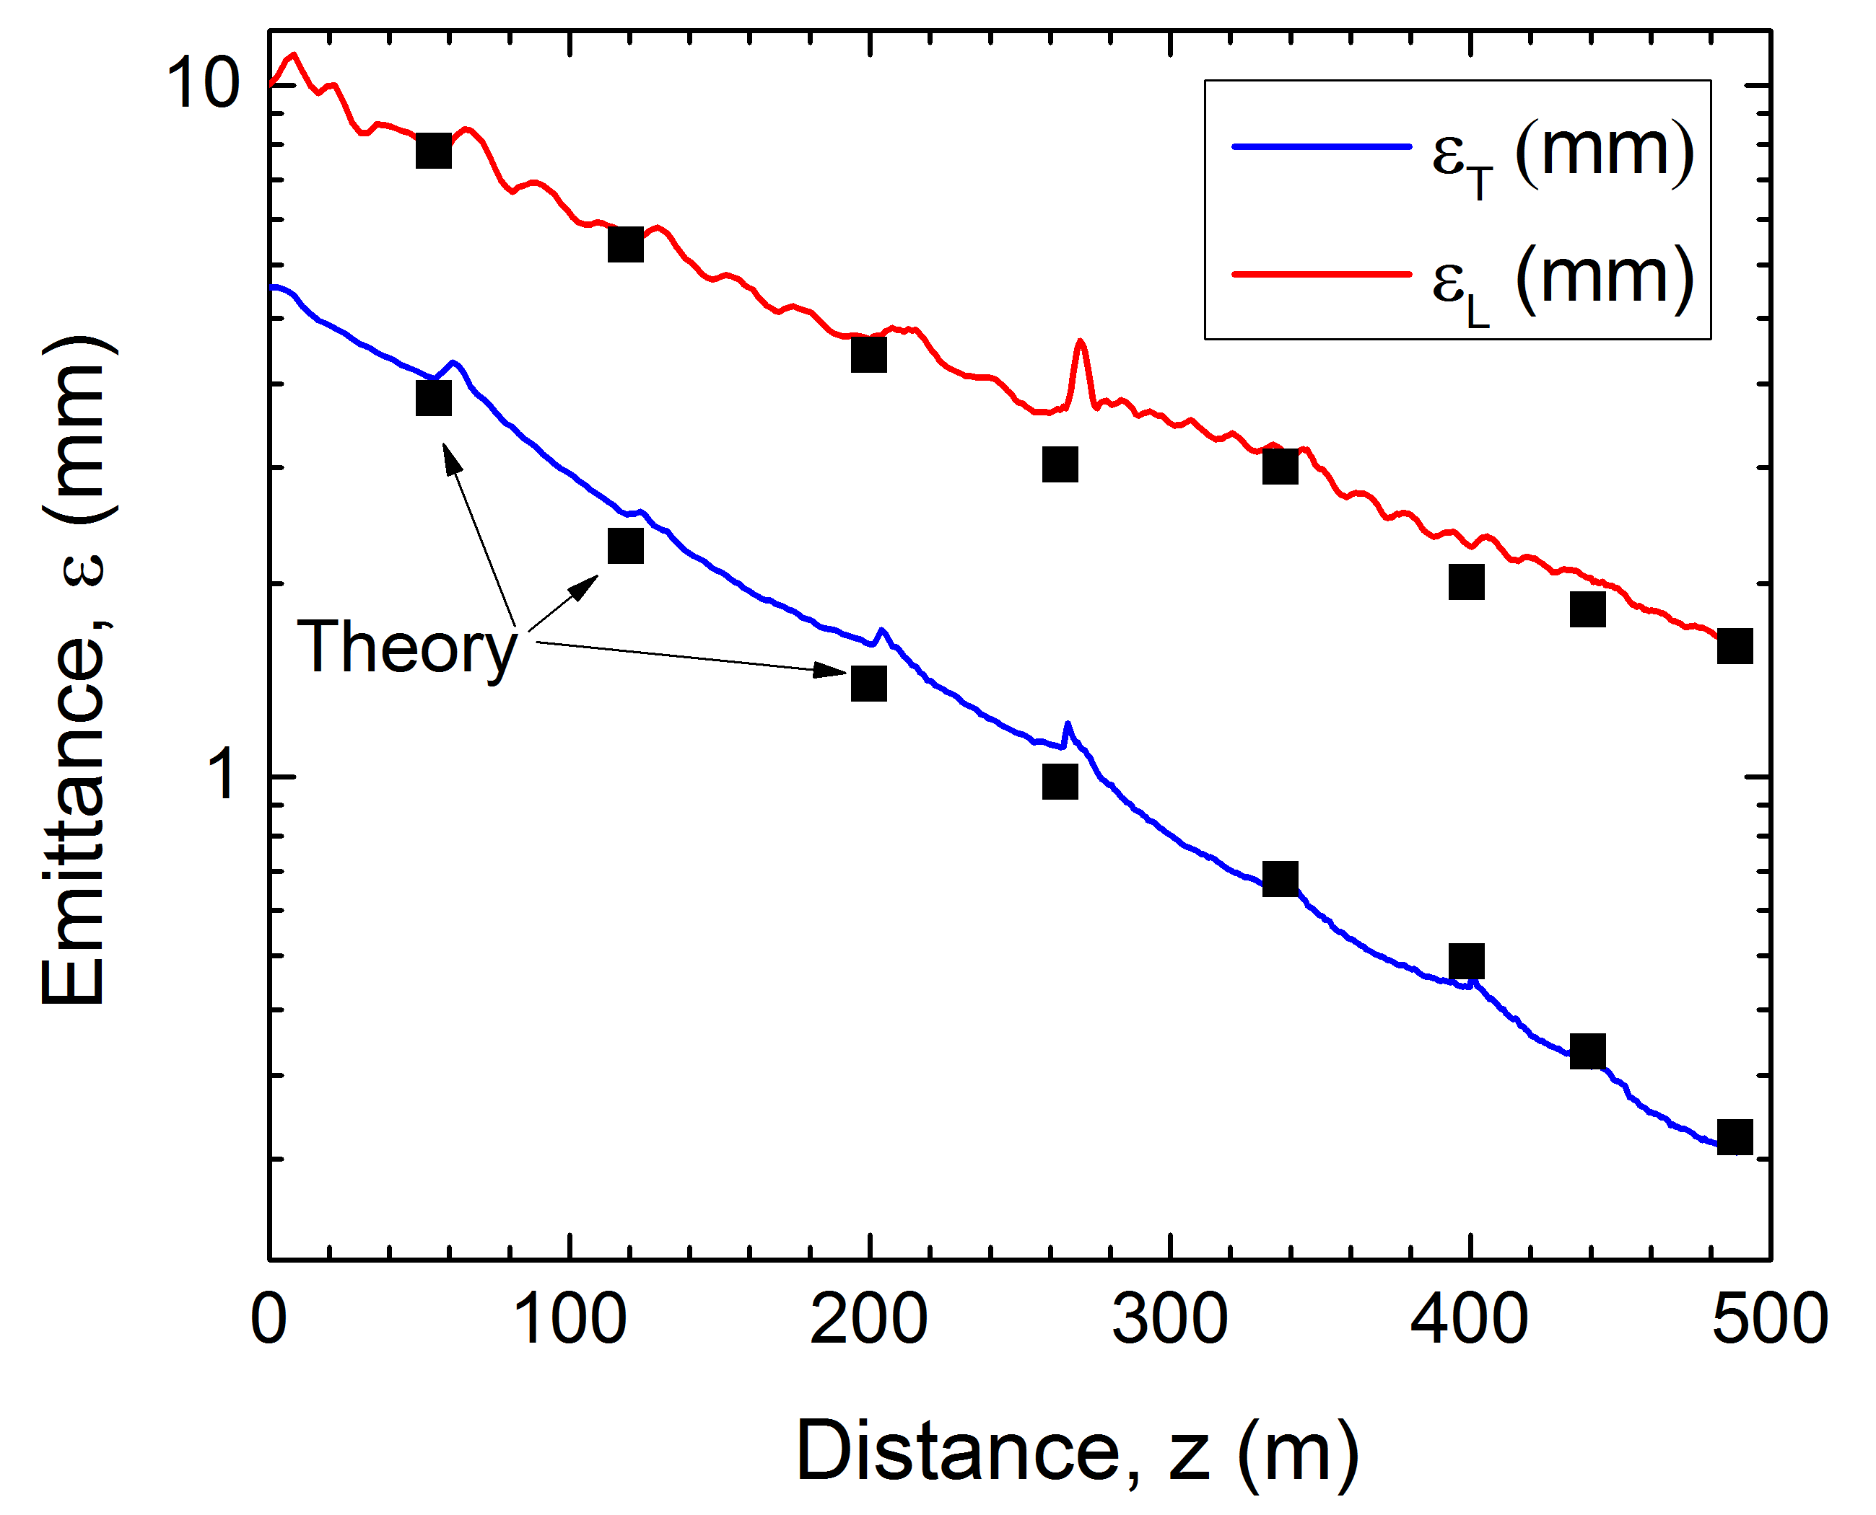
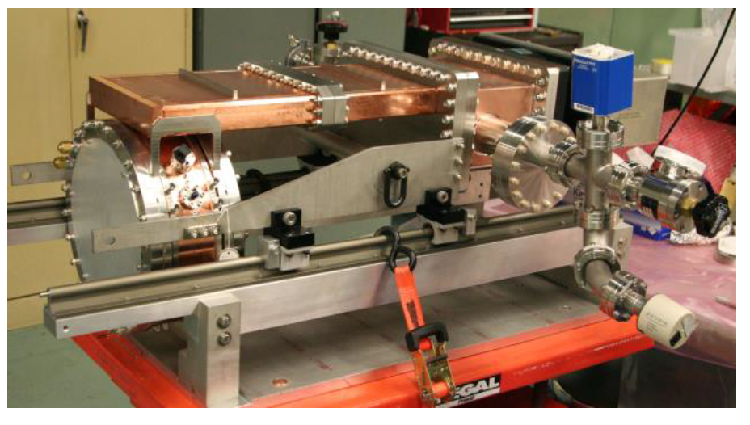
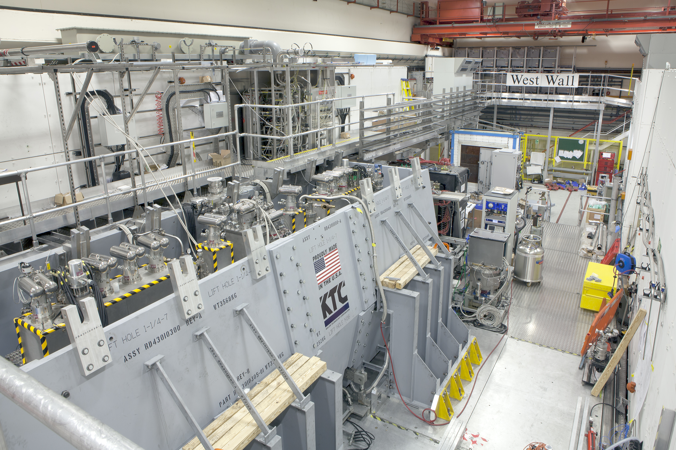
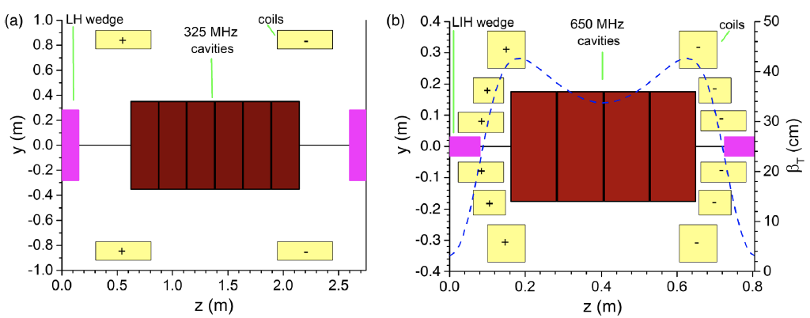
What has changed? Concept Maturity
One Example: Ionization Cooling
Cooling designs with good performance and significant
room for improvement based on recent R&D
Rectilinear Cooling Channel – PRSTAB 18, 031003 (2015)
>50MV/m operation
in up to 5 T B-field
MICE Cooling Channel
MICE Demo of
Ionization Cooling
Nature 578, 53–59 (2020)
RF in Magnetic Fields
~2.5x improvement over
current designs
Phys. Rev. Accel. Beams 23, 072001
2018 JINST 13 P01029

Slide 19
What has changed? MC R&D Progress
Issues
Status
Target
Multi-MW Targets
High Field, Large Bore Capture Solenoid
Ongoing >1 MW target development
Solenoid specs similar to ITER Central Solenoid
Front End
Energy Deposition in FE Components
RF in Magnetic Fields (see Cooling)
Current designs handle energy deposition
Cooling
RF in Magnetic Field
High and Very High Field SC Magnets
Overall Ionization Cooling Performance
MAP designs use ~20 MV/m → 50 MV/m demo
>30 T solenoid demonstrated for Final Cooling
Cooling design that achieves most goals
Acceleration
Acceptance
Ramping System
Complete design concept to all energies
Designs in place for accel to 125 GeV CoM
Magnet system development needed for TeV-scale
Additional design work needed for TeV-scale
Collider Ring
Magnet Strengths, Apertures, & Shielding
High Energy Neutrino Radiation
Lattices with magnet conceptual design to 3 TeV
ν radiation at 10 TeV currently under study
MDI/Detector
Backgrounds from μ Decays
IR Shielding
Physics studies show good performance (2020 JINST 15 P05001)
Further design work required for multi-TeV

Slide 20
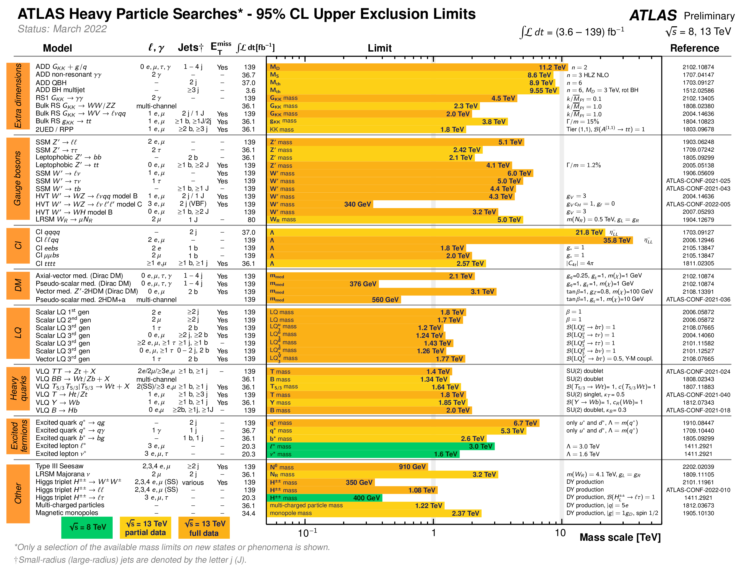
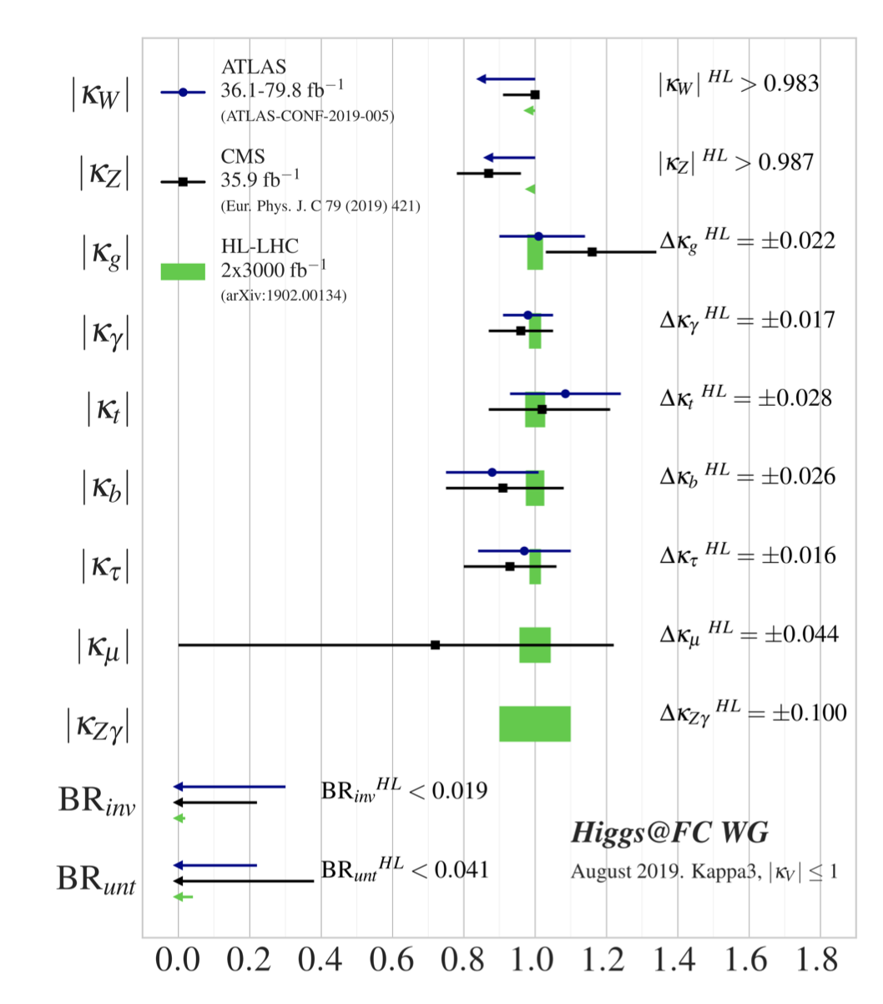
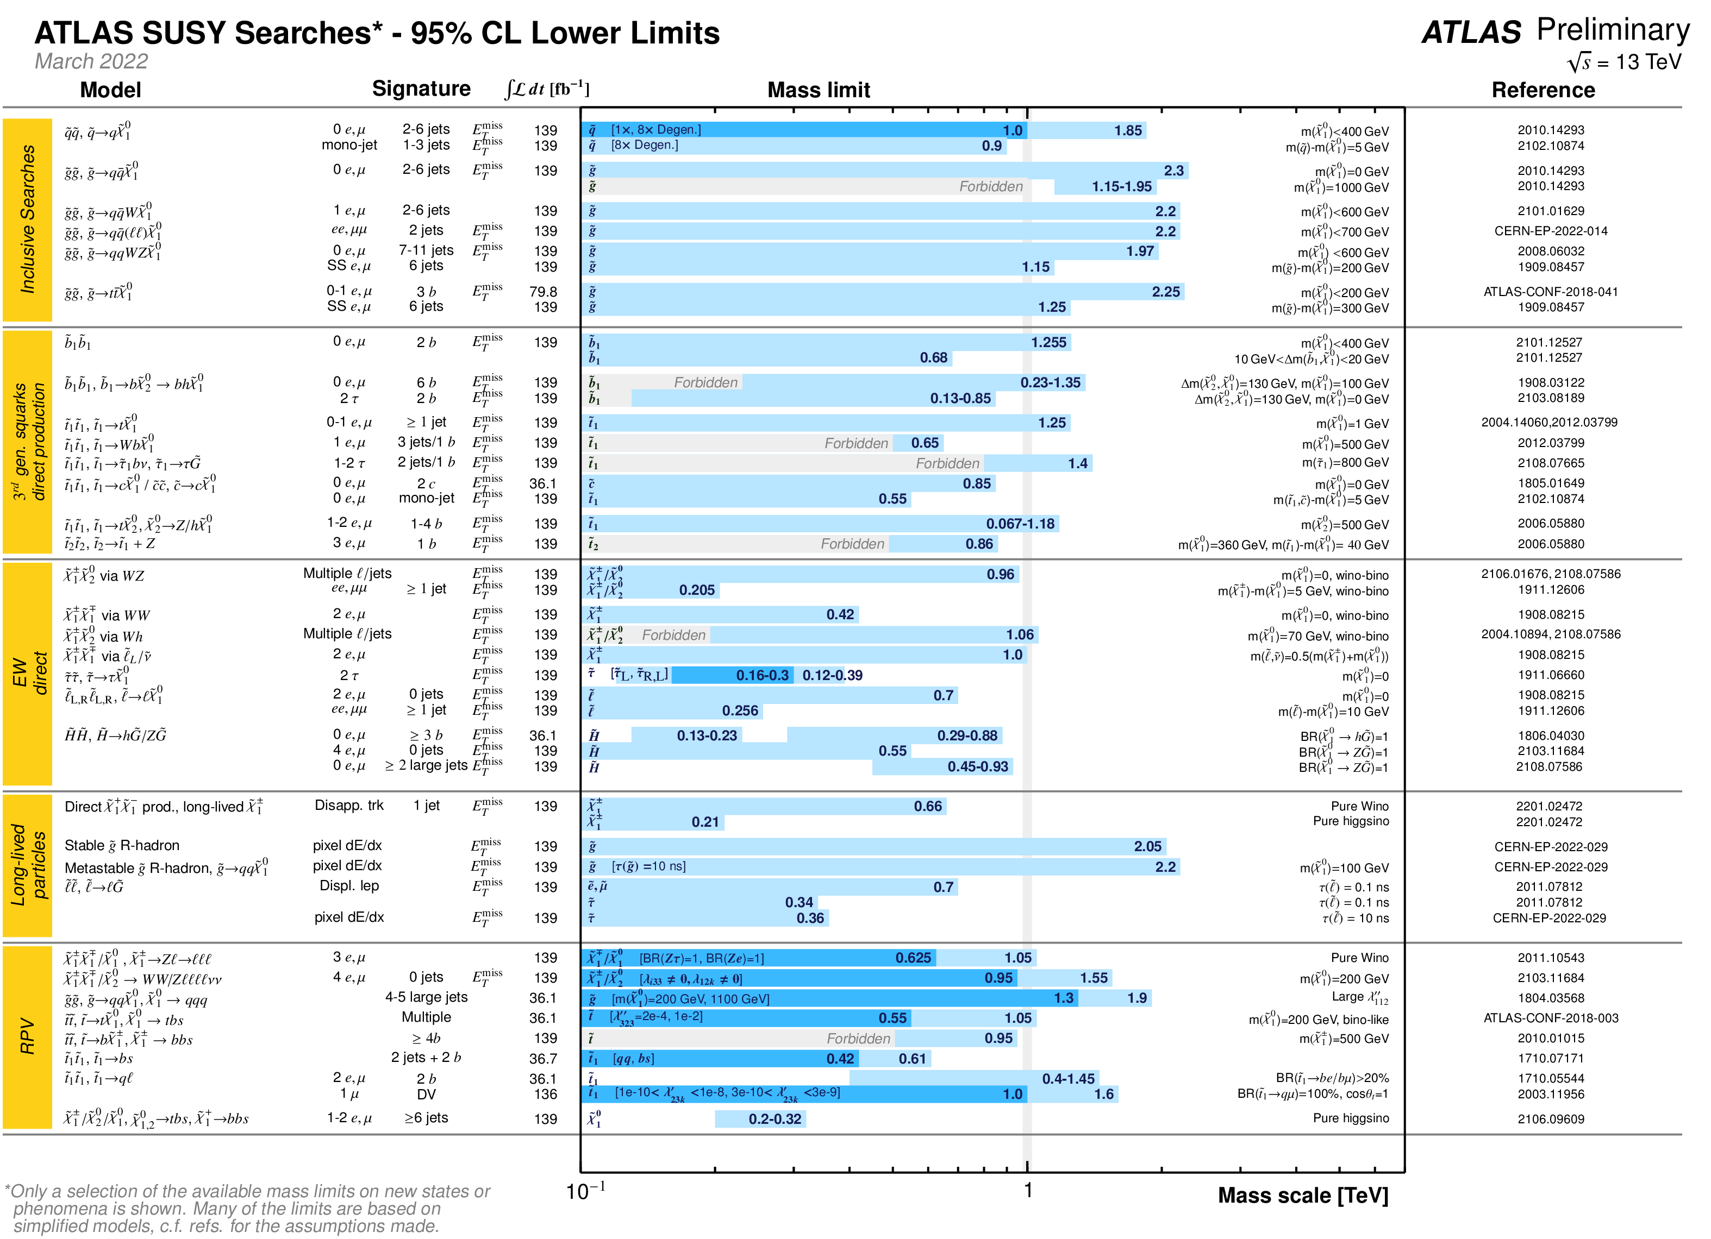
What has changed? The Physics Landscape – Generic Lessons from the LHC
There could still be New Physics at LHC/HL-LHC…
However, data suggests
generically there is a gap from
EW scale to scale of New Physics
We need to be able to probe
>>1 TeV
10 TeV is interesting as a step
into the unknown but also for
physics targets
~1% tests on the Higgs
Implies roughly the ~ TeV scale for New Physics which could cause such a deviation
Courtesy Patrick Meade (SBU)
1 TeV

Slide 21
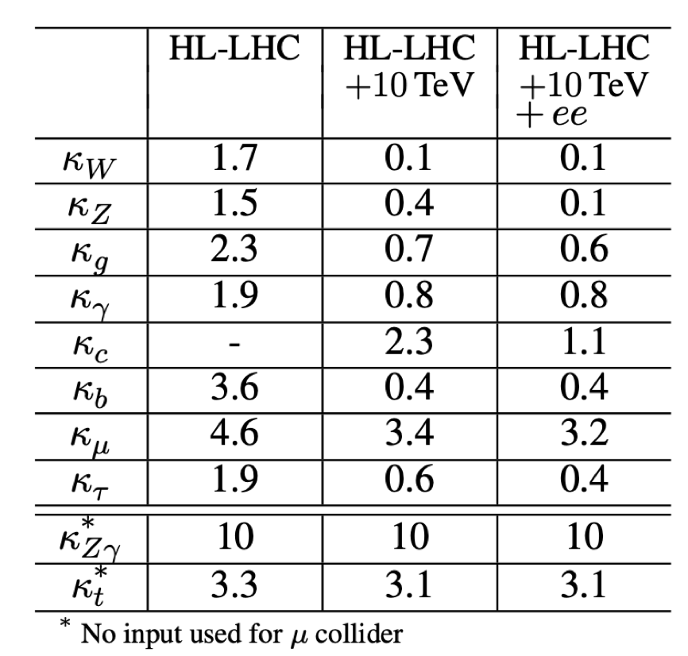
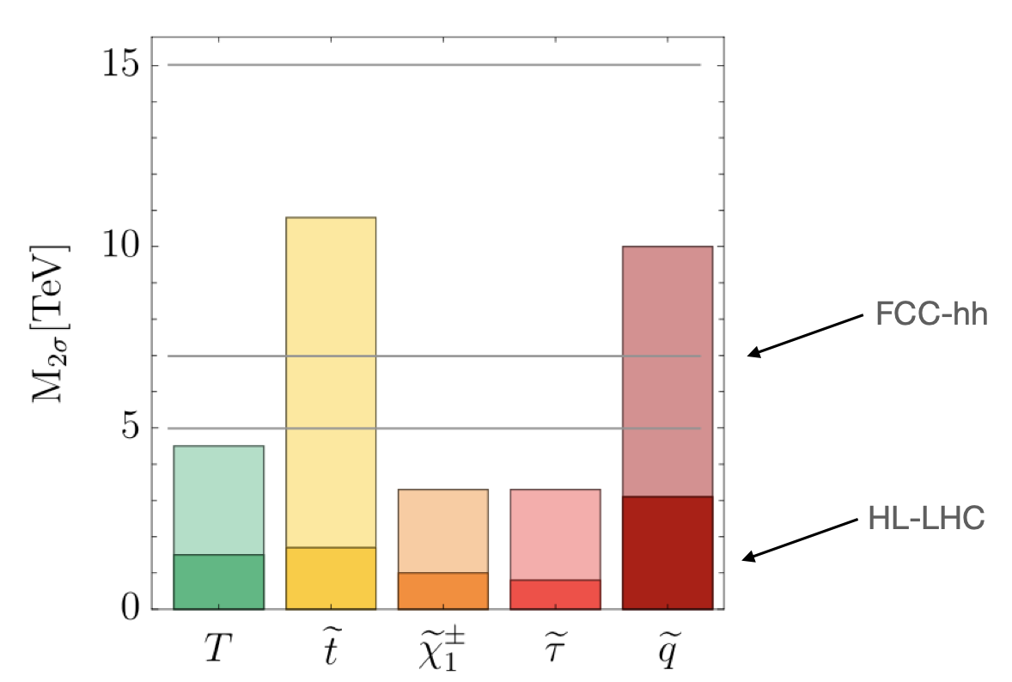
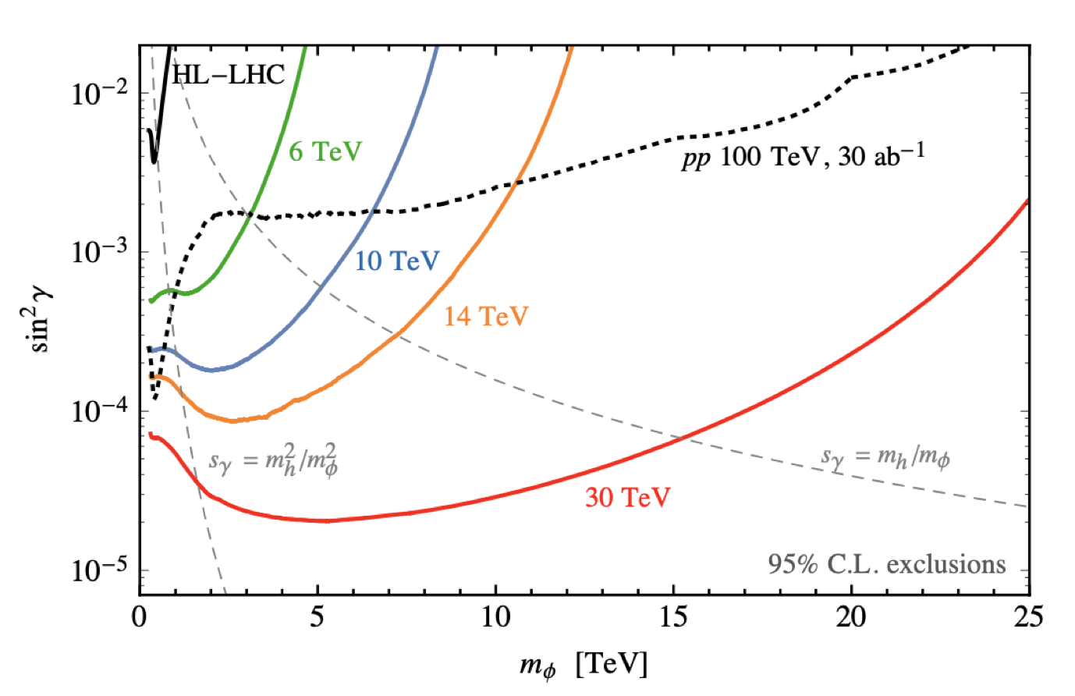
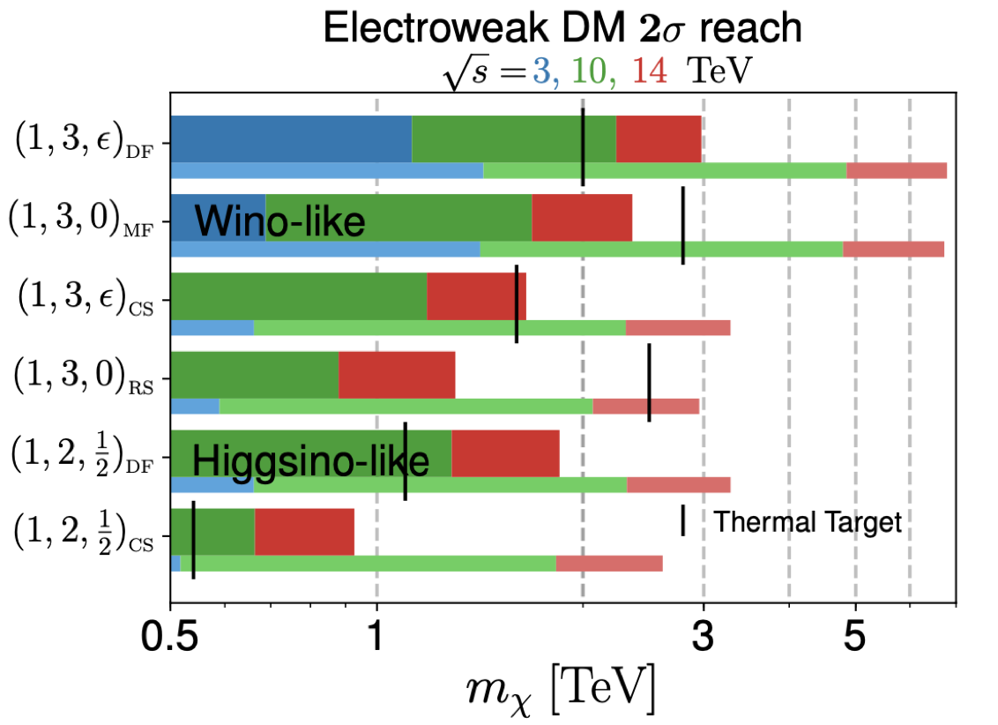
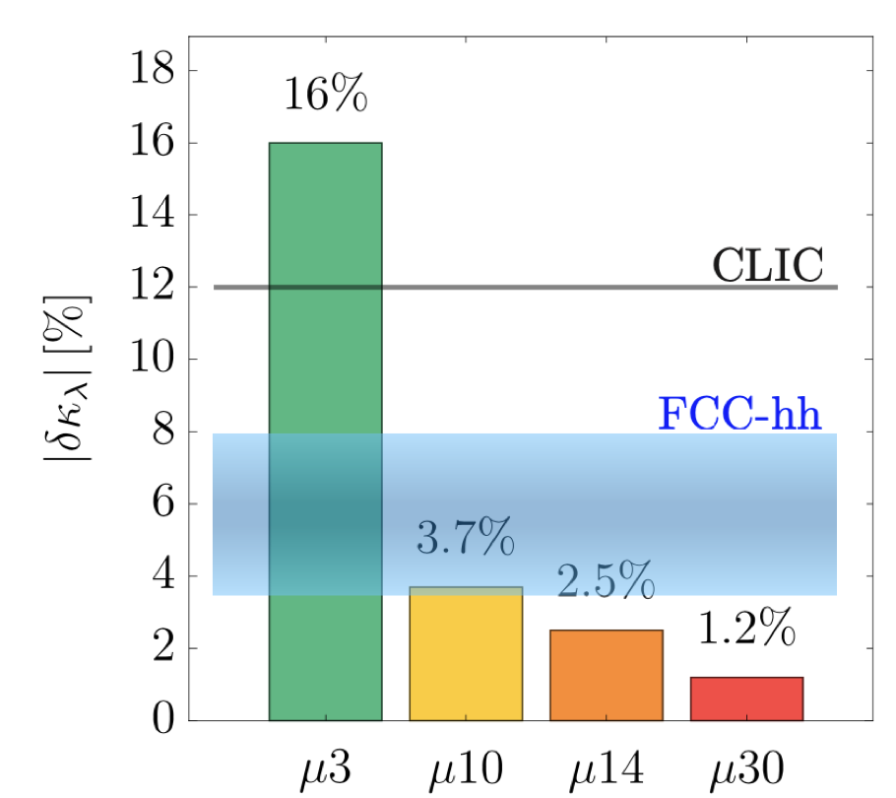
Physics Reach of a 10 TeV Muon Collider
10 TeV MC
Direct production at higher scales –
strongly motivated targets up to 10 TeV
Qualitatively improved reach into
Higgs Portal
Order of magnitude
in Higgs precision
and
can directly probe
the scale implied
in same machine!
Courtesy
Patrick Meade (SBU)
Covers simplest WIMP candidates –
hard or impossible with next generation DM direct detection
Turn Higgs potential into precision science
(e.g., needed for EW
phase transition)

Slide 22


Transition Initiated with the European Strategy Update
European Strategy Update
arXiv:2201.07895 [physics.acc-ph]
Prior to the 2020 European Strategy Update
  Considerable interest in LEMMA approach
  European colleagues pursued the detector and physics analysis utilizing MAP background studies (Mokhov, et al.)
ESPP Update supported pursuit of R&D towards a MC
Accelerator R&D Roadmap
  Described a technically limited program to validate MC concepts
  Goal: Readiness for a construction decision in <20 yrs

Slide 23
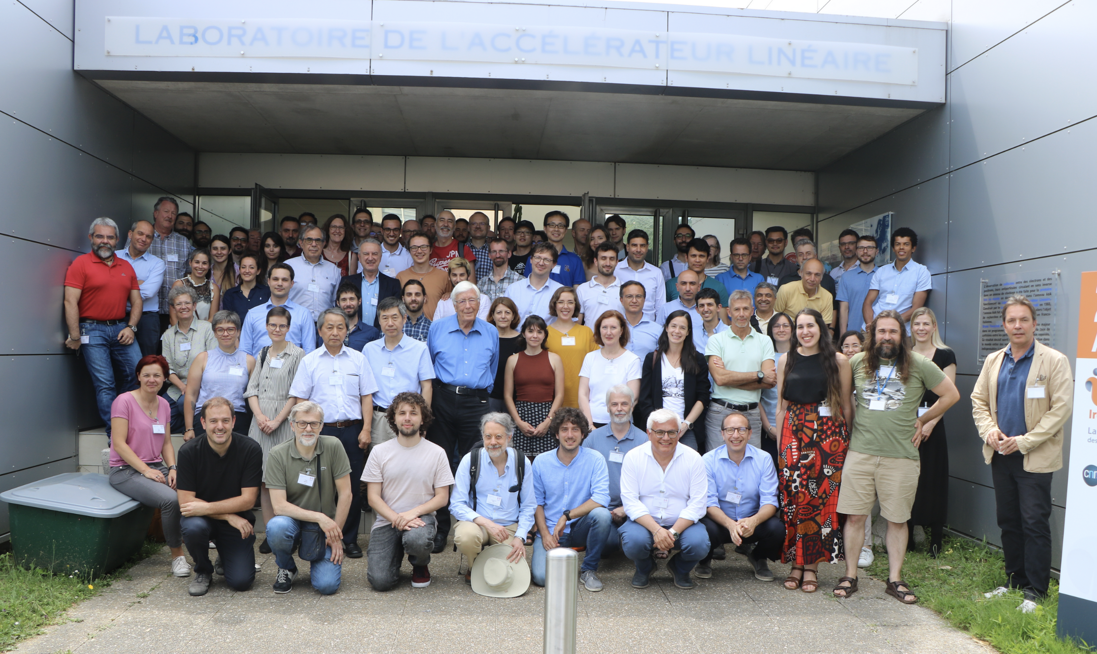
Formation of the International Muon Collider Collaboration (IMCC)
Annual meetings CERN October 2022 and Orsay June 2023
Many other meetings
e.g. synergy meeting Orsay June 2023, …
Design meetings on Mondays, …
Next Annual Meeting at CERN March 12-15, 2024
Governance is active: ICB 4 times, SB once, MuCol GB twice, …
Publication policy defined (Publication and Speakers Committee)
Web site to collect information on resources of partners
Are now in “grey book”
Started signing addenda to MoC
Courtesy D. Schulte

Slide 24
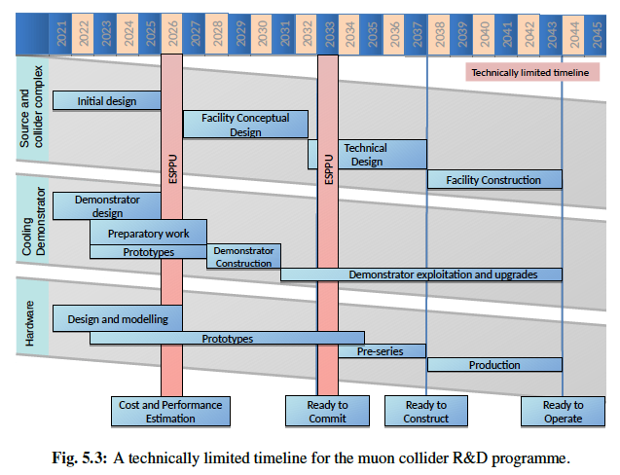
IMCC and MuCol Efforts
IMCC Technically Limited Timeline in Accel R&D Roadmap
MuCol Project
  EU HORIZON funded support for MC development
Courtesy D. Schulte

Slide 25
A Lightning Survey of Recent Progress

Slide 26
MC Parameters as Developed by MAP
RAST, Vol 10, No. 01, pp. 189-214 (2019)
Where would the most interesting physics be for a staging option?

Slide 27
Parameter Sets for the International MC Collaboration
Performance Aims:
  Achieve the target
  integrated luminosity
  in ~5 years of running
Energy Efficiency
Compare: 28 MW for 3 TeV CLIC

Slide 28
IMCC Technical Progress
The IMCC (with MuCol) has continued development of the proton-driven MC concept from the starting point of the US MAP studies
Courtesy D. Schulte

Slide 29
Courtesy D. Schulte

Slide 30
Courtesy D. Schulte

Slide 31
Courtesy D. Schulte

Slide 32
High Energy Physics
A Brief Perspective
Why Muons?
A Vehicle for Discovery
The Physics Challenges
A Muon Collider
Machine Concepts
Charting a Path Forward

Slide 33
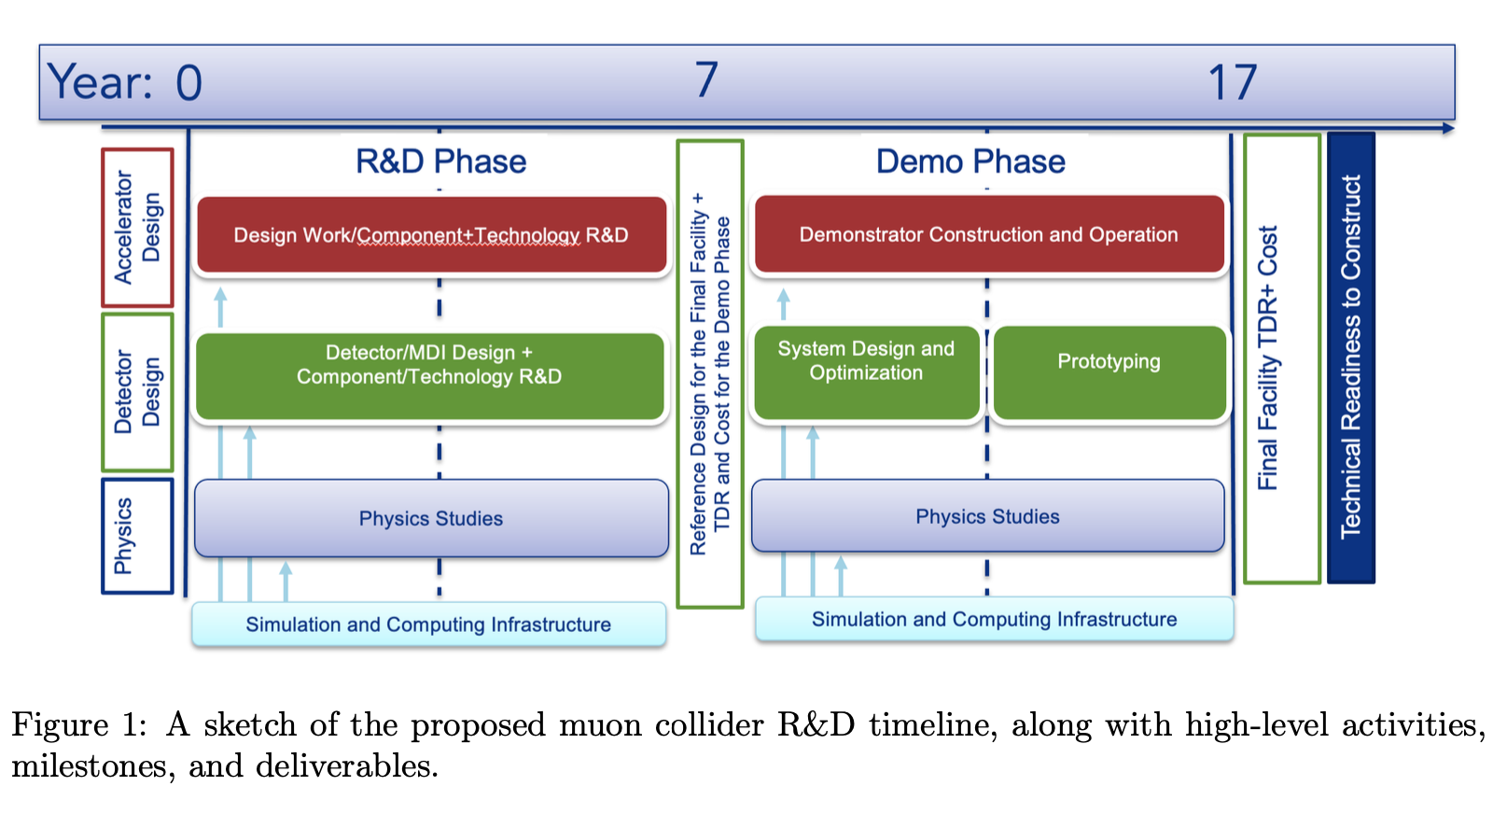
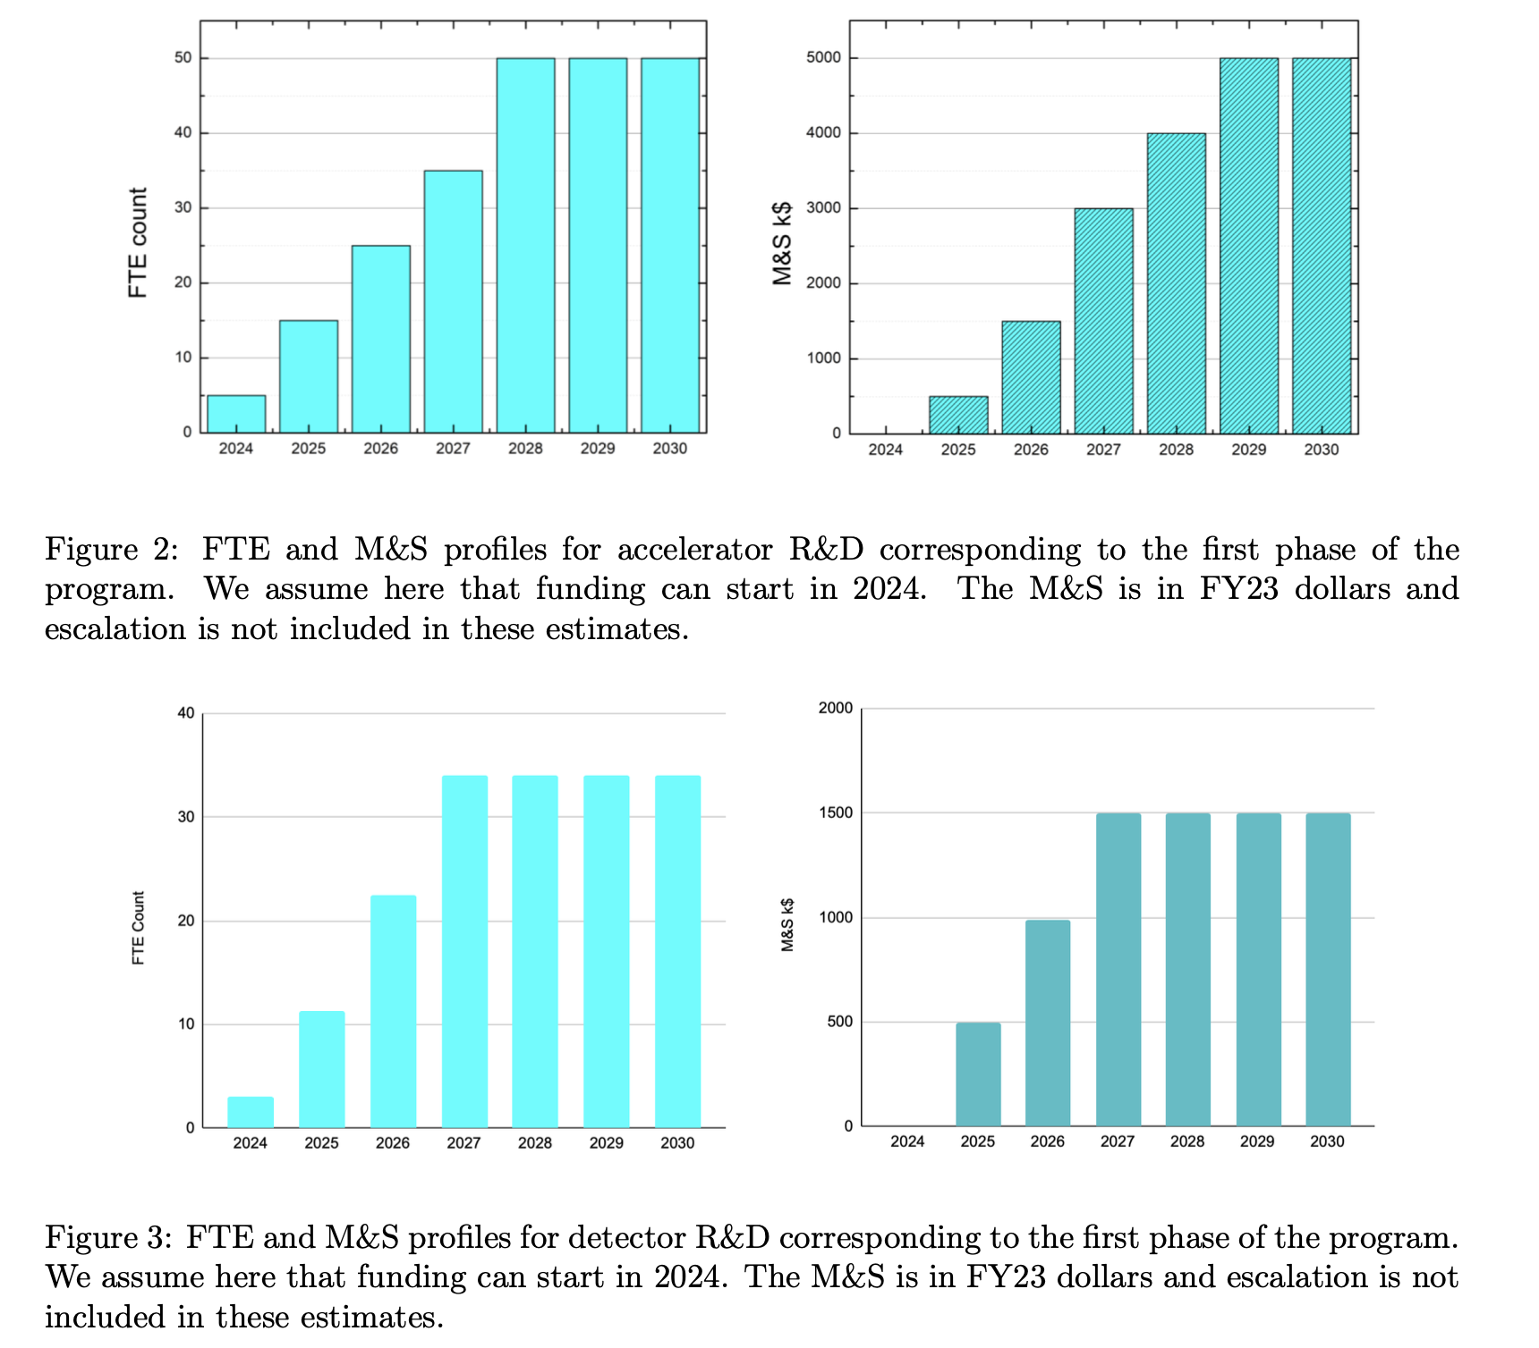
P5 “Ask” from the US MC Community
S. Jindariani, D. Stratakis, Sridhara Dasu et al.
Aims for the US to be a co-equal partner with Europe in an International Effort
Timeline trails the European “technically-limited” roadmap somewhat
33

Slide 35
2.3 The Path to a 10 TeV pCM
Realization of a future collider will require resources at a global scale and will be built through a world-wide collaborative effort where decisions will be taken collectively from the outset by the partners. This differs from current and past international projects in particle physics, where individual laboratories started projects that were later joined by other laboratories. The proposed program aligns with the long-term ambition of hosting a major international collider facility in the US, leading the global effort to understand the fundamental nature of the universe.
…
In particular, a muon collider presents an attractive option both for technological innovation and for bringing energy frontier colliders back to the US. The footprint of a 10 TeV pCM muon collider is almost exactly the size of the Fermilab campus. A muon collider would rely on a powerful multi-megawatt proton driver delivering very intense and short beam pulses to a target, resulting in the production of pions, which in turn decay into muons. This cloud of muons needs to be captured and cooled before the bulk of the muons have decayed. Once cooled into a beam, fast acceleration is required to further suppress decay losses.
…
Although we do not know if a muon collider is ultimately feasible, the road toward it leads from current Fermilab strengths and capabilities to a series of proton beam improvements and neutrino beam facilities, each producing world-class science while performing critical R&D towards a muon collider. At the end of the path is an unparalleled global facility on US soil. This is our Muon Shot.
P5 Presentation to HEPAP Excerpt

Slide 36
Recommendation 4
Not Rank-Ordered
Support vigorous R&D toward a cost-effective 10 TeV pCM collider based on proton, muon, or possible wakefield technologies, including an evaluation of options for US siting of such a machine, with a goal of being ready to build major test facilities and demonstrator facilities within the next 10 years (sections 3.2, 5.1, 6.5, and Recommendation 6).
Enhance research in theory to propel innovation, maximize scientific impact of investments in experiments, and expand our understanding of the universe (section 6.1).
Expand the General Accelerator R&D (GARD) program within HEP, including stewardship (section 6.4).
Invest in R&D in instrumentation to develop innovative scientific tools (section 6.3).
Conduct R&D efforts to define and enable new projects in the next decade, including detectors for an e⁺e– Higgs factory and 10 TeV pCM collider, Spec-S5, DUNE FD4, Mu2e-II, Advanced Muon Facility, and line intensity mapping (sections 3.1, 3.2, 4.2, 5.1, 5.2, and 6.3).
Support key cyberinfrastructure components such as shared software tools and a sustained R&D effort in computing, to fully exploit emerging technologies for projects. Prioritize computing and novel data analysis techniques for maximizing science across the entire field (section 6.7).
Develop plans for improving the Fermilab accelerator complex that are consistent with the long-term vision of this report, including neutrinos, flavor, and a 10 TeV pCM collider (section 6.6).
We recommend specific budget levels for enhanced support of these efforts and their justifications as Area Recommendations in section 6.
P5 Presentation to HEPAP Excerpt

Slide 37
Conclusion
A 10 TeV pCM Muon Collider R&D and design effort is currently underway!
The 2023 P5 Report recommends establishment of a robust US Collider R&D Program
  Both for a Higgs Factory and towards future 10 TeV pCM machines
  With the aspiration for the US to host a future machine
  Any of these machines will be a global endeavor
For the US MC community, engagement with the international effort is the next critical step
  Provide a critical mass of world-wide expertise for the R&D and Design efforts
  Ensure that R&D and design schedules can deliver results that support a machine decision within the 20-year time frame
Challenges do exist…
  DOE-HEP funding is not presently at the levels assumed in the P5 Scenarios
  Time will be required to ramp up a well-managed effort
  International agreements need to be put in place
  The shape of the US Collider R&D Program needs to be defined
a Looking forward to growing a US team to engage in the Muon Shot!
Princeton University Physics Department Colloquium - February 22, 2024

Slide 38
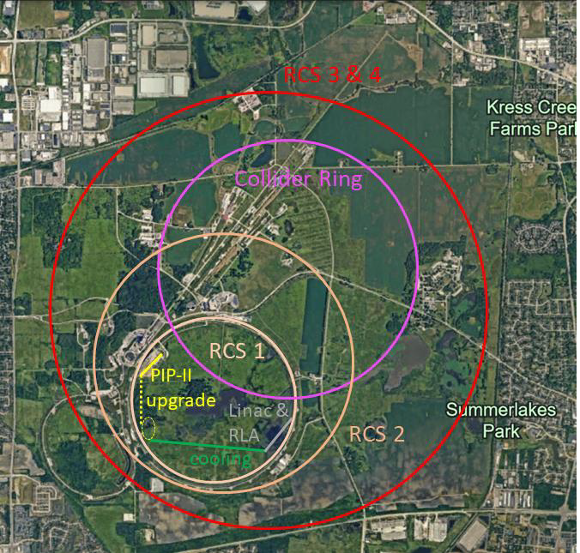
Thank you for your attention!
The potential scale of the
accelerator complex for a
10 TeV MC at Fermilab

