Slide 1
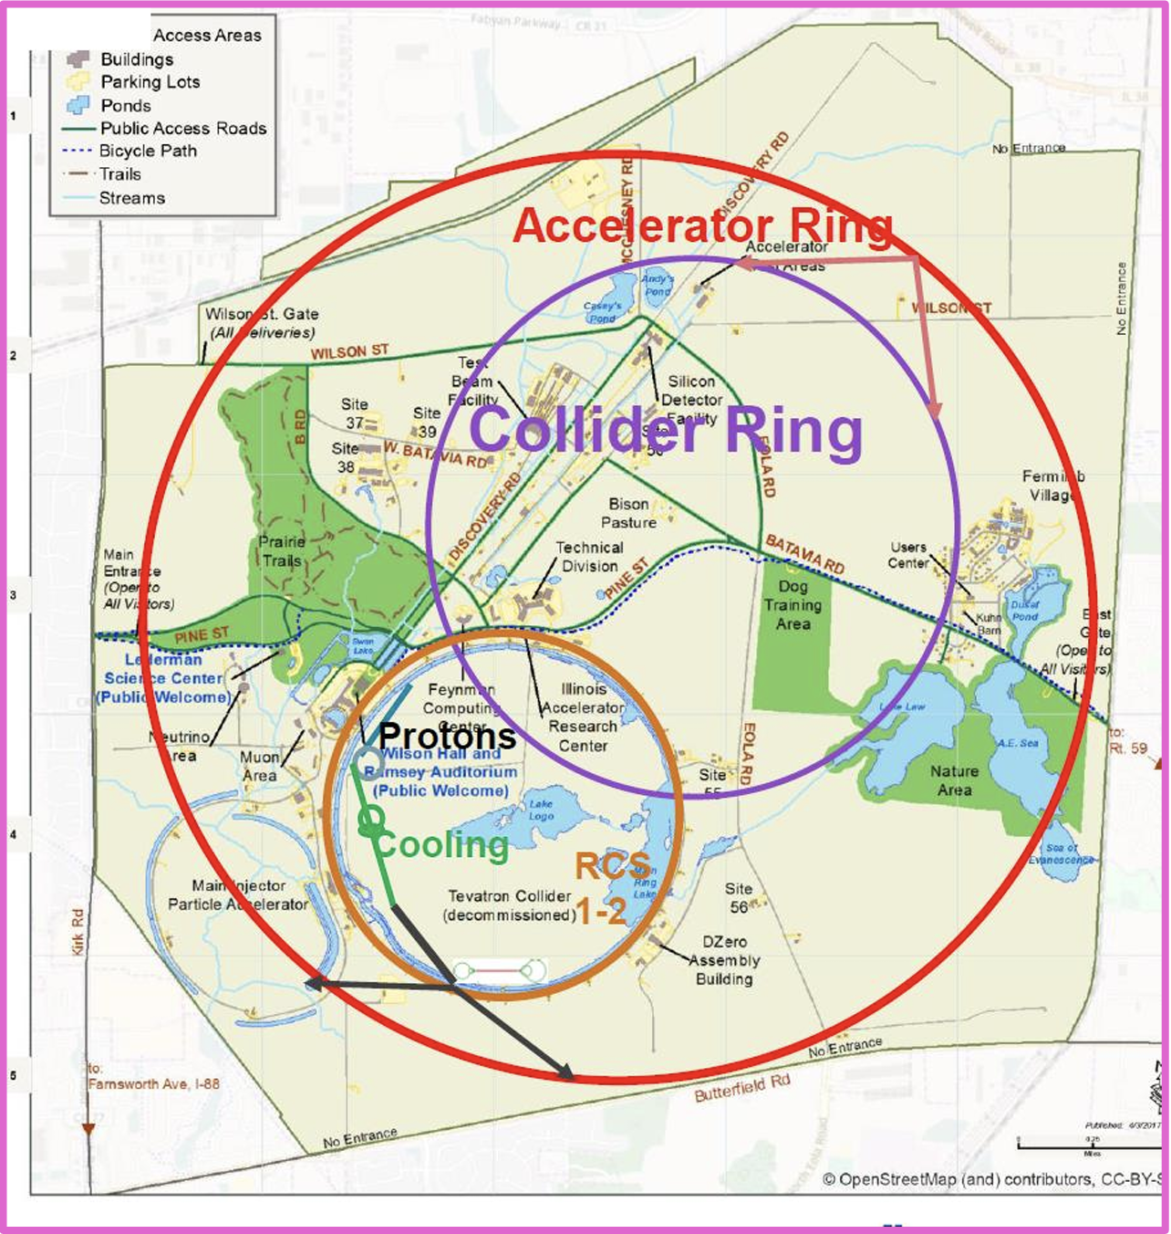
Advancing Targetry R&D for
The US Muon Collider
Katsuya Yonehara
Princeton Workshop
2/23/2024

Slide 2
Layout of muon accelerator complex for colliders
Targetry (cover in this talk)
MAP baseline design (based on simulation study)
Proton driver: 10¹⁴-10¹⁵ protons within 1-3 ns bunch length
Front end: π/μ capture section (μ/p efficiency 10-15 % for each sign)
MW-Class Target: Interface between proton driver and Front end channel

Slide 3
Characteristics of Proton beam parameter at intense beam facility
 | Neutron spallation source (ESS, SNS, CSNS) | Accelerator Neutrino beam (T2K, CNGS, NuMI, SBN, LBNF) | Muon collider (MAP, IMCC design)
Proton beam energy | Low (1-3 GeV) | Wide range (8-400 GeV) | Medium (5-20 GeV)
Proton beam bunch length | Short (105-700 ns) | Long (4.2-10.5 μs) | Extremely short (1-3 ns)
Proton beam intensity per bunch | Medium (1e13-1.5e14) | Medium (4.8e13-3.2e14) | High (1e14-1e15)
Repetition rate | High (14-60 Hz) | Low (0.4-2 Hz) | Medium (5-15 Hz)
Target material | Liq. Hg, W, Liq. Li etc | graphite | ?
Is there any target capable of withstanding such an exceptionally high thermal shock?

Slide 4
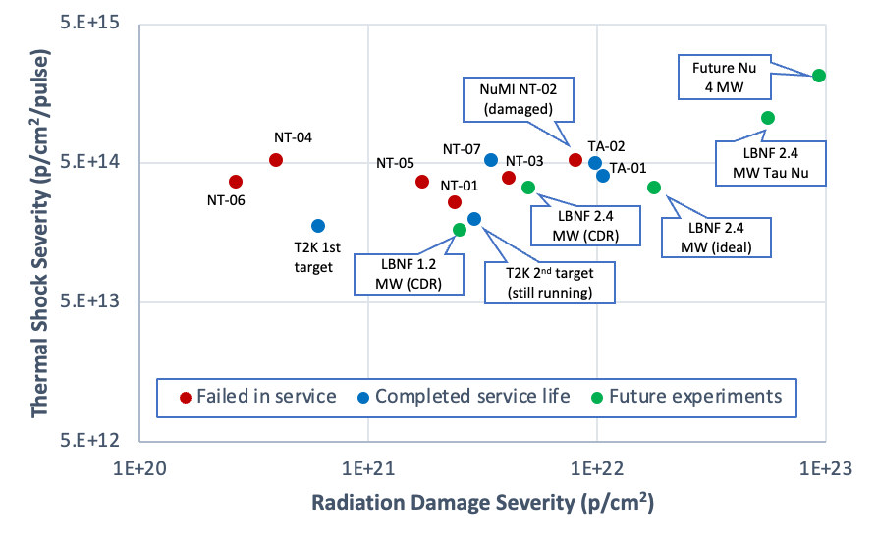
Thermal shock is a key parameter for survivability of High-Power Target
Metal rod exploded by beam impact
Neutrino HPT R&D Materials Exploratory Map (Graphite)
Boundary represents operational threshold for thermal shock on graphite targets
Iridium rod target tested at CERN’s HiRadMat facility

Slide 5
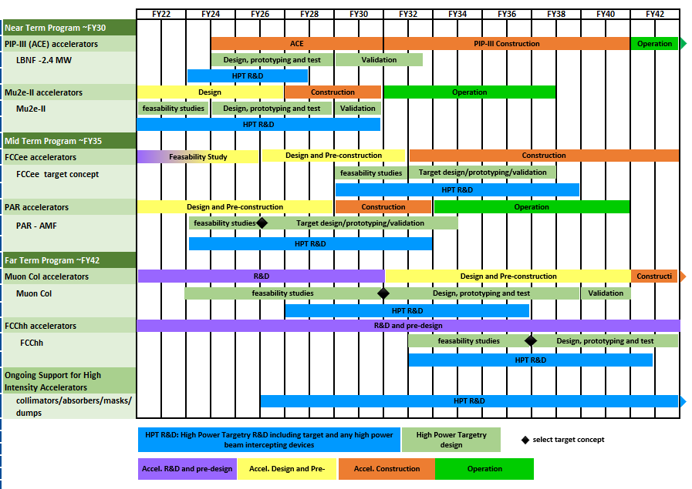
DOE suggests to make a roadmap for HPT R&D
HPT R&D is aligned with timeline of HEP Accelerators
NOTE:
Each project set a specific target parameter, thus
each target has a specific challenge and specific R&D.
Current HPT R&D plan works on a generic item.
We should identify a specific issue on MC.
HEP HPT R&D Workshop
April 11-12 2023

Slide 6
Explorer Radiation Material Science for Advancing High Power Target R&D

Slide 7
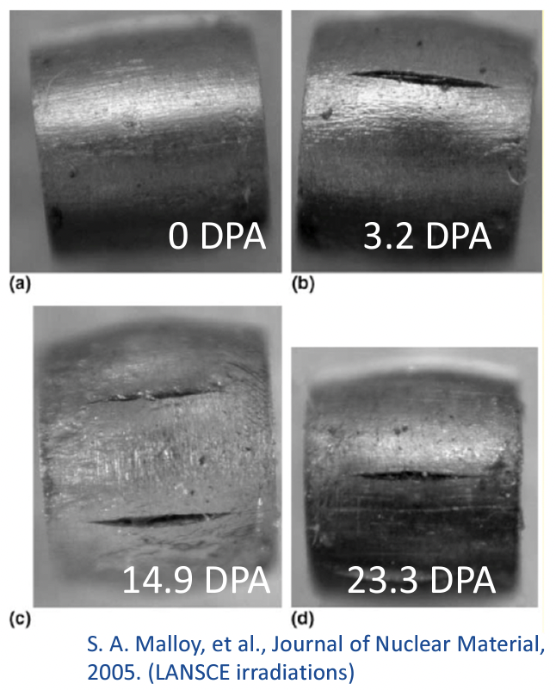
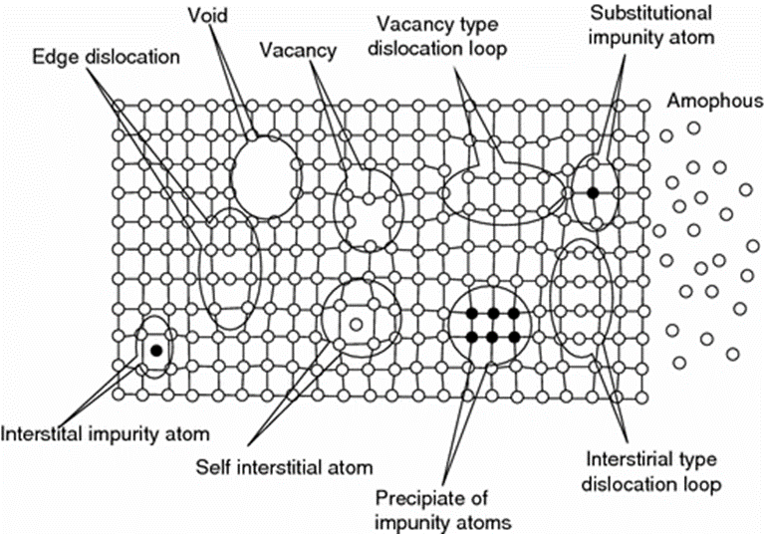
Challenges associated with Beam Intercepting Device
Radiation Damage: Displacements in crystal lattice expressed as Displacements Per Atom (DPA)
Hardening and embrittlement
Creep and swelling
Fracture toughness reduction
Thermal/electrical conductivity reduction
Coefficient of thermal expansion
Modulus of elasticity
Transmutation products (H, He gas production can cause void formation and embrittlement)
Movement of lattice elements mimics like “Billiard ball” influenced by incident particles

Slide 8
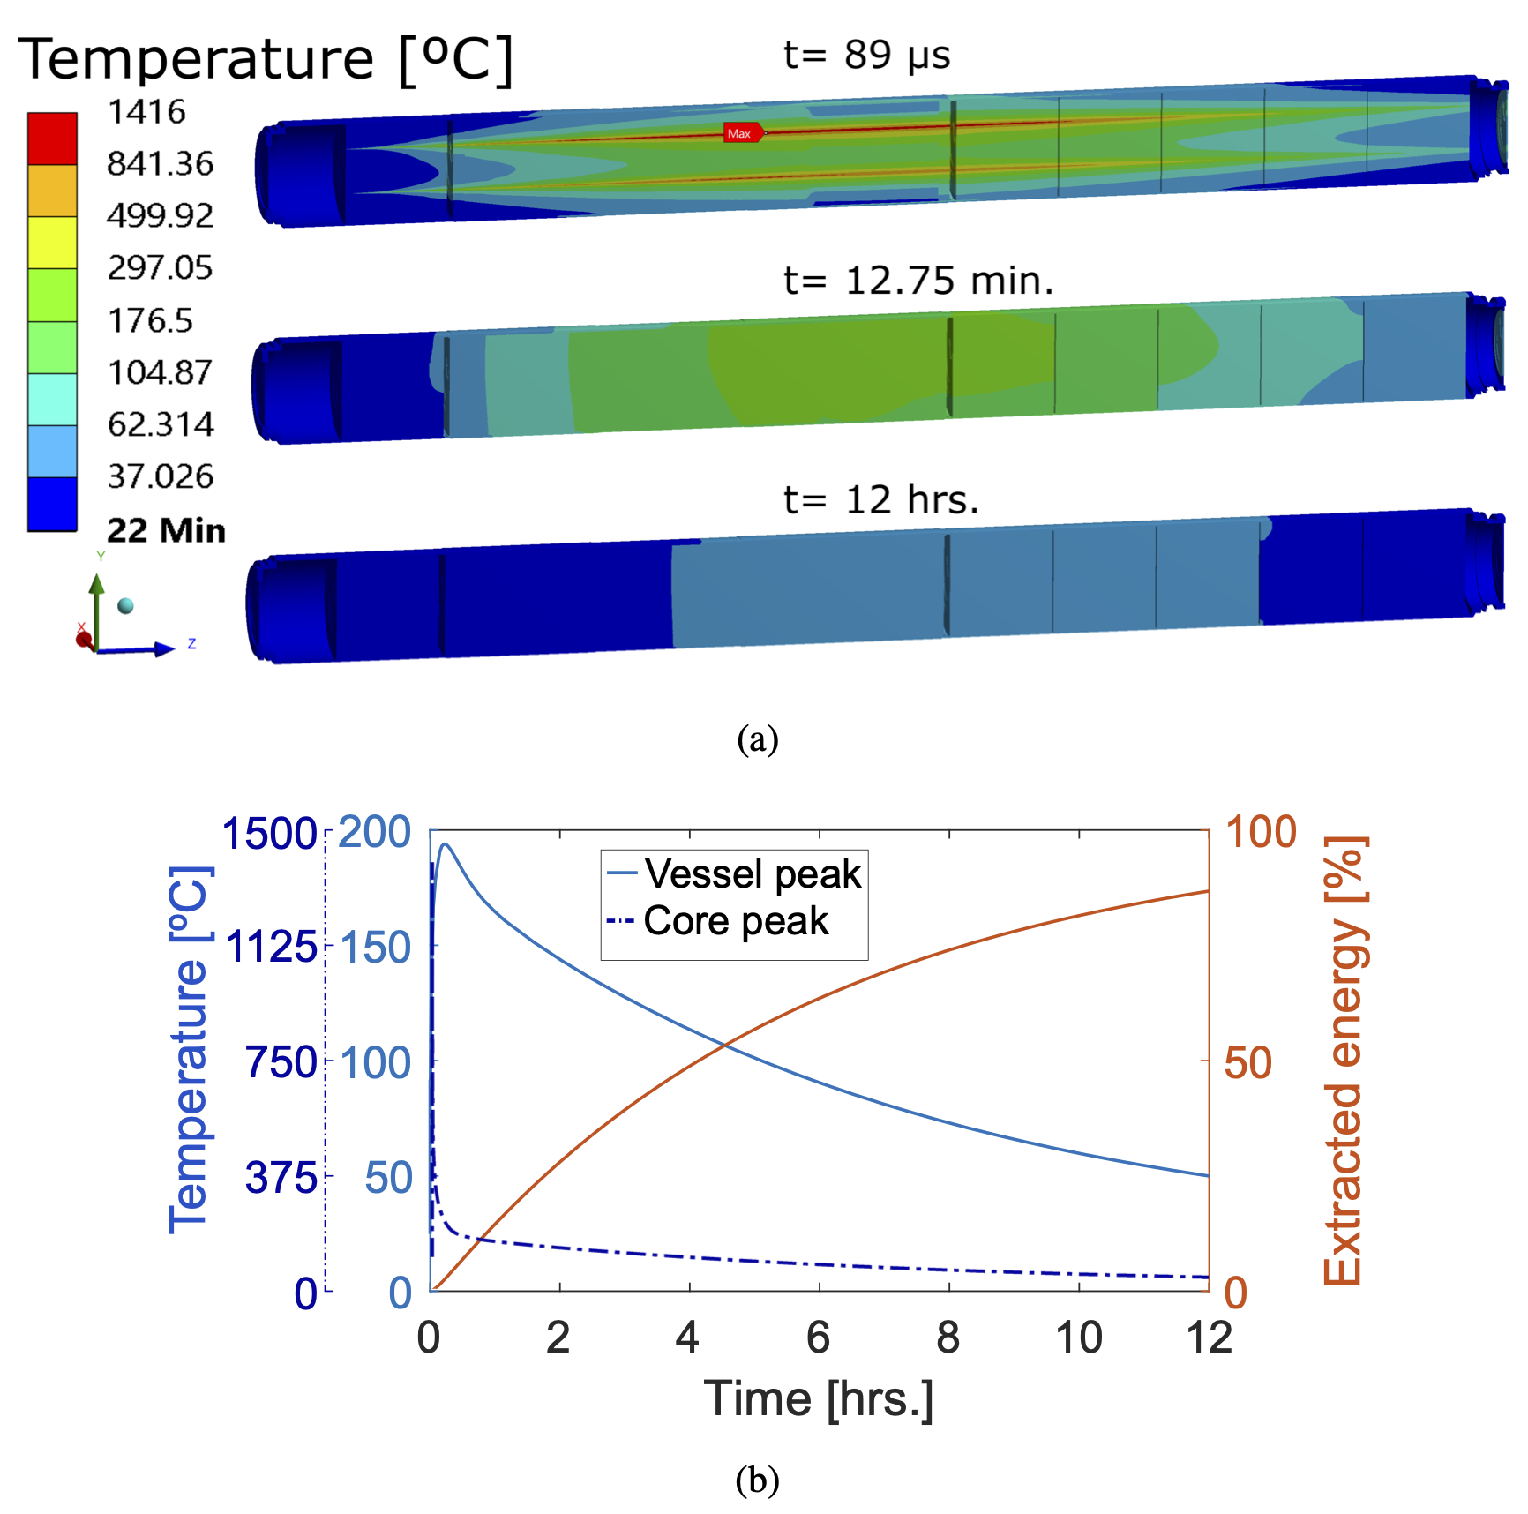
Challenges associated with Beam Intercepting Device
Relaxation time of thermal
vibration is very long
Thermal Shock: Sudden energy deposition from pulsed beam
Fast expansion of the material surrounded by cooler material generates localized area of compressive stress
Stress waves move through the material at sonic velocities. Plastic deformation, cracking and fatigue failure can occur. Stress waves stay long time.
Simulated displacement of LHC beam damper

Slide 9
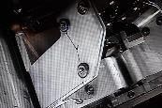
Challenges associated with Beam Intercepting Device
Thermal Fatigue: Cycling loading environment
Cycling loading progressively damage material’s microstructure such that it can ultimately fail at stress levels that are actually lower than its failure strength
Horn stripline fatigue failure after 20M pulses (2023)
NuMI horn striplines
200 kA pulsed current flows every second

Slide 10
R a D I A T E Collaboration
Radiation Damage In Accelerator Target Environments
RaDIATE collaboration created in 2012, with Fermilab as the leading institution. The collaboration has grown up to 20 institutions over the years.
First MoU was signed with 5 institutions 10 years ago!
Objective:
Harness existing expertise in nuclear materials and accelerator targets
Generate new and useful materials data for application within the accelerator and fission/fusion communities
Activities include:
Analysis of materials taken from existing beamline as well as new irradiations of candidate target materials at low and high energy beam facilities
In-beam thermal shock experiments
Contact:
Frederique Pellemoine, fpellemo@fnal.gov
Web: radiate.fnal.gov
Notes:
To address these material challenges, the HPT community formed the RaDIATE collaboration in 2012, with Fermilab as the leading institution. The goal was to bring experts from the accelerator and fission/fusion communities together to generate new data for accelerator materials. The collaboration has grown up to 14 institutions over the years.

Slide 11
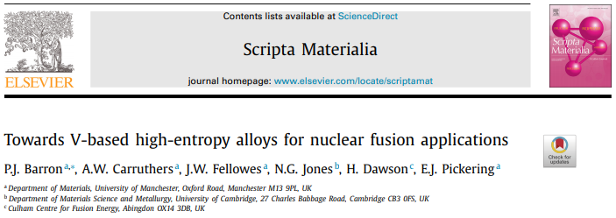
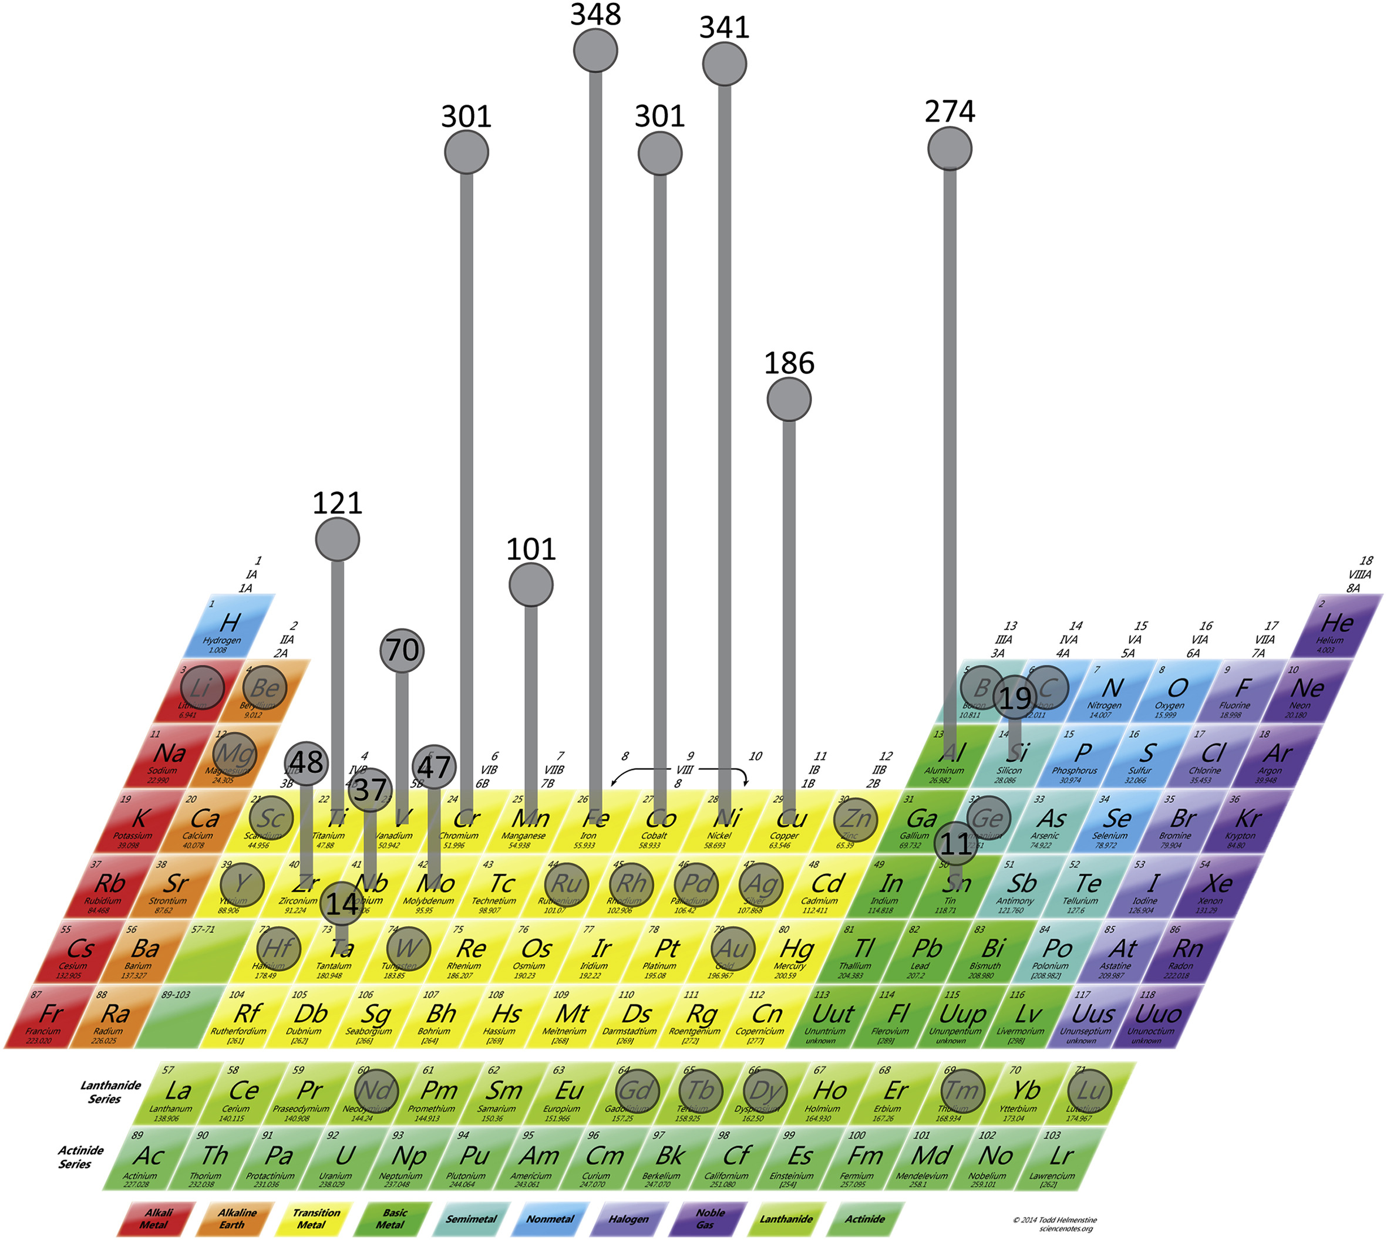
High Entropy Arroy for Accelerator Beam Windows
Elemental selection considerations
Light-weight elements (low density)
Reduced interaction with protons
Minimize energy loss and multiple scattering
Primarily a single-phase alloy
Better ductility and manufacturability
Minimal activation
Safer/easier to handle and dispose after use
Most commonly used elements in HEAs from literature (Miracle, 2017)
Equimolar Cr-Mn-V shown to be single-phase BCC
Ti additions reduce concentration of interstitial impurities by forming Ti-(C,O,N)
Concerns Ti concentrations above ~8% will promote Laves phase formation
Fe forms intermetallic compounds near the equimolar ratio with Cr, Ti, V
Common alloys: CoCrFeMnNi (Cantor alloy), Al_{x}CoCrFeNi, Al_{x}CoCrCuFeNi
HEA technology drastically grows over the past decade
Optimal blending configurations is designed in advanced simulation

Slide 12
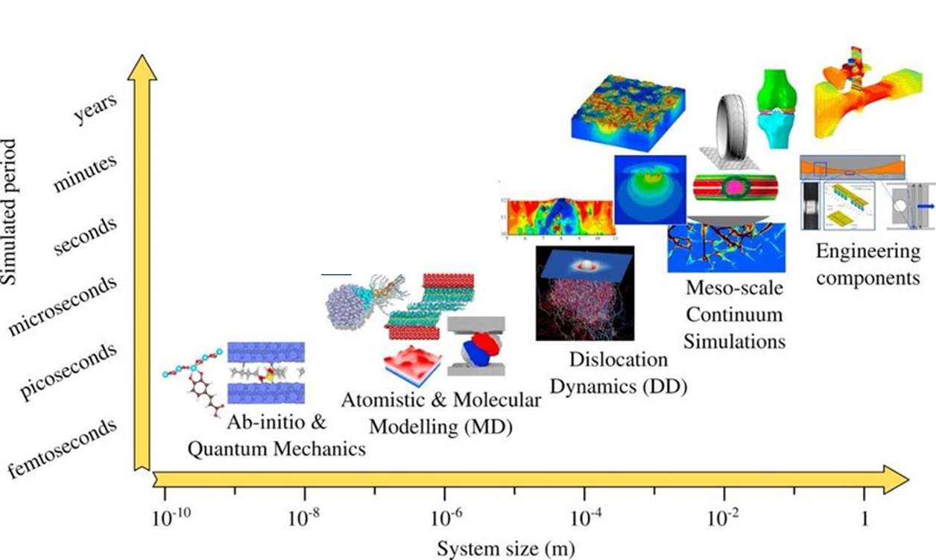
Types of simulations: Time vs. system size
Macroscopic phenomena
Microscopic phenomena
Goel, Saurav, et al. Materials Today Chemistry 18 (2020): 100356
Arora, Gaurav, et al." Materialia 15 (2021): 100974
Density functional theory (DFT): Defect formation energies, band gap, etc.
Apply this technique to design HEA
Molecular dynamics (MD): Radiation damage such as void formation, evolution of system with respect to temperature, etc.
DFT is capable to simulate defect annihilation, clustering and mobility in sub-pico-sec time step
Notes:
David senor PNNL
Give example of formation energy of defect.

Slide 13
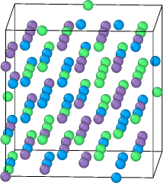
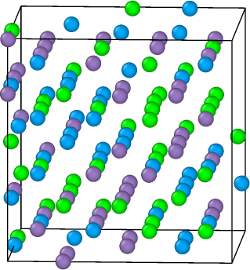
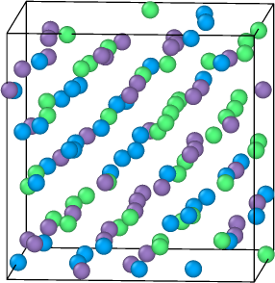
Apply DFT simulation for designing HEA
To study the evolution of system following set of simulations are performed
Compressive and tensile strain
Shear strain
Vacancies and interstitial
Different temperature
Approximately 600 simulations are performed for each composition.
Forces and energies are extracted and fed into making of machine learning potential.
Including beam interaction models into DFT is currently considered
FY25 LDRD approved to develop non-contact ultra high-speed radiation damage sensor for observing pico-sec phenomena

Slide 14
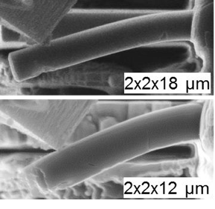
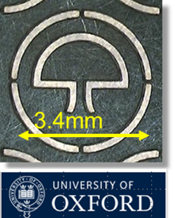
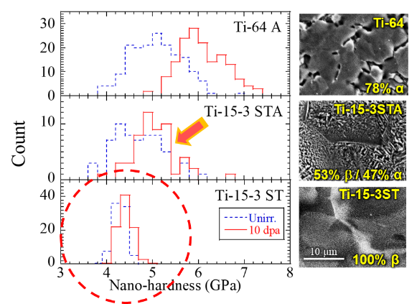
New technology for High Power Targetry R&D
Post Irradiation Examination (PIE) technology significant advancements over past decade
Apply force
Specific shape of sample
for micro-scale PIE
Phase transition of Tungsten
PIE in atomic scale by using TEM and SEM

Slide 15
Optimize MC target system (Physics output)

Slide 16
Enhance MC targetry performance
Manage mechanical stress within specified tolerances
Maximize pion yield with preferred energy band
Find most effective configuration of low Z (to reduce edep and pion recapture) and high Z materials (to increase and localize pion yield)
Determine optimal dimensions to satisfy engineering tolerance as well as pion yield
Capture pions & muons
Ideally capture both signs → Solenoid or FODO cell magnet
Transport them into the downstream channel
Remove primary proton beam from muons
Manipulate phase space of pions and muons if needed
Develop AI technology to enhance target performance

Slide 17
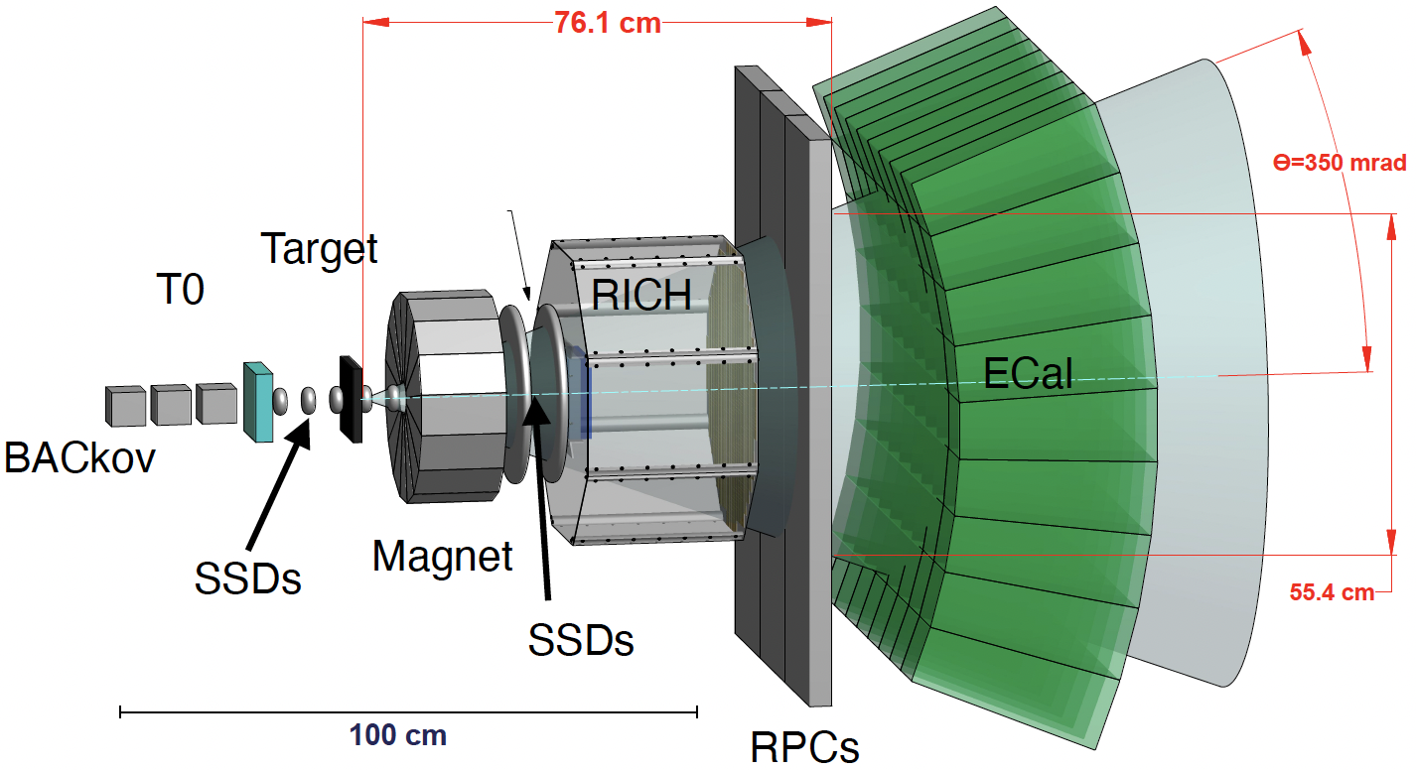
Pion yield measurement at Fermilab
Study beam interactions in beam intercepting devices
Because the EMPHATIC spectrometer is compact, it realizes
Large angular acceptance
Small dead space
Fine position detection
Precise angular distribution measurement
Pico sec fast counter
Precise energy measurement
US-Japan collaboration
FY25 budget requested
EMPHATIC spectrometer

Slide 18
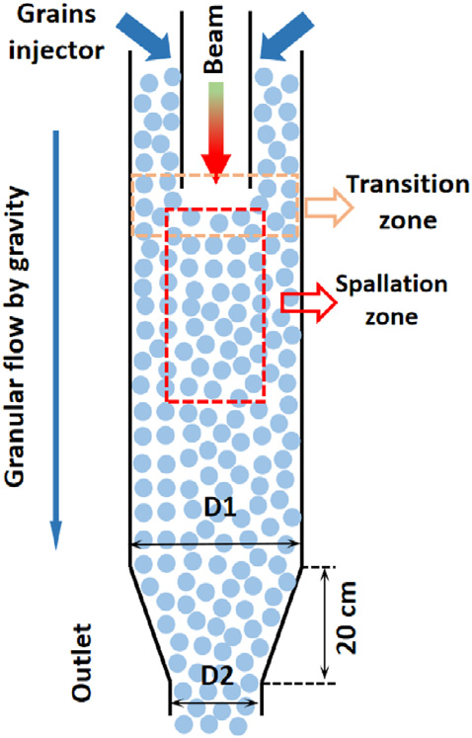
Granular Tungsten Target R&D
The RAL group has pioneered the development of granular tungsten targets
Tungsten powder is ionized and scattered in the target chamber
CSNS group has developed the concept and use large sphere particle
Gravity force is employed to mitigate the dispersal by charge
No beam window needed
Attractive option for MC target

Slide 19
Propose MC High Power Targetry R&D

Slide 20
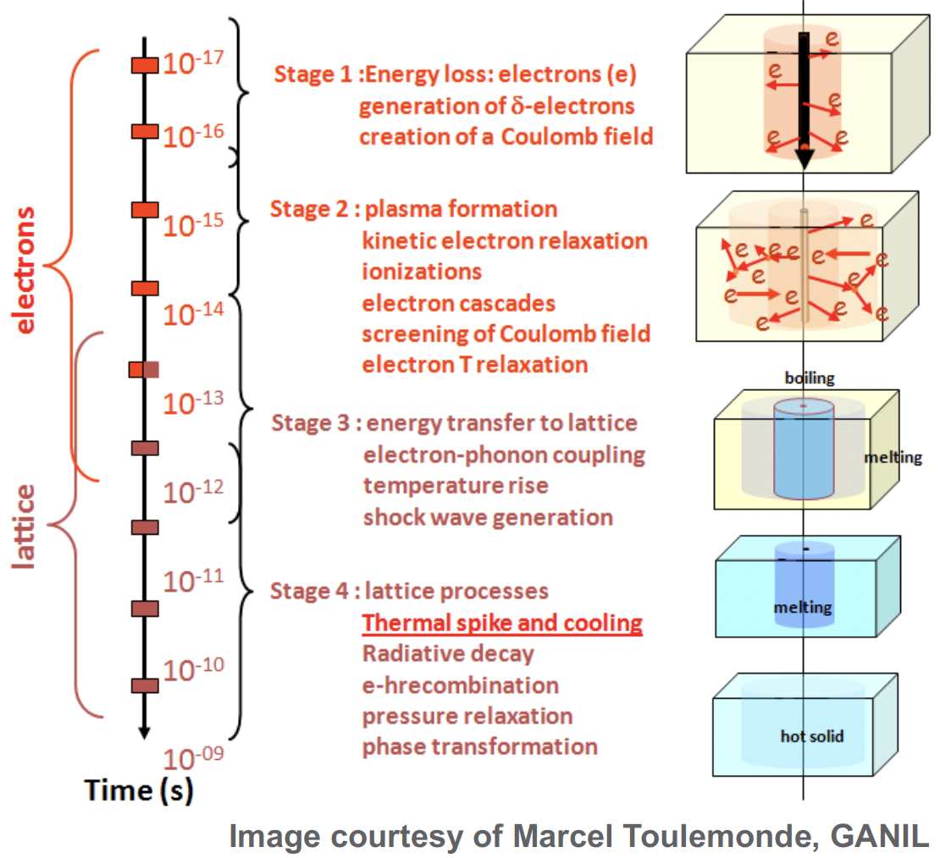
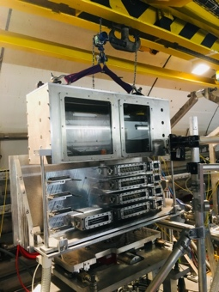
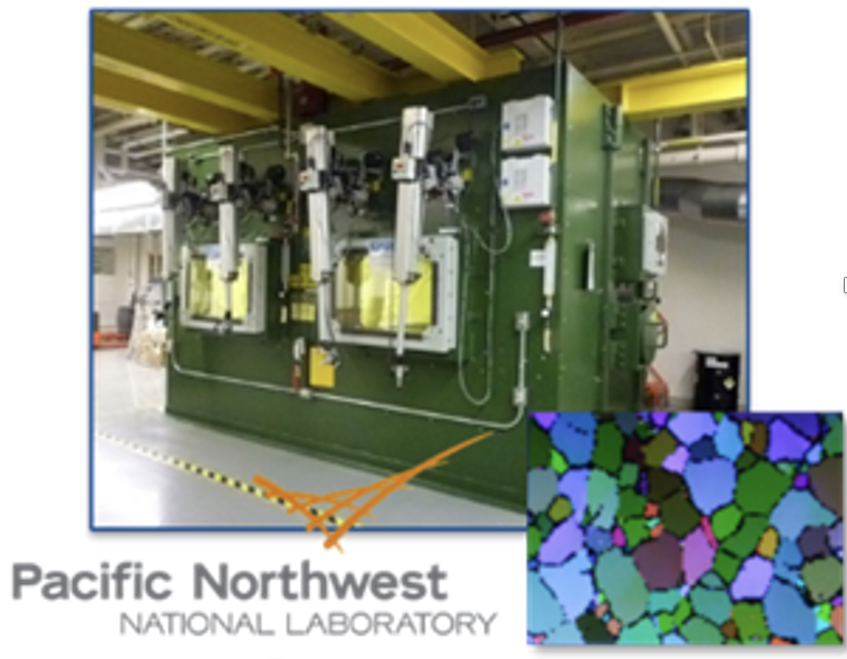
Specific subject on the MC Target R&D
Utilize High Performance Computing Facility
Build AI to enhance target performance
Look into the MC target system from multiple view-point
Develop simulation to study sub-pico second evolution of defect
Develop the sub-pico radiation damage sensor to validate the simulation
Propose pion-yield measurement
Propose beam irradiation test and PIE
HiRadMat@CERN
PNNL

Slide 21
Plan
Forming MC Targetry R&D working group
Scientist + Target engineer + AI scientist
Join RaDIATE collaboration
Utilize their expertise and facility to develop the MC target technology (next slide shows the current world RaDIATE map)
Gain resources
FY25 LDRD approved to make an ultra-high-speed non-contact radiation damage sensor for future HPT system
FY25 US-Japan collaboration requested
Anticipate more resources from the GARD HPT
Budget for utilizing Beam Irradiation Facility & PIE Facility

Slide 22
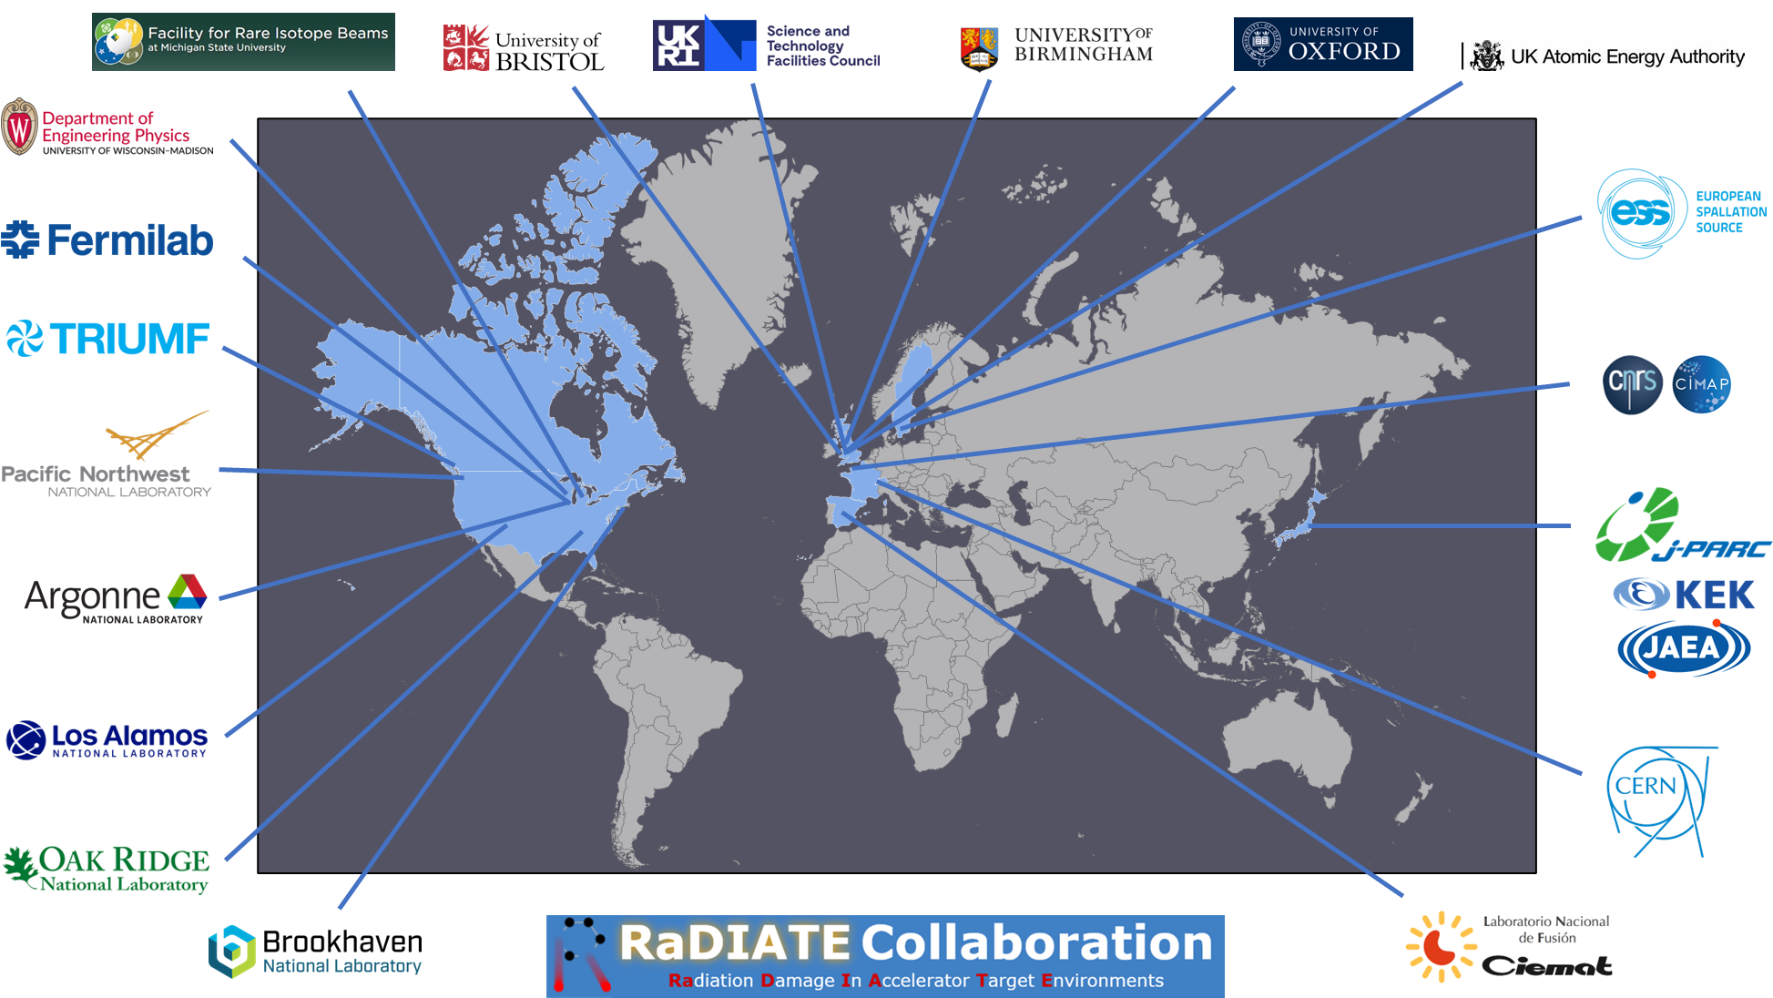
R a D I A T E Collaboration
Radiation Damage In Accelerator Target Environments
Facility/Accelerator
Irradiation station
Post Irradiation Examination

