Slide 1

Magnet R&D needs and Priorities for the next 3-5 years
Kathleen Amm, Steven Gourlay, Mark Palmer
2/23/2024

Slide 2
Outline
Magnet needs for Muon colliders – based upon MAP and IMCC progress to date
  Cover magnet needs for front end, cooling, acceleration and collider ring
  Potential technologies
  Challenges
Synergies
Summaries

Slide 3
Muon Collider magnet “specs”
Accelerator magnets
Field: ±1.8 T (NC), < 10 T (SC)
Rate: 400 Hz (NC), SS (SC)
Bore: 100 mm(H) x 30 mm(V)
Length: 3 m … 5 m (x 1500)
Radiation heat: ≈ 3 W/m
Radiation dose: TBD
Target solenoids
Field: ~20T (15T) … 2T
Bore: 1200 mm
Length: 18 m
Radiation heat: ≈ 4.1 kW
Radiation dose: 80 MGy
6D Cooling solenoids
Field: 4 T … 19 T
Bore: 90 mm … 600 mm
Length: 1 km (x 2)
Radiation heat: TBD
Radiation dose: TBD
RCS
Final Cooling solenoids
Field: ≥30T (MAP), ≥40T (IMCC), ideally ≥50 T
Bore: 50 mm
Length: ≈ 500 mm (x 17)
Radiation heat: TBD
Radiation dose: TBD
Collider ring magnets
Field: 16 T peak (IR 20 T) – NOT a
hard requirement! ℒ ∝ B_{dip}
Bore: 150 mm
Length: 10 m … 15 m (x 700)
Radiation heat load: ≈ 5 W/m
Radiation dose: ≈ 20…40 MGy

Slide 4
Target and Capture
MAGNET SPECS
Field: 20T (or 15T) … 2T
Bore: 1200 mm
Length: 18 m
Radiation heat load: ≈ 4.1 kW
Radiation dose: 80 MGy

Slide 5
Target and Capture: Magnet Technologies
Technology | Pro’s | Con’s
ALL Resistive | Known technology (TRL 9) | Large dimension and mass Very large electric power consumption o(100MW)
LTS + Resistive | Known technology (TRL 9) | Large dimension and mass Electric power consumption ο(10 MW)
LTS + HTS, Insulated | Known design principles Synergy with other fields of science application Can profit from development by others (e.g. NHMFL) | Large dimension and mass Developmental technology (TRL 6/7)
ALL HTS, Insulated | More compact than LTS/HTS Allows for operation at higher temperature | R&D at low readiness (TRL 4/5)
ALL HTS, Non-insulated | Most compact magnet winding Synergies with other fields of science and societal applications Can profit from development by others (e.g. NHMFL) | R&D at low readiness (TRL 3/4/5) Ramping time and field stability need to be demonstrated

Slide 6
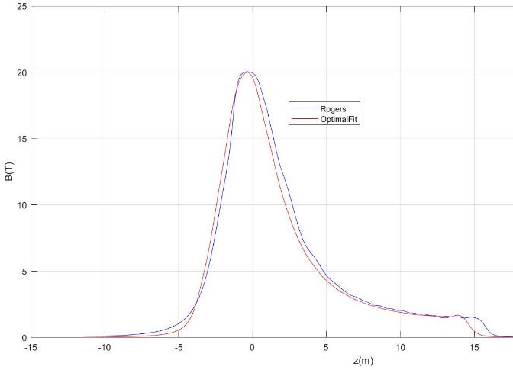
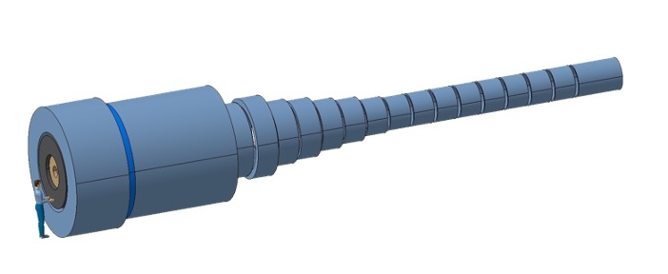
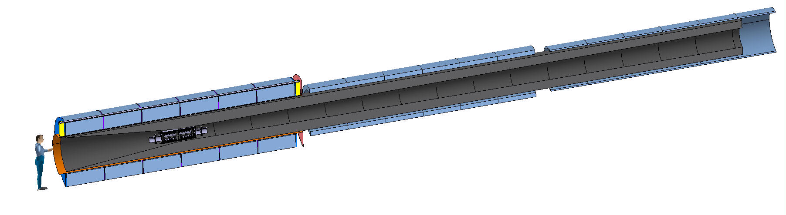
Target and Capture: Magnet specifications
E_{M} = 2.9 GJ
T_{op} = 4.2 K
M_{coils} = 200 tons
M_{shield} = 300 tons
P = 12 MW
Field profile matches the requirements from beam optics
US-MAP
Proposal
Remove resistive insert (10 MW), HTS to achieve field of 20 T
Reduce shield thicknes, accepting higher heat load at 20 K
E_{M} = 1 GJ
T_{op} = 10…20 K
M_{coils} = 110 tons
M_{shield} = 196 tons
P = 1MW

Slide 7
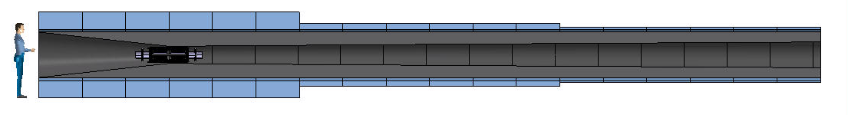
Target and Capture Design Considerations
Main design drivers are power consumption and heat deposition
Hybrid US-MAP (5 resistive coils and 19 SC coils, 2.4 m bore ∅) OR
Alternative - All HTS, 1.2 m bore ∅ and operating at 10 – 20K
Strong synergy with requirements on magnets for tokamak nuclear fusion devices
  Central Solenoid Coils: Higher B_{op}→ higher flux → higher reactor availability factor
  Toroidal Field Coils: Higher T_{op}→ larger acceptable heat load → compact shielding → cost

Slide 8
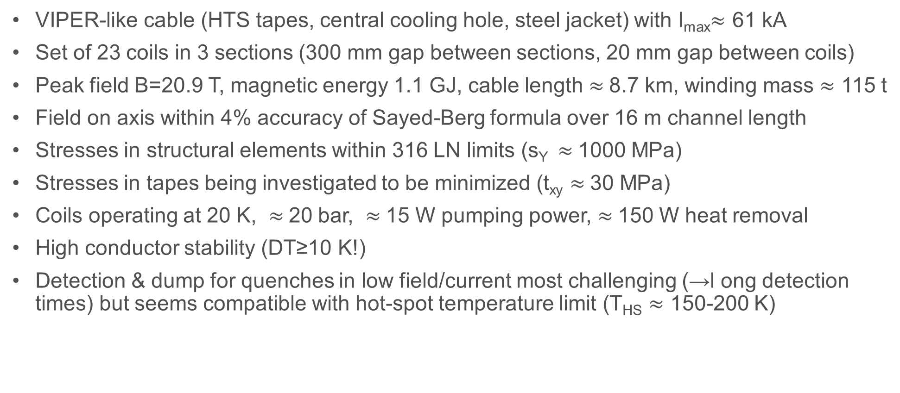
Target and Capture: Magnet Design Highlights
VIPER-like cable (HTS tapes, central cooling hole, steel jacket) with I_{max}$≈$ 61 kA
Set of 23 coils in 3 sections (300 mm gap between sections, 20 mm gap between coils)
Peak field B=20.9 T, magnetic energy 1.1 GJ, cable length $≈$8.7 km, winding mass $≈$ 115 t
Field on axis within 4% accuracy of Sayed-Berg formula over 16 m channel length
Stresses in structural elements within 316 LN limits (s_{Y} $≈$1000 MPa)
Stresses in tapes being investigated to be minimized (t_{xy} $≈$30 MPa)
Coils operating at 20 K, $≈$20 bar, $≈$15 W pumping power, $≈$150 W heat removal
High conductor stability (DT≥10 K!)
Detection & dump for quenches in low field/current most challenging (→l ong detection times) but seems compatible with hot-spot temperature limit (T_{HS} $≈$ 150-200 K)

Slide 9
6D Cooling
6D Cooling solenoids
Field: 4 T … 19 T
Bore: 90 mm … 600 mm
Length: 1 km (x 2)
Radiation heat: TBD
Radiation dose: TBD

Slide 10
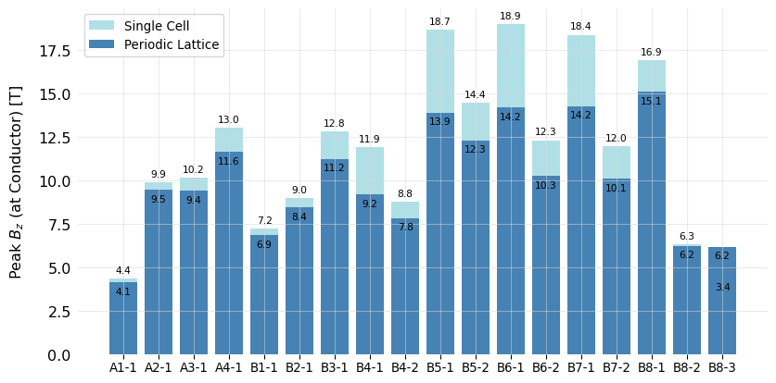
Cooling Channel
Full list based on original US MAP design (field on axis)
12 unique stages:
  4 cooling stages before bunch recombination (A1-A4)
  8 cooling stages after bunch recombination (B1-B8)
Each stage has a repeating series of a cell type
High field, very compact solenoids
Each cell has symmetric solenoids of opposite polarity
Some stats:
Fields on axis: 2 to 14 T
Cell Lengths: 0.8 to 2.7 m
Total length of all Stages: ~ 1 km
Total number of solenoids: 2432
HTS
Nb₃Sn
NbTi
By S. Fabbri and J. Pavan

Slide 11
To be investigated
We are defining technologies
Conductor
Operating conditions, i.e. temperature and cooling method
To be investigated
Conductor performance
Conductor configuration
Field quality
Thermal/mechanical configuration

Slide 12
Technologies 6D cooling solenoids
Technology | Pro’s | Con’s
LTS | Known technology (TRL 9) | Operating temperature
HTS ReBCCO Insulated | More compact than LTS/HTS Allows for operation at higher temperature Batch above 100 m demonstrated | R&D at low readiness (TRL 4/5) Quench detection protection Production of km batches to be demostrated
HTS ReBCCO Non-insulated | Most compact magnet winding Synergies with other fields of science and societal applications Batch above 100 m demonstrated Can profit from development by others (e.g. NHMFL) | R&D at low readiness (TRL 3/4/5) Ramping time and field stability need to be demonstrated Quench detection and protection Production of km batches to be demostrated
HTS BiSSCO/IBS | Round wire demonstrated for BiSSCO | R&D at low readiness (TRL 3/4) for IBS Production lengths (?)

Slide 13
Final Cooling Channel
Final Cooling solenoids
Field: ≥30T (MAP), ≥40T (IMCC), ideally ≥50 T
Bore: 50 mm
Length: ≈ 500 mm (x 17)
Radiation heat: TBD
Radiation dose: TBD

Slide 14
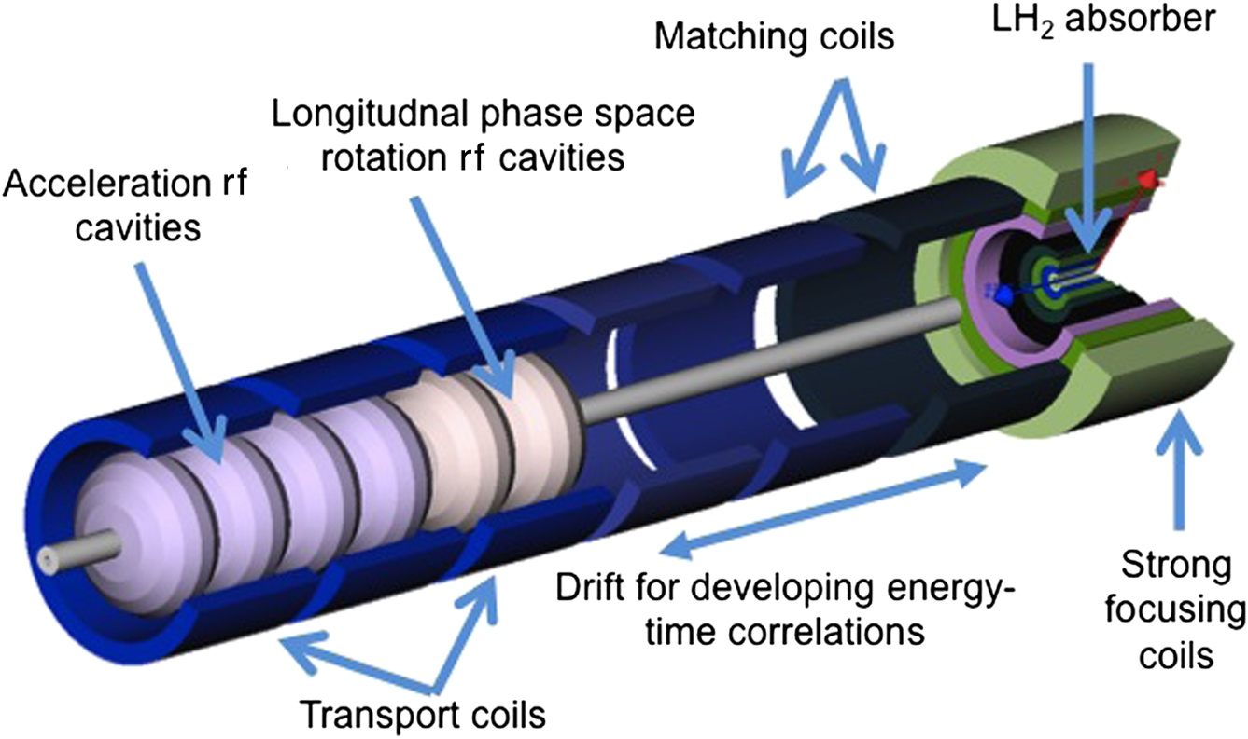
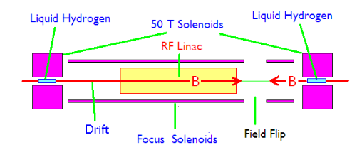
Ionizing Cooling Cell
16 Cells (MAP)
  Set of eight superconducting coaxial coils
  Peak field of 30T, 50 mm diameter
  Sayed et al. Phys. Rev. ST Accel. Beams 18, 091001
14 Cells (CERN-IMCC)
  B > 40T, 50 mm diameter
Abandoned by MAP
3.5 T
MAP 30T Design
R. Palmer, BNL

Slide 15
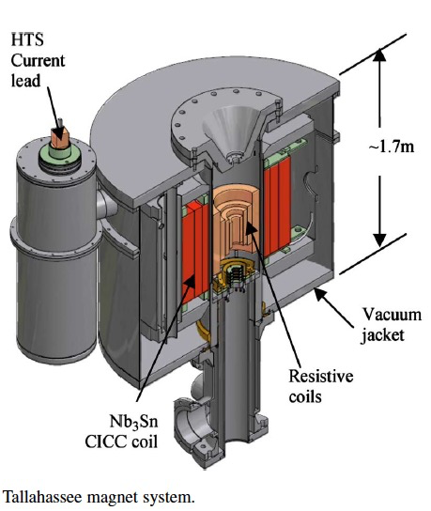
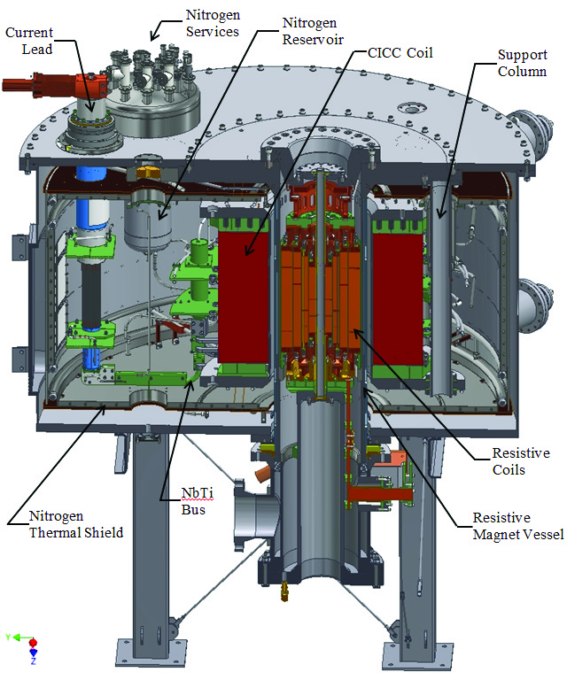
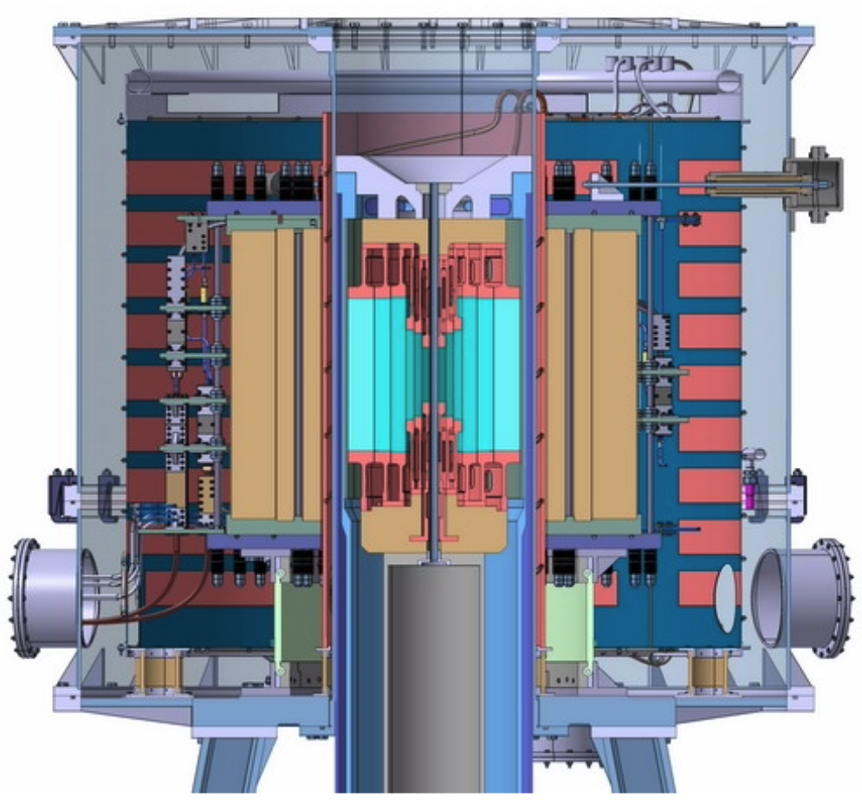
Not exactly starting from scratch on high field solenoids – but . . .
https://nationalmaglab.org/user-facilities/dc-field/magnets-instruments/
http://english.hmfl.cas.cn/uf/ms/202202/t20220224_301451.html
Cross section of 45 T, 32 mm NHFML user facility solenoid
Hybrid Magnet 33.5 T from resistive insert, 11.5 T by superconducting outsert
30 MW power comsumption
Cross section of 36 T, 48 mm NHFML user facility (NMR) solenoid
Hybrid Magnet 23 T from resistive insert, 13 T by superconducting Nb₃Sn CICC outsert
14 MW power comsumption
Cross section of 40*/37 T, 32/50 mm CHMFL user facility solenoid
Hybrid Magnet 29/26 T from resistive insert, 11 T by superconducting Nb₃Sn CICC outsert
20 MW power comsumption

Slide 16
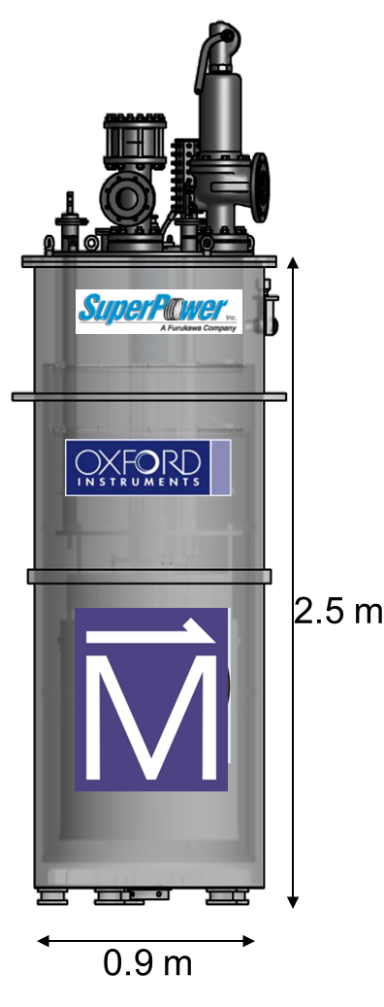
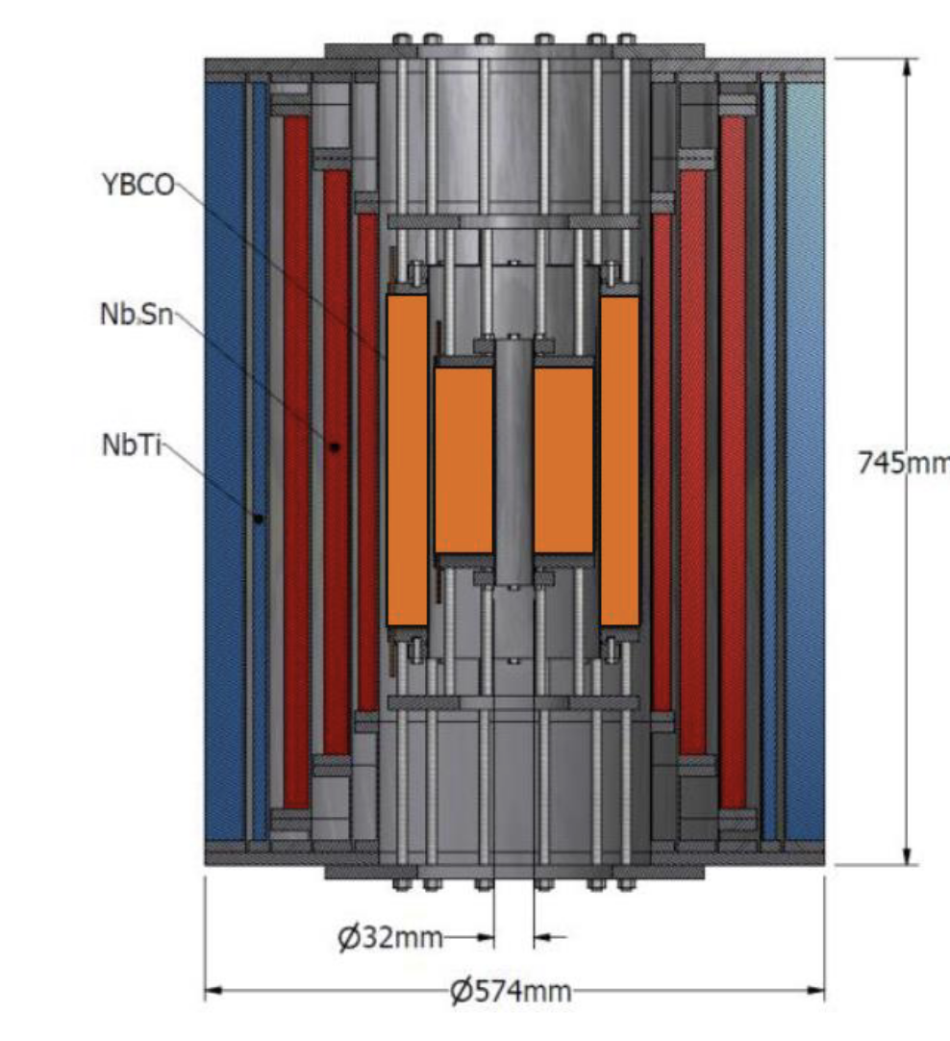
Getting closer
Cross section of 32 T (15 T LTS, 17 T two ReBCO double pancake coils), 32 mm user facility solenoid https://nationalmaglab.org/user-facilities/dc-field/magnets-instruments/
Just increase the field and bore
Operate REBCO coils at 20K?
And then the 40T
But will nested coils work for MC?
Low J, mechanical challenges, QP
B. Bordini, CERN

Slide 17
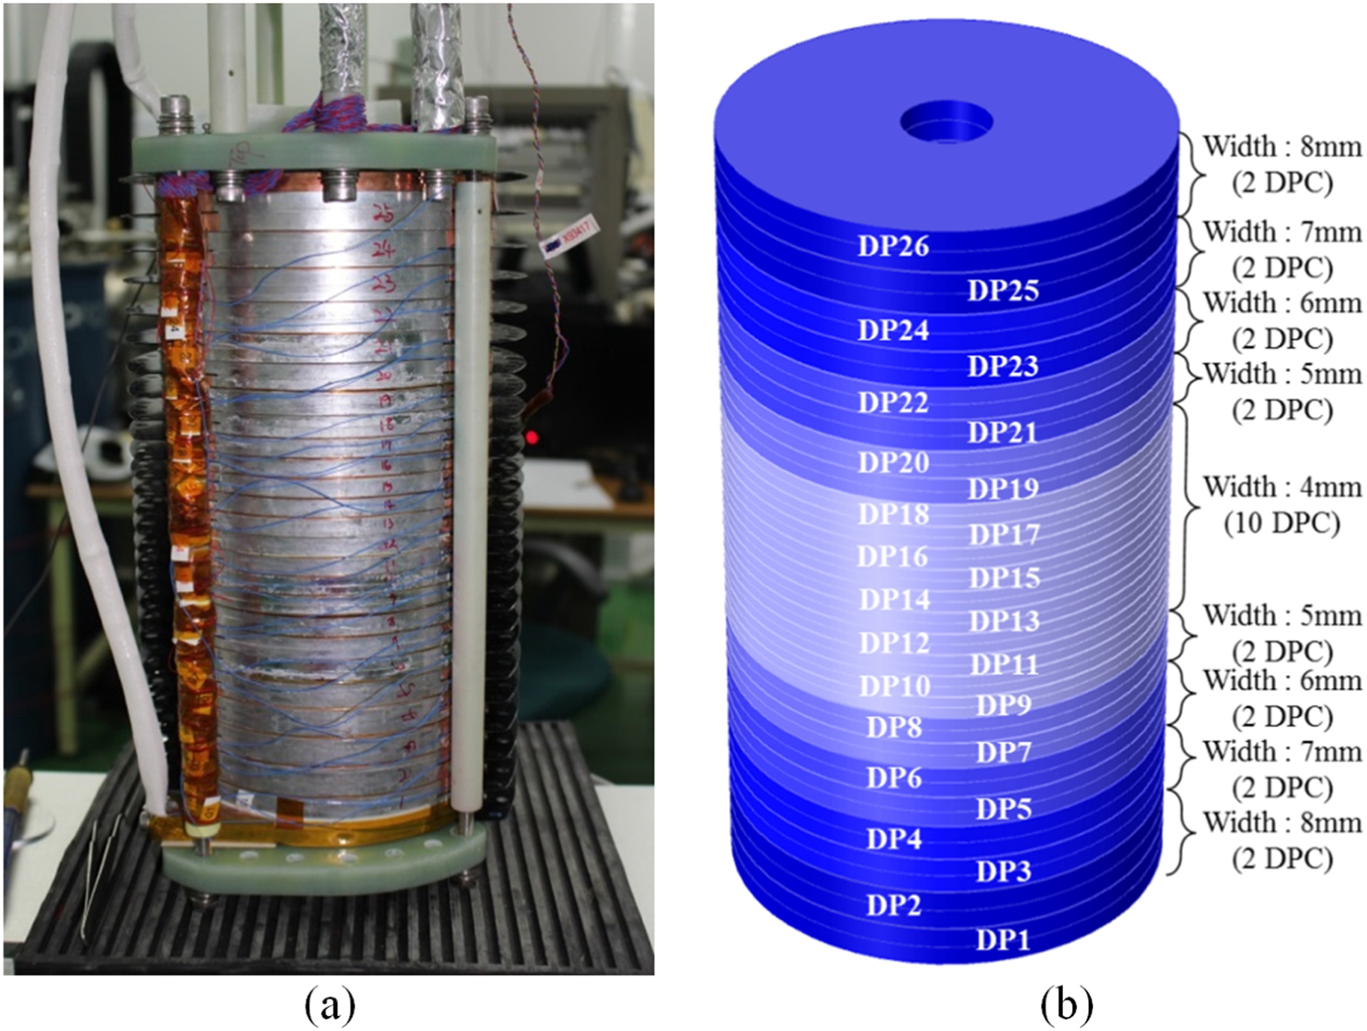
CERN approach
Sunam NI one-body ReBCO magnet
26.4 T in 35 mm, J central pancake 404 A mm⁻² (26.4 T HTS multi-width)
overall diameter and height: 172 and 327 mm
Single coil, high J_{e}
  40T, 50 mm bore
Need higher field – but higher tensile radial stress
Apply precompression to all-HTS NI/MI single coil.
High potential for future particle accelerators and other societal applications
Substantial progress on design
Challenges
  High stresses
  Magnet protection – transients to control
  Charging time
S. Yoon et al. Supercond. Sci. Technol. 29 (2016) 04LT04
B. Bordini, CERN

Slide 18
Accelerator Ring
Accelerator magnets
Field: ±1.8 T (NC), < 10 T (SC)
Rate: 400 Hz (NC), SS (SC)
Bore: 100 mm(H) x 30 mm(V)
Length: 3 m … 5 m (x 1500)
Radiation heat: ≈ 3 W/m
Radiation dose: TBD
NOTE: ± > 2T
would greatly
improve RCS
perfomance

Slide 19
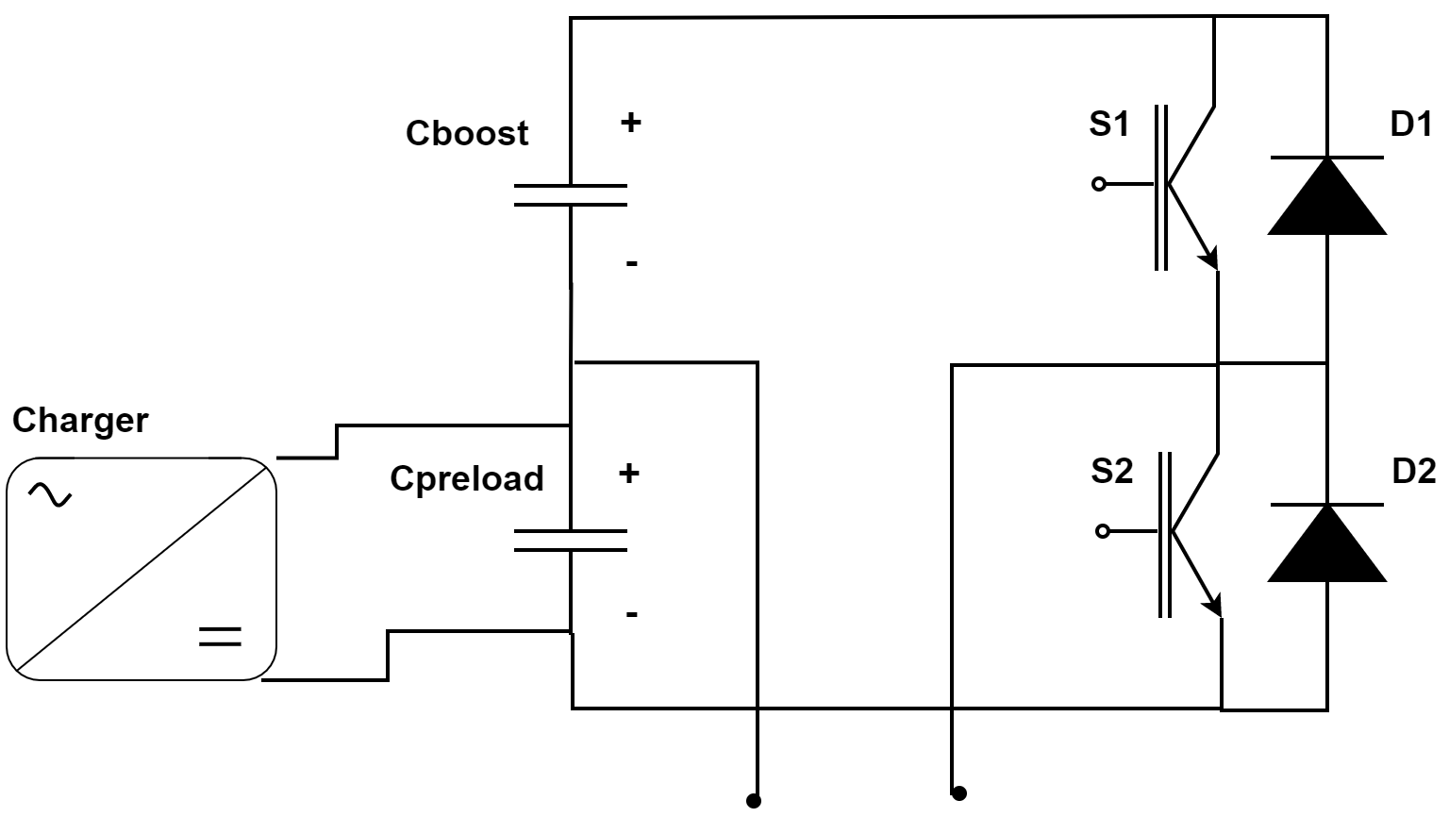
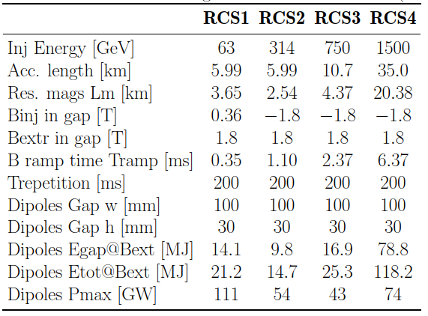
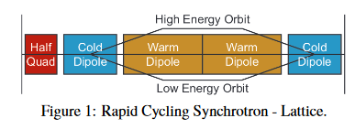
Critical systems and main- specifications
The powering system is very interlinked with the resistive magnets design
The key performance drivers are directly related to the total energy and power to be delivered to the magnets, but also to the tracking accuracy that will have to be guaranteed.
This input should come from the beam studies
F. Boattini

Slide 20
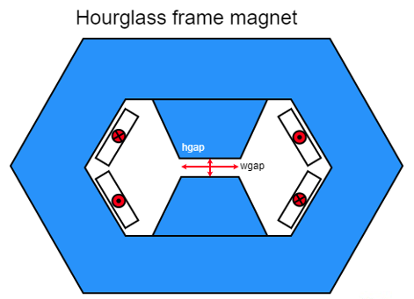
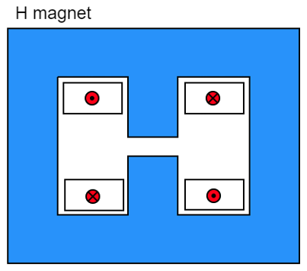
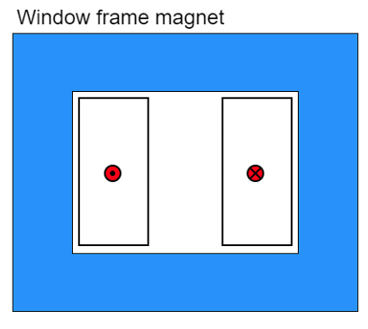
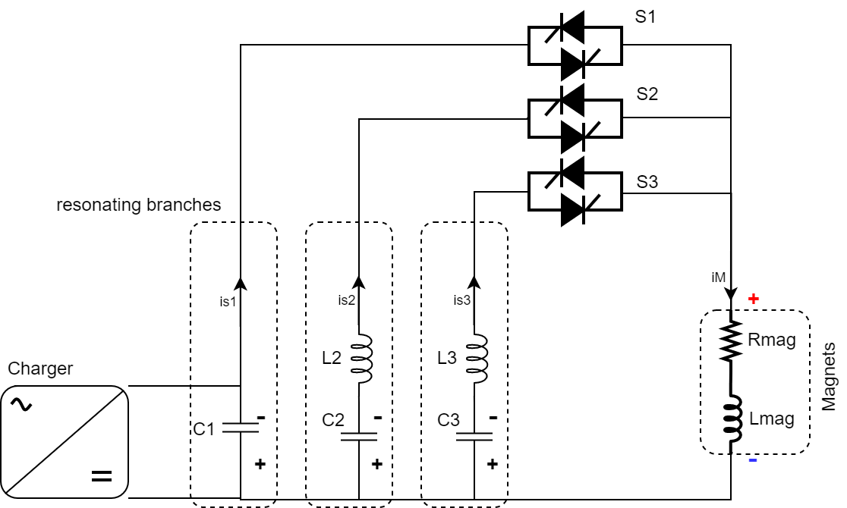
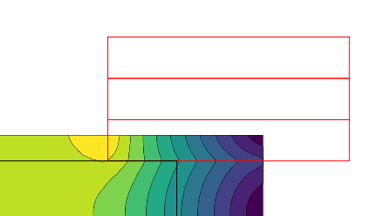
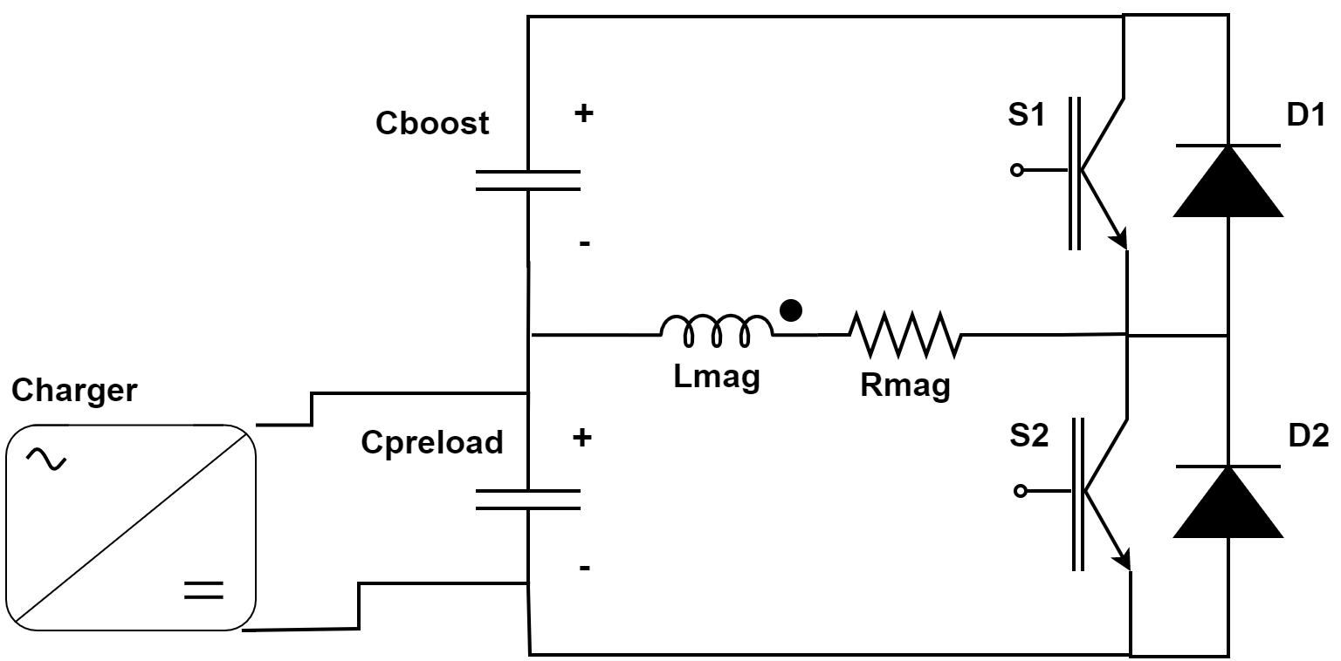
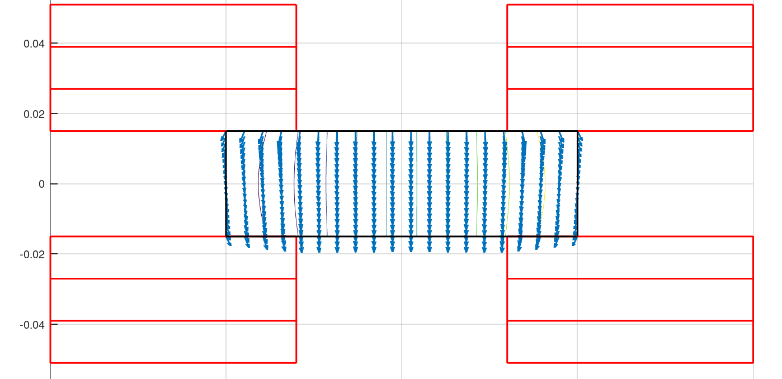
Fast-ramping Magnets
Differerent power converter options investigated
Full wave resonance
5.07 kJ/m
5.65…7.14 kJ/m
5.89 kJ/m
Main challenge is management of the power in the resistive dipoles (several tens of GW):
Minimum stored magnetic energy
Highly efficient energy storage and recovery
Simple HTS racetrack dipole could match the beam requirements and aperture
Commutated resonance (new)
HTS flat racetracks
F. Boattini et al.
1.8T RC with 10T SC
Rectangular magnet bore 100 mm x 30 mm

Slide 21
Collider Magnets
Collider ring magnets
Field: 16 T peak (IR 20 T)
Bore: 150 mm
Length: 10 m … 15 m (x 700)
Radiation heat load: ≈ 5 W/m
Radiation dose: ≈ 20…40 MGy
10 TeV IMCC Targets

Slide 22
Material Options
Technology |  | Pro’s | Con’s
LTS (Nb-Ti) |  | Known and well developed technology (TRL 8) | Probably do not meet all magnet requirements
LTS (Nb₃Sn) |  | Known technology, reaching demonstration level in accelerators (TRL 6/7) | Probably do not meet all magnet requirements Brittle/stress limited
Hybrid (LTS Nb₃Sn) + (HTS) |  | Lower cost Exploit potential of both materials | Low readiness level for HTS insert (TRL 3/4) LTS/HTS joints and integration to be developed Temperature limited by LTS
All-SC (HTS) | Insulated | Most compact solution Allows operation at high temperature Profit from on-going R&D activities on insulation/no-insulation windings | R&D at low readiness (TRL 3/4) Quench protection to be demonstrated Field delay and field stability in case of NI winding
 | Controlled Insulated
 | Non Insulated

Slide 23
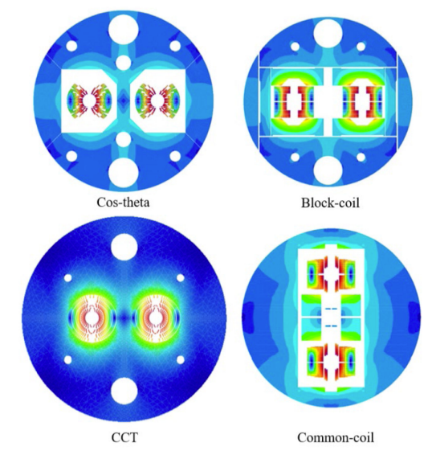
Design Options (1/2)
Technology | Pro’s | Con’s
Cos-theta Design | Well known design Wound around a cylindrical mandrel, end shape already suitable for beam tube insertion | Mechanical structure can be complex Not most easy winding geometry for HTS tapes
Block Coil Design | Known design principles Mechanical structure simplify stress management Easier geometry for HTS-tapes | Difficult stress management on coil ends Higher ratio conductor length/produced field
Canted Cos-theta Design | Intrinsic stress management Low number of parts and tools Easy winding procedure | Requires more cable than the other layouts Quench protection more difficult R&D needed

Slide 24
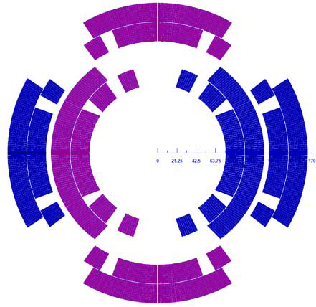
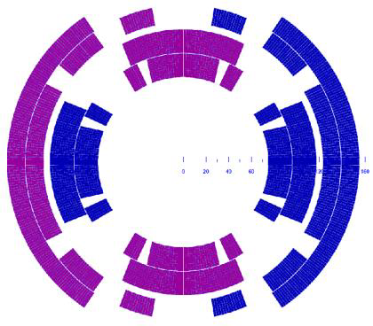
Design Options (2/2) Combined function
A. Zlobin
Technology | Pro’s | Con’s
NESTED Configuration | Separate Powering Dipole/Quadrupole Inherit experience on Nb₃Sn magnets for HiLumi and LARP-US development program | High Stress on Internal Coil Alignment Higher Costs
Asymmetric Coil Design | Single type of coil Optimized margin and field quality | Fixed Dipole/Quadrupole ratio Stress on the supporting structure is not balanced
Fields for 3 TeV are high, but 10 TeV very high!
Important negotiation point with machine designers
T. Ogitsu

Slide 25

Summary of the Muon Collider Magnet Pull
Muon Ionization
6-Dimensional Cooling Channel
Acceleration to the TeV Energy Scale for Muon Colliders
Muon Collider Magnet Needs
Muon Ionization Final Cooling Channel
HTS Magnet Development
Capture Solenoid for Simultaneous mu+ & mu- Beams
High field (15-20T)
Large bore (meter-scale)
Intense radiation environment – NC or HTS insert coil
Characteristics:
Characteristics:
Solenoid-based cooling channel (LH₂/LiH absorbers)
RF cavities integral to focusing channel
Fields ranging from LTS to HTS conductor regime
Characteristics:
Emittance exchange channel for TeV-scale colliders –
trade increased longitudinal beam emittance for smaller transverse emittance
Goal: 40-60 T HTS solenoids with d ~ 50mm
Characteristics:
Present baseline based on the use of Rapid Cycling Synchrotrons
Requires magnets capable of ~400Hz operation with B>1.5T
Characteristics:
Decaying muon beams mean that luminosity is inversely proportional to circumference
10T dipole a 15-20T dipoles improves luminosity
Radiation environment
Challenging IR magnets
Characteristics:
A MC (w/decaying beams) obtains the greatest performance enhancement of any HEP collider from HTS magnet technology
High quality HTS cables and magnets must be a priority
Novel magnets, suitable modeling, efficient power system

Slide 26
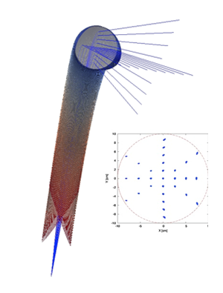
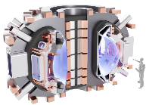

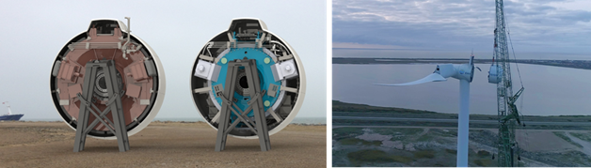
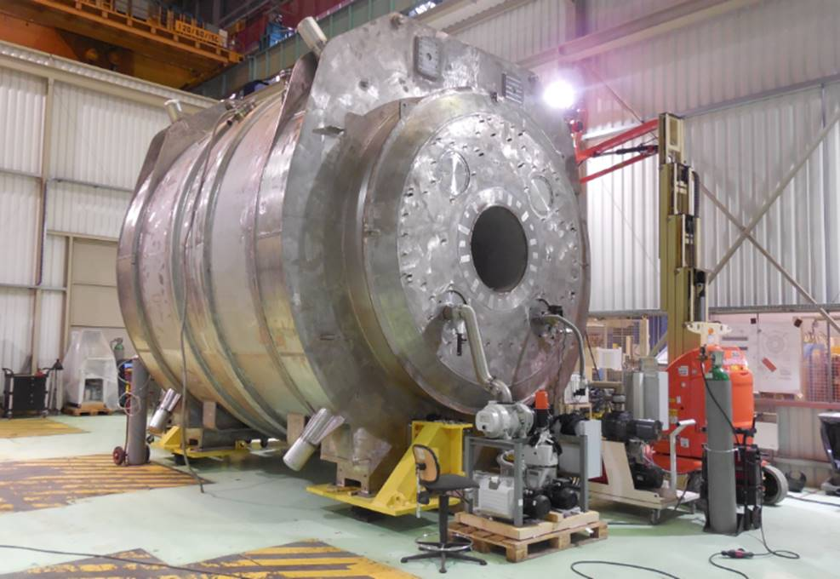
HEP-Driven Magnet Technology Chain
Benefits more than particle physics
Physics
Facilities
Magnet and
Materials Technology
Broader Applications/Societal Benefits
Clean Energy
MRI and
High Field Science
Particle Therapy
Compact Fusion Reactors

Slide 27
Summary
The accelerator and collider magnet goals for Muon colliders are aggressive but the fundamental machine requirements for a muon collider are more relaxed than those needed for the FCC-hh
Muon colliders will need significant advances in magnet design beyond currently available magnet technologies
Significant development will need to be made in the HTS magnet space
Synergies with compact fusion, high field science magnets help with this development and should be leveraged
Dialogue between machine designers and magnet folks is critical to explore the many trade offs
Current efforts in the US (MDP) and EU (HFM) are inadequate to support muon collider magnet needs in a reasonable timeframe – tradeoff studies needed to define approach
IMCC contends that a 3 TeV Muon Collider could be ready shortly after LHC shutdown in 2041. Technically limited schedule and will need substantial increase in resources on both sides of the Atlantic to be realized

