Slide 1
Ionization Cooling Prototyping and Demonstrator Program
J. Scott Berg Brookhaven National Laboratory Princeton Muon Collider Organizational Workshop
Feb. 23, 2024

Slide 2
Outline
Background: P5 and timelines
The cooling demonstrator
A cooling cell prototype
Component R&D and prototyping

Slide 3
Muon Colliders and P5
From the draft report:
“With a 10 TeV pCM muon collider at Fermilab as the long-term vision...”
“a goal of being ready to build major test facilities and demonstrator facilities within the next 10 years”
“The US should pursue a leading role in the muon collider design effort, in concert with the International Muon Collider Collaboration (IMCC)”
These are the boundary conditions for our ionization cooling prototyping and demonstration program

Slide 4
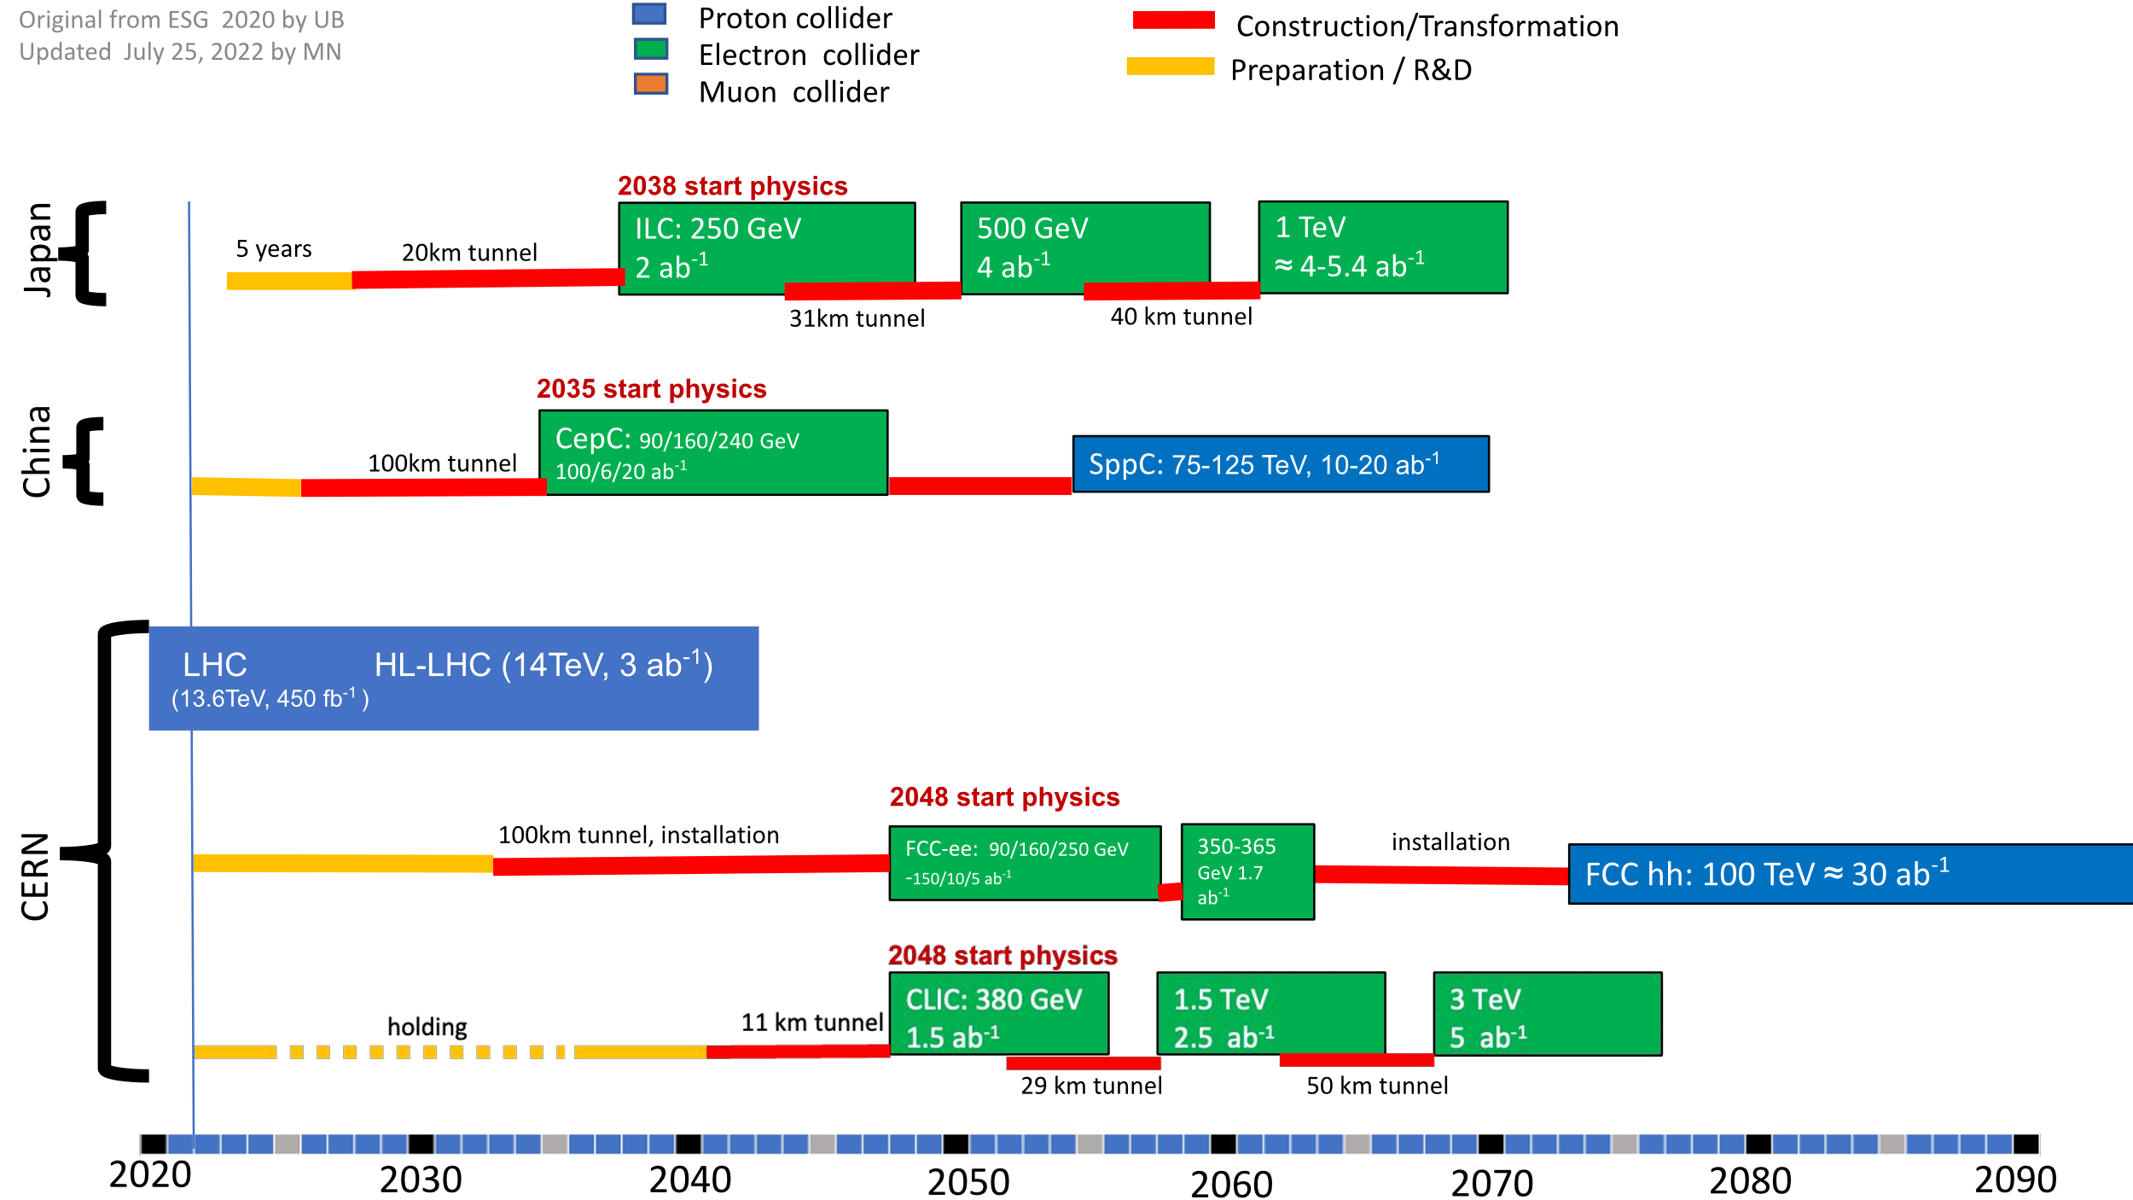
Timelines
One aspect driving the physics motivation is that we could be doing energy frontier physics before FCC-hh (circa 2070)
Timelines (“technically limited”) talk about first muon collider physics in 2045
This is not long. We need to
Prototype our most challenging components
Answer engineering questions to inform accelerator design
Finalize a machine design
Engineer and build/procure components
Build everything together into an accelerator
Narain et al., arXiv:2211.11084

Slide 5
Cooling Demonstrator
Show significant cooling in a longer channel
A longer channel washes out (some) initial condition dependencies
Face operational issues with a long string, such as
RF phasing & control
Quench protection
Diagnostics
Unlikely to really see intensity-dependent effects (the most difficult effects to simulate), at least not with muons
Build community confidence

Slide 6
The Current IMCC Effort: MuCol WP8
Quoting from the MuCol proposal, WP8:
The first objective of this workpackage is to select the technologies that are more suitable for a construction of a cooling cell that will demonstrate the feasibility of the concept including:
absorbers...
Superconducting solenoids...
RadioFrequency Cavities...
The second objective is to design each component of the cooling cell and integrate them in a single assembly to demonstrate that there is no showstopper for such systems.
Note: this will likely be complete before we see significant funding

Slide 7
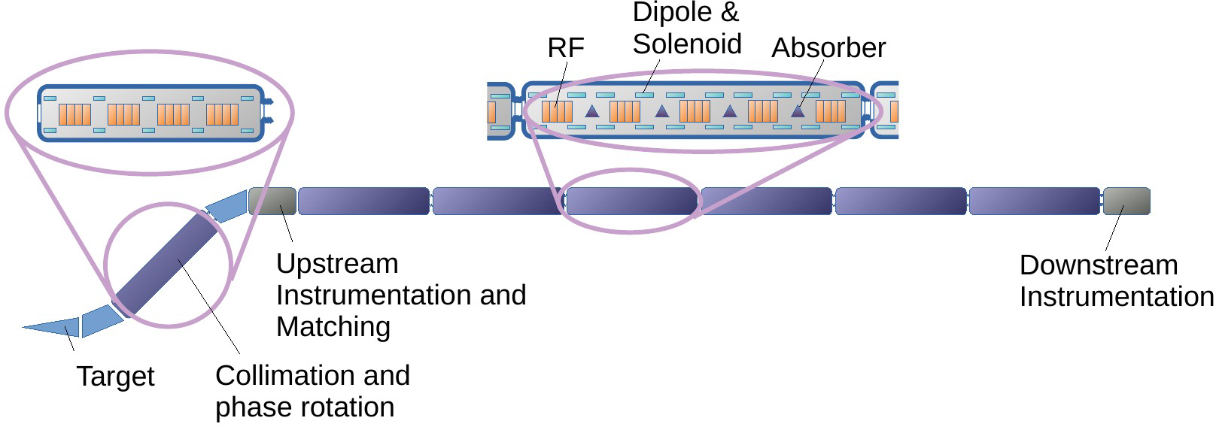
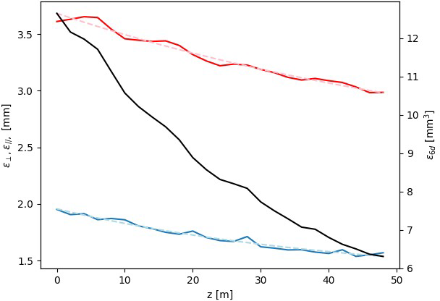
IMCC Demonstrator Layout and Lattice
Chris Rogers proposed a demonstrator layout and a basic cooling cell to use
Cooling cell based on one of Diktys’ cells, operating in the 2nd passband
2 m cell length, 30 MV/m cavities
Cooling performance simulated, not quite as much as I would expect
Close to equilibrium? Improve capture acceptance
Work in progress, expect to improve

Slide 8
Muon Beam and Diagnostics
IMCC layout currently only has diagnostics at beginning and end
What diagnostics will we need/have in the muon collider?
Can we build those diagnostics into the demonstrator at intermediate locations?
Conventional diagnostics typically want at least 10⁸ particles
Have a proton source with target producing sufficient muons
Get good capture efficiency → large phase space area captured
Solenoid (moderate field) capture and sign selection?
Up to 5 orders of magnitude fewer muons per pulse than collider

Slide 9
Cooling Prototyping and Demonstration
A muon cooling demonstrator
Demonstrate significant ionization cooling
Requires multiple cells, each cell should have reasonable cost
Source will have large emittance, so should have large acceptance
Can (and should) achieve its purpose with easier to build cooling cells
A cooling cell prototype
Design, build, and power the most challenging cooling cell
Should face all the challenging engineering issues
Convince the community (and us) that we can meet our specifications
Engineering design process will provide input to physics design

Slide 10
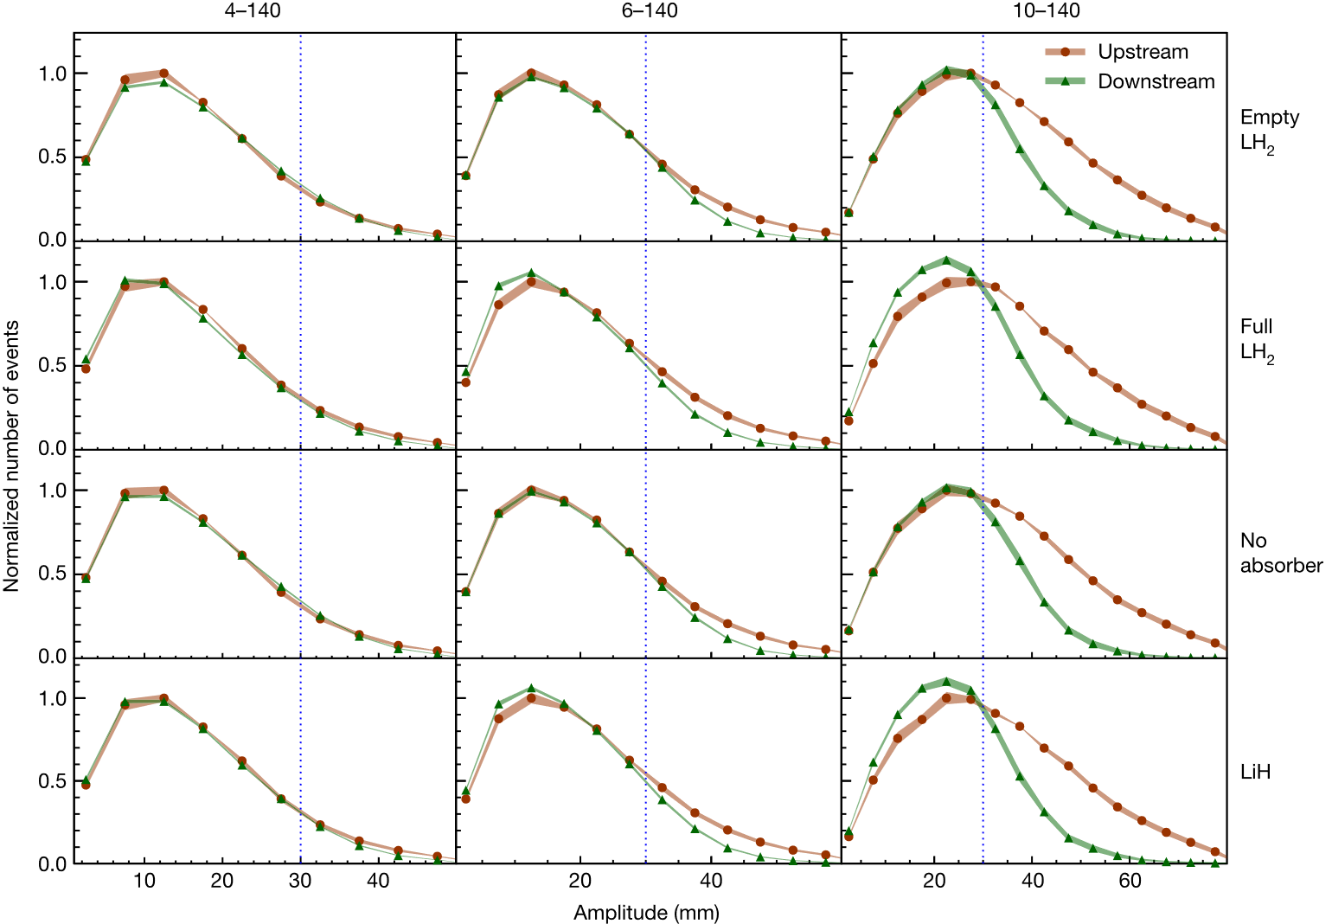
Demonstrating Ionization Cooling Physics
The physics behind ionization cooling is well understood
Used regularly in the simulation of particle physics experiments
The MICE experiment demonstrated that muon beam phase space density is increased by ionization cooling, and that the results are consistent with simulations
Not critical to demonstrate that ionization cooling works
The MICE Collaboration, Nature 578, 53 (2020)

Slide 11
Key Requirements for Performance
Generate a high angular divergence at the absorber
High solenoid fields with rapid longitudinal variation
Compact cells
High RF gradient
Accelerating gradient proportional to cooling rate
Need RF voltage to generate longitudinal focusing (bucket)
Magnets in close proximity to RF
Breakdown in RF enhanced by magnetic fields
Force, cyrogenic management

Slide 12
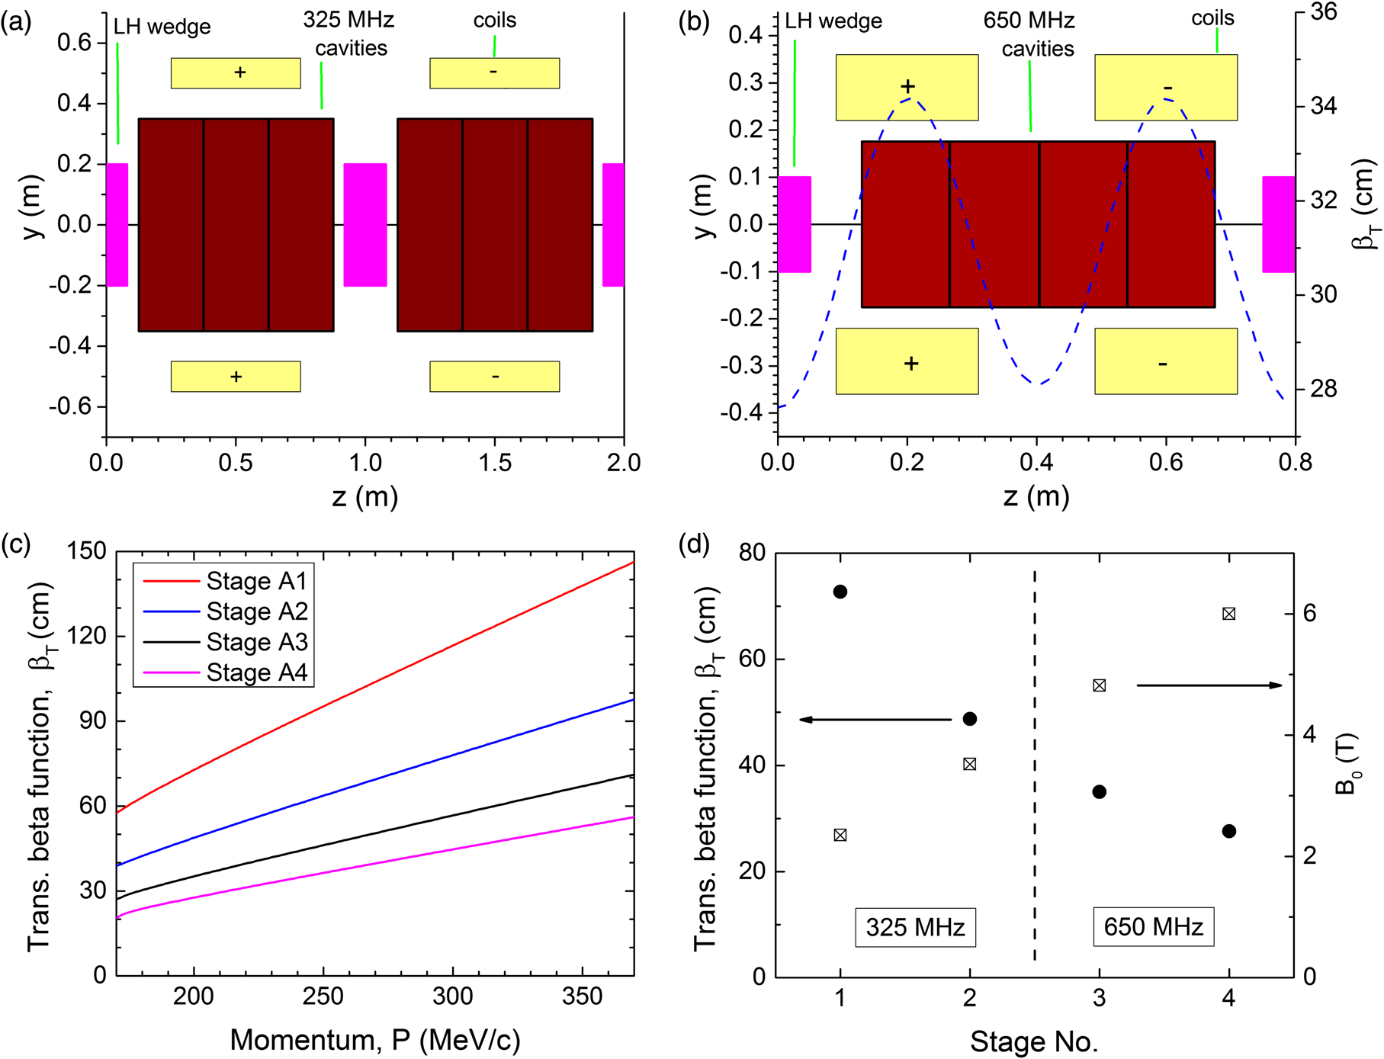
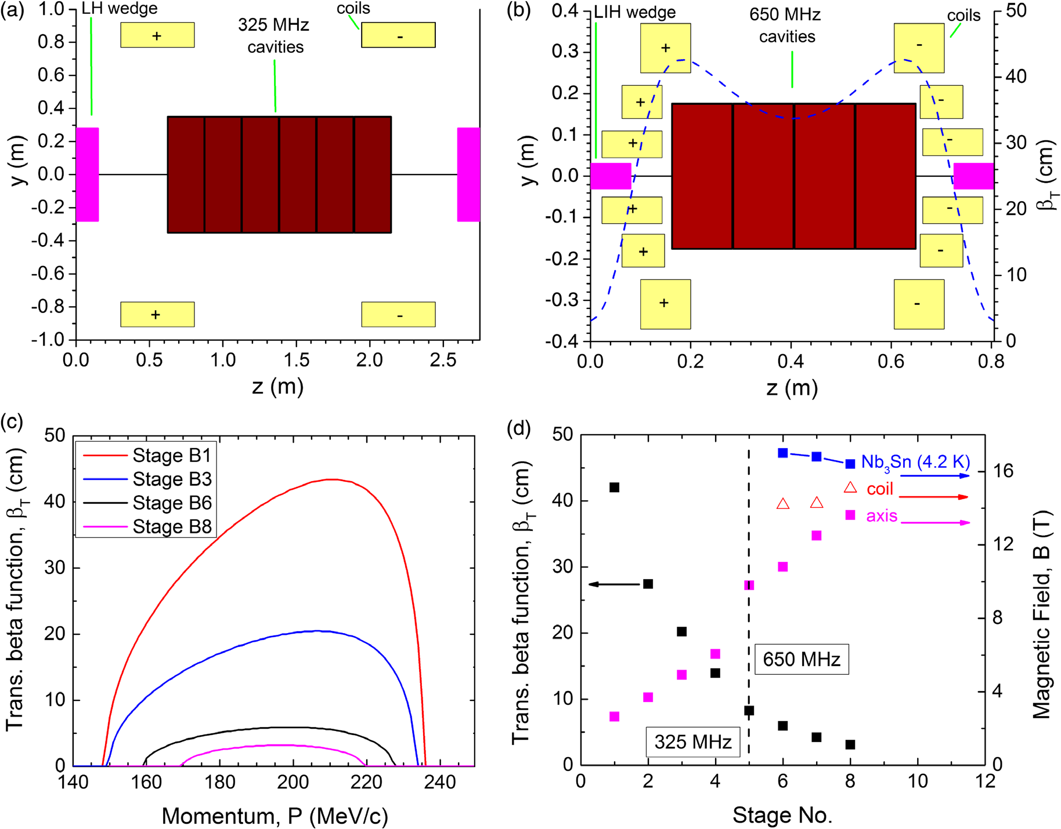
Simulated Cooling Channel
Simulated cooling down to ≈0.3 mm normalized trans. emittance
Gives “physics design” of cooling channel cells
Based on engineering input
Stratakis PRSTAB 18, 031003 (2015)

Slide 13
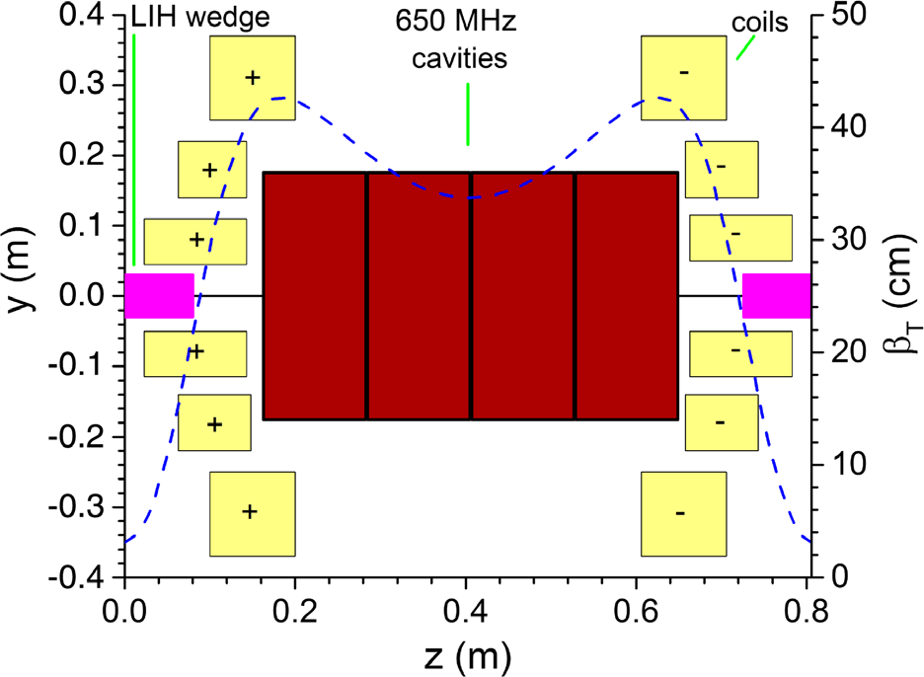
Rectilinear Cell Reaching Lowest Emittance
6 solenoids per cell
High solenoid fields: 15 T at coils
There’s a dipole field too
Superconducting coils very close to RF cavities
28 MV/m RF gradient
Magnet design studied, appears reasonable (Witte 2014).

Slide 14
Why Prototype the most Difficult Cell?
Want to demonstrate the hardware that will create the minimum emittance we can achieve
Face the most challenging engineering issues
High field, large aperture solenoids
Force management within and between coils
Tight spacing between coils themselves and to RF
The engineering design process will provide input to the physics design
Minimum spacing between components
Limits of magnets and design compromises needed
Success here is the real test showing we can achieve our emittances

Slide 15
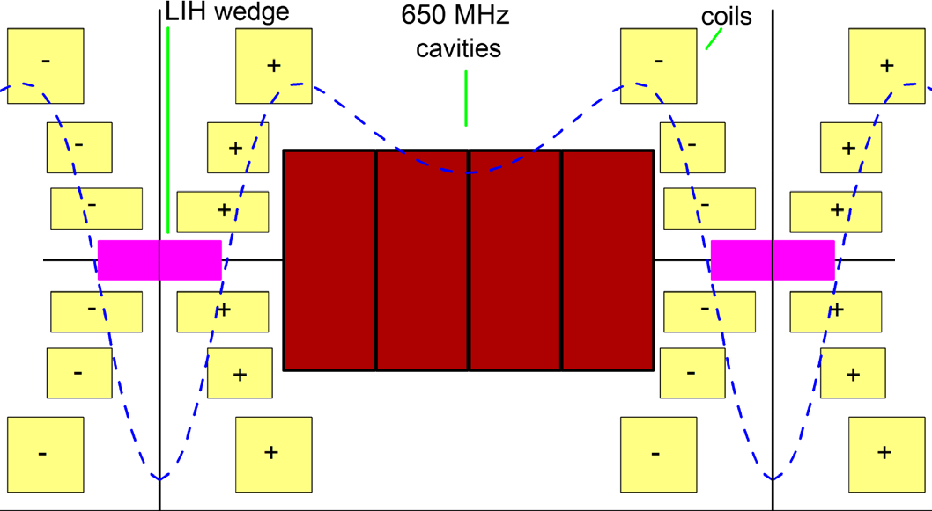
1.5 Cell Prototype
2 cells of magnets, one cell of RF
Magnets will see similar forces to full system
RF in magnetic field of full system
Not just solenoids: dipole component
Magnets powered to full current
RF powered to full voltage
Demonstrate required gradients in magnetic field
Simulate beam heating of absorber?
Vacuum, diagnostics

Slide 16
Component Prototyping
Will require component prototyping for both cooling demonstrator and cooling cell prototype
Demonstrator prototyping need only be sufficient for demonstrator
For cooling cell prototype, should meet/determine collider requirements
Solenoids
RF cavities
Cavity designs for demonstrator/prototype
Continued testing of RF in magnetic fields, cavity materials
RF power supplies

Slide 17
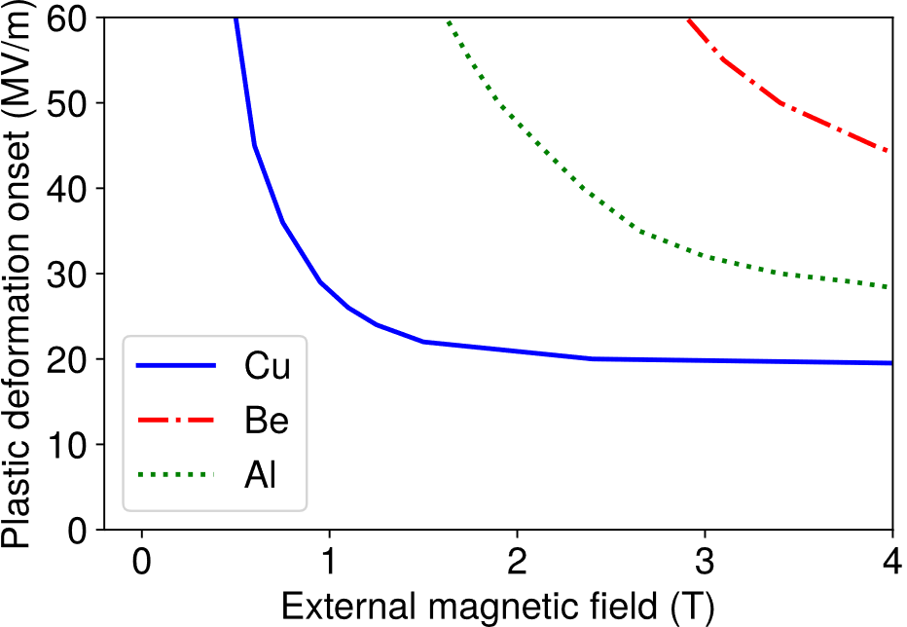
MTA RF Gradient Demonstration
Concern: RF cavity breakdown worse in high magnetic field
MTA demonstrated 50 MV/m RF gradients at 800 MHz in 3 T magnetic field (Bowring 2020) with Be walls
Safety concerns with Be
Theory hints that Al may provide acceptable gradient
High frequency RF studies suggest other materials
Hard copper alloys
Copper at 77 K
Bowring, PRAB 23, 072001 (2020)

Slide 18
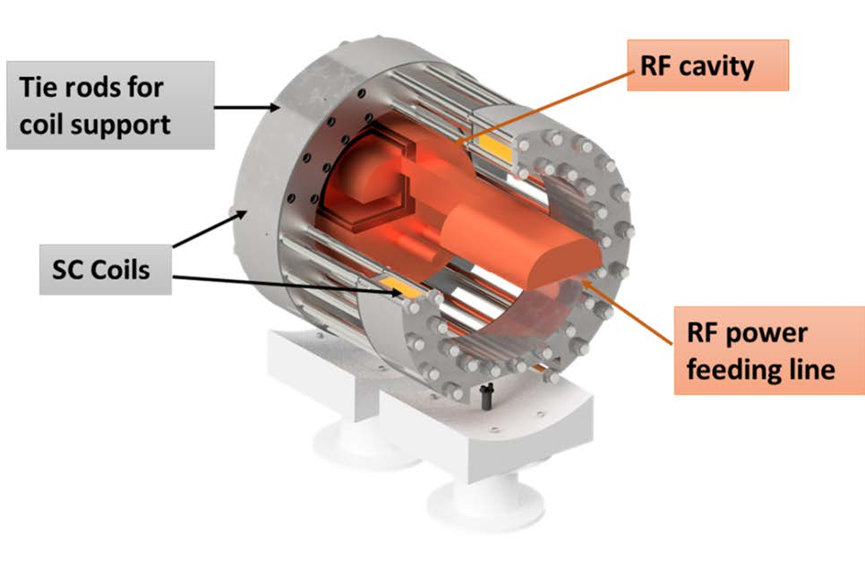
IMCC Efforts
Initial proposals made by CEA and INFN
CEA has some 704 MHz klystrons available
INFN beginning a design for a 3 GHz RF in magnetic field test setup
With a view to later testing of 704 MHz
Studies of powering scenario for cavity in demonstrator
Traveling/standing wave, pi mode or not

Slide 19
Solenoid Program
Solenoids to be designed/prototyped for demonstrator
First as single solenoids
Then need to include neighboring solenoids
Insure with have a path for RF power
Earliest designs for demonstrator and for RF test program
How do we create the dipole field?
Tunability of dipole component is important, especially for the demonstrator
Layers, canted, with two opposite cantings, separate circuits?
Cryogenics, insulation, integration with RF, quench, ...

Slide 20
Collider/Prototype Cavity Program
Need to design/prototype cavity for demonstrator
Cavity design
Method to supply power (impacts cavity design)
Continue studies of RF cavity materials and achievable gradients
Hints the aluminum may provide good performance
Other materials to study (e.g., Cu/Au alloy)
Copper at 77K
Don’t want to be limited by power source: want to determine limits
Cavity frequency in correct range: 650–800 MHz
Flexible magnetic field configuration
Solenoid pair, independently powered
Use largest solenoids from cooling cell prototype design
High enough field to understand limits
+
+
−
−

Slide 21
Strawman Prototype Program
Components for cavity material/limitation testing, design/build
Cavity and power supply
Solenoids to supply fields
RF experiments, continue 1.5 cell prototype design
Test cavity materials, determine gradient limits: choose technology
Design/test remaining solenoids, engineering for all together
Begin to address other integration issues (vacuum, cryo, absorber...)
Full cavity design, RF power supply, and integration of all components for 1.5 cell prototype
Build it and power it up...

Slide 22
Summary and Last Thoughts
There is broad interest in demonstrating a long cooling channel with beam
A cooling cell prototype for our most challenging cell could show we can meet the engineering specifications to achieve our desired emittances
All of these requires prototyping of individual components
High RF gradients and magnet fields are essential for performance
Need to learn the limits
Need input for our collider design
If we hope to even approach technically limited timescales for muon collider physics
Demonstrator and prototyping to test limits should occur in parallel
There are synergies in the component prototyping program
We need to work together with the IMCC, need everyone we can get

