Slide 1
Calorimetry R&D Directions
Needs in the Next 3-5 Years
Chris Tully (Princeton)
February 23, 2024
Princeton Muon Collider Organizational Workshop

Slide 2
Importance of Order of Magnitude Leaps
Past Three Decades
  Tens of microseconds to tens of nanoseconds
  Thousands of channels to millions
  kRad to MRad tolerances
  100kBytes to GBytes of per event data
  Trigger based on a handful of scalar sums to thousands of individual particle tag quantities
  …many firsts with every new calorimeter
With each leap, we create opportunities for invention and innovation in the physics program and deliver more events, max out resolution within constraints, high granularity, and lower backgrounds for more sensitivity to new physics

Slide 3
Muon Collider Era
We have to be even more impressive than before
  Sub-nanosecond tags for each individual particle region
  Multi-signal/multi-dimensional discrimination to further particle identification for all particles
  Tens to hundreds of millions of channels
  Tens of Mrad tolerances
  Tens of GBytes of per event data
  Triggers based on all real-time reco particles in the event
  First AI/ML fully optimized detector design
Above all, the great leap for the muon collider detector calorimeter is to deliver new order of magnitude advances across the board while fully cleaning each event of beam-induced-background
LPC success was grounded in excellent software/computing

Slide 4
Calorimeter R&D Directions
Complex landscape of potential technologies
  Si-W based on-detector/MAPS readout
  Cryo/Noble Liquid/LAr high granularity with cold readout
  Optical calorimetry with Dual-Readout/hybrid crystals
  Emerging timing-centric approaches/Fast glass/Crillin
Time-domain important and pervasive dimension
  (AC-)LGAD/silicon
  Fast glass/Crillin
  LYSO/Fast Scint/SiPM
  And several evolving 10’s to 100’s of picosecond leading-edge discrimination for many of the full-detector calorimeter technologies

Slide 5
Calorimeter R&D Future
Maximize information content
  Measure and identify particles and event - and parameters needed to maintain calibration and remove backgrounds
  Dig deep: high quality local data, but save frugally/intelligently
A strong guiding paradigm is Particle-Flow, but previous incarnations were hardly well-implemented
  In fact, PF is largely, at this time, based on a lot of assumptions
  Energy “Flow”: assumes time is measured at different points along the trajectories – few examples of that
  Assembly of particles out of the parts collected from vertex/tracking/calorimeter/muon – not fail safe
  Calorimetry – often downgraded to minimum performance, driving many of the mistakes made in the algorithm

Slide 6
Example Muon Collider Outline
https://arxiv.org/abs/1204.5739
https://accelconf.web.cern.ch/ipac2012/papers/moppc037.pdf
Calorimeter
Region
Electron flux
Tungsten cones
(5 sigma elliptic openings)
Gamma flux
N. Mokhov (FNAL)

Slide 7
Expected Flux Through Calorimeters
Muon Flux
Charged Hadron Flux
Calorimeter
Region
Calorimeter
Region
Neutron Flux
Photon Flux
Calorimeter
Region
Calorimeter
Region

Slide 8
Time-domain is different than HL-LHC/muC
HL-LHC has a class of backgrounds that are from inelastic proton-proton interactions from the beam (sub-ns spread) – Much less of this in muC
There is significant ambient neutron flux from hadron interactions in neutron rich materials in the calorimeters (diffuse in time) – More from collimators upstream and tungsten nose
Significant low energy flux from tungsten nose
Beam halos (muons produced in secondary lost beam interactions) – large flux from off-momentum electron-initiated showers upstream
Cosmics (grow in rate when there is random overlap in broad time window for collecting events) – narrower IP time windows help here

Slide 9
Example hadron calorimeter time-alignment
Depth-1
2007-2020

Slide 10
Muon Collider Calorimetry
Need to drop some assumptions
  Measure hit times along trajectories
  Track from IP outward and from Beam Collimators inward
Standard geometries are designed to be hermetic and uniform – tunnel vision on IP
  Locations of calorimeter surfaces influences the separation power on beam backgrounds
  Prompt time of arrival distributions should not peak at background arrival times – and overlap should be suppressed by multiple times along trajectories leading up to calorimeter
  Timing layers/walls should be arranged to efficiently catch beam backgrounds and maintain high event quality
  Projective to the IP is for signal

Slide 11
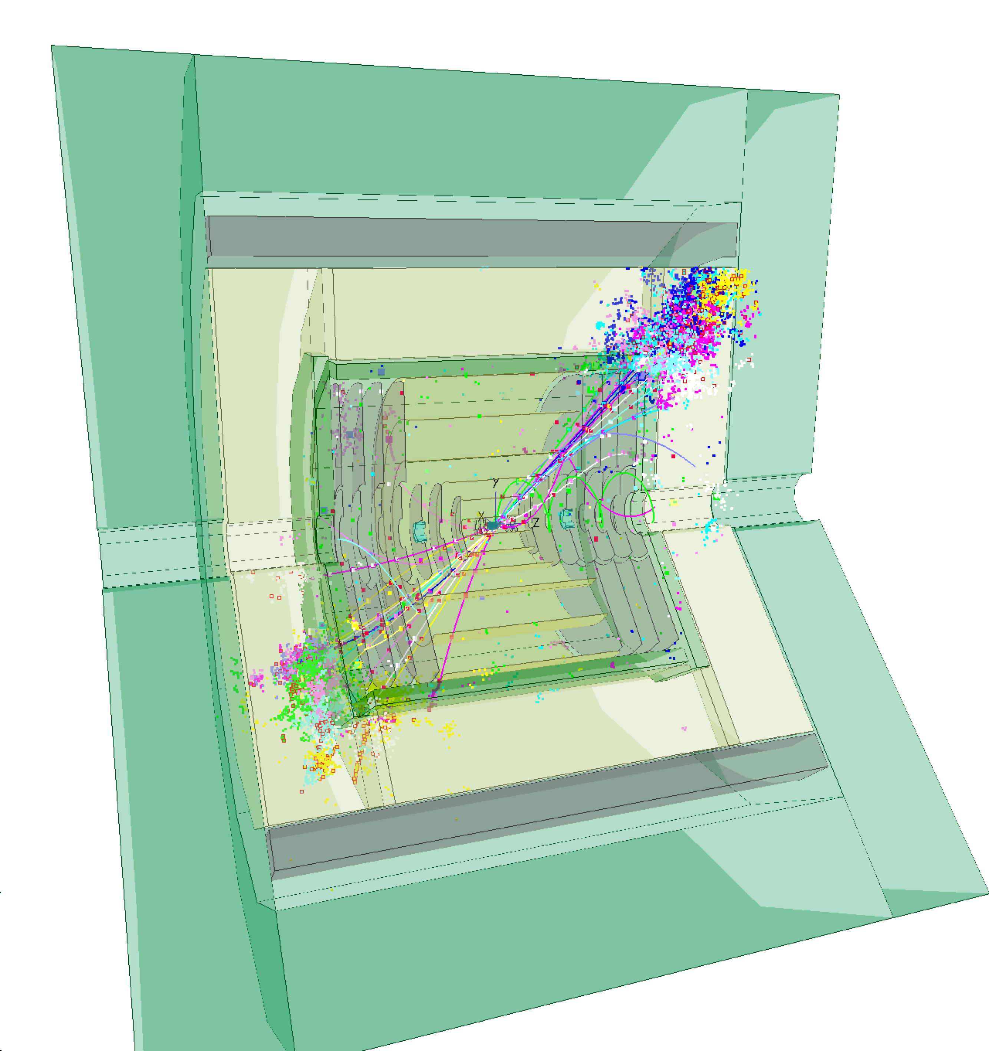
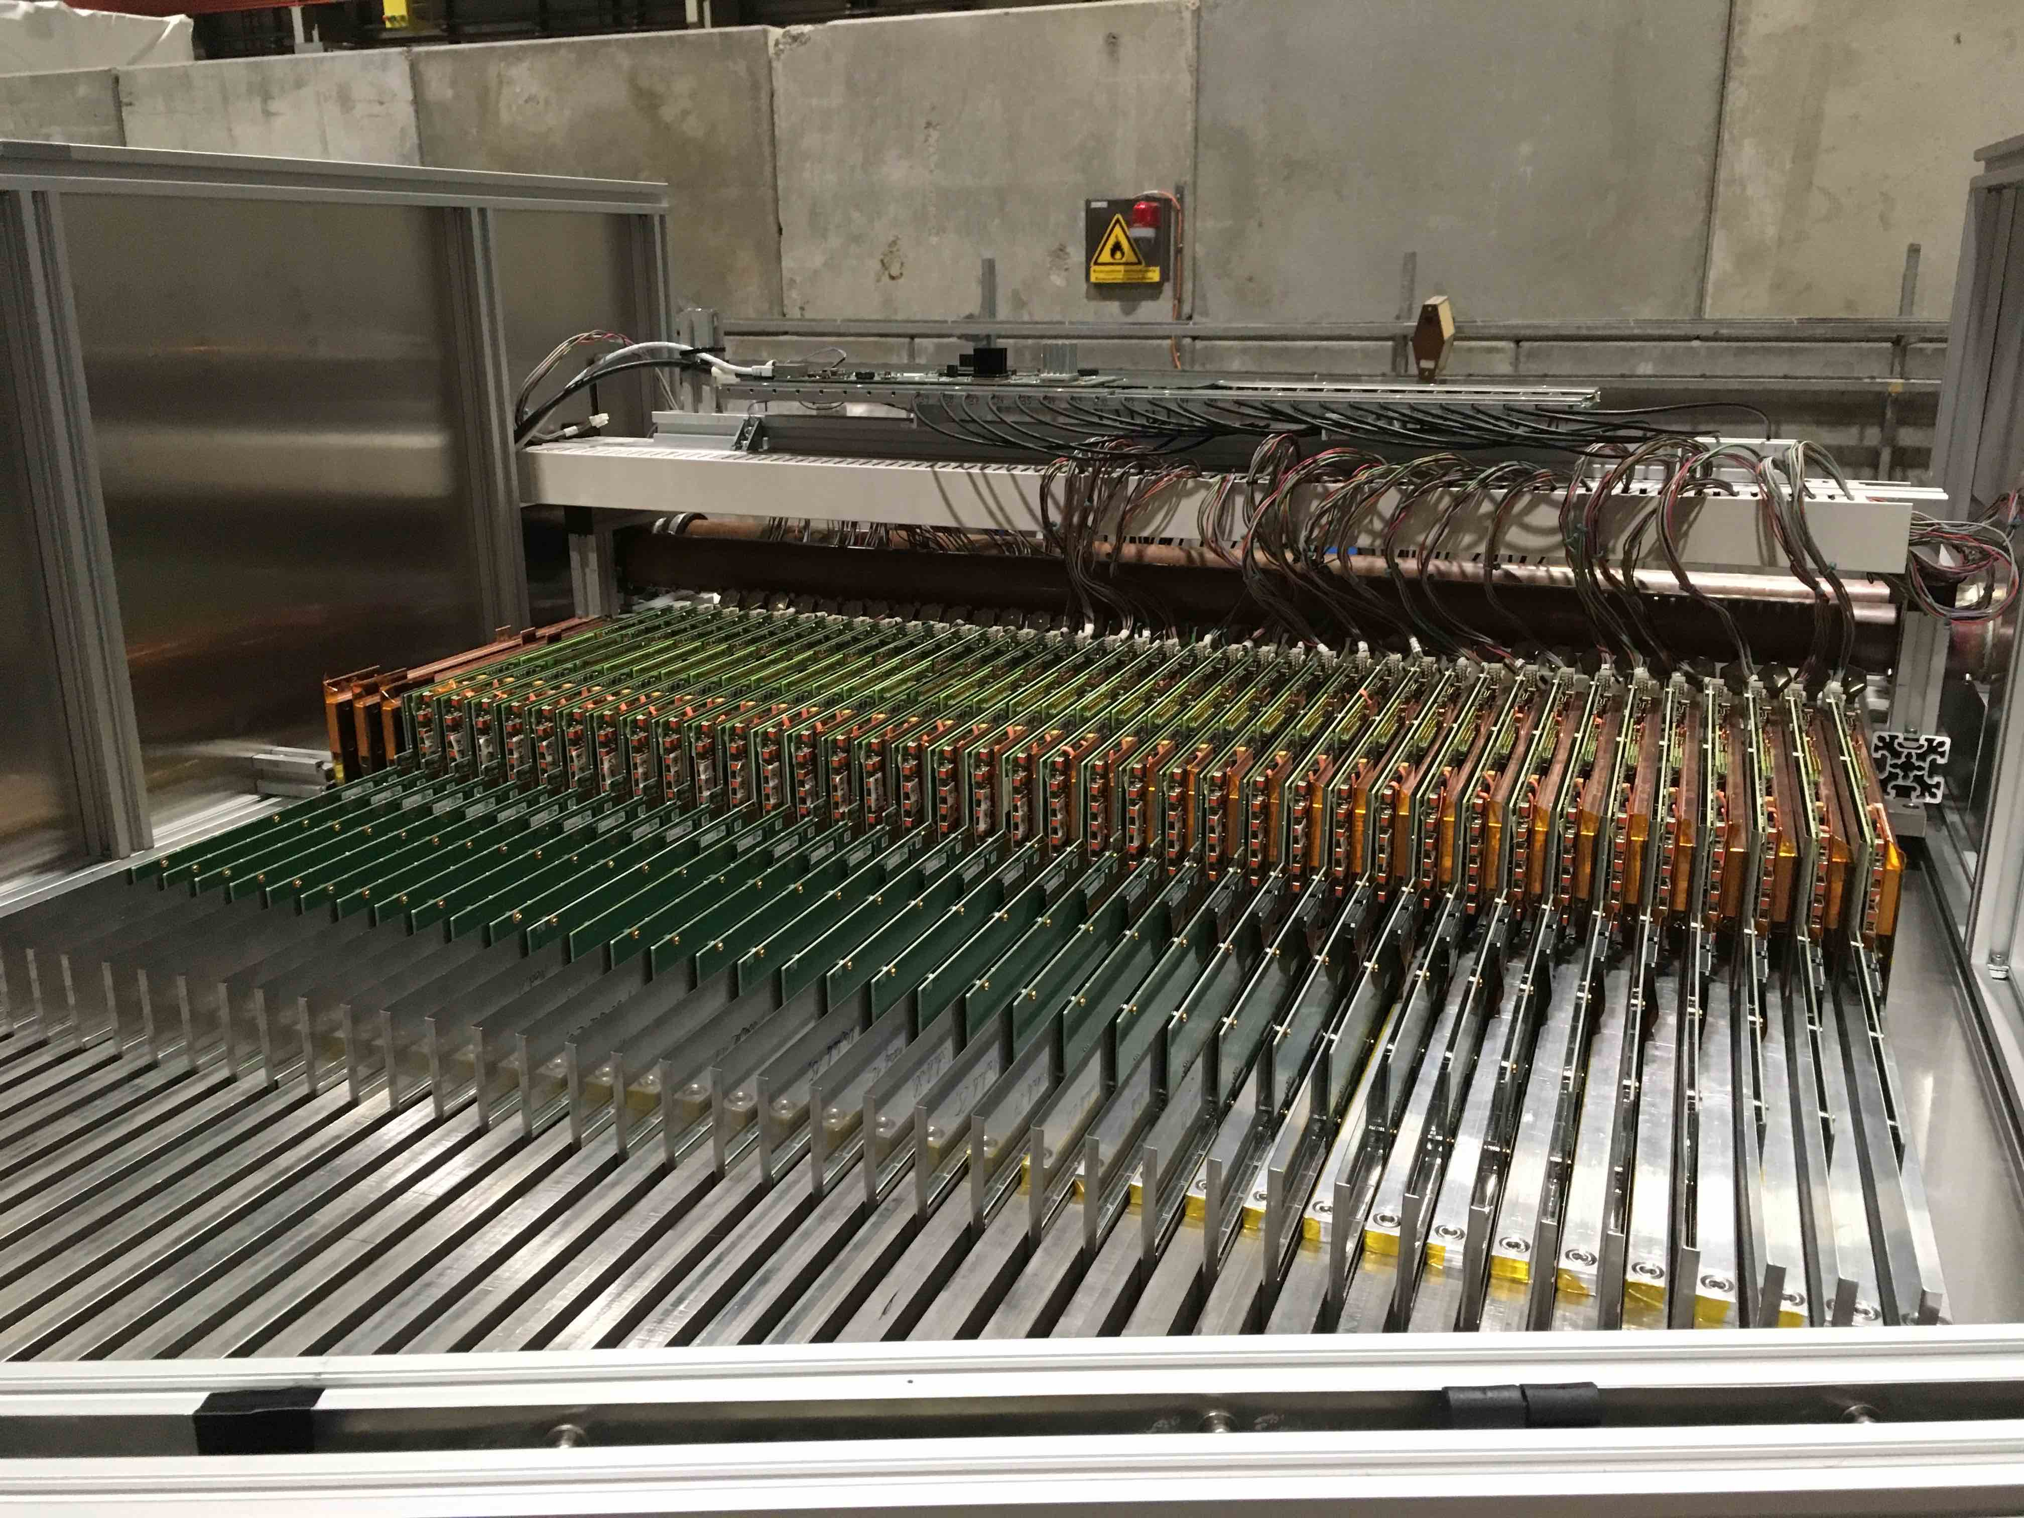
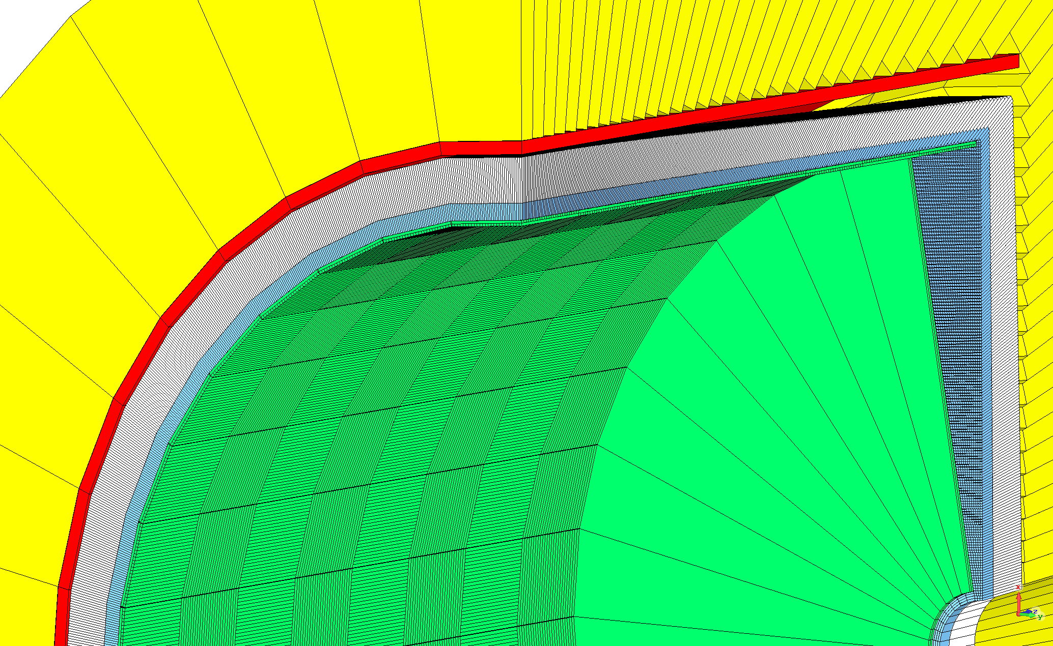
Optimize w/ Simulation and Test Beam
https://arxiv.org/abs/2109.00391
Si-W
Sandwich
LAr
DRO/Hybrid
Benchmarking
W
Z
H

Slide 12
Summary Table of Energy Resolutions
https://arxiv.org/abs/2109.00391
If the focus is mainly jets, then high-granularity with PFA delivers 4% at 50 GeV – often called “PFA calorimetry”
Noble Liquid is a better calorimeter across the board, but needs PFA studies
Higher EM performance with Noble Liquid or Fibers – Highest with Crystals
Best Intrinsic Hadron Performance with Dual-Readout Fibers
Hybrid Dual-Readout Crystals+Fibers attempts to maximize all performances

Slide 13
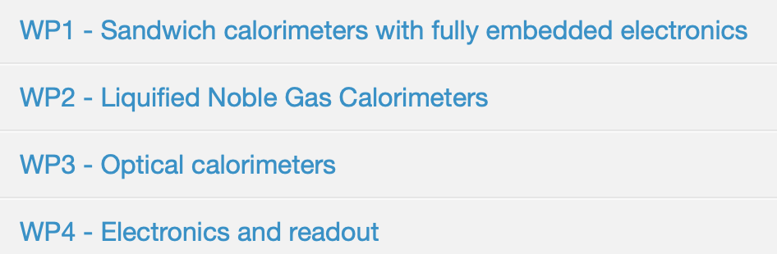
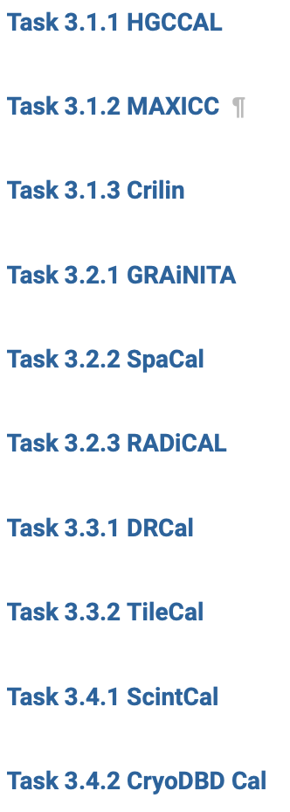
Many small projects
Limited full detector
optimization and performance benchmarking

Slide 14
Hybrid Dual-Readout Crystals+Fibers
https://arxiv.org/abs/2008.00338
M. Lucchini

Slide 15
Dual-Readout PFA
M. Lucchini

Slide 16
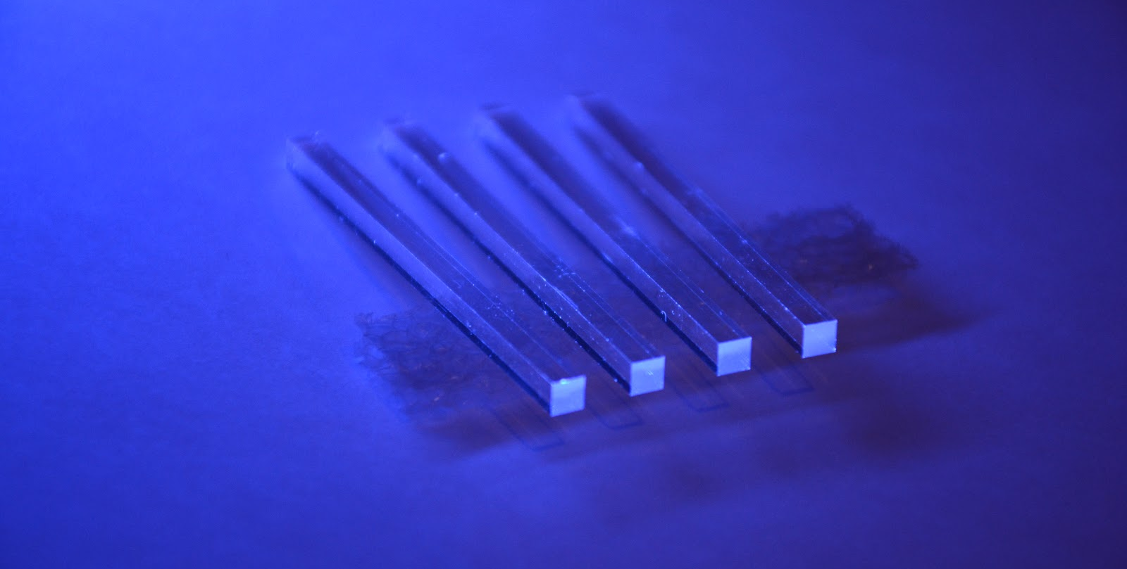
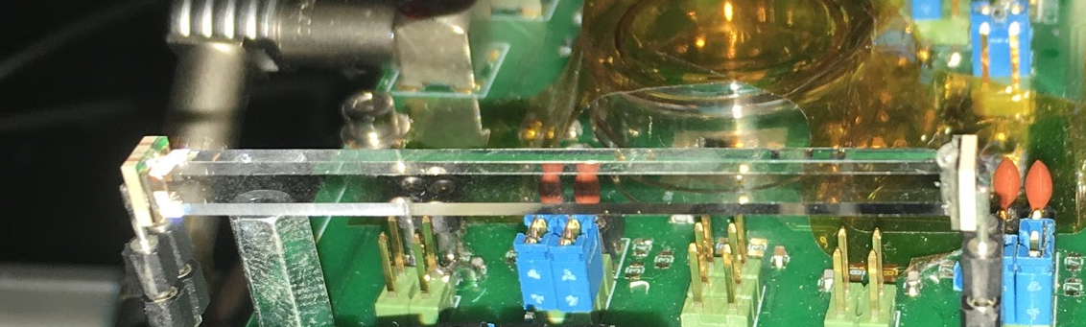
Importance of Timing Layers
(in front of calorimeter)
New era of MIP timing
  ~25ps resolution per hit (1/c = 33ps/cm)
Non-wrapped crystal bar with 2 SiPMs attached at each end
3x3x50mm³
crystal
Option A for CMS MIP Timing Detector TDR
incoming particles
Low occupancy timing layer timing for ~0.3-1 X0
Transverse orientation w/ stereo readout
Hermetic 30 ps timing layers a first-ever

Slide 17
Importance of Timing Layers in tracker
Future direction:
AC-Coupled with Doping
Concentration RadHard
Compensation
New era of MIP timing
  ~40ps resolution per hit per layer

Slide 18
Sparks of New Ideas
Dual-Readout Blue Sky R&D
Look for these from all technologies
(CalVision Proposal, H. Newman)

Slide 19




10 TeV has to the potential to observe the
“God Process” of matter creation in the Universe
1/3
1/3
1/3
$$\left({u_{L}^{2/3} \atop }\right)$$
1/3
1/3
B=
1/3
$$\left({ \atop d_{L}^{−1/3}}\right)$$
1/3
Conserved
Δ(B - L)=0
1/3
1
$$\left({ \atop d_{L}^{−1/3}}\right)$$
Baryogenesis
Δ(B - anti-B)>0
1/3
1
L=
1
Balance Drowned
in Relic Neutrinos
$$\left({ν_{L} \atop }\right)$$
Δ(L - anti-L)>0
+
= 0
Major Calo Benchmark: 9 jets and 3 leptons (or neutrinos)

Slide 20
Summary
Importance of Order of Magnitude Advancement
  Sub-nanosecond for every corner of the calorimeter
  Multi-signal evaluation concurrent with energy measurement
  Real time-domain information
  Energy flow in and out of calorimeter cells
  On detector reconstruction from pulse shapes to multi-signal to regional and event reconstruction – the whole range of fast and precise on-detector evaluation
  Orders of magnitude in cleanup and robustness against BIB
  State-of-the-art New ASICs
  First AI/ML optimized detector

Slide 21
Final Remarks
Simulation is absolutely central to optimizing the calorimeter in concert with PFA/PID performance
  Many options are open, but the software needs to be able to cycle through them and compare
Timing layers at ~20-40ps resolution will quickly be indispensable
Physical self-cleaning demonstrator essential as a focus of Detector R&D (CASTOR-table like env)
Calorimeter R&D should continue to be impressing, pushing on ASICs, PID, and novel detector signals (look for very new ideas)
  Once even proposed a SQUID sampling array to estimate electron longitudinal polarization from statistical sampling of the EM shower
  Embedded spatially distributed arrays of entangled coherent states for correlated decoherence signals
  …

Slide 22
Additional slides

Slide 23
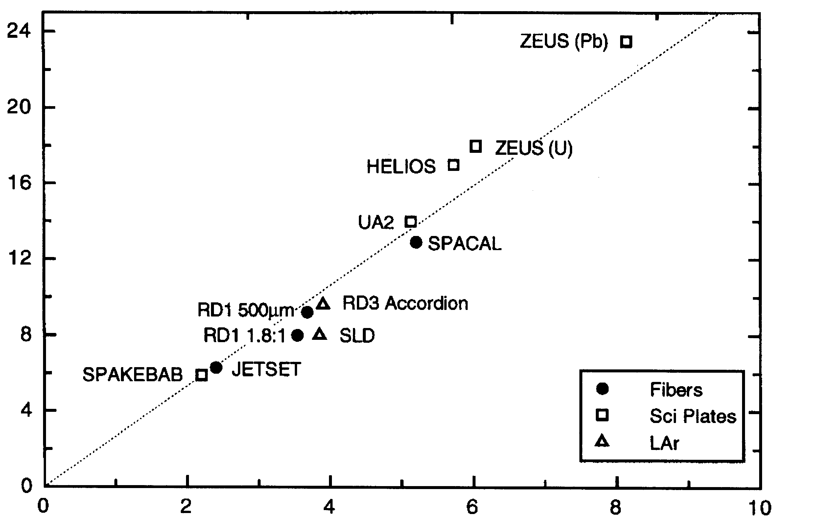
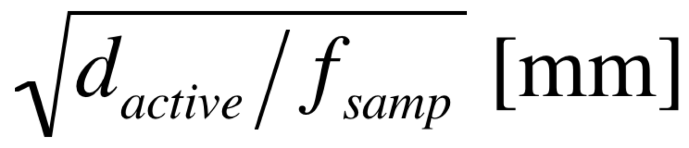
Three Regimes of EM Resolution
For EM showers in a sampling calorimeter, the energy resolution is dominated by the sampling fluctuations:
Silicon
* Si-W (100μm - HGC)
* Si-W (300μm - HGC)
X₀(Si)/X₀(W)=27
Segmented
Crystal?
(σ_{Ε} /E)_{EM} *√E [%]
Plastic/Quartz
Fiber
(Courtesy of R. Wigmans)
Homogeneous crystals
Notes:
The vertical axis is a demonstration by Wigmans of how to estimate the X%/sqrt(E) term for an electromagnetic calorimeter.
The current PFA concepts favor silicon (>20%/sqrt(E)) – which have a sampling fraction of ~1/270 from the ratio of the radiation lengths of Si and W (27) and the relative thicknesses ~0.3mm of Silicon divided by 3mm of W (1/10). The DREAM/fiber calorimeter hope to get 1-15%/sqrt(E).
We demonstrate in the next pages < 5%/sqrt(E) for segmented crystals.

Slide 24
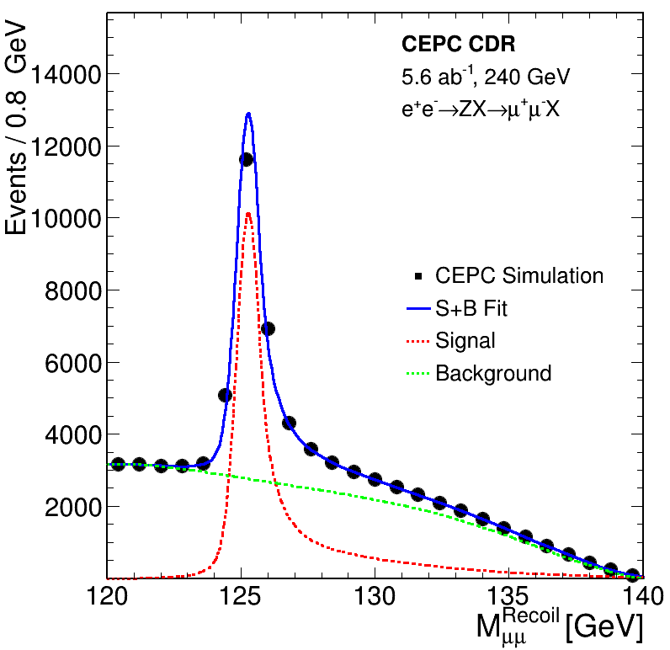
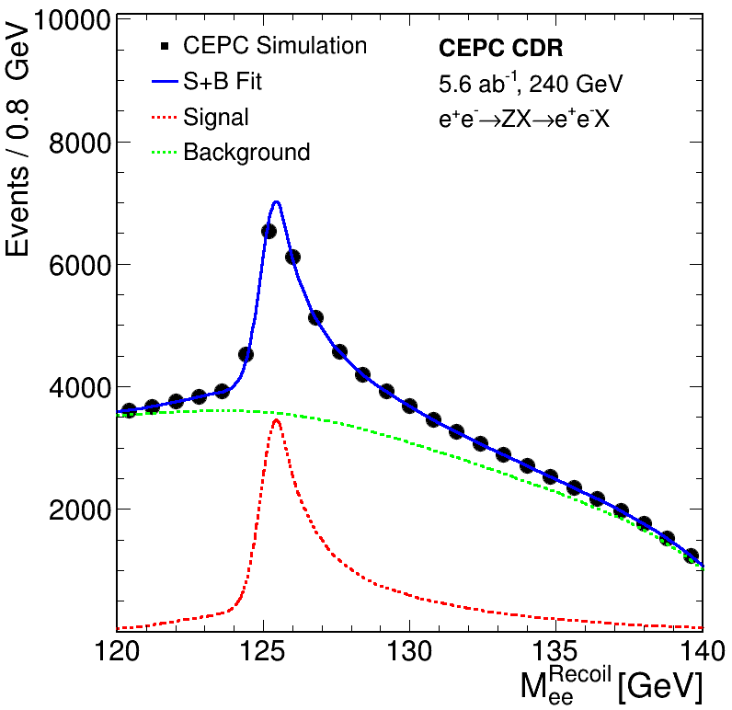
Recoil Analysis – Single Most Important Unbiased Sample of Higgs Boson Decays
Z→μ⁺μ⁻ Recoil
Z→e⁺e⁻ Recoil
Muon Track
Δp/p ~0.3%
Electron Track
Δp/p tail ~1-2%
(two tracks)
Example from CDR reference design
(electron tracks with no Brem. recovery)
→ ~80% of Resolution Recovery with 3%/√E

Slide 25
Silicon Photomultiplier (SiPM) Cells
Typical dynamic range customization for SiPM
  More (small) SPADS to count more photons (50→15μm)
  Bright crystal (LYSO, GAGG) and high photodetection efficiency (PDE) and light collection efficiency (LCE)
Currently:
Large device ~6x6mm²
CMS MTD ~4.5 m² of SiPMs
(of 3x3mm²)
Segmented Crystal ECAL:
~200 m² of crystal surface
(3-4 layers)
Which SiPM device?
Notes:
This is some added material I put in on SiPM customization which we studied extensively for the HCAL Phase-I and the MTD detectors.
The CEPC segmented crystal calorimeter would be significantly more total area of SiPMs. One might worry, for instance, that the timing
Detector SiPMs will not have enough dynamic range for early showers. Next slides on some ideas for further customization.

Slide 26
Further Possibilities for SiPMs with
High Dynamic Range and Packing Density
Large pixel count w/ large gain leads to current output limitations for large area devices
  Multiple analog outputs per device
    Regional lumped analog sums - split output currents per region and sum (1/128, 1/32,1/8,1/2)
    Multi-gain SPADs (5, 15, 50μm) for different cell sizes and fill factors – dynamic range built into SPAD layout
  On-chip ADC with regional serializers
  Commercial market for LIDAR advances is growing rapidly – many new developments expected
Notes:
These are some ideas about how SiPMs could have multiple analog outputs to handle dynamic range.
Technological development – when involving timing impacts
LIDAR and TOFPET medical imaging

