Slide 1
Using Astronomy Big Data and National Cyberinfrastructure to Drive AI Access and Innovation
Curt Dodds - Institute for Astronomy
University of Hawaii, Manoa

Slide 2
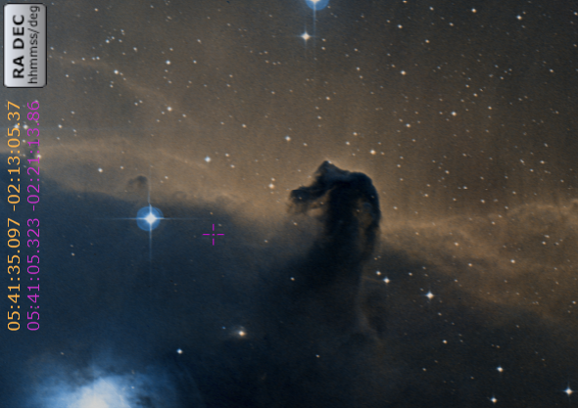
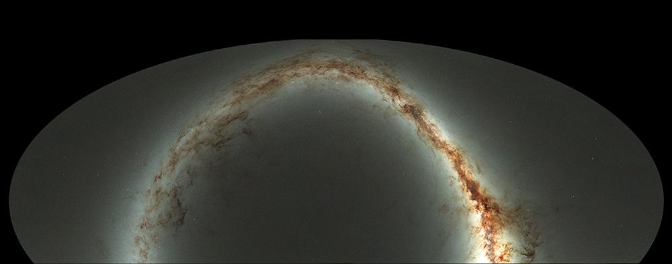
Pan-STARRS Milky Way Gigapan
Notes:
¾ of the visible sky,

Slide 3
Astronomy Big Data
Sources of Big Data
Observation (ground, space)
Simulation
Surveys
Long duration time-series telescope observations
Moore’s Law
Increased image size and dimensionality
Increased simulation grid resolution and step frequency
Notes:
Maybe two slides, one observational and one simulation
Give examples of each with quantitative metrics (# of files, total footprint, format)

Slide 4
Astronomy Big Data
Solar System
Sun, asteroids, comets, planets
Galactic
Stars
Exoplanets
Extragalactic
Galaxies, quasars
Cosmology
Notes:
Maybe two slides, one observational and one simulation
Give examples of each with quantitative metrics (# of files, total footprint, format)

Slide 5
The Sun

Slide 6
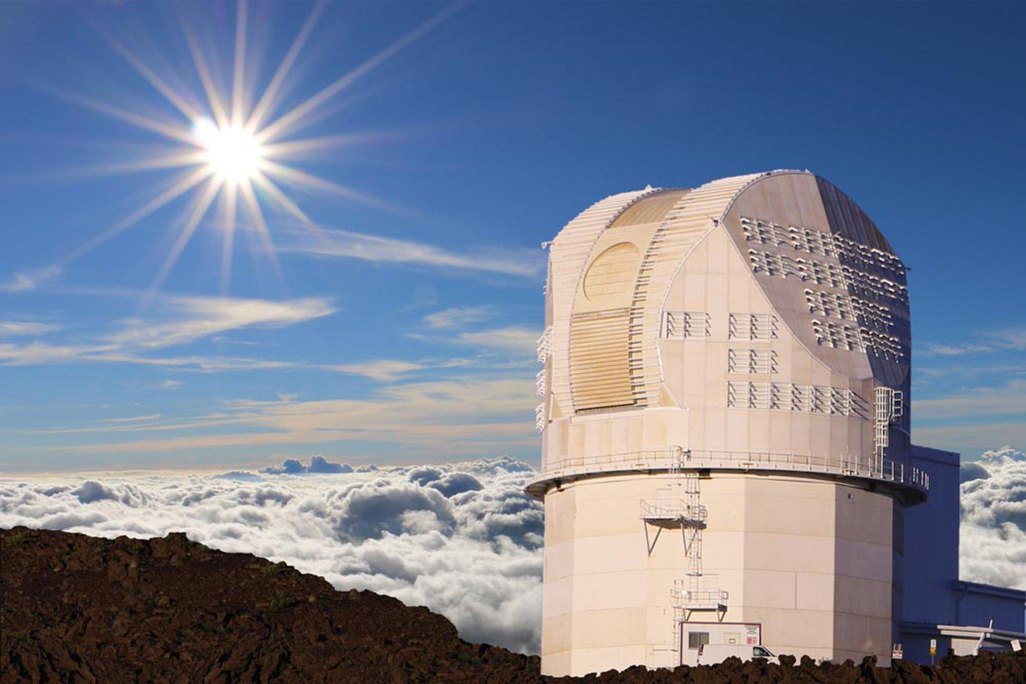
Daniel K Inouye Solar Telescope (DKIST)
Notes:
New instruments add dimensionality, resolution and speed driving order of magnitude increase in data velocity

Slide 7
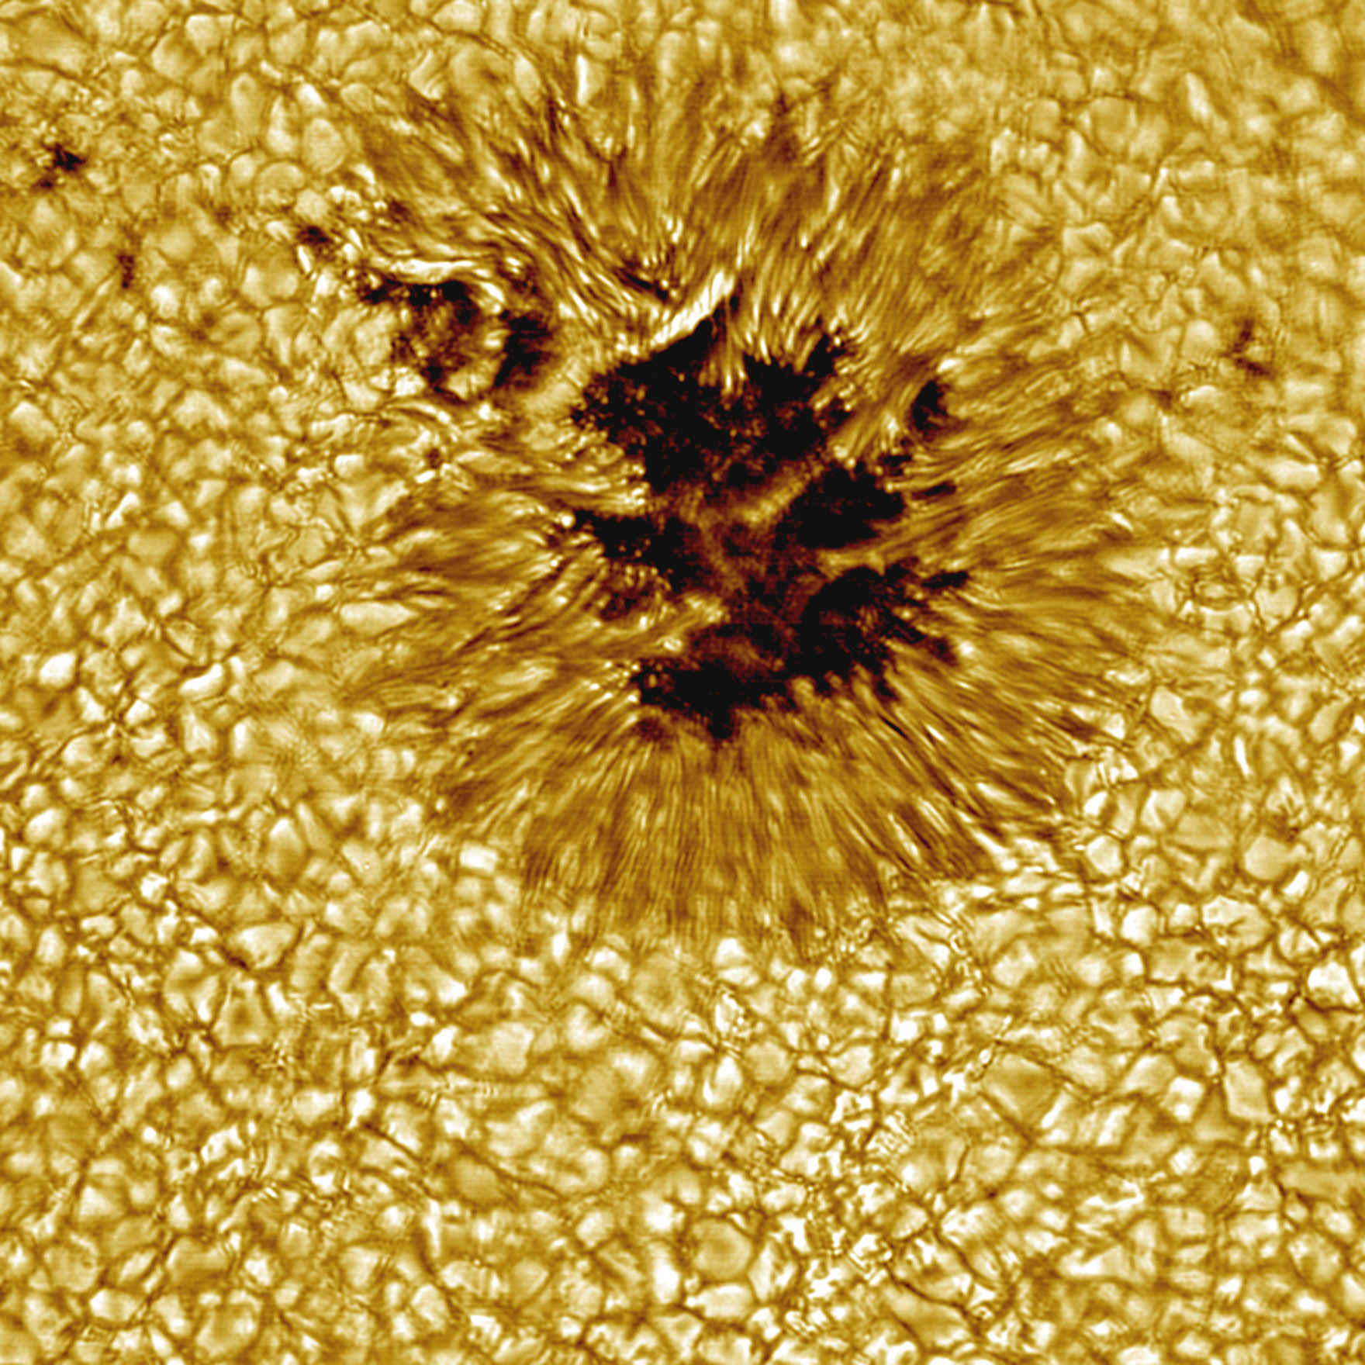
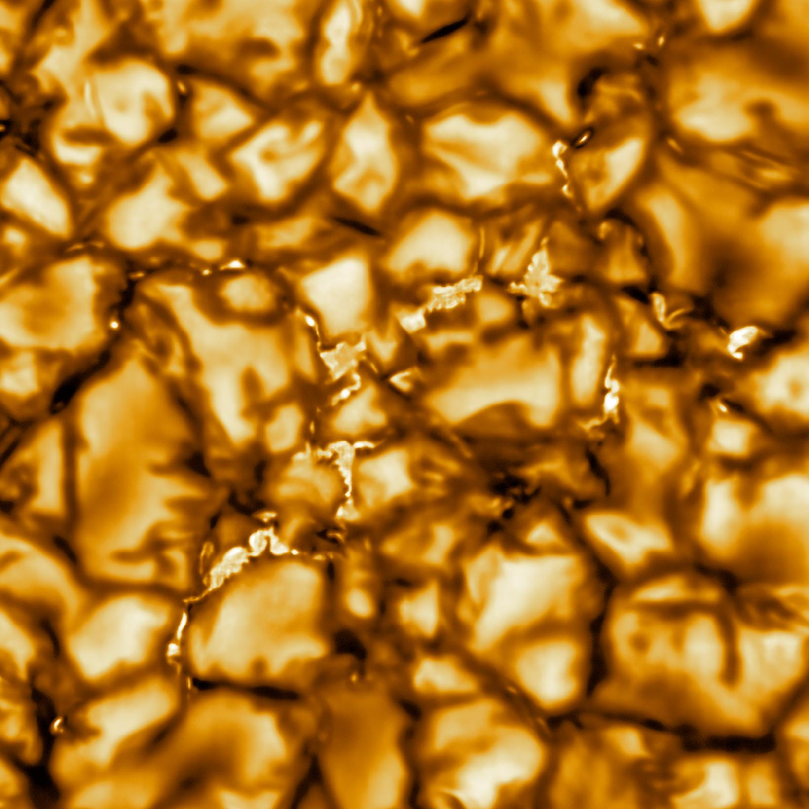
Daniel K Inouye Solar Telescope (DKIST)
Notes:
New instruments add dimensionality, resolution and speed driving order of magnitude increase in data velocity

Slide 8
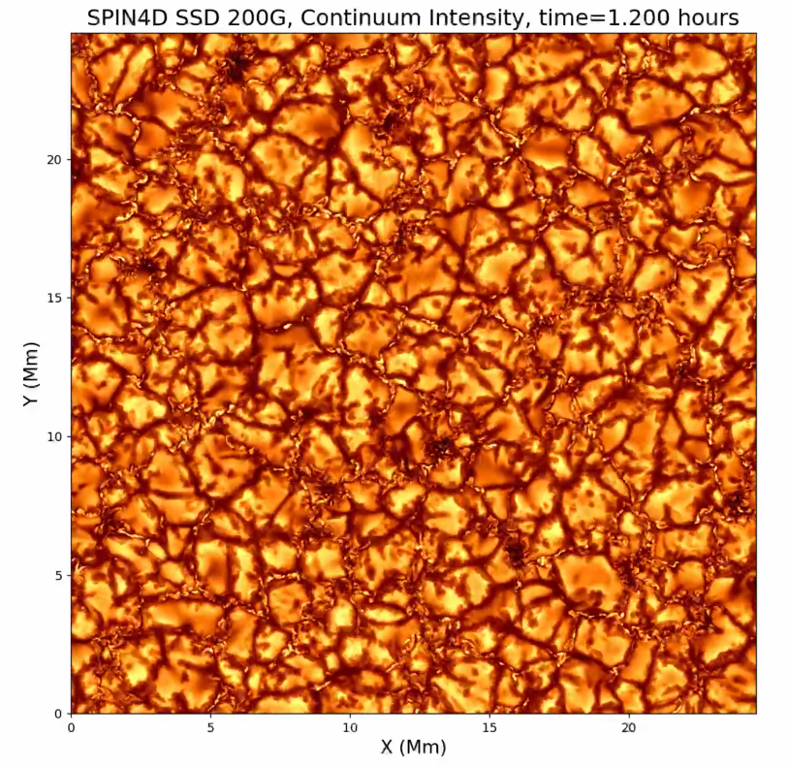
Spectropolarimetric Inversion in 4-Dimensions (SPIN4D)
Notes:
Solar photosphere simulation, visible light image(left), Stokes Profiles (green/blue) and cross-section

Slide 9
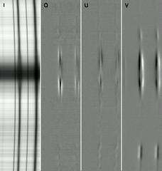
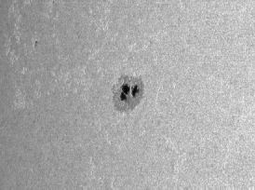
Hinode Solar Optical Telescope Spectropolarimeter
Notes:
High-dimensional images 4D (I,Q,U,V) for each spatial pixel where

Slide 10
All Sky Surveys

Slide 11
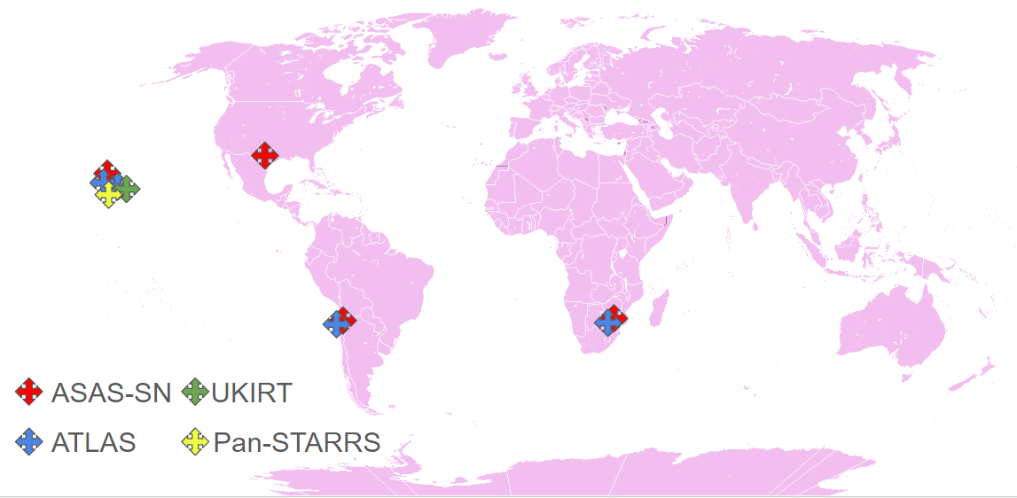
All-Sky Surveys
All-Sky Automated Survey for Supernovae (ASAS-SN)
Asteroid Terrestrial-impact Last Alert System (ATLAS)
Panoramic Survey Telescope and Rapid Response System (Pan-STARRS)
Notes:
http://asas-sn.ifa.hawaii.edu/skypatrol/objects/103079449737

Slide 12
All-Sky Surveys
Time-domain Astronomy
Variable stars
Supernovae (exploding stars)
Solar flares and coronal mass ejections (CME)
Object Classification
Galaxy, quasar, star, asteroid, comet, supernova, variable star type
Regression
Estimated photometric redshift (distance from Earth)
Notes:
http://asas-sn.ifa.hawaii.edu/skypatrol/objects/103079449737

Slide 13
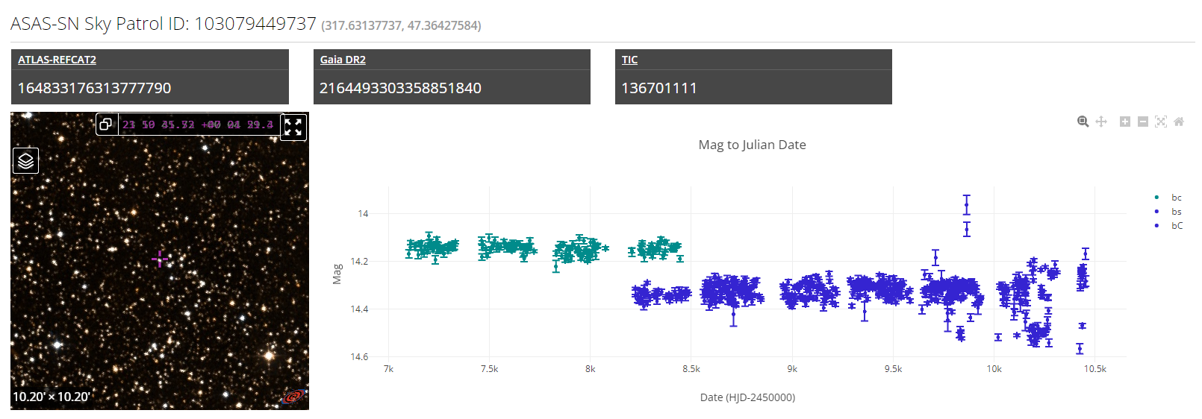
ASAS-SN Sky Patrol 2.0 light curve service
Notes:
103,874,668 light curves (objects)

Slide 14
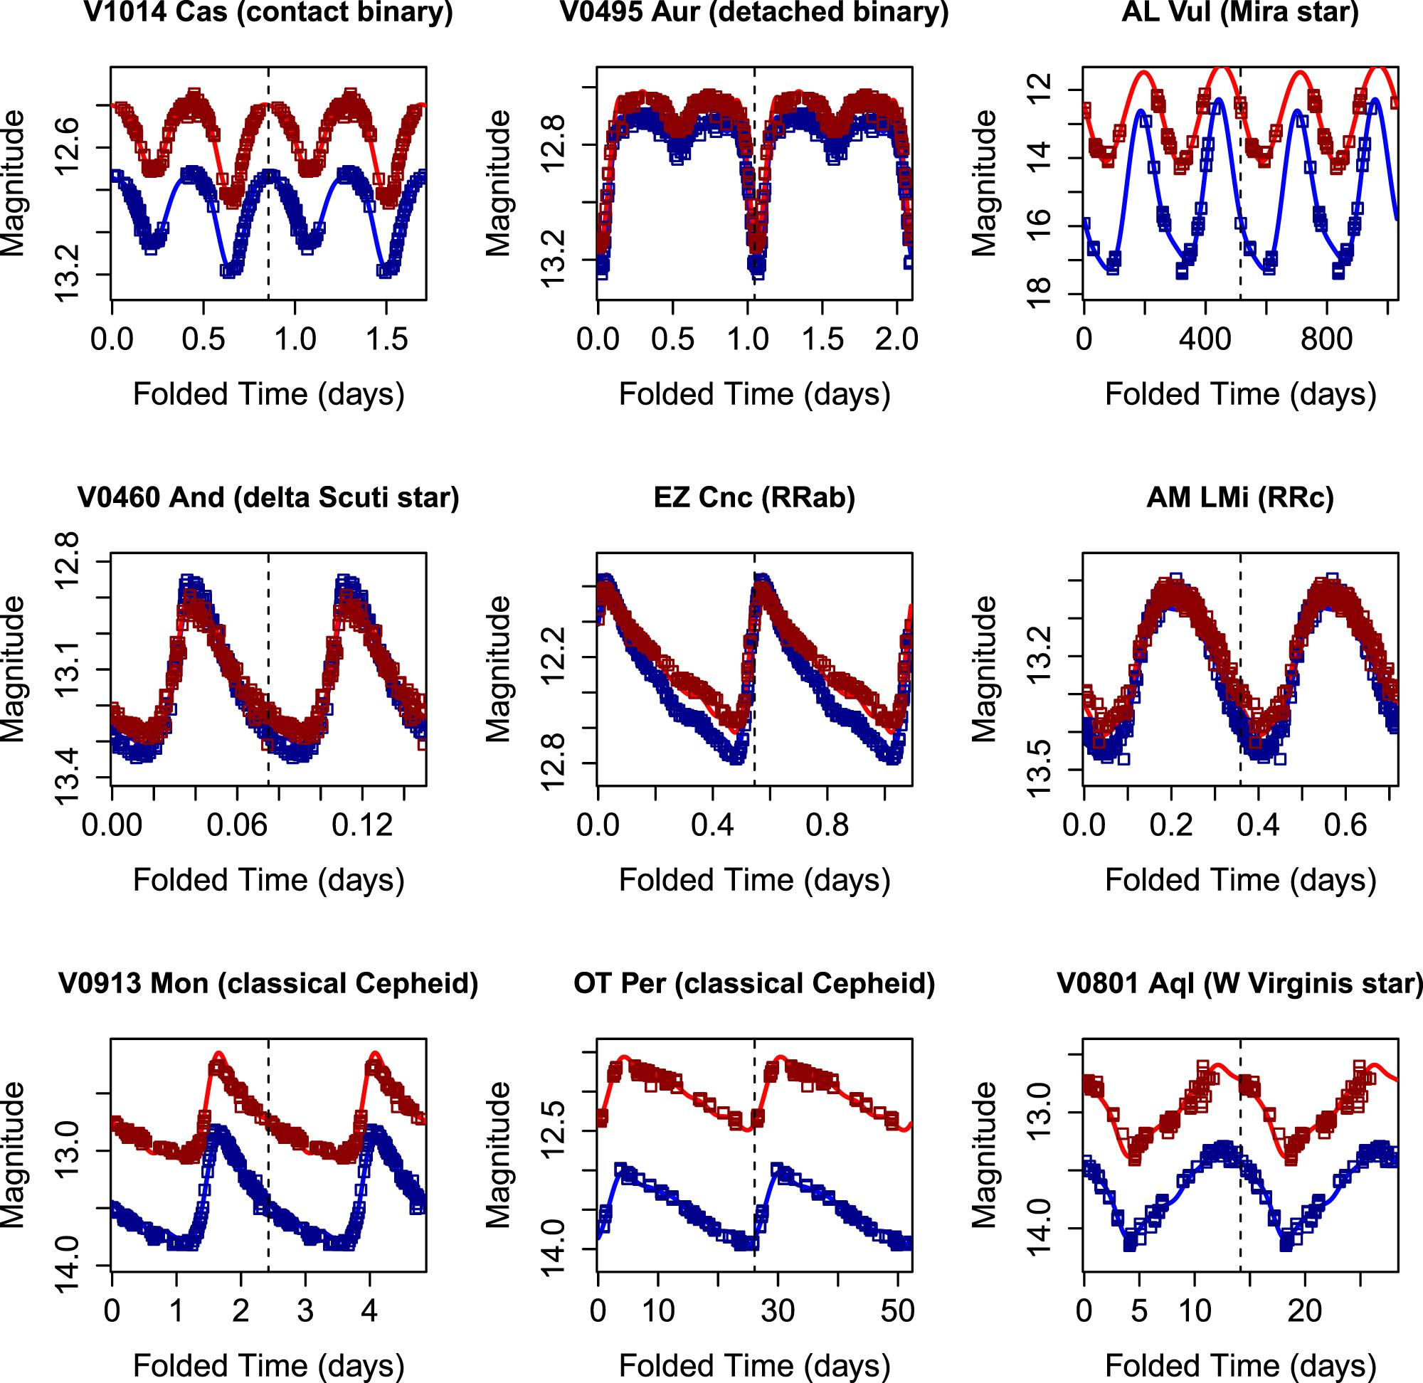
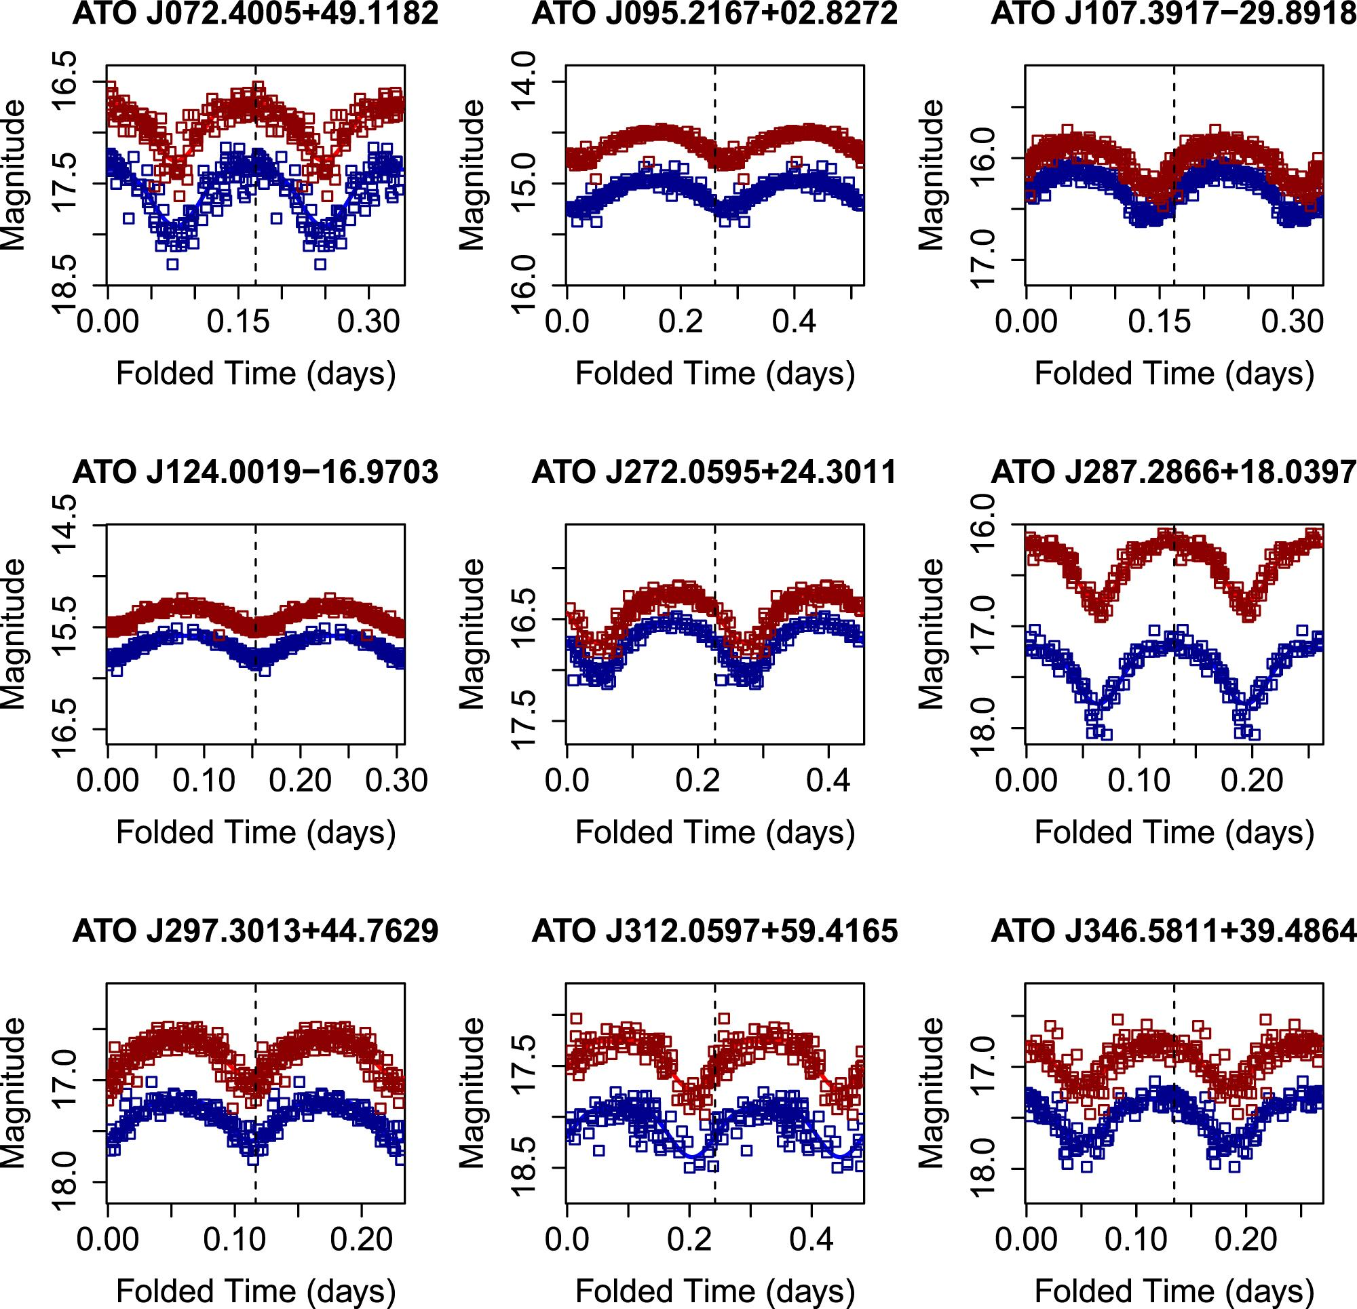
ATLAS-VAR data release of light curves with classification
Notes:
230,000 classified variable stars

Slide 15
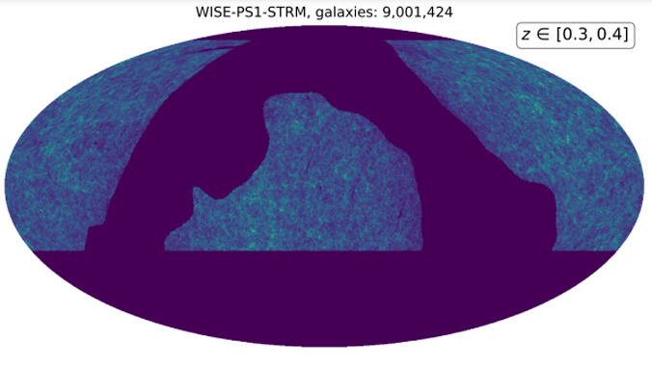
Pan-STARRS WISE-PS1-STRM Catalog
Notes:
WISE-PS1-STRM 354.6 Million objects - star, galaxy, quasar and if not a star, photometric redshift (distance)
Point out M31 - extragalactic
Everything else - Milky Way galaxy - stars, dust, gas

Slide 16
National AI Cyberinfrastructure

Slide 17
National AI Cyberinfrastructure
ACCESS
Open Science Grid
Open Science Data Federation (OSDF) / Pelican Platform
National Research Platform
Commercial cloud providers: EC2, GCP, Azure, etc.
National AI Research Resource (NAIRR) pilot
National Data Platform (NDP)
National Science Data Fabric (NSDF)
Campus HPC, Science DMZ, DTNs
Notes:
Possibly make this just a description of NAIRR compute resources?
Gather facts about scaling, data capacities, heterogeneity of nodes, etc.

Slide 18
National AI Cyberinfrastructure
ACCESS
Open Science Grid
Open Science Data Federation (OSDF) / Pelican Platform
National Research Platform
Commercial cloud providers: EC2, GCP, Azure, etc.
National AI Research Resource (NAIRR) pilot
National Data Platform (NDP)
National Science Data Fabric (NSDF)
Campus HPC, Science DMZ, DTNs
Notes:
Possibly make this just a description of NAIRR compute resources?
Gather facts about scaling, data capacities, heterogeneity of nodes, etc.

Slide 19
National Astronomy Cyberinfrastructure

Slide 20
National Astronomy Data
NASA archives were not designed for AI/ML
Designed before the AI renaissance
SQL queries with extremely limited result sizes
Typically <<10Gbps bandwidth from archive sites
Large N**2 crossmatch queries unsupported (but important!)
Image cutout services are not performant or scalable
Friction prevents researchers (grad students!) from working at scale
Tools and services are fragmented and heterogeneous
Some recent projects have addressed these issues in part (ASAS-SN, DKIST, LSST)

Slide 21
Legacy Data Access
ATLAS Photometry Server
“Next, submit an RA and Dec coordinate to the server to obtain a URL for checking the status. Note that our request may be throttled if we make too many in a short time.”
Mikulski Archive for Space Telescopes (MAST)
(Hubble Space Telescope, Pan-STARRS, JWST, Kepler, TESS)
3GB MyDB for query results (to query 150TB Pan-STARRS DR2 catalog)
You can retrieve 0.002% of the data BY DESIGN!
Notes:
ATLAS photometry server returns the ATLAS light curve for an RA,Dec coordinate.
Note ASASSN SkyPatrol v2.0 does this for precomputed ASAS-SN light curves very efficiently and at scale.

Slide 22
Legacy Data Access Patterns
Example: Download ATLAS Variable Stars from MAST
https://archive.stsci.edu/hlsp/atlas-var (Heinze et al. 2018)
Shard 360deg into 180x 2deg partitions each 100MB < x < 2GB
Had to use trial and error to determine partition limits
Manually write a download script
Wait 5 days for download of 29GB of data to finish
Notes:
The ATLAS Variable Stars dataset is at STScI MAST is 29GB in total.
I wanted to download it to Hawaii. It took 5 days to download and required sharding it into 180 partitions each 2 degs of dec.

Slide 23
Legacy Data Access
Example: “A catalog of broad morphology of Pan-STARRS galaxies based on deep
Learning”, Hunter Goddard (MS thesis)
https://krex.k-state.edu/bitstream/handle/2097/41353/HunterGoddard2021.pdf
Notes:
Example of a masters degree student who used lossy JPEG not lossless FITS because they are a) smaller and b) faster
It took 62 days to download 2.4M galaxy cutouts. Downloading the same resolution as FITS would have taken 4.24 years!

Slide 24
Notes:
Queries that produce large results or that make complicated calculations that take a long time to run will be aborted automatically by the system to allow small, simple queries to finish.
An astronomer can work around these limits by limiting the amount of data requested at a time.

Slide 25
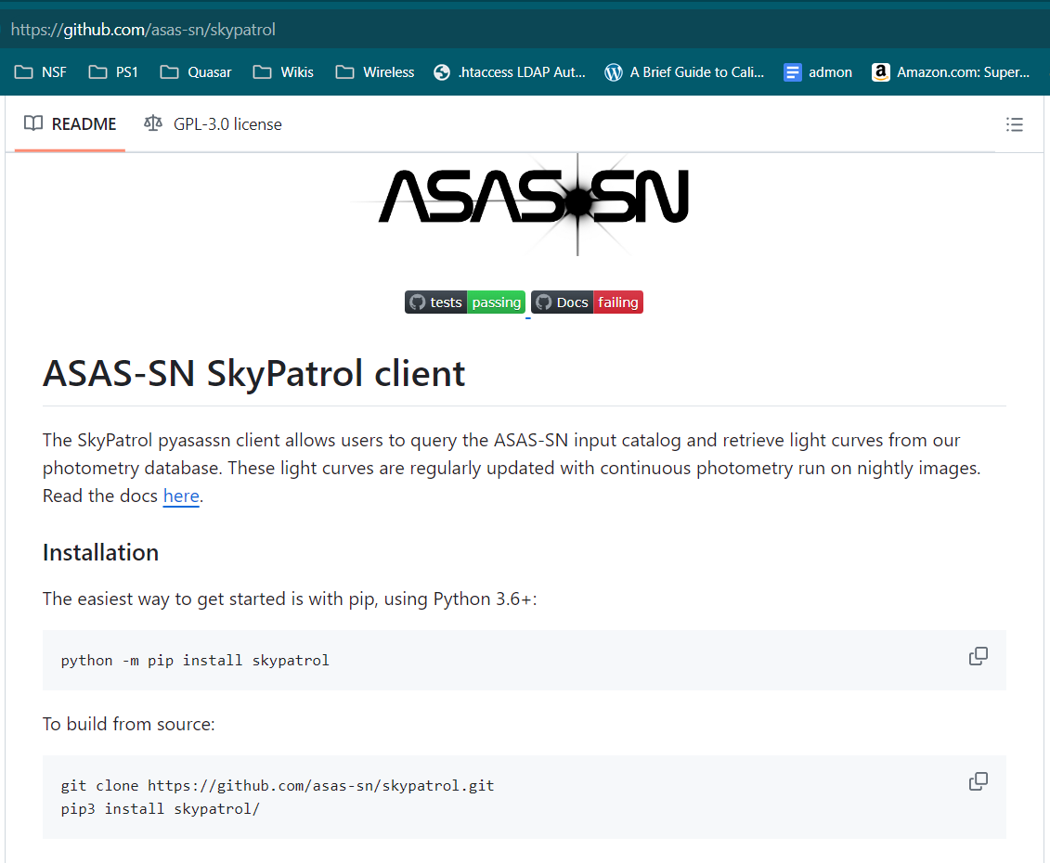
New Data Access
Notes:
ASAS-SN Python API

Slide 26
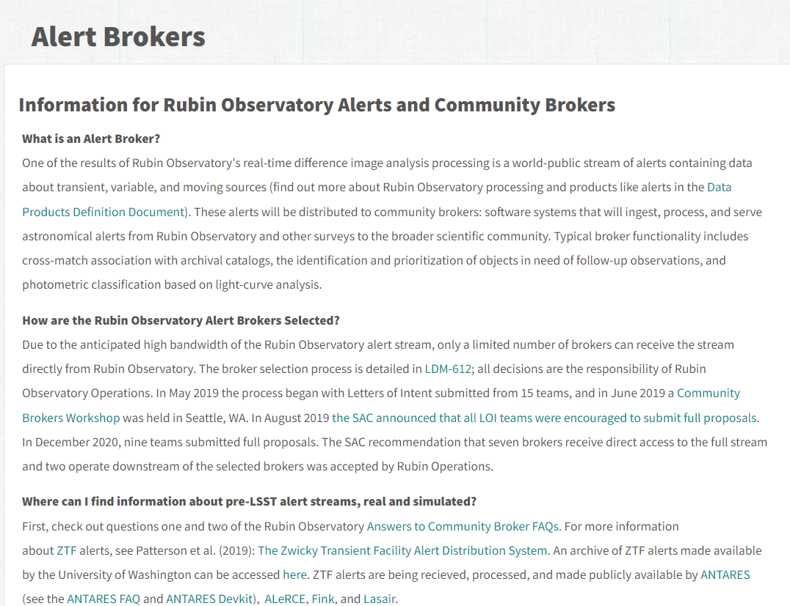
New Data Access
Notes:
LSST Alert Brokers - pub/sub pattern

Slide 27
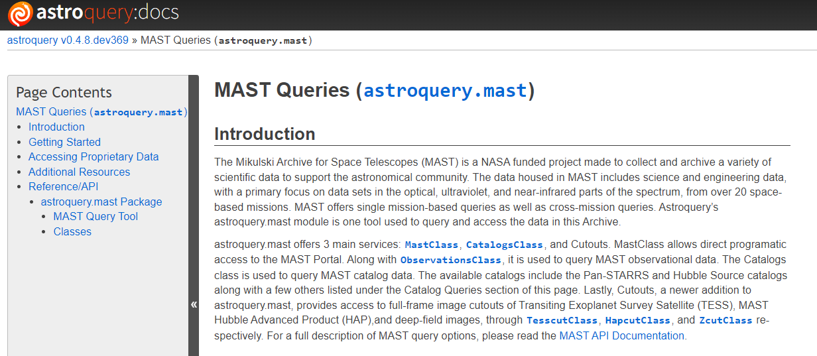
New Data Access
Notes:
LSST Alert Brokers - pub/sub pattern

Slide 28
Driving AI Innovation

Slide 29
Driving AI/ML Innovation
Reduce time to get started
Data discovery as a service
Data exploration as a service
Data ready for AI/ML training
Preprocessing adjacent to data origin
High throughput data distribution optimized for Pytorch, Keras
Transparent data caching
Eliminate sources of friction
Notes:
National Science Data Framework (NSDF)

Slide 30
Driving AI/ML Innovation
Support novel data access patterns
Online training data for AI/ML on time-series
Real-time data sources
AI/ML inference applications
Data exploration without data movement
Data preprocessing without data movement
Move only the data you want
Transparent caching for efficiency and performance
Notes:
SDAAS moana:/scratch/sdaas
FABRIC ML Data Transport Experiment

Slide 31
OSDF/Pelican

Slide 32
Hawaii OSDF Data Origins
Participate in OSDF/Pelican
Deploy data origin service on UH/IfA DTNs
Deploy data origin service on CC* HPC storage
Internal outreach to researchers
Who produce data
Who consume data
Notes:
Hinode space telescope spectropolarimetry and Stokes inversions from HAO in Boulder - snapshot 10TB
SPIN4D 50TB DR1 simulations of solar photosphere and simulated Stokes Profiles
ATLAS-VAR light curve dataset 29GB
ASAS-SN 120TB snapshot

Slide 33
Hawaii OSDF Data Origins
IfA DTNs
dtn-itc
Hinode SOT SP solar observations and inversions mirror from High Altitude Observatory in Boulder, CO
Critical Early DKIST Science: Spectropolarimetric Inversion in Four Dimensions with Deep Learning (SPIN4D)
ATLAS-VAR variable star light curves
dtn-max (Baltimore)
dtn-naoj (Tokyo)
dtn-hurp (Hilo, Hawaii)
dtn-uk (planned - London)
Notes:
Hinode space telescope spectropolarimetry and Stokes inversions from HAO in Boulder - snapshot 10TB
SPIN4D 50TB DR1 simulations of solar photosphere and simulated Stokes Profiles
ATLAS-VAR light curve dataset 29GB
ASAS-SN 120TB snapshot

Slide 34
Hawaii OSDF Data Origins
UH CC* KoaStore data origin (new):
CC* UH 800TB set aside for data federation using OSDF
Datasets (work in progress)
ASAS-SN - light curves for any source
SPIN4D - solar photosphere simulation
Hinode SOT SP - solar spectropolarimetric survey
ATLAS-VAR - variable stars
StePS - cosmological N-body simulation
Notes:
Hinode space telescope spectropolarimetry and Stokes inversions from HAO in Boulder - snapshot 10TB
SPIN4D 50TB DR1 simulations of solar photosphere and simulated Stokes Profiles
ATLAS-VAR light curve dataset 29GB
ASAS-SN 120TB snapshot

Slide 35
NRP

Slide 36
Institute for Astronomy K8s/NRP
Heterogeneous K8s cluster in Hawaii
640 CPU cores
8x L40S GPU, 2x V100GPU
Federate to NRP
Storage integration
on-premise project storage clusters (ATLAS, ASAS-SN, SPIN4D, Pan-STARRS, H20)
campus HPC Lustre storage cluster
IfA DTNs
Notes:
Scalable to PB scale
Suitable for both OSDF data origins, DTN datasets and siloed data (e.g. Pan-STARRS, ATLAS)

Slide 37
Data Services
Vision: to make siloed astronomy data from Hawaii available for ML training on NAIRR, NDP, NRP, OSG and other HPC resources.
Objectives:
Dataset discovery service on OSDF data origin, UH DTNs
Dataset discovery/exploration on OSG, NRP resources (Jupyter Notebook)
Dataset streaming service on OSDF data origin, UH DTNs
Dataset client streaming to OSG, NRP resources (Jupyter Notebook, PyTorch, Keras)
Notes:
Scalable to PB scale
Suitable for both OSDF data origins, DTN datasets and siloed data (e.g. Pan-STARRS, ATLAS)

Slide 38
Extract-Transform-Distribute (ETD)
ETD Data Discovery and Streaming Service is deployed adjacent to a data source using containers, (Docker, K8s).
Discovery - enumerate available datasets, file exploration and access
Extract - select, slice and sample from data sources
Transform - process extracted examples for AI training, e.g. torch.utils.data.DataLoader and tf.data.Dataset
Distribute - asynchronous parallel streaming
Proof of Concept at Univ. of Hawaii using DTNs, NRP, OSDF
Applications for education, training, transfer-learning, real-time inference
Notes:
Scalable to PB scale
Suitable for both OSDF data origins, DTN datasets and siloed data (e.g. Pan-STARRS, ATLAS)

Slide 39
Resources
ACCESS
Open Science Grid (OSG)
Open Science Data Federation (OSDF)
Pelican Platform
National Research Platform (NRP)
National AI Research Resource (NAIRR) pilot
National Data Platform (NDP)
National Science Data Fabric (NSDF)
Science DMZ
Data Transfer Node (DTN)
Notes:
Scalable to PB scale
Suitable for both OSDF data origins, DTN datasets and siloed data (e.g. Pan-STARRS, ATLAS)

Slide 40
Contact Information
Curt Dodds
Institute for Astronomy, University of Hawaii, Manoa
dodds@hawaii.edu
Notes:
Scalable to PB scale
Suitable for both OSDF data origins, DTN datasets and siloed data (e.g. Pan-STARRS, ATLAS)

