Slide 1
OSDF Deployment & Use Frank Würthwein OSG Executive Director UCSD/SDSC July 8th 2024

Slide 2
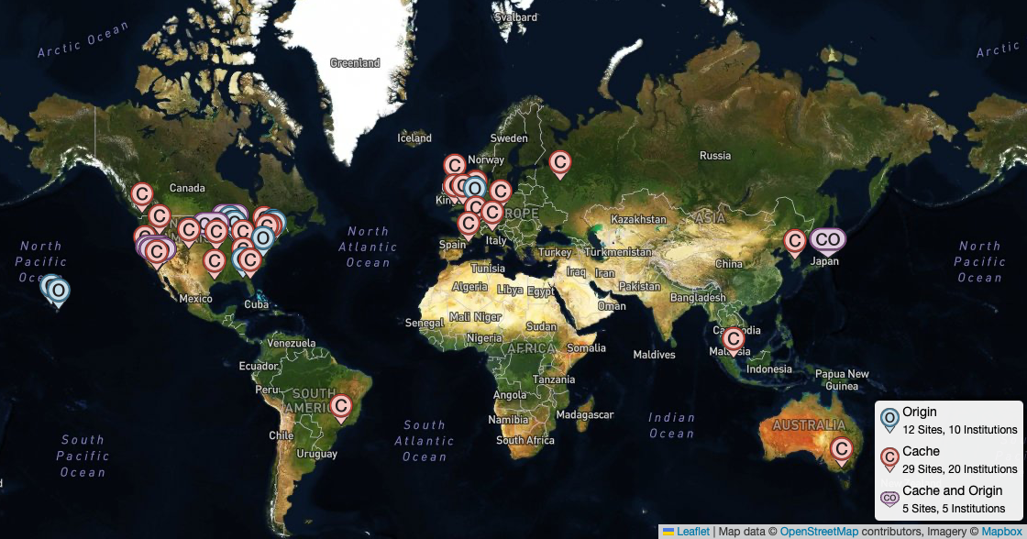
35 Institutions Contribute to OSDF Today
17 Origins and 34 caches across 5 continents
Notes:
this does not include institutions registered in gFactory but not topology ….

Slide 3
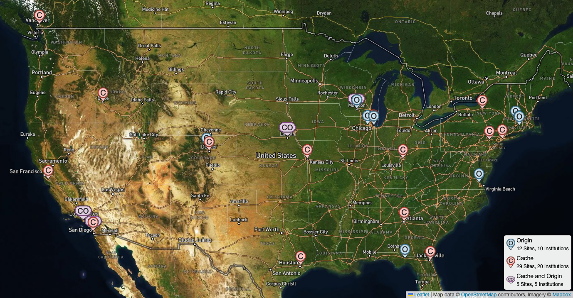
Zoomed in on Continental USA
Data stored on Origins
is accessed via caches
Data stored on Origins
is accessed via Caches.
24.9 PB read in June 2024
on average:
10 Gigabytes/second
114PB accessed in 12 months
On average 80 files per second
80 Gigabit per second … that’s 80% of a 100G pipe
Observe <3% cache misses => OSDF caches save >75Gbps in network traffic

Slide 4
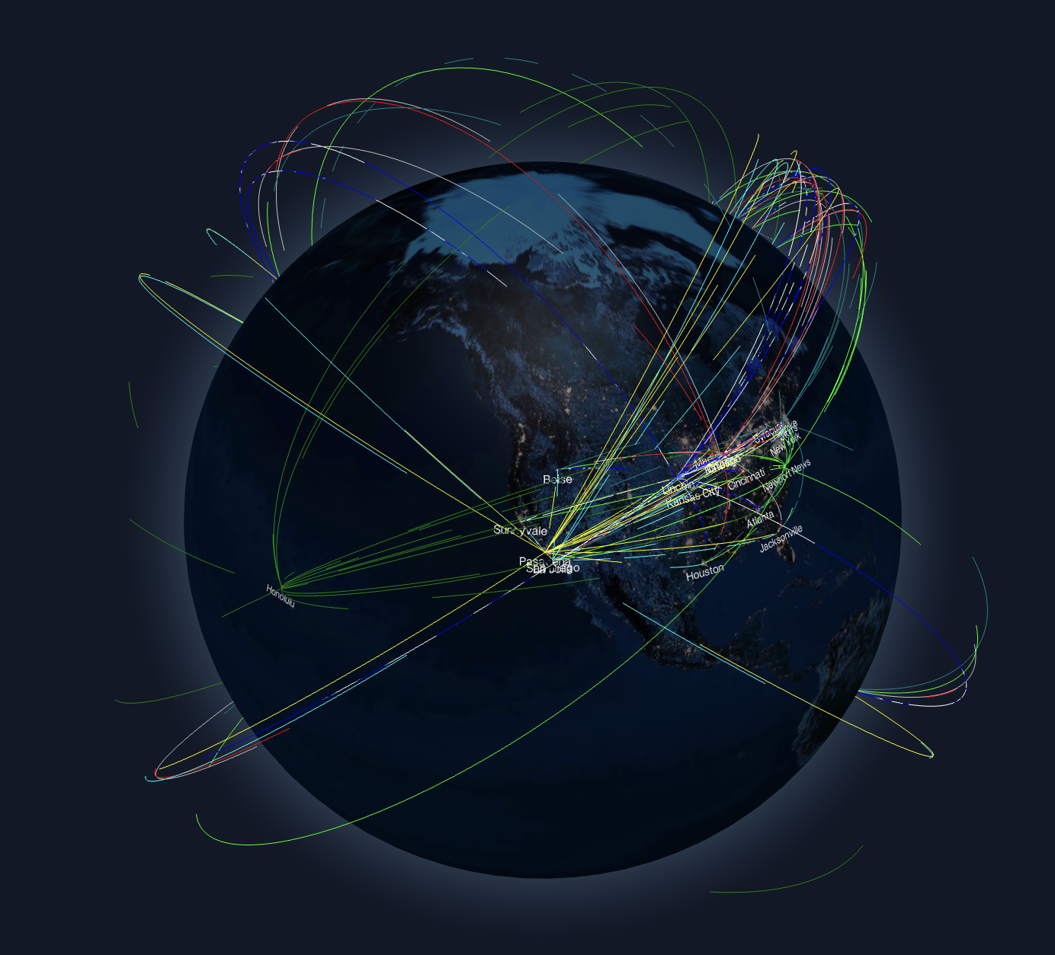
OSDF by Numbers
Realtime visualization at:
https://osdf.osg-htc.org

Slide 5
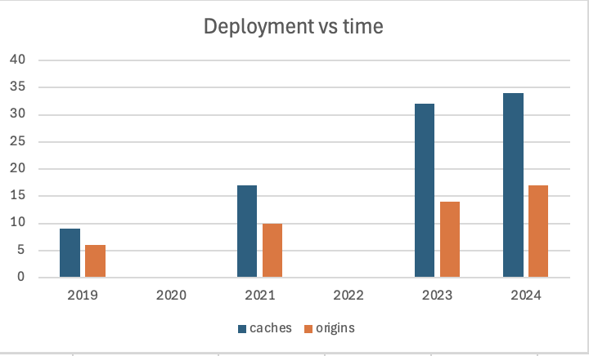
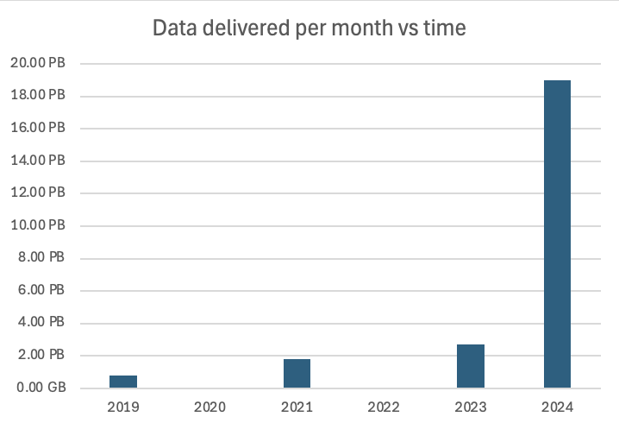
Historic Perspective
~5 caches added per year
~2 origins added per year
Data volume delivered per month
went from ~40% growth per year
between 2019 – 2023 to 7x growth in the last year
“Pelican Effect” ?

Slide 6
Fun Facts for the Month of June
24.9 PB read total
10% of this is accounted for by the OSPool

Slide 7
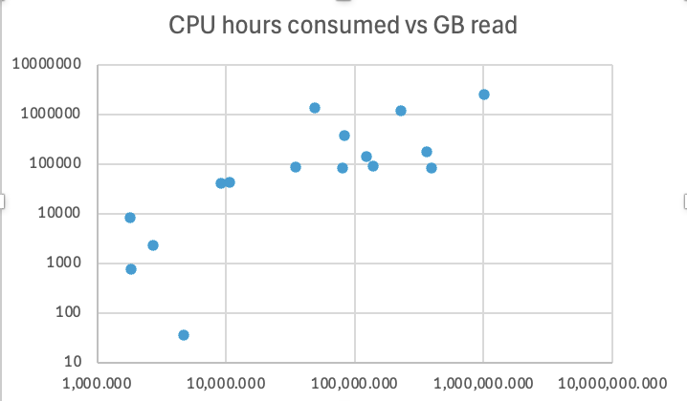
June 2024 OSPool Numbers
61 out of 172 users used OSDF
31 out of 98 projects used OSDF
OSPool users transfer small files with HTCondor and large files with OSDF:
43% of all bytes transferred by OSDF
But only 2.3% of all files
~ 1/3 of OSPool uses OSDF !!!
About a dozen projects
read 10TB to 1PB
consuming 10k to 1M CPU-h
during the month of June
1M hours
100k hours
10k hours
100 hours
Data use is only very
loosly correlated with CPU use
10TB
100TB
1PB

Slide 8
Top OSPool Data Users in June 2024
PI | Institution | Science | Description | TB’s Read | CPU-h
Chun Shen | Wayne State | Nuclear Physics | Dynamical Modelling of relativistic heavy Ions | 1,020 | 2.5M
Paul Vaska | Stonybrook | Biology | MC for developing better image reconstruction | 398 | 85k
Jeffrey D. Jensen | ASU | Biology | Population genetics to study evolutionary processes | 363 | 178k
J. Pixley | Rutgers | Physics | Condensed Matter Theory incl. quantum phase transitions of many-body systems | 230 | 1.2M
D. Katz | CSU Northridge | Math | Searchers for binary sequences with identical autocorrelation spectra | 140 | 91k
O. Isayev | CMU | Chem | QC & ML insights into supra-molecular organization of molecular Xtals | 123 | 140k
H. Fricker | UCSD | Geo & Earth Sciences | Use satellite remote sensing data to study processes that affect mass loss of Antarctic Ice Sheet | 81 | 83k
The top data users span a wide range of sciences
… and institutions … and locations

Slide 9
Fun Facts for the last year
Working set size = volume of unique data read last year
Total read = volume of data read last year
Re-use multiplier = total read / working set size

Slide 10
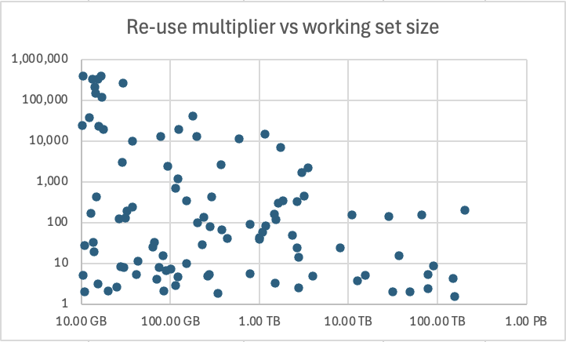
OSDF Usage Accounting by namespace
100 namespaces with
more than 10GB of data
Looking at the 100 namespaces
with >10GB of working set size
Working set size
1TB
10TB
10,000
TB datasets were read
between a few to 10,000 times
10
Little correlation between size of
a namespace & how often it’s read
Working set size

Slide 11
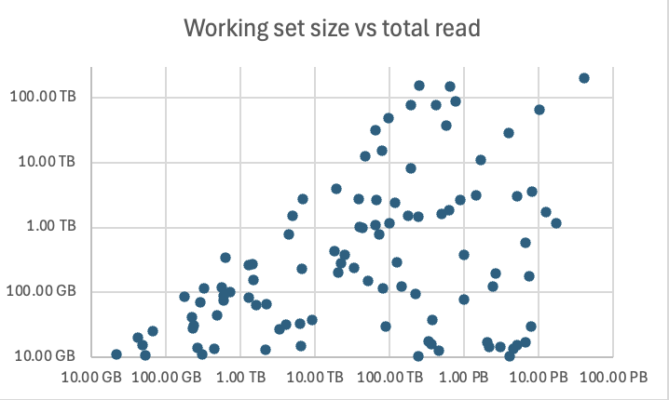
Let’s look at two patterns
>1 PB read
for >1TB unique data
>1 PB read
for <50 GB unique data
Each of these patterns comprise ~1/3 of
the namespaces with >1 PB read

Slide 12
>PB read of a >TB dataset
There are 9 namespaces like this, and all 9 belong to international collaborations
=> See Panel Discussion Tuesday Afternoon
name | Read | Unique data
LIGO IGWN | 40 PB | 203 TB
IceCube | 10 PB | 66 TB
LIGO users | 4 PB | 28 TB
IGWN shared | 1.7 PB | 11 TB
KOTO | 8 PB | 3.5 TB
name | Read | Unique data
Einstein Telescope | 1.5 PB | 3.2 TB
Nova | 5 PB | 3 TB
MicroBoone | 12 PB | 1.7 TB
IGWN CIT | 17 PB | 1.2 TB
Gravitational Wave Observatories Community dominates unique data
Next come neutrino physics experiments (IceCube, Nova, MicroBoone)

Slide 13
>PB read of a 10-50GB dataset
There are 7 namespaces like this, and all 7 belong to OSPool users
name | Read | Unique data
J. Pixley 1 | 7.8 PB | 29 GB
G. Thomson | 2 PB | 17 GB
Chin Shen 1 | 5.2 PB | 15 GB
name | Read | Unique data
Chin Shen 2 | 3 PB | 14 TB
Chin Shen 3 | 2.2 PB | 14 GB
Paul Vaska | 4.5 PB | 13 GB
J. Pixley 2 | 4.1 PB | 10 GB
J. Pixley: Condensed Matter Theory
G. Thomson: Telescope Array (TA) is the largest cosmic ray detector in the
Northern hemisphere, which is located in Millard county, Utah.
Ch. Shen: Nuclear Physics Theory
P. Vaska: MC simulation for better image reconstruction for biological sciences

Slide 14
OSDF use from outside of OSG
10 namespaces in OSDF that belong to NRP communities
1.5 PB was read from 311 TB of unique data for these.
We assume that at least some of this reading was done via native NRP access mechanisms, i.e. from outside OSG.

Slide 15
Summary & Conclusion
The Open Science Data Federation has seen a 7x increase of use within the last year.
At this point our caching saves >75% of a 100G transnational network pipe.
Roughly 1/3 of all OSPool users now use OSDF
OSPool users account for roughly 10% of the total reads.
The top projects by OSDF reads span Biology, Physics, Math, Chemistry, and Geological & Earth Sciences
The usage pattern we observe from international collaborations and OSPool users are quire different
We start to see usage of OSDF from outside OSG

Slide 16
Acknowledgements
This work was partially supported by the NSF grants OAC-2112167, OAC-2030508, OAC-1841530, OAC-1836650, the CC* program, and in kind contributions by many institutions including ESnet, Internet2, and the Great Plains Network.
Notes:
PNRP = 2112167, PATh = 2030508, CESER award = 1841530, iris-hep = 1836650

