Slide 1
Welcome to HTC24

Slide 2
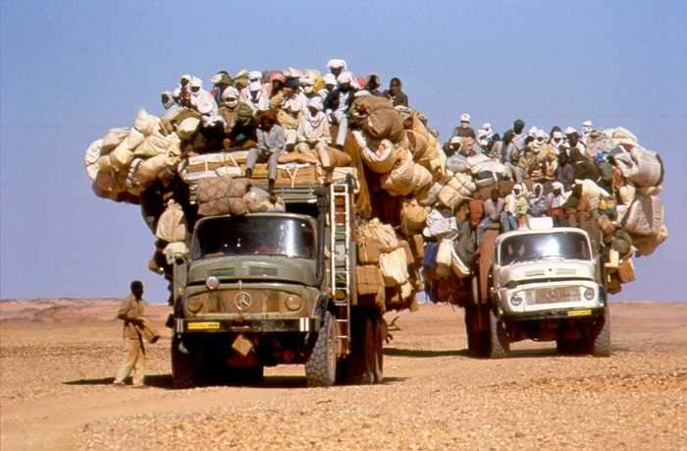
Thank you joining us
Together building a thriving
Throughput Computing community

Slide 3
1986 – First deployment of (HT)Condor
1996 – High Throughput Computing (HTC) formulated
1998 – First (HT)Condor Week
2005 – OSG Consortium established
2006 – Center for High Throughput Computing (CHTC) established
2007 – First OSG AHM
2020 – Partnership for Advanced Throughput Computing (PATh) funded by NSF
2023 – First Throughput Computing event (HTC23)
2024 – Pelican: Advancing the Open Science Data Federation Platform funded by NSF

Slide 4
"Replace the D with an O!" : No more "Data," "Directories," "Folders" and "Files." Only "Buckets" and "Objects"
Miron Livny
Vilas Research Professor
John P. Morgridge Professor of Computer Science
Director UW Center for High Throughput Computing
Technical Director of the OSG

Slide 5
“The Partnership to Advance Throughput Computing (PATh) project will expand Distributed High Throughput Computing (dHTC) technologies and methodologies through innovation, translational effort, and large-scale adoption to advance the Science & Engineering goals of the broader community.”
PATh Proposal 04/21/2020

Slide 6
We (the providers of dHTC technologies and services) are not (and should not) be in the
“Data Business”
We do not understand data models or ontologies
We do not understand data structures
We do not understand “meta data”
We do not facilitate researcher to find input data for their applications

Slide 7
All we must do is provide technologies and services that when given a name (Object store, bucket, object) of an object reliably and effectively place the object at the
designated Execution Point (EP)
We need to understand and report why we failed to place the object
We need to understand the “reuse profile” of an object
We need to facilitate object access authorization
We need to monitor and report Object/Bucket/Object-Store access patterns

Slide 8
Objects are immutable!
Names of Buckets and Objects are managed (autonomously) by the Object Store
We need to manage the namespace (including authentication) of the Object Stores
Organizations may store multiple copies of the same object (same name!) across multiple Object Stores

Slide 9
HTCondor Software Suite (HTCSS) continues to support placement of files and directories from/to the local file system of the Access Point
Research is responsible for impact of updates after placement of job and before completion

Slide 10
OSDF->OSOF?

