Slide 1
Implementation of NRAO’s imaging workflow in HTCondor
Felipe R. H. Madsen - NRAO

Slide 2
Implementation of NRAO’s imaging workflow on HTCondor - F. R. H. Madsen - NRAO
A distributed workflow to make interferometric images was developed at NRAO and successfully deployed to nearly one hundred GPUs gathering resources from PATh and OSPool, to enable processing VLA data to make the deepest radio image of the Hubble Ultra Deep Field. We present the details of the HTCondor implementation of this workflow, as well as detailed results of performance metrics and how these results helped in identifying and prioritizing work on improvement opportunities.

Slide 3
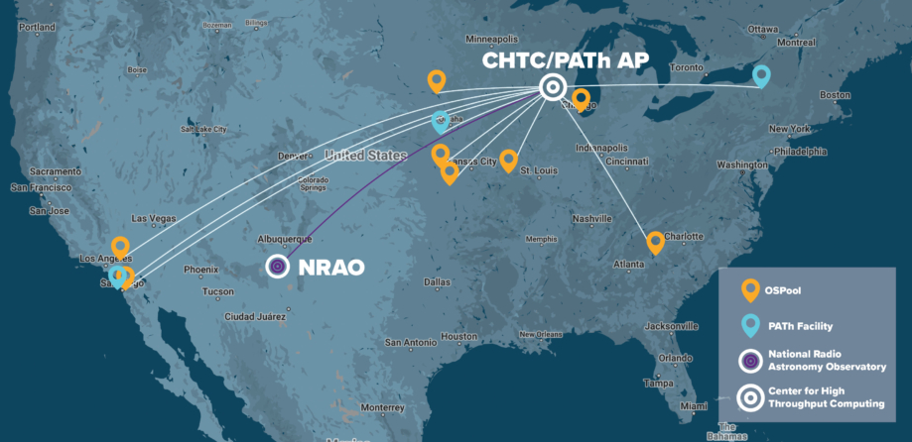
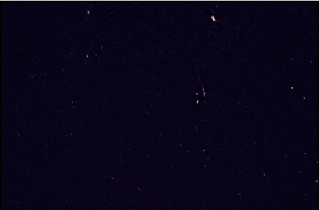
Some facts about December’s imaging run
Implementation of NRAO’s imaging workflow on HTCondor - F. R. H. Madsen - NRAO
Deepest radio image of the Hubble Ultra Deep Field
76 concurrent GPU jobs (peak)
2.7 jobs/minute, 1.5 TB/h (average of fastest cycle)
~ 750 total GPU hours
1650 jobs
5 days wall clock time, ~ 24 hours aggregate processing time

Slide 4
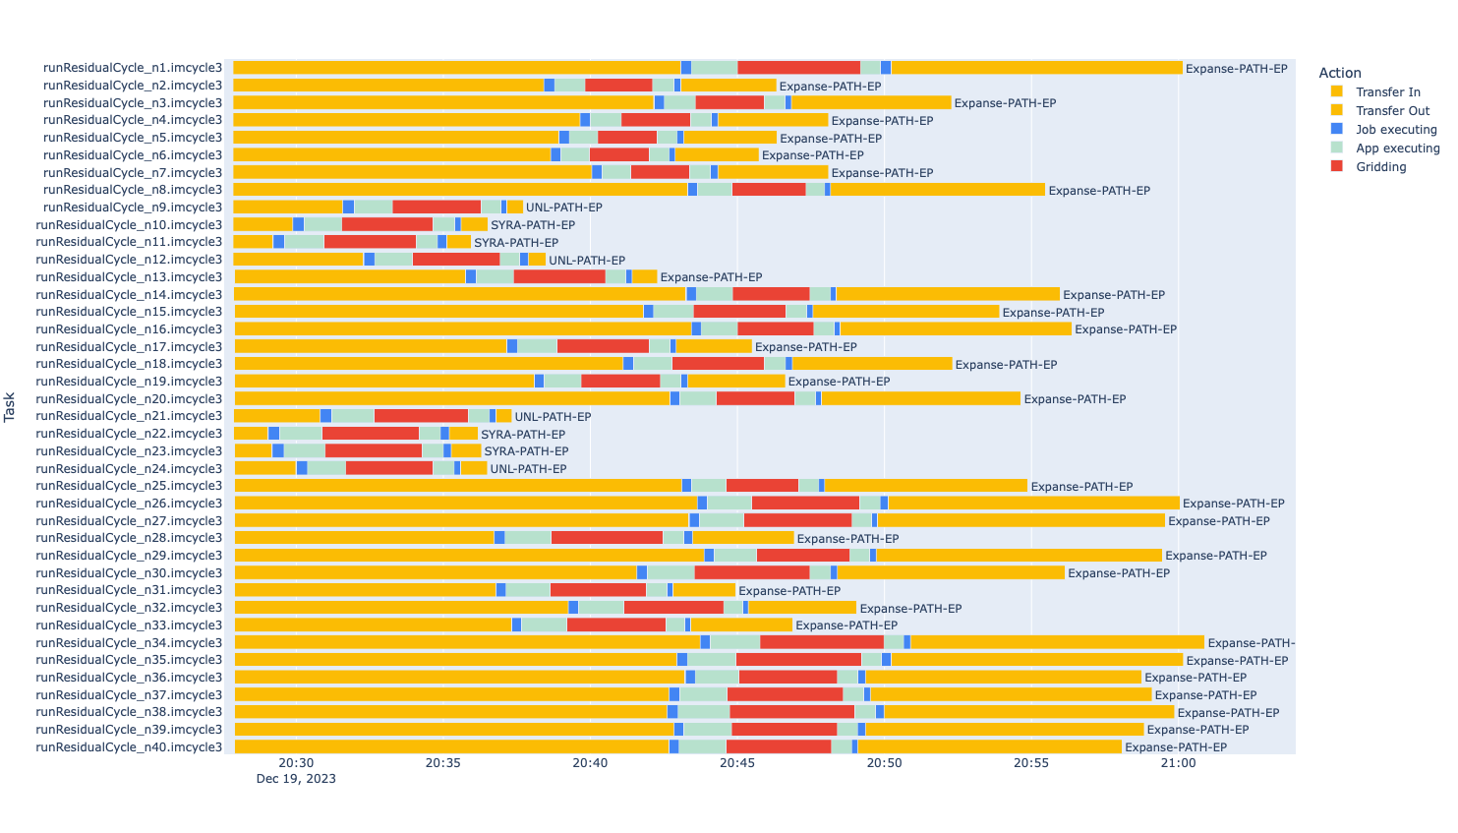
Concurrency plot
Implementation of NRAO’s imaging workflow on HTCondor - F. R. H. Madsen - NRAO

Slide 5
Analysis of the concurrency plots helps identifying and prioritizing improvement opportunities
Implementation of NRAO’s imaging workflow on HTCondor - F. R. H. Madsen - NRAO
Future work / challenges from my talk on HTC23 (prioritized tasks completed/ongoing marked red)
Improve IO efficiency of gridding jobs
Further expand data partitioning to other axes
Integrate/test new model cycle software module
“Gather barrier”
Optimize DAG design to minimize barrier
Investigate scalable design solutions
Scale up residual cycle partitioning / distribution by at least 1-2 orders of magnitude - will need larger number of available GPUs, or hybrid distribution model (GPU/CPU)
From the infrastructure’s perspective, the concurrency plot can be a powerful tool to help identify sites or EPs with long transfer times, especially if combined with unit tests designed to monitor system performance.

Slide 6
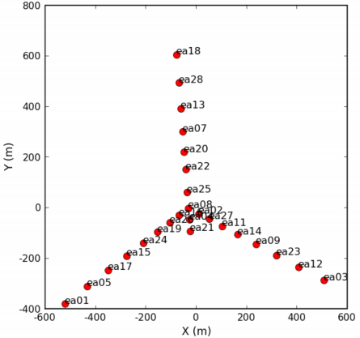
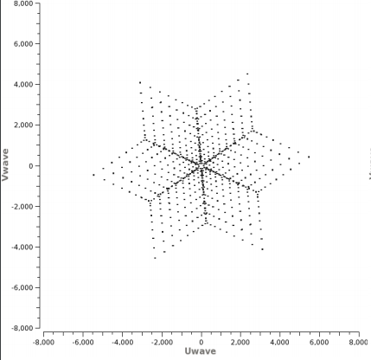
Interferometric Imaging is a Computational Problem
Implementation of NRAO’s imaging workflow on HTCondor - F. R. H. Madsen - NRAO
Antenna positions (VLA)
Sampling function
Distance, Orientation of all antenna pairs
Gridding + FFT⁻¹ of measurements
Post processing
Dirty Image
Final Image

Slide 7
Interferometric imaging workflow (CLEAN method)
Implementation of NRAO’s imaging workflow on HTCondor - F. R. H. Madsen - NRAO
Initial cycle
Imaging Cycle - O(10) iterations
weight, PSF
gridding + FFT
‘Dirty’ image
gridding + FFT
Model
Residual image
gridding + FFT
Restore
Initial cycle
compute individual data weights and point spread function (PSF) for image reconstruction
compute ‘dirty’ image
Imaging cycle - typically O(10) iterations
update Model: iteratively ‘deconvolve’ sampling function (PSF) and identify model components
update Residual: subtract model components from data and make new image
Restore: combine PSF, model and residual to generate final image

Slide 8
HTClean implementation (HTCondor + CLEAN = HTClean)
Implementation of NRAO’s imaging workflow on HTCondor - F. R. H. Madsen - NRAO
DAG htclean
SUBDAG Initial cycle
SUBDAG Imaging Cycle
Partition
CPU
SUBDAG PSF
Multiple GPU gridders
SUBDAG Dirty Image
Multiple GPU gridders
Model
CPU
SUBDAG Residual
Multiple GPU gridders
Restore
CPU
early dev. 2020 (multiple CPU jobs) → 1st GPU job 2021 → multiple GPUs 2022 → deployment/development on PATh: late 2022 → Science run Dec 2023
Nested DAGs with a RETRY+POSTSCRIPT to control iterations
HTClean breaks down the imaging process in independent sessions that can be distributed
Addresses asymmetry in the two main stages of imaging:
residual cycle: highly parallelizable, high FLOPS, visibility domain
model cycle: serial (continuum imaging), low FLOPS, image domain

Slide 9
HTClean implementation - main DAG
Implementation of NRAO’s imaging workflow on HTCondor - F. R. H. Madsen - NRAO
DAG htclean
SUBDAG Initial cycle
SUBDAG Imaging Cycle
Partition
CPU
SUBDAG PSF
Multiple GPU gridders
SUBDAG Dirty Image
Multiple GPU gridders
Model
CPU
SUBDAG Residual
Multiple GPU gridders
Restore
CPU
JOB MSpartition MSpartition.htc
SUBDAG EXTERNAL initialCycle initialCycle.dag
SUBDAG EXTERNAL imagingCycle imagingCycle.dag
JOB makeFinalImages makeFinalImages.htc
SCRIPT PRE initialCycle set_retry.sh -1
SCRIPT PRE imagingCycle set_retry.sh $RETRY
RETRY imagingCycle 8
SCRIPT POST imagingCycle stopIterations.sh
PARENT MSpartition CHILD initialCycle
PARENT initialCycle CHILD imagingCycle
PARENT imagingCycle CHILD makeFinalImages
VARS ALL_NODES jobmode="$(JOB)"
VARS ALL_NODES input_file="../bin/libra_htclean.def"
VARS ALL_NODES partId="n"

Slide 10
HTClean implementation - SUBDAG initial cycle
Implementation of NRAO’s imaging workflow on HTCondor - F. R. H. Madsen - NRAO
DAG htclean
SUBDAG Initial cycle
SUBDAG Imaging Cycle
Partition
CPU
SUBDAG PSF
Multiple GPU gridders
SUBDAG Dirty Image
Multiple GPU gridders
Model
CPU
SUBDAG Residual
Multiple GPU gridders
Restore
CPU
SUBDAG EXTERNAL makePSF makePSF.dag
JOB gatherPSF gatherPSF.htc
SUBDAG EXTERNAL makeDirtyImage makeDirtyImage.dag
JOB gather gather.htc
SCRIPT PRE makePSF writeGriddingDAGs.sh libra_htclean.def
SCRIPT PRE gatherPSF makeInputFileList.sh libra_htclean.def imcycle.htc psf
SCRIPT PRE gather makeInputFileList.sh libra_htclean.def imcycle.htc dirty
VARS ALL_NODES jobmode="$(JOB)"
VARS ALL_NODES input_file="../bin/libra_htclean.def"
VARS ALL_NODES partId="n"
PARENT makePSF CHILD gatherPSF
PARENT makePSF CHILD makeDirtyImage
PARENT makeDirtyImage CHILD gather
PARENT gatherPSF CHILD gather

Slide 11
HTClean implementation - SUBDAG imaging cycle
Implementation of NRAO’s imaging workflow on HTCondor - F. R. H. Madsen - NRAO
DAG htclean
SUBDAG Initial cycle
SUBDAG Imaging Cycle
Partition
CPU
SUBDAG PSF
Multiple GPU gridders
SUBDAG Dirty Image
Multiple GPU gridders
Model
CPU
SUBDAG Residual
Multiple GPU gridders
Restore
CPU
JOB runModelCycle runModelCycle.htc
SUBDAG EXTERNAL runResidualCycle runResidualCycle.dag
JOB gather gather.htc
SCRIPT PRE gather makeInputFileList.sh libra_htclean.def imcycle.htc residual
VARS ALL_NODES jobmode="$(JOB)"
VARS ALL_NODES input_file="../bin/libra_htclean.def"
VARS ALL_NODES partId="n"
RETRY runModelCycle 2
PARENT runModelCycle CHILD runResidualCycle
PARENT runResidualCycle CHILD gather

Slide 12
HTClean implementation - Inner DAGs
Implementation of NRAO’s imaging workflow on HTCondor - F. R. H. Madsen - NRAO
DAG htclean
SUBDAG Initial cycle
SUBDAG Imaging Cycle
Partition
CPU
SUBDAG PSF
Multiple GPU gridders
SUBDAG Dirty Image
Multiple GPU gridders
Model
CPU
SUBDAG Residual
Multiple GPU gridders
Restore
CPU
Inner DAGs are written dynamically according to input parameters
from initialCycle.dag:
SCRIPT PRE makePSF writeGriddingDAGs.sh libra_htclean.def
for i in `seq 1 ${nparts}`
do
JOBtext+="JOB ${DAG}_n${i} ${DAG}.htc"$'\n'
VARStext+="VARS ${DAG}_n${i} partId=\"n${i}\""$'\n'
cfsize=`du -sh ${cfcachedir}/${cfcache}.tar | awk '{gsub(/G/, "", $1)}{print int($1)+1}'`
mssize=`du -sh ${msdir}/${msname}_n${i}.ms.tar | awk '{gsub(/G/, "", $1)}{print int($1)+1}'`
diskrq=$((2 * (cfsize + mssize) + 10))
VARStext+="VARS ${DAG}_n${i} diskResidual=\"${diskrq} G\""$'\n'
done
VARStext+="VARS ALL_NODES jobmode=\"${jobmode}\""$'\n'
VARStext+="VARS ALL_NODES input_file=\"../bin/${input_file}\""$'\n'
VARStext+="RETRY ALL_NODES 2"
TEXT=${JOBtext}$'\n\n'${VARStext}
echo "${TEXT}" > ${DAG}.dag
Dynamic disk allocation

Slide 13
Other highlights of the current implementation
Implementation of NRAO’s imaging workflow on HTCondor - F. R. H. Madsen - NRAO
Data transfers:
auto-expand input data tarballs
Job configuration:
detailed GPU requirements
all jobs request singularity image
unified parameter file for environment and imaging configuration
all jobs use lightweight and specialized LibRA applications
transfer_input_files = $(cfcachedir)/$(cfcache).tar?pack=auto, $(msdir)/$(msname)_$(partId).ms.tar?pack=auto, $(imagesdir)/$(imagename).divmodel.imcycle$(imcycle).tar?pack=auto
+DESIRED_GPU_MIN_Capability = 8.0
+DESIRED_GPU_MIN_GlobalMemoryMb = 24000
+DESIRED_GPU_MIN_DriverVersion = 12.0
RequireGPUs = (Capability >= DESIRED_GPU_MIN_Capability) && (GlobalMemoryMb > DESIRED_GPU_MIN_GlobalMemoryMb) && (DriverVersion >= DESIRED_GPU_MIN_DriverVersion)
+SingularityImage = "/cvmfs/singularity.opensciencegrid.org/opensciencegrid/osgvo-el8:latest"

Slide 14
Other highlights of the current implementation
Implementation of NRAO’s imaging workflow on HTCondor - F. R. H. Madsen - NRAO
GPU software execution:
monitor GPU utilization
copy systems’s libcuda.so.1 into application bundle
nvidia-smi --query-gpu=timestamp,name,utilization.memory,memory.used --format=csv -l 5 --id=${NVIDIA_VISIBLE_DEVICES} > working/logs/nvidia.${jobmode}.${partId}.out &
bundles_dir=`ls libra/bundles`
echo "bundles_dir: $bundles_dir"
if [ -e /.singularity.d/libs/libcuda.so.1 ]
then
cp -f /.singularity.d/libs/libcuda.so.1 libra/bundles/${bundles_dir}/lib64
else
if [ -e /lib64/libcuda.so.1 ]
then
cp -f /lib64/libcuda.so.1 libra/bundles/${bundles_dir}/lib64
else
echo "libcuda.so.1: File not found on knwon paths. Trying with packaged version"
fi
fi

Slide 15
Future work / challenges
Implementation of NRAO’s imaging workflow on HTCondor - F. R. H. Madsen - NRAO
Improve automation / reduce need of human intervention in running workflows:
Error: “Job credentials are not available” - fix deployed?
Applications and convolution functions currently pre-staged manually - is it a good use case for a Pelican origin?
Improve flexibility and scalability of data partition jobs
Deploy / integrate LibRA container

